Slide 1
Inequality in income
Jolyon Miles-Wilson
07/09/2023

Slide 2
Variables
ISO3
Country
Continent
Hemisphere
HDI Rank (2021)
Human Development Groups – “Very high” to “Low”
UNDP developing regions:
SSA – Sub-Saharan Africa
LAC – Latin America and the Caribbean
EAP – East Asia and the Pacific
AS – Arab States
ECDA – Europe and Central Asia
SA – South Asia
Inequality in Income from 2010 to 2021

Slide 3
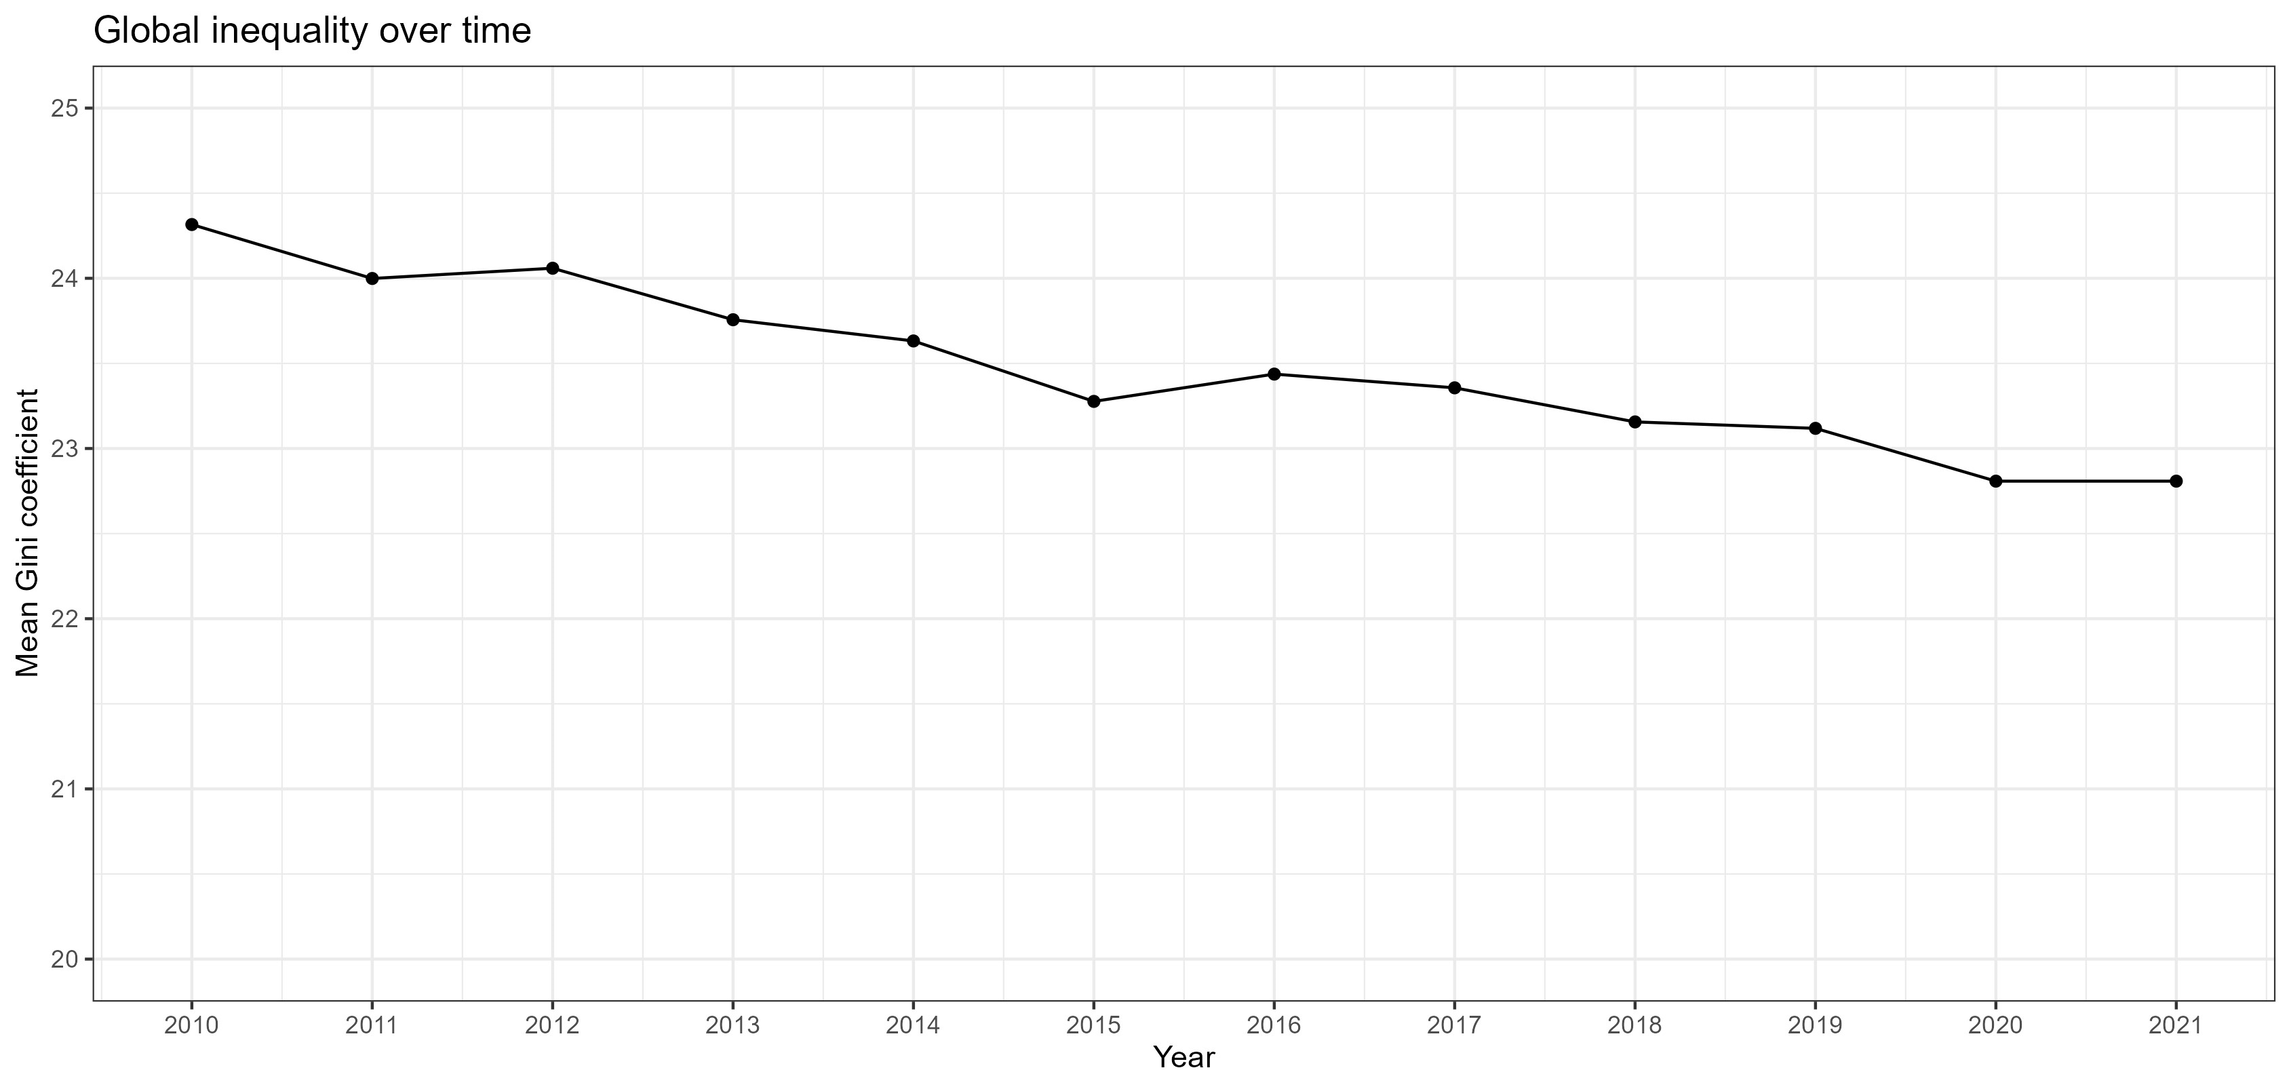
Inequality in income over time
Globally, over time, income inequality has decreased (β = -0.11, p < .001)

Slide 4
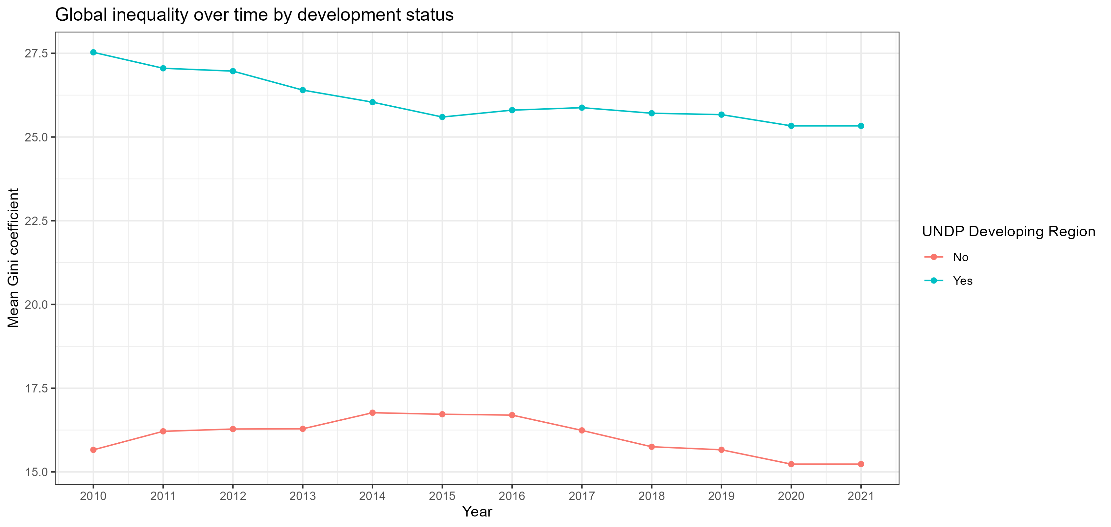
Inequality in income over time & developing regions
Countries in UNDP developing regions have on average higher inequality than countries in non-developing regions (β = 9.58, p < .001)
Between 2010 and 2021, income inequality decreased in both developing and non-developing regions, and there is no evidence to indicate that the rates at which inequality decreased differed between the two types of region
Notes:
Although it’s notable

Slide 5
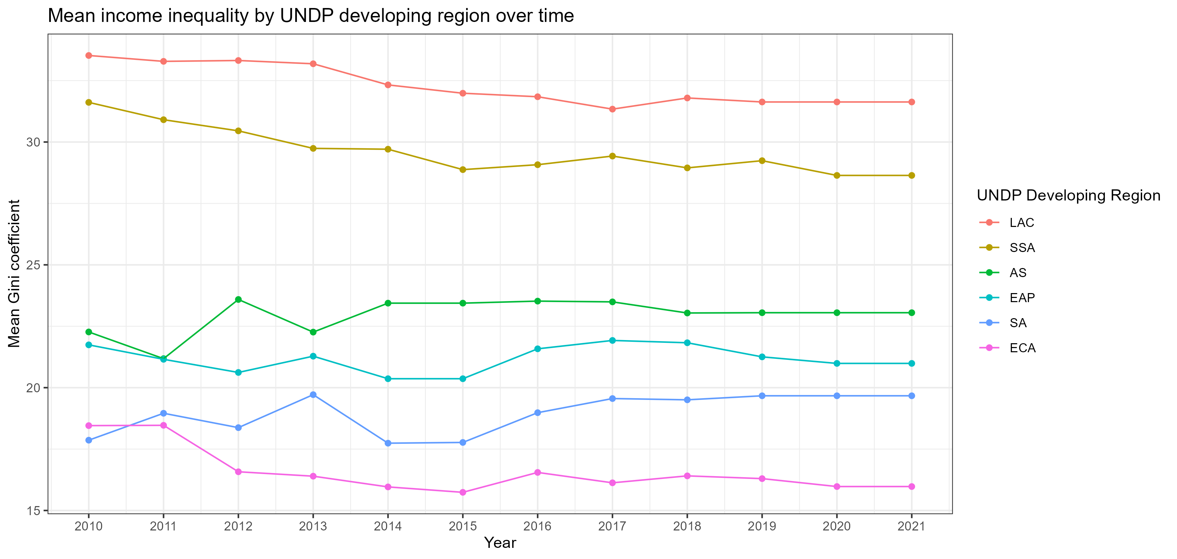
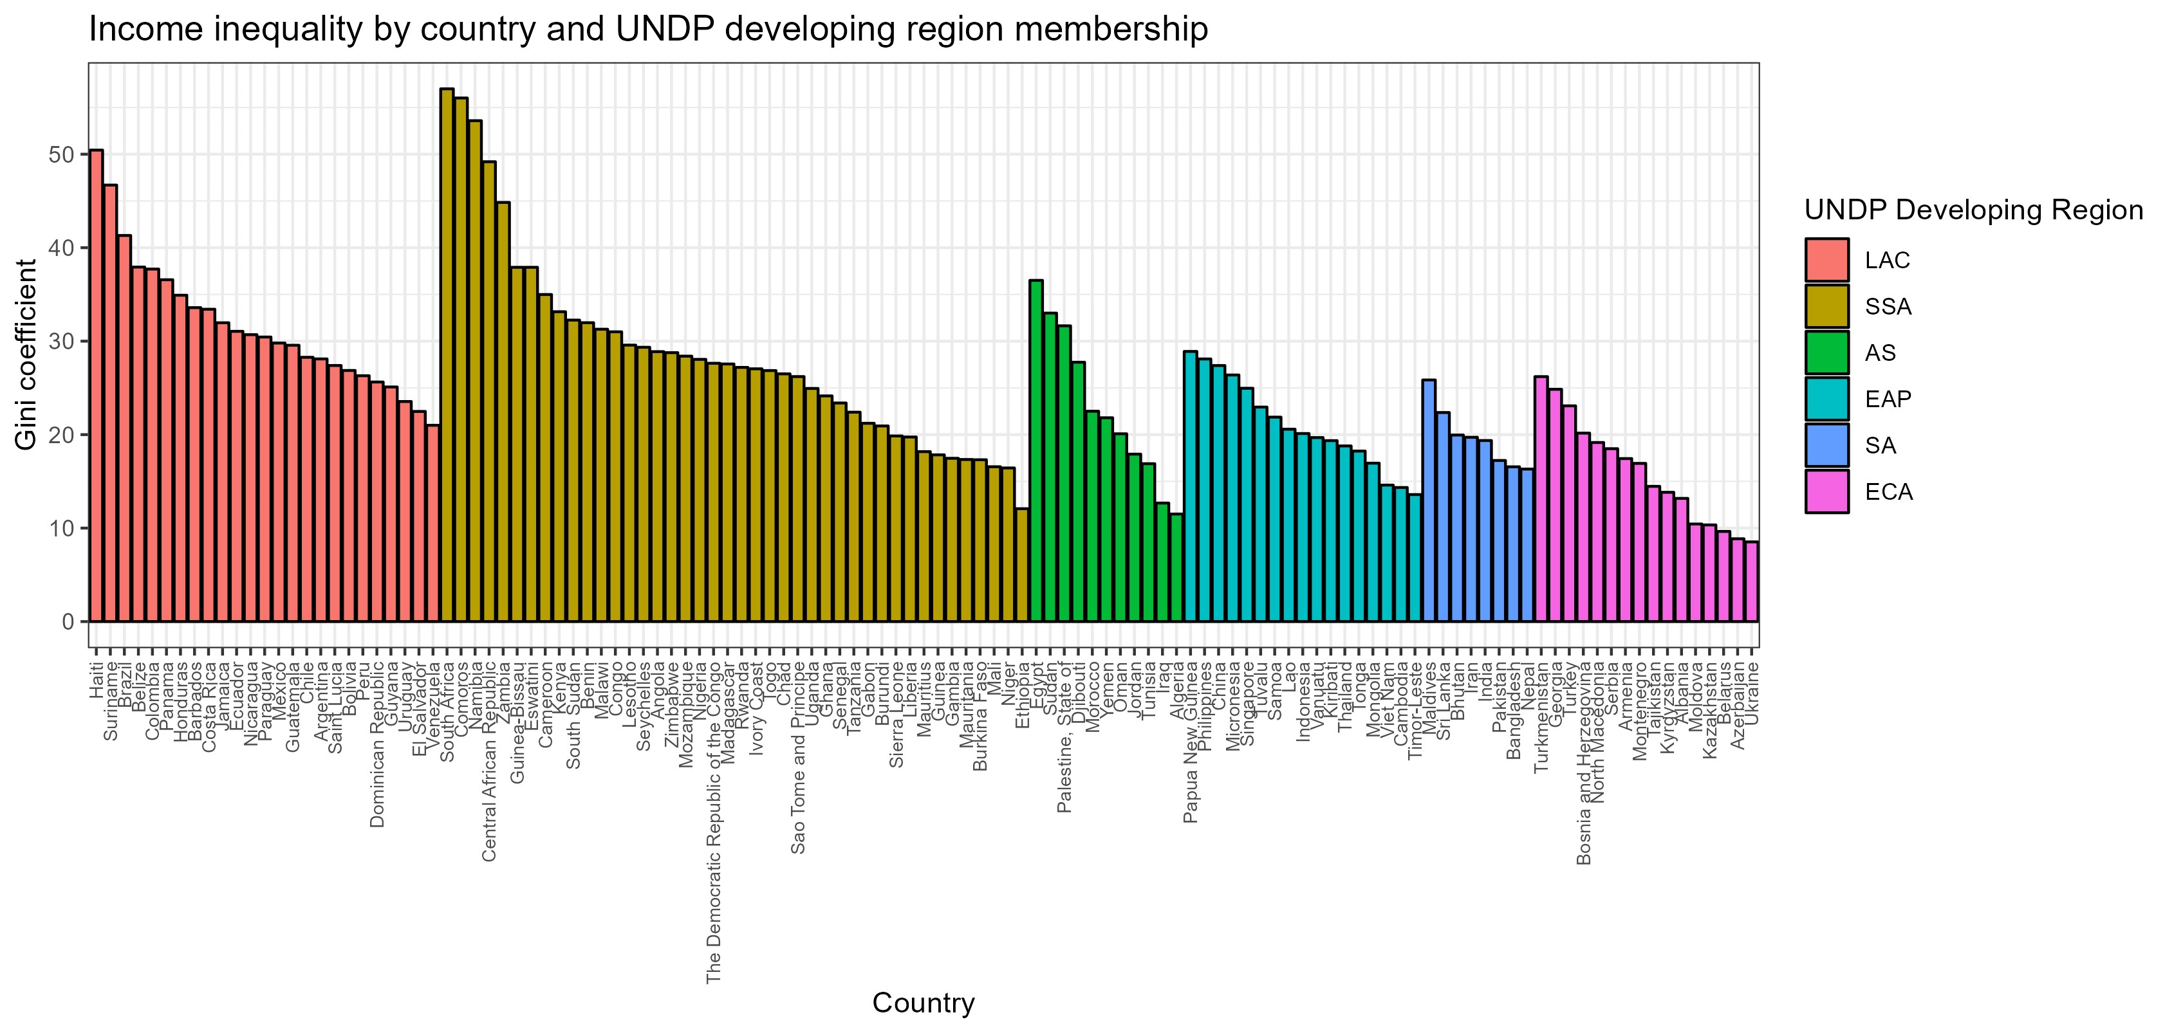
Variations in inequality
There is variation in mean inequality between and within developing regions
LAC and SSA notably exhibit the greatest inequality at all time points

Slide 6
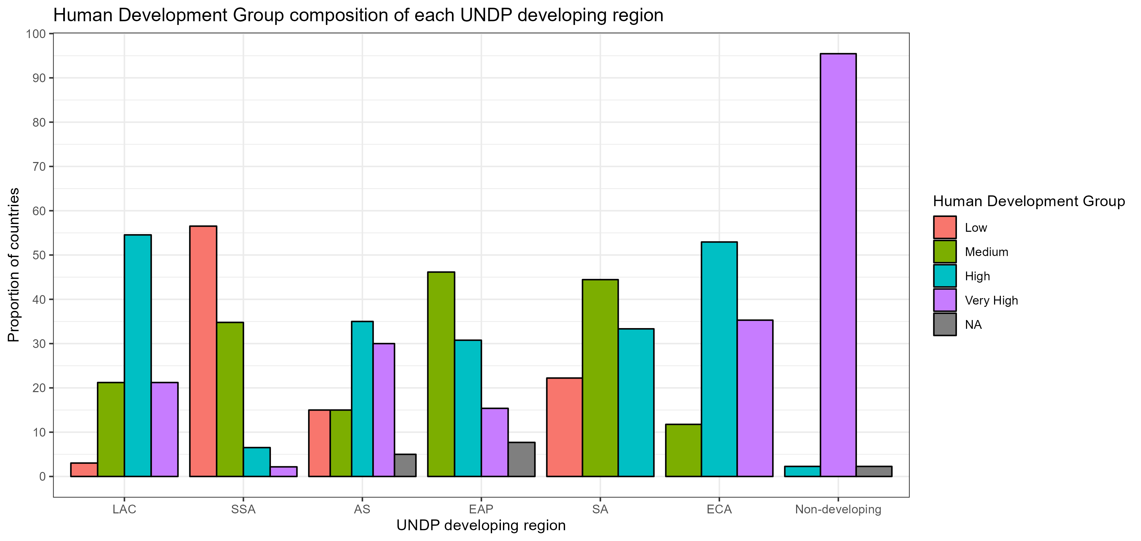
Developing region composition
LAC and SSA have notably different profiles in terms of their composition
Notes:
LAC has more high developing countries
SSA has more low developing countries

Slide 7
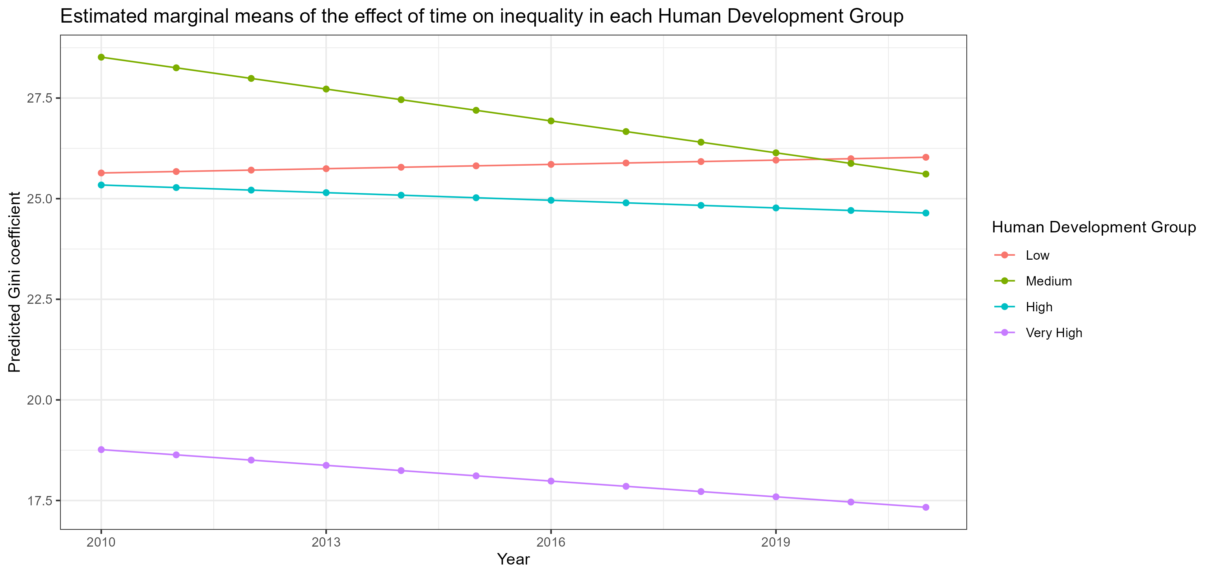
Exploring the difference
Modelling the relationship between development group and inequality suggests a divergence:
Low development countries become more unequal over time
High development countries become less unequal over time compared to low development groups, but not as quickly as medium and very high development groups

Slide 8
Thank you!

