Slide 1




DESIGN AND SIMULATION OF A SINGLE-CYCLE / PIPELINED RISC-V PROCESSOR
RANIA OSSAMA HASSAN 231001334
ADHAM AHMED MOHAMED 221001783
YOMNA MEDHAT SAAD 231000762
MOHAMMED HESHAM 231000359
JOMANA AMIN 231001427

Slide 2

AGENDA
  Overview of the RISC-V processor project
  ALU & Arithmetic Logic Design
  Control Unit (Main + ALU Control)
  Register File & Immediate Generator
  Program Counter, Branch Logic & PC Update
  Instruction Memory, Data Memory & Top-Level Integration
  Simulation Results – Testbenches, PC updates, instruction execution, waveform verification

Slide 3
OVERVIEW
  Design and implement a RISC-V processor in Verilog HDL.
  Supports R-Type, I-Type, Load/Store, and Branch instructions.
  Simulate both single-cycle and pipelined versions.
  Understand the internal CPU structure: instruction fetch, decode, execute, memory, and write-back.
  Verify module functionality using simulation waveforms.
  Gain hands-on experience in CPU design, control signals, and datapath integration.

Slide 4
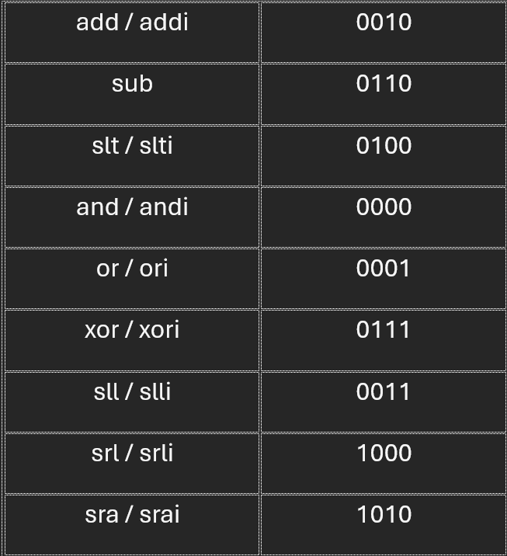
ALU & ARITHMETIC LOGIC DESIGN
  Located in the Execute stage of the 5-stage pipeline
  Performs all RISC-V operations
  Uses signed comparison for slt (-5 < 10 result = 1)
  Outputs a Zero flag using beq to detect equality
  Purely combinational (no clock or reset needed)
  Controlled by 4-bit ALUCtl from the ALU Control Unit
  Verified with full testbench (all operations tested)

Slide 5
ALU & ARITHMETIC LOGIC DESIGN
ALU Control Codes (ALUCtl)

Slide 6
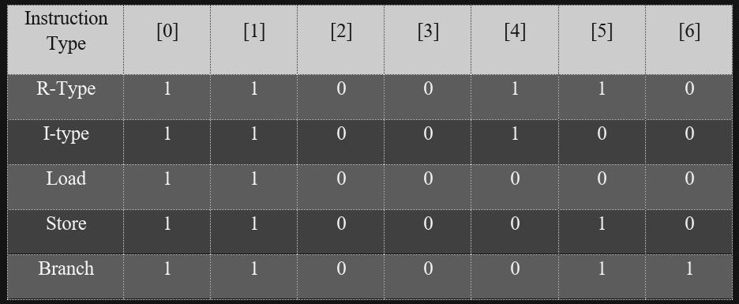
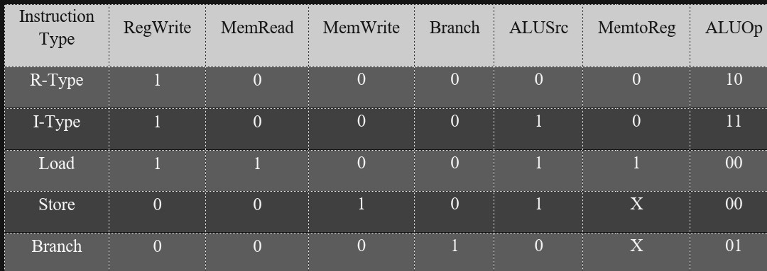
CONTROL UNIT
  Located in the Decode stage of the 5-stage pipeline
  Generates control signals based on opcode and finds what type of instruction the ALU will do (R-type, I-type ... etc)
  Purely combinational (no clock or reset needed)
  Verified with full testbench

Slide 7
IMMEDIATE GENERATOR
  Extracts and sign-extends immediates from instructions
  I-type, S-type and B-type instructions
  Handles shift-immediates
  Combinational logic
TYPE | INSTRUCTION
I - type | addi, andi, ld
S - type | sd
B - type | beq
Shift | slli, srli

Slide 8
REGISTER FILE &
IMMEDIATE GENERATOR
Instruction [31:0]
  32 Registers
  x0 always 0
  Two read ports
  One write port
  Synchronous write
  Asynchronous read
Immediate Generator
Register File
Immediate Generator Output
rs1, rs2
ALU
ALU

Slide 9
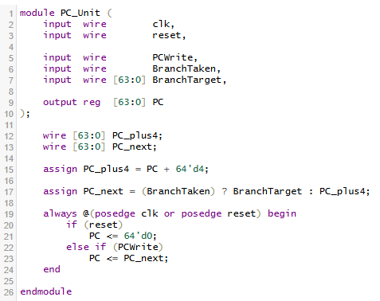
PROGRAM COUNTER & BRANCH LOGIC
  Designed the Program Counter (PC) unit for instruction sequencing.
  PC handles two cases:
  Normal instruction: PC increments by 4.
  Branch taken: PC updated to branch target address.
  Implemented asynchronous reset to initialize PC to zero.
  Added control signals:
  PCWrite → allows stalling of PC.
  BranchTaken → indicates if a branch is taken.

Slide 10
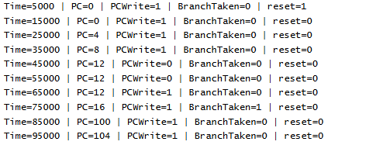
PROGRAM COUNTER & BRANCH LOGIC
  Tested functionality using simulation:
  Normal PC increment
  Branch taken
  Branch not taken

Slide 11
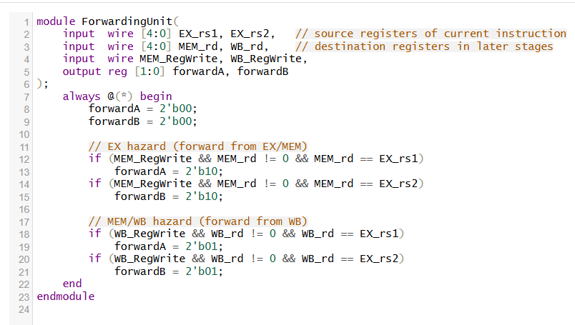
RISC-V PIPELINED PROCESSOR
Hazard Handling
Data Hazards: Forwarding unit enables ALU-to-ALU and MEM-to-ALU bypassing, ensuring zero stalls for register dependencies.
Control Hazards:
  Simple prediction: branch not taken
Pipeline Stage Operations & Decisions
  IF → ID: Instruction is fetched using the PC; PC is updated based on sequential execution or a branch decision.
  ID → EX: Instruction is decoded, control signals are generated, source registers are read, and immediates are prepared.
  EX → MEM: ALU performs arithmetic/logic operations, computes memory addresses, and evaluates branch conditions.
  MEM → WB: Data memory is accessed for load/store instructions, and the correct result is selected.
  WB: Final result is written back to the register file if required by the instruction.

Slide 12
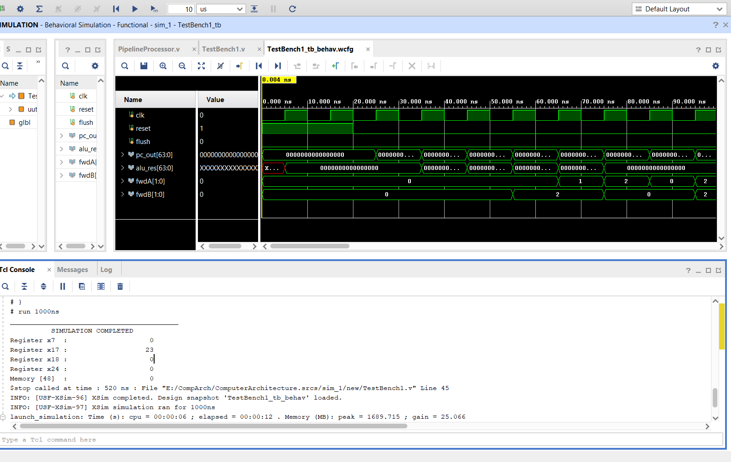
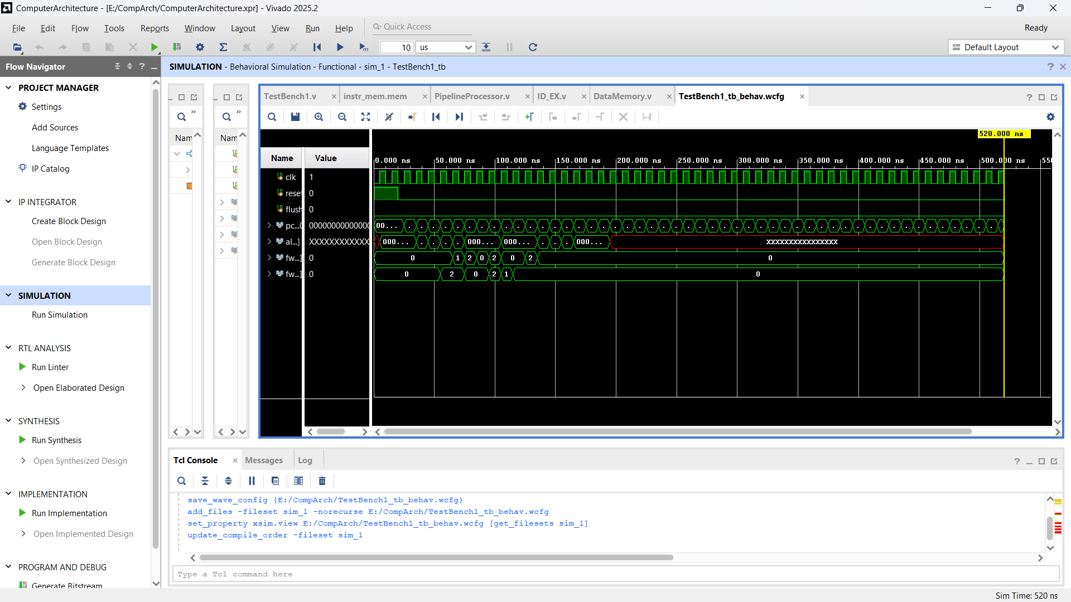
IMPLEMENTATION, VERIFICATION & RESULTS
Verification
  Implemented and simulated in Vivado, verifying:
    Correct instruction execution
    Proper register write-back
    Correct memory load/store behavior
    Accurate branch handling and pipeline flushing
Results
  Expected outputs observed in simulation
  Processor executes RISC-V programs correctly under pipelining
  No functional stalls for ALU-to-ALU dependencies

Slide 13
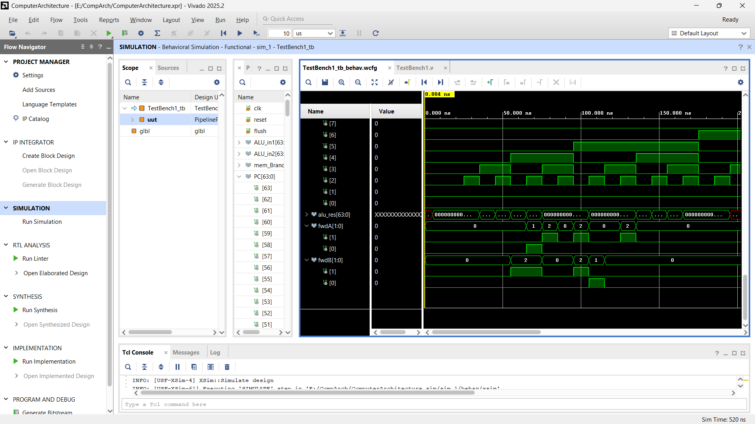
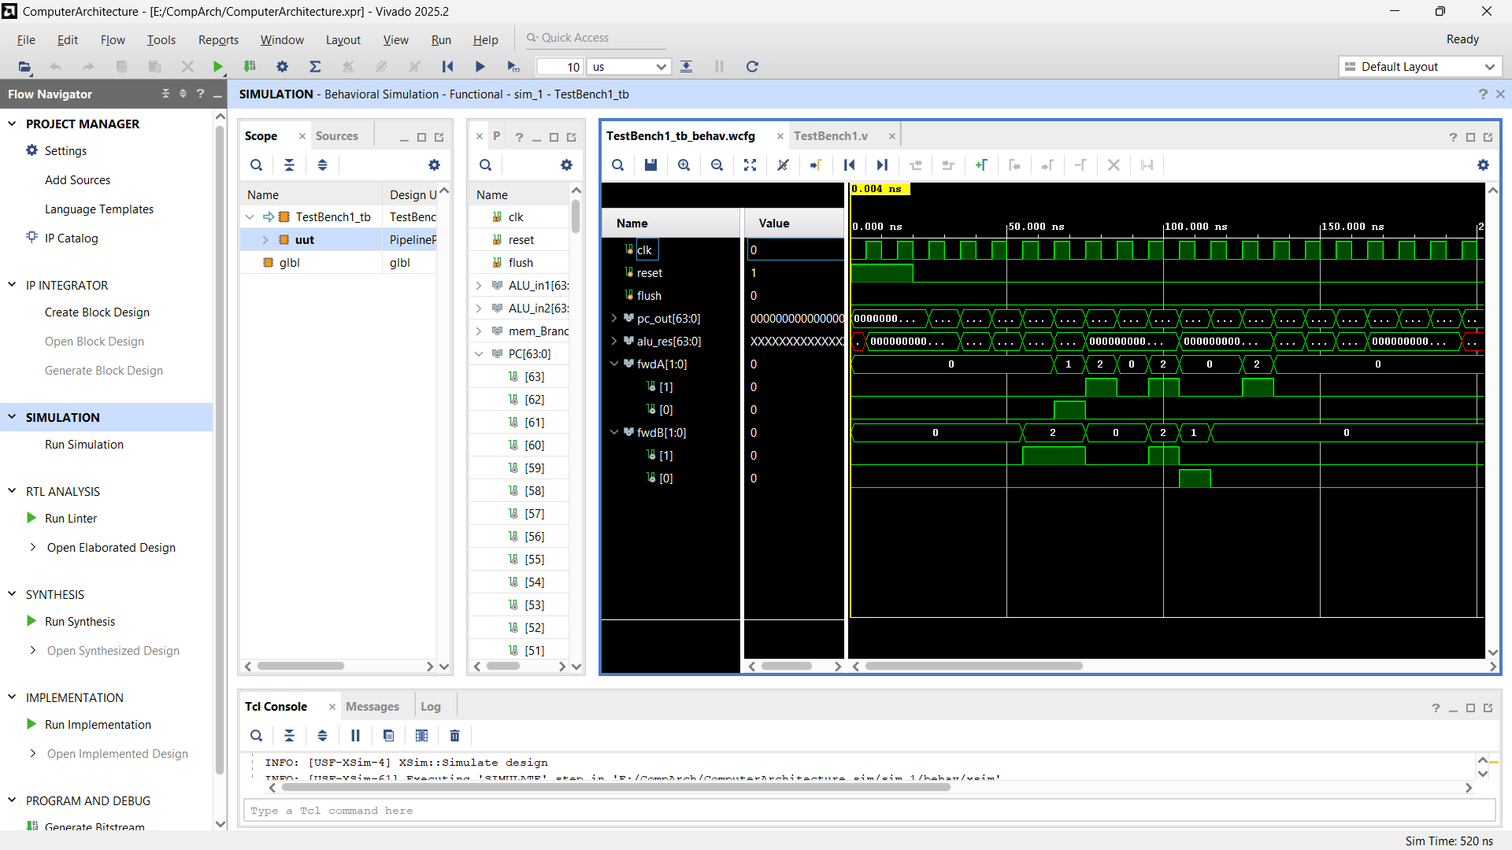
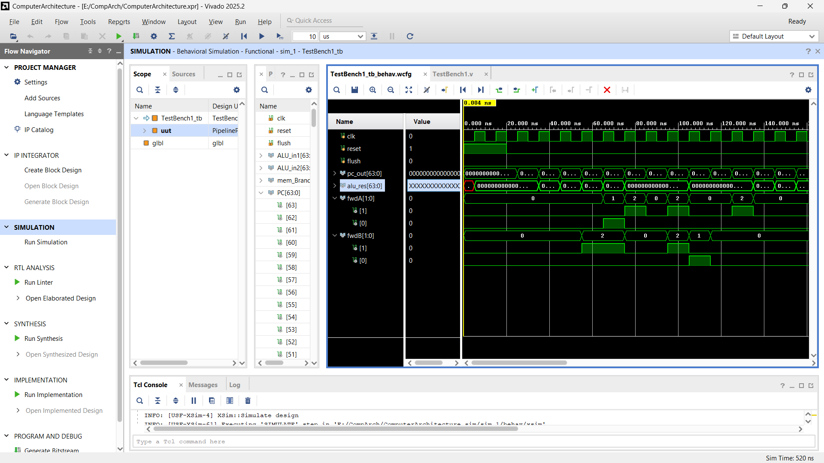

Slide 14
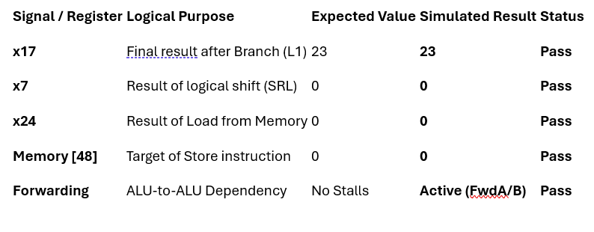
The most significant proof of correct operation is the value of x17. For the processor to reach the value 23, the following must have occurred correctly:
DISCUSSION OF VERIFICATION
  The ALU correctly compared x24 and x7 in the beq instruction.
  The Branch Logic detected the equality and calculated the target PC.
  The IF/ID Flush successfully cleared the instructions that entered the pipe before the branch was resolved.
  The Write-Back stage successfully committed the value 23 to the register file on the negative edge of the clock.

Slide 15
THANK YOU
GitHub Repository: https://github.com/JomanaAmin/Computer-Architecture-Project

