Slide 1

HOPECMS
HopeCMS
Customer Management System for Hope, Inc.
PRESENTED BY
Trixian Castro
Rights & Authentication Specialist
Jomar Auditor
UI Developer
Christian Adlawan
Project Manager / Lead Developer
Gabriel Antonino
Database Specialist
Wayne Andy Villamor
QA / Documentation Specialist
New Era University | BS Information Technology | Sir Jeremias Esperanza | [DATE]

Slide 2
OVERVIEW
About HopeCMS
A web-based Customer Management System that consolidates customer records, sales transactions, product listings, and pricing history into a single, role-aware platform for Hope, Inc.
customer
sales
Account records & terms
Transactions
salesdetail
product
Built around five core entities, governed by a four-module rights system, and protected end-to-end by Supabase Auth and Row-Level Security.
Line items
Catalog
pricehist
Pricing history
HOPECMS
2 / 12

Slide 3






ENGINEERING
Tech Stack
FRONTEND
STYLING
React + Vite
Tailwind CSS
JSX, fast HMR dev server
Utility-first, v4
BACKEND & DB
AUTH
Supabase
Email + Google OAuth
PostgreSQL, Auth, RLS
PKCE, login guard
TESTING
TOOLING
Vitest
Git + GitHub
43 tests, jsdom env
Branch protection, PRs
HOPECMS
3 / 12

Slide 4
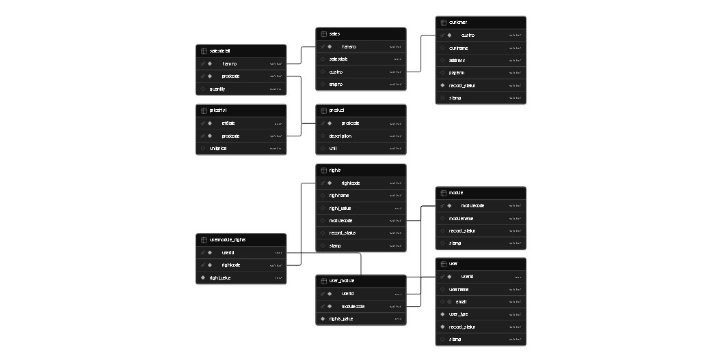
DATA MODEL
Entity Relationship Diagram
5 business tables · 4 rights & auth tables · enforced via Foreign Keys + Row-Level Security
HOPECMS
4 / 12

Slide 5
ACCESS CONTROL
User Roles
USER
ADMIN
SUPERADMIN
View-only access
Full operations
System-level control
View Customers, Sales, Products, Price History
Cannot add, edit, or delete records
Cannot access Admin or Deleted Customers
Everything a USER can do
Add, edit, soft-delete customers
Activate / deactivate user accounts
Recover soft-deleted records
Everything an ADMIN can do
Protected from deactivation by other admins
Row-level security guarantees integrity
HOPECMS
5 / 12

Slide 6
MODULE 01
Authentication
Two ways to sign in, one login guard, and an admin-controlled activation gate.
USER LIFECYCLE
1
Sign up
Email or Google → auth.users insert
01
Email & Password — Standard Supabase email auth with form validation.
2
Provisioned
Trigger creates USER / INACTIVE row
02
Google OAuth — Single-click sign-in via Google with PKCE flow.
3
Blocked
Login guard rejects until activated
03
Login Guard — Blocks accounts with record_status = 'INACTIVE'.
4
Activated
Admin promotes to ACTIVE
04
Auto-Provisioning — Trigger creates public.user row on every signup.
5
Signed in
Lands on /customers
HOPECMS
6 / 12

Slide 7





MODULE 02
Customer Management
The primary managed module. Full CRUD with rights gating, search, and soft-delete recovery.
List & Search
Add Customer
Edit Customer
Live filter by name or payment term across 82+ customers.
Inline validation, defaults to record_status = 'ACTIVE'.
Modal-based, gated to ADMIN/SUPERADMIN via CUST_EDIT right.
Soft Delete
Customer Detail
Recover
Flag to 'INACTIVE' rather than DELETE — preserves audit trail.
Drill into per-customer sales history with stamps.
Deleted Customers page lets admins restore in one click.
HOPECMS
7 / 12

Slide 8


MODULES 03 & 04
Sales & Products
Read-only catalog and transaction history — view-only enforcement at both the UI and database level.
Sales Module
Products Module
124 transactions
247 line items across 5 product units
VIEW RIGHT: SALES_VIEW · SD_VIEW
52 products
70 price history entries (pc, ea, mtr, pkg, ltr)
VIEW RIGHT: PROD_VIEW · PRICE_VIEW
Click a transaction to view its line items, quantities, and the price each product was sold at on that date.
Each product carries its current unit price (latest pricehist entry) — historical prices remain queryable for past sales.
HOPECMS
8 / 12

Slide 9
ANALYTICS
Reports
Three SQL-view-backed reports turn raw transactions into business insight.
01
02
03
Customer Sales Summary
Top Customers
Product Revenue
customer_sales_summary
top_customers
product_revenue
Per-customer total revenue and transaction count, sortable by performance.
Revenue leaderboard ranked highest to lowest — quick view of where the money comes from.
Per-product gross revenue across all historical sales, accounting for price changes over time.
HOPECMS
9 / 12

Slide 10

MODULE 05
Admin Module
SUPERADMIN's command center: user activation, role visibility, and the SUPERADMIN row protection that prevents lockout.
WHAT ADMINS CAN DO
SUPERADMIN PROTECTION
View the full user roster
Activate pending (INACTIVE) accounts
Deactivate accounts that no longer need access
See each user's role and current status at a glance
Other admins cannot deactivate or demote the SUPERADMIN account. This guarantee is enforced at the database level by Row-Level Security — not just hidden in the UI.
No accidental lockouts. Ever.
HOPECMS
10 / 12

Slide 11
QUALITY ASSURANCE
Testing
43
12
Auth Flows
Email signup, Google OAuth, login guard ACTIVE/INACTIVE
27
Rights Matrix
Every role × every right combination
automated tests passing
via Vitest + React Testing Library
4
Functional Logic
Domain helpers and edge-case validation
HOPECMS
11 / 12

Slide 12
Thank you.
Questions?
github.com/JomarAuditor/HOPECMS
HOPECMS Team · New Era University · BS Information Technology

