Slide 1
EMPLOYEE PORTAL
The Employee Side
of the ICT Helpdesk
Portal screens, ticket steps, and a worked example
Walkthrough from sign-in to ticket follow-up
Standard support • MBWin / Sky360 sample • Admin Burnout path
Notes:
This guide explains the employee portal interface and the ticket journey. The screenshots are supplied sample UI captures; account details shown in them are test/example values. The worked ticket later in the deck uses clearly marked demo values.

Slide 2
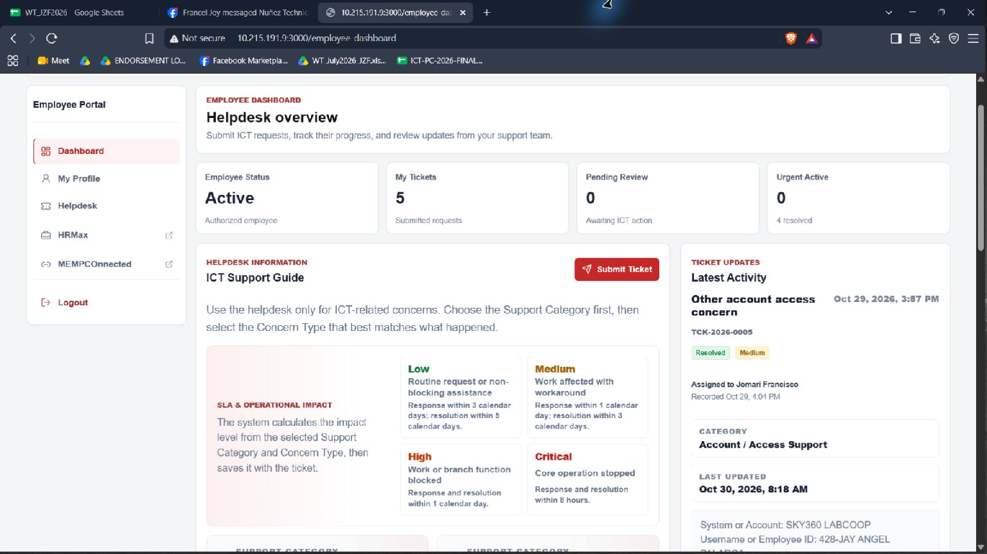
Employee Portal navigation
The Helpdesk sits inside the broader Employee Portal.
LEFT NAVIGATION
Dashboard
My Profile
Helpdesk
HRMax
MEMPCOConnected
Logout
Use Helpdesk for ICT requests and ticket updates.
MEMPCO • EMPLOYEE PORTAL GUIDE
02
Notes:
The left navigation provides Dashboard, My Profile, Helpdesk, HRMax, MEMPCOConnected, and Logout. The top bar includes notifications and the user profile menu. This deck focuses on the employee helpdesk journey, with the surrounding portal included for context.
Sources: employee-side-screenshots; app/employee-dashboard/employee-dashboard.jsx; lib/tickets/sla.js

Slide 3
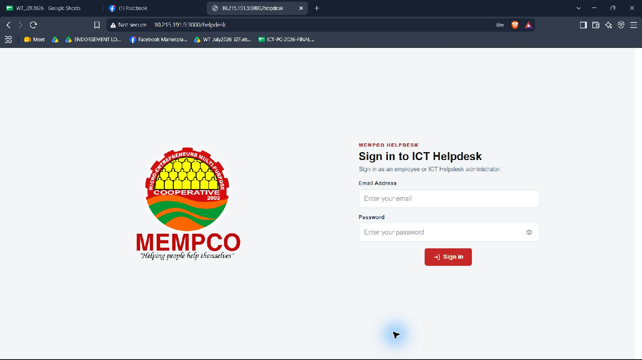
Sign in to the Employee Portal
1
Enter account email
Use your authorized employee email.
2
Enter password
Keep sign-in credentials private.
3
Select Sign in
Continue to the employee portal.
MEMPCO • EMPLOYEE PORTAL GUIDE
03
Notes:
Employees use their authorized employee account to sign in. After a successful sign-in, the employee portal opens. If access fails, the employee should contact their internal helpdesk or portal administrator. Do not include passwords in a ticket or presentation.
Sources: employee-side-screenshots; app/employee-dashboard/employee-dashboard.jsx; lib/tickets/sla.js

Slide 4
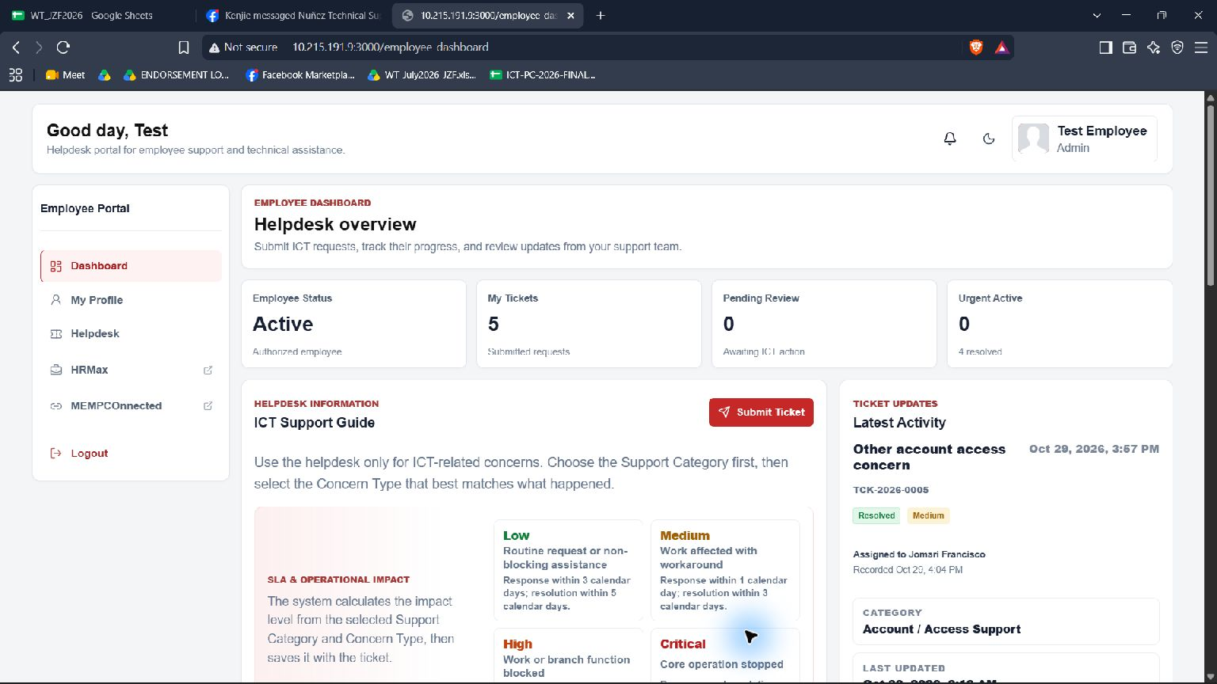
Dashboard: start or review a request
1
Start a request
Select Submit Ticket from the dashboard or Helpdesk.
2
Review recent activity
Open the latest ticket when you need its details.
3
Use the ICT guide
Choose a category that matches your concern.
MEMPCO • EMPLOYEE PORTAL GUIDE
04
Notes:
The Employee Dashboard shows employee status, ticket count, pending review, and urgent active counts. It provides an ICT support guide and a Submit Ticket action. A Latest Activity area shows the most recent ticket and links to details. The counts and ticket values in this screenshot are sample data.
Sources: employee-side-screenshots; app/employee-dashboard/employee-dashboard.jsx; lib/tickets/sla.js

Slide 5
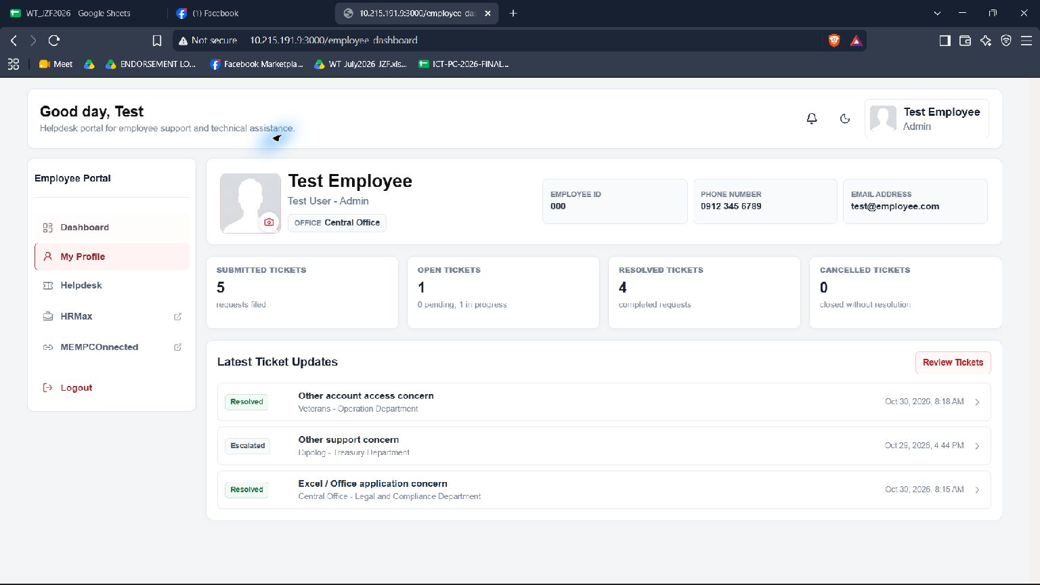
My Profile: employee information and activity
1
Review your details
Check your contact information and office.
2
Review ticket activity
See open and resolved request counts.
3
Go to Helpdesk
Use the portal navigation to submit or track.
MEMPCO • EMPLOYEE PORTAL GUIDE
05
Notes:
My Profile displays employee information such as employee ID, phone, email, and office, plus counts for submitted, open, resolved, and cancelled tickets and latest ticket updates. The profile photo can also be updated. Screenshot values are test/demo data.
Sources: employee-side-screenshots; app/employee-dashboard/employee-dashboard.jsx; lib/tickets/sla.js

Slide 6
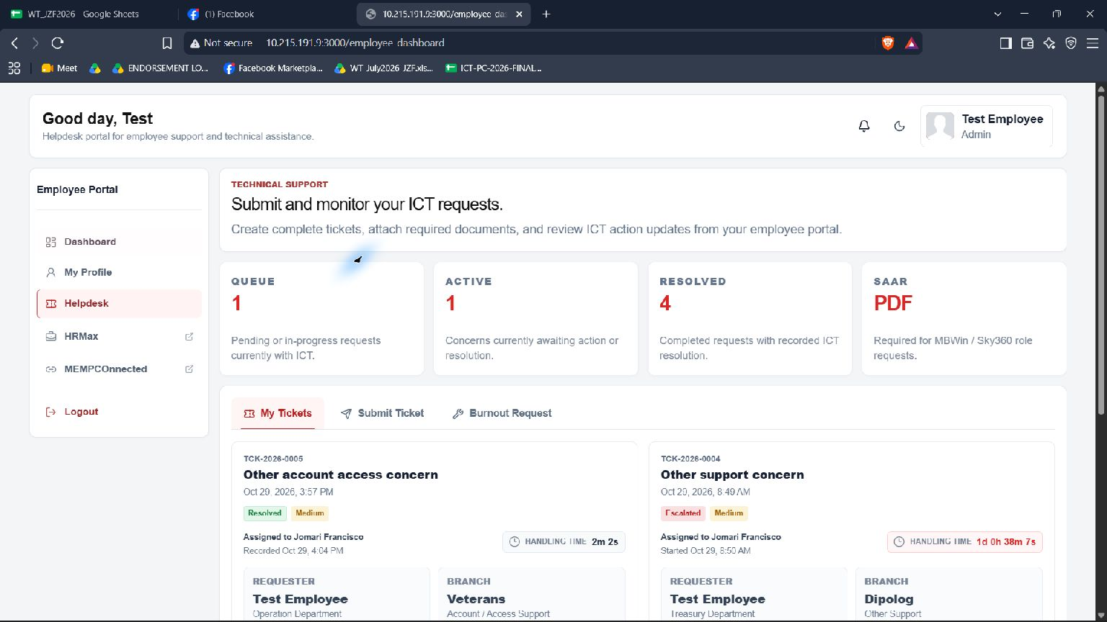
Helpdesk: employee ticket workspace
1
My Tickets
Open requests you already submitted.
2
Submit Ticket
Start a standard ICT helpdesk request.
3
Burnout Request
Separate path shown for Admin department.
MEMPCO • EMPLOYEE PORTAL GUIDE
06
Notes:
The Helpdesk page summarizes queue, active, and resolved ticket counts and provides tabs for My Tickets and Submit Ticket. Admin-department accounts also see Burnout Request. Ticket counts and details shown in this screenshot are demo data.
Sources: employee-side-screenshots; app/employee-dashboard/employee-dashboard.jsx; lib/tickets/sla.js

Slide 7
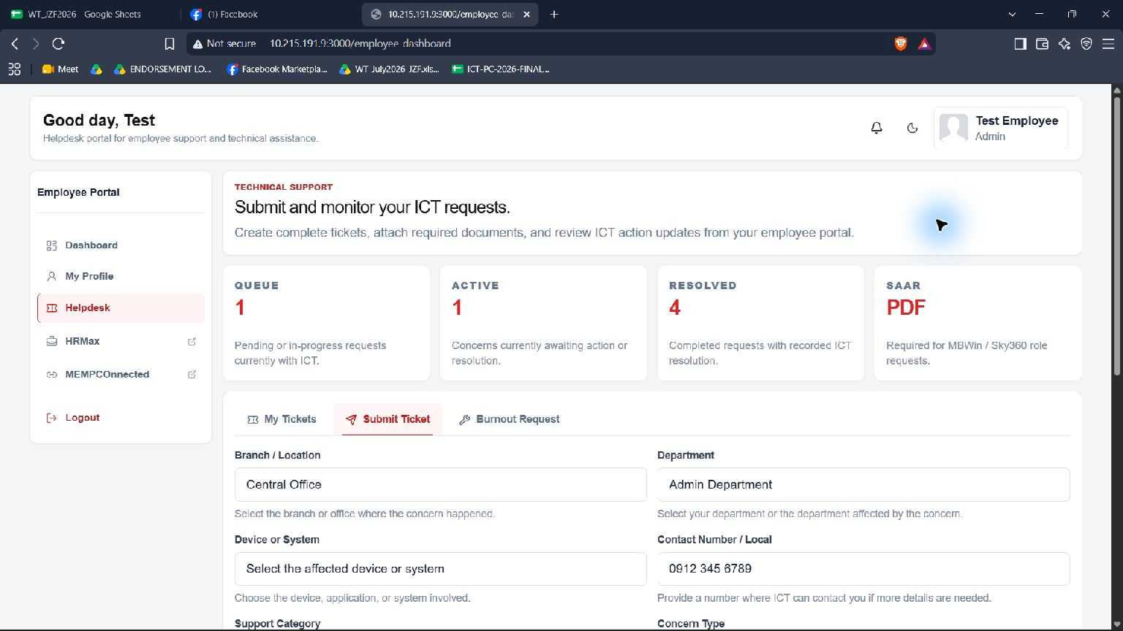
Submit Ticket: form layout
REQUIRED REQUEST DETAILS
Branch / Location
Department
Device or System
Contact Number / Local
Support Category
Concern Type
MEMPCO • EMPLOYEE PORTAL GUIDE
07
Notes:
The standard ticket form asks for branch/location, department, device or system, contact number/local, support category, and concern type. Profile values may prefill some fields. Choose Device or System before Support Category; the category determines available concern types.
Sources: employee-side-screenshots; app/employee-dashboard/employee-dashboard.jsx; lib/tickets/sla.js

Slide 8
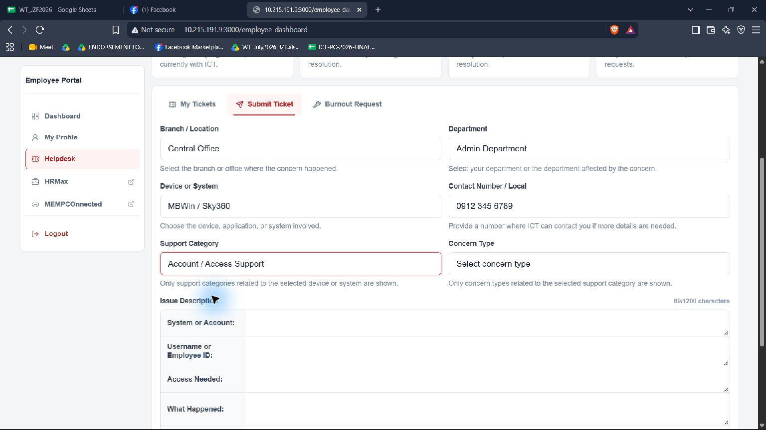
Choose the device, category, and concern
1
Select the affected system
Example: MBWin / Sky360.
2
Choose a matching category
Example: Account / Access Support.
3
Choose the concern
Example: Password reset.
MEMPCO • EMPLOYEE PORTAL GUIDE
08
Notes:
The device selection filters available support categories. The selected category filters concern types. For MBWin / Sky360, Account / Access Support includes new user account request, password reset, login problem, teller reactivation, teller role modification, and other access concerns.
Sources: employee-side-screenshots; app/employee-dashboard/employee-dashboard.jsx; lib/tickets/sla.js

Slide 9
Worked ticket example: MBWin password reset
THE EMPLOYEE’S ISSUE
SAMPLE CLASSIFICATION
“My MBWin account is locked and I cannot complete my work.”
Device or System
MBWin / Sky360
Support Category
Account / Access Support
Concern Type
Demo ticket values only
Password reset
Replace bracketed employee details with your own before submitting.
MEMPCO • EMPLOYEE PORTAL GUIDE
09
Notes:
The example follows an employee who cannot sign in to MBWin after the account becomes locked. This is a fictional demonstration. It uses the MBWin / Sky360 device, Account / Access Support, and Password reset concern. The system rule assigns Medium impact to Password reset.
Sources: employee-side-screenshots; app/employee-dashboard/employee-dashboard.jsx; lib/tickets/sla.js

Slide 10
Worked example: complete the request details
Branch / Location
Device or System
Central Office
MBWin / Sky360
Department
Support Category
[Your department]
Account / Access Support
Contact Number / Local
Concern Type
[Your contact number]
Password reset
Select the actual branch, department, and contact details for the request.
The selected device, category, and concern type determine the tailored description fields and auto impact.
MEMPCO • EMPLOYEE PORTAL GUIDE
10
Notes:
Use real employee and ticket details when submitting. This presentation leaves personal fields as placeholders. The issue description follows the prompts displayed for MBWin / Sky360 account requests: system, username or employee ID, access needed, what happened, and AnyDesk number.
Sources: employee-side-screenshots; app/employee-dashboard/employee-dashboard.jsx; lib/tickets/sla.js

Slide 11
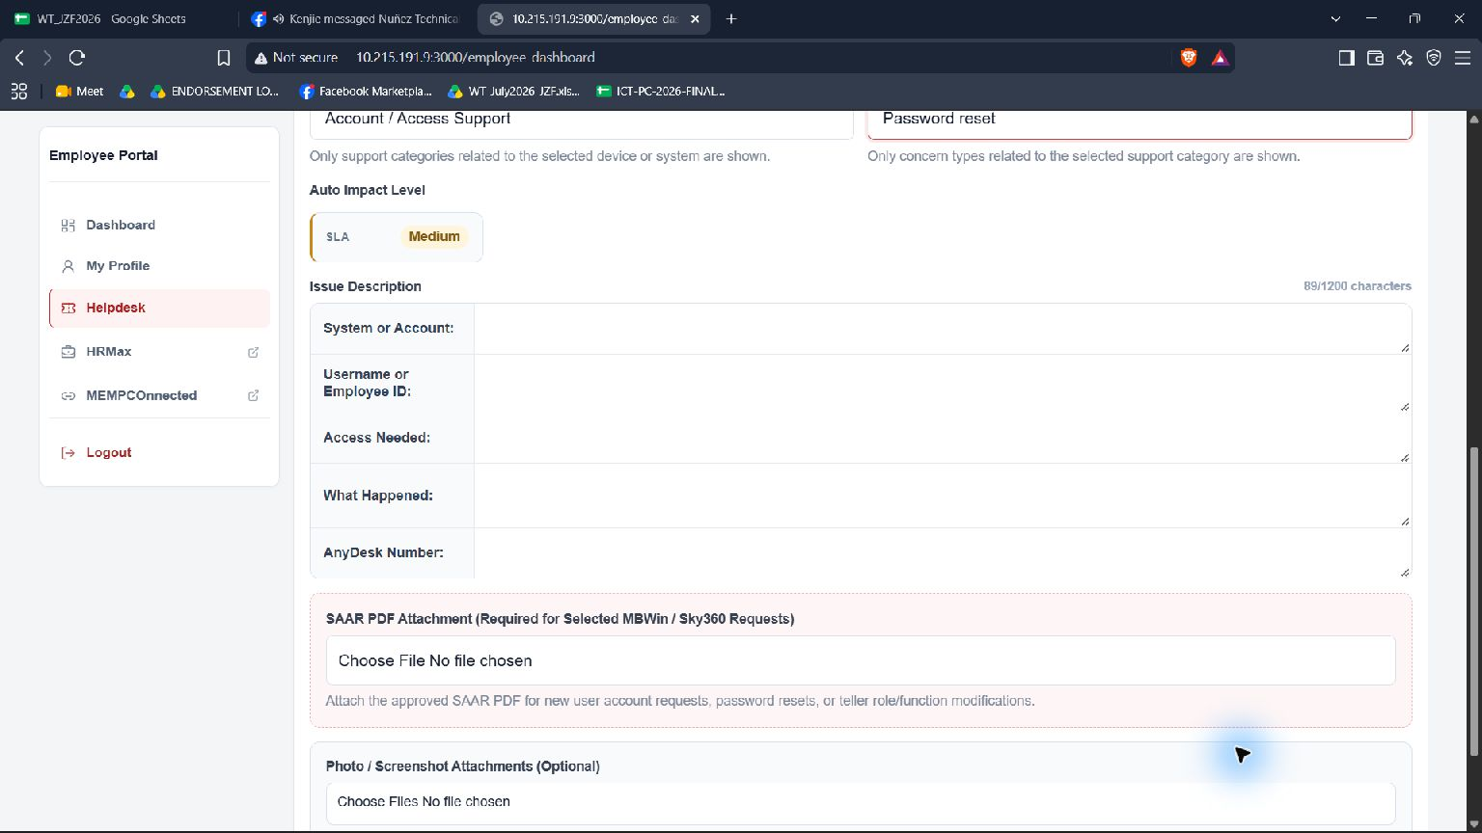
Worked example: describe the issue and attach SAAR
SAMPLE ANSWERS
System / Account
MBWin / Sky360
User ID
[Demo employee ID]
Access needed
Password reset
What happened
Locked after failed sign-ins
AnyDesk
[Your AnyDesk number]
Attach approved SAAR PDF
SAAR limit: 4 MB
MEMPCO • EMPLOYEE PORTAL GUIDE
11
Notes:
Example description: System or Account: MBWin / Sky360; Username or Employee ID: [Demo employee ID]; Access Needed: Password reset; What Happened: Account locked after unsuccessful sign-in attempts; AnyDesk Number: [Your AnyDesk number]. For MBWin / Sky360 password reset requests, attach the approved SAAR PDF. SAAR is not required for teller reactivation or expiry changes. Photos are optional.
Sources: employee-side-screenshots; app/employee-dashboard/employee-dashboard.jsx; lib/tickets/sla.js

Slide 12
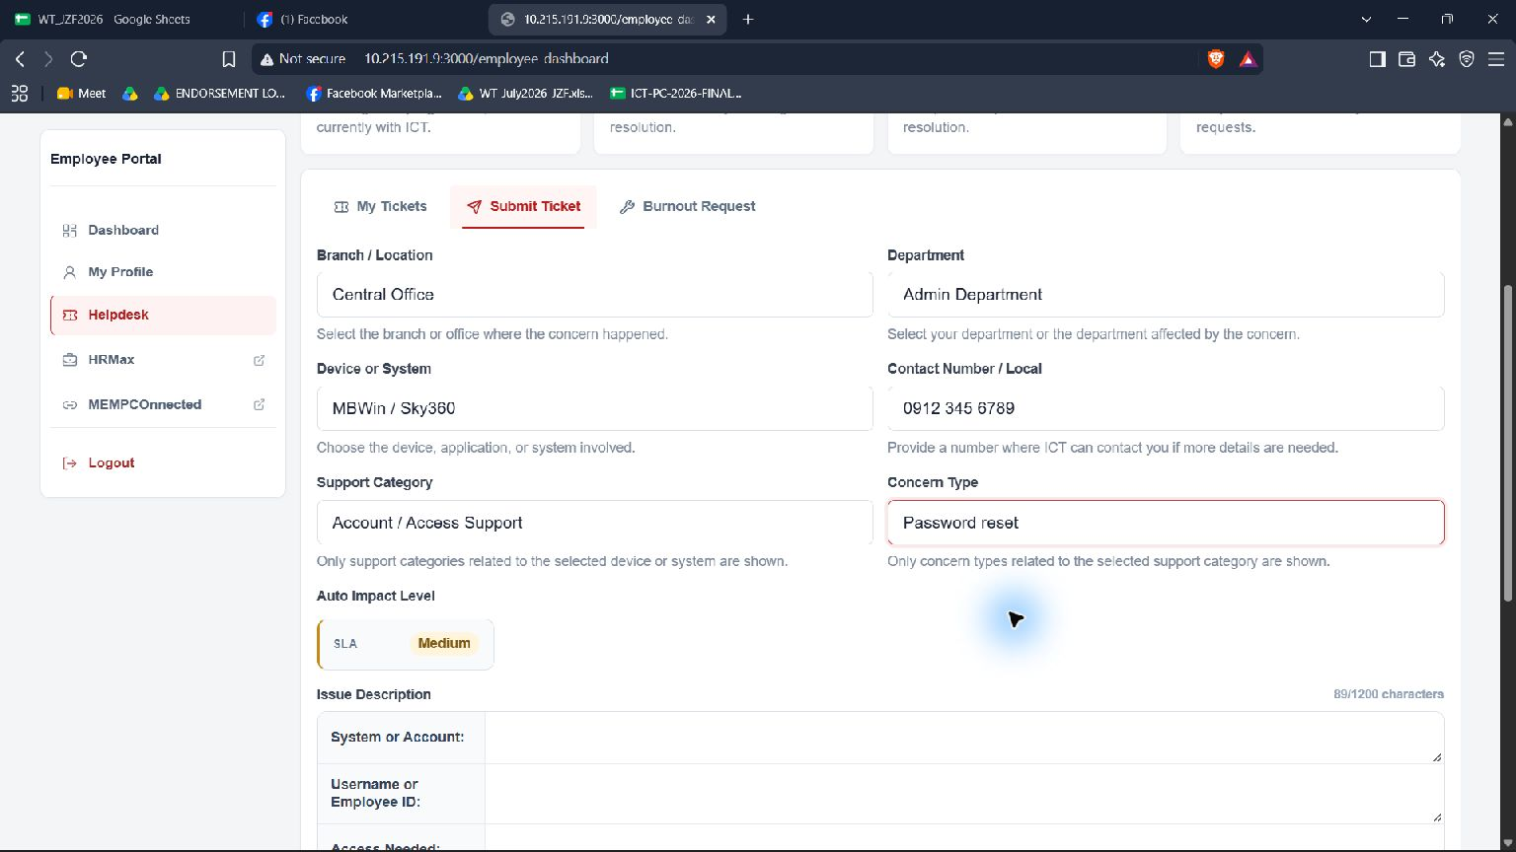
Auto impact and attachment rules
SAMPLE RESULT
MEDIUM
1
Auto-calculated
Employees do not select the impact level.
2
SAAR required here
MBWin / Sky360 password reset needs approved PDF.
Teller reactivation and expiry changes do not need SAAR.
MEMPCO • EMPLOYEE PORTAL GUIDE
12
Notes:
For the sample Password reset under Account / Access Support, the portal displays Medium impact. Impact is calculated from selected category and concern type. For this MBWin / Sky360 request, the approved SAAR PDF is required. The form supports up to five optional photo/screenshot attachments, limited to 4 MB each.
Sources: employee-side-screenshots; app/employee-dashboard/employee-dashboard.jsx; lib/tickets/sla.js

Slide 13
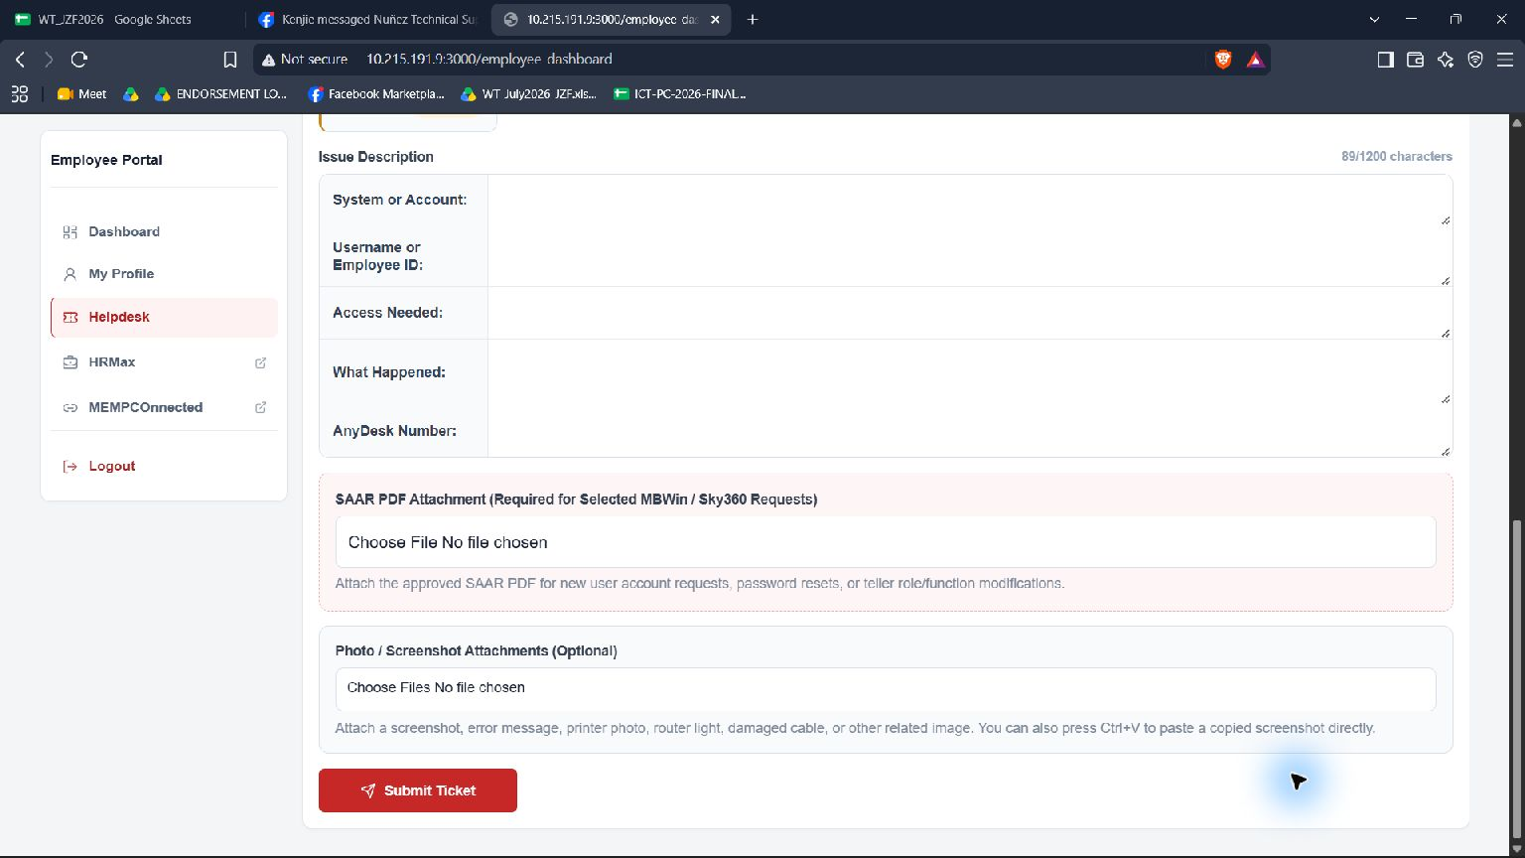
Review, submit, and confirm
1
Check required details
Resolve any missing-field message.
2
Select Submit Ticket
Review the summary shown.
3
Confirm Submission
The request is sent to ICT.
MEMPCO • EMPLOYEE PORTAL GUIDE
13
Notes:
Before submission, check all required fields, the issue description, and the applicable SAAR attachment. Select Submit Ticket. The form validates the details and presents a confirmation summary with concern and calculated impact. Select Confirm Submission to send it to ICT. A success notice appears and the ticket is added to My Tickets.
Sources: employee-side-screenshots; app/employee-dashboard/employee-dashboard.jsx; lib/tickets/sla.js

Slide 14
Worked example: submission outcome
SUBMITTED TO ICT
MBWin / Sky360 password reset
Next step
Open My Tickets
Select the new ticket
Follow ICT status updates
Ticket number
Generated by portal
Status
Submitted / Pending
Impact
Medium
Attachment
Approved SAAR PDF
MEMPCO • EMPLOYEE PORTAL GUIDE
14
Notes:
On successful submission, the portal confirms the request and returns to My Tickets. A ticket number is generated by the portal; it is intentionally not fabricated in this example. The starting status appears in the ticket list. Keep the ticket number for follow-up.
Sources: employee-side-screenshots; app/employee-dashboard/employee-dashboard.jsx; lib/tickets/sla.js

Slide 15
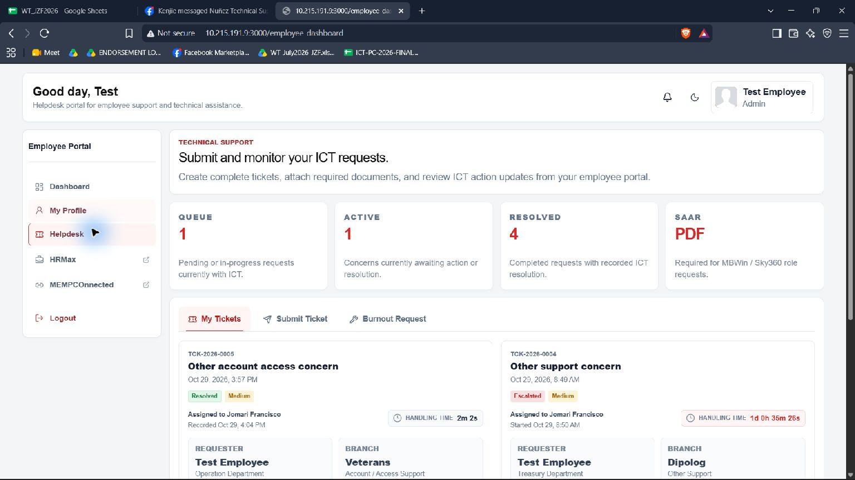
My Tickets: status, queue, and ticket list
1
Find the new ticket
Use its generated ticket number and concern type.
2
Check the status
Review latest status and impact.
3
Open its details
Select the ticket card.
MEMPCO • EMPLOYEE PORTAL GUIDE
15
Notes:
My Tickets displays submitted requests as selectable cards. The card shows ticket reference, concern, date, status, and impact. Eligible pending/in-progress tickets may show an ICT queue position; urgent work can move ahead. The screenshot values are test/demo data.
Sources: employee-side-screenshots; app/employee-dashboard/employee-dashboard.jsx; lib/tickets/sla.js

Slide 16
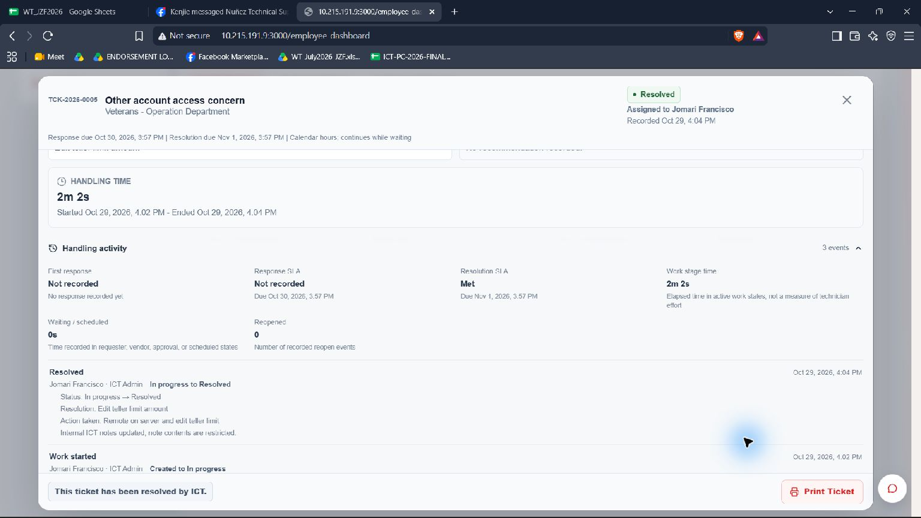
Ticket details: handling and history
WHEN A TICKET IS OPEN
Review the status
Read ICT action history
Check timing information
Use ticket number in follow-up
Open the card to see full details.
MEMPCO • EMPLOYEE PORTAL GUIDE
16
Notes:
Opening a ticket shows its submitted details, current status, assigned ICT staff where available, handling information, and action history. The ticket view may also show response and resolution timing. Timers and timeline values in screenshots are sample data and are not guarantees of a resolution time.
Sources: employee-side-screenshots; app/employee-dashboard/employee-dashboard.jsx; lib/tickets/sla.js

Slide 17
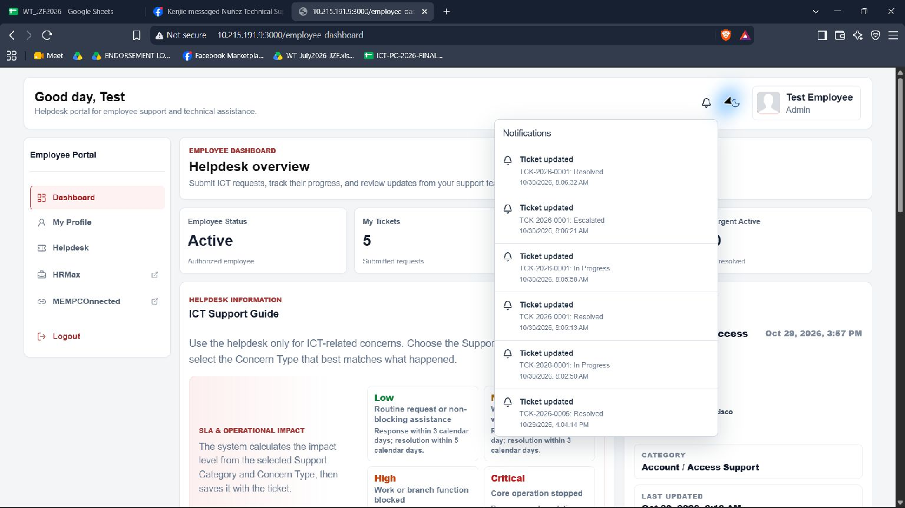
Notifications and ticket conversation
1
See an update
Open the notification or go to My Tickets.
2
Open the relevant ticket
Read the current status and messages.
3
Reply in the thread
Add details or a photo if requested.
MEMPCO • EMPLOYEE PORTAL GUIDE
17
Notes:
The portal notification area can show ticket updates. Opening a ticket also provides the ticket conversation for replies and photo attachments. Reply in the ticket thread when ICT requests more information so the response stays linked to the request. Screenshot notifications are example/test values.
Sources: employee-side-screenshots; app/employee-dashboard/employee-dashboard.jsx; lib/tickets/sla.js

Slide 18
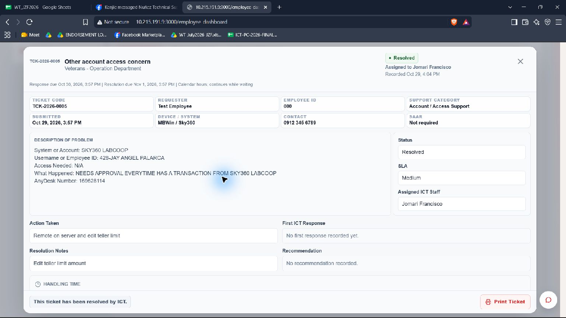
Edit a ticket when the portal allows it
1
Open the ticket
Find it under My Tickets.
2
Choose Edit Ticket
Only if editing is available.
3
Save changes
ICT receives the updated request.
MEMPCO • EMPLOYEE PORTAL GUIDE
18
Notes:
Some tickets can be edited from the employee side when the edit action is available. Update details and save changes; saved employee changes are sent back to ICT for review. When a ticket has been locked for editing, the portal can prevent employee changes.
Sources: employee-side-screenshots; app/employee-dashboard/employee-dashboard.jsx; lib/tickets/sla.js

Slide 19
Admin department: Burnout Request
ADMIN-ONLY FORM
Burnout Request
Branch / Location to be Assigned
Custodian
[Enter request details]
[Enter request details]
Brand
Model
[Enter request details]
[Enter request details]
Serial Number
Custodian Department
[Enter request details]
[Enter request details]
Optional remarks • Select Submit Burnout Request
MEMPCO • EMPLOYEE PORTAL GUIDE
19
Notes:
Only employees whose department is Admin see the separate Burnout Request tab. Required fields are assignment branch/location, custodian, brand, model, serial number, and custodian department. Notes or remarks are optional. Submit with Submit Burnout Request. This special path is not the standard ICT issue form.
Sources: employee-side-screenshots; app/employee-dashboard/employee-dashboard.jsx; lib/tickets/sla.js

Slide 20
The sample ticket from start to follow-up
01
Sign in
02
Submit
03
Describe
Employee Portal
MBWin / Sky360
Password reset
04
Attach
05
Confirm
06
Track
Approved SAAR
Medium impact
My Tickets
Portal-generated ticket number • Follow status and ICT replies in the ticket
MEMPCO • EMPLOYEE PORTAL GUIDE
20
Notes:
Recap the worked MBWin / Sky360 Password reset request. The employee opens the portal, completes the required details, enters the issue summary and AnyDesk number, attaches approved SAAR, reviews the automatic Medium impact, submits, and tracks the generated ticket from My Tickets. ICT status changes and any follow-up are viewed in ticket details and conversation.
Sources: employee-side-screenshots; app/employee-dashboard/employee-dashboard.jsx; lib/tickets/sla.js

