Slide 1
轉接板
I2C
Uart
Gnd
INT
SCL
SDA
Vcc_i2c
Vcc
Tx
Rx
Gnd
1
9
16
8
16
1

Slide 2
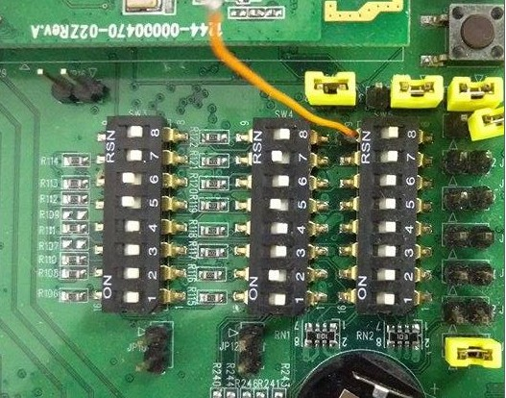
PLL0
664MHz
ARM11
PLL2
528MHz
PLL1
528MHz

Slide 3
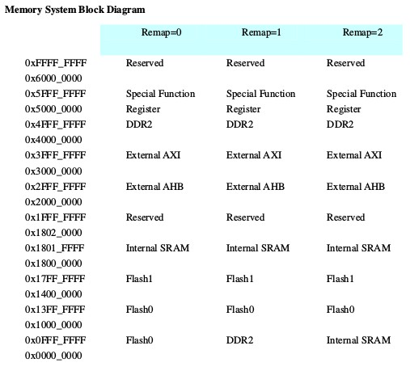
User設計
L6021 資料
0x1000_0000
U-boot
0x1000_0000
Flash 1
0x1007_FFFF
0x1022_0000
Kernel
64MB
0x106F_FFFF
0x1080_0000
File Sys
0x13FF_FFFF
0x11FF_FFFF
0x1400_0000
Flash 2
64MB
0x17FF_FFFF

