Slide 1
Linux RTC Device Driver
BenTsai
2016/4/13

Slide 2
OUTLINE
Linux Device Driver – RTC via I2C bus
Linux - I2C架構 – master
RTC驅動

Slide 3
Linux Device Driver – RTC via I2C bus

Slide 4
Linux - I2C架構 - master
user space
應用程式
kernel space
I2C Device Driver
I2c slave device 實現
i2c-client
i2c-client
i2c-dev
i2c-client
i2c-client
I2C-CORE
為linux內核中提供的i2c構架核心機制，管理各種重要i2c要素的接口函數，例如struct i2c_adapter、struct i2c_driver等驅動的註冊和註銷接口.
i2c device driver
I2C-Core
i2c-core
I2C Bus Driver
I2C-Adapter:
代表SoC內的各組I2C Controller. 提供Controller的Base Address,對應的Algorithm等資訊. 對應物理上的一個適配器
I2C-Algorithm:
對應SoC的I2C通信方法, 包括I2C Start Condition, Stop Condition, Data Transmit, Data Receive等實際上的Reg設定.
i2c-adapter
/algorithm
i2c-adapter
/algorithm
i2c-adapter
/algorithm
i2c-adapter
/algorithm
i2c Bus Driver
HW
i2c slave device
i2c host controller
Notes:
i2c-core : I2C 核心提供了I2C總線驅動和設備驅動的註冊、註銷方法
I2c host driver code : I2C總線驅動主要包括I2C適配器結構i2c adapter和I2C適配器的algorithm數據結構。
http://blog.csdn.net/sirzjp/article/details/6599285

Slide 5
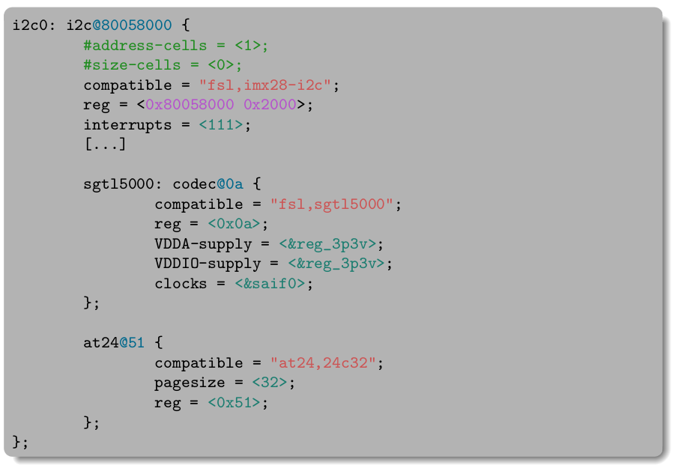
rtc 驅動框架
device tree
i2c client dts
of_i2c_register_devices
i2c bus dts
i2c board info
rtc
device
platform device : i2c
i2c_new_device
platform bus
adapter
i2c bus
i2c_add_numbered_adapter
platform driver : i2c
rtc driver
algorithm
Bus
controller
slave device
Notes:
Sgt15000 : audio machine at24 : i2c EEPROM
I2c platform device ➔ compatible(dts) / Name
I2c platform driver (socle_i2c_driver) ➔ of_match_table / name
I2C device ➔ compatible / of_match_table
I2C driver ➔ Type (i2c_board_info) / name

Slide 7
Back Up

Slide 8
I2C驅動框架
Slave device
Type (i2c_board_info)
Slave device(dts)
compatible
device tree
i2c client dts
of_i2c_register_devices
i2c bus dts
compatible(dts)
name
i2c board info
platform device : i2c
i2c slave device
i2c_new_device
platform bus
adapter
i2c bus
i2c_add_numbered_adapter
platform driver : i2c
algorithm
i2c slave driver
socle_i2c_driver
of_match_table
name
Slave driver
of_match_table
name
Bus
controller
slave device
Notes:
Sgt15000 audio machine

