Slide 1
F2 Project – S2C fpga v2.2
MTD Implement
BenTsai
2016/7/15

Slide 2
OUTLINE
Environment
HW
SW
Compiler
Flash 規劃
U-Boot 修改
Linux 修改
MTD Usage
MTD Info
MTD Erase
MTD Copy
Booting
待解決問題

Slide 3
Environment

Slide 4
Environment
HW
S2C fpga bit file v2.2 (P2S1521A_0624_V2.2_S2C.bit)
SW
Git clone
repo init -u git@10.63.246.9:CDB/manifests/Linaro-15.06/linux/f2-fpga.git
repo sync
U-boot
Branch : FTK_F2_FPGA
Commit id : b5d0410a93cf89e1b2f2ea75cf8bdc506fc26966
Kernel
Branch : FTK_F2_FPGA
Commit id : 9ff2a741255919040f193d466bab0249ef924679
Buildroot
Branch : FTK_F2_FPGA
Commit id : 2397f9c1124fc26b3761d30c52f82b7782d43a51
Build
Branch : develop
Commit id : 2a648fff7c2fd4579c5e090b14316e0cec377491

Slide 5
Compiler

Slide 6
Flash 規劃 – 20160715
U-Boot
MTD0
U-Boot
0x00000000 ~ 0x00040000, 0x40000
ENV
0x00040000 ~ 0x00060000, 0x20000
MTD1
uImage
0x00060000 ~ 0x00560000, 0x500000
MTD2
uInitrd(rootfs.jffs2)
0x00560000 ~ 0x02d60000, 0x2800000
MTD3
board.dtb
0x02d60000 ~ 0x02d70000, 0x10000
MTD4
data
0x02d70000 ~
ENV
Linux
Buildroot
dts
data

Slide 7
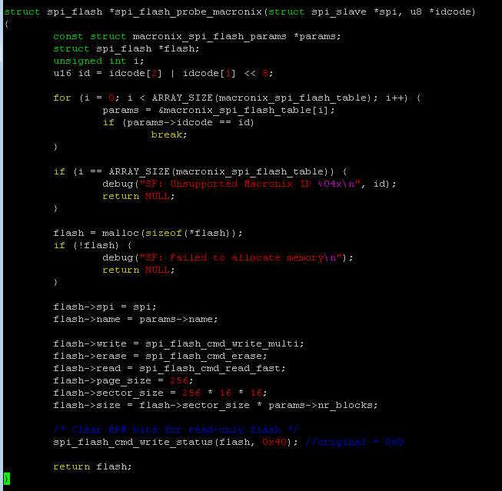
U-Boot - flash
Mx25u51245g default setting
File : drivers/mtd/spi/macronix.c
修改spi_flash_probe_macronixs內
spi_flash_cmd_write_status(flash, 0x40);
將0x00改為0x40，這是將Quad Enable設
為1，確保4 I/O模式可以正常執行。
4 I/O ↹ 2 I/O 注意事項
SCU 0x31000328 數值0x10E ↹ 0x10D (SoC Spec.)
QE設成1是4 I/O必要條件(flash Spec)
目前bit file 版本，SCU 0x31000328
初始值為0x10E(4 I/O)，之後可能會改為
0x10D(2 I/O)。

Slide 8
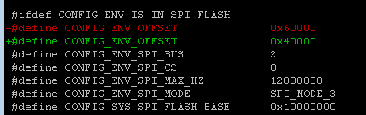

U-Boot – default setting
ENV Saving Address
File : include/configs/f2-fpga.h
依照flash規劃，設定ENV Offset
CONFIG_ENV_OFFSET 0x60000 → 0x40000
TEXT Base
File : include/configs/f2-fpga.h
修改Text base

Slide 9
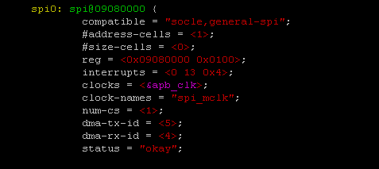
Linux - SPI
Device Tree
File : arch/arm/boot/dts/f2-fpga.dts
確認Device Tree Spi 設定
Spi Vs Spi-nor, 思考spi flash是否應該掛載在spi bus上, 還是另外撰寫spi-nor driver.
此外，spi device name 設定上目前有瑕疵。

Slide 10
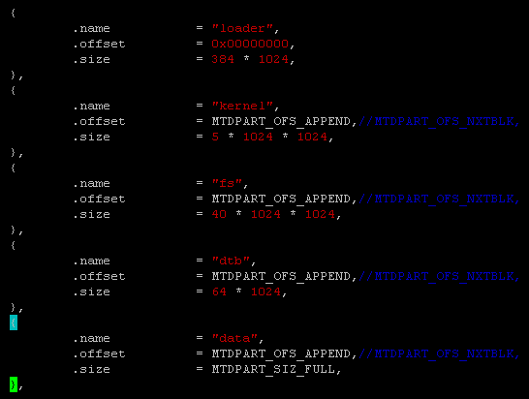
Linux – MTD Device
Device
File : arch/arm/mach-socle/board_F2_FPGA.c
依flash規劃，修改spi_flash_part內的數值

Slide 11
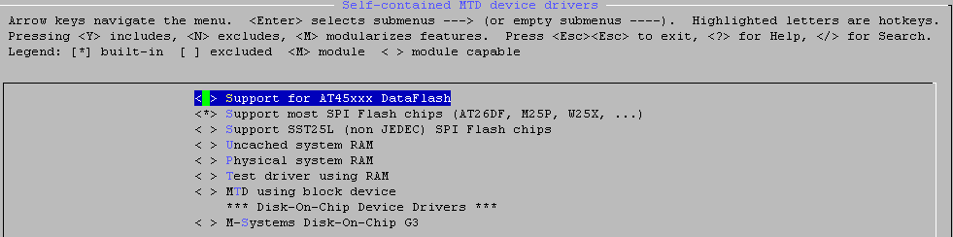
Linux – MTD Driver
Driver
mm menuconfig
Device Drivers --->
<*> Memory Technology Device (MTD) support --->
<*> SPI-NOR device support --->
Device Drivers --->
<*> Memory Technology Device (MTD) support --->
Self-contained MTD device drivers --->

Slide 12
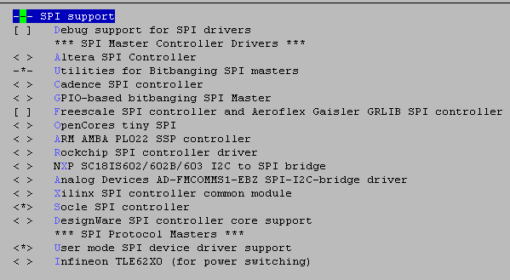
Linux – SPI Driver
Driver
mm menuconfig
Device Drivers --->
<*> SPI support --->

Slide 13
MTD Usage

Slide 14
MTD Usage
MTD info
mtdinfo [mtd device]
example : mtdinfo /dev/mtd2
cat /proc/mtd
Erase
flash_erase [mtd device] [start block] [erase block number]
example : flash_erase /dev/mtd2 0 640
640可以從mtdinfo得到
Copy to Mtd device
flashcp [file] [mtd device]
example : flashcp ~/uInitrd /dev/mtd2

Slide 15
Booting

Slide 16
Booting From Flash
依照Flash 的規劃，in u-boot
Copy file to DDR from flash
uImage : mdma 0x50000000 0x10060000 0x50000
uInitrd : mdma 0x51000000 0x10560000 0x2800000
dtb : mdma 0x54000000 0x12D60000 0x10000
Switch SPI-Nor AHB to APB
mw.l 0x0908004c 0x01
Bootm
bootm 0x50000000 0x051000000 0x54000000

Slide 17
待解決問題

Slide 18
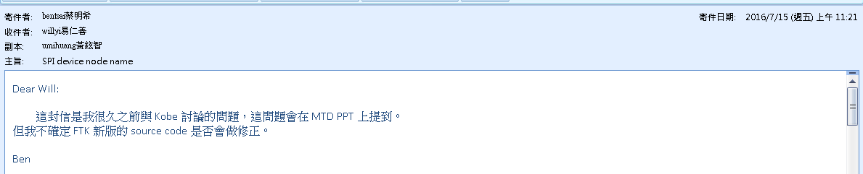
待解決問題
Booting時，須先執行Spi-Nor AHB/APB切換不合理，思考kernel driver的修正方式
目前台北使用的source code，在啟spi controller後，不可以開啟DMA controller，會造成資料傳輸的問題，應該是driver與IP匹配上有問題。
SPI-Nor IP 4 I/O ↹ 2 I/O 與 address 4byte mode ↹ 3byte mode需要注意。
Spi device node name 目前driver撰寫上有些瑕疵

