Slide 1
F2 Project – S2C fpga v2.2
RTC Implement
BenTsai
2016/7/18

Slide 2
OUTLINE
Environment
HW
SW
Compiler
U-Boot 修改
Linux 修改
Usage
U-Boot - date
Linux - hwclock

Slide 3
Environment

Slide 4
Environment
HW
S2C fpga bit file v2.2 (P2S1521A_0624_V2.2_S2C.bit)
參考文件 : S2C_RTC_HW.pptx
SW
Git clone
repo init -u git@10.63.246.9:CDB/manifests/Linaro-15.06/linux/f2-fpga.git
repo sync
U-boot
Branch : FTK_F2_FPGA
Commit id : b5d0410a93cf89e1b2f2ea75cf8bdc506fc26966
Kernel
Branch : FTK_F2_FPGA
Commit id : 9ff2a741255919040f193d466bab0249ef924679
Buildroot
Branch : FTK_F2_FPGA
Commit id : 2397f9c1124fc26b3761d30c52f82b7782d43a51
Build
Branch : develop
Commit id : 2a648fff7c2fd4579c5e090b14316e0cec377491

Slide 5
Compiler

Slide 6
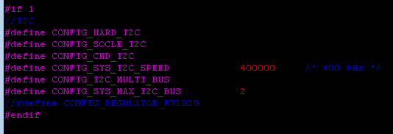
U-Boot – I2C
I2C Implement
File : include/configs/f2-fpga.h
開啟Socle I2C

Slide 7

U-Boot – Cmd Date
M41T62 Implement & Date Cmd
File : include/configs/f2-fpga.h
確認i2c開啟
開啟date cmd & m41t62
CONFIG_SYS_RTC_BUS_NUM 若沒設定，則default 為0，即I2C0控制RTC

Slide 8
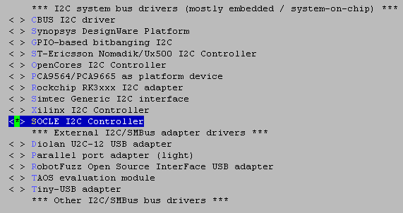
Linux – i2c Driver
Driver
mm menuconfig
Device Drivers --->
I2C support --->
I2C Hardware Bus support --->
<*> SOCLE I2C Controller

Slide 9
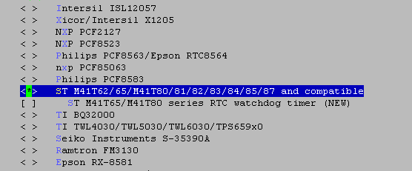
Linux – RTC Driver
Driver
mm menuconfig
Device Drivers --->
<*> Real Time Clock --->
<*> ST M41T62/65/M41T80/81/82/83/84/85/87 and compatible

Slide 10
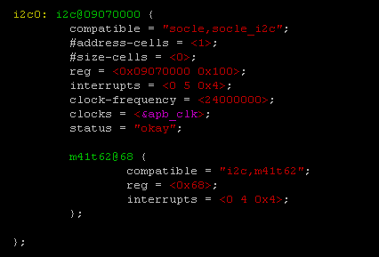
Linux – I2C
Device Tree
File : arch/arm/boot/dts/f2-fpga.dts
確認Device Tree spi/rtc module 設定
可參考socle wiki : http://10.63.246.9/mediawiki/index.php/F2_Test_Plan_RTC

Slide 11
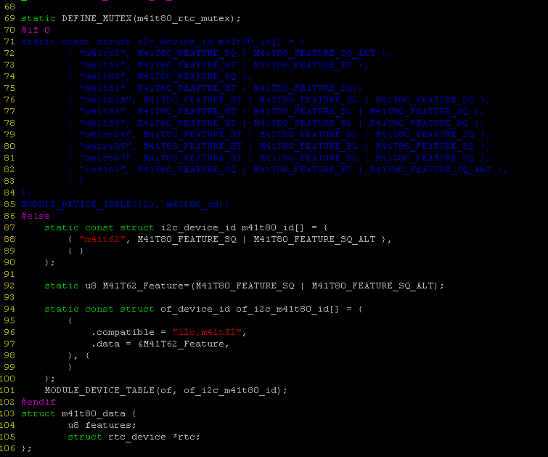
Linux – m41t62 driver -1
Driver
File : drivers/rtc/rtc-m41t80.c， 詳細程式碼請參閱wiki

Slide 12
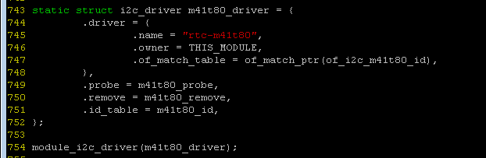
Linux – m41t62 driver - 2
Driver
File : drivers/rtc/rtc-m41t80.c， 詳細程式碼請參閱wiki
http://10.63.246.9/mediawiki/index.php/F2_Test_Plan_RTC

Slide 13
Usage

Slide 14
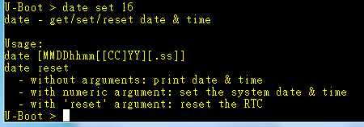
Usage – U-boot
U-Boot - date
Date setting
example : 2016/07/18 13:53
cmd : date 0718135316
Date show
cmd : date

Slide 15
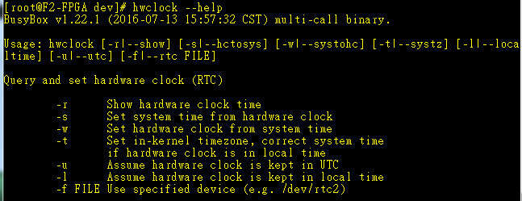

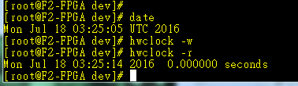
Usage – linux
Linux - hwclock
hwclcok
Date show
cmd : hwclock –r
Date set
date
hwclcok -w

