Slide 1
Linux SPI Device Driver
BenTsai
2015/11/2

Slide 2
OUTLINE
I2C
UART
Uart Packet Frame
8250/16450/16550
Linux Device Driver – I2C
TTY Device/Driver
Platform Device/Driver
Uart Driver – 8250 Driver
Adapter : L6021
Device Tree
Client Device : F75111R
SMBus

Slide 3
I2C

Slide 4
I2C 硬體架構
vcc
上拉電阻
上拉電阻
SDA
I2C 總線
SCL
SDA
SCL
SDA
SCL
SDA
SCL

Slide 5
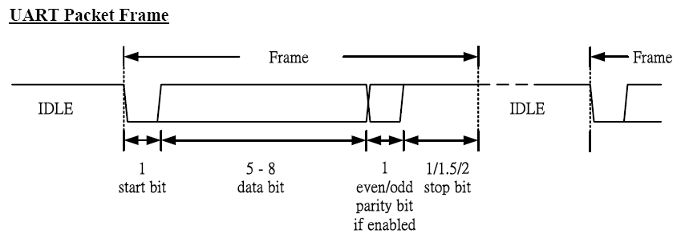
I2C Data Format
Start Bit : 1 bit, always low.
Data Bit : 5~8 Bit
Parity Bit : None/Even/Odd, three options.
Stop Bit : 1/1.5/2 Bit, always high.
常用設定 : N81, baud rate : 115200.

Slide 6
I2C Data Format
Start Bit : 1 bit, always low.
Data Bit : 5~8 Bit
Parity Bit : None/Even/Odd, three options.
Stop Bit : 1/1.5/2 Bit, always high.
常用設定 : N81, baud rate : 115200.

Slide 7
Linux Device Driver – SPI

Slide 8
Linux - I2C
i2c-core
i2c-adapter
i2c-algorithm
i2c-client (F75111R)
user space
應用程式
用戶模式驅動
kernel space
spi-dev
/sys,/dev
spi-core
i2c-client
i2c-adapter
/algorithm
i2c-client
i2c-adapter
/algorithm
i2c-client
i2c-adapter
/algorithm
spi-client
spi-master
HW
spi slave device
spi host controller
Notes:
User Space 若要使用Uart, 需要藉由ttyS這個node. 而這個node, 是tty core 向linux kernel 註冊ttys的char device.
藉由tty 的介面與行為, 實際操作Uart.

Slide 9
Linux - SPI架構 - master
user space
應用程式
kernel space
i2c-client
SPI-Core
為linux內核中提供的spi構架核心機制，管理各種重要SPI要素的接口函數，例如struct spi_master、struct spi_driver、struct spi_device 、struct spi_transfer、struct spi_message、struct spi_board_info.
i2c-client
spidev
i2c-client
SPI Device Driver
SPI client device 實現
SPI-client
SPI device driver
SPI
SPI-Core
SPI Bus Driver
spi-master:
代表SoC內的各組I2C Controller. 提供Controller的Base Address,對應的Algorithm等資訊. 對應物理上的一個適配器
I2C-Algorithm:
對應SoC的I2C通信方法, 包括I2C Start Condition, Stop Condition, Data Transmit, Data Receive等實際上的Reg設定.
i2c-adapter
/algorithm
i2c-adapter
/algorithm
i2c-adapter
/algorithm
SPI-master
SPI Bus Driver
HW
SPI client device
SPI host controller
Notes:
i2c-core : I2C 核心提供了I2C總線驅動和設備驅動的註冊、註銷方法
I2c host driver code : I2C總線驅動主要包括I2C適配器結構i2c adapter和I2C適配器的algorithm數據結構。
http://blog.csdn.net/sirzjp/article/details/6599285

Slide 10
SPI驅動框架-master
device tree
SPI client dts
spi_add_driver
spi_register_master
of_register_spi_devices
spi_match_master_to_boardinfo
device tree (platform device)
list_add_tail
list_for_each_entry
of_register_spi_devices
SPI dts
Slave device(dts)
compatible
compatible(dts)
name
client device
platform device : SPI
spi_match_master_to_boardinfo
(bus_num)
Slave device
modalias
platforn bus
board info
SPI bus
spi_register_master
spi_add_device
platform driver : SPI
master
client driver
SOCLE_SPI_driver
of_match_table
name
Slave driver
of_match_table
id_table | name
host controller
slave device
Notes:
Master->bus mumber對Device Tree的架構不是重點, 因此有spidev32766這奇怪數字的問題, 但若我們使用board info 來建立spi client device則是很重要的判斷機制.

Slide 11
L6021 – I2C

Slide 12
I2C
Feature
Item Compatible with I2C-bus
AMBA APB slave interface
Supports master and slave modes of I2C bus
Multi master operation
SW programmable clock frequency and transfer rate up to 400Kbit/sec
Supports 7 bits and 10 bits addressing modes
Interrupt or polling driven byte-by-byte data transfer
Clock stretching and wait state generation

Slide 13
Master Mode Programming
SCL Clock
Data Receiver Register Access
Start Command and 1’st Byte Address
Interrupt and Resume
Read/Write Command
Multi-Master Arbitration
Master Interrupt Condition
Stop Command

Slide 14
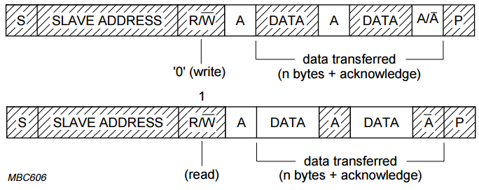
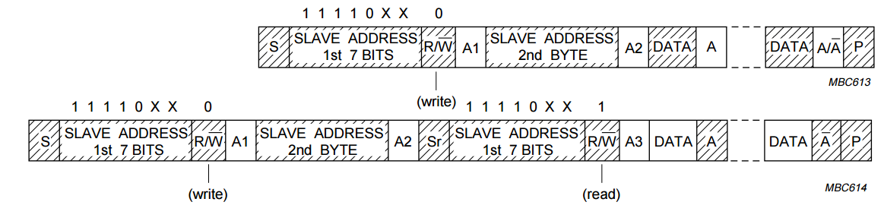
Detail Register Description
socle_i2c_do_address()
socle_i2c_read_bytes()
socle_i2c_send_bytes()
socle_i2c_stop()

Slide 15
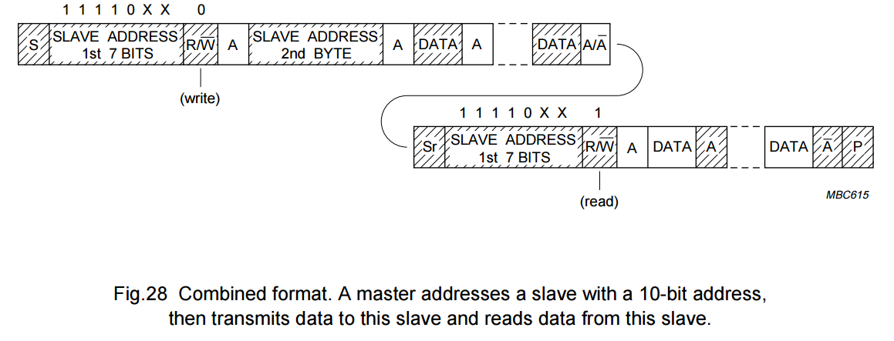

Slide 16
F75111R

Slide 17
Notes:
http://wiki.csie.ncku.edu.tw/embedded/I2C

Slide 19
Back Up

Slide 20
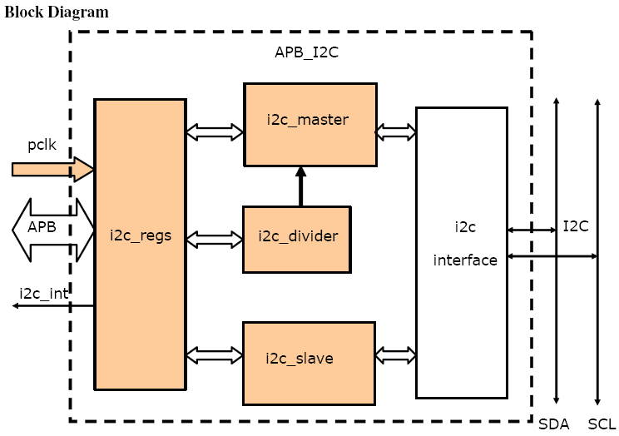
I2C
i2c_regs – Control and Status Registers
The i2c_regs component is used to control the I2C controller operation by the host with APB interface. It implements the register set and the interrupt functionality. The CSR component operates synchronously with the pclk clock.
i2c_master – I2C Master Control and State Machine
The I2C master controller implements the I2C master operation for transmit data to and receive data from other I2C devices. The I2C master controller operates synchronously with the pclk.
i2c_slave – I2C Slave Control and State Machine
The I2C slave controller implements the I2C master operation for transmit data to and receive data from other I2C devices. The I2C slave controller operates synchronously with the pclk.
i2c_divider – Clock Divider
The clock divider module generates I2C clock SCL output signals from pclk at
frequency according the given equation.
i2c_interface – I2C interface (These are logics under top module. There is actually no such a module)
SDA output enable from I2C master controller and slave controller are ANDed together as the output ports. Similarly, SCL output enable from I2C
master controller and slave controller are ANDed together. SDA output and SCL output are actually ties to the ground since I2C is an open drain
architecture. So once enabled, SDA/ SCL on I2C will be pulled low.

Slide 21
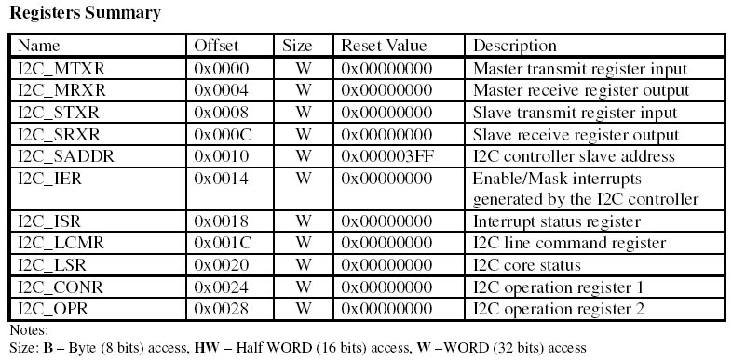
Registers Summary

Slide 22
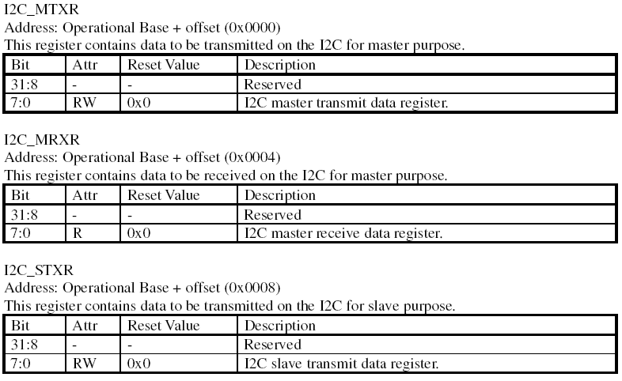
Detail Register Description

Slide 23
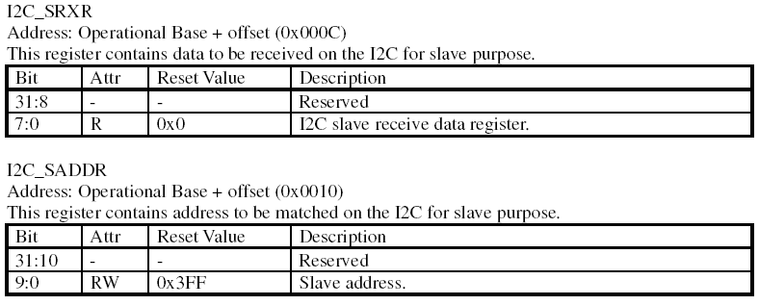
Detail Register Description

Slide 24
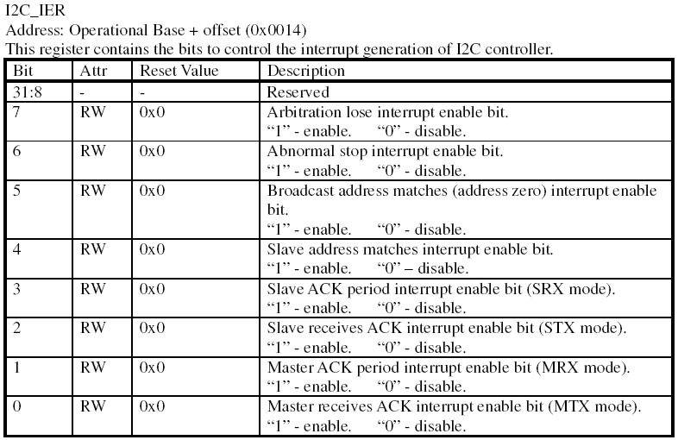
Detail Register Description

Slide 25
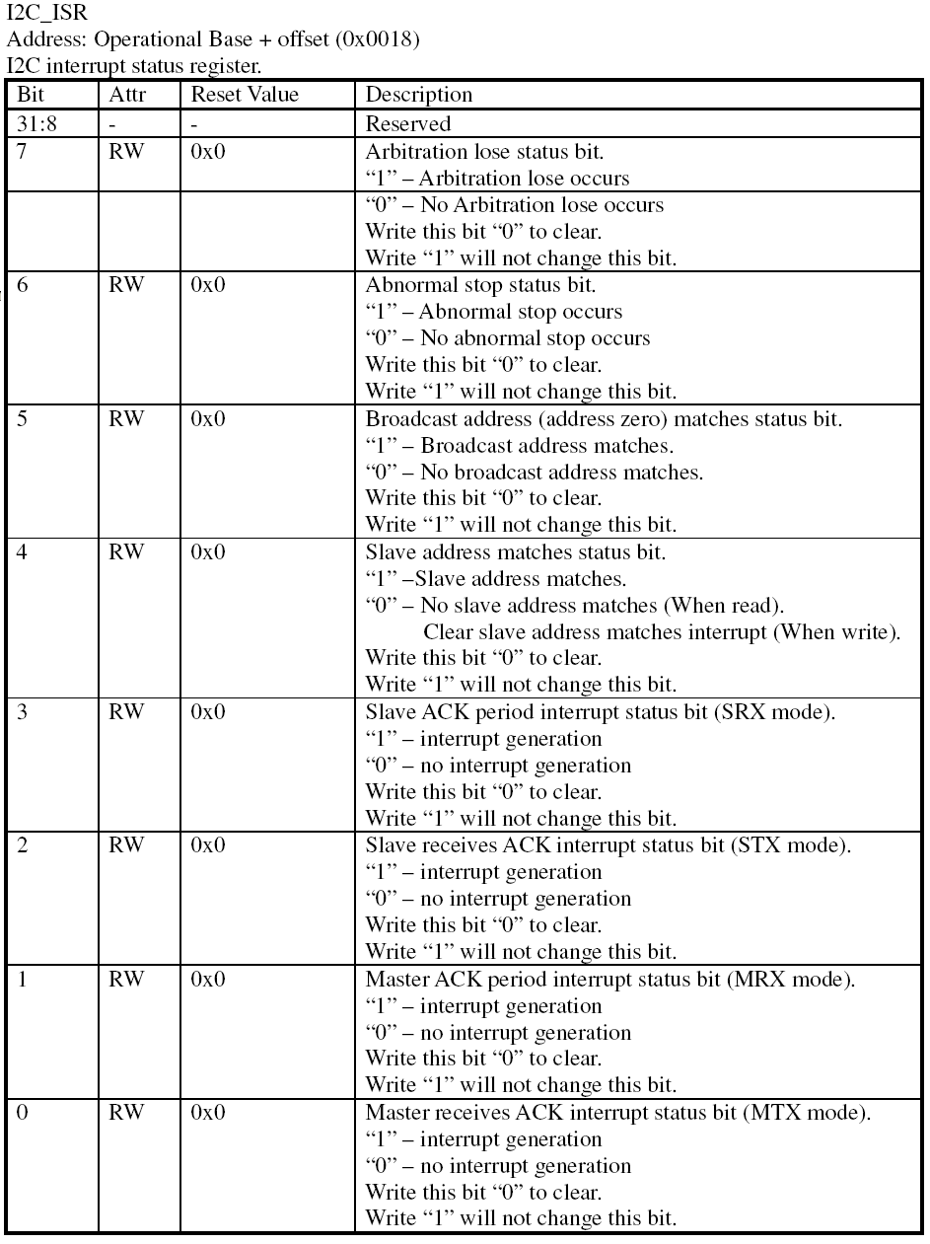
Detail Register Description

Slide 26
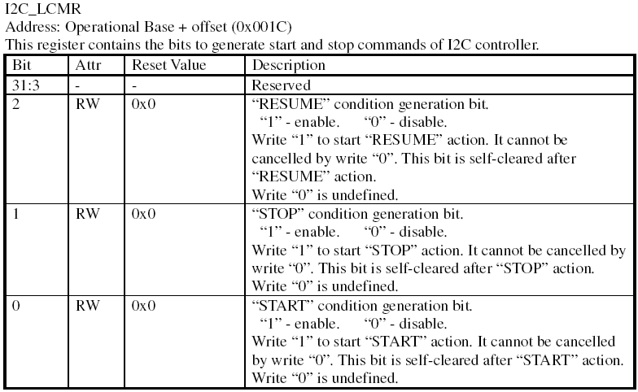
Detail Register Description

Slide 27
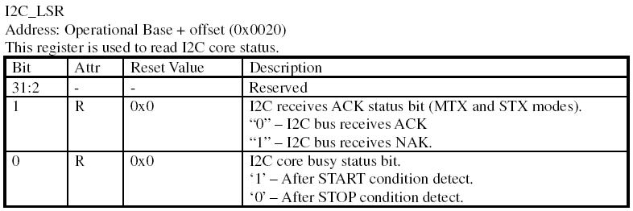
Detail Register Description

Slide 28
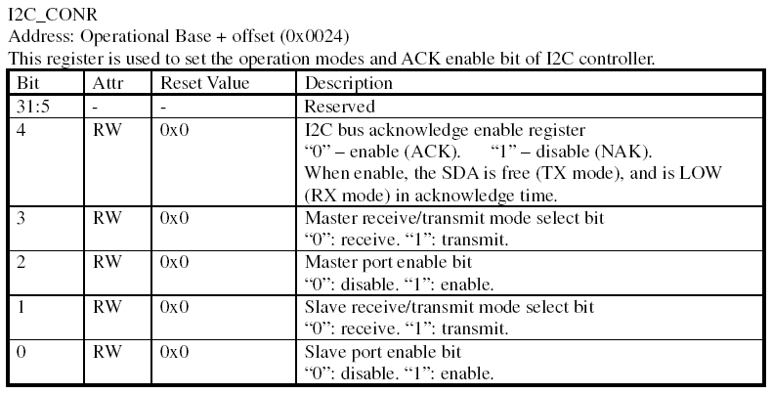
Detail Register Description

Slide 29
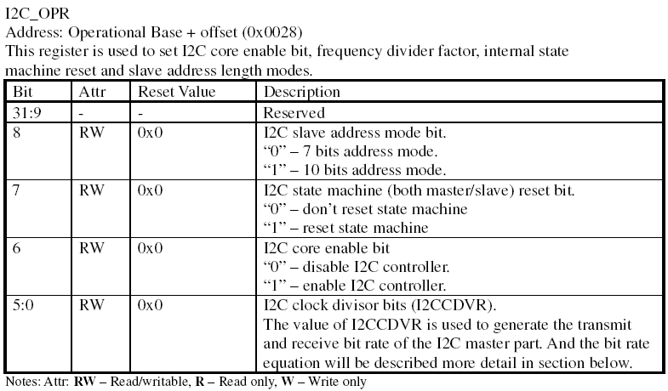
Detail Register Description

