Slide 1
Linux i2c Device Driver
BenTsai
2015/11/23

Slide 2
OUTLINE
I2C
I2C - Inter-Integrated Circuit
I2C 訊號時序圖
I2C Packet Format
Linux Device Driver – I2C
Linux - I2C架構 – master
I2C驅動
I2C – Algorithm

Slide 3
I2C

Slide 4
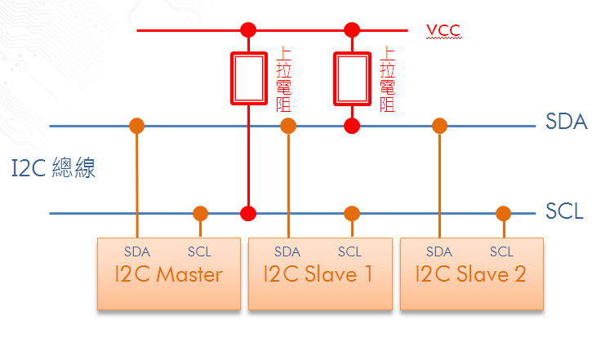
I2C - Inter-Integrated Circuit
半雙工同步匯流排
串列資料線(SDA)與串列時脈線(SCL or SCK)
定址模式: 10-bit（允許連接1024個裝置）與 7-bit （允許連接128個裝置）
傳輸模式: 10kbps 的低速模式、100kbps 的標準模式、及 400kbps 的快速模式
I2C連接的裝置都是Open Drain的接腳，外接Pull-Up電阻.
Notes:
I2C 是半雙工的匯流排, 提供雙向但不可同時的資料傳遞.
藉由兩條線連接所有的裝置, 一條為Data線, 一條為clock線(同步使用)
連接在I2C上的裝置, 都擁有自己的Address, 利用定址的方式,裝置知道Master是與自己做溝通, 而他的地址模式分為7-bit與10-bit兩種, 我們今天會以7-bit為主
I2C Bus 硬體架構
傳輸模式有3種, 低速,標準與高速
Od接腳

Slide 5
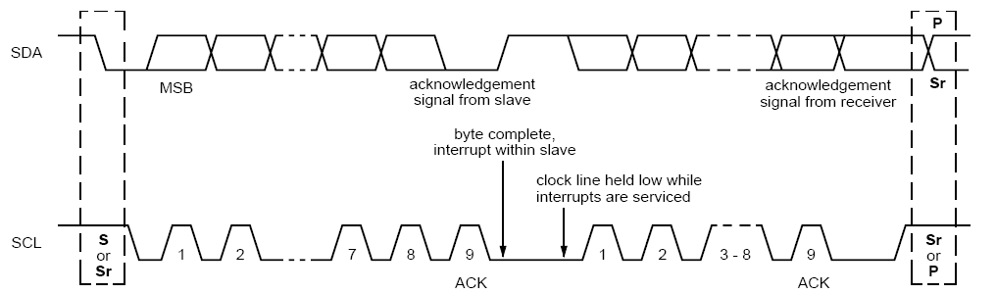
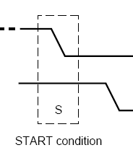
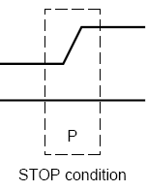
I2C 訊號時序圖
Data Transfer : Byte
Wait : SCL – Low, SDA – High
Ack Signal : Ack(0), No Ack (1)

Slide 6
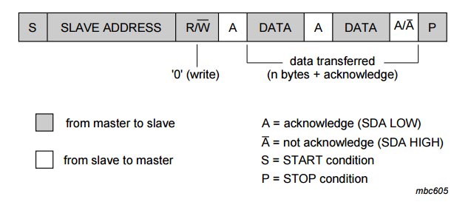
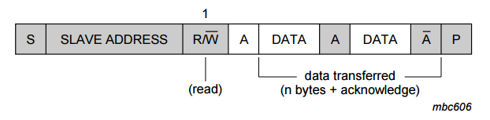
I2C Packet Format
Slave Address : 7 Bit
Read/Write Bit : 0 , Write Data to Slave. 1 , Read From Slave
Data :1Byte, Cmd, Address, Data.

Slide 7
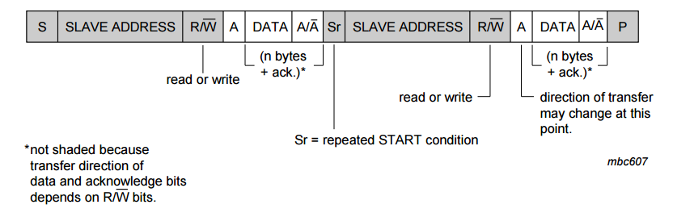
I2C Packet Format – Write And Read
I2C EEPROM : Read Data (I2C Write + I2C Read)
S
Slave Address
W
A
ADDR
A/A
Sr
Slave Address
R
A
DATA
A
DATA
A
P
讀取資料的起始位置
資料完結時,
回No Ack

Slide 8
Linux Device Driver – I2C

Slide 9
Linux - I2C架構 - master
user space
應用程式
kernel space
i2c-client
I2C-CORE
為linux內核中提供的i2c構架核心機制，管理各種重要i2c要素的接口函數，例如struct i2c_adapter、struct i2c_driver等驅動的註冊和註銷接口.
i2c-client
i2c-dev
i2c-client
I2C Device Driver
I2c slave device 實現
i2c-client
i2c device driver
i2c-core
I2C-Core
I2C Bus Driver
I2C-Adapter:
代表SoC內的各組I2C Controller. 提供Controller的Base Address,對應的Algorithm等資訊. 對應物理上的一個適配器
I2C-Algorithm:
對應SoC的I2C通信方法, 包括I2C Start Condition, Stop Condition, Data Transmit, Data Receive等實際上的Reg設定.
i2c-adapter
/algorithm
i2c-adapter
/algorithm
i2c-adapter
/algorithm
i2c-adapter
/algorithm
i2c Bus Driver
HW
i2c slave device
i2c host controller
Notes:
i2c-core : I2C 核心提供了I2C總線驅動和設備驅動的註冊、註銷方法
I2c host driver code : I2C總線驅動主要包括I2C適配器結構i2c adapter和I2C適配器的algorithm數據結構。
http://blog.csdn.net/sirzjp/article/details/6599285

Slide 10
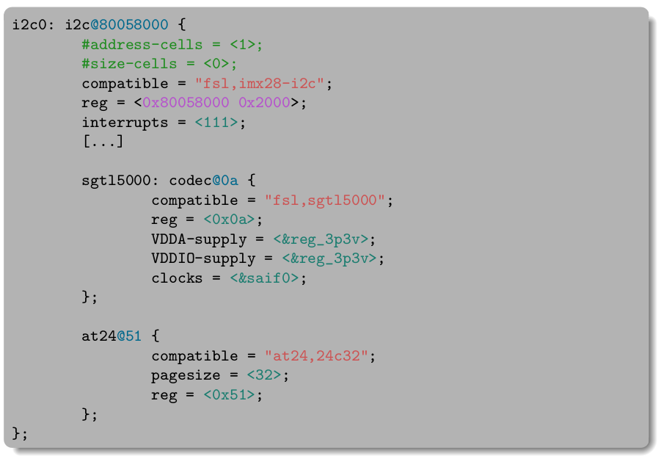
I2C驅動框架
device tree
i2c client dts
of_i2c_register_devices
i2c bus dts
i2c board info
platform device : i2c
i2c device
i2c_new_device
platform bus
adapter
i2c bus
i2c_add_numbered_adapter
platform driver : i2c
algorithm
i2c driver
Bus
controller
slave device
Notes:
Sgt15000 : audio machine at24 : i2c EEPROM
I2c platform device ➔ compatible(dts) / Name
I2c platform device (socle_i2c_driver) ➔ of_match_table / name
I2C device ➔ compatible / of_match_table
I2C driver ➔ Type (i2c_board_info) / name

Slide 11


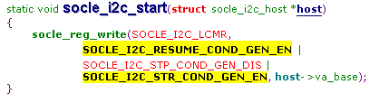

I2C – Algorithm –L6021
對應SoC的I2C通信方法, 包括I2C Start Condition, Stop Condition, Data Transmit, Data Receive等實際上的Reg設定.
Start Condition + Addr + R/W Bit
Data Transfer
Data Receiver
Stop Condition
Set I2C to Tx Mode
Set I2C to Tx Mode
Set I2C to Rx Mode
Set Line Control
<STOP>
Write to Tx Buffer
Data(8) = Addr(7) + W/R(1)
Write to Tx Buffer
Data(8) = Cmd/Data
Set Line Control
<RESUME>
Set Line Control
<START + RESUME>
Set Line Control
<RESUME>
Wait interrupt
Read Rx Buffer
Wait Ack Signal
Wait Ack Signal
Send Ack Signal

Slide 12
I2C – Algorithm –L6021
對應SoC的I2C通信方法, 包括I2C Start Condition, Stop Condition, Data Transmit, Data Receive等實際上的Reg設定.
Start Condition + Addr + R/W Bit
Data Transfer
Data Receiver
Stop Condition
Set I2C to Tx Mode
Set I2C to Tx Mode
Set I2C to Rx Mode
Set Line Control
<STOP>
Write to Tx Buffer
Data(8) = Addr(7) + W/R(1)
Write to Tx Buffer
Data(8) = Cmd/Data
Set Line Control
<RESUME>
Set Line Control
<START + RESUME>
Set Line Control
<RESUME>
Wait interrupt
Read Rx Buffer
Wait Ack Signal
Wait Ack Signal
Send Ack Signal

Slide 14
Back Up

Slide 15
I2C驅動框架
Slave device
Type (i2c_board_info)
Slave device(dts)
compatible
device tree
i2c client dts
of_i2c_register_devices
i2c bus dts
compatible(dts)
name
i2c board info
platform device : i2c
i2c slave device
i2c_new_device
platform bus
adapter
i2c bus
i2c_add_numbered_adapter
platform driver : i2c
algorithm
i2c slave driver
socle_i2c_driver
of_match_table
name
Slave driver
of_match_table
name
Bus
controller
slave device
Notes:
Sgt15000 audio machine

Slide 16
I2C
Feature
Item Compatible with I2C-bus
AMBA APB slave interface
Supports master and slave modes of I2C bus
Multi master operation
SW programmable clock frequency and transfer rate up to 400Kbit/sec
Supports 7 bits and 10 bits addressing modes
Interrupt or polling driven byte-by-byte data transfer
Clock stretching and wait state generation

Slide 17
Master Mode Programming
SCL Clock
Data Receiver Register Access
Start Command and 1’st Byte Address
Interrupt and Resume
Read/Write Command
Multi-Master Arbitration
Master Interrupt Condition
Stop Command

Slide 18
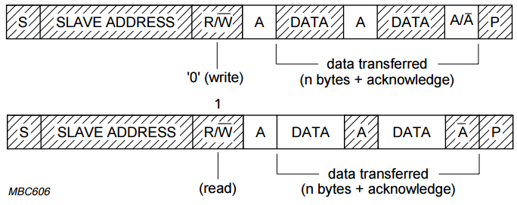
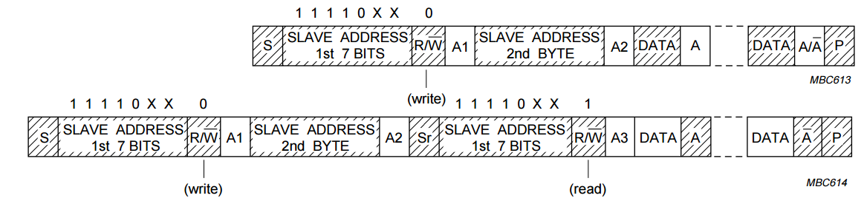
Detail Register Description
socle_i2c_do_address()
socle_i2c_read_bytes()
socle_i2c_send_bytes()
socle_i2c_stop()

Slide 19
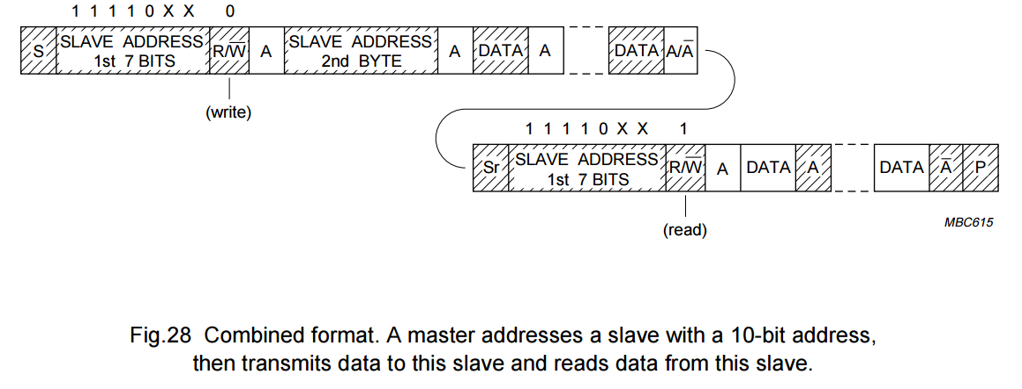

Slide 20
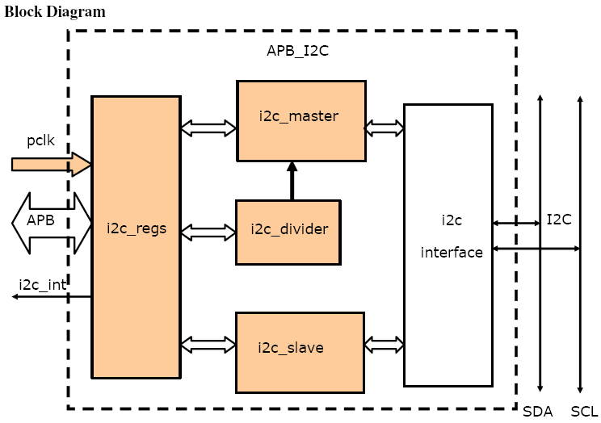
I2C
i2c_regs – Control and Status Registers
The i2c_regs component is used to control the I2C controller operation by the host with APB interface. It implements the register set and the interrupt functionality. The CSR component operates synchronously with the pclk clock.
i2c_master – I2C Master Control and State Machine
The I2C master controller implements the I2C master operation for transmit data to and receive data from other I2C devices. The I2C master controller operates synchronously with the pclk.
i2c_slave – I2C Slave Control and State Machine
The I2C slave controller implements the I2C master operation for transmit data to and receive data from other I2C devices. The I2C slave controller operates synchronously with the pclk.
i2c_divider – Clock Divider
The clock divider module generates I2C clock SCL output signals from pclk at
frequency according the given equation.
i2c_interface – I2C interface (These are logics under top module. There is actually no such a module)
SDA output enable from I2C master controller and slave controller are ANDed together as the output ports. Similarly, SCL output enable from I2C
master controller and slave controller are ANDed together. SDA output and SCL output are actually ties to the ground since I2C is an open drain
architecture. So once enabled, SDA/ SCL on I2C will be pulled low.

Slide 21
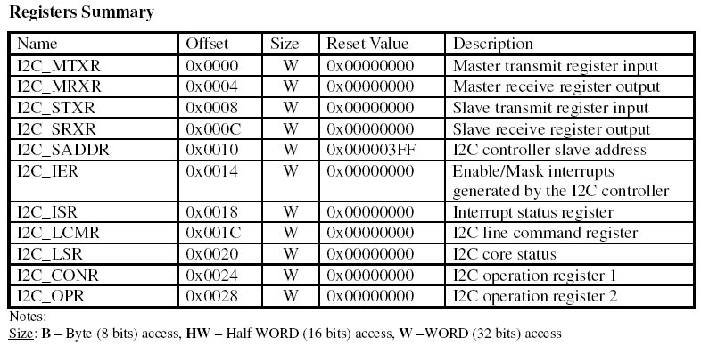
Registers Summary

Slide 22
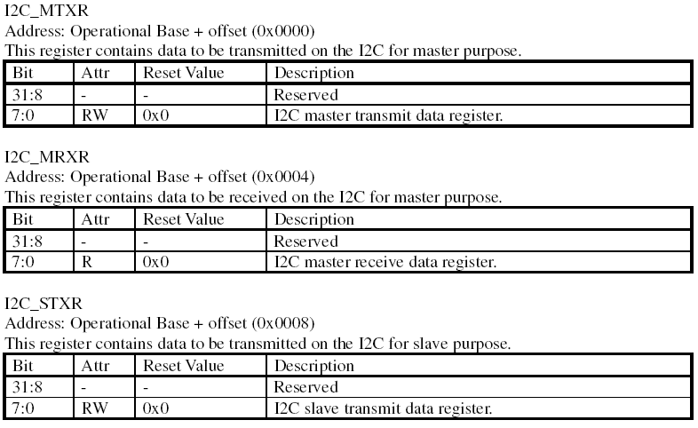
Detail Register Description - MTXR

Slide 23
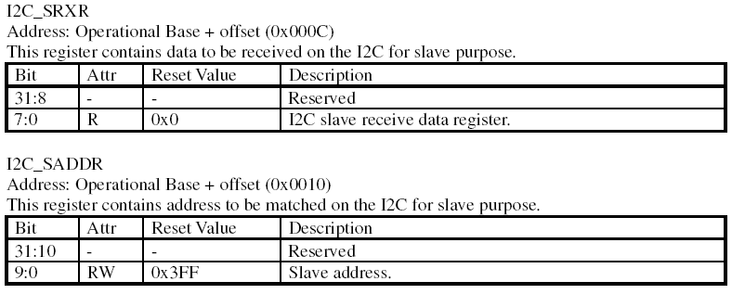
Detail Register Description – SRXR, SADDR

Slide 24
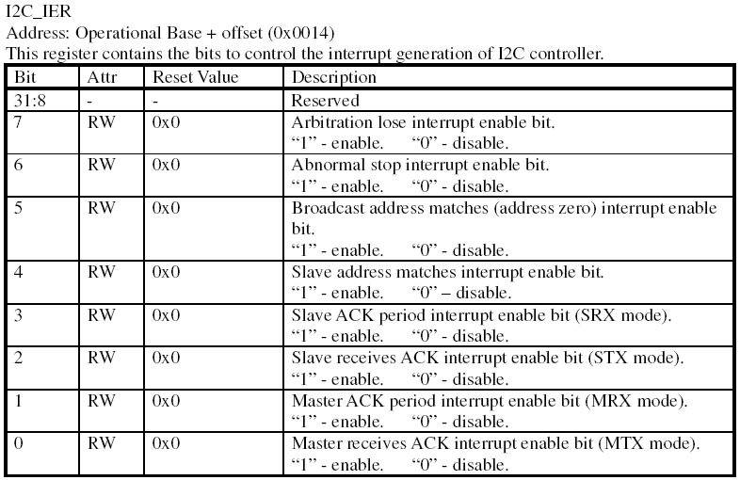
Detail Register Description – I2C_IER

Slide 25
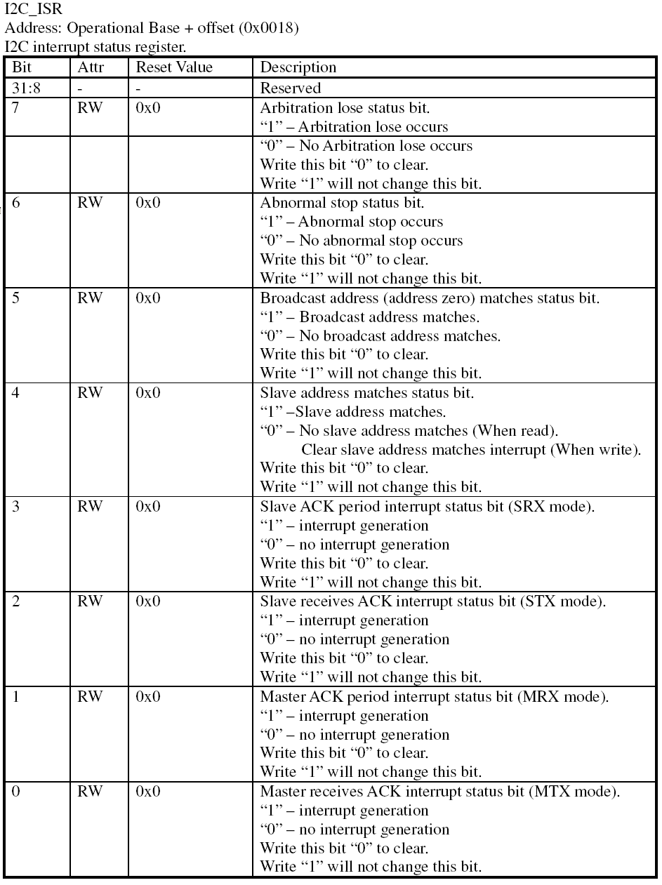
Detail Register Description - ISR

Slide 26
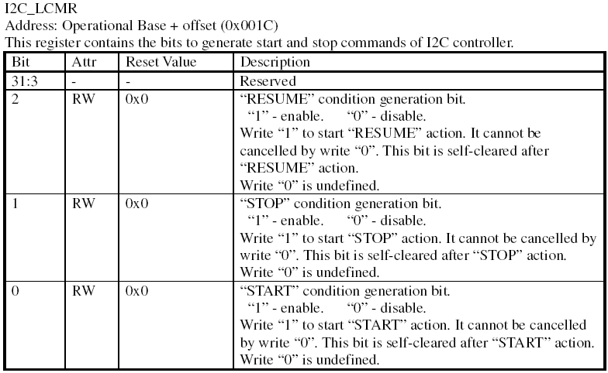
Detail Register Description - LCMR

Slide 27
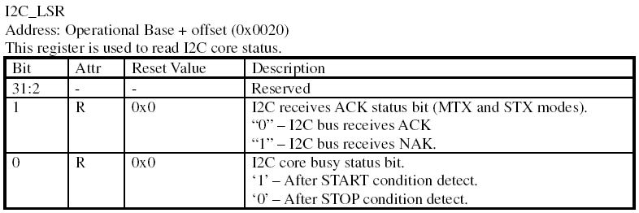
Detail Register Description - LSR

Slide 28
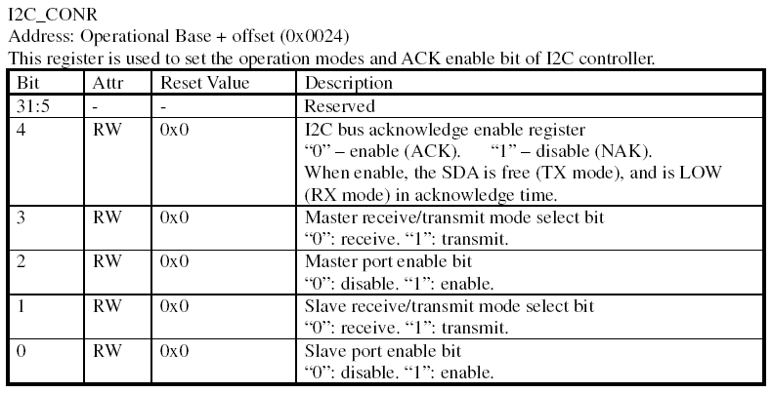
Detail Register Description - CONR

Slide 29
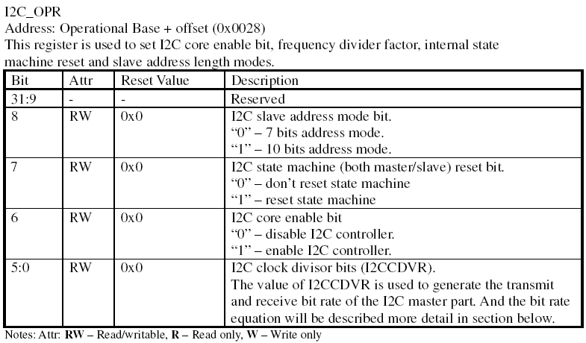
Detail Register Description - OPR

Slide 30
I2C 硬體架構
vcc
上拉電阻
上拉電阻
SDA
I2C 總線
SCL
I2C Master
SDA
SCL
I2C Slave 1
SDA
SCL
I2C Slave 2
SDA
SCL

Slide 31
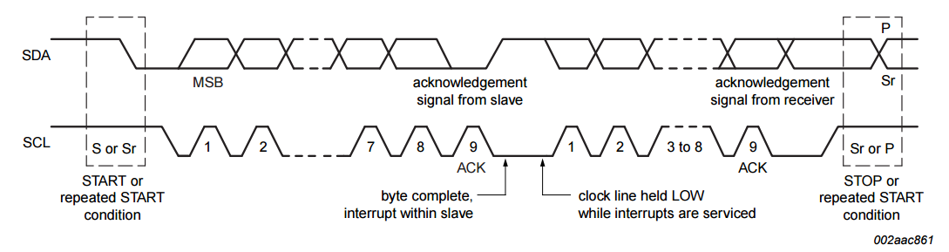
I2C 訊號時序圖
Start Condition
Stop Condition
Ack Signal : Ack(0), No Ack (1).
Wait State : SCL – Low(Slave), SDA – High.
Data Transfer : Byte

Slide 32
I2C Data Format - Recieve
Start Bit : Start Condition
Slave Address : 7 Bit
Read/Write Bit : 1 , Read Data from Slave.
Ack Bit : Ack/no Ack from Master And Slave
Data : Data.

