Slide 1
Linux SPI Device Driver
BenTsai
2015/11/9

Slide 2
OUTLINE
I2C
UART
Uart Packet Frame
8250/16450/16550
Linux Device Driver – I2C
TTY Device/Driver
Platform Device/Driver
Uart Driver – 8250 Driver
Adapter : L6021
Device Tree
Client Device : F75111R
SMBus

Slide 3
SPI

Slide 4
I2C 硬體架構
vcc
上拉電阻
上拉電阻
SDA
I2C 總線
SCL
SDA
SCL
SDA
SCL
SDA
SCL

Slide 5
Linux Device Driver – SPI

Slide 6
Linux - SPI架構 - master
user space
應用程式
kernel space
i2c-client
SPI-Core
為linux內核中提供的spi構架核心機制，管理各種重要SPI要素的接口函數，例如struct spi_master、struct spi_driver、struct spi_device 、struct spi_transfer、struct spi_message、struct spi_board_info.
i2c-client
spidev
i2c-client
SPI Device Driver
SPI client device 實現
SPI-client
SPI device driver
SPI
SPI-Core
SPI Bus Driver
spi-master:
代表SoC內的各組I2C Controller. 提供Controller的Base Address,對應的Algorithm等資訊. 對應物理上的一個適配器
I2C-Algorithm:
對應SoC的I2C通信方法, 包括I2C Start Condition, Stop Condition, Data Transmit, Data Receive等實際上的Reg設定.
i2c-adapter
/algorithm
i2c-adapter
/algorithm
i2c-adapter
/algorithm
SPI-master
SPI Bus Driver
HW
SPI client device
SPI host controller

Slide 7
SPI驅動框架-master
device tree
SPI client dts
spi_add_driver
spi_register_master
of_register_spi_devices
spi_match_master_to_boardinfo
device tree (platform device)
list_add_tail
list_for_each_entry
of_register_spi_devices
SPI dts
Slave device(dts)
compatible
compatible(dts)
name
client device
platform device : SPI
spi_match_master_to_boardinfo
(bus_num)
Slave device
modalias
platforn bus
board info
SPI bus
spi_register_master
spi_add_device
platform driver : SPI
master
client driver
SOCLE_SPI_driver
of_match_table
name
Slave driver
of_match_table
id_table | name
host controller
slave device
Notes:
Master->bus mumber對Device Tree的架構不是重點, 因此有spidev32766這奇怪數字的問題, 但若我們使用board info 來建立spi client device則是很重要的判斷機制.

Slide 8
SPI– Full Duplex and Half Duplex

Slide 9
Linux - SPI架構 - master
user space
應用程式
kernel space
i2c-client
i2c-client
spidev
i2c-client
SPI-client
SPI
i2c-adapter
/algorithm
i2c-adapter
/algorithm
i2c-adapter
/algorithm
SPI-master
HW
SPI client device
SPI host controller

Slide 10
SPI數據傳輸可以有兩種方式：同步方式和異步方式。
對於SPI控制器來說，要支持異步方式必須要考慮以下兩種狀況：
對於同一個數據傳輸的發起者，既然異步方式無需等待數據傳輸完成即可返回，返回後，該發起者可以立刻又發起一個message，而這時上一個message還沒有處理完。
對於另外一個不同的發起者來說，也有可能同時發起一次message傳輸請求。
隊列化正是為了為了解決以上的問題，所謂隊列化，是指把等待傳輸的message放入一個等待隊列中，發起一個傳輸操作，其實就是把對應的message按先後順序放入一個等待隊列中，系統會在不斷檢測隊列中是否有等待傳輸的message，如果有就不停地調度數據傳輸內核線程，逐個取出隊列中的message進行處理，直到隊列變空為止。
線程(thread)與進程(process)的區別

Slide 11
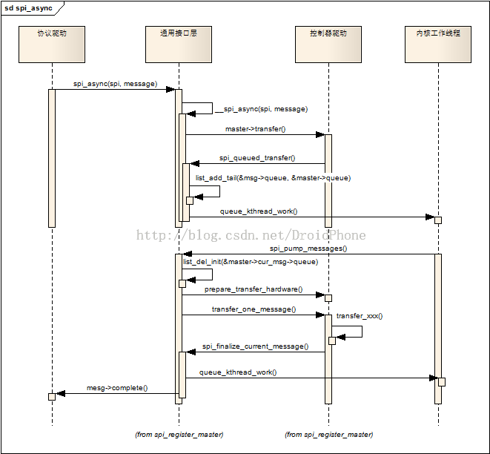
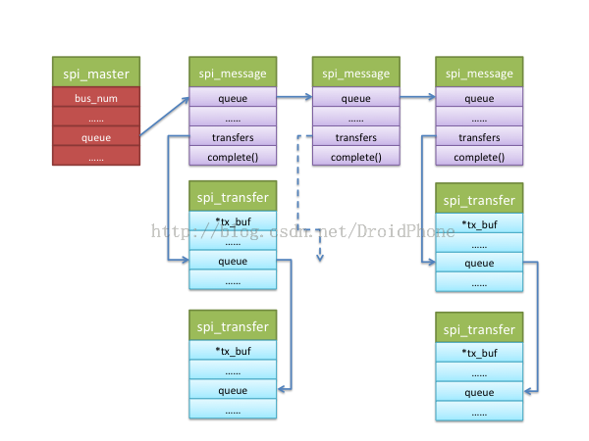
SPI – 隊列化

Slide 12
SPI-異同步方式
spi_async
Master->transfer
spi_queued_transfer
spi_pump_messages
prepare_transfer_hardware
transfer_one_message
spi_register_master
spi_finalize_current_message
spi_master_initialize_queue
spi_init_queue
spi_start_queue
message->complete

Slide 13
L6021 – SPI

Slide 14
Key Features
AMBA APB slave interface
Support master or slave mode
DMA Interface
Four transfer protocols available with selectable clock polarity and clock phase
Different bit rates available for SCLK
Full duplex synchronous serial data transfer
Bi-direction mode
Support 2 slave devices
MSB or LSB first data transfer

Slide 15
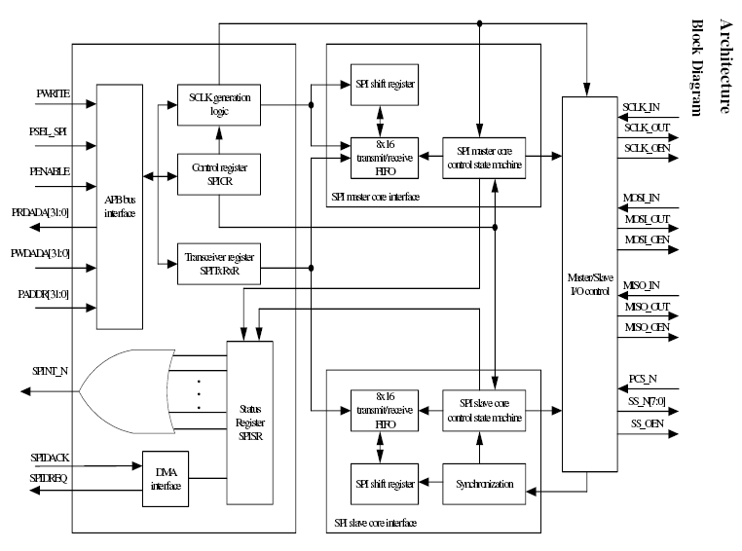
Block Diagram

Slide 16
SPI Block Diagram
SPI master core
control state machine
Rx | Tx
1
TxCR = 3
APB bus
interface
Run Bit
0
SCLK generation
logic
Master/Slave
I/O control
8x16
transmit/receive
FIFO
8*16 Tx FIFO
SPI shift register
Control register
SPICR
Transceiver register
SPITxRx
16 bit
Synchronization
8x16
transmit/receive
FIFO
LSB
MSB
1 bit
SPI shift register
Status Register
SPISR
SPI slave core
control state machine
Rx | Tx
DMA
Interface

Slide 17
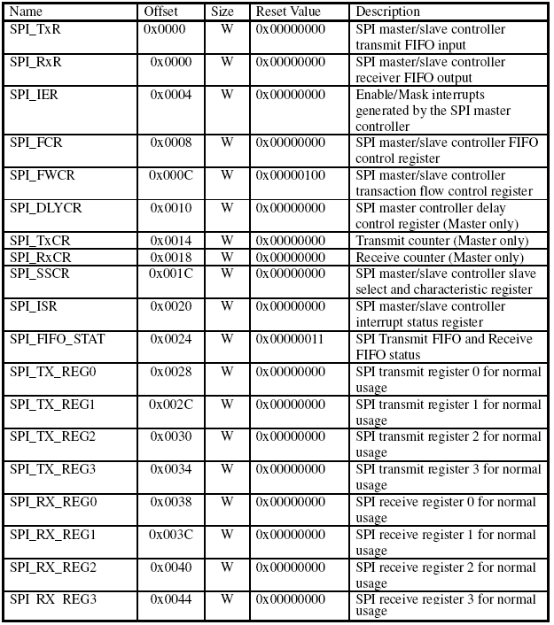
Registers Summary

Slide 18
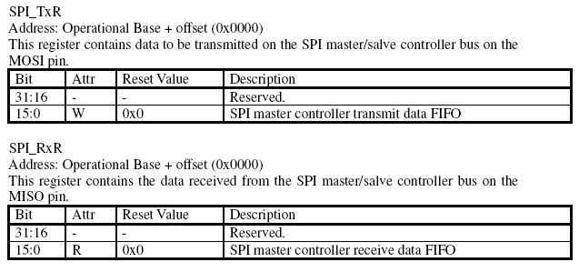

Slide 19
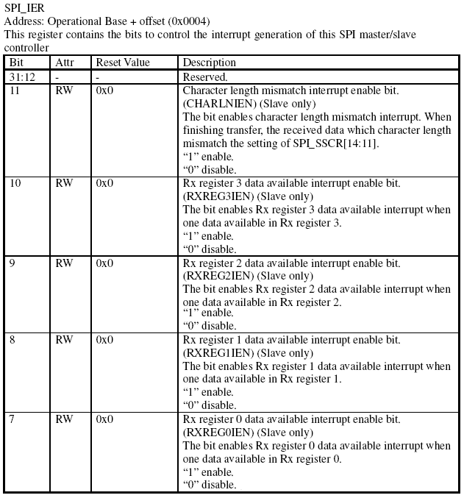
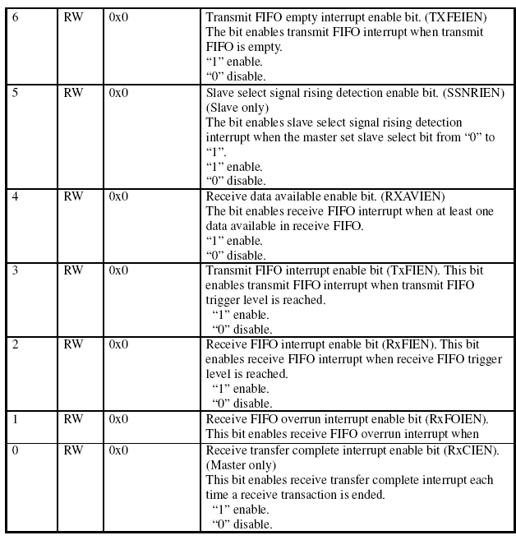
SPI-IER

Slide 20
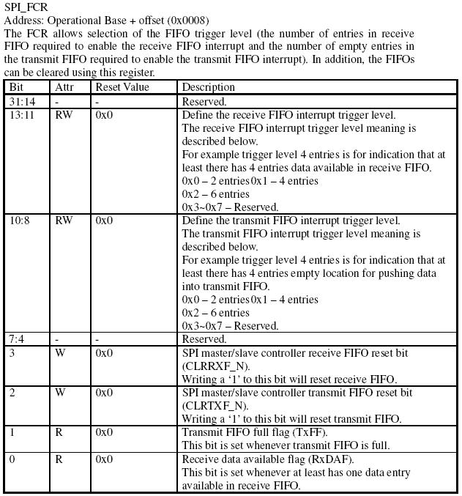
Notes:
The transmit and receive FIFO reset signal would sustain 3 pclk cycle, during the reset period any access to FIFO would be ignored.

Slide 21
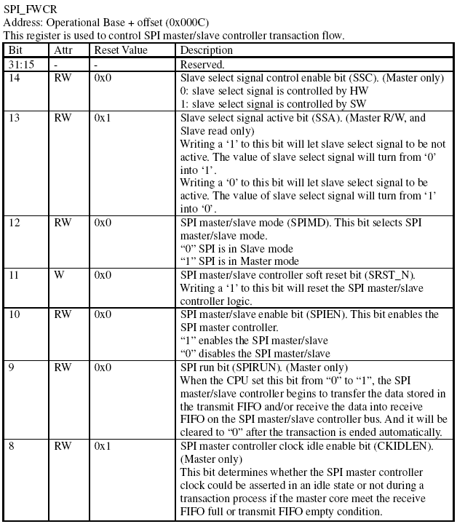
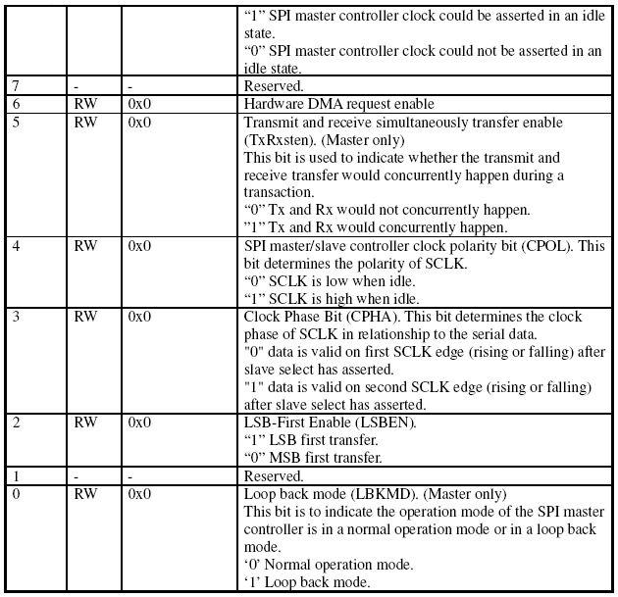
Notes:
The soft reset signal would sustain 3 pclk cycles, during the reset period any access to
FIFO would be ignored.

Slide 22
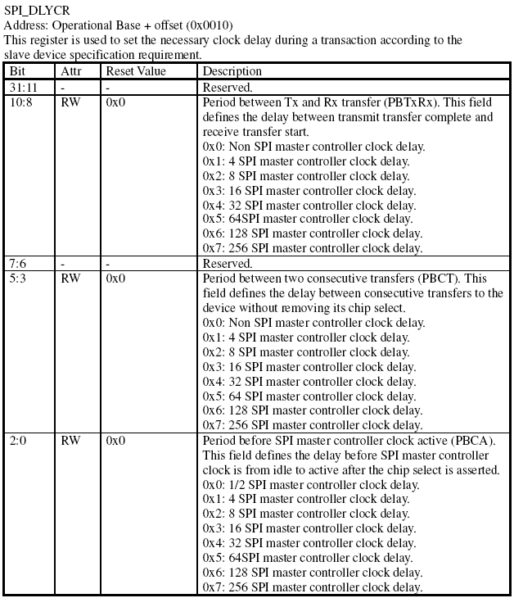
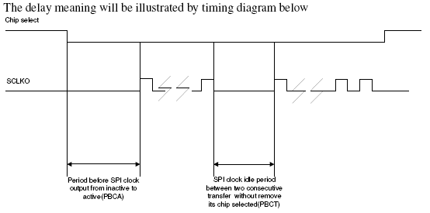

Slide 23
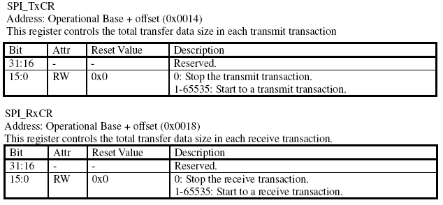

Slide 24
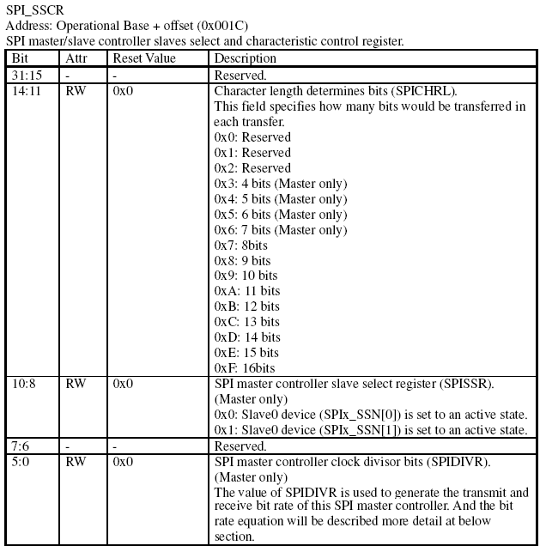
Notes:
CPHA, CPOL, should be set to match the protocol expected by the SPI slave device.

Slide 25
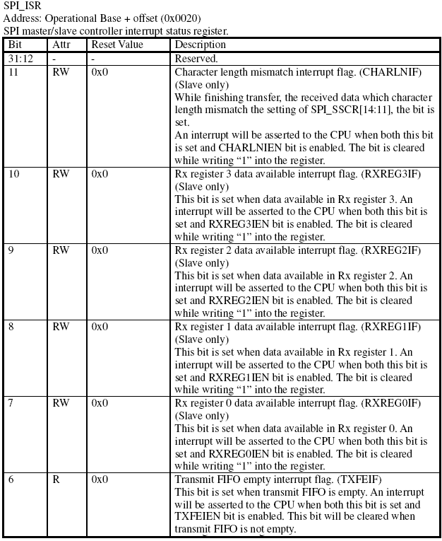
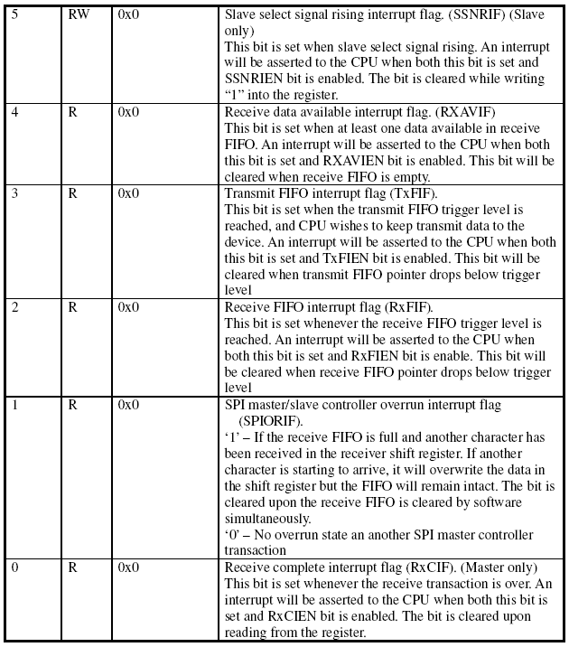

Slide 26
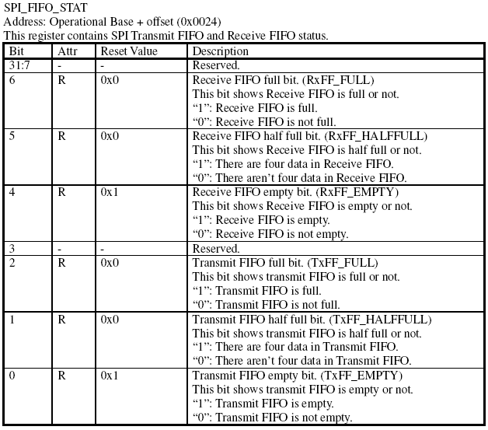

Slide 27
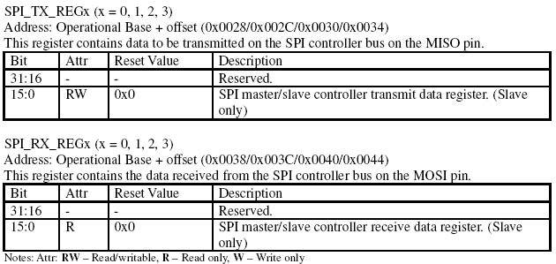

Slide 28
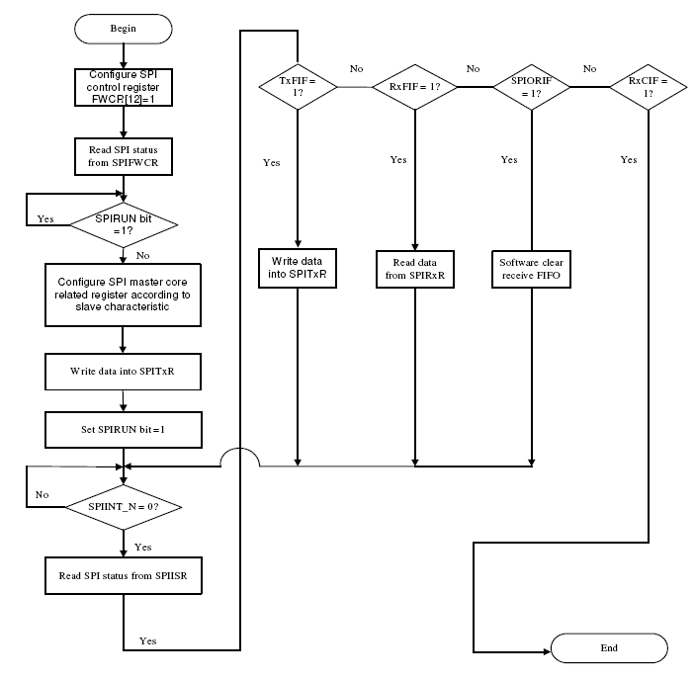
Master

Slide 29
F75111R

Slide 30
Notes:
http://wiki.csie.ncku.edu.tw/embedded/I2C

Slide 32
Back Up

Slide 33
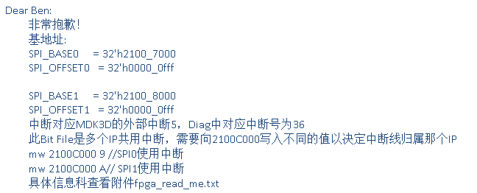

Slide 34
SPI 參考網頁
http://blog.csdn.net/lanmanck/article/details/4479185
http://www.openedv.com/posts/list/18467.htm
http://www.holtek.com.tw/chinese/tech/appnote/uc/pdf/ha0151t.pdf
http://stackoverflow.com/questions/15895338/spidev-do-not-write-read-simultaneously-using-ioctl (good)
http://blog.csdn.net/droidphone/article/details/24663659 (good)
http://fanli7.net/a/bianchengyuyan/C__/20121204/265208.html
Notes:
Bpi : https://www.olimex.com/forum/index.php?topic=3809.0

