Slide 1
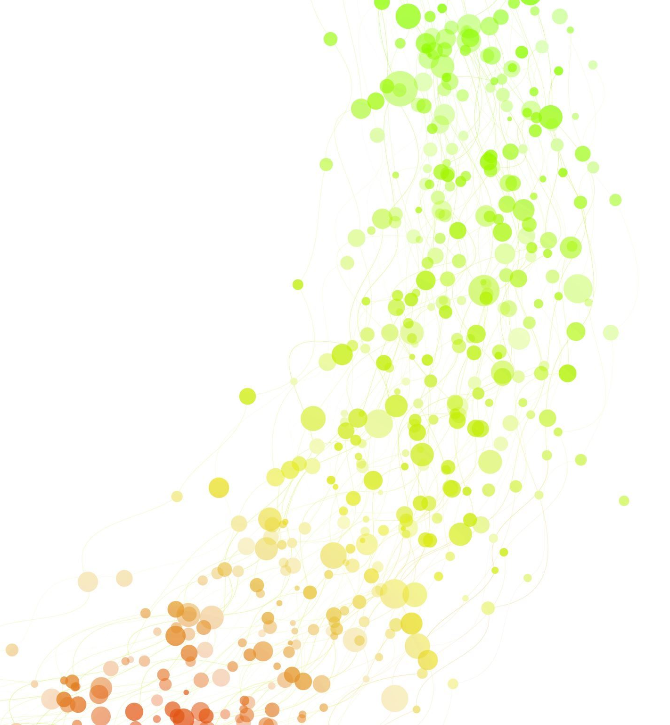
Development of a Database for HIV and PrEP Patients
By Jose Fuentes
CST3504 - E310
New York City College of Technology

Slide 2
Business Description
The project will be executed in a community healthcare center that provides primary care services to people; in this case this project will be focus on those individuals who are at risk of getting or living with HIV. For those persons on risk of getting HIV there is a biotechnology knows a Pre-Exposure Prophylaxis (PrEP) services that can be provided. There is a need to improve the patient data management system to better serve patients and to comply with healthcare regulations.
Mission: Our mission is to provide the highest quality healthcare services to our patients by leveraging technology to improve patient outcomes, reduce healthcare costs, and increase operational efficiency.

Slide 3
Information Systems Architecture:
The proposed database will be based on client-server architecture, with the server hosting the database and the client accessing the database through a user interface. The database will be developed using a secure and scalable platform, such as Oracle. The user interface will be developed using a web-based platform, and the database will be hosted on a secure cloud-based platform to ensure high availability and disaster recovery.

Slide 4
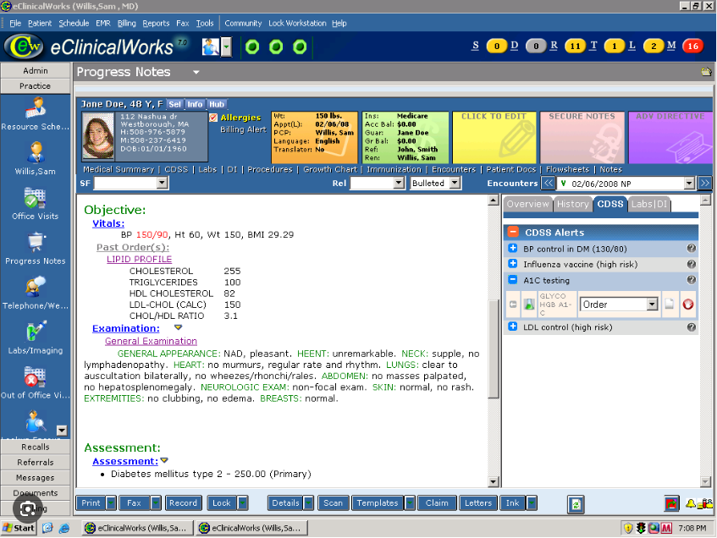
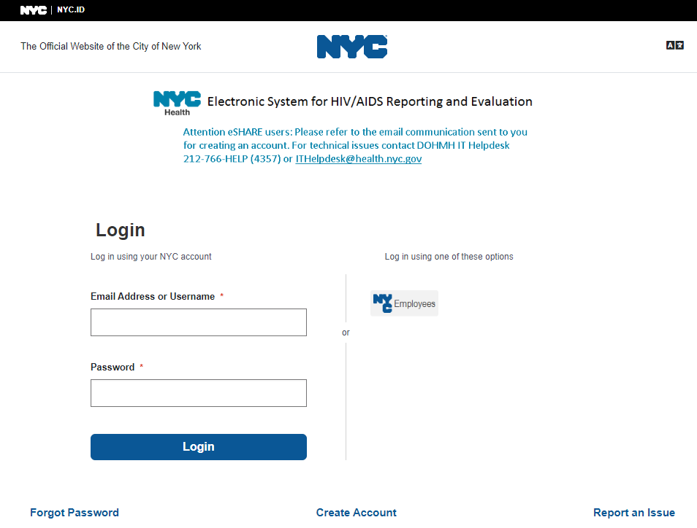

Software use in the healthcare facility.

Slide 5
The objectives of this project are
To create a comprehensive database that tracks the medical histories and treatment plans for patients with HIV and those taking PrEP.
Monitor patient adherence to medication and treatment plans to improve treatment outcomes.
Facilitate patient referrals between healthcare providers.
Identify and address social determinants of health that may impact patient health outcomes. • Track patient STI testing and treatment history to inform treatment decisions and prevention strategies.
Identify and track patient risk behaviors to develop targeted interventions to reduce the risk of STI and HIV transmission.
Provide a user-friendly interface for healthcare providers to access and update patient information in a timely and efficient manner.
Maintain patient privacy and security by implementing appropriate security measures and adhering to HIPAA regulations.

Slide 6
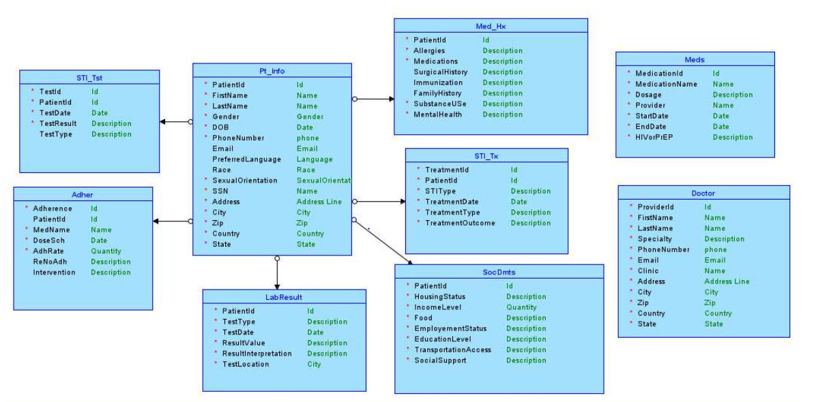
Data Diagrams
Logical Diagram

Slide 7
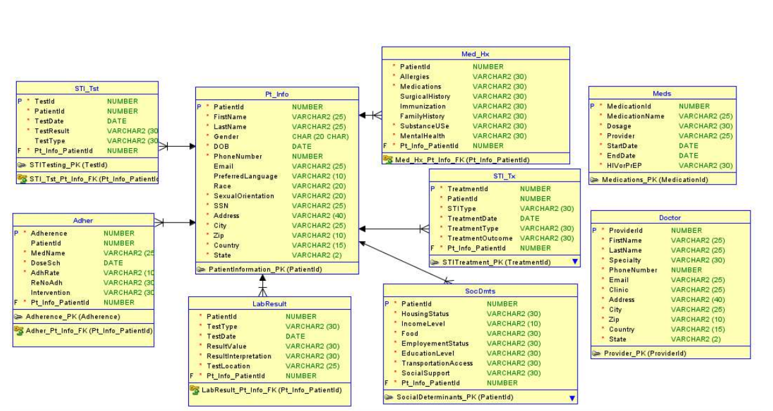
Relational Diagram

Slide 8
Explanation of the process
To generate DDL in Data modeler.
To alter the Data format
To create tables
To insert data in tables
Testing the data inserted.

Slide 9
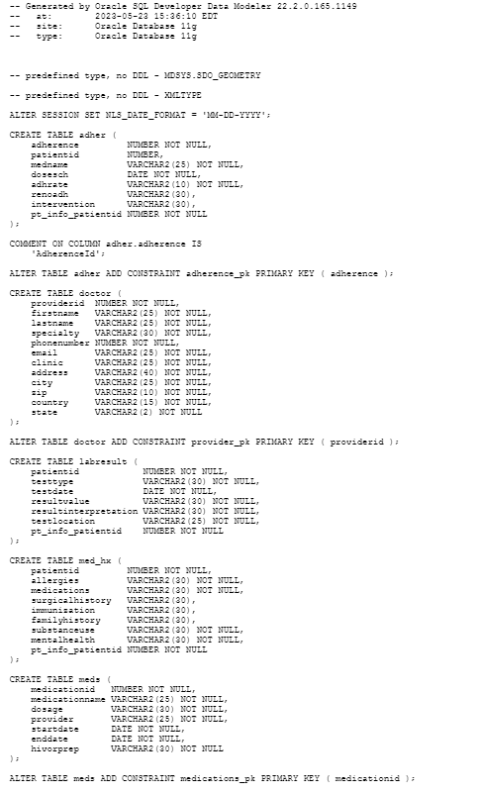
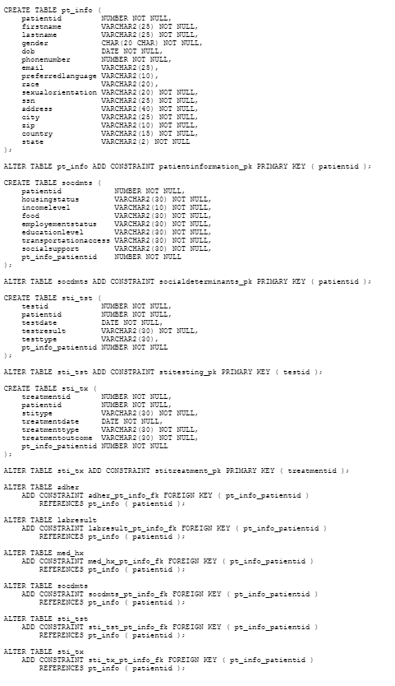
DDL

Slide 10
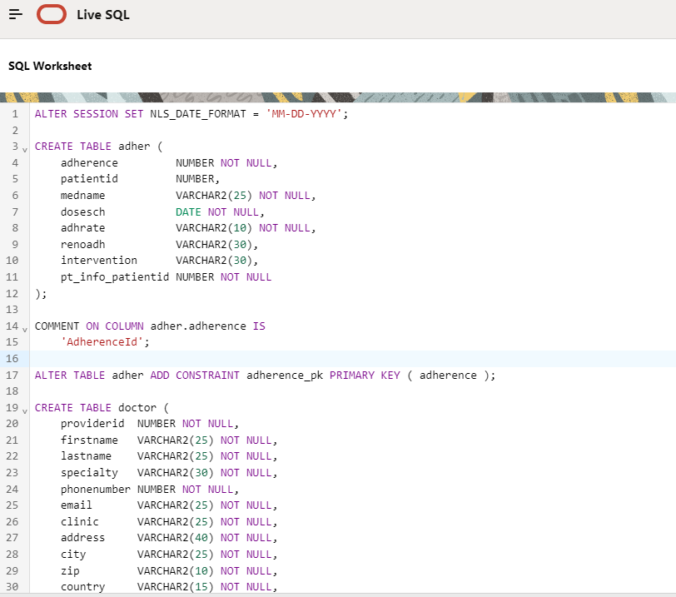
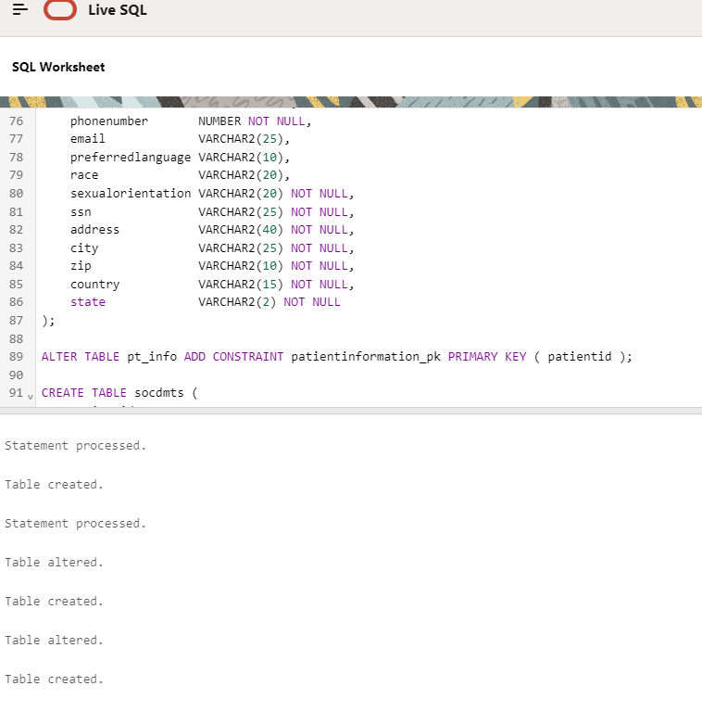
Imprementling the Script

Slide 11
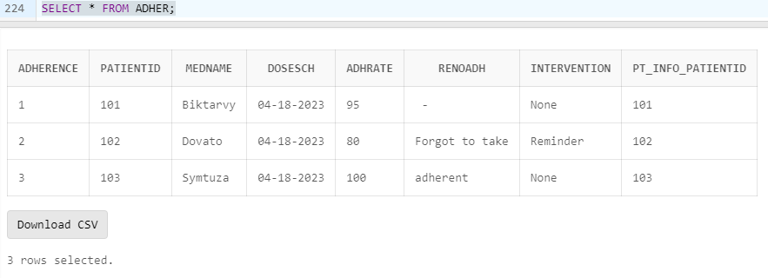
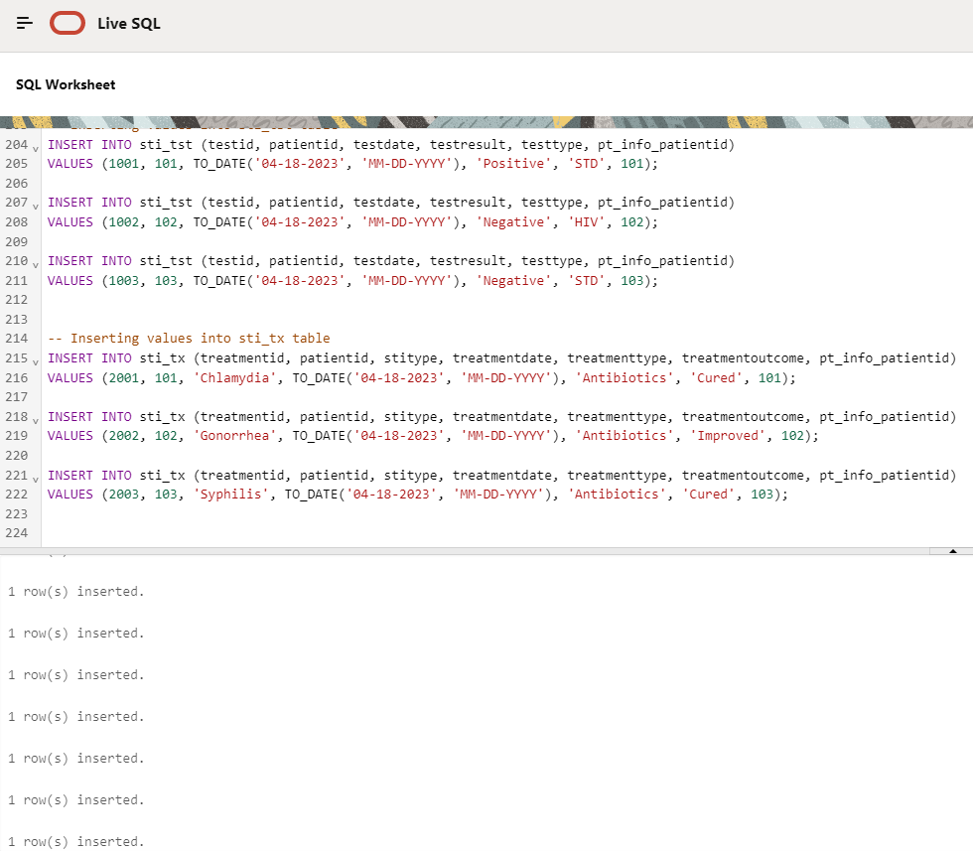
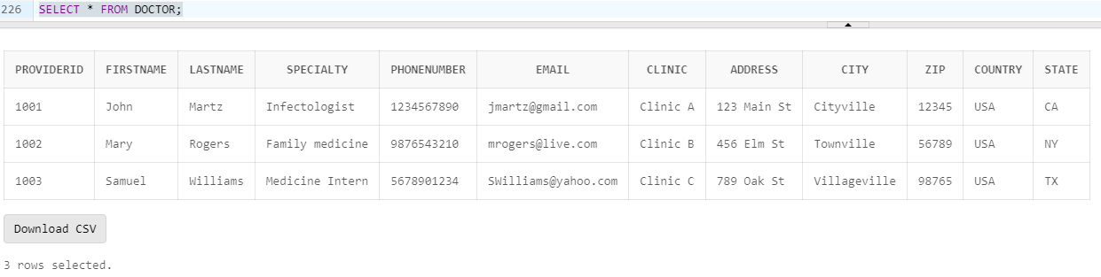
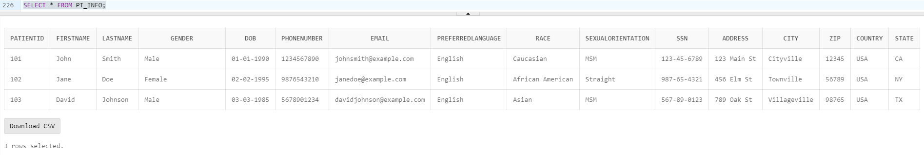
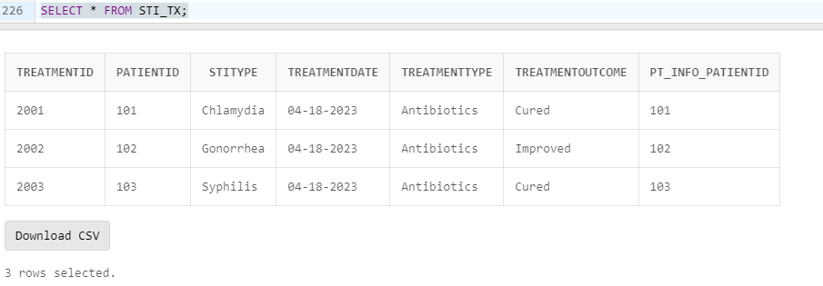
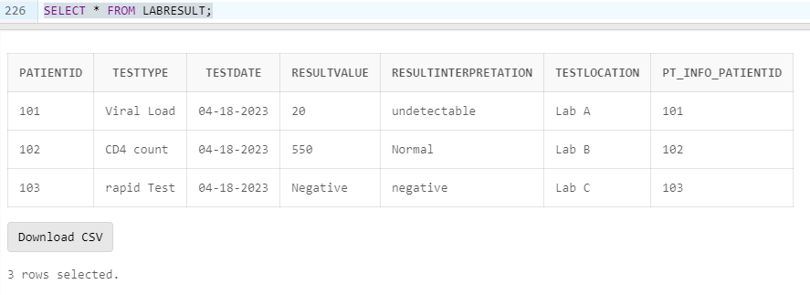
Inserting Data in tables

Slide 12
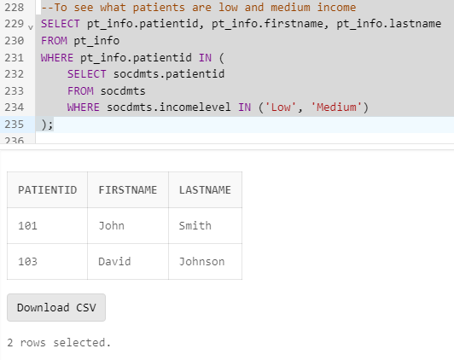
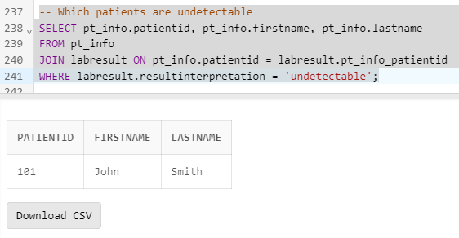
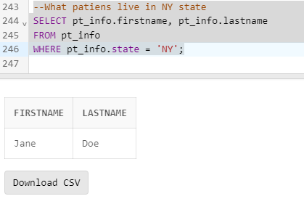
Testing the Code

Slide 13
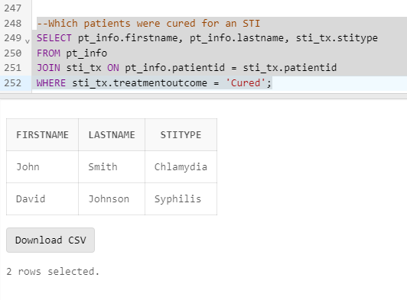
Testing the data

Slide 14
Conclusion
The database for HIV and PrEP patients will improve our patient data management system, enable us to provide better care for the patients, and help us comply with healthcare regulations. The use of technology in healthcare is crucial in improving patient outcomes and reducing healthcare costs, and we are committed to leveraging it to achieve our mission of providing high-quality healthcare services to individuals at risk of or living with HIV. We look forward to implementing this database and working with care team members to ensure its success.

