Slide 1
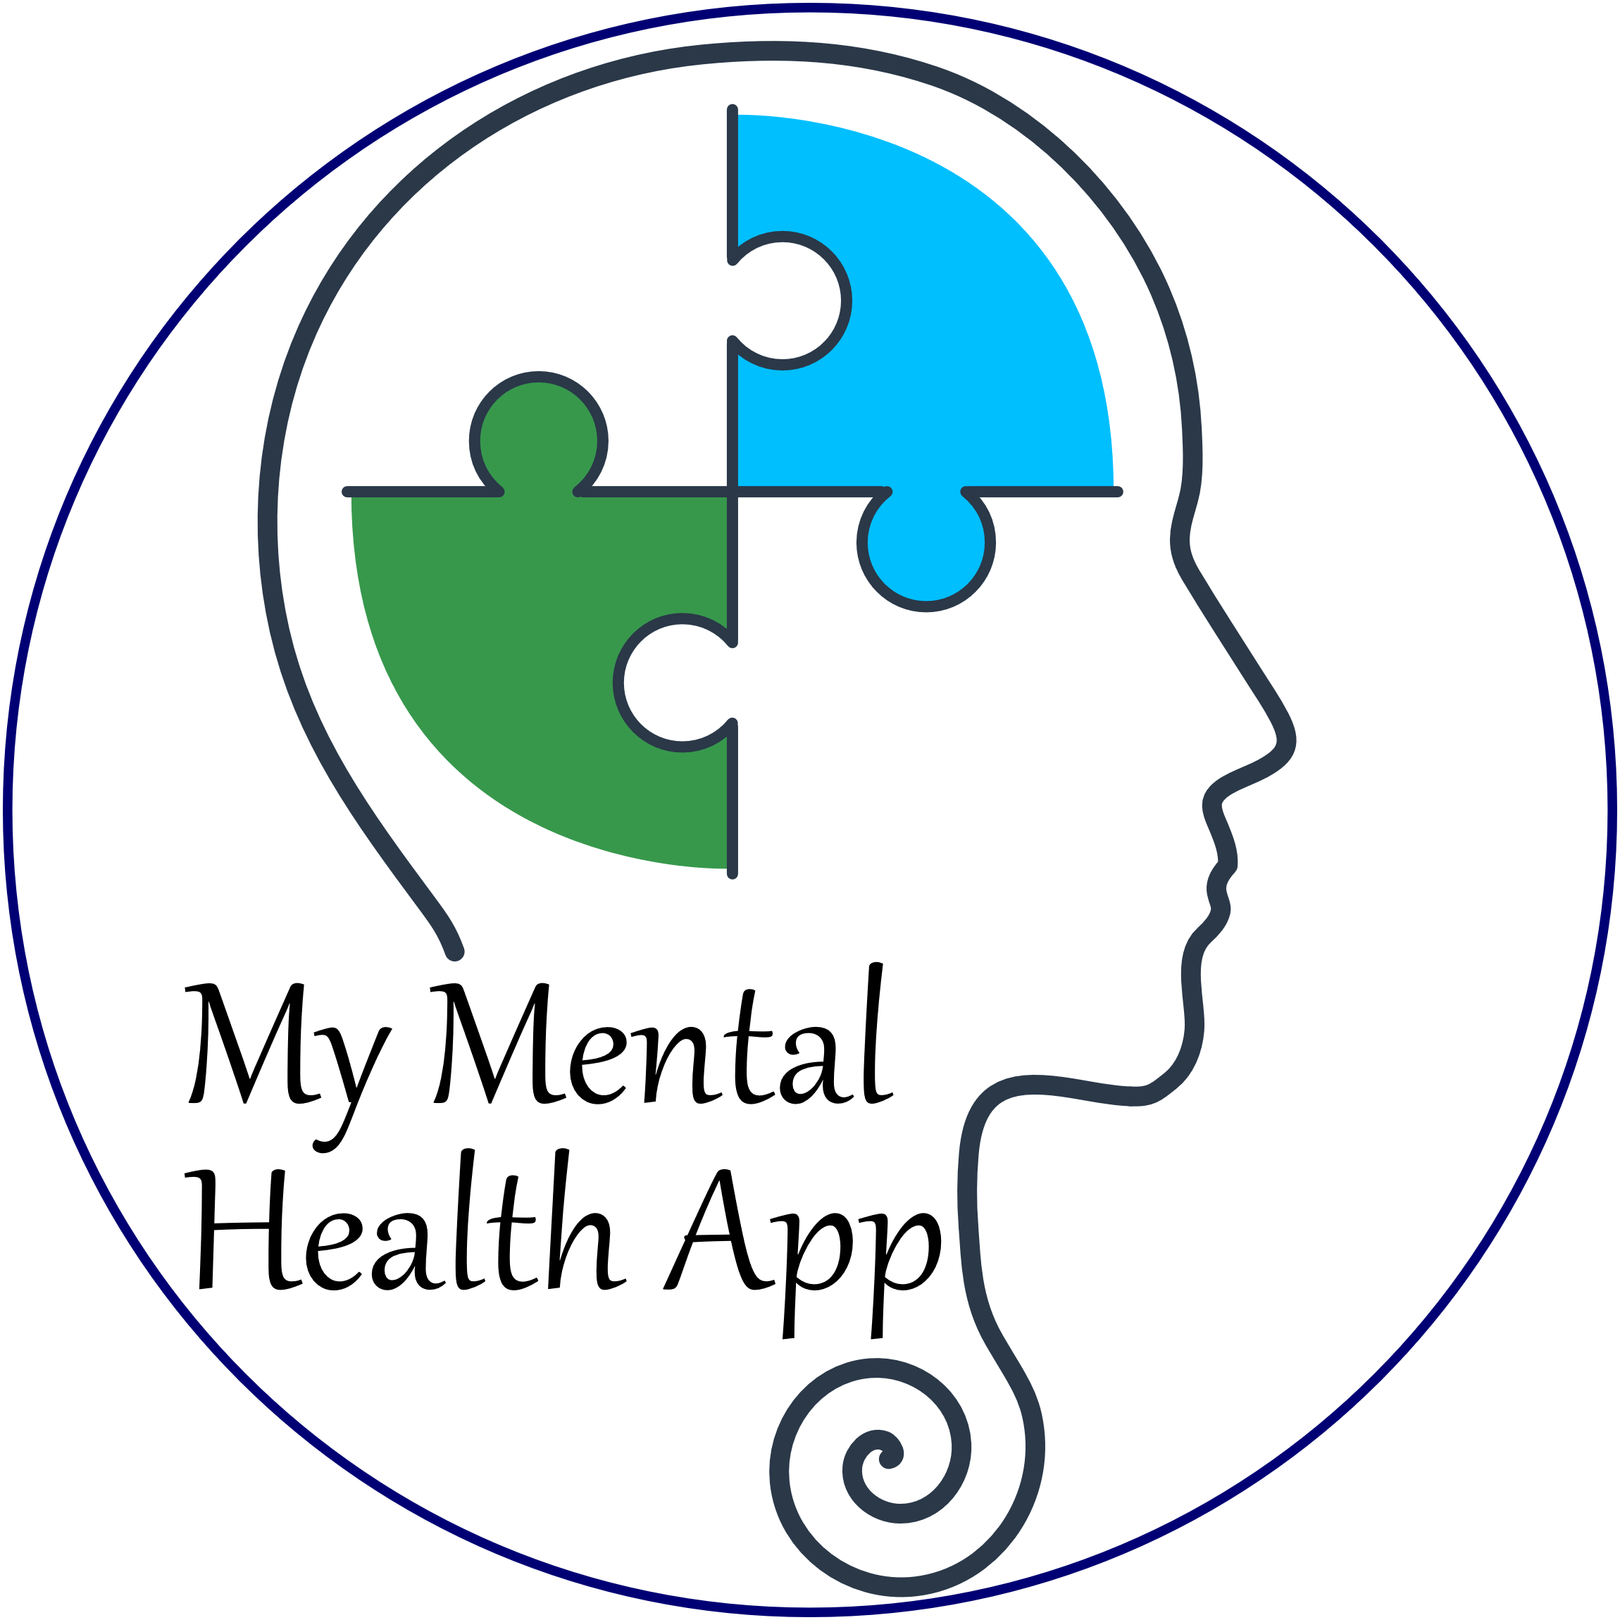
CS 4471: Therapy Session App
Group 9 Authors: Yonatan, Michael, and Yassine

Slide 2
Technology
We are building an Android app inside Android Studio with the following technologies:
Frontend will use base Android
Backend will use Java.
Database will use SQLite
Docker for Deployment
Latex and Draw.io for documents
GitHub for version control
Discord for communications

Slide 3
Project Methodology
System Architecture: Model View View Controller (MVVC)
Project Process: Agile-Iterative
Meetings have been weekly with minutes recorded.

Slide 4
Work Breakdown
Everyone is responsible with editing and proof-checking.
Here are the individual responsibilities:
Yonatan: Backend, Class diagrams, Use Case Descriptions, Architecture
Michael: Use Case diagrams, Database, Gantt chart, Integration
Yassine: Worksheet Breakdown, Front end, User stories

Slide 5
Project Progress
We are working towards building base features first and then nice-to-have.
Progress so far:
1. Diagrams
Rough copies of diagrams have been created.
A final copy will be created for the final iteration.
2. Program
Base feature code is established.
Android app works with minimum features

Slide 6
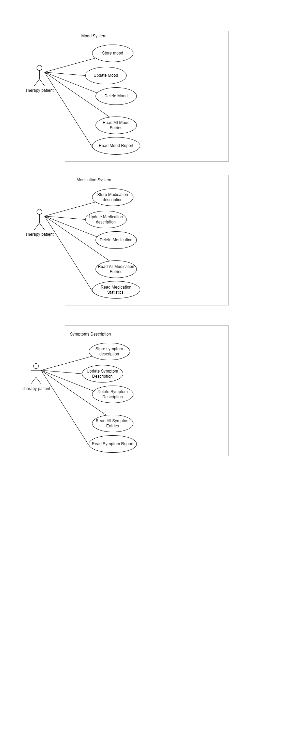

Slide 7
Demo

Slide 8
Things Left to Do
Build as many nice-to-have features as possible
Deploy on Google Play or Docker
Test Matrix
Final Draft of Design Documents

