Slide 1
Volatility analysis
John S. Smith

Slide 2
Data
We are analysing SP-500 returns
from 2003-01-03 to 2022-12-30
5034 observations
If you like thousand commas in your numbers, then 5,034 observations

Slide 3
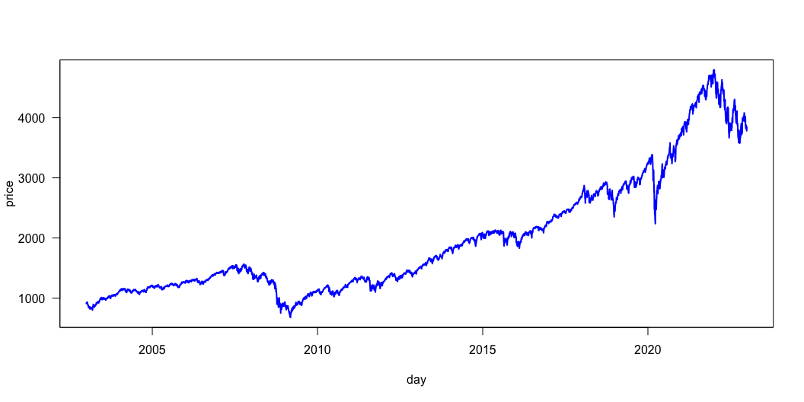
The SP-500 index

Slide 4
Fitted model parameters
 | Estimate | Std. Error | t value | Pr(>|t|)
omega | 0.0000024 | 0.0000008 | 3.140765 | 0.0016851
alpha1 | 0.1202890 | 0.0097730 | 12.308242 | 0.0000000
beta1 | 0.8594914 | 0.0106664 | 80.579245 | 0.0000000

Slide 5
Summary
Note that since alpha+beta=0.98<1, the model is covariance stationary
Note that since $α+β=0.98<1$, the model is covariance stationary
The Log Likelihood is 16,443.07

Slide 6
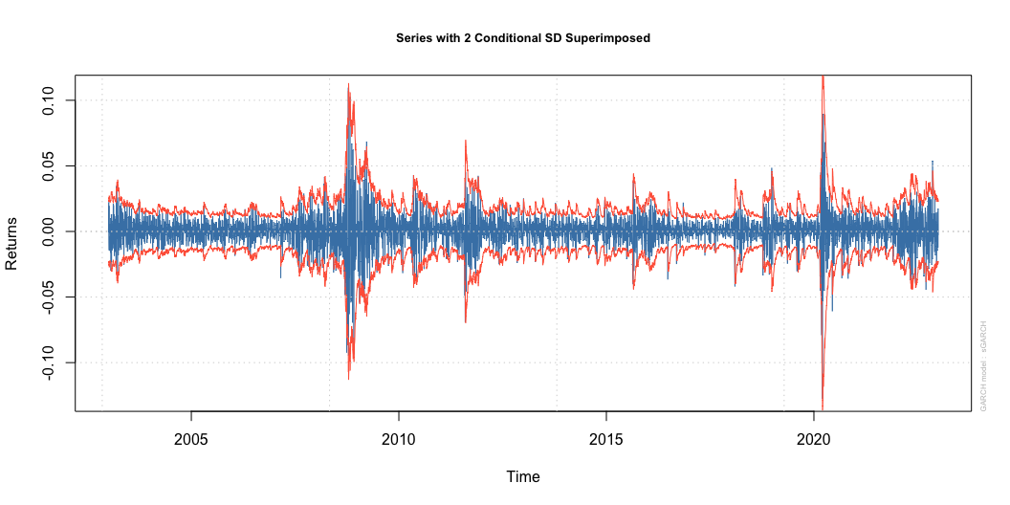
Returns with 2 times volatility

Slide 7
Some VaR analysis
Risk is $16.4 according to the VaR.

