Slide 1

Unity Editor Scripting
Jonathan Reynolds

Slide 2

Agenda
My Background
What is Unity Editor Scripting
Common Tools
Example Project
Questions?

Slide 3

Introduction
Graduate With BS From Shawnee State
Past internship with NASA
Currently Working as an AR/VR Software Engineer at Aptima Inc. A contractor for the Navy/Airforce/NASA/Space Force.
Two Publications about AR/VR work

Slide 4
Publications
Rebensky, S., Flowers, A., Reynolds, J., Rizzardo, C., Neubauer, P., & Halverson, K. (2022). Training alchemy—effectively converting traditional training content to gold. 2022 Interservice/Industry Training, Simulation, and Education Conference.
Rebensky, S., Flowers, A., Reynolds, J., & Perry, S. (2022, June 15-16). Using VR as an AR Testbed [Conference Poster]. Human Systems Conference, Arlington, VA, United States.

Slide 5
What Is Unity Editor Scripting?

Slide 6
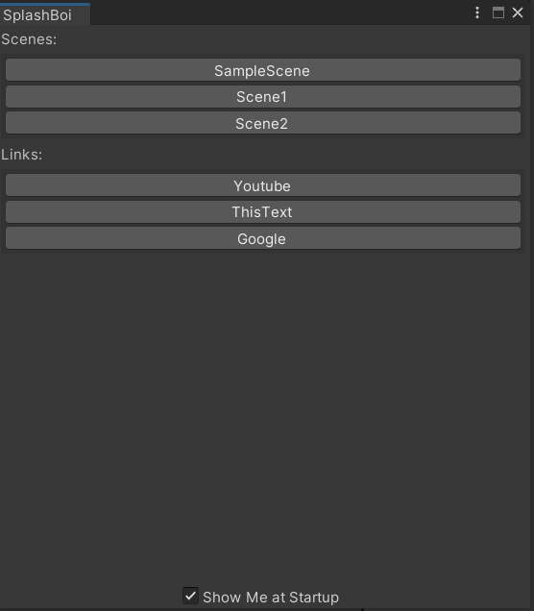
“Editor Scripting can help you customize and extend the Unity editor to make it easier to use on your projects…”
- Unity Learn

Slide 7
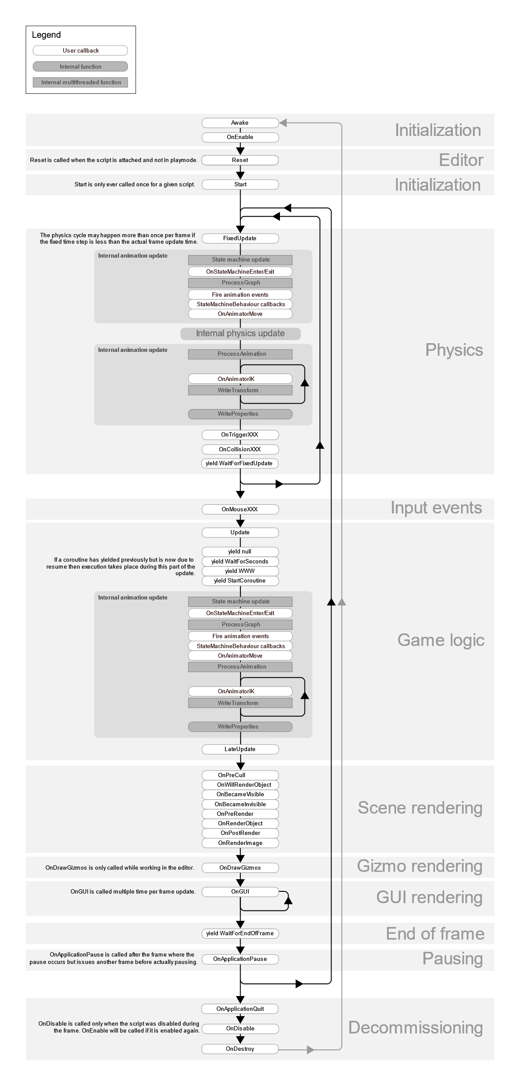

Slide 8
Common Tools

Slide 9
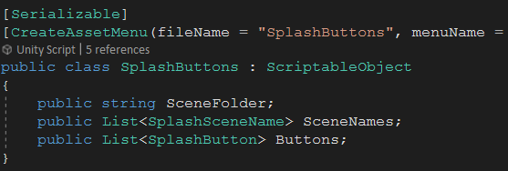
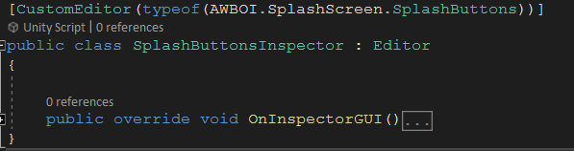
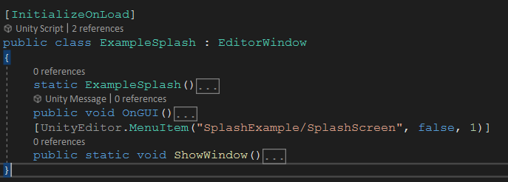
Overview
Basic Editor Tools are core functions that are used when writing editor scripts, editor window scripts, and editor custom inspectors.

Slide 10
GUI for the Editor
EditorGUILayout.
BeginHorizontal()
EndHorizontal()
BeginVertical()
EndVertical()
Foldout()
PropertyField()
LabelField()
GUILayout.
Space(int pixels)
FlexibleSpace()
Button()

Slide 11
Additional Functions
EditorPerfs.
EditorSceneManager.
SetBool(string key, string value)
GetBool(string key, bool default)
OpenScene(string path)
GetActiveScene()
GetSceneAt(int index)
SaveScene(Scene scene)
CloseScene(Scene scene)
sceneCount

Slide 12
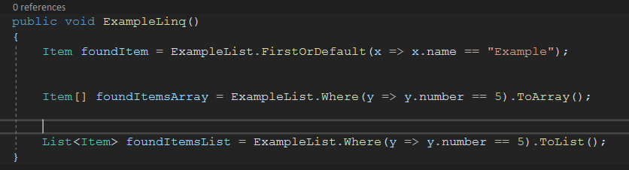
Additional Functions
SceneManager.
Linq (c#)
GetActiveScene()
FirstOrDefault()
Where()

Slide 13
Additional Functions (Attributes)
[System.Serializable]
[UnityEngine.SerializeField]
[UnityEngine.Header(String)]
[UnityEngine.CreateAssetMenu(filename, menuName, order)]
[UnityEngine.ToolTip(string)]
[UnityEditor.InitializeOnLoad]
[UnityEditor.CustomEditor(type)]
[UnityEditor.MenuItem(string)]

Slide 14
Bonus
UnityEvent
EditorApplication.update += …
EditorApplication.update -= …
Invoke()
AddListener()

Slide 15
Example Project

Slide 16
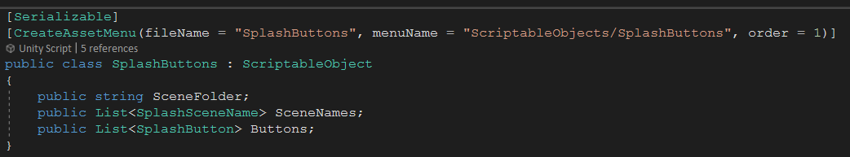
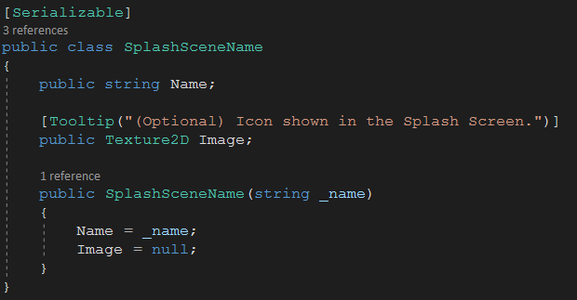
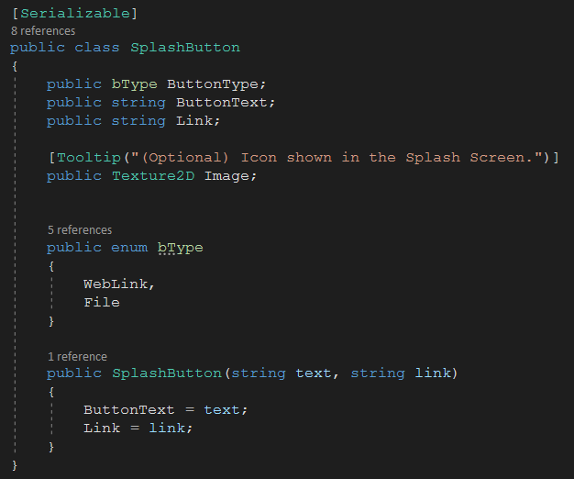
SplashButtons : ScriptableObject

Slide 17
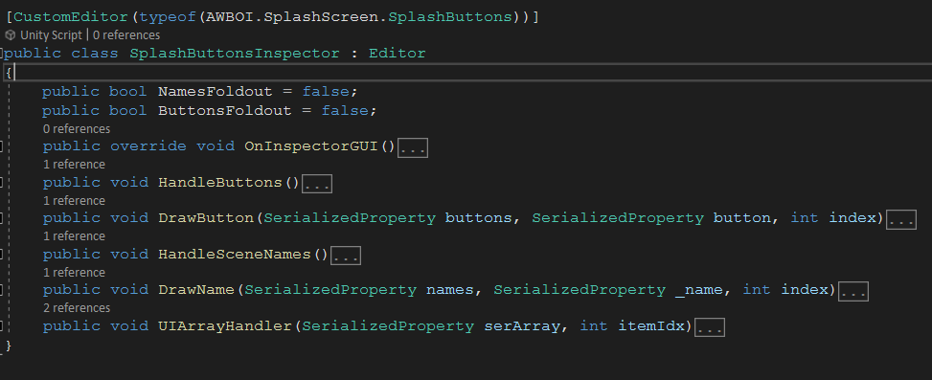
SplashButtonsInspector : Editor

Slide 18
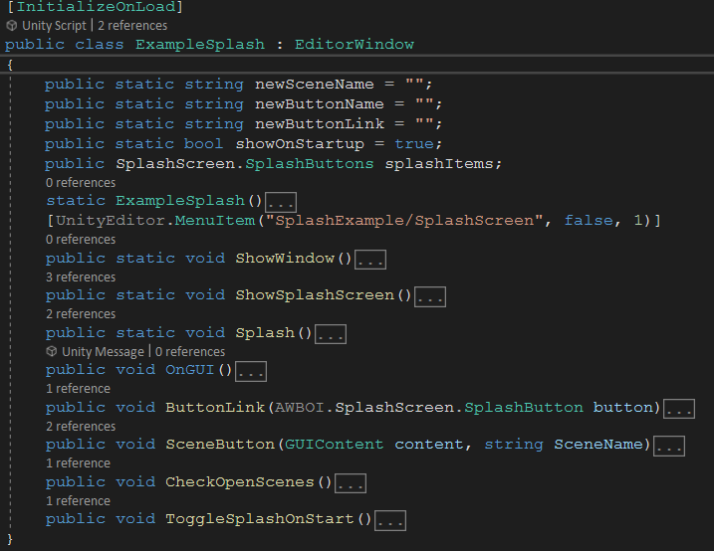
ExampleSplash : EditorWindow

Slide 19




Thank you, Questions?
Jonathan Reynolds
reynoldsjt24@gmail.com
Discord: JonReynolds#8790

