Slide 1
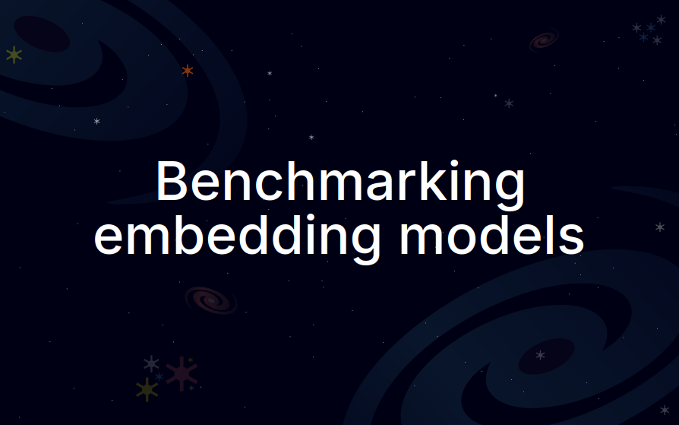

Slide 2


Slide 3



Benchmarking embedding models
Embedding models convert text (or other modalities) to a dense vector.
With embedding models, you can build RAG and recommendation systems.
But how do you choose an embedding model?
Hi Cassiopeia! Have you talked with Andromeda?
Embedding model
[0.69, 0.42, ...]

Slide 4
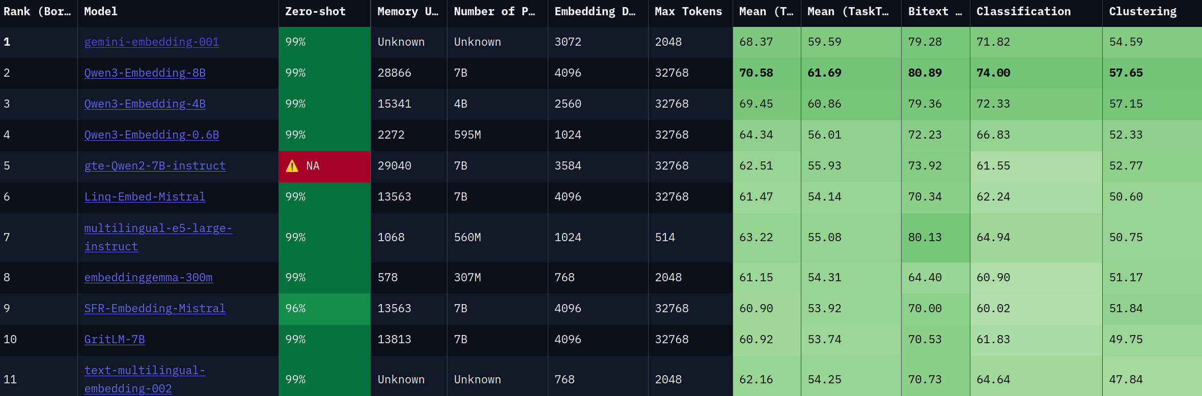
Benchmarking embedding models
How do you choose an embedding model?
You look at benchmarks!
MTEB ranks models based on their performance on different benchmarks.
The MTEB leaderboard on 20/09/2025.

Slide 5
Benchmarking embedding models
Should we trust these public benchmarks?
You can also create your own benchmark with your private data.
The dataset must be clean, diverse, and in your language (or multilingual).
The MTEB leaderboard on 20/09/2025.

Slide 6
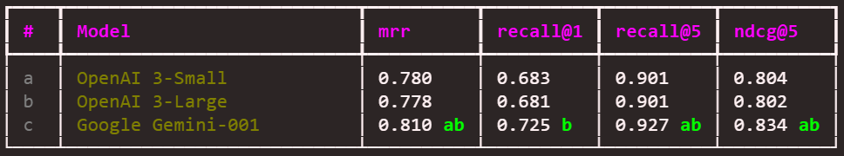
Benchmarking embedding models
In this course, you will:
  Create a golden dataset.
  Run open source and proprietary models.
  Compute metrics to grade the models.
  Perform statistical tests to prove if a model is better than another.
  Automate some steps in the pipeline.
  Generate tables to compare the models.
Comparing Gemini embedding to OpenAI’s embedding models.

