Slide 1
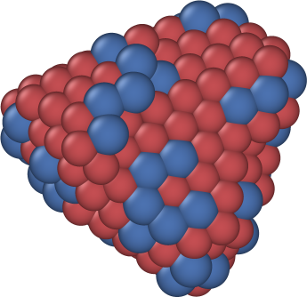




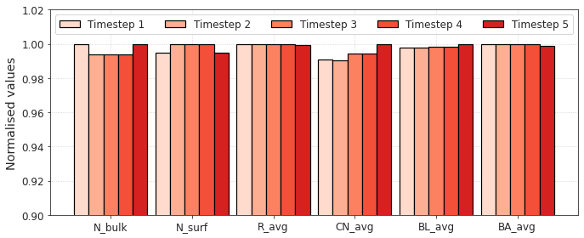

Slide 2
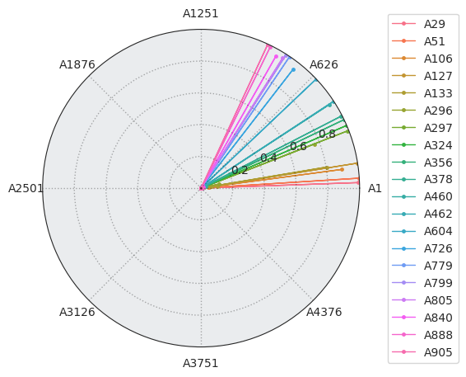
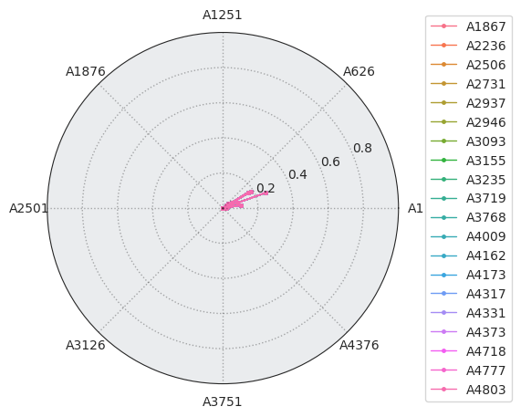
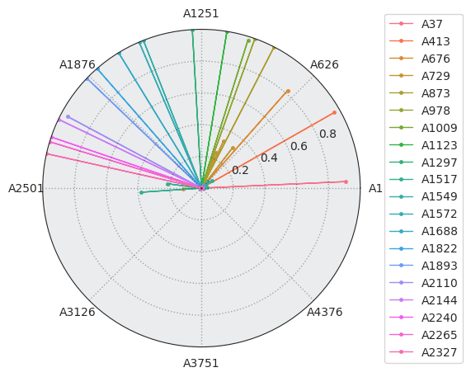
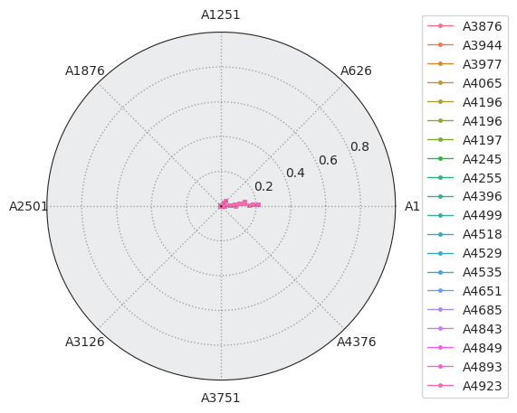
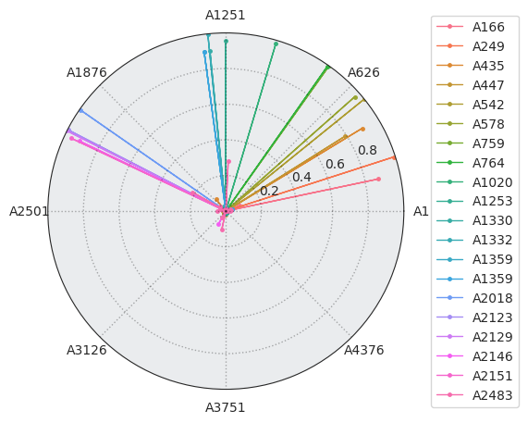
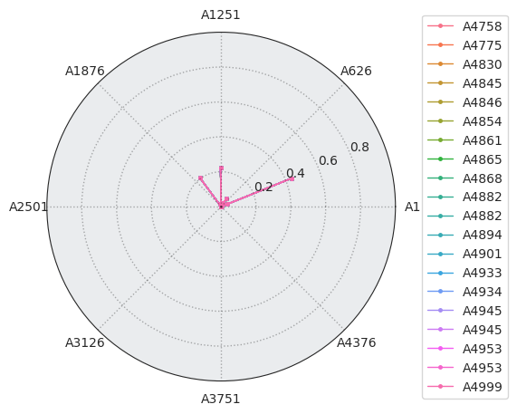
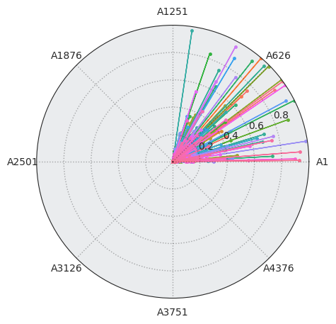
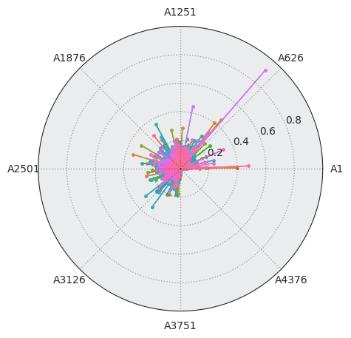
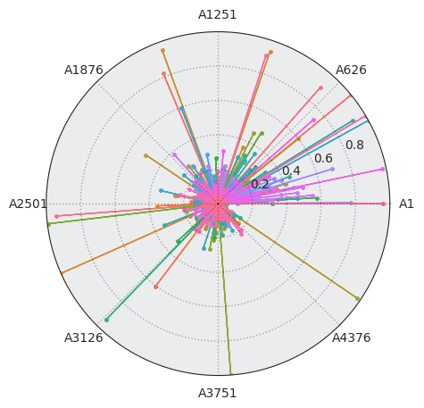
(a)
(b)
(c)
(d)
(e)
(f)
(a)
(b)
(c)

Slide 3
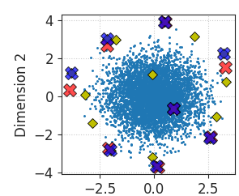
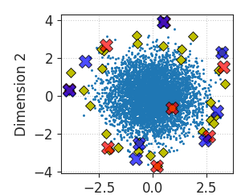
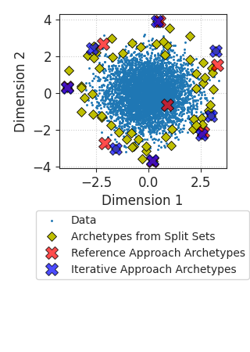
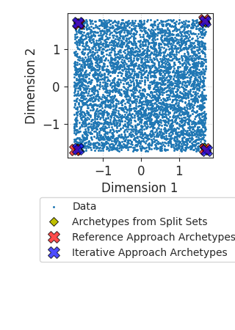


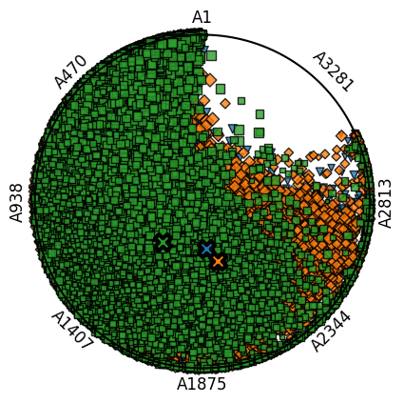
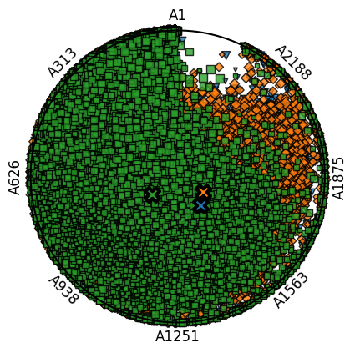
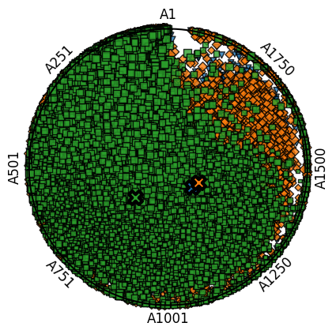
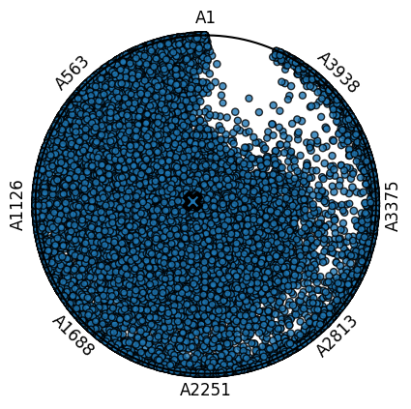
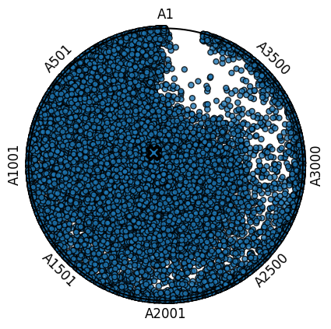
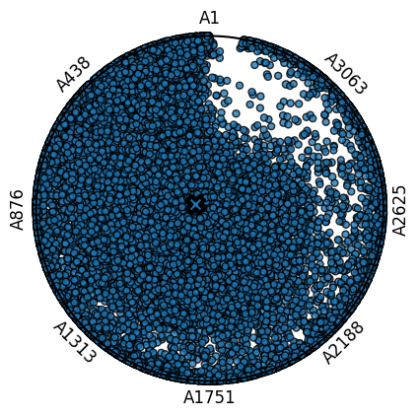
(a)
(b)
(c)
Whole Data
Subset
Splitting
Subset 1
Subset 2
……
Subset k
Individual
Archetypal
Analyses
Intermediate Instances 1
Intermediate Instances 2
……
Intermediate Instances k
Combined Intermediate Instances
(a)
(b)
(c)
Final
Archetypal Analysis
Final Archetypes
(a)
(b)
(c)
(d)
(e)
(f)

Slide 4
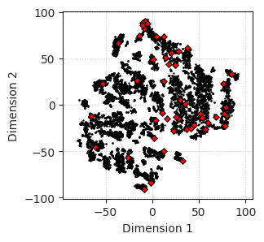
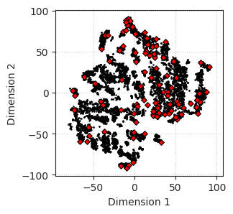
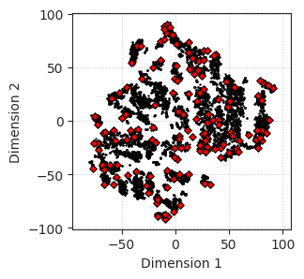
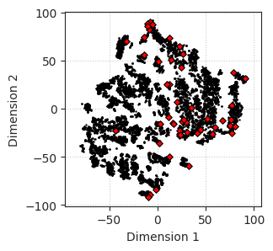


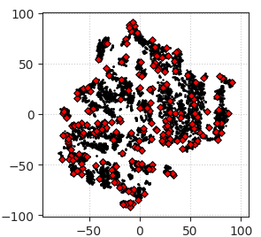
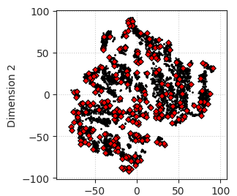
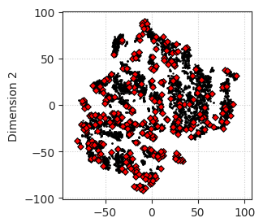
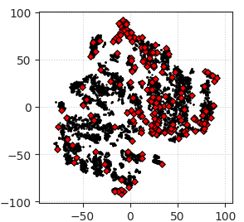


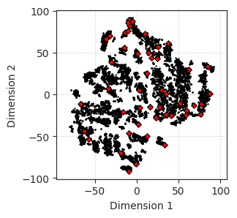

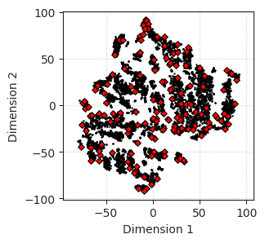



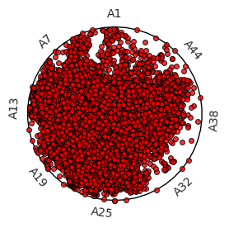
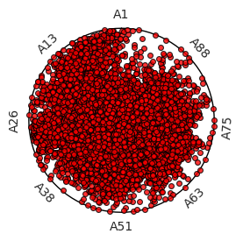
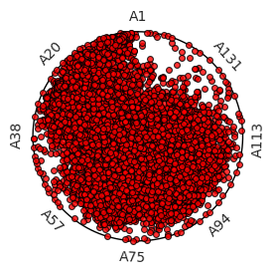
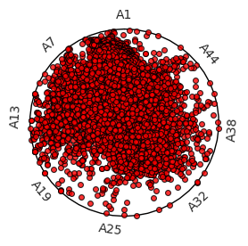
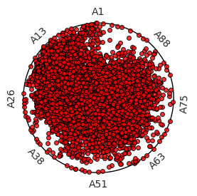
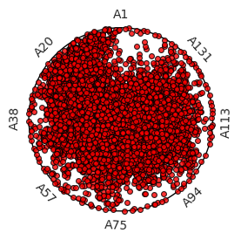
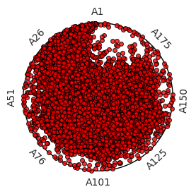
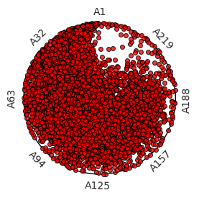
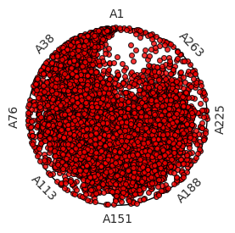
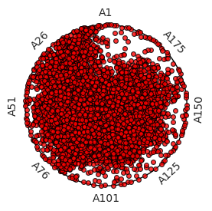
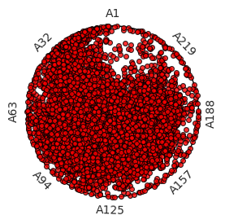
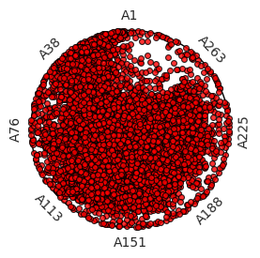
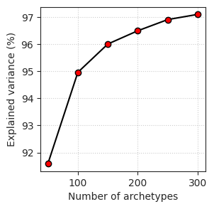
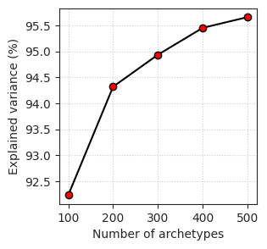
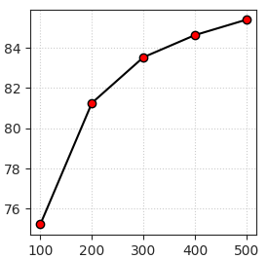
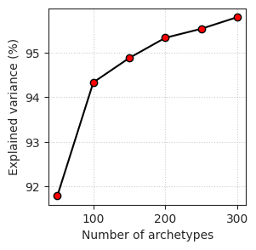
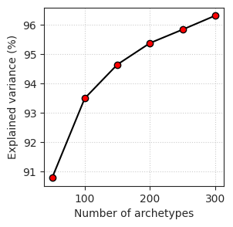
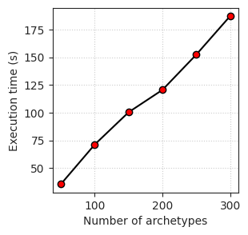
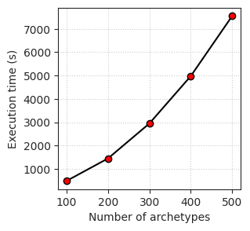



(a)
(b)
(c)
(a)
(b)
(c)
(d)
(e)
(f)
(d)
(e)
(f)
(a)
(b)
(c)
(a)
(b)
(c)
(d)
(e)
(f)
(d)
(e)
(f)
(a)
(b)
(c)
(a)
(b)
(c)
(e)
(f)
(g)
(a)
(b)
(c)
Notes:
Upper left: MNP p=50 to 300, random splitting, 3 subsets
Lower left: MNP p=50 to 300, random splitting, 10 subsets
Upper right: MNP p=50 to 300, split by elements, 3 subsets
Lower right: MNP p=50 to 300, random (top row) vs element-based (bottom row) splitting, 3 subsets
Lower right
a = MNP 3 subsets random split
b = MNP 3 subsets element split
c = MNP 10 subsets random split

Slide 5










(a)
(b)
(c)
Notes:
Number of archetypes chosen based on elbow plots
MNP: 100
BNP: 200
TNP: 200

Slide 6










(a)
(b)
(c)
Notes:
Number of archetypes chosen to maximise return on computational investment (5000)

Slide 7









(a)
(b)
(c)
Notes:
Number of archetypes chosen such that there is no archetypes that do not contribute significantly to any instance.
MNP: 250
BNP: 1800
TNP: 3000

Slide 8















(a)
(b)
(c)
Notes:
Radar plots:
(a) MNP
(b) BNP
(c) TNP

Slide 9


















(a)
(b)
(c)
Notes:
Radar plots:
(a) MNP
(b) BNP
(c) TNP

Slide 10
















(a)
(b)
(c)
Notes:
Top: Random splits
Left = MNP
Mid = BNP
Right = TNP
Bottom: MNP
Left = random split 3 subsets
Right = element split 3 subsets

Slide 11


















(a)
(b)
(c)
(a)
(b)
(c)
(d)
(e)
(f)
(d)
(e)
(f)
(a)
(b)
(c)
(d)
(e)
(f)
Notes:
Upper left: MNP p=50 to 300, random splitting, 3 subsets
Lower left: MNP p=50 to 300, random splitting, 10 subsets
Upper right: MNP p=50 to 300, split by elements, 3 subsets

Slide 12


Iterative Archetypal Analysis
$$X∈ℝ^{n×m}$$
$n$ = number of samples
$m$ = number of features
Notes:
So this iterative approach is based on the understanding that we can simply get the final convex hull from a set of smaller convex hulls.
So given a data set with $n$ samples and $m$ features,

Slide 13



$$X_{1}∈ℝ^{\left(\frac{n}{k}\right)×m}⊂X$$
$$X_{2}∈ℝ^{\left(\frac{n}{k}\right)×m}⊂X$$
$$X_{3}∈ℝ^{\left(\frac{n}{k}\right)×m}⊂X$$
$n$ = number of instances
$m$ = number of features
$k$ = number of subsets
$p$ = number of archetypes
$$Z_{1}=AA(X_{1})∈ℝ^{p×m}$$
$$Z_{2}=AA(X_{2})∈ℝ^{p×m}$$
$$Z_{3}=AA\left(X_{3}\right)∈ℝ^{p×m}$$
Notes:
And run the archetypal analysis algorithm on each of the subset.
Say the archetypes are found at somewhere close to the actual vertices,
[The theoretical results of the original authors only guarantee that archetypes will be found on the convex hull, but not necessary close to the actual vertices, so the caveat is that a sufficient number of archetypes should be specified at this stage, excessive archetypes is not as much of a problem though, as it will be eliminated in the final stage.]

Slide 14




Iterative Archetypal Analysis (Output)
$n$ = number of instances
$m$ = number of features
$k$ = number of subsets
$p_{i}$ = number of intermediate archetypes
$p_{f}$ = number of final archetypes
$$X_{f}=\left[Z_{1} Z_{2} Z_{3}\right]∈ℝ^{(p×k)×m}$$
$$Z,A,B=AA\left(X_{f}\right)$$
$$Z∈ℝ^{p_{f}×m}$$
$$A∈ℝ^{n×p_{f}}$$
$$B∈ℝ^{p_{f}×n}$$
$$RSS={\sum_{i=1}^{n}{\left\|X_{i}−\sum_{k=1}^{p_{f}}{A_{ik}Z_{k}}\right\|}}^{2}$$
Notes:
Which will return the final set of archetypes, which would resemble the ones obtained from the classical algorithms, but with shorter overall execution time.

Slide 15

Reduced Nanoparticle Data Set (Outcome)
100 archetypes
93.5% explained variance
Notes:
I then applied this algorithm to the combined set of monometallic data sets, with about ten thousand instances.
On the left {click} is the elbow plot to decide number of archetypes.
And the right figure shows the 10,000 instances projected onto 2D manifold learnt from t-Stochastic Neighbour Embedding from its original 135 dimension.
The red diamonds are the 100 most archetypal instances, which allows all instances to be reconstructed with 93.5% explained variance.
[Now there are more that could be explored with the algorithm, but I have yet to get to them.]

Slide 16



Reduced Nanoparticle Data Set (Outcome)
Notes:
These are simplex plots to show the distribution of the instances as convex combinations of a specific number of archetypes.
The last one is when all 100 archetypes are included.
[The more archetypes the more even the distribution will be.]

Slide 17

Reduced Data Sets (Impact)
$\sim$99% instance space reduction (9300 -> 100 instances)
93.5% explained variance
Notes:
And we also managed to downsample the data sets without introducing much bias to the process, which would allow downstream data-driven models to be applied more efficiently.

Slide 18












Parse coordinates
Parse atomic coordinates
Box-counting at different scales
Find nearest neighbours
Find surface atoms
Box-counting at different scales
Fit linear regression
Fit linear regression
Compute box-counting dimension

Slide 19


Parse atomic coordinates
Find nearest neighbours
Find surface atoms
Surface representation
Voxelised Point Cloud
Mathematically Exact Surface
Surface point cloud generation
Point cloud voxelisation
Exact surface box-counting
3D binary image box-counting
Box counts
Fit linear regression
Compute box-counting dimension

Slide 20



