Slide 1
Atomic coordinates
Calculate
root-mean-square deviation of
coordinates
Calculate
distances and divergences
of
radial distribution functions
Calculate
p-values from similarity tests
of
radial distribution functions
Calculate
absolute difference
of
box-counting dimensions
No
No
Yes
Below threshold?
Below threshold?
Below threshold?
Below threshold?
No
Retain conformation
Yes
Redundant conformation

Slide 2
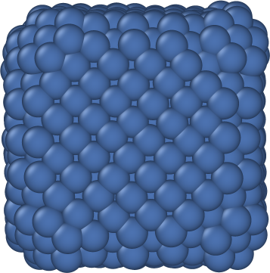
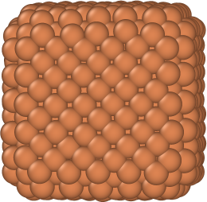
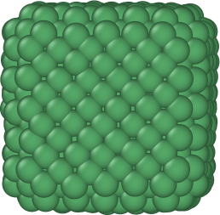
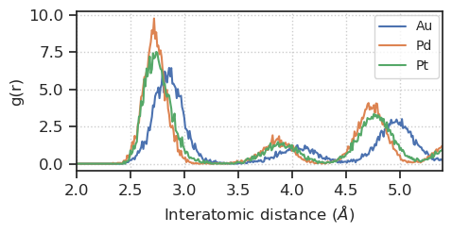
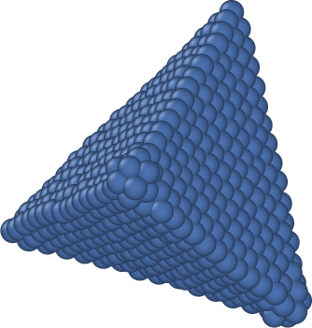
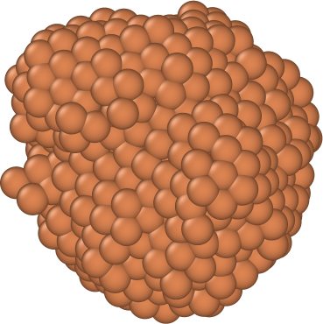
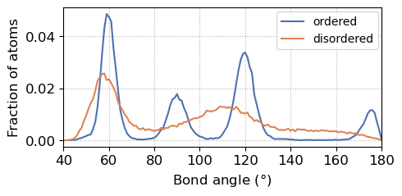
Mean: 96.0°
Standard deviation: 35.4°
Mean: 94.9°
Standard deviation: 34.1°

Slide 3
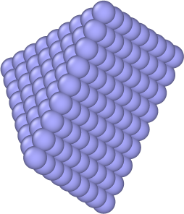
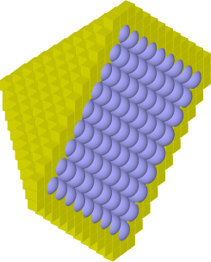
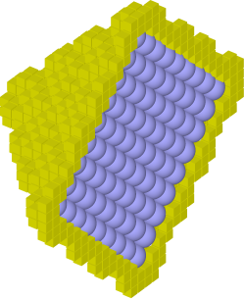
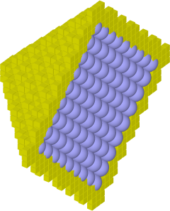
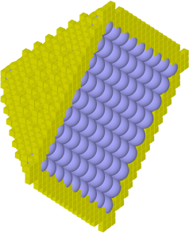
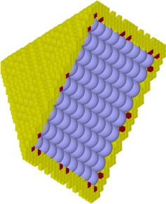
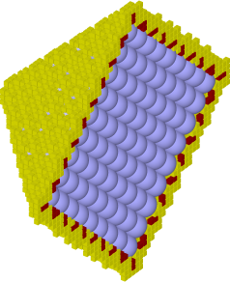
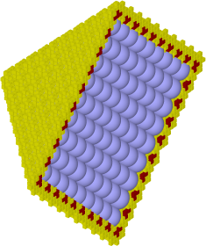
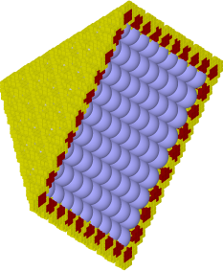
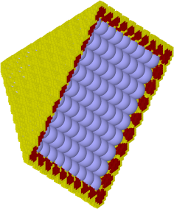
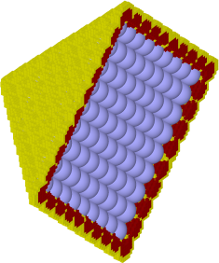
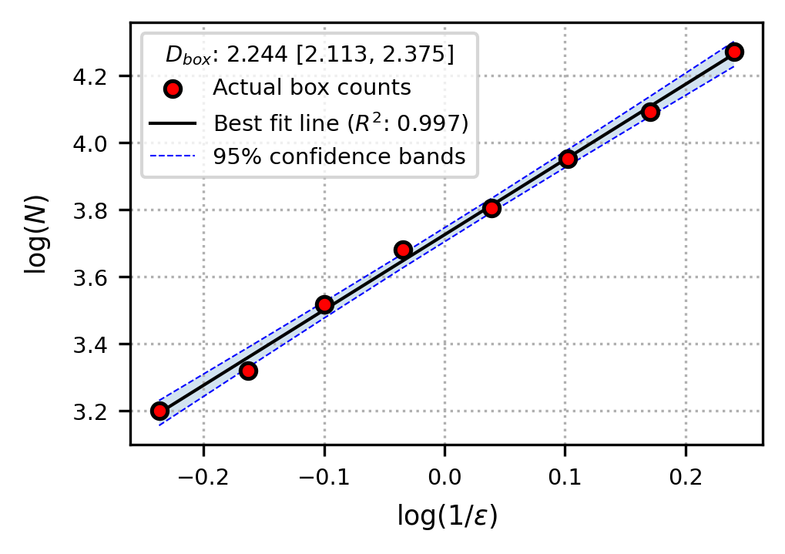
(a)
Parse atomic coordinates
Find nearest neighbours
(b)
Find surface atoms
Box-counting at different scales
Fit linear regression
(c)
Compute box-counting dimension

Slide 4
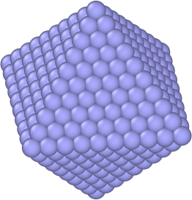


Slide 5
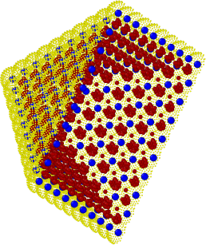
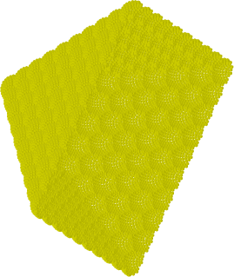
Parse atomic coordinates
Find nearest neighbours
Find surface atoms
Surface representation
Voxelised Point Cloud
Mathematically Exact Surface
Surface point cloud generation
Point cloud voxelisation
Exact surface box-counting
3D binary image box-counting
Box counts
Fit linear regression
Compute box-counting dimension

Slide 6


