Slide 1
Core Flight System
Scheduler (SCH) Application
Design Review

Slide 2
SCH - Heritage Analysis & Results
Heritage Analysis presented December, 2007
Heritage Missions Studied:
  LRO
  SWIFT / BAT
  ST-5 (as an antithesis of using a scheduler application)
Heritage Analysis Results
  Primary Features
    Provide Enable/Disable Activity and Enable/Disable Group Commands
    Provide Time-Division Multiplexing (TDM) of repetitive Activities
      An Activity is defined as the sending of a specific message to the Software Bus
    Divide TDM structure into a Major Frame (typically 1 Hz) consisting of a number of Minor Frames (typically 100 Hz)
    Major Frame should be able to be synchronized to an external timing reference
    Minor Frames should be performed relative to the start of a Major Frame

Slide 3
SCH - Heritage Analysis & Results (continued)
  Rejected
    Multiple Schedule Definition Tables
      Unnecessary with a file system supporting multiple table images
    Command for Selecting one of multiple Schedule Definition Tables
      Same as above
    Cross Validation between the Message Definition Table and the Schedule Definition Table to prevent incompatible table images from causing problems
      Schedule tables unlikely to be modified via table loads on the fly and cross validation techniques were insufficient or unreasonably complicated

Slide 4
SCH – Changes Since Heritage Analysis Review
  Command Definition Table (CDT) renamed
    Command Definition Table now referred to as the Message Definition Table
  Addition of Activity Identifier
    Activity Identifier will allow for future expansion of the Scheduler Application to handle additional types of Activities
  Addition of Schedule Processing Library
    Library allows disabling and enabling of schedule processing during critical activities by other applications

Slide 5
SCH - Subsystem Requirements
Number | Requirement Text | Rationale/Comments | Heritage Reference
CFS-400 | The FSW shall support a table driven Time Division Multiplexed (TDM) Input/Output Scheme for scheduling system activities | Provides ability to deterministically schedule application processing at specific times | LRO, BAT

Slide 6
SCH – Overview
Responsible for:
  The driving of a Time Division Multiplexed (TDM) operation of Applications via Software Bus Messages
    Synchronized to external Major Frame (typically 1 Hz) signal
    Each Major Frame split into a platform configuration number of smaller slots (typically 100 slots of 10 milliseconds each)
    Each slot can contain a platform configuration number of software bus messages (typically 5 messages) that can be issued within that slot

Slide 7
SCH – Context Diagram
HW
Timer
SCH
Library
OS API
1 Hz
Interface
Enable/Disable
Schedule
Processing
Minor Frame
Timing Control
And Notification
cFE TIME
CI
Major Frame
Timing Control
And Notification
Ground Cmds
Scheduler
HK Packets
Scheduled Msgs
HK, TO,
DS
Apps
Schedule
of Message
Generation
Message
Content
Definition
Schedule
Definition
Table
Message
Definition
Table

Slide 8
SCH – Flow Control
cFE TIME Services
Start
1 Hz
Registry
1 Hz Callback Function Ptr
Initialize
TIME 1 Hz
Child Task
1 Hz ISR
1 Hz Interrupt
From Mission
Defined Source
Timer Callback Function Ptr
OSAL TIMER
Services
via Semaphore
Wait for
Semaphore
Timer Interrupt
From OSAL Managed Timer
via Semaphore
Timer
Callback
Function
via Semaphore
Processing
Enabled?
1 Hz
Callback
Function
Design Implications:
SCH App pends on common semaphore associated with two timing sources.
Application can continue to run (freewheel style) if 1 Hz source fails.
However, resynchronization may cause skipping over a number of Schedule Table Entries.
No
Yes
Determine
Next Slot
Time
Sync
Slot?
Process
Next Set of
Schedule Table
Activities
No
Yes
Process
Pending
Command
Messages
Schedule
OSAL Timer
With Extended
Period

Slide 9
SCH – Initialization
Power-On Reset
  Perform cFE application specific initialization
  Initialize housekeeping data
  Inhibit Schedule Processing
Processor Reset
  Perform cFE application specific initialization
  Initialize housekeeping data
  Inhibit Schedule Processing

Slide 10
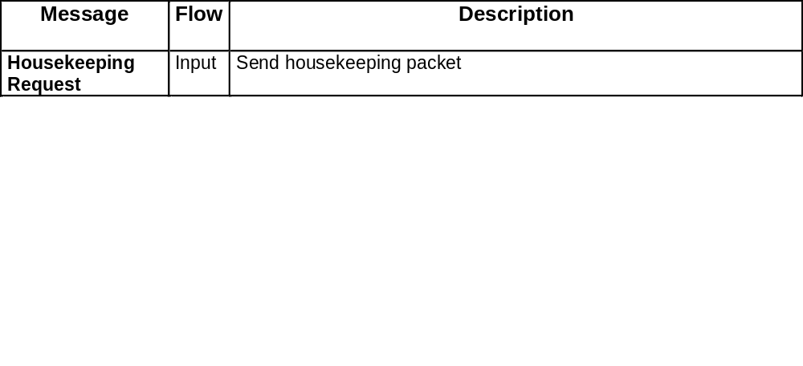
SCH – Internal Messaging

Slide 11
SCH – Schedule Table Processor
Schedule Table
Slot 0
One Schedule Table slot processed every (T / M) microseconds
[default: T/M = 10000us = 10ms]
Slot 1
Slot 2
Entire schedule processed once per Major Frame (T microseconds)
[default: T = 1000000us = 1s]
Activity 0
Activity 1
Slot M-3
Activity N-2
Slot M-2
Activity N-1
Slot M-1
Each Schedule Table Slot
contains N Activities
- SCH maintains a count of number of times entire table is processed and reports it in housekeeping telemetry

Slide 12
SCH – Activity Messages
Activity 0
Schedule Table
Activity 1
Message Table
Slot 0
Msg 0
Slot 1
Msg 1
Slot 2
Activity N-2
Msg 2
Activity N-1
Activities may reference
common messages
Activity 0
Activity 1
Slot M-3
Msg Z-3
Slot M-2
Msg Z-2
Slot M-1
Activity N-2
Msg Z-1
Activity N-1

Slide 13
SCH – Schedule Definition Table (1)
Activity Definition
Size (in bytes) | Field Name | Description
1 | Group ID | Activity’s Assigned Group Number (0=Unused, 1-255=Group ID #)
3 | Multi-Group Identifiers | Multi-Group(s) Activity is Assigned to (0=Unused, Each bit represents a platform specified Multi-Group)
2 | Frequency | How often Activity is Performed (0=Unused, 1=1 MF, 2=0.5 MF, 3=0.333 MF, etc)
2 | Offset | How many seconds to wait before performing the Activity the first time (0=Unused, 1=1 MF, 2= 2 MF, 3= 3 MF, etc)
2 | Definition Index | Index into Message Definition Table’s (MDT’s) Table of Contents (0=Unused, 1-65535=Index)
1 | Activity Type | Type of Activity to be Performed (0=Unused, 1=Send Message, 2-255= Reserved)
1 | Activity State | State of Activity (0=Unused, 1=Enabled, 2=Disabled)
“Group ID” and “Multi-Group Identifiers” are combined into a single 32-bit integer
- If Activity is enabled and (Table Lap Count % Frequency) = Remainder
Then send indexed Message from Message Definition Table

Slide 14
Groups and Multi-Groups
31 | 30 | 29 | 28 | 27 | 26 | 25 | 24 | 23 | 22 | 21 | 20 | 19 | 18 | 17 | 16 | 15 | 14 | 13 | 12 | 11 | 10 | 9 | 8 | 7 | 6 | 5 | 4 | 3 | 2 | 1 | 0
Group ID #
Multi-Group Bit Masks
Group ID #
  Each Activity can be assigned a single Group # (1-255)
  A single Group can be Enabled/Disabled collectively
Multi-Groups
  An activity can be assigned any number of Multi-Groups
  Allows for single groups to be combined with other single groups to form larger groups
  These larger groups can then be Enabled/Disabled collectively with a single command
Example of Usage
  Activities associated with collecting Reaction Wheel (RW) data, Three Axis Magnetometer (TAM) Data and Gyro Data could be assigned individual groups of #1, #2, and #3 collectively
  Failure of the TAM could result in Disabling TAM Group #2 without affecting RWs or Gyro
  All three groups could also be associated with Multi-Group #1 called “ACS”
  During launch phase when the ACS is not operating, Multi-Group #1 could be Disabled until separation and then Enabled via a single command once separation is detected

Slide 15
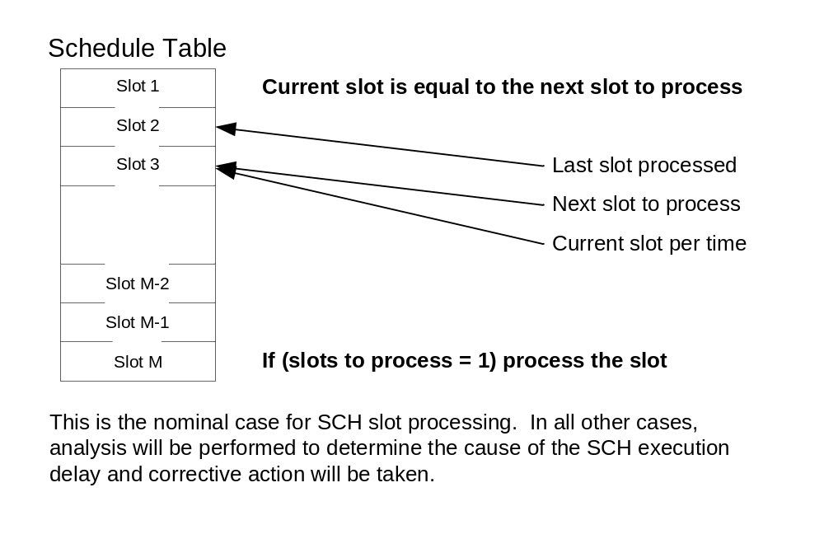
SCH – Slot Processing Example (1)

Slide 16
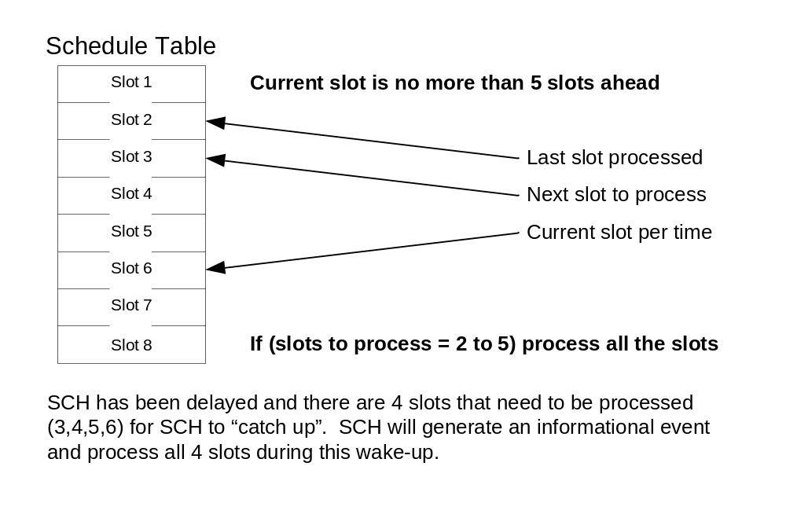
SCH – Slot Processing Example (2)
NOTE: The “5” is a configurable parameter (SCH_MAX_SLOTS_PER_WAKEUP)

Slide 17
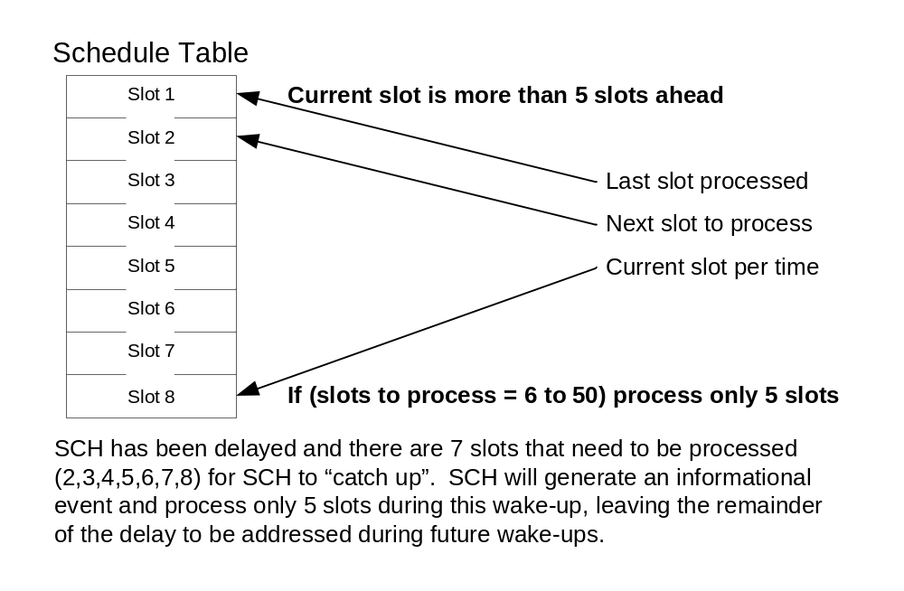
SCH – Slot Processing Example (3)
NOTE: The “5” is a configurable parameter (SCH_MAX_SLOTS_PER_WAKEUP)

Slide 18
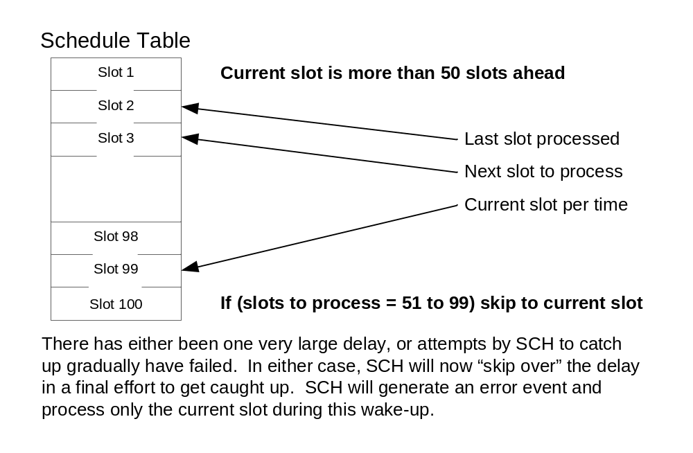
SCH – Slot Processing Example (4)
NOTE: The “50” is a configurable parameter (SCH_MAX_LAG_COUNT)

Slide 19
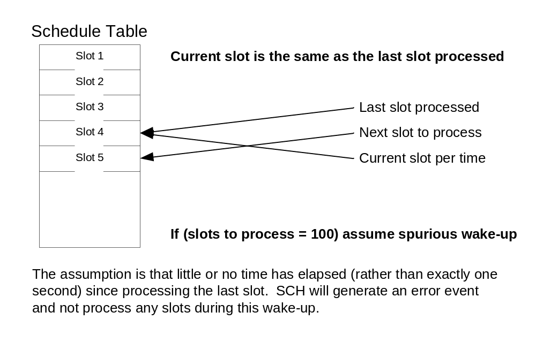
SCH – Slot Processing Example (5)

Slide 20
SCH – Configuration Parameters (1)
Parameter | Description | Default Value
SCH_PIPE_DEPTH | Software bus command pipe depth | 12
SCH_TOTAL_SLOTS | Minor Frame Frequency (in Hz) | 100
SCH_ENTRIES_PER_SLOT | Maximum Activities per slot | 5
SCH_MAX_MESSAGES | Maximum Number of Message Definitions in Message Table | 128
SCH_MDT_MIN_MSG_ID | Minimum Message ID allowed in Message Definition Table | 0
SCH_MDT_MAX_MSG_ID | Maximum Message ID allowed in Message Definition Table | CFE_SB_HIGHEST_VALID_MSGID
SCH_MAX_MSG_WORDS | Maximum Length, in Words, of a Message in the message table | 64
SCH_MAX_LAG_COUNT | Maximum Number of slots allowed for catch-up before skipping | (SCH_TOTAL_SLOTS/ 2)
SCH_MAX_SLOTS_PER_WAKEUP | Maximum Number of Slots to be processed when in "Catch Up" mode | 5
SCH_MICROS_PER_MAJOR_FRAME | Conversion factor for how many microseconds in a wake-up period | 10000000

Slide 21
SCH – Configuration Parameters (2)
Parameter | Description | Default Value
SCH_SYNC_SLOT_DRIFT_WINDOW | Additional time allowed in Sync Slot to wait for Major Frame Sync | 5000
SCH_STARTUP_SYNC_TIMEOUT | Timeout on waiting for all applications to start at initialization | 50000
SCH_STARTUP_PERIOD | Number of microseconds to attempt major frame synchronization | (5*SCH_MICROS_PER_MAJOR_FRAME)
SCH_MAX_NOISY_MAJORF | Maximum noisy major frames prior to desynchronization | 2
SCH_LIB_PRESENCE | Presence of SCH Library | 1
SCH_LIB_DIS_CTR | Processing disabled counter at startup | 0
SCH_SCHEDULE_FILENAME | Default schedule table filename to load at startup | "/cf/apps/sch_def_schtbl.tbl"
SCH_MESSAGE_FILENAME | Default message table filename to load at startup | "/cf/apps/sch_def_msgtbl.tbl"
SCH_MISSION_REV | Mission revision number | 0

Slide 22
SCH – Message Definition Table
Table Offset | Field Size | Description
0 | 2 | Message Definition Type (0=Unused, 1=Message to Send, 2-255=Reserved)
(M+1)*2 | 2 | First Word of Message to Send (Stored in the same format as all cFE SB Messages)
• | • | •
• | • | •
• | • | •
(M+1)*2+(N-2) | 2 | Last Word of Message to Send (N = Length of Message, in bytes)
(M+1)*2+N | 2 | Message Definition Type (0=Unused, 1=Message to Send, 2-255=Reserved)
• | • | •
• | • | •
• | • | •

Slide 23
SCH – Commands
Command | Description
No-op | Increments the Command Accepted Counter and sends a debug event message
Reset Counters | Initializes housekeeping counters to zero
Enable Entry | Enables an entry in the Schedule Definition Table
Disable Entry | Disables an entry in the Schedule Definition Table
Enable Group and/or Multi-Group(s) | Enables a group and/or multi-group(s) of entries in the Schedule Definition Table
Disable Group and/or Multi-Group(s) | Disables a group and/or multi-group(s) of entries in the Schedule Definition Table
Enable Sync | Enables usage of Major Frame Signal if previously autonomously disabled for being “noisy”
Send Diagnostic Tlm | Generates and sends the SCH Diagnostic Telemetry Packet that contains the current state of all activities defined in the Schedule Definition Table

Slide 24
SCH – Housekeeping Message
Telemetry Point | Description
CommandCounter | Number of accepted ground commands
CommandErrCounter | Number of rejected ground commands
ScheduleActivitySuccessCounter | Number of scheduled activities processed
ScheduleActivityFailureCounter | Number of scheduled activities failed due to error
SlotsProcessedCounter | Number of schedule slots processed
SlotsSkippedCounter | Number of instances when one or more slots were skipped
MultipleSlotsCounter | Number of instances when two or more slots were processed at once
SameSlotCounter | Number of instances when SCH woke up in the same time slot as previously
BadTableDataCount | Number of table entries with an error that have been encountered
TableVerifySuccessCount | Number of successful table verifications performed
TableVerifyFailureCount | Number of failed table verifications performed
TablePassCounter | Number of times Schedule Table was completely processed
ValidMajorFrameCount | Number of Valid Major Frame Signals received
MissedMajorFrameCount | Number of Major Frame Signals that did not occur when expected
UnexpectedMajorFrameCount | Number of Major Frame Signals that occurred when nor expected to occur
MinorFramesSinceTone | Number of Minor Frames processed since last Major Frame

Slide 25
SCH – Housekeeping Message(2)
Telemetry Point | Description
NextSlotNumber | The next slot to be processed in the Schedule Definition Table
LastSyncMETSlot | Slot Number when last Time Synchronization occurred
IgnoreMajorFrame | Major Frame Signals are ignored because they are deemed “noisy”
UnexpectedMajorFrame | Last Major Frame Signal occurred when not expected
SyncToMET | Minor Frames are synchronized to MET.
MajorFrameSource | Identifies the source of the Major Frame Signal (timer, MET, etc)

Slide 26
SCH – Diagnostic Message
Telemetry Point | Description
ActivityStates | Bit flags indicating the state of each Activity in Schedule Definition Table
MessageIDs[# of Activities] | Message ID associated with the specified activity
ActivityStates Definition:
Activities states are bit packed. Each Activity’s State
takes 2 bits and are defined as follows:
0 = Unused
1 = Enabled
2 = Disabled

Slide 27
SCH – Event Messages (1)
Event Type | Event Description
Debug | Slot did not increment: slot = %d
Debug | Schedule table verify results -- good[%d] bad[%d] unused[%d]
Debug | Message tbl verify results - good[%d] bad[%d] unused[%d]
Debug | RESET command
Debug | ENABLE command: slot = %d, entry = %d
Debug | DISABLE command: slot = %d, entry = %d
Debug | ENABLE GROUP command: match count = %d
Debug | DISABLE GROUP command: match count = %d
Debug | Major Frame Synchronization Enabled
Debug | Transmitting Diagnostic Message
Information | SCH Initialized. Version %d.%d.%d.%d
Information | SCH App: terminating, err = 0x%08X
Information | OS Timer Accuracy (%d > reqd %d usec) requires Minor Frame MET sync
Information | Multiple slots processed: slot = %d, count = %d
Information | NO-op command. Version %d.%d.%d.%d

Slide 28
SCH – Event Messages (2)
Event Type | Event Description
Error | Error Creating SB Pipe, RC=0x%08X
Error | Error Subscribing to HK Request(MID=0x%04X), RC=0x%08X
Error | Error Subscribing to GND CMD(MID=0x%04X), RC=0x%08X
Error | Error Registering SDT, RC=0x%08X
Error | Error Registering MDT, RC=0x%08X
Error | Error (RC=0x%08X) Loading SDT with %s
Error | Error (RC=0x%08X) Loading MDT with %s
Error | Error Acquiring Tbl Ptrs (RC=0x%08X)
Error | Error creating Minor Frame Timer (RC=0x%08X)
Error | Error Subscribing to Major Frame Tone (RC=0x%08X)
Error | Error creating Main Loop Timing Semaphore (RC=0x%08X)
Error | Slots skipped: slot = %d, count = %d
Error | Corrupt data error (1): slot = %d, entry = %d
Error | Corrupt data error (2): msg = %d, freq = %d, type = %d, rem = %d
Error | Activity error: slot = %d, entry = %d, err = 0x%08X
Error | Major Frame Sync too noisy (Slot %d). Disabling synchronization.
Error | Schedule tbl verify error - idx[%d] ena[%d] typ[%d] fre[%d] rem[%d] msg[%d] grp[0x%08X]
Error | Message tbl verify err - idx[%d] mid[0x%X] len[%d] buf[%d]

Slide 29
SCH – Event Messages (3)
Event Type | Event Description
Error | ENABLE cmd: invalid argument, slot=%d (<%d), entry=%d (<%d)
Error | ENABLE command: invalid state = %d, slot = %d, entry = %d
Error | DISABLE cmd: invalid argument, slot=%d (<%d), entry=%d (<%d)
Error | DISABLE command: invalid state = %d, slot = %d, entry = %d
Error | ENABLE GROUP command: invalid argument, no groups selected
Error | ENABLE GROUP command: Neither Group %d nor Multi-Group 0x%06X found
Error | DISABLE GROUP command: invalid argument, no groups selected
Error | DISABLE GROUP command: Neither Group %d nor Multi-Group 0x%06X found
Error | Invalid command code: ID = 0x%04X, CC = %d
Error | Msg with Invalid message ID Rcvd -- ID = 0x%04X
Error | Cmd Msg with Bad length Rcvd: ID = 0x%04X, CC = %d, Exp Len = %d, Len = %d

