Slide 1
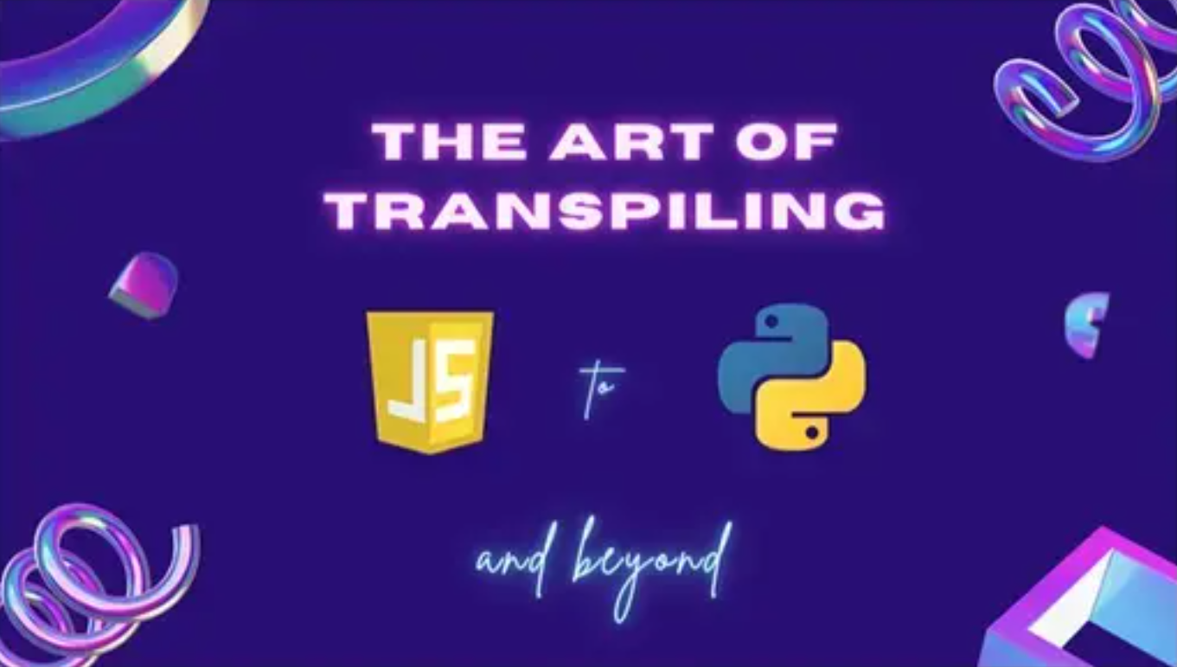

Slide 2
What Is Transpiling ?

Slide 3
Transpiling:
Translating source code between programming languages that operate at approximately the same level of abstraction.

Slide 4
Why Do We Do it ?

Slide 5
Reasons for Transpiling
Compatibility
Extendibility
Reusability
Reliability

Slide 6
Is all transpiling the same?

Slide 7
Transpiling Priorities
Machine Interpretability
Human Interpretability

Slide 8
How Do We Do it?

Slide 9
Breaking
Breaking down a language into abstract categories

Slide 10
Common abstract categories:
Syntax
Operators
Keywords
Features
Libraries

Slide 11
Syntax :
“set of rules that define the combinations of symbols that are considered to be correctly structured statements or expressions…”
Source: Wikipedia.org

Slide 12
Syntax :
Stuff that uses these things:
", ( ), { }, [ ], ;, : , \n, \t
Source: Wikipedia.org

Slide 13
Syntax :
Create blocks of code (conditions, loops, classes, functions)
define statements
declare variables
instantiate objects
separate values and conditions

Slide 14
Operators :
Symbol that represents an action or process

Slide 15
Operators :
Assignment (=, +=…)
Arithmetic (+, -, /, *, %...)
Boolean (&&, ||, !)
Relational (<, > , ==…)
Bitwise (&, |, ^, ~)

Slide 16
Keywords :
Words reserved by a language for a specific purpose

Slide 17
Keywords :
Javascript
Python
abstract arguments await boolean
break byte case catch
char class const continue
debugger default delete do
double else enum eval
export extends false final
finally float for function
goto if implements import
in instanceof int interface
let long native new
null package private protected
public return short static
super switch synchronized this
throw throws transient true
try typeof var void
volatile while with yield
False None True and
as assert async await
break class continue def
del elif else except
finally for from global
if import in is
lambda nonlocal not or
pass raise return try
while with yield

Slide 18
Features :
A “distinguishing characteristic of a software item (e.g., performance, portability, or functionality).”
Source: IEEE 829

Slide 19
Features :
Data types (Strings, numbers, Objects, Date)
Loops (for, do, while, iterators)
Conditional statements
Boolean expressions
Collections (Array, Map, Set…)
Built-in functions
Import statements

Slide 20
Libraries :
A “suite of data and programming code that is used to develop software programs and applications.”
Source: Techopedia.com

Slide 21
Libraries :
Language (Strings, numbers, exceptions…)
Utilities (collections, formatting, datetime…)
I.O. (files, text, bytes, buffers…)
Cryptography (sha-256, hmac, public/private keys…)
Networking (URL, IPAddress, Socket's…)

Slide 22
https://github.com/JonBoynton/JSConvert

