Slide 1
Lessons Learned--Building and Maintaining a Thriving Makerspace
NCCE 2016
Jonathan Briggs
Eastside Preparatory School, Kirkland WA

Slide 2
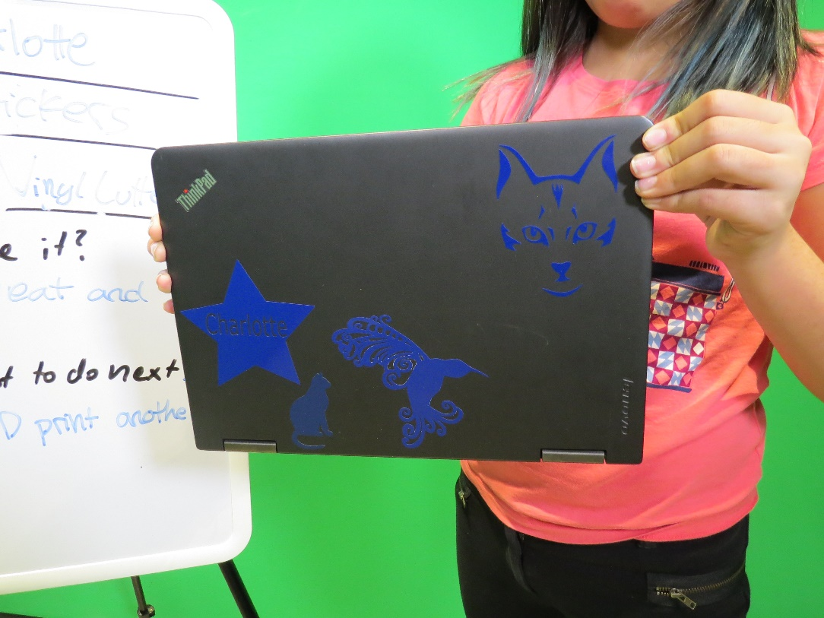
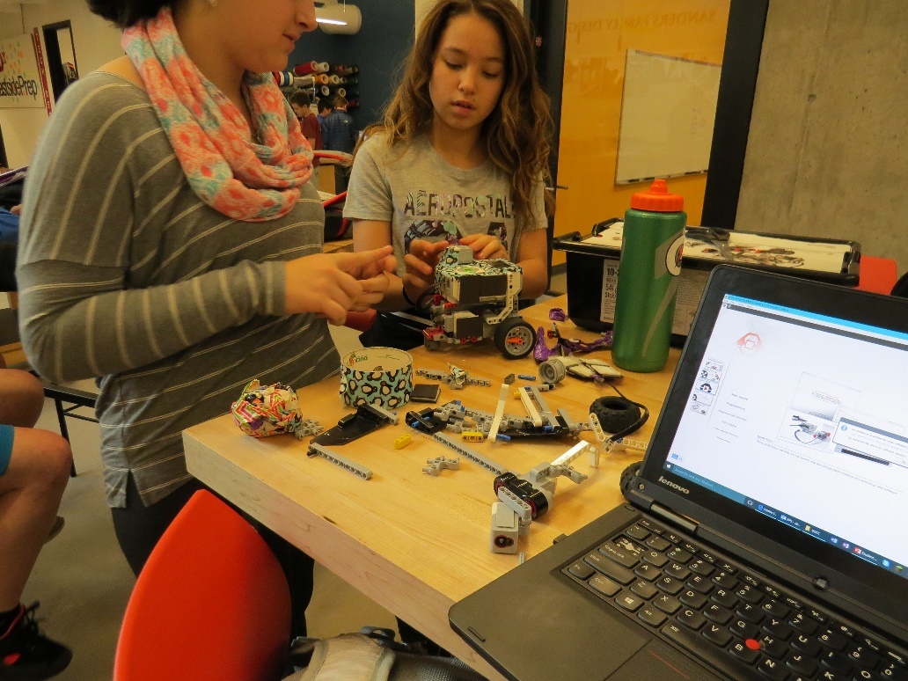
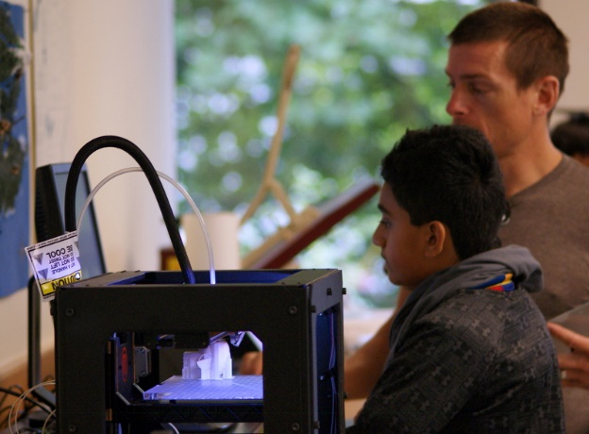
Makerspaces, why bother?
Comfort with failure
Design Experience
The interface between the physical and digital world is fascinating

Slide 3
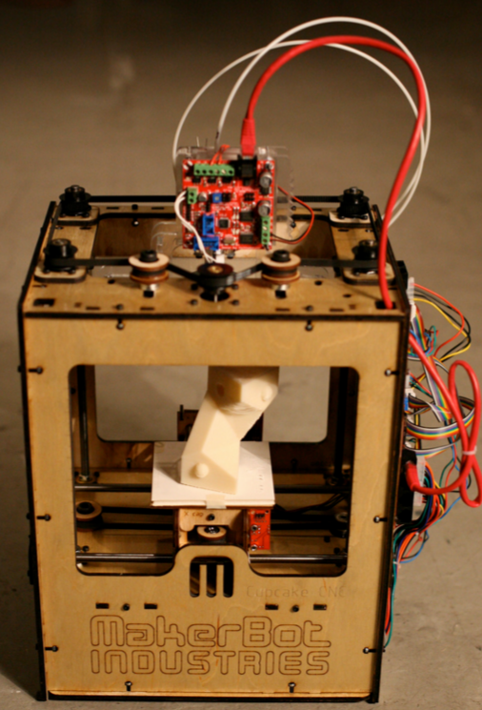
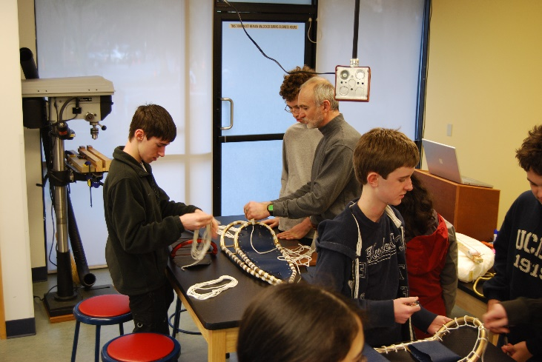
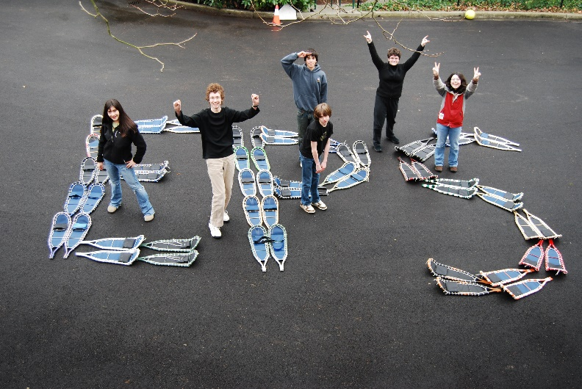
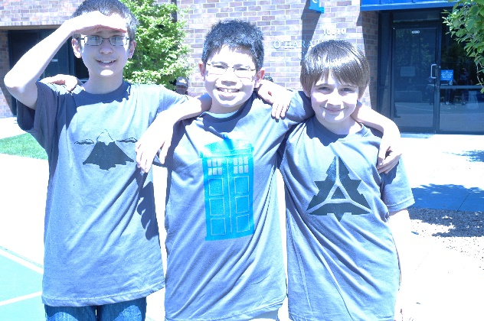
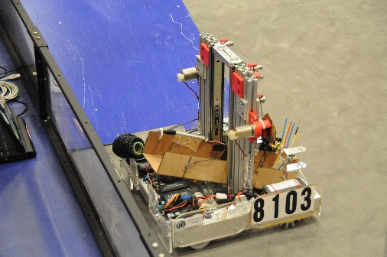
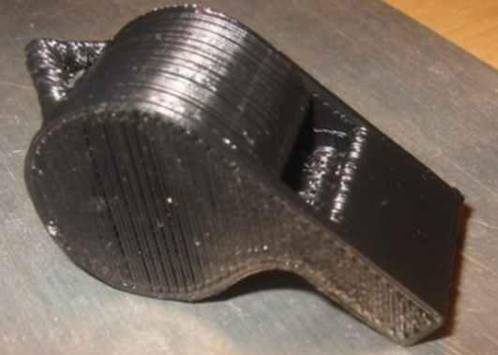
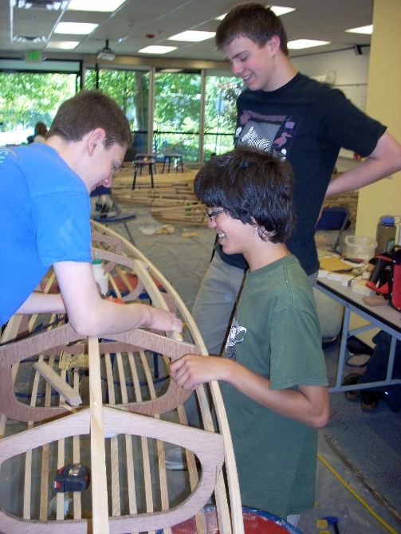
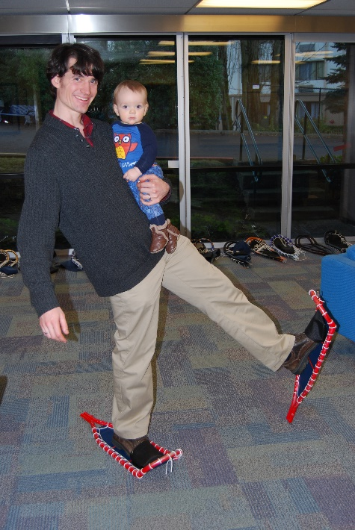
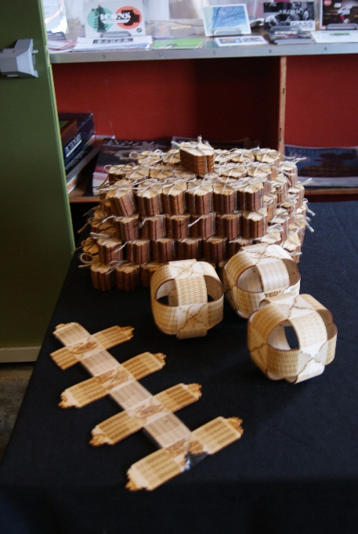
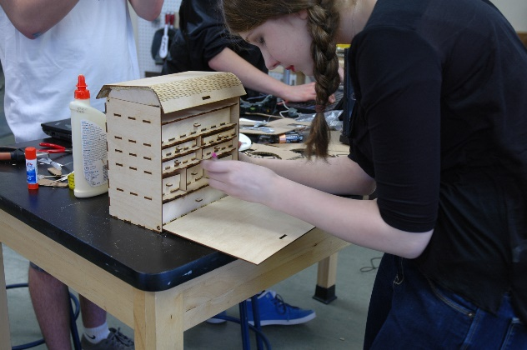
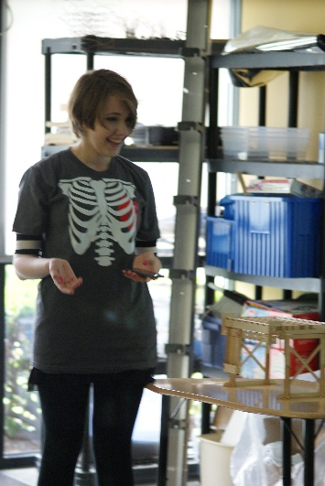
Our History
2007
2010
2011
2012
2013
2015
Fabrication Studio Concept
Cupcake CNC 3D printer – Entering Digital Tools
Added a Laser Cutter
Started building class experiences.
FTC Team
New 6th grade Class
New Home
Student Leadership

Slide 4
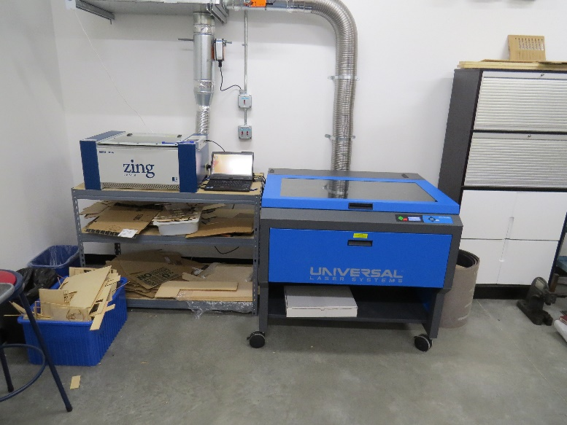
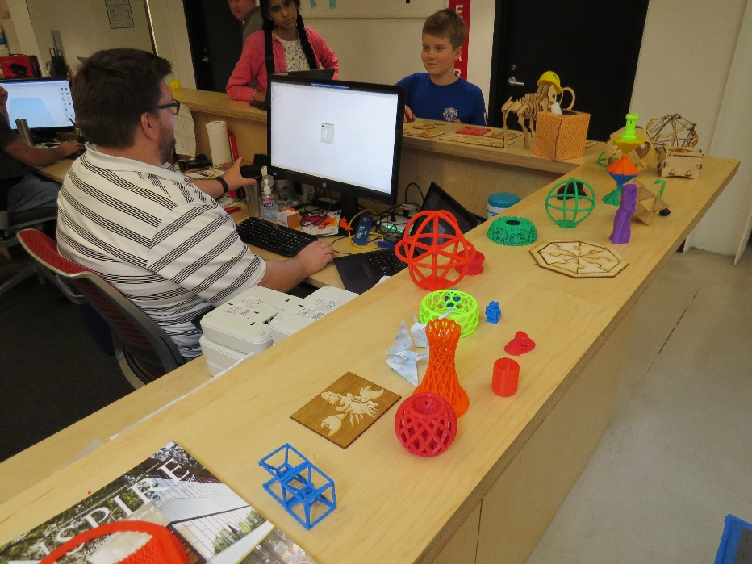
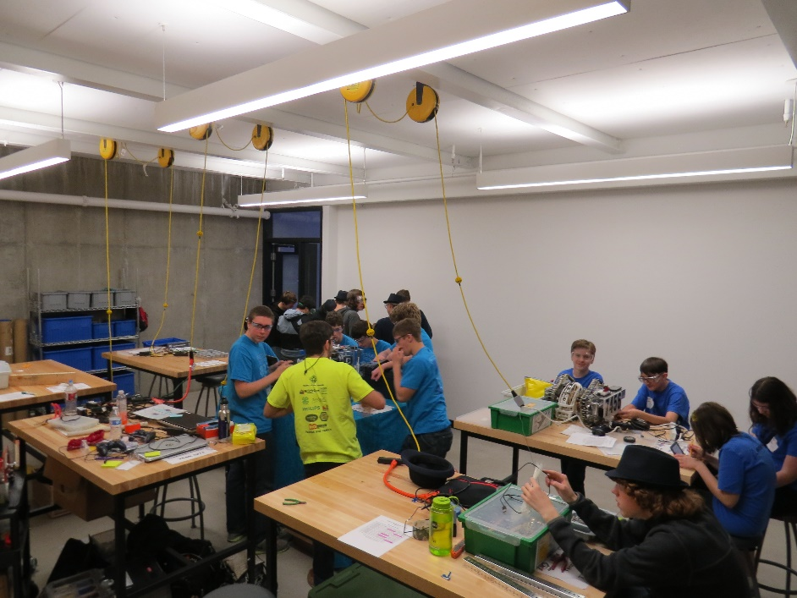
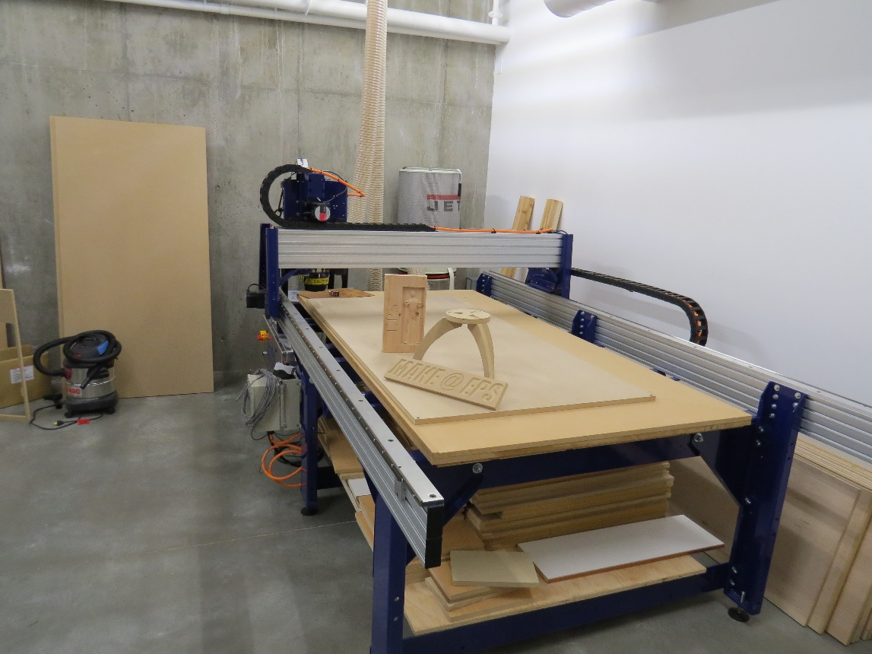
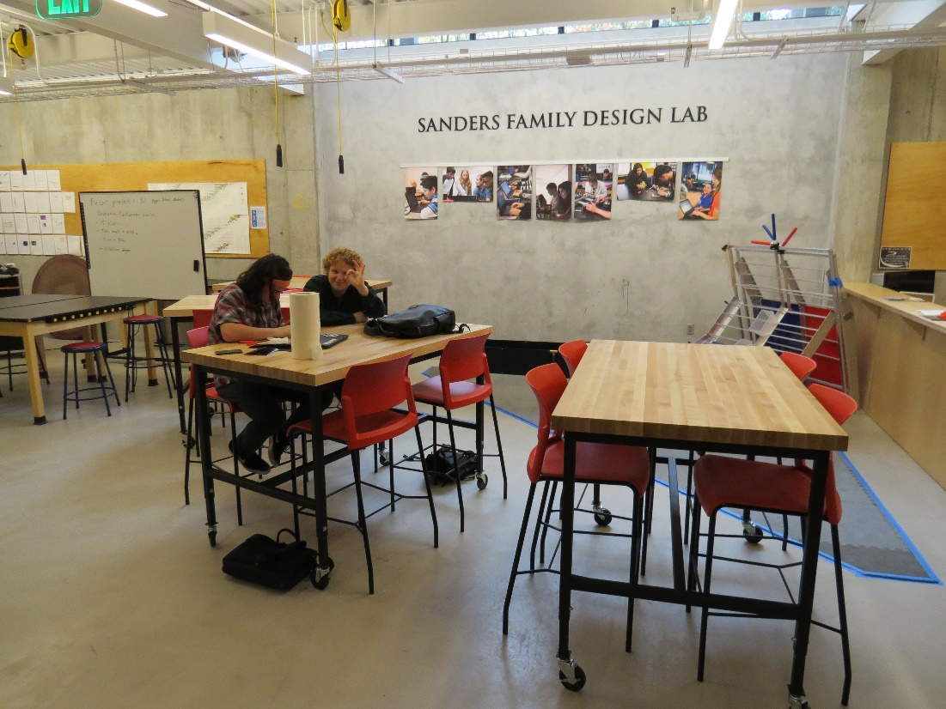
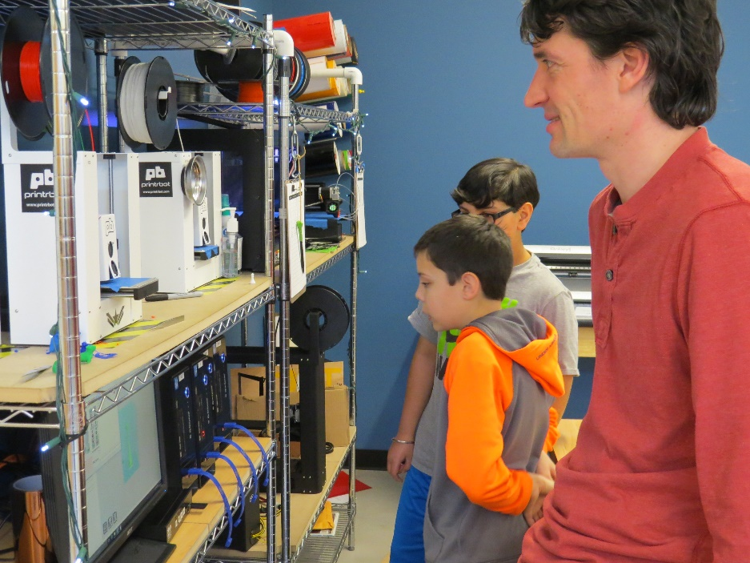
Current Space

Slide 5
People involved
Organizer/ Maximizer
Philosophy
Mission / Why?
Students / Leadership
Feedback loop
Tools and resources
You must spend but spend wisely
Cheerleader
Tinkerer
Defn. of Success
Scale
How we think about our makerspace
Notes:
Build the framework

Slide 6
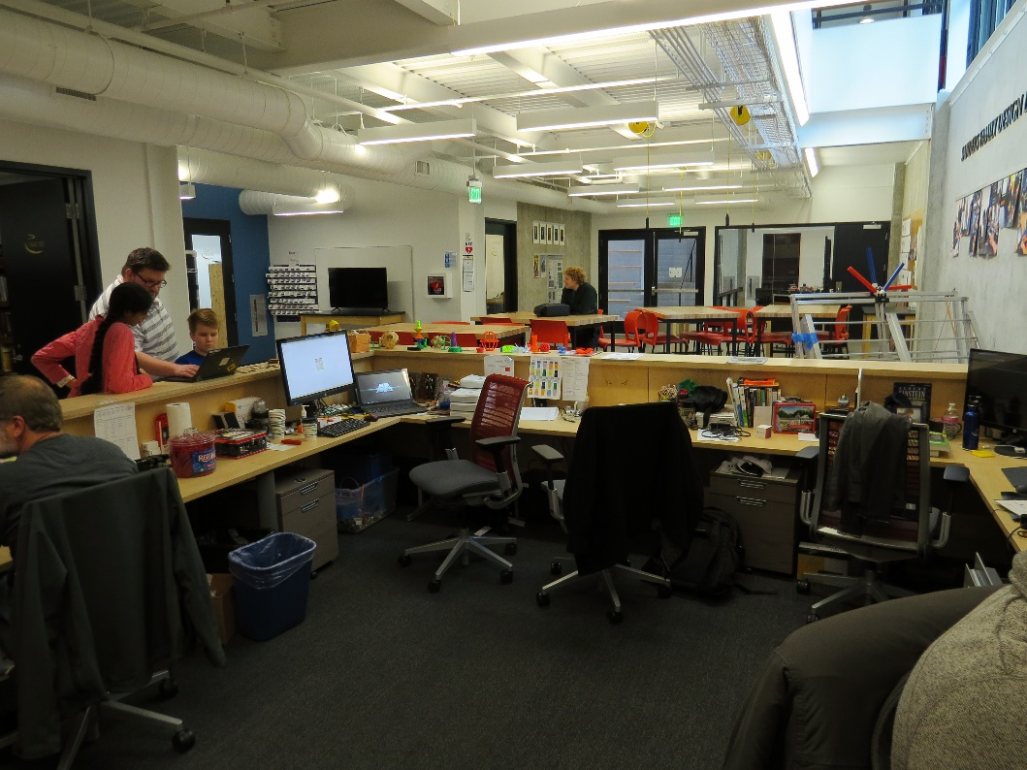
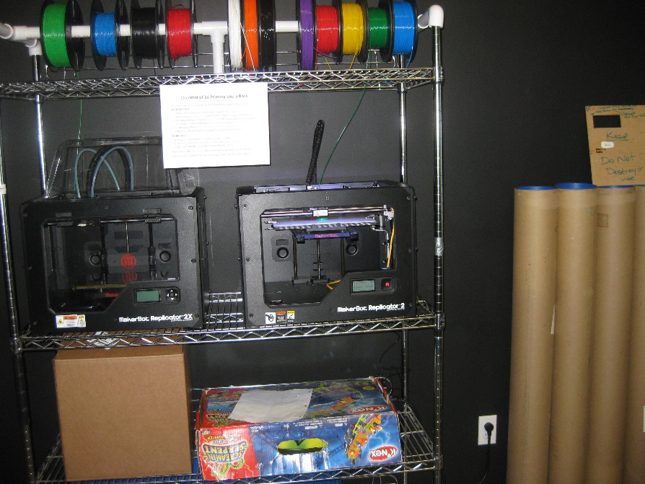
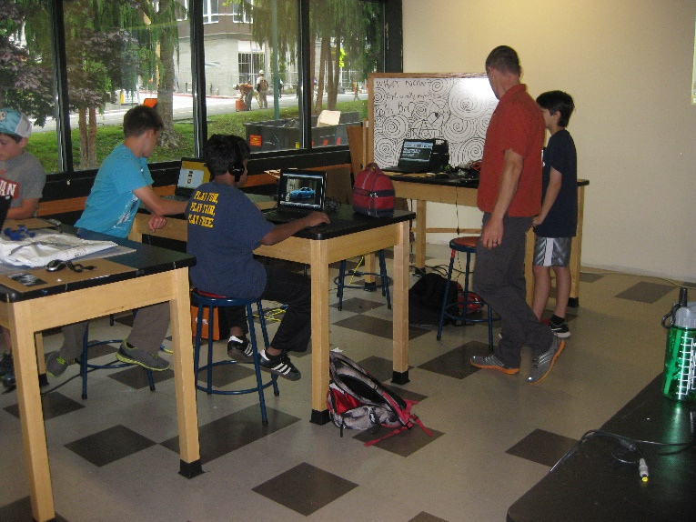
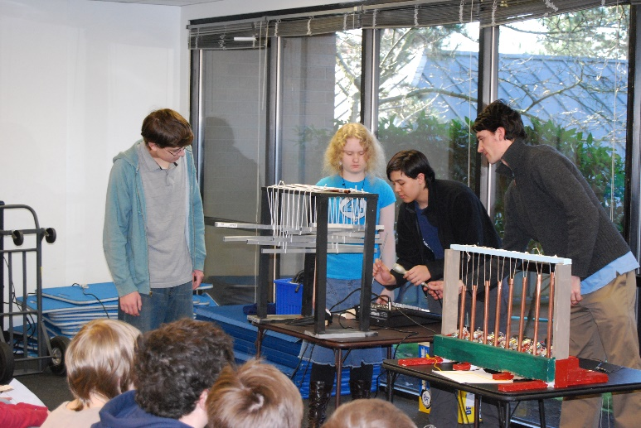
Lesson #0
Evolve your makerspace
Understand that you are in a domain where things are changing rapidly.
Embrace the design process for your makerspace.
You don’t have to make it perfect, just continually make it better than it was.

Slide 7
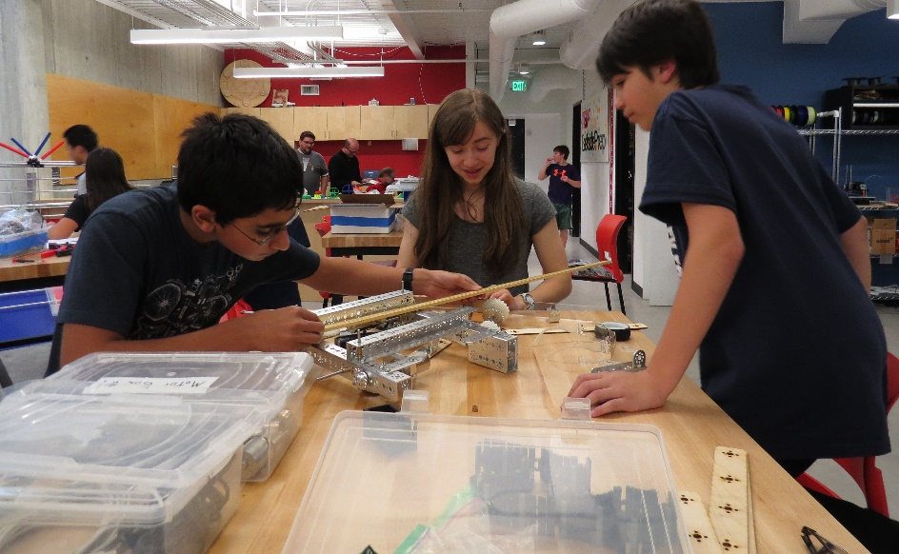
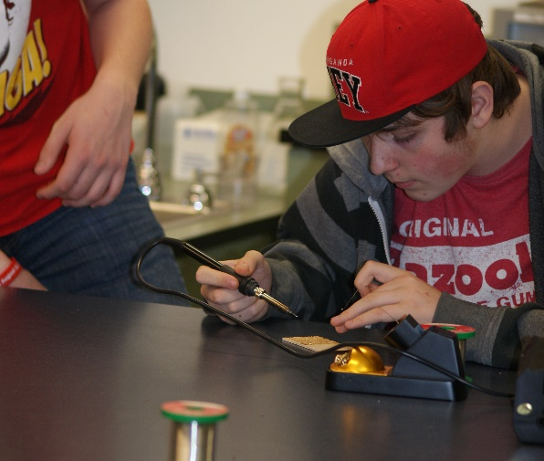
Philosophy: Lesson #1
Start with the Why
Engage and empower students to solve novel problems with whatever tools are available.
…that’s ours, pick something that speaks to your community.
People involved
Philosophy
Students / Leadership
Tools and resources
Defn. of Success
Mission / Why?
Notes:
Without a shared mission/vision, it is very difficult to get a team of people pulling in the same direction.

Slide 8
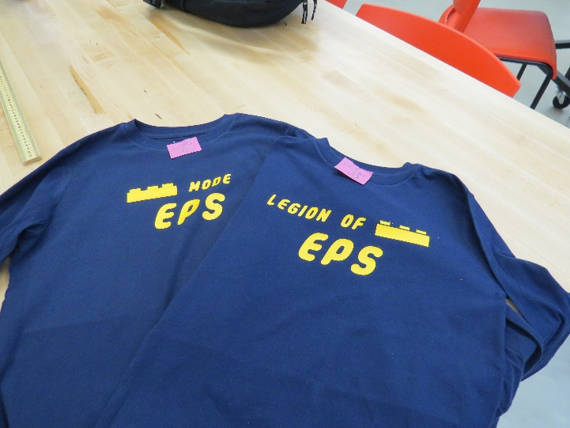
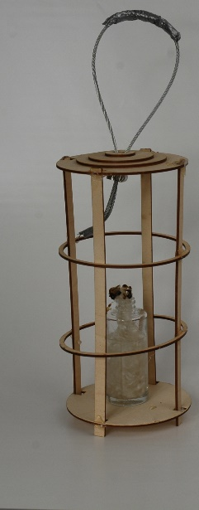
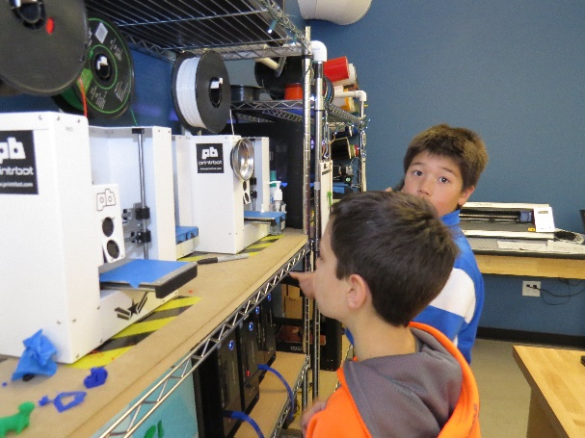
Philosophy: Lesson #2
Know what success looks like
Students (and teachers) using the makerspace as a resource beyond what we have shown them directly
  Making things for projects in other subjects
  Making gifts
  More students and faculty knowing how to use more tools
…those are ours, pick something
that speaks to your community.
People involved
Philosophy
Students / Leadership
Tools and resources
Defn. of Success
Mission / Why?
Notes:
Without a shared mission/vision, it is very difficult to get a team of people pulling in the same direction.

Slide 9
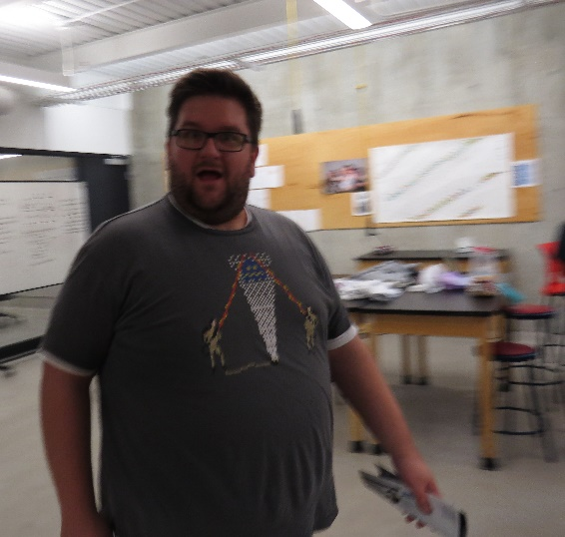
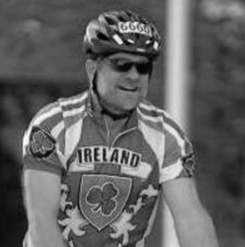
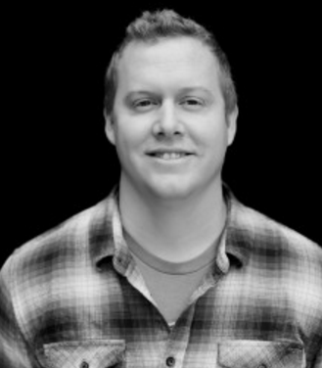
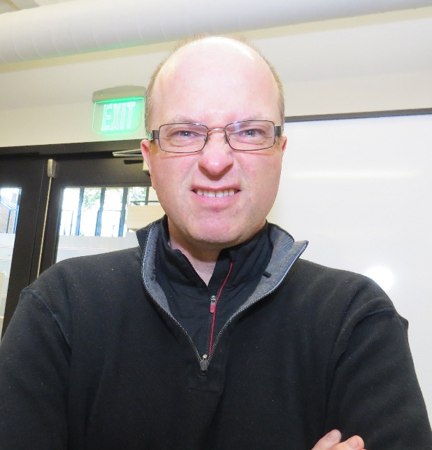
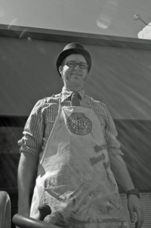
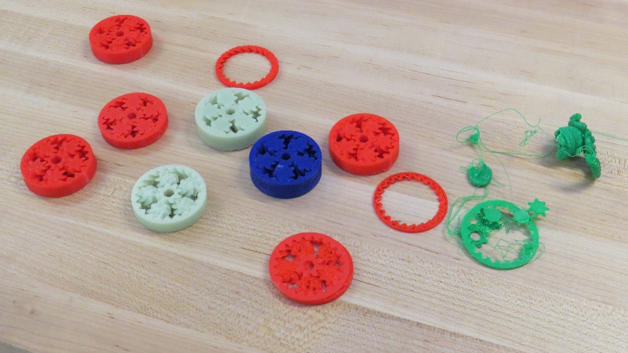
People: Lesson #1
You need these ROLES involved
TINKERER
CHEERLEADER
ORGANIZER
* People are generally able to fill
more than one role.
Pre-reqs: Sense of Humor,
Lead by Example
People involved
Philosophy
Students / Leadership
Tools and resources
Tinkerer
Cheerleader
Organizer/ Maximizer

Slide 10
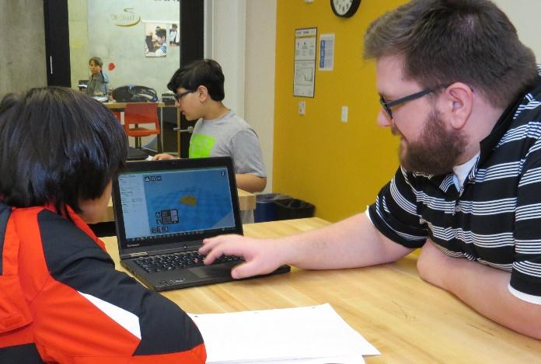
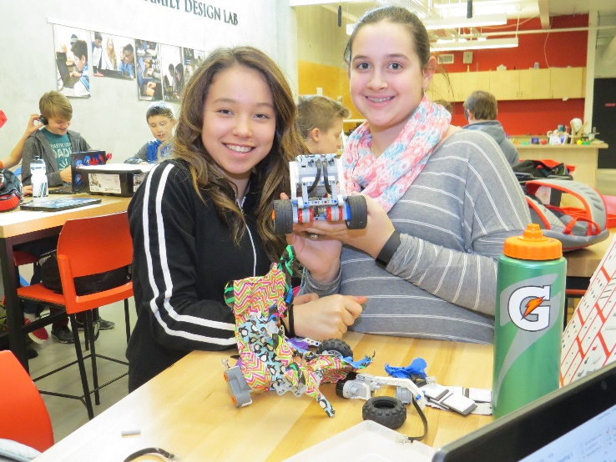
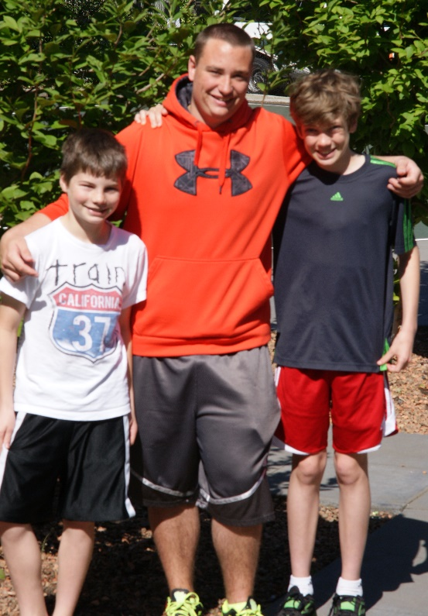
Students: Lesson #1
Scale with students
After school and summer experiences
Regular course work, FTC
Certifications and maintenance
Augment your
tinkerer / cheerleader / organizer roles
People involved
Philosophy
Students / Leadership
Feedback loop
Tools and resources
Scale

Slide 11
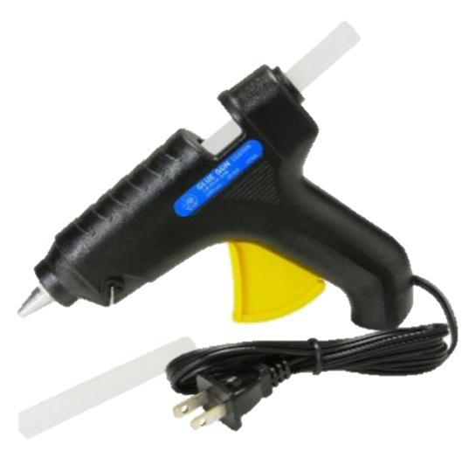
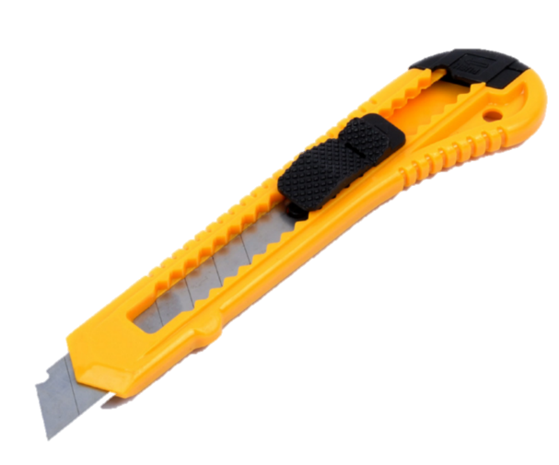
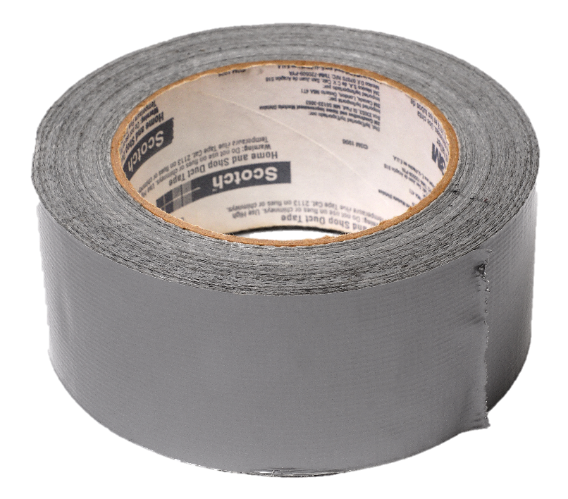
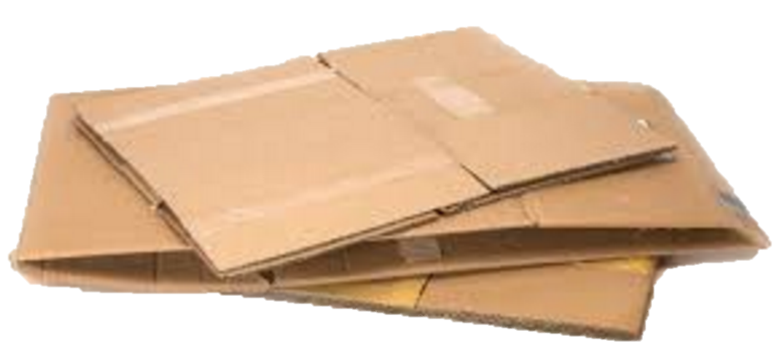
Tools and Resources: Lesson #1
You can do a lot with a little
Minimum viable product:
you can do a lot of
making with cheap
tools and materials
People involved
Philosophy
Students / Leadership
Tools and resources
You must spend but spend wisely

Slide 12
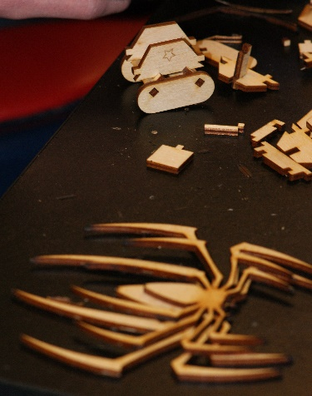
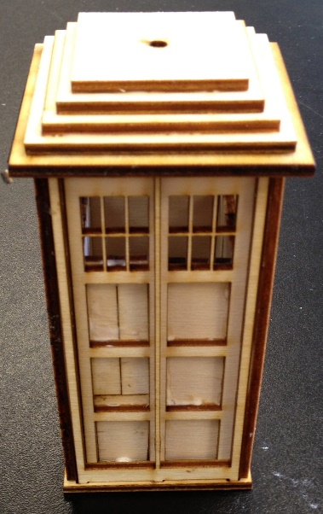
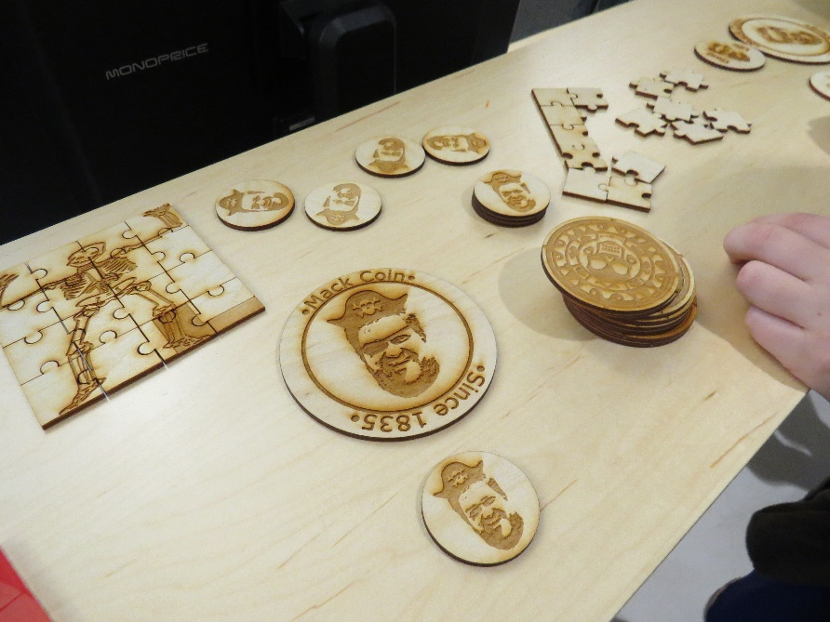
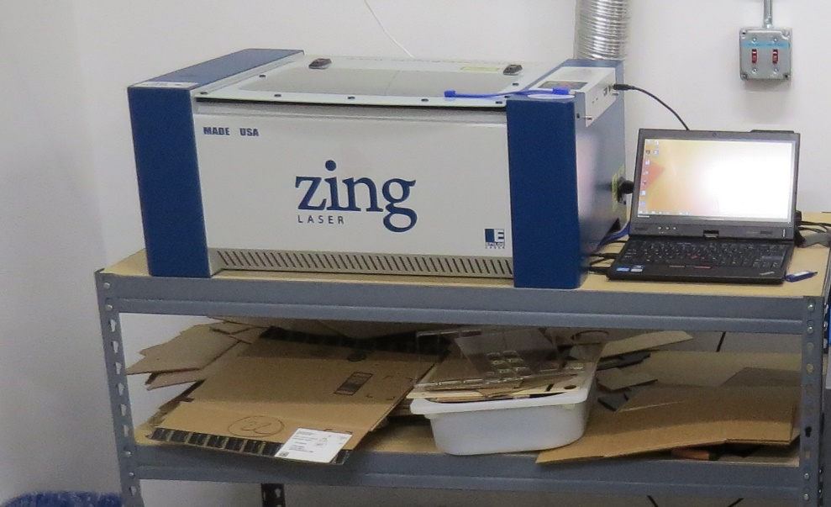
Tools and Resources: Lesson #2
If you can afford a laser cutter get one!
By far the most useful and satisfying tool in the maker space. Ask what your signage budget is, our laser cutter (Epilog Zing 40w) has paid for itself in signage cost savings (a donor wall in particular).
Glowforge: 2.5K
Epilog Zing: 12K
People involved
Philosophy
Students / Leadership
Tools and resources
You must spend but spend wisely

Slide 13
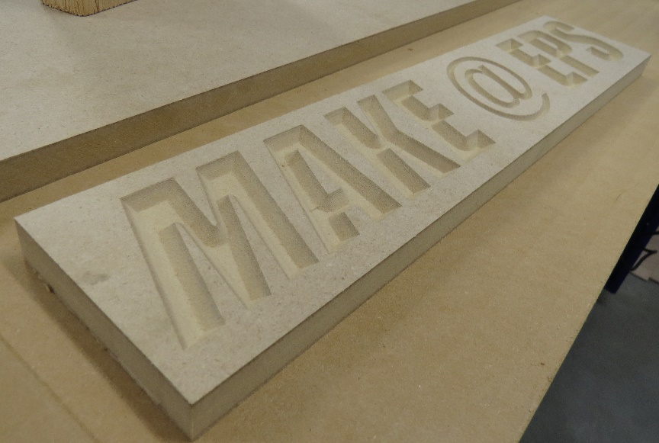
Summary
Start now, evolve your makerspace as you go
Know why you are doing this and what success looks like
Get the right people involved
Scale with students
VISIT existing makerspaces!

Slide 14
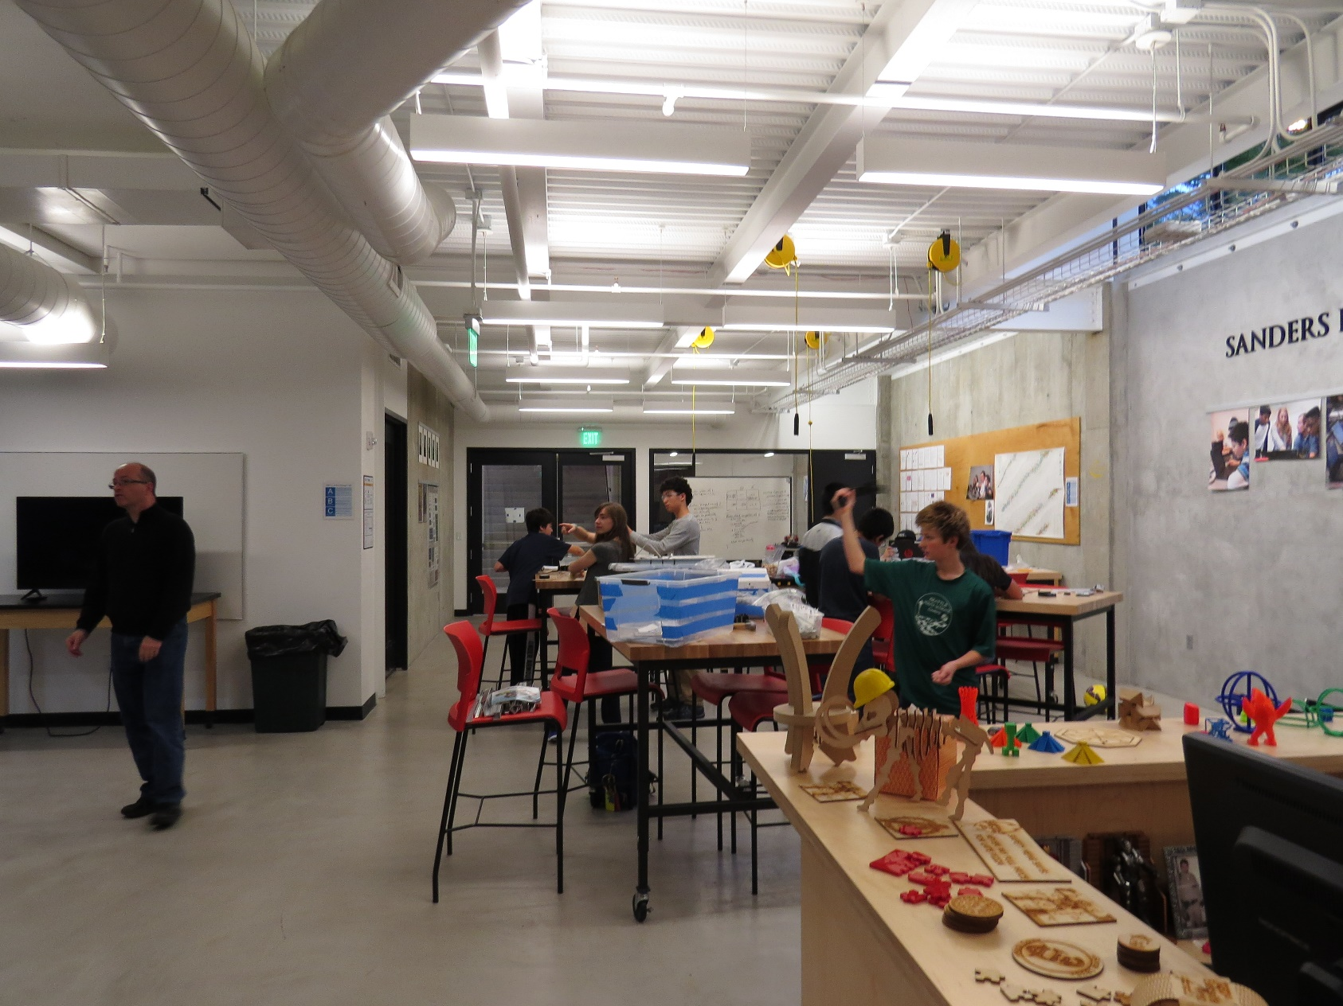
Good luck!!!
People involved
Philosophy
Mission / Why?
Students / Leadership
Feedback loop
Tools and resources
You must spend but spend wisely
Defn. of Success
Scale
Tinkerer
Cheerleader
Organizer/ Maximizer
Jonathan Briggs
jbriggs@eastsideprep.org
Eastside Preparatory School, Kirkland, WA (COME VISIT!)
Slides will be posted at:
http://bit.ly/JBriggsNCCE2016

