Slide 1
MakerSpaces: The Missing Manual
NWAIS 2016
Jonathan Briggs, CTIO & Roger Mack, Make Teacher and Sys Admin
Eastside Preparatory School, Kirkland WA
Notes:
JB

Slide 2
Know Your Audience
Name?
What School You are From?
Does Your School Have (or looking to build) a Makerspace?
What Your Background is With Making?
What You Hope to Get from This Session?
Notes:
RM

Slide 3
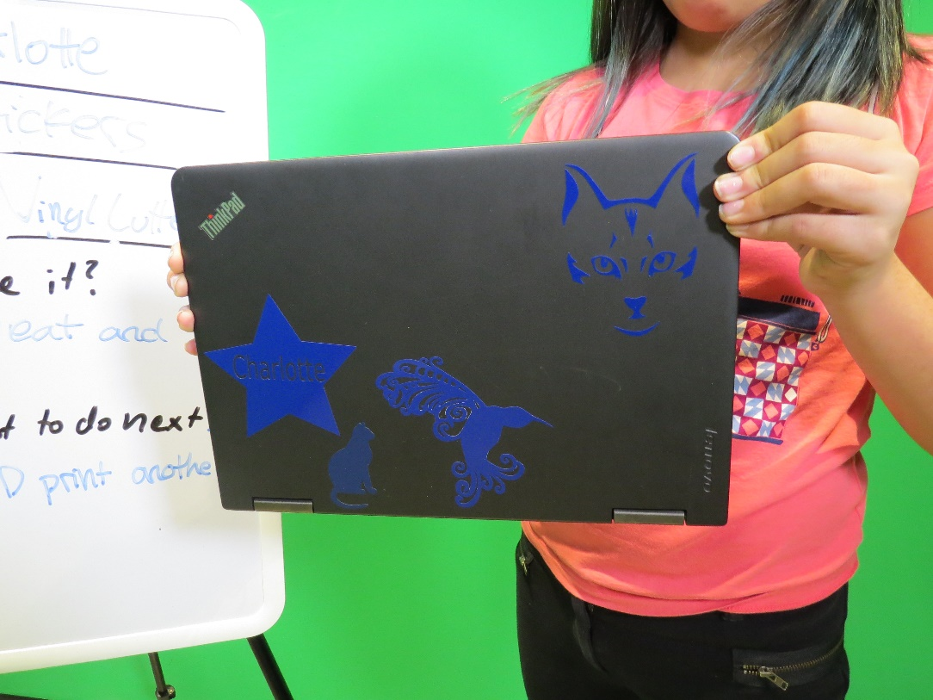
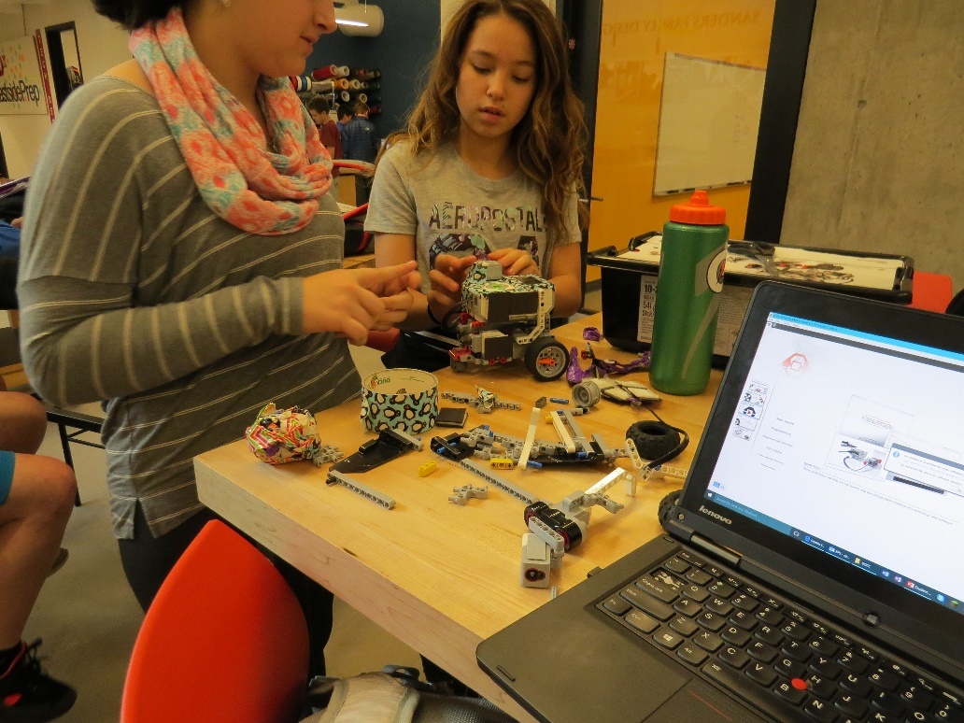
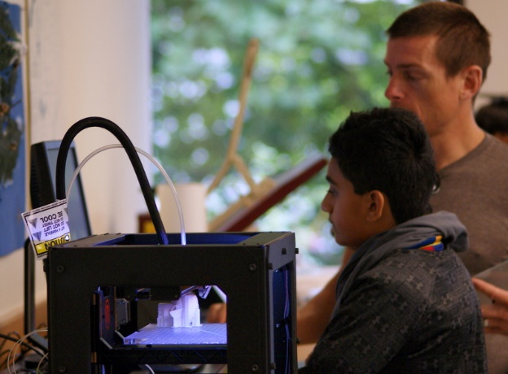
Makerspaces, why bother?
Comfort with failure
Design Experience
The interface between the physical and digital world is fascinating
Notes:
RM

Slide 4
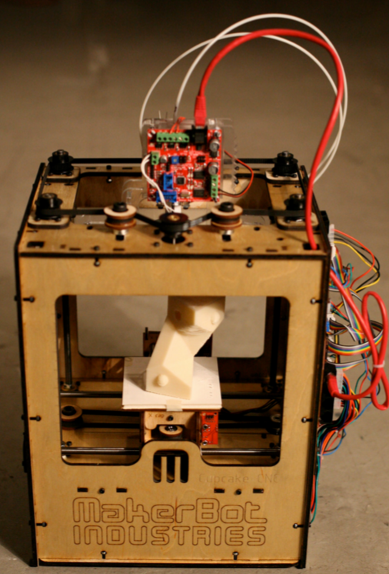
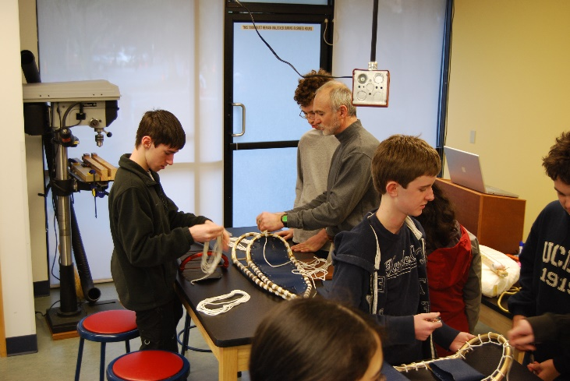
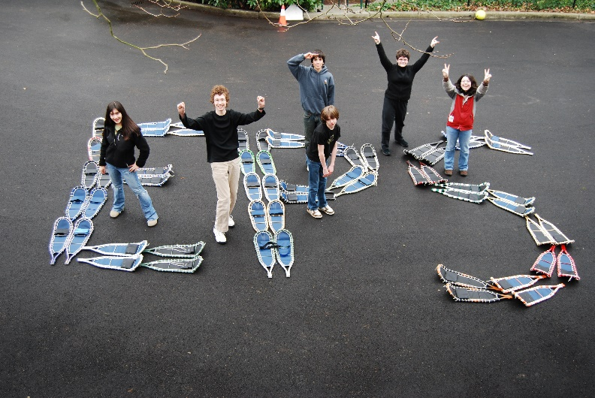
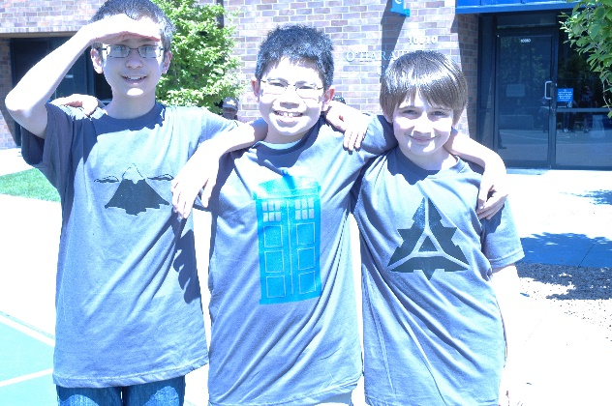
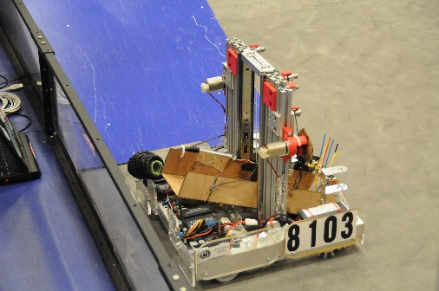
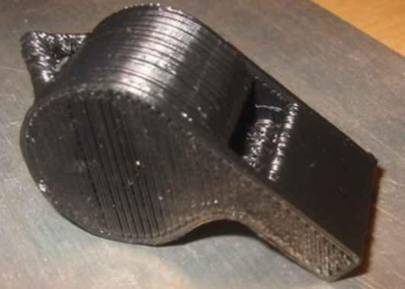
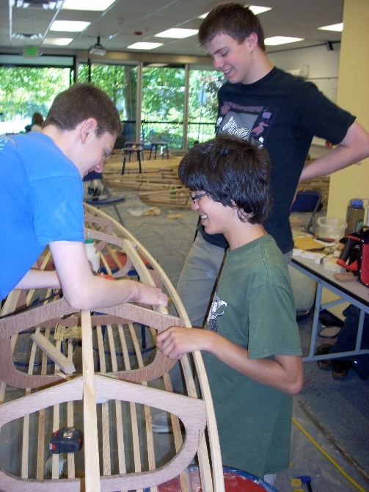
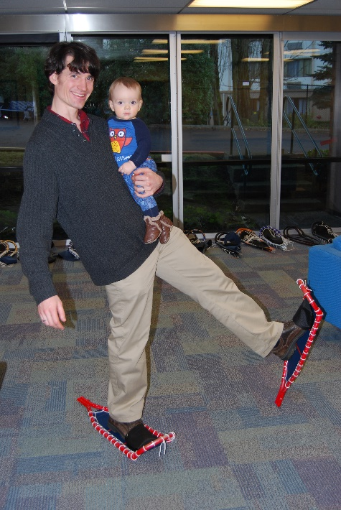
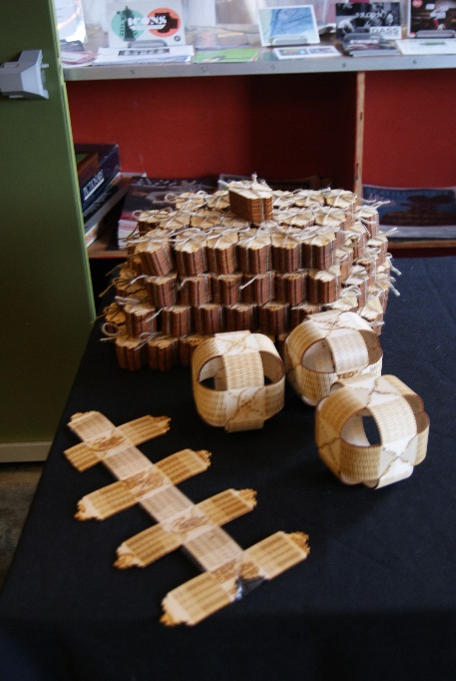
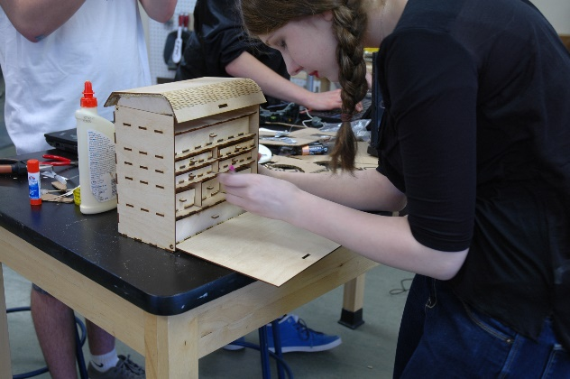
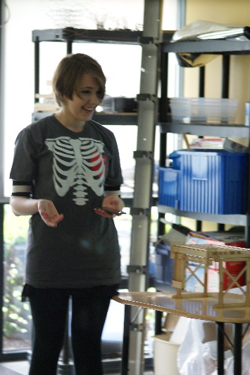
Our History
2007
2010
2011
2012
2013
2015
Fabrication Studio Concept
Cupcake CNC 3D printer – Entering Digital Tools
Added a Laser Cutter
Started building class experiences.
FTC Team
New 6th grade Class & FLL
New Home
Student Leadership
Notes:
JB

Slide 5
Design Challenge
Teams of 4
20 sticks of dry spaghetti
one yard of string
one yard of tape
one marshmallow
12 Minutes
GOAL: Build a free-standing structure to hold the marshmallow as high as possible.
Notes:
RM

Slide 6
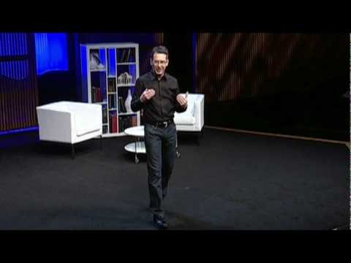
Observations?
Notes:
JB

Slide 7
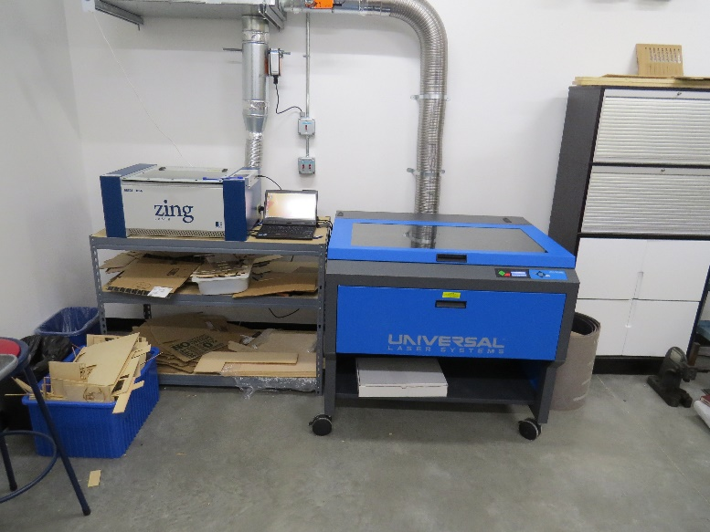
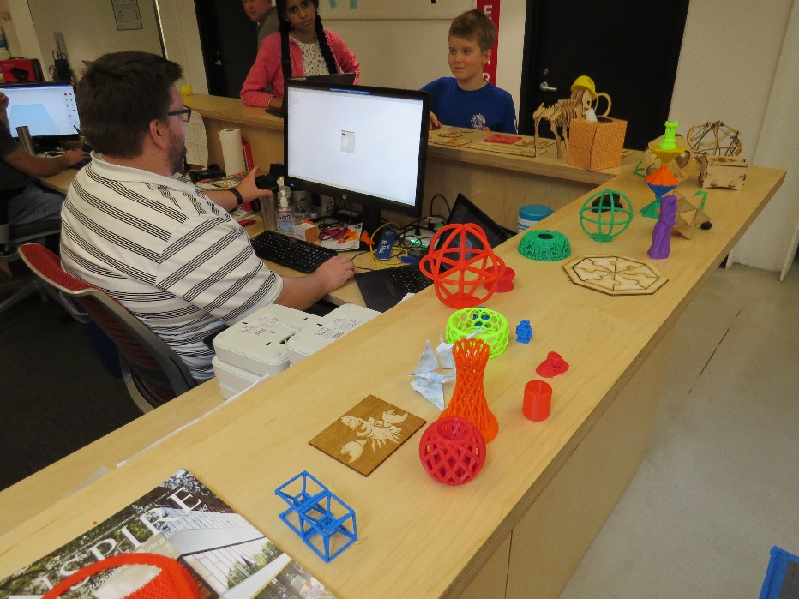
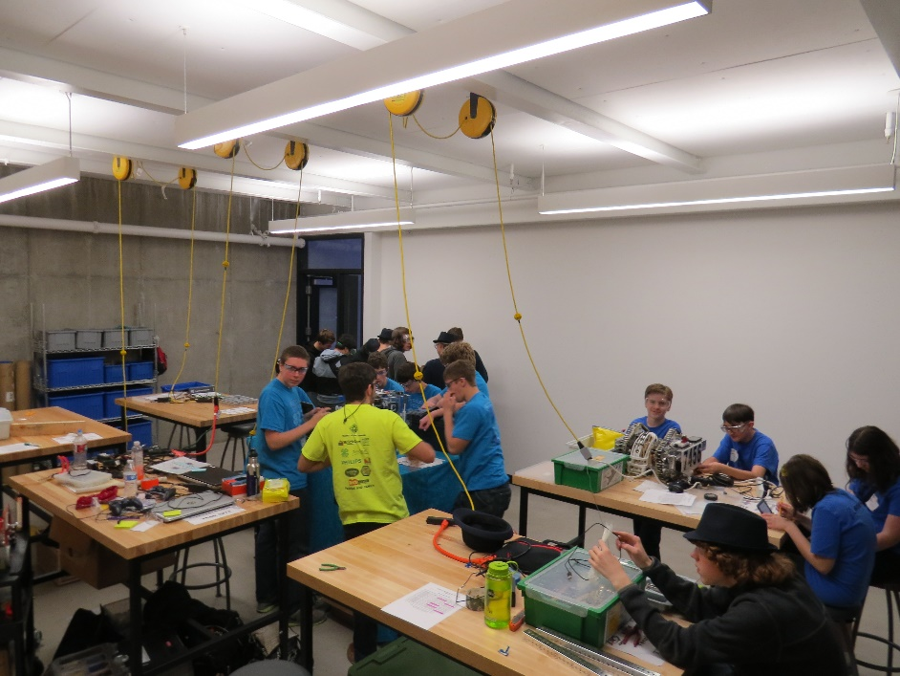
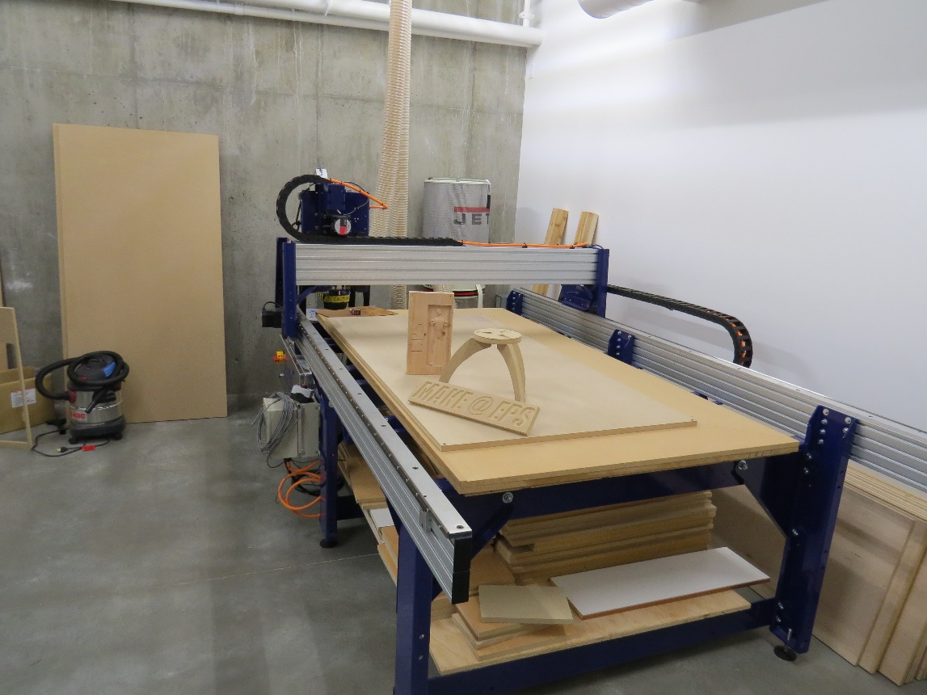
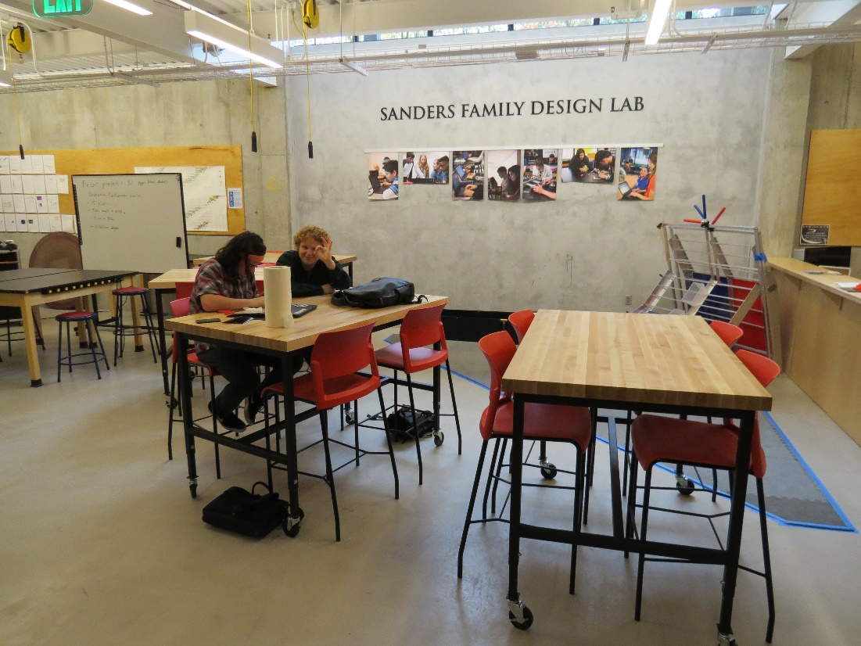
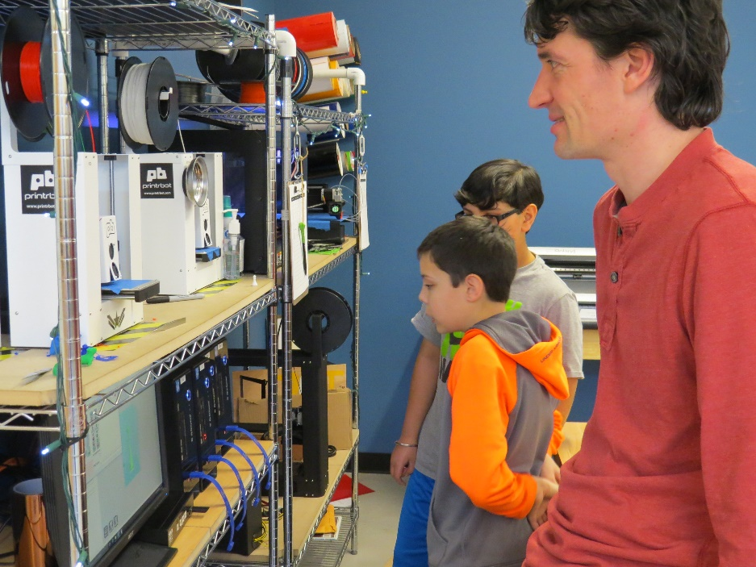
Current Space
Notes:
RM

Slide 8
People involved
Organizer/ Maximizer
Philosophy
Mission / Why?
Students / Leadership
Feedback loop
Tools and resources
You must spend but spend wisely
Cheerleader
Tinkerer
Defn. of Success
Scale
How we think about our makerspace
Notes:
JB Build the frameworkJ

Slide 9
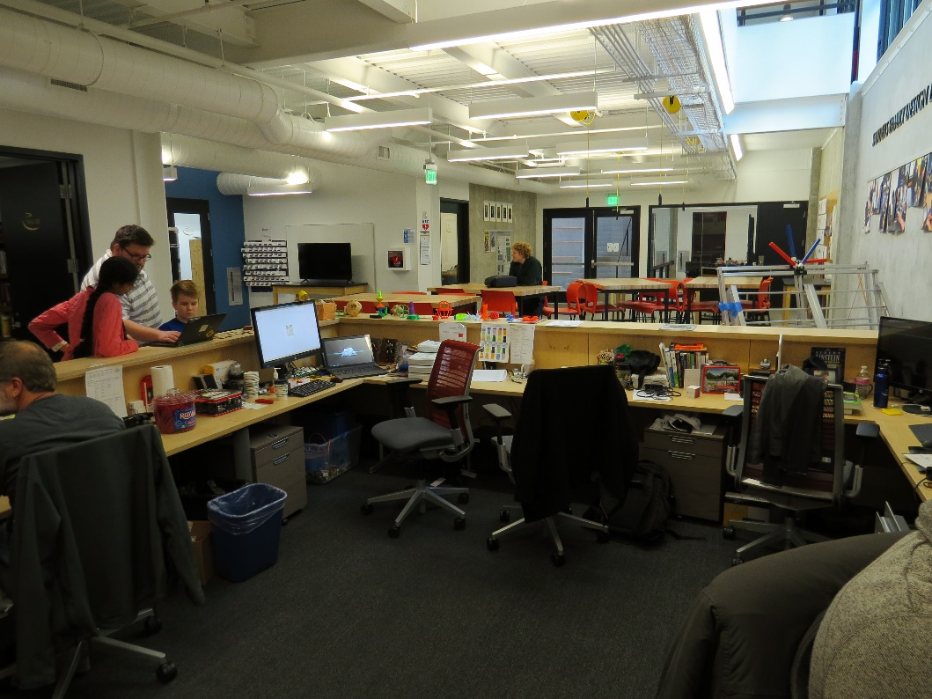
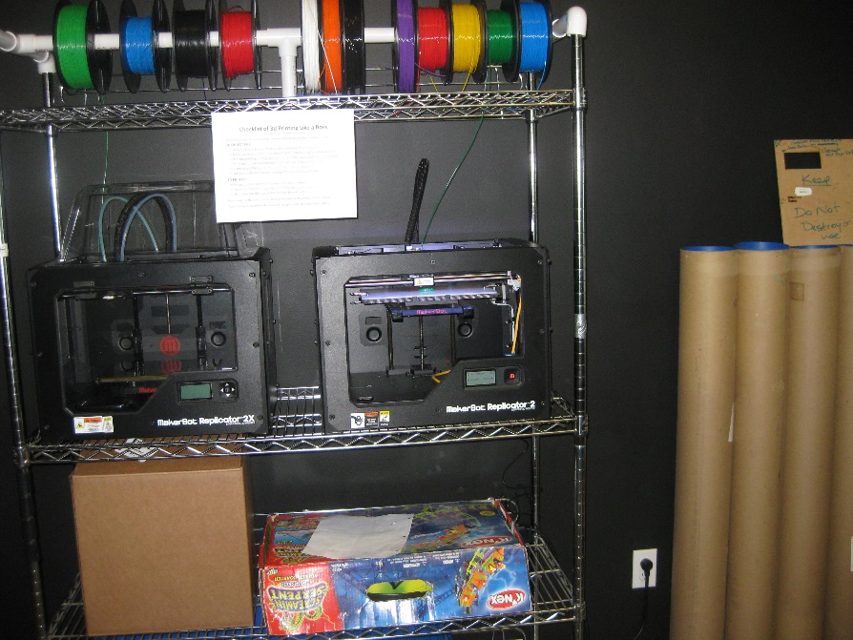
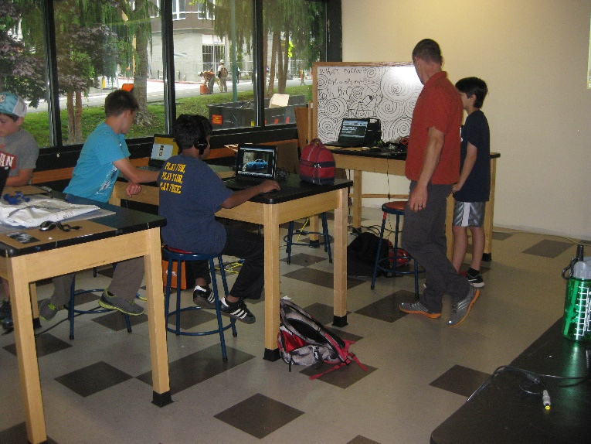
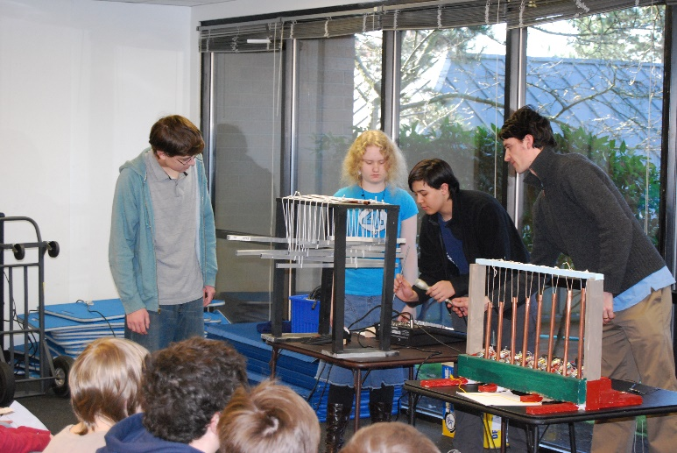
Lesson #0
Evolve your makerspace
Understand that you are in a domain where things are changing rapidly.
Embrace the design process for your makerspace.
You don’t have to make it perfect, just continually make it better than it was.
Notes:
JB

Slide 10
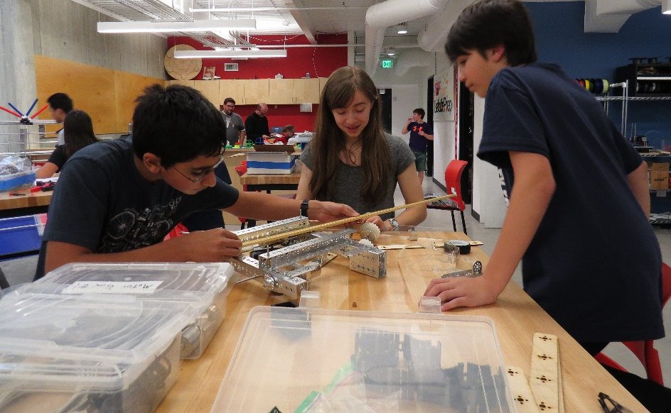
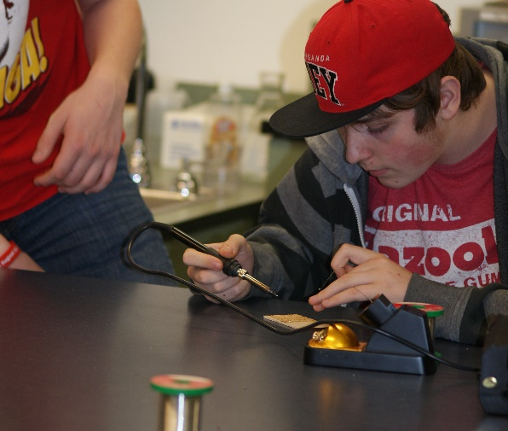
Philosophy: Lesson #1
Start with the Why
Engage and empower students to solve novel problems with whatever tools are available.
…that’s ours, pick something that speaks to your community.
People involved
Philosophy
Students / Leadership
Tools and resources
Defn. of Success
Mission / Why?
Notes:
JB Without a shared mission/vision, it is very difficult to get a team of people pulling in the same direction.

Slide 11
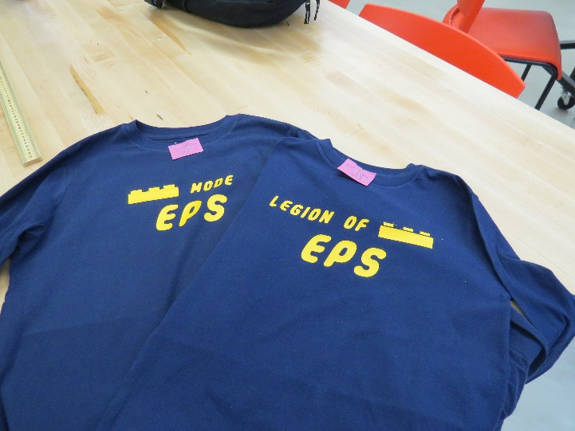
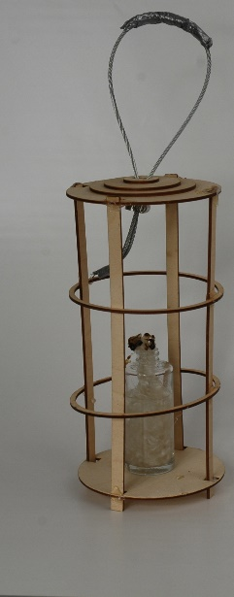
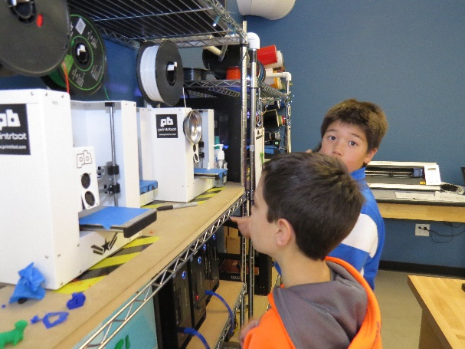
Philosophy: Lesson #2
Know what success looks like
Students (and teachers) using the makerspace as a resource beyond what we have shown them directly
  Making things for projects in other subjects
  Making gifts
  More students and faculty knowing how to use more tools
…those are ours, pick something
that speaks to your community.
People involved
Philosophy
Students / Leadership
Tools and resources
Defn. of Success
Mission / Why?
Notes:
RM

Slide 12
Hands on with CAD
Today, many levels of software allow for scaffolding! And Free for Edu
TinkerCAD https://tinkercad.com
  Sketchup (with STL plugin)
  123D
  Fusion 360
    Inventor
    Blender
    Maya
    Solidworks ($140 a seat)
  OpenSCAD (entirely different environment)
Notes:
RM

Slide 13
Build something in TinkerCAD
TinkerCAD https://tinkercad.com
  When you are done, export as an STL to the flashdrive
  Henry will print some of your creations (starting with the smallest ones)
[20 minutes]
Notes:
RM

Slide 14
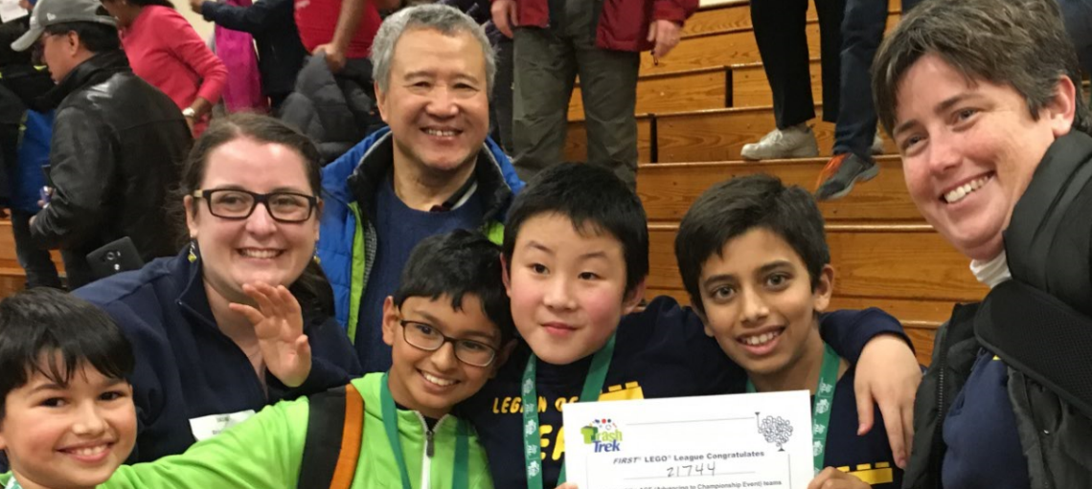


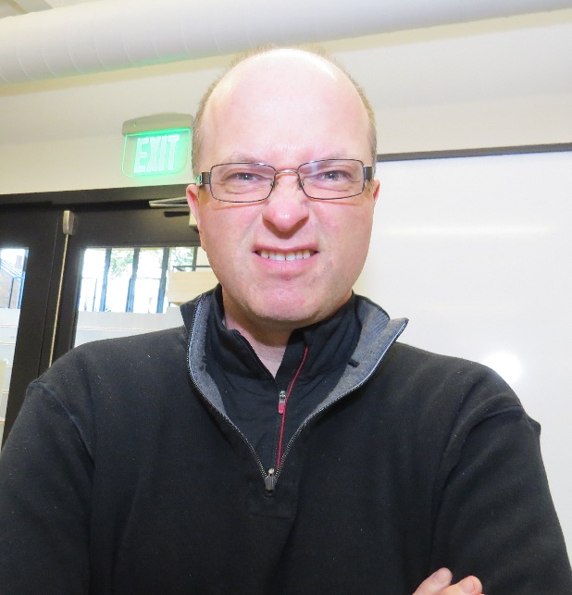
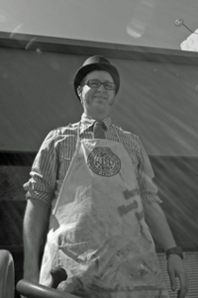
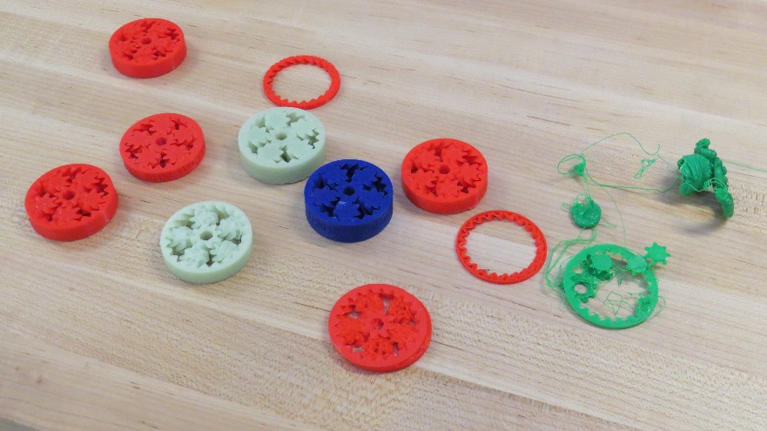
People: Lesson #1
You need these ROLES involved
TINKERER
CHEERLEADER
ORGANIZER
* People are generally
able to fill more than one role.
Pre-reqs: Sense of Humor,
Lead by Example
People involved
Philosophy
Students / Leadership
Tools and resources
Tinkerer
Cheerleader
Organizer/ Maximizer
Notes:
JB

Slide 15
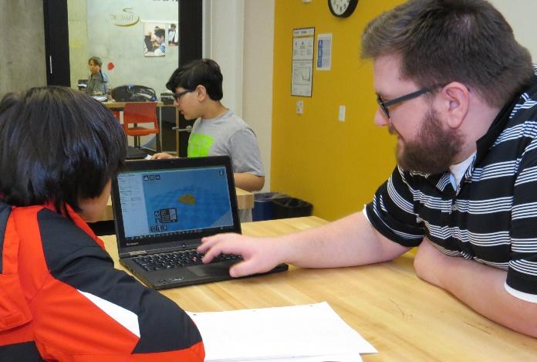
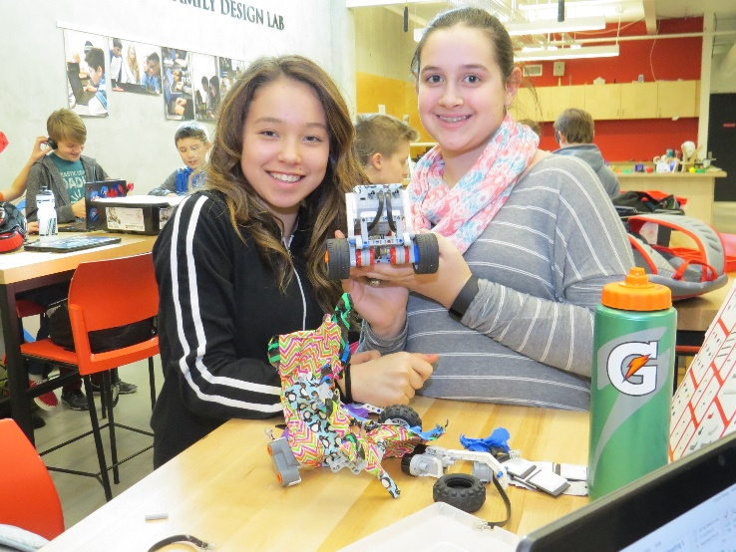
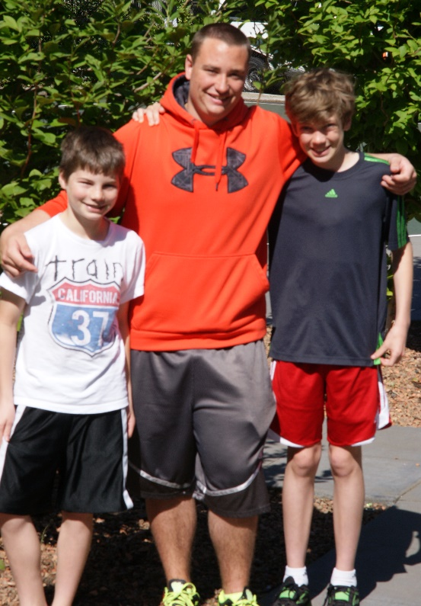
Students: Lesson #1
Scale with students
After school and summer experiences
Regular course work, FTC
Certifications and maintenance
Augment your
tinkerer / cheerleader / organizer roles
People involved
Philosophy
Students / Leadership
Feedback loop
Tools and resources
Scale
Notes:
RM

Slide 16
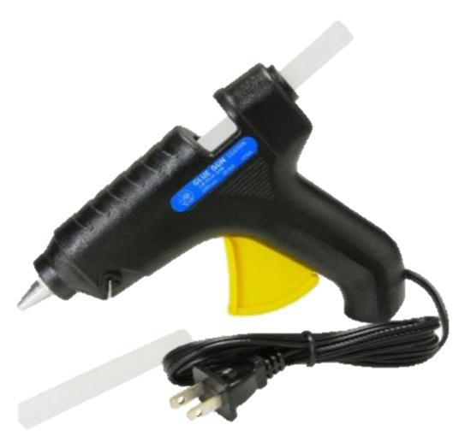
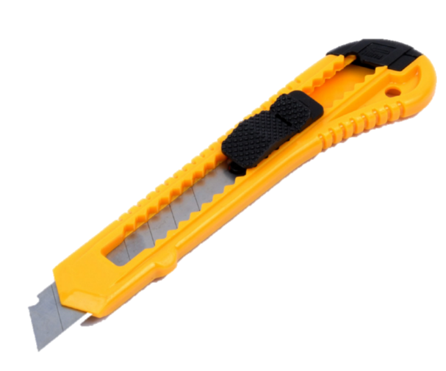
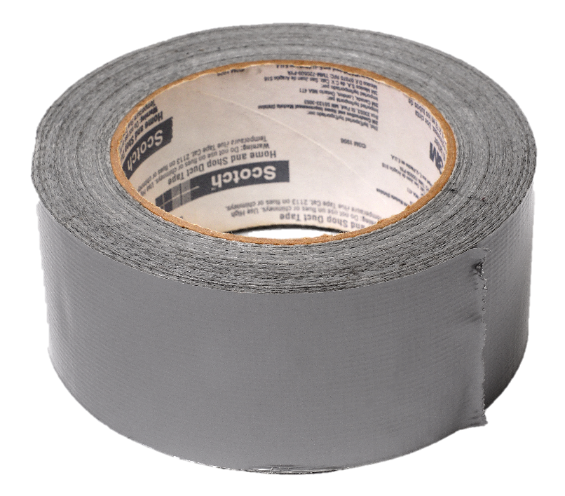
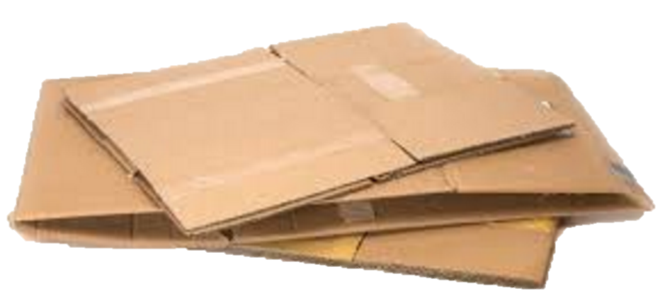
Tools and Resources: Lesson #1
You can do a lot with a little
Minimum viable product:
you can do a lot of
making with cheap
tools and materials
People involved
Philosophy
Students / Leadership
Tools and resources
You must spend but spend wisely
Notes:
JB

Slide 17
3D vs 2D Making
3D printers, CNC, etc use GCode as their language
2D vinyl cutters, laser cutters, plotters use Vectors (SVG/PDF generally)
Inkscape Sticker Tutorial [10 minutes]
Finish up your TinkerCAD and get stickers cut [10 minutes]
Notes:
JB while RM sets up

Slide 18
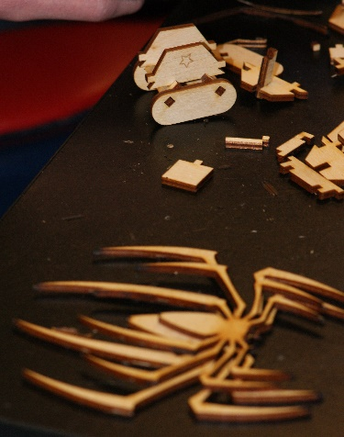
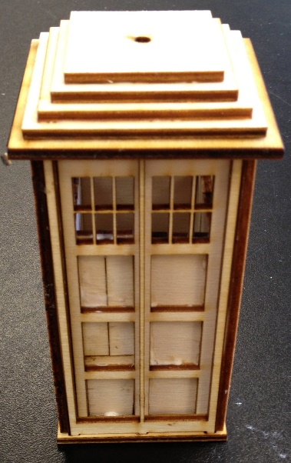
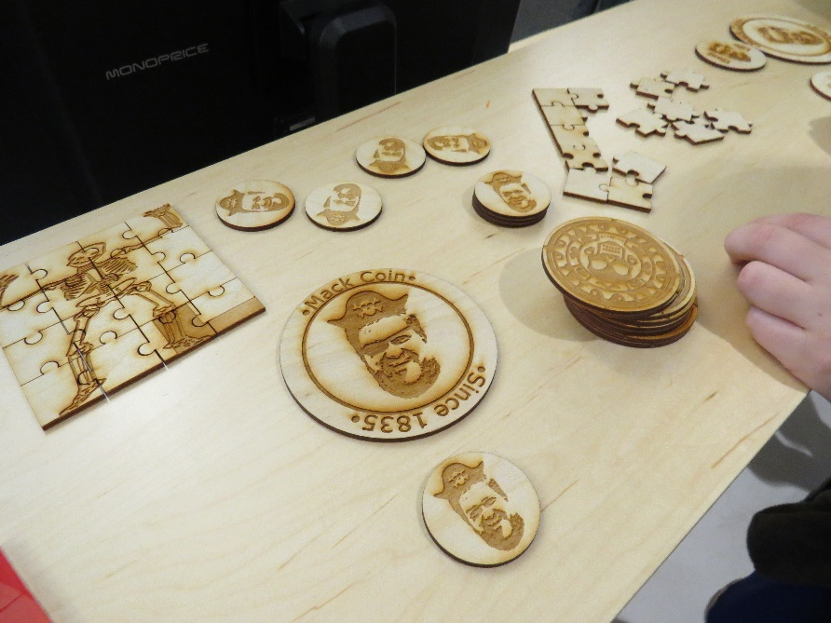
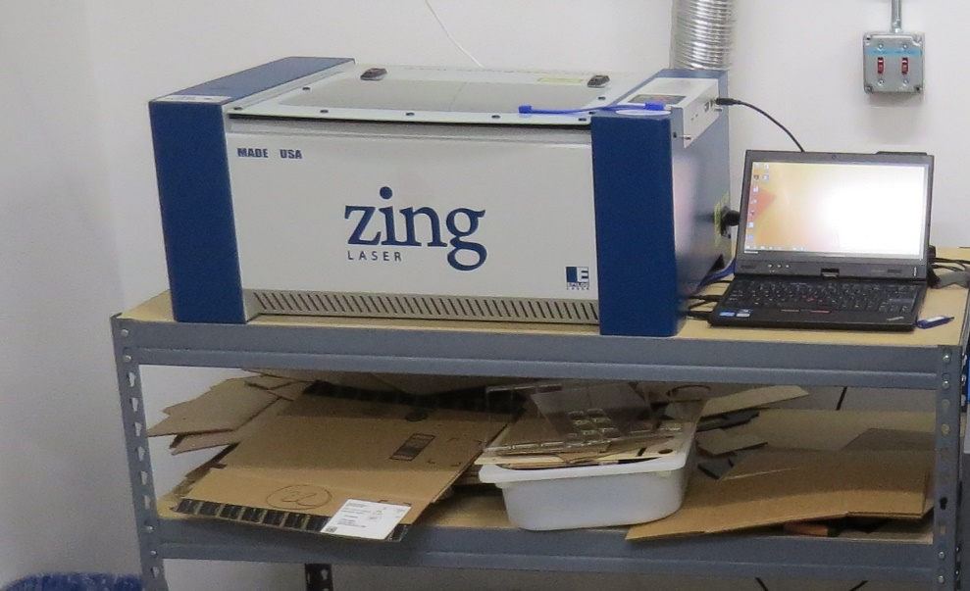
Tools and Resources: Lesson #2
If you can afford a laser cutter get one!
By far the most useful and satisfying tool in the maker space. Ask what your signage budget is, our laser cutter (Epilog Zing 40w) has paid for itself in signage cost savings (a donor wall in particular).
Glowforge: 2.5K
Epilog Zing: 12K
People involved
Philosophy
Students / Leadership
Tools and resources
You must spend but spend wisely
Notes:
JB

Slide 19
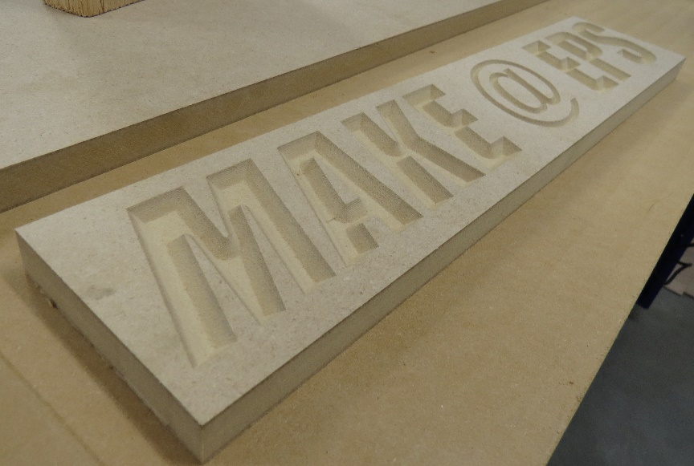
Summary
Start now, evolve your makerspace as you go
Know why you are doing this and what success looks like
Get the right people involved
Scale with students
VISIT existing makerspaces!
Notes:
JB

Slide 20
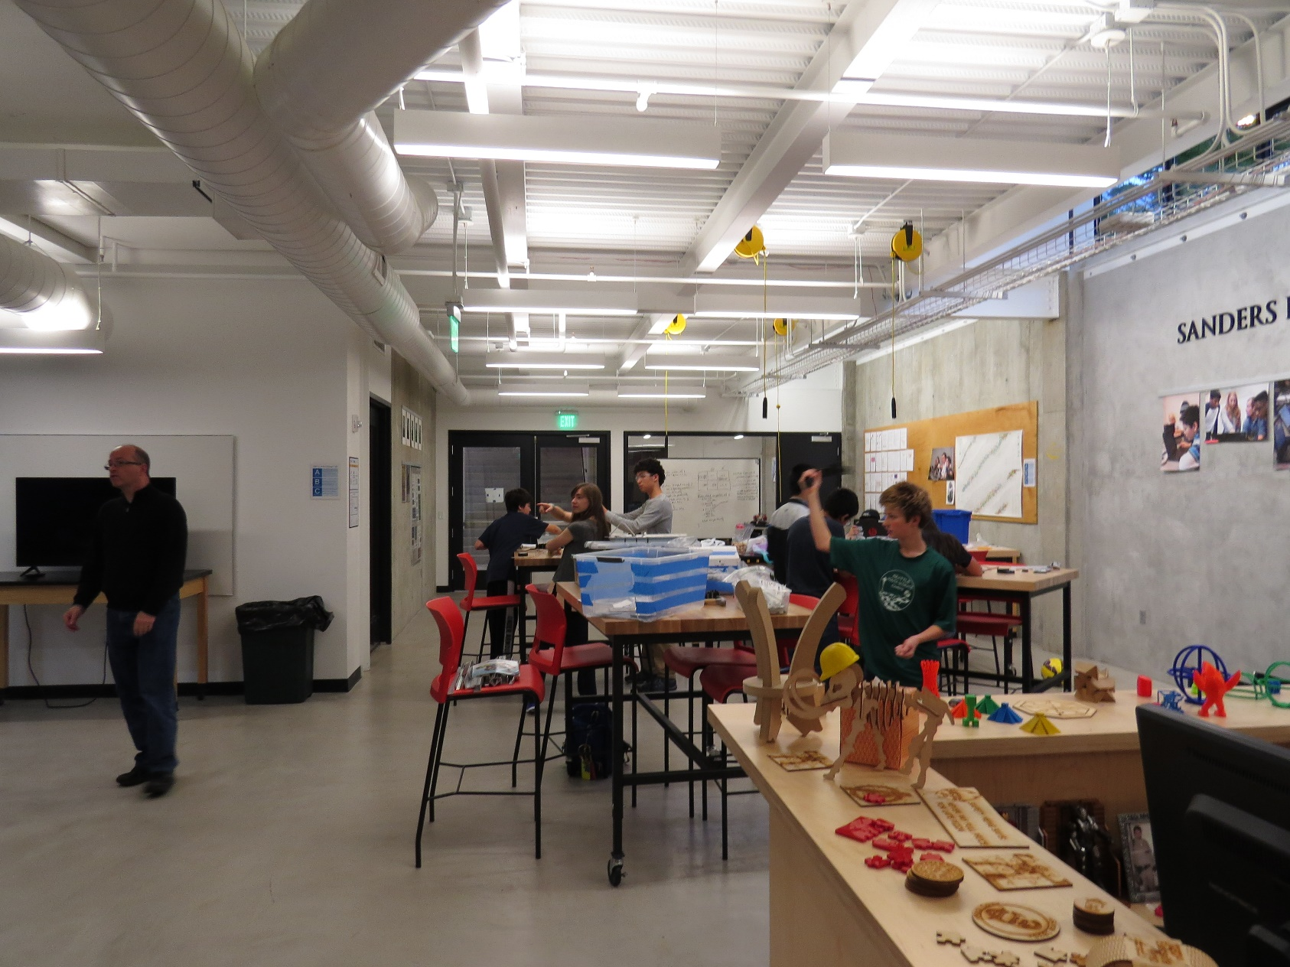
Questions / Good luck!!!
People involved
Philosophy
Mission / Why?
Students / Leadership
Feedback loop
Tools and resources
You must spend but spend wisely
Defn. of Success
Scale
Tinkerer
Cheerleader
Organizer/ Maximizer
Jonathan Briggs Roger Mack
jbriggs@eastsideprep.org rmack@eastsideprep.org
Eastside Preparatory School, Kirkland, WA (COME VISIT!)
Slides will be posted at:
http://bit.ly/EPSatNWAIS2016
Notes:
RM

Slide 21
Bring Wristband USBs 5
Bring 2 Plays, White Robo
Vinyl Cutter
  Vinyl in 3 colors
  Transfer Tape
  Squeegies
  Tweezers
  Box Cutter
Demo Made Things
Marshmallow stuff

