Slide 1
Bring the Real World In
Relevant, Meaningful Projects that Engage Students
Jonathan Briggs
Chief Technology & Innovation Officer
Eastside Preparatory School
jbriggs@eastsideprep.org
http://bit.ly/BriggsNCCE18

Slide 2


Why?
Engage Students
Additional Incentive Beyond Grade
Pride of Place
Sense of Accomplishment
It’s fun
Saves time

Slide 3
candidate projects
Importance of timely completion
Students help
by prototyping designs or proof of concepts.
Projects that need to get done
Projects tied directly to courses
Projects that would be nice to have
These projects are rarely successful unless tied to courses.
Guidance Required
Students can take these projects on solo or in teams.
These projects rarely exist, you would have done them already.

Slide 4
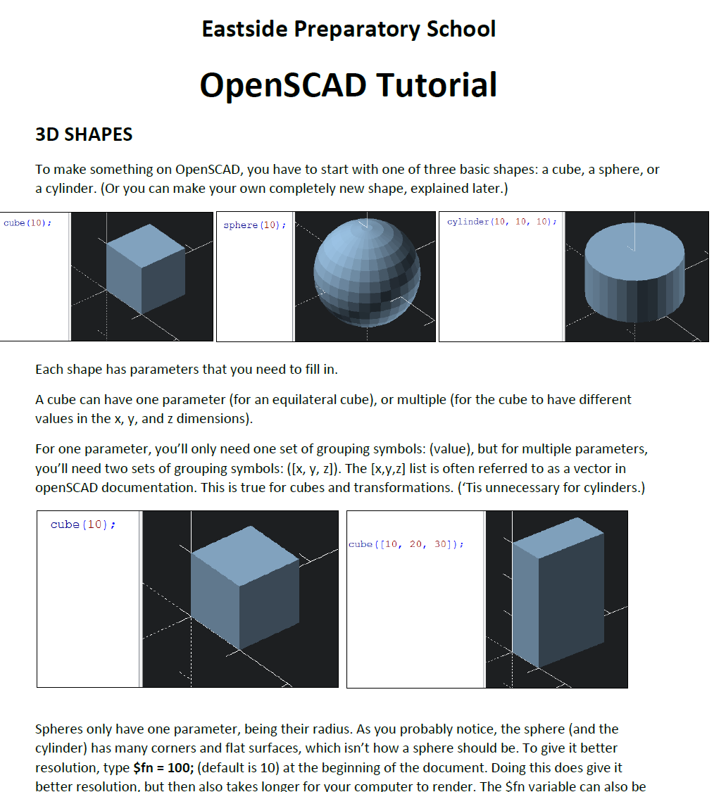
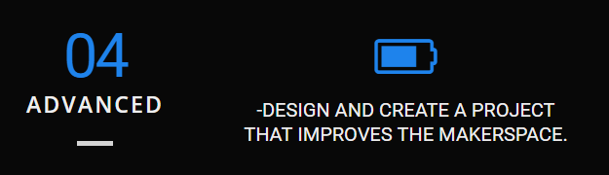
Makerspace tutorials
Goal: To launch students into using makerspace tools
  More consumable than web tutorials
  Written to a 5th-12th grade student audience
Often a leveling up activity for a tool

Slide 5
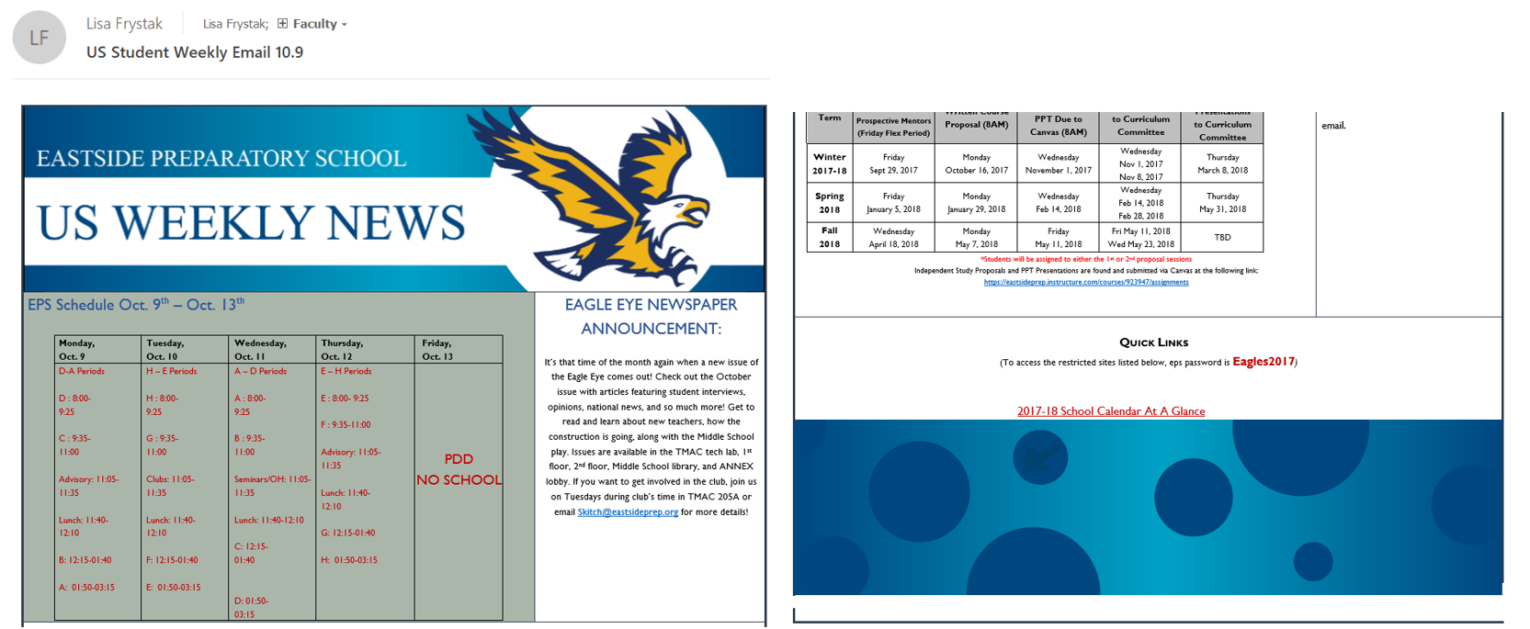
Student Weekly Email Design
Goal: To make a nicer looking student newsletter
Graphic Design Project
  Student designed and created graphics
  Tech assisted the implementation into an HTML email

Slide 6
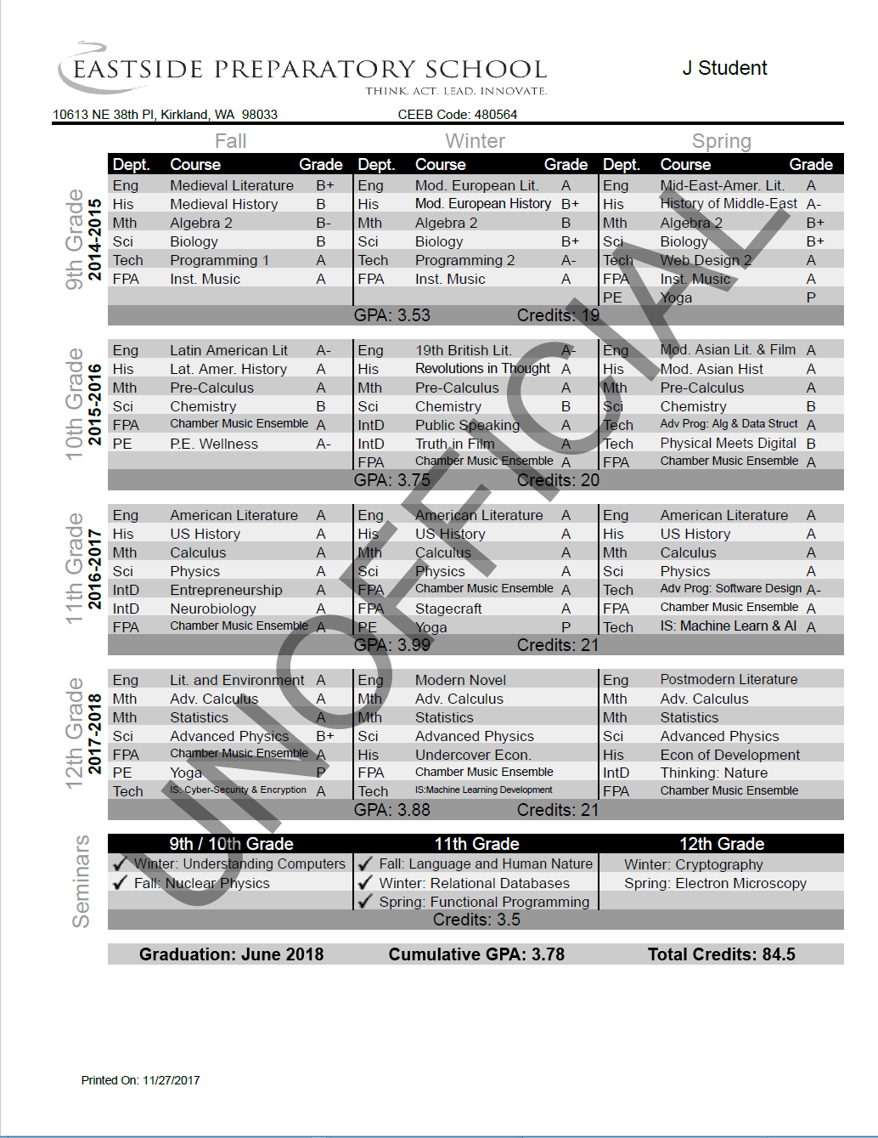
Transcript Redesign
Goal: To build a more modern looking transcript design
  Needed to accommodate longer course titles
  Needed to accommodate seminars
  Moving from landscape to portrait
Graphic design project (student)
  Programming done by school
  Final design done by school

Slide 7
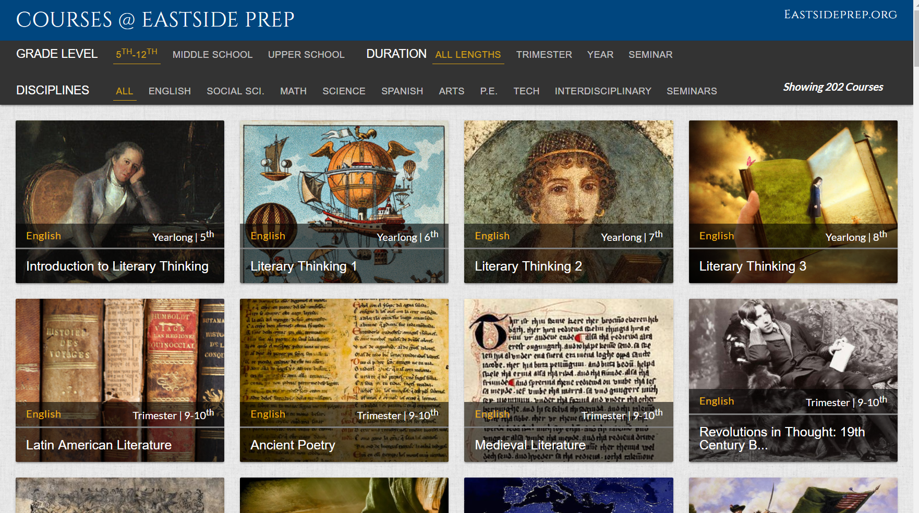
Online Course Catalog
Goal: A more attractive course catalog
Student did initial design
  Tech, Curriculum and Arts finished

Slide 8
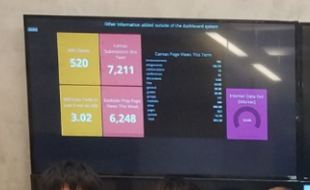
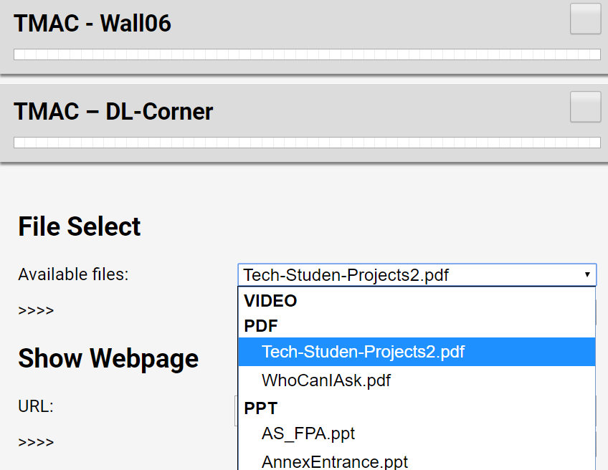
EPSigns
Goal: Create a digital signage system
  Raspberry Pi’s connected to network and TVs
  Central server to control them en masse
Single Student (Alum)
  Summer

Slide 9

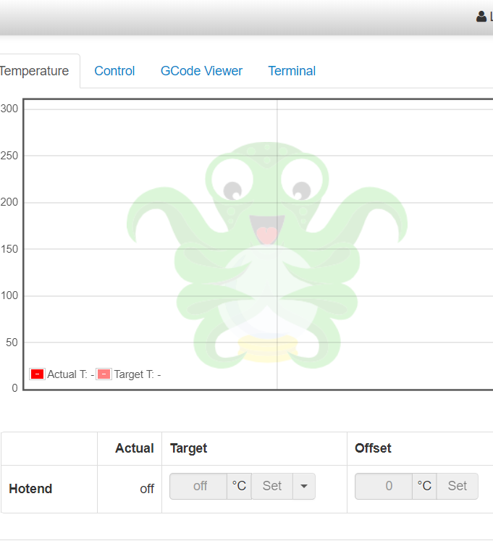
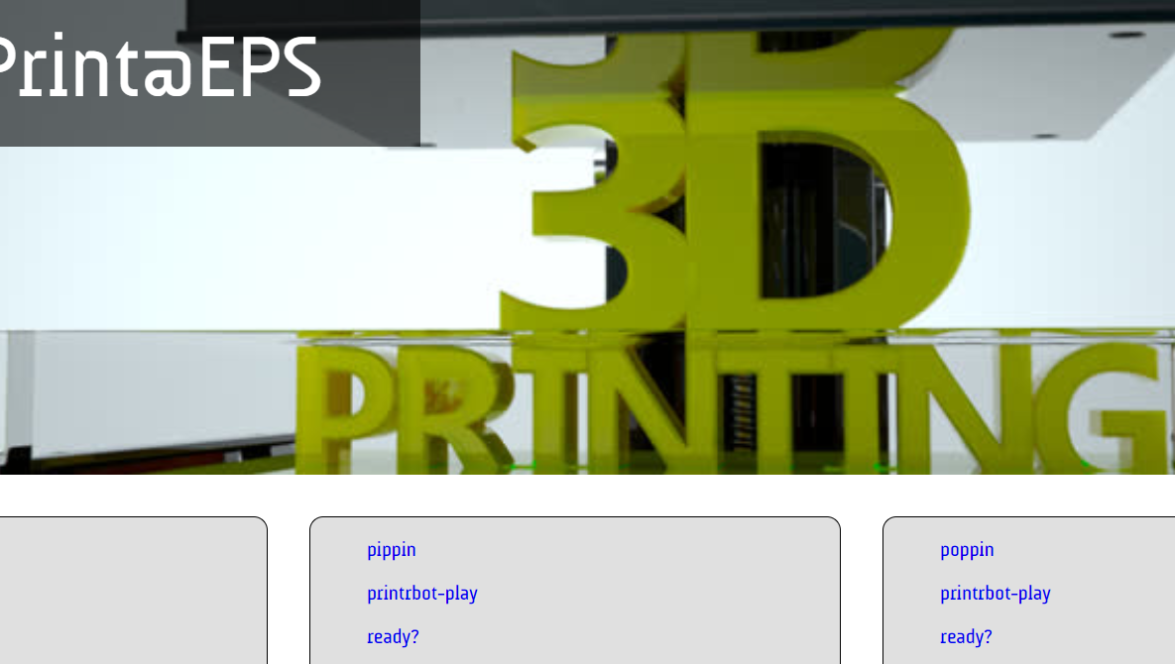
3D print server
Goal: To create a single entry point for printing to our 3D printers
  All 3D printers connected to one computer running octoprint
  Ability to load prints over the web to the print server
Small group of students
  Summer
  A work in progress

Slide 10
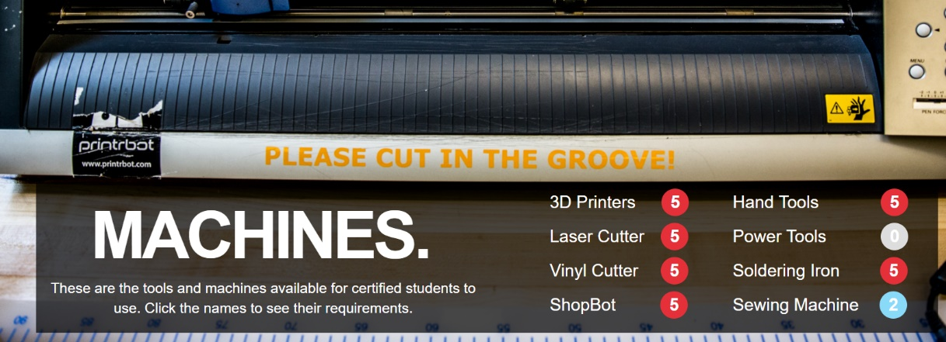
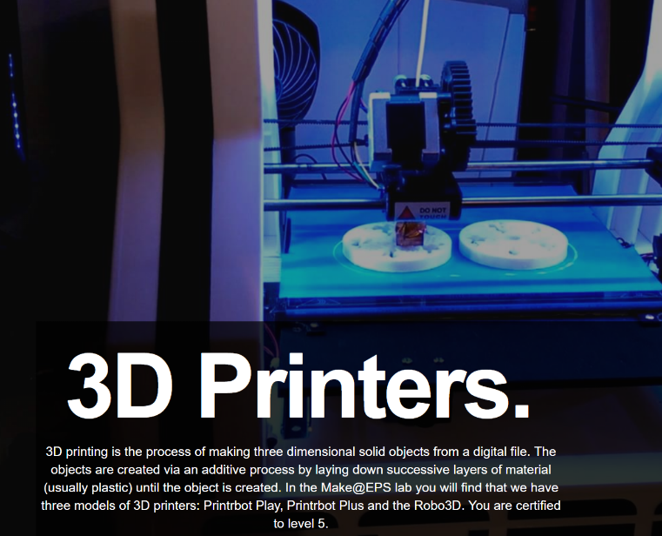
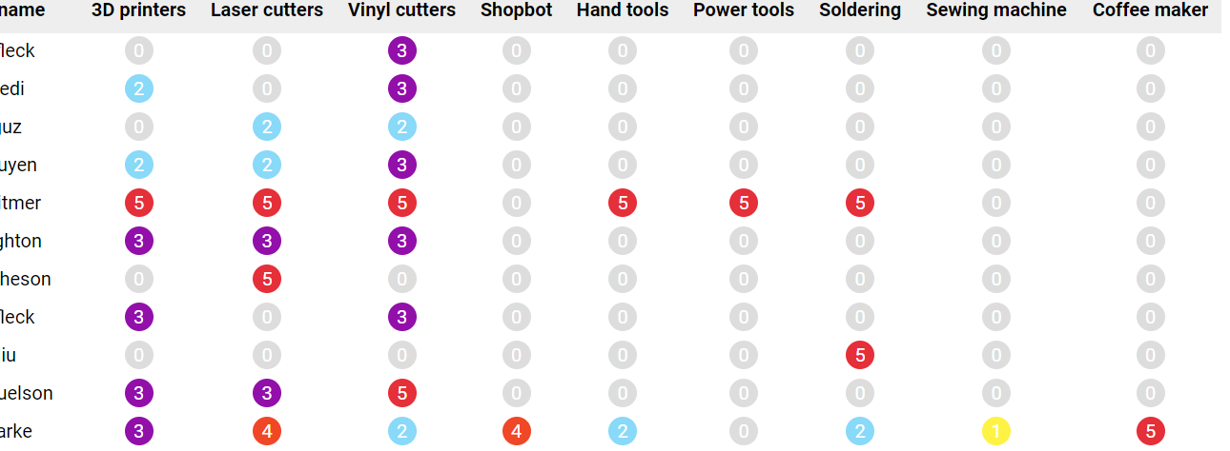
Design Lab Web Application http://www.designlab.madeateps.org/
Goal: create a resource to explain…
  The tools in the design lab (maker space)
  The certification levels for each of the tools
  Track certifications of students and teachers
Team of students (Summer Project)
  Web
  Coding
  Photos

Slide 11
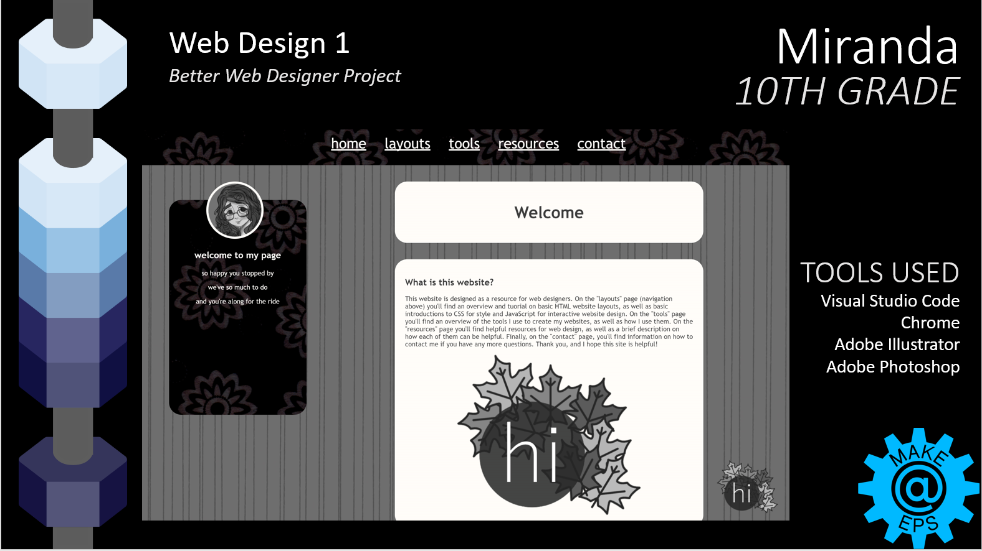
Logo and PPT Template
Goal: To showcase work
  Needed consistent design that could house any content
Student Graphic Design Project
  Logo bottom right was another student’s project.

Slide 12
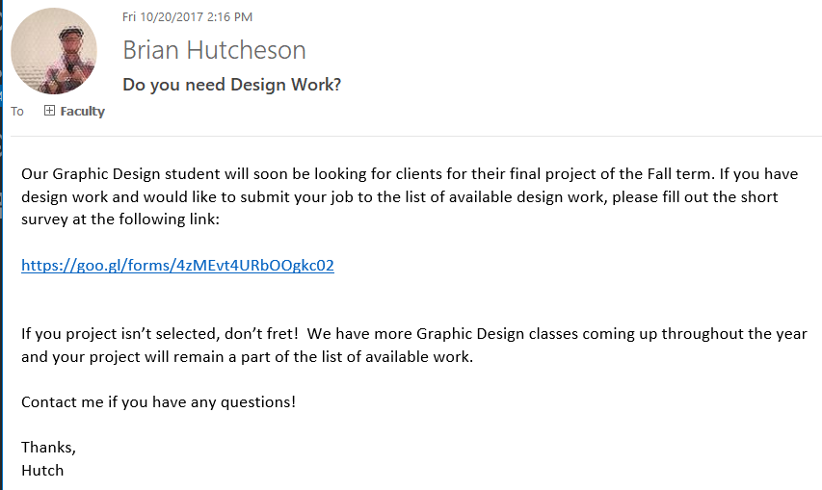
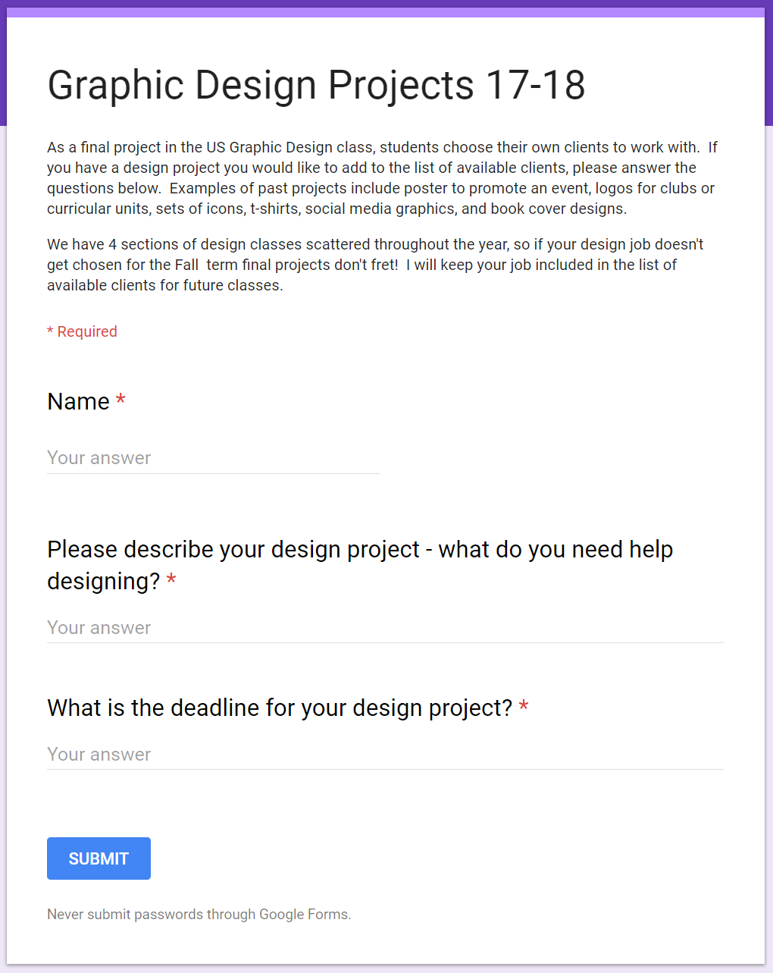
Generating Projects
Projects Tied to Courses
Crowdsource ideas.
You need quantity.
Let students choose among the options.

Slide 13
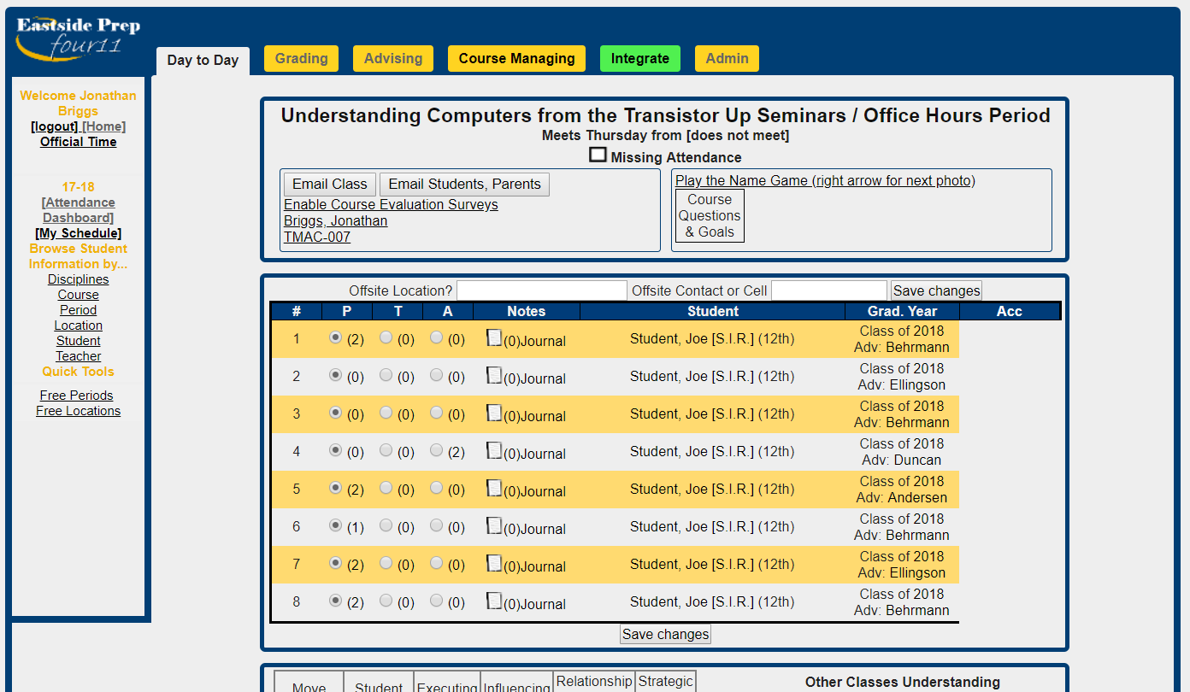
Tied to Class
Redesign Course Roster Page
ORIGINAL

Slide 14
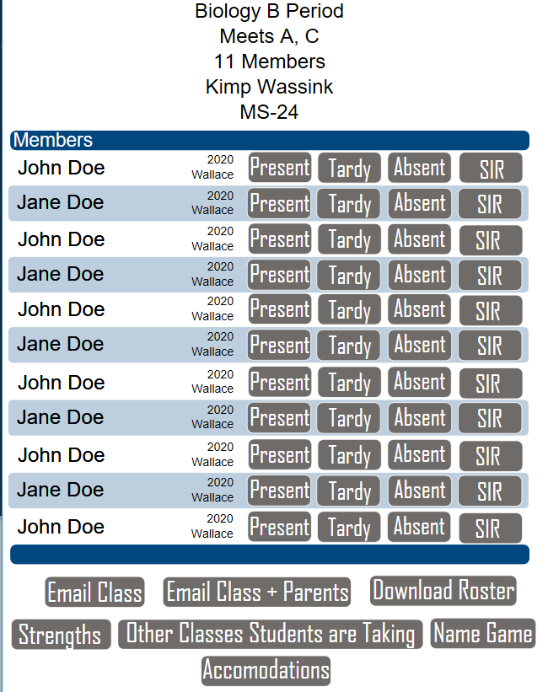
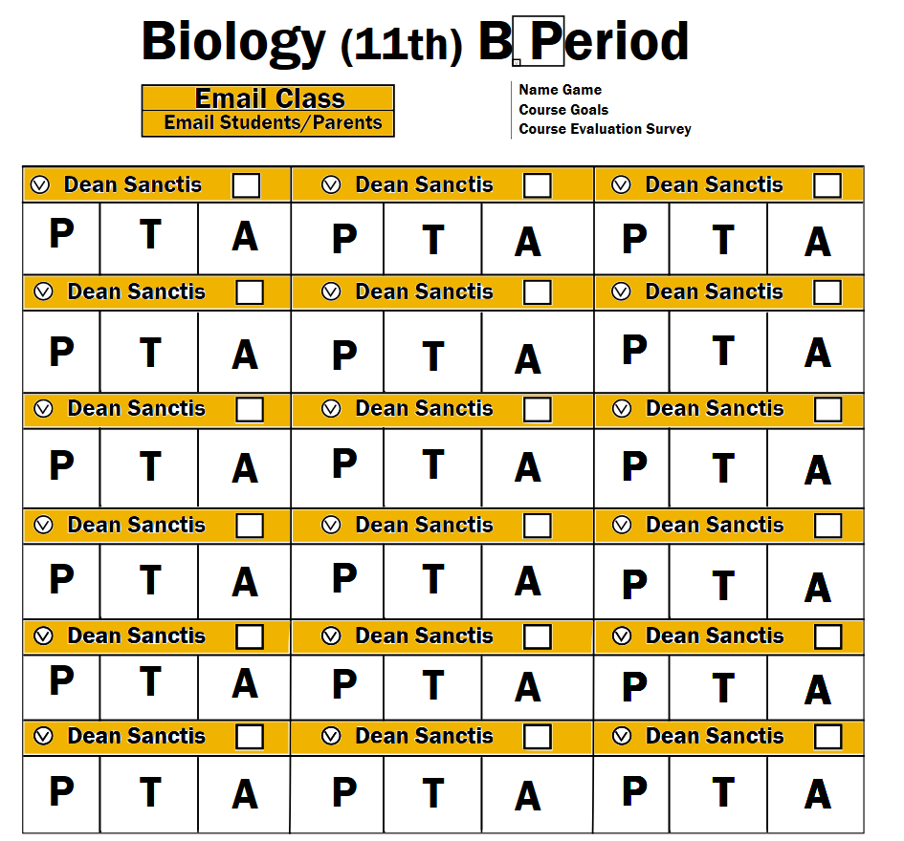
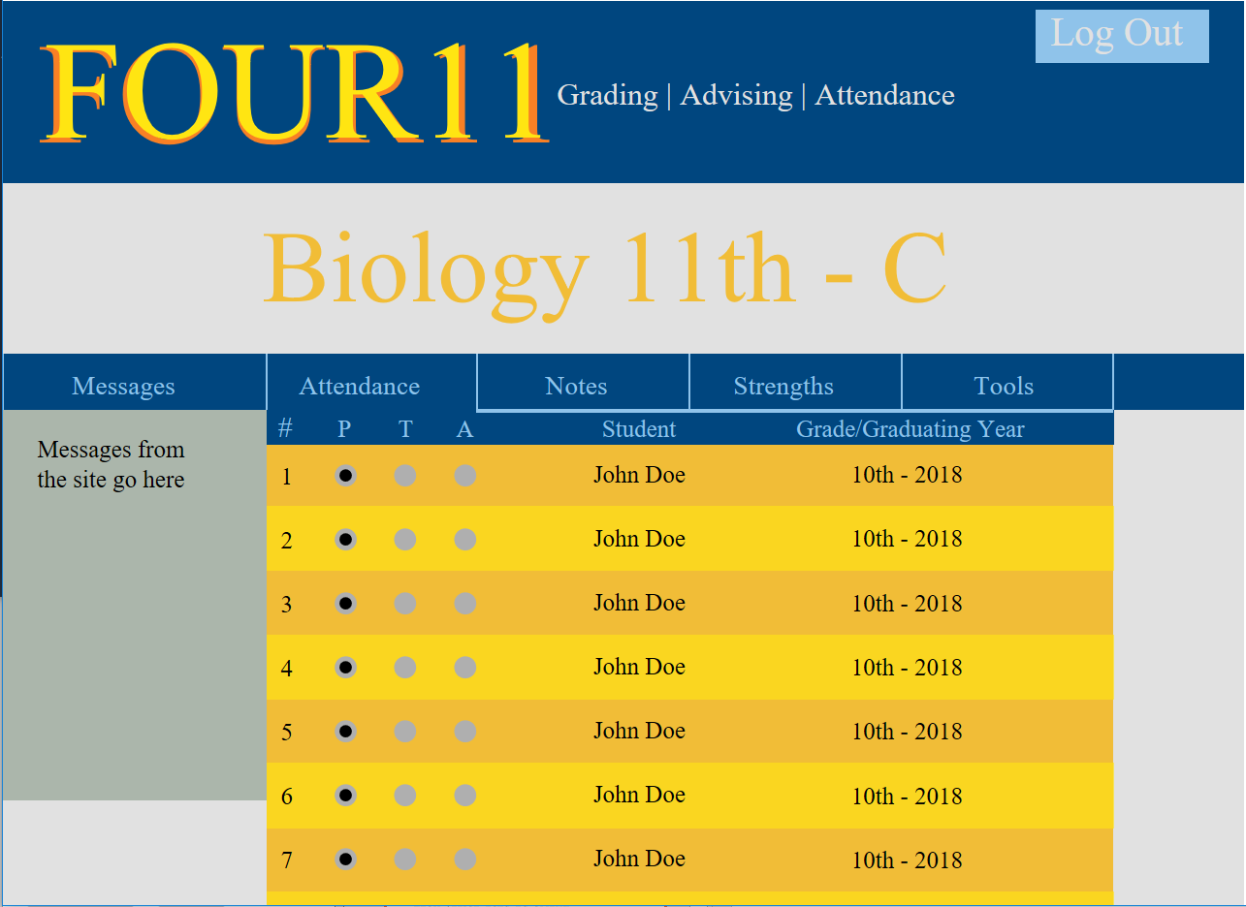
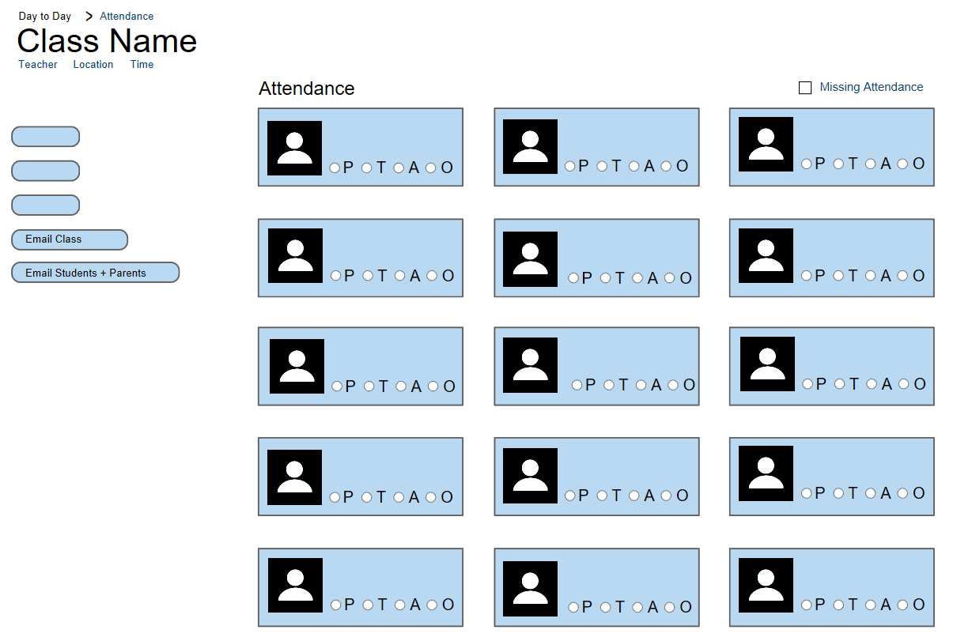
Tech office acts as client

Slide 15
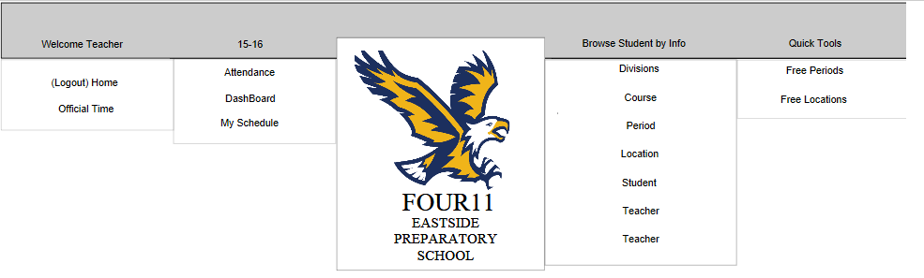
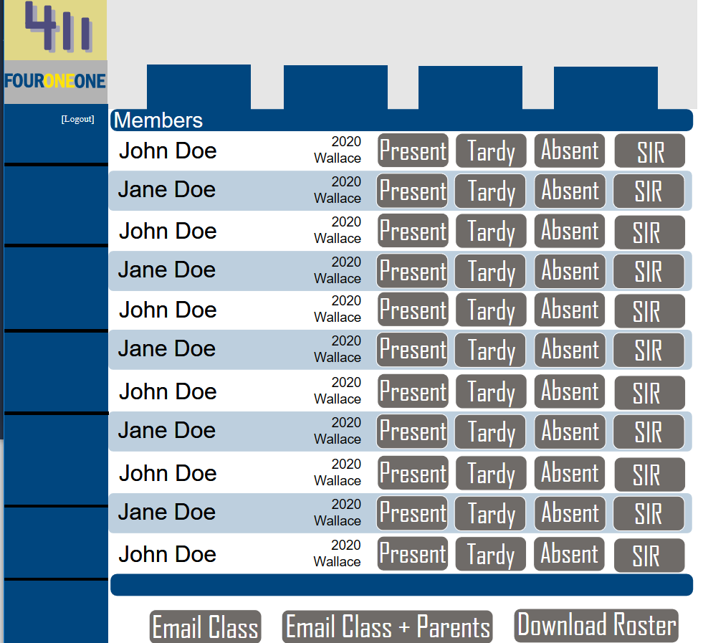

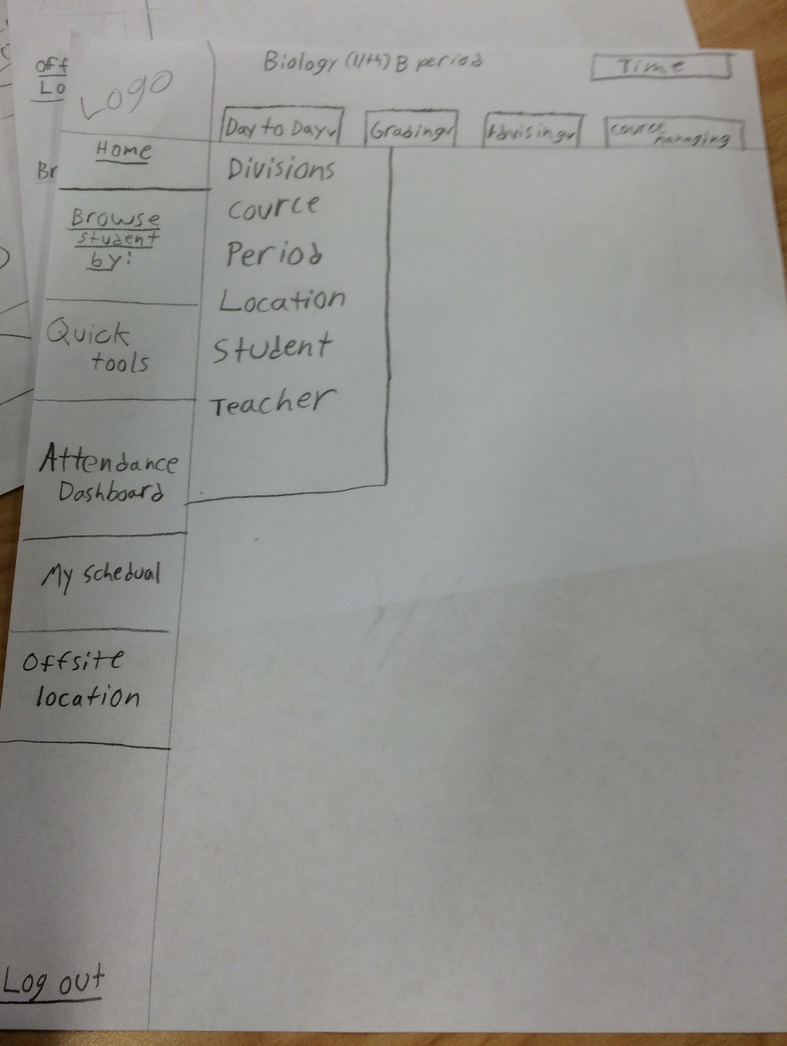


Logos and Nav

Slide 16
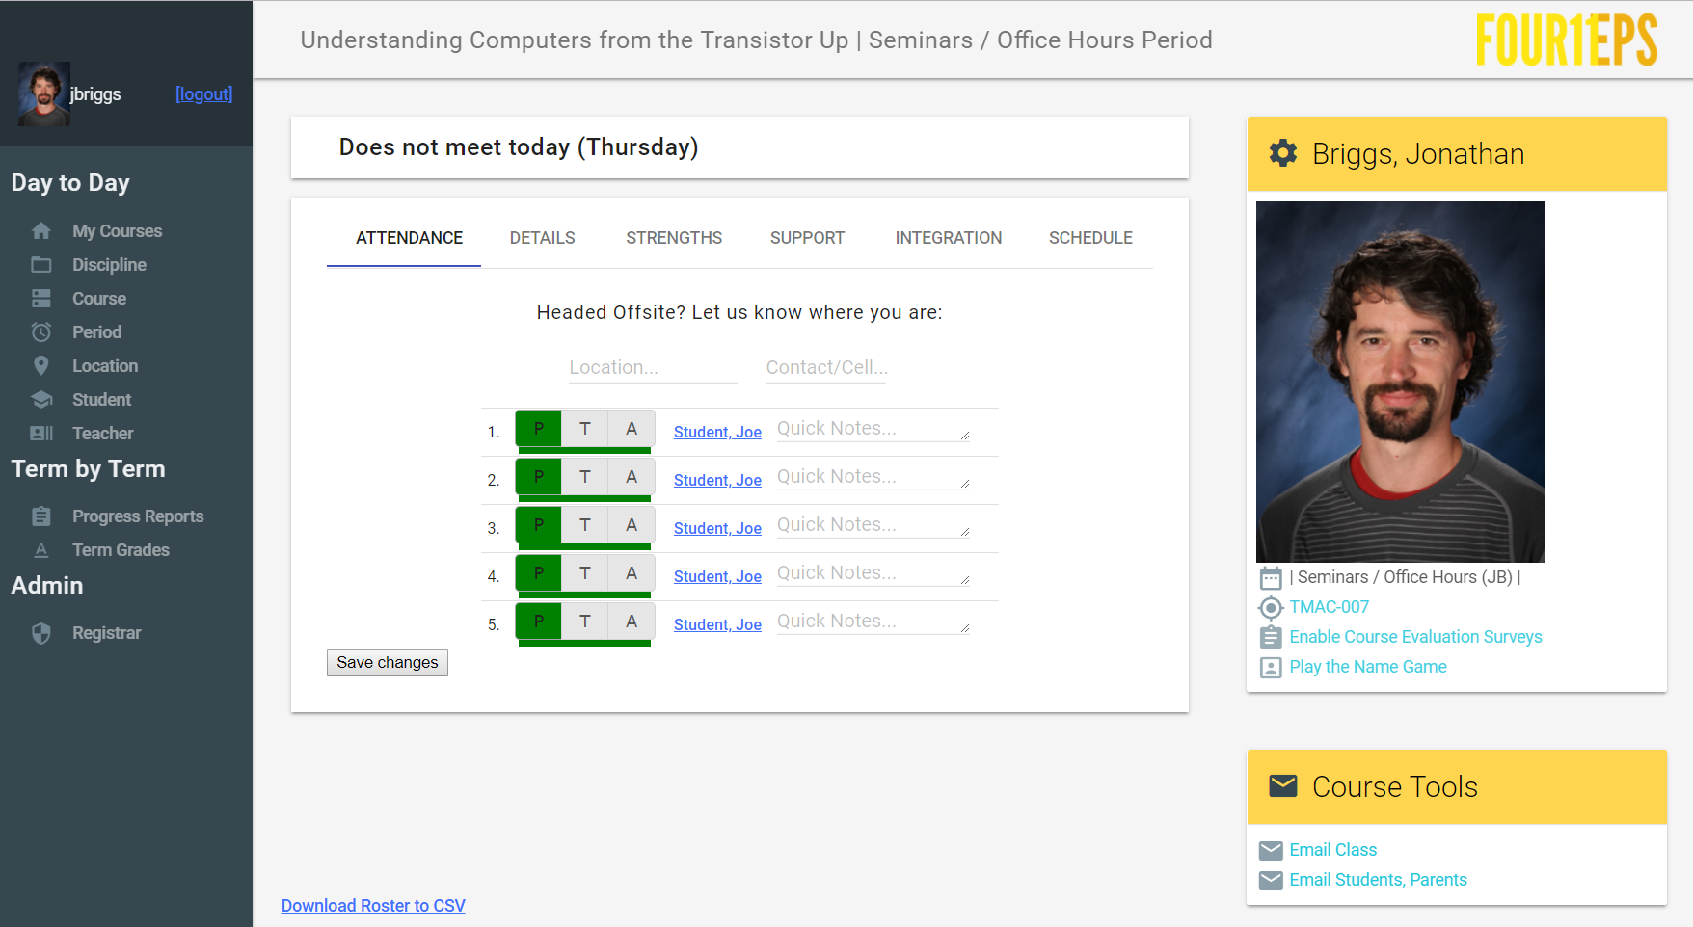
Final Design – Integrates Student Elements

Slide 17
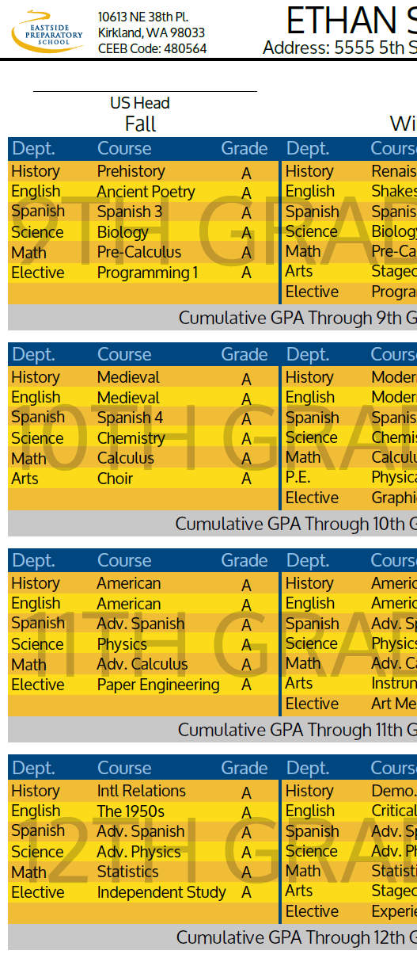
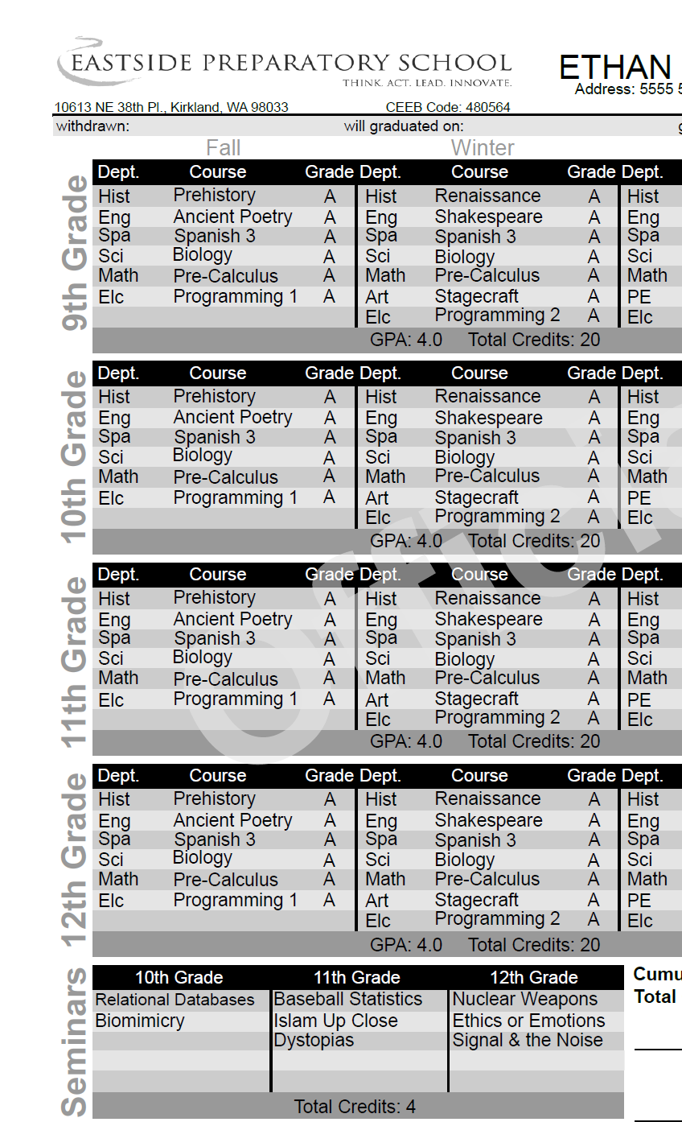
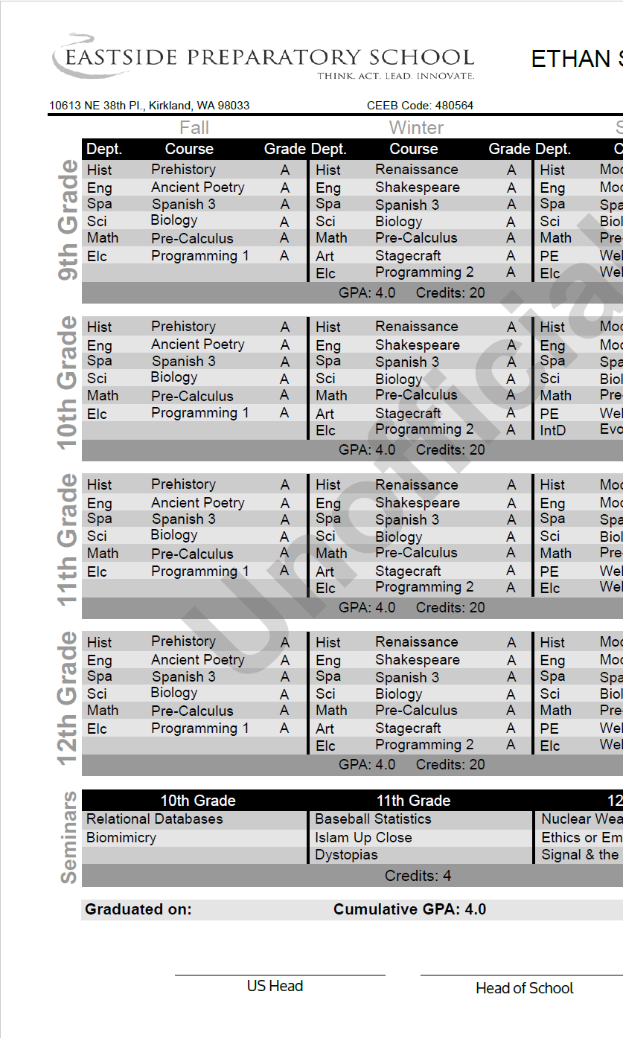
School Sponsored – Transcript
Student did first 3 iterations, school took it from there

Slide 18
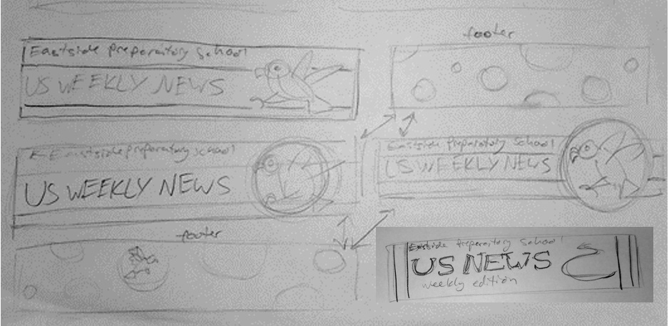
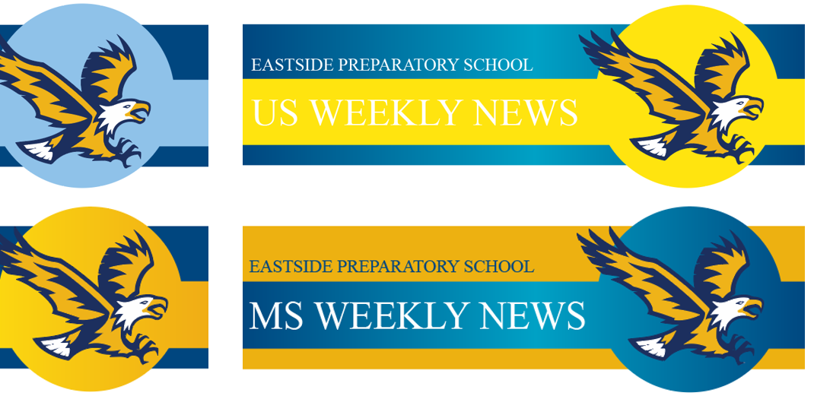
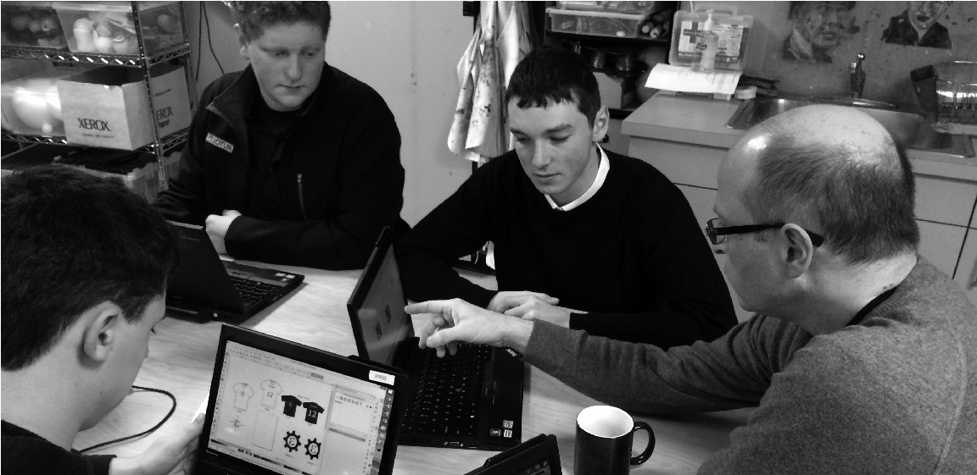
Making Real World Projects Successful
Get ahead of the project. These take time. Strive for clarity of project goals.
Have students meet multiple times with the faculty/staff lead.
Require multiple ideas and directions

Slide 19
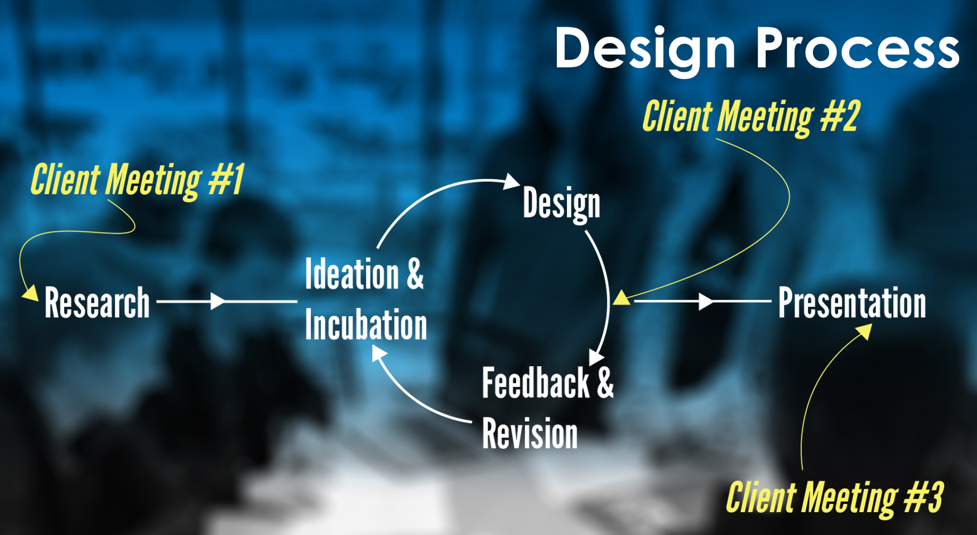
The process in Graphic Design

Slide 20
Ad-hoc – small, non - timely
Signage
  In the design lab / makerspace
  Compost / Trash / Recycling
  Event posters
  Certification / Instruction
Building tool organization objects.
  SD card holders.
  Laser cutting example pieces
  Demonstration activities
General Contribution
  Fixing 3D printers
  Building activities for other students
All the ideas we don’t have time to implement

Slide 21
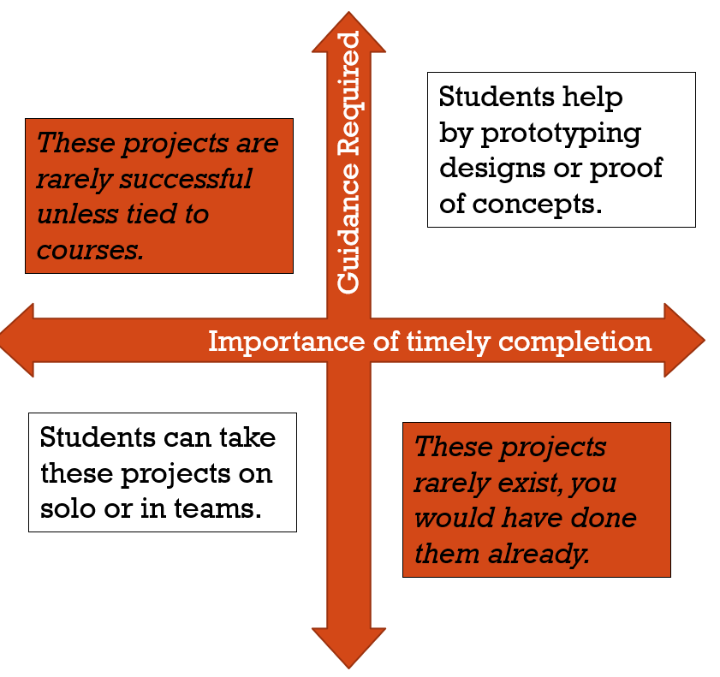
Know your projects
Stay away from the Top-Left quadrant
Start looking for opportunities to involve students
Collect requests from you community
Build a professional atmosphere of client meetings
  Have them schedule them
  Have them run the meetings
  Have them meet their own deadlines
Only use what’s good. Let the outcome be the motivation.

Slide 22
Questions, Contact and thanks
Jonathan Briggs
Eastside Preparatory School
jbriggs@eastsideprep.org
http://bit.ly/BriggsNCCE18
Thank you to Brian Hutcheson and Derek Clarke who do this work in their classrooms.
Design Process Resources (primarily used in Graphic Design Projects)
Inspiration
  Brand New
    http://www.underconsideration.com/brandnew/
  Canva Design School
    https://designschool.canva.com/
  Aaron Draplin Design Process
    https://www.youtube.com/watch?v=zOPA0NaeTBk
Design Books
  Why Fonts Matter by Sarah Hyndman
  Go: A Kidd’s Guide to Graphic Design by Chip Kidd
  Visual Literacy: A Conceptual Approach to Graphic Problem Solving by Richard and Judith Wilde

