Slide 1

Designing Systems for Fluid Teacher Adoption
Opening survey bit.ly/JB-OSCON
Jonathan Briggs
Director of Technology
Eastside Preparatory School
jbriggs@eastsideprep.org
@gotphysics

Slide 2

Lessons Learned from Teaching
Don’t Lecture
Know Your Audience
Don’t over generalize
Beware of the last class of the day
Context matters

Slide 3

Lessons Learned from Teaching – Directing Attention Matters
http://www.youtube.com/watch?v=vJG698U2Mvo

Slide 4
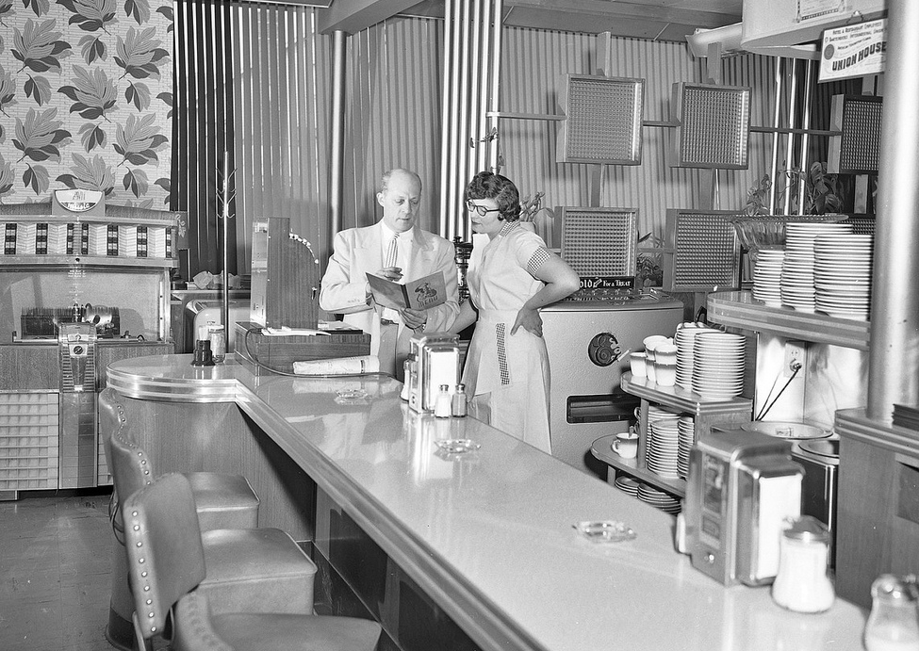

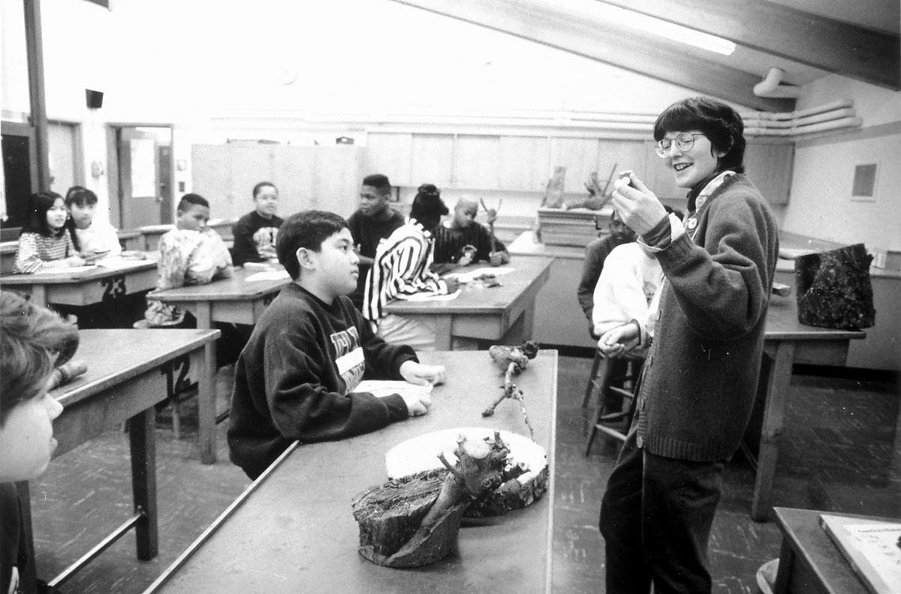
30 Seconds - fill out bit.ly/JB-OSCON - About our audience
Seattle Municipal Archives, “King Eddie's Restaurant, 1954”
via Flickr, Creative Commons Attribution
bunchofpants, “waiter”, taken 11/30/2004
via Flickr, Creative Commons Attribution, Non-Commercial, Share Alike
Seattle Municipal Archives, “Teacher and students in classroom, circa 1990s”
via Flickr, Creative Commons Attribution

Slide 5
Outline
A bit about me and the School I am a part of
Overview of a School Software Stack
The Two Paths to Software Adoption in Schools
Building and Maintaining a Healthy School Tech Culture

Slide 6


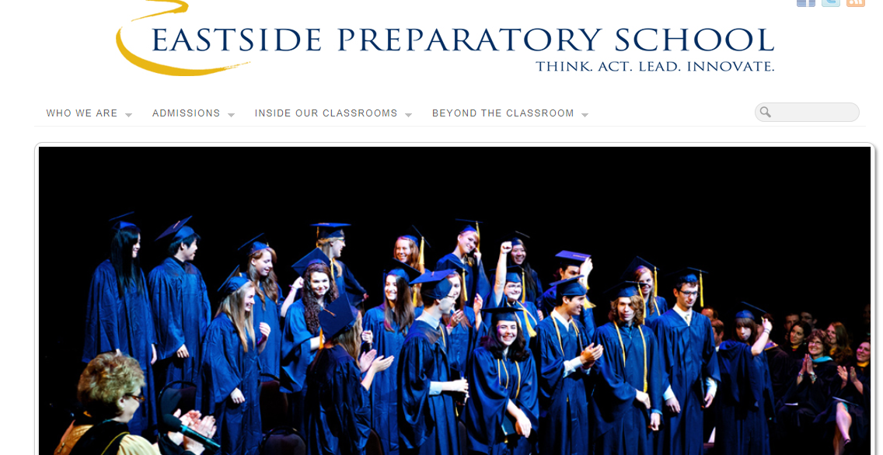

Eastside Prep, Kirkland, WA

Slide 7
Standard School Software Stack – Independent School
Bookkeeping Software (for the business office, point of sale, online payments)
Admissions Software (tracking inquiries -> admits -> enrolled students, online apps)
School Information System (tracking currently enrolled students, transcripts, attendance, online forms, online term reports)
Development Software (tracking alumni, donations)
Learning Management System (online portal to support class work, online grades)
Website for marketing purposes
Software for classroom use
Software for faculty and staff use
Email Server (students, staff, mailing lists for parents)
Library Database
File Server, Print Server, Radius, Active Directory, Wireless Controller, Firewall, VPN

Slide 8
Standard School Software Stack – Independent School
No single company or project will ever meet the needs of a school
Be a team player by having robust integration points through APIs and adopting standards like LTI
Open Source has an advantage

Slide 9
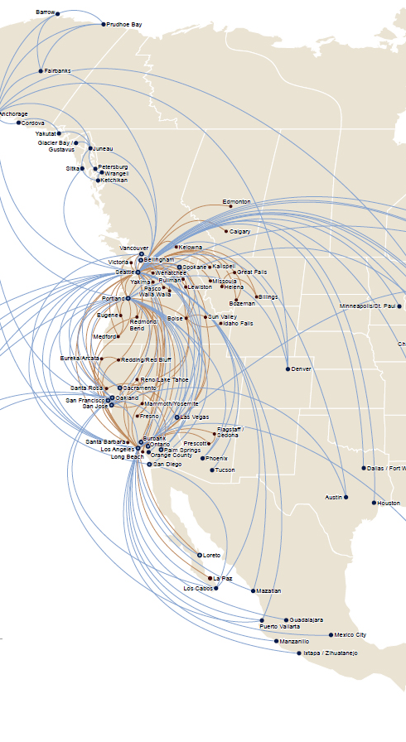
Two types of software – hubs, spokes
Hubs (LMS, SIS, Billing, Admissions)
Spokes (Online Forms, Gradebook software, wikis, blogs, data analysis, online donations)
Alaska/Horizon Route Map

Slide 10
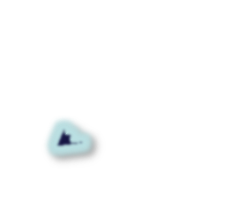
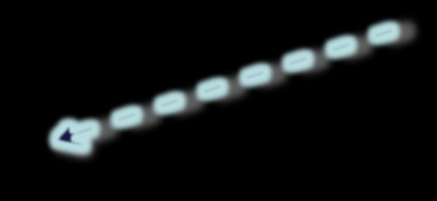
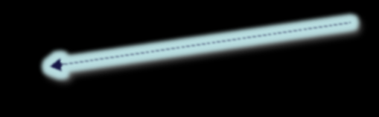
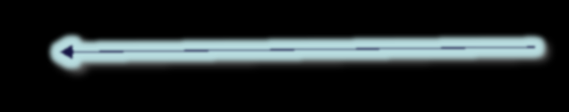
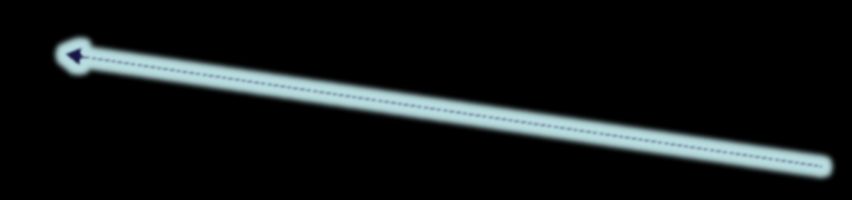
Eastside Prep Example – Teaching Side of the House
Note all authentication goes to Active Directory
TurnItIn.com
Kaltura
OnlineForms
LMS
TED-ED
EtherPad
Admissions
WordPress
Barnes & Noble
SIS
Grade Reporting
File/Print Servers
AD
Email
FreeRadius / Wifi Controller

Slide 11
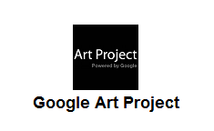
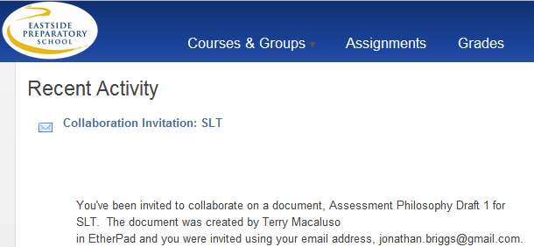
Live LTI integration
LTI integrations Available
an LMS

Slide 12
Great, so how does this equate to Fluid Teacher Adoption?
Are you aiming to be a hub or a spoke?
Most spokes of course also need to work as stand alone products. Typically the spoke model works by setting up a standalone server and using something like OAuth to connect to it from the hub. If you don’t know about LTI – check that one out.
Hubs need to be able to share data with other hubs – not just in CSV dumps but programmatically, in real time as well.

Slide 13
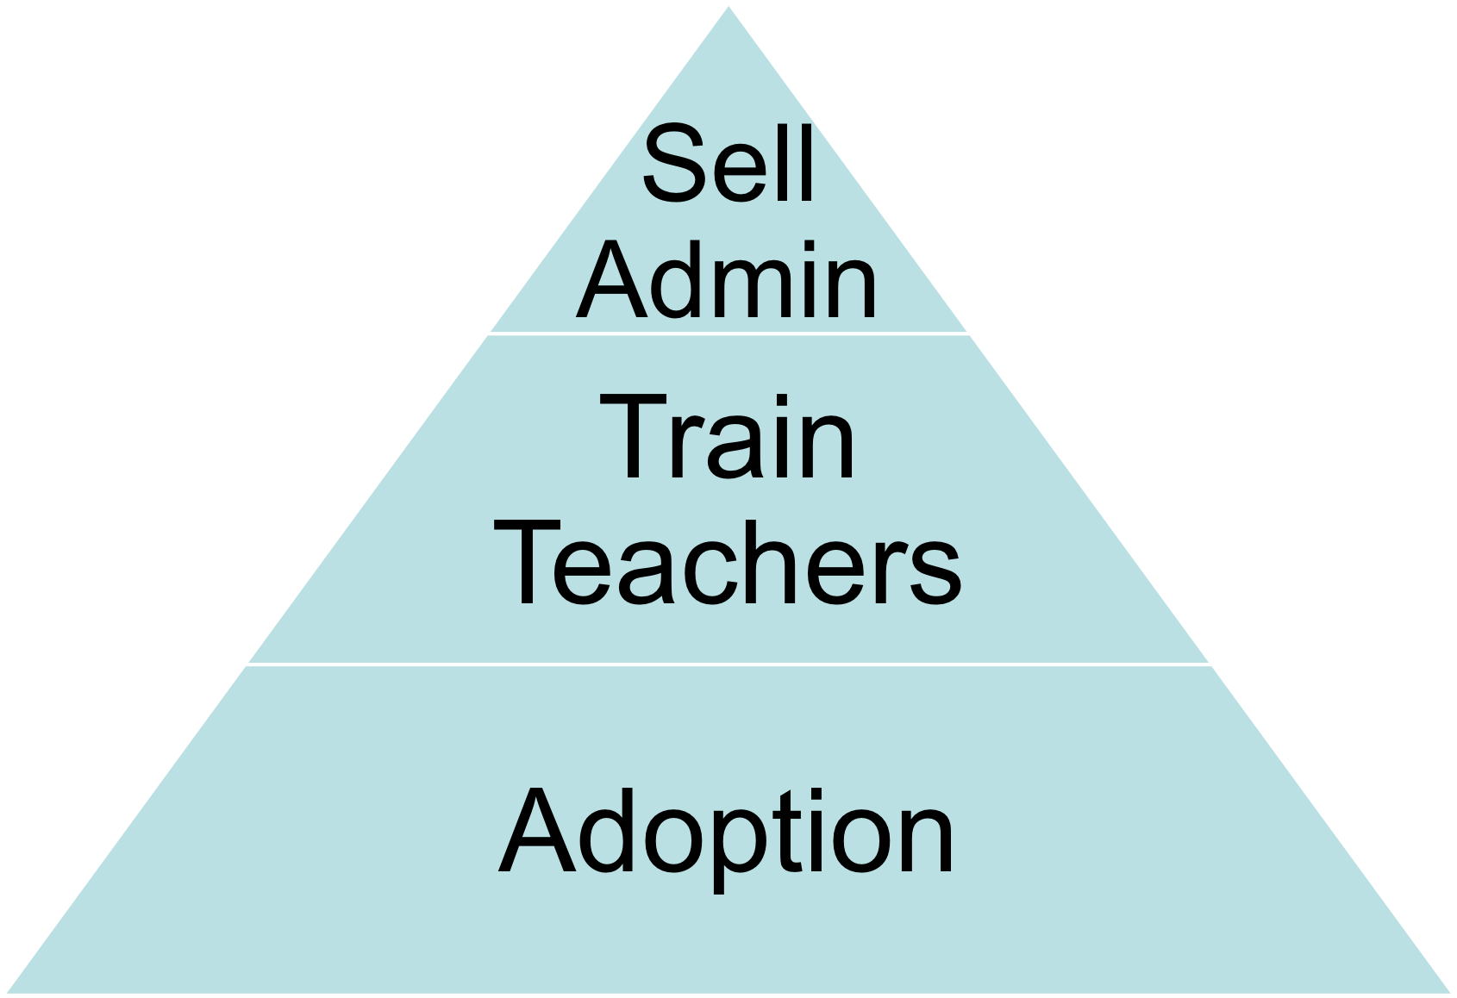
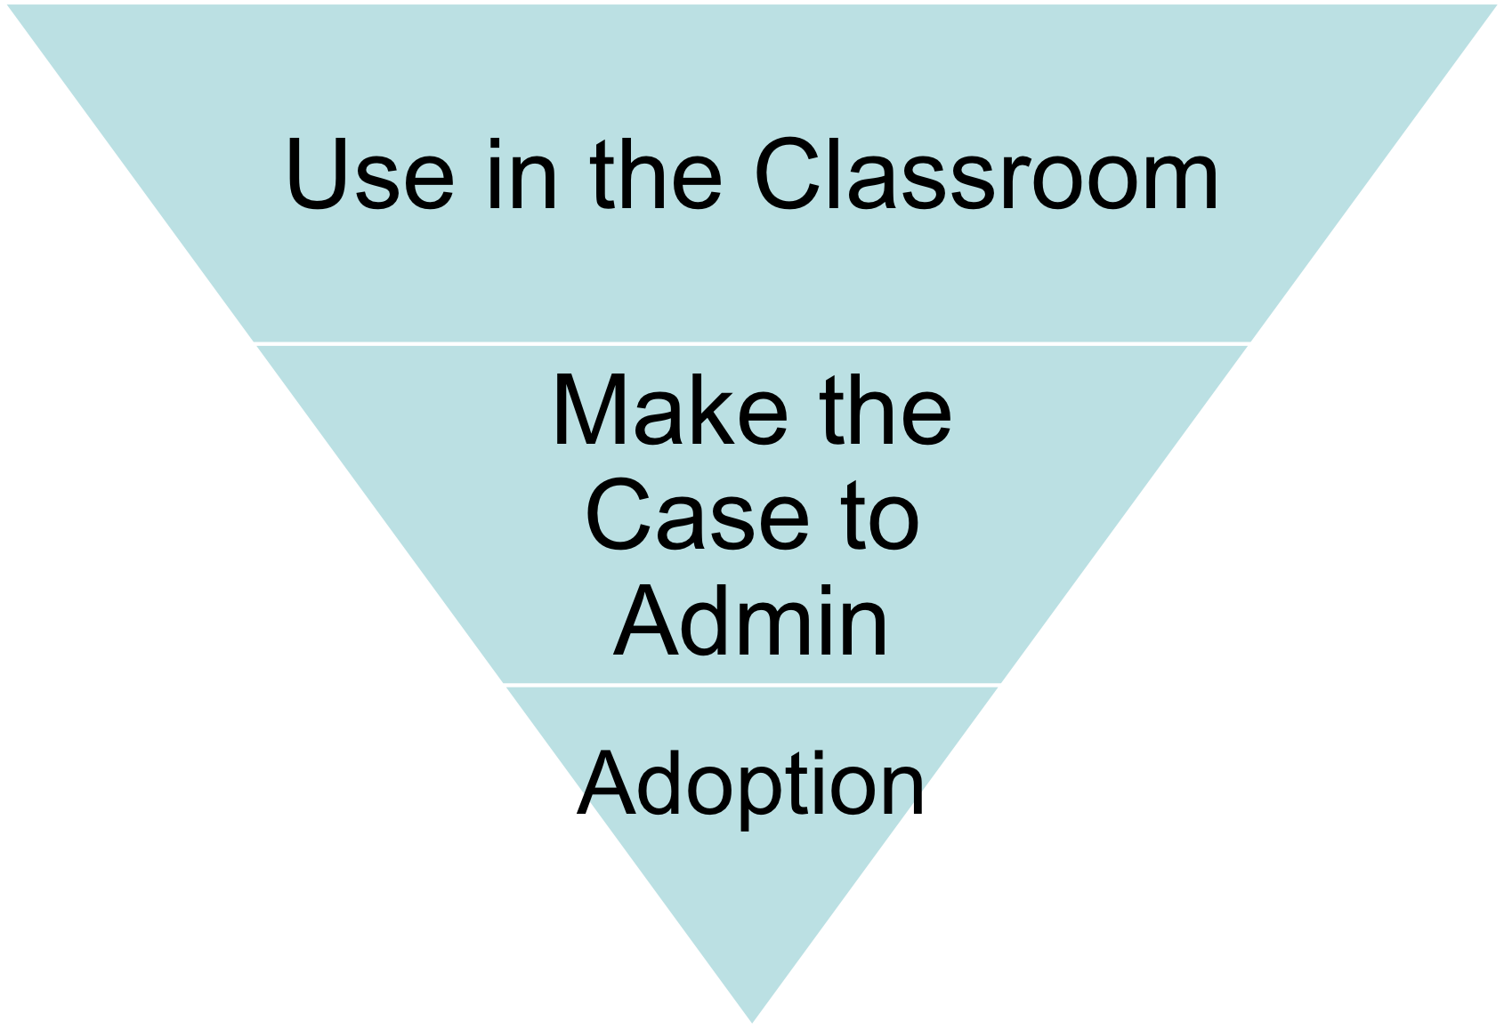
Two Strategies for Getting Your Software into Schools
Choose any two!

Slide 14
You NEED to pursue both strategies
Teachers only use what they see value in
Administration only pushes what it sees value in
And there’s two more constituencies
  Students
  And more often than not, Parents

Slide 15




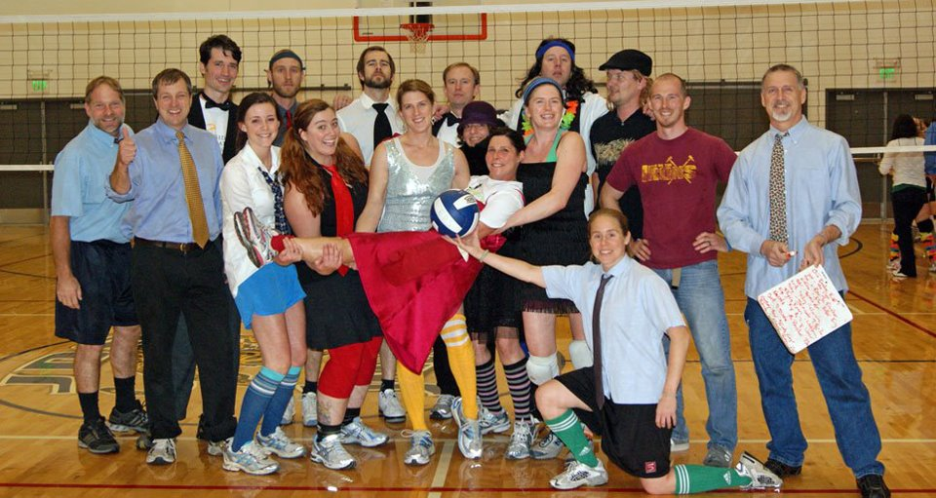


Who are you targeting with teachers

Slide 16

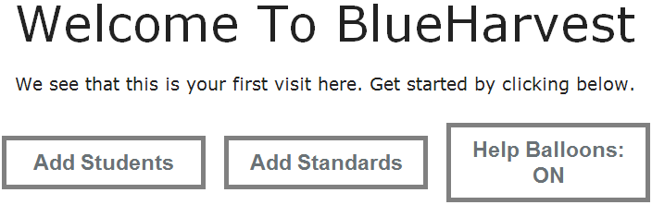
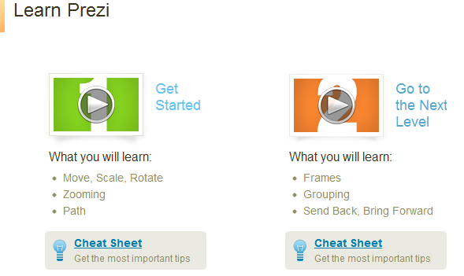
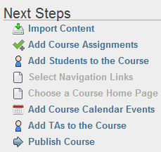
Bottom Up – Aiming at Teachers
Instantly USABLE sandbox for them to try in their class – and free
  Give them a tutorial to try right away
  Blueharvestfeedback.com
  5 minutes to hook them
    UX matters a lot
Low Transaction costs keep them

Slide 17

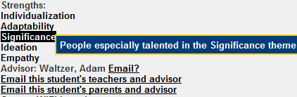
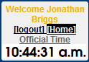
UX: Examples of Seemingly Minor Decisions
Preselecting students as present
  Saves teachers over 13K clicks per year
Strengths
Email shortcuts
Official Time
Internet Traffic Light

Slide 18

Examples of Transaction Cost
Where is the value?
Everything else is part of your transaction cost

Slide 19
Dream up the assignment
Write up the assignment document (MS Word) – including pre-steps on a calendar of completion (Outlook)
Upload assignment document to EPSnet Shared Documents (create folder, then upload)
Update EPSnet calendar with all assignment deadlines (Outlook)
Update Big Due Dates Calendar with major deadlines (Outlook)
Discuss the assignment in class/deliver the assignment
For each deadline:
  Create assignment in Easy Grade Pro
  Monitor student turn-ins (HW Dropbox or via Outlook)
    When HW Dropbox, I must create folders and subfolders for submission, and approve each of the folders
    When Outlook, I must create folders and subfolders for me to store work as it comes in
  Update Easy Grade Pro as steps come in
  Update Assignment Register. as Easy Grade Pro evolves
  Sometimes - chase down students who are missing step (by e-mail usually… sometimes cc´d to parent/advisor
  Grade or provide feedback
  Enter grades into Easy Grade Pro
    Sometimes: Enter grades into my “Temporary Grade Holder” Excel file, where I store scores that I don’t yet want updated to the A.R….. then later I transfer them to EGP
  Re-upload feedback to HW Dropbox or e-mail back to student as attachment
  Save my feedback in a file for myself future reference

Slide 20
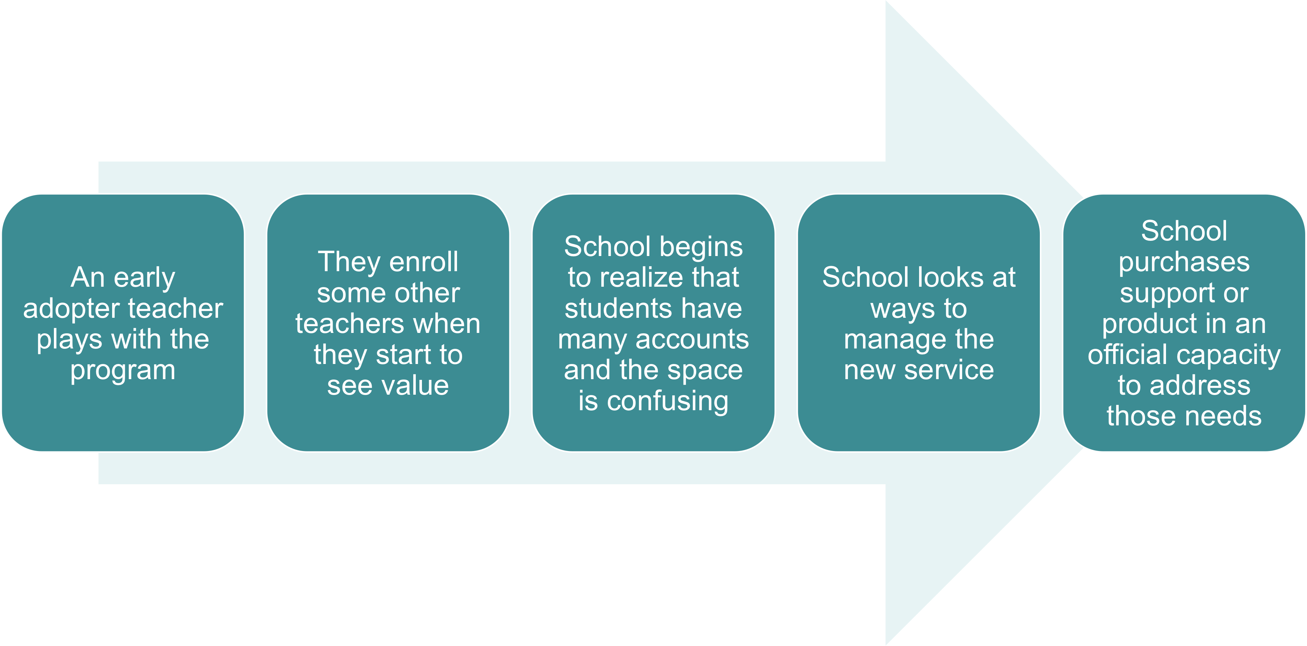
What the Path is To Full Adoption

Slide 21
Top Down – What does a tech director care about?
  Integrated authentication (LDAP/SAML/etc.)
  Can I get the data out and migrate if necessary?
  Can I programmatically access the data to build tools? (API)
  Can I bolt on features (LTI)
  Robust help system
  Can I connect to my other hubs

Slide 22
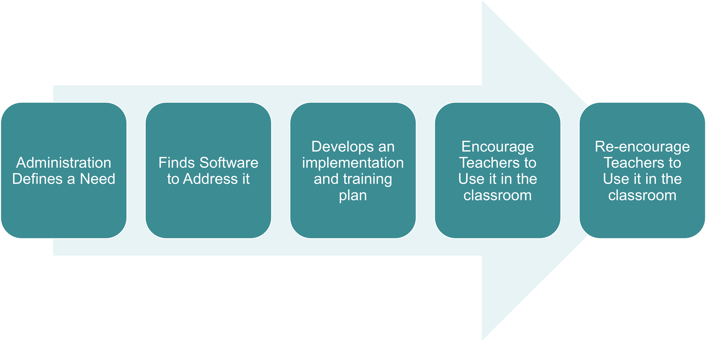
Top Down Process

Slide 23
Building School Culture
Trust – give them laptops with admin rights – let them take them home, even for summer
Targeted Professional Development over lab tutorials
Hire for Friendliness with your tech staff
Give people time to solve their own problems
Set aside resources to encourage faculty exploration
Give away the credit for good ideas
Aim to reduce frustration

Slide 24

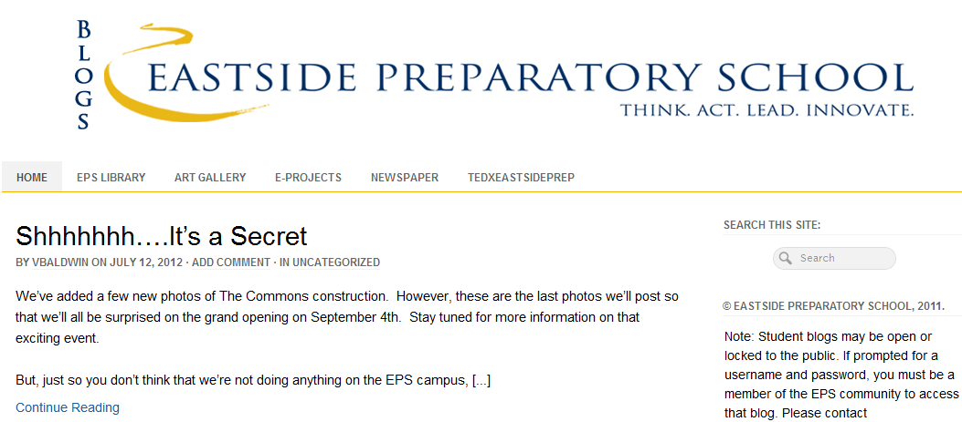
Three Stories
Scratching an itch / top down – four11
Bottom up, teacher driven project – individual student blogs
Moving from our homebrew LMS to instructure canvas

Slide 25
Scratching an itch/top down - four11
Built to reduce paperwork around term grades
Evolved to reduce transaction costs wherever possible
Also enables us to do unique things to our school – Integration builder
Acts as a hub and enables projects specific to our school’s mission

Slide 26
Wordpress Blogs for Students
Bottom up, teacher driven project – individual student blogs (140+ now)
Open Source allows us to integrate it with the four11 hub
Modules allow us to use multi-site and password projecting younger student blogs
We have found many other uses as well

Slide 27
Homebrew LMS to Canvas
Moving from our homebrew LMS to instructure canvas
  Hybrid of Top-Down and Bottom-Up
Process
  Live Sandbox demo on their site
  Install locally to play with integration abilities
  Lead faculty through transaction cost benefit over our homebrew system
  Check in with faculty individually if concerned over the move – give them demos
  Pull the trigger – start to finish in ten weeks.

Slide 28
Recommendations for Open Source Projects
API, LTI, Authentication Integration
“TRY [Project]” for teachers on the home page – real deal, persistent for the whole term
Give as much of it away as you can but upgrade it often to encourage revenue
Have a philosophy to govern feature addition decisions
  For our four11 project – Provide information to empower teachers to teach in the ways they aspire to. Float relevant information to the surface, reduce transaction costs to enable more time spent on teaching and less time spent on the data management of teaching.

Slide 29
Teachers Teach to Make a Difference
If you build a product that empowers a teacher to make a difference they will use it
Jonathan Briggs
Director of Technology
Eastside Preparatory School
www.eastsideprep.org
jbriggs@eastsideprep.org
@gotphysics
Plug: TEDxEastsidePrep.com
Questions

