Slide 1
Making Canvas Your Own
Learning Management Myths
One Size Fits All
Canvas should fill all my needs
It’s too hard to customize canvas
Jonathan Briggs, Director of Technology, Eastside Preparatory School

Slide 2




Using the API and LTI to Make Canvas Your Own
Why wait for a feature when you can find it or build it? Bolt that sucker on!
Jonathan Briggs, Director of Technology, Eastside Preparatory School

Slide 3
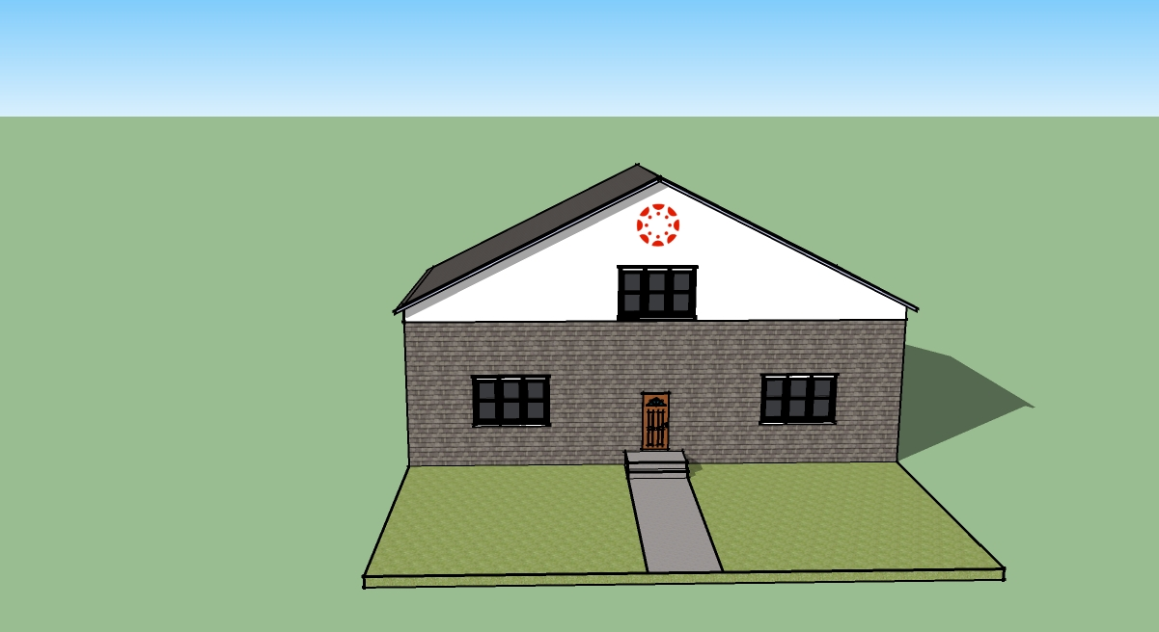
But really…
Notes:
More like House
Put stuff there
Get stuff there
Go there

Slide 4
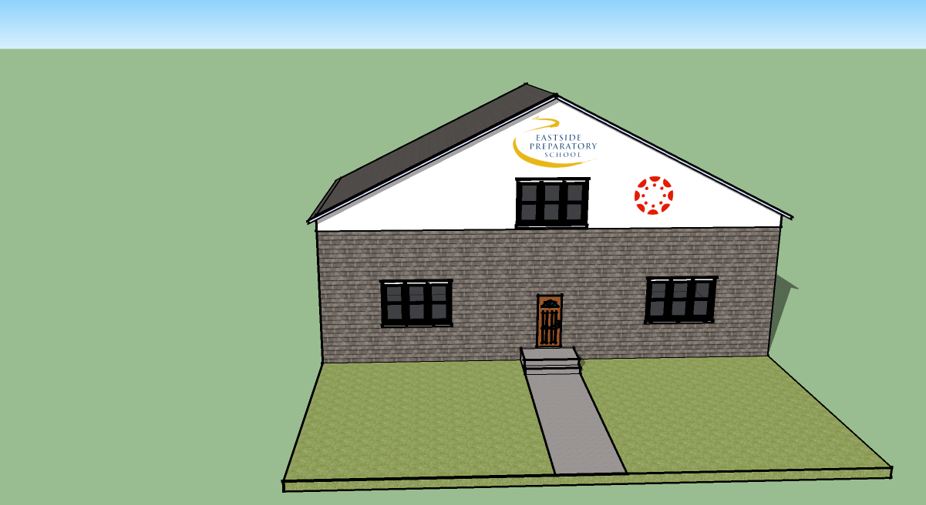
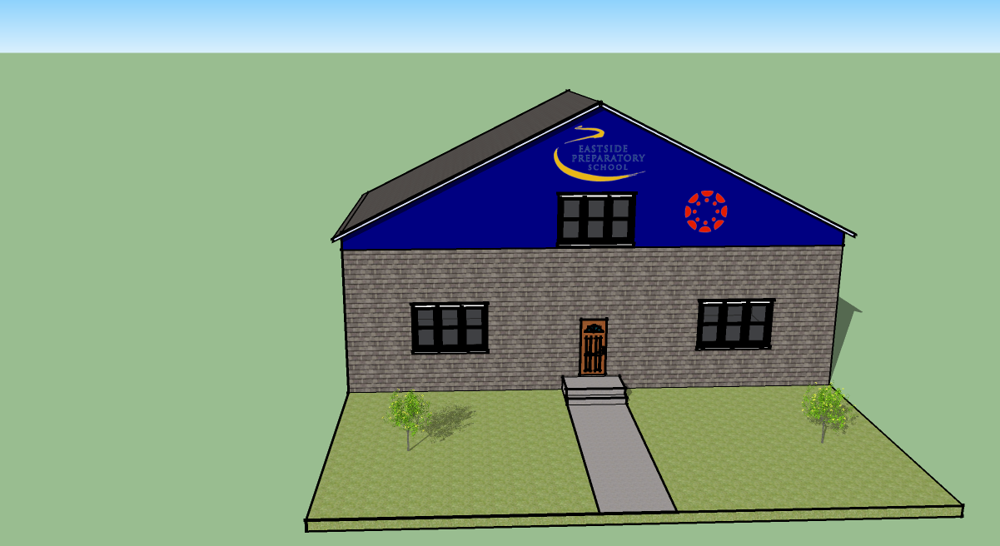
Move in, fix it up a little bit
add some Furniture
Notes:
When you buy your house
- you hang your art
- you paint
Nearly every canvas instance does this already
- you move in some stuff

Slide 5
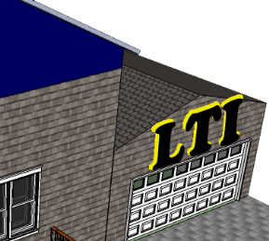
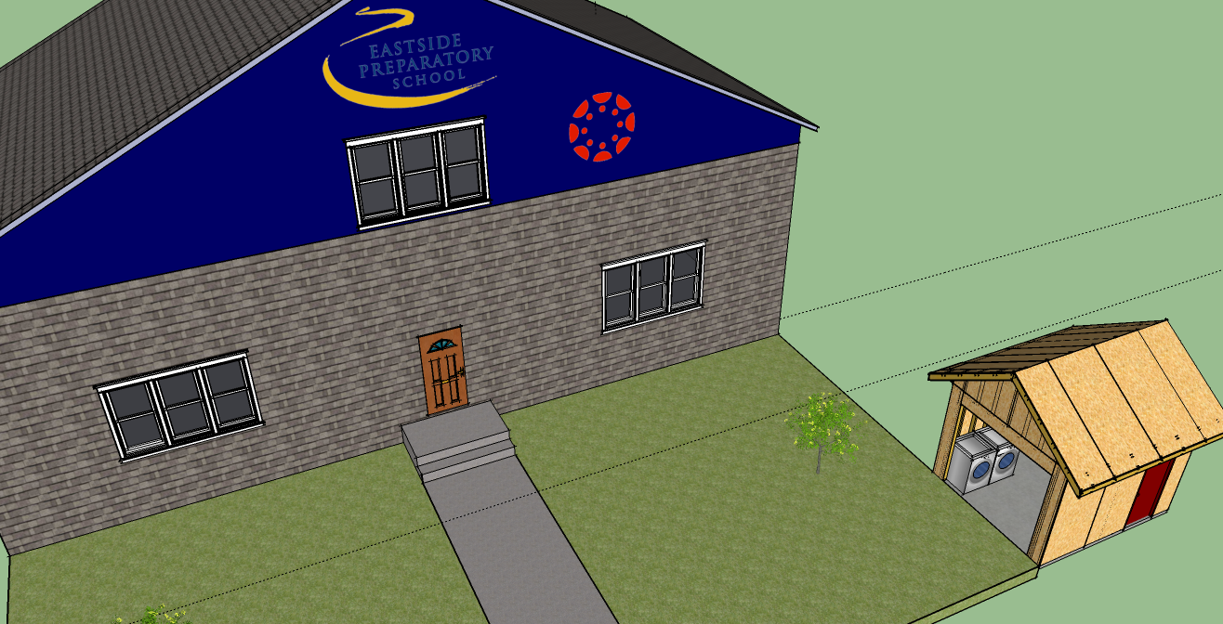
Aside: LTI
What are they? Why LTIs are so important?
Request LTIs all the time! - Here’s How
Notes:
What is an LTI – feature that you add to canvas school/department/course levels
Not unlike an app on a smart phone
Washing Machine
We need more LTIs
Favor – role play:
Do you have an LTI integration? –if they say no- say, hmm… ohh… ok, go on.

Slide 6

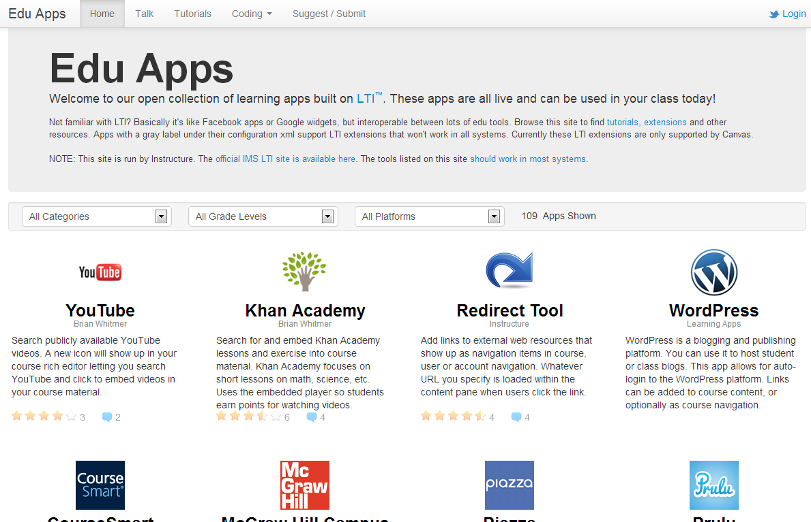





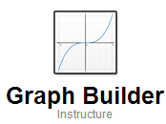

Head to
.
Notes:
This site is great, highly recommended and most things are free.
App center should make this process even closer to the smart phone experience

Slide 7
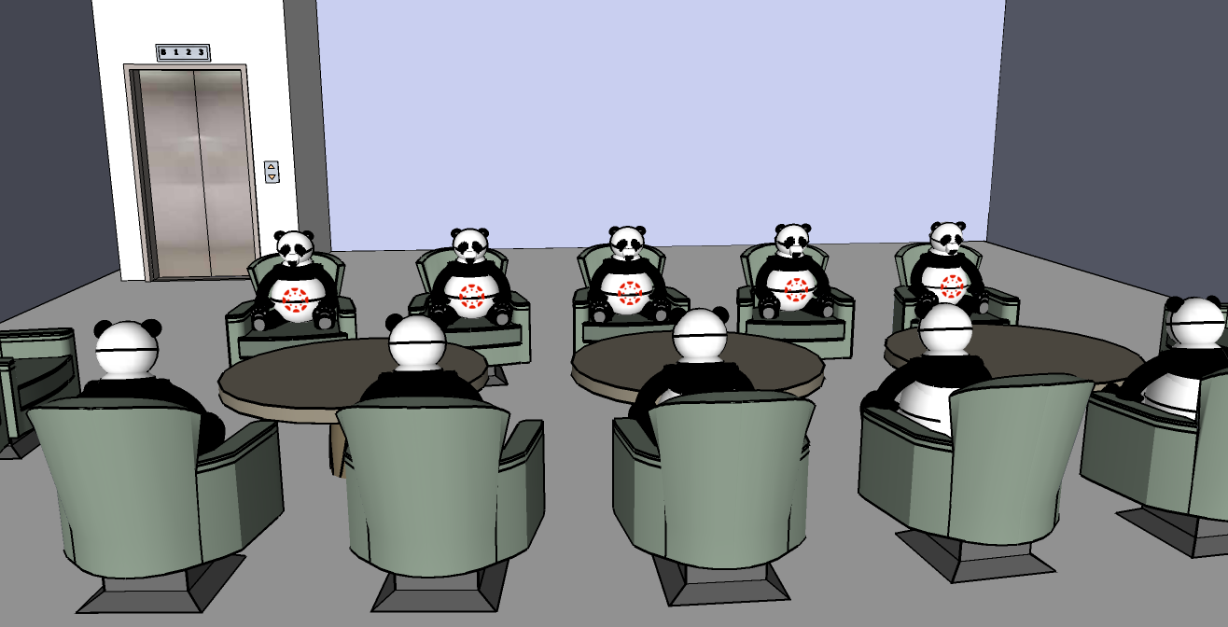
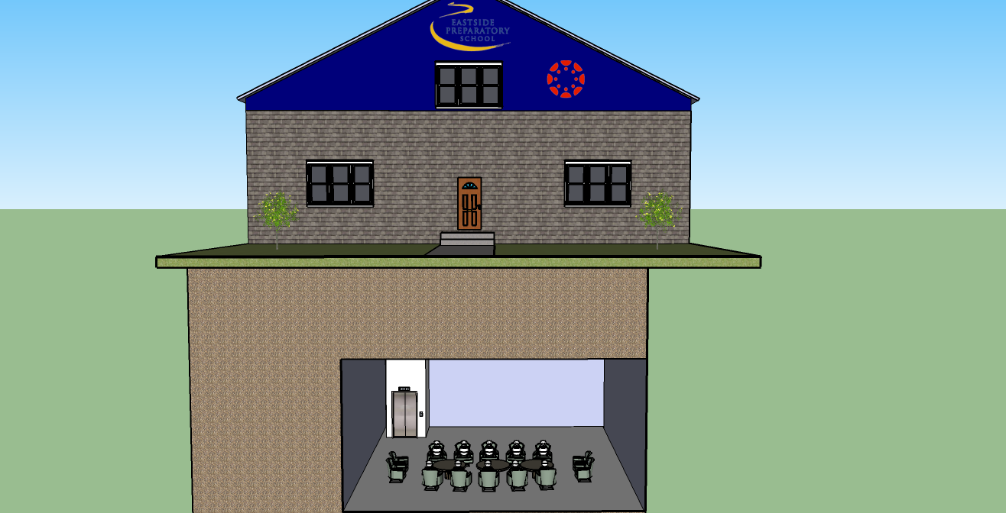
It’s really a house⁺
Notes:
Your house comes with a panda care-bear army
Deep underground they plot and plan how to upgrade YOUR house
Pretty cool

Slide 8
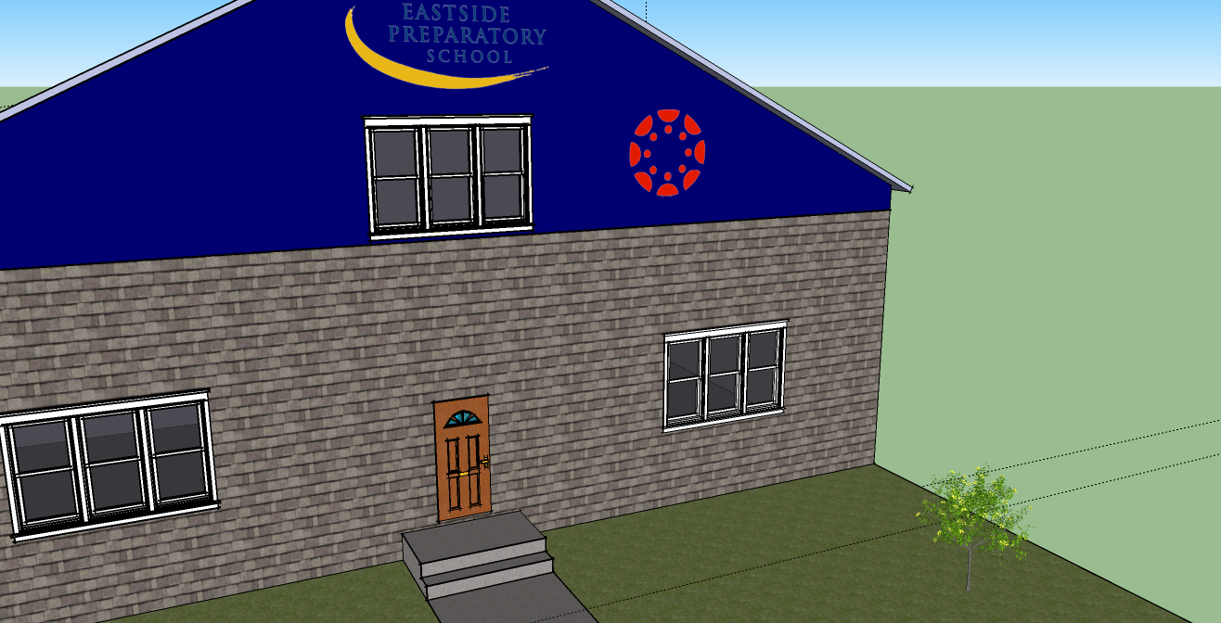
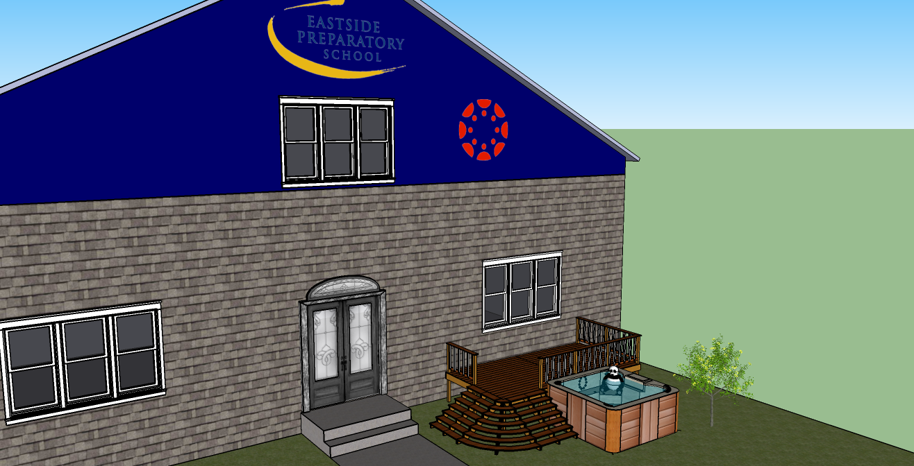
Helper Care Bear Pandas?
Notes:
Every three weeks or so your house gets some nice upgrades. Sometimes they change things that you liked. But overall it always improves.

Slide 9
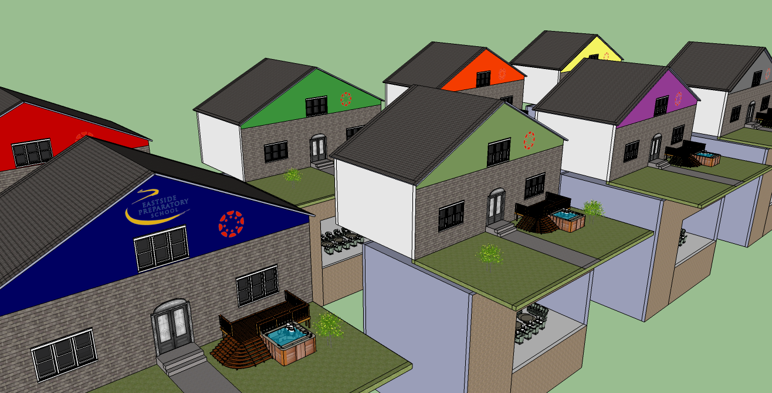
But We’re Special
…Just like everyone else…
Notes:
As great as it is to have your own panda care bear army…
You still want canvas to reflect your school

Slide 10
How Can
Canvas Reflect
Your School’s
Identity?
By making your canvas different

Slide 11
First We Need a Plan
Then We Need to Know Our Tools
Then We Go to Work
Notes:
Intentionally out of order

Slide 12
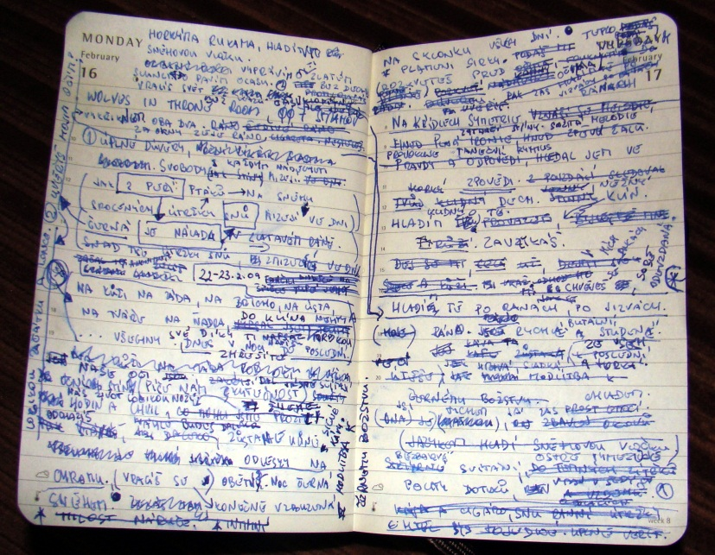
Aside: No Need to Take Notes
Technical details at bit.ly/CustomizingCanvas
This is being recorded
We’ll be going fast, you are browsing for ideas
You can always email me – jbriggs@eastsideprep.org
Notes:
Alt-tab to CustomizingCanvas
This deck will be posted there as well

Slide 13




Panda Approved Tools (in order of complexity)
CSS - Design
Javascript – User Interaction
API – Getting data out, putting data in
LTI – Putting an addition on to your house
Lobbying Instructure that your feature should be their focus
Notes:
Go slow
Remember – info will be available online

Slide 14
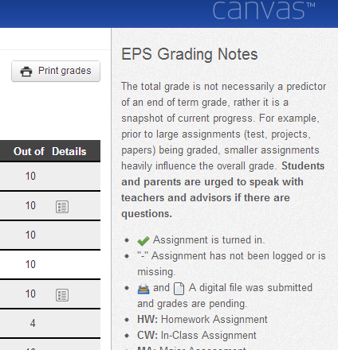
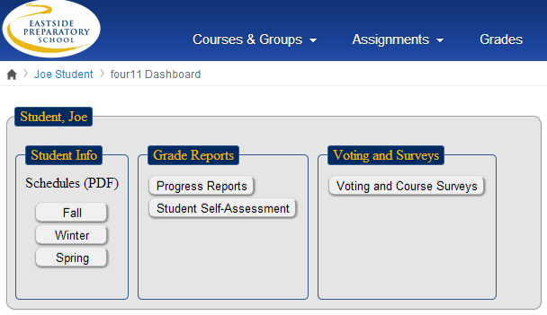
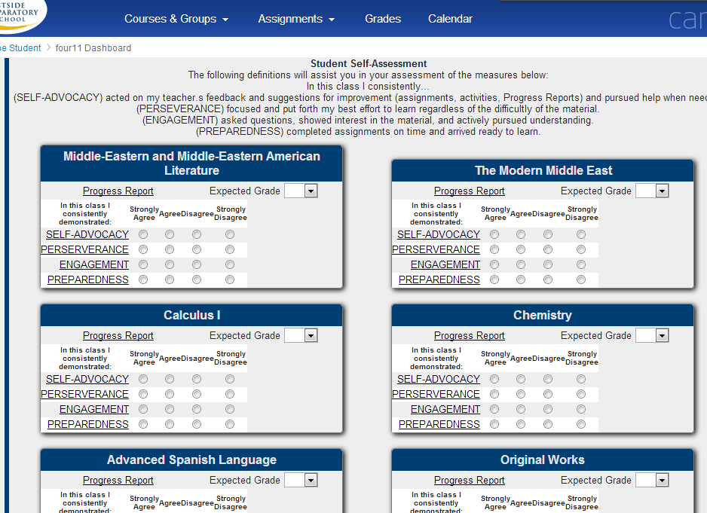
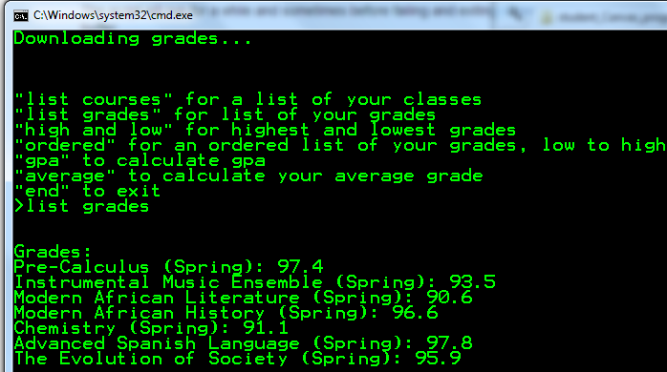
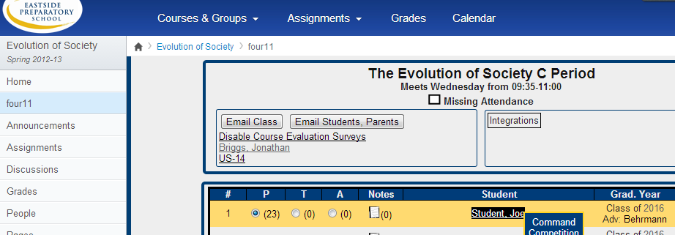
ARCHITECTURAL DIGEST: Canvas Edition
Eastside Preparatory School
Notes:
As we go through this it is important to get in the right frame of mind…
Ideas, browsing, might not agree
You don’t have to build, you can hire a contractor Instructure has a department or you can go elsewhere

Slide 15

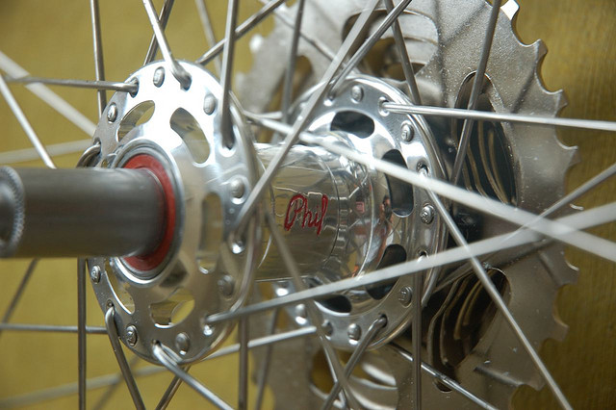
Eastside Prep’s Architectural Concept:
Hubs and Spokes
Hubs:
Organizing sites of information.
LMS, CMS, SIS, AD
Spokes:
Features that enhance.
Graphing Calculator, Flickr Search, TurnItIn
Esteban, Flickr: http://www.flickr.com/photos/25671211@N02/2487085812/
Notes:
Like any good article -> start with concepts
How We Think About Edu Software – Hubs and Spokes

Slide 16
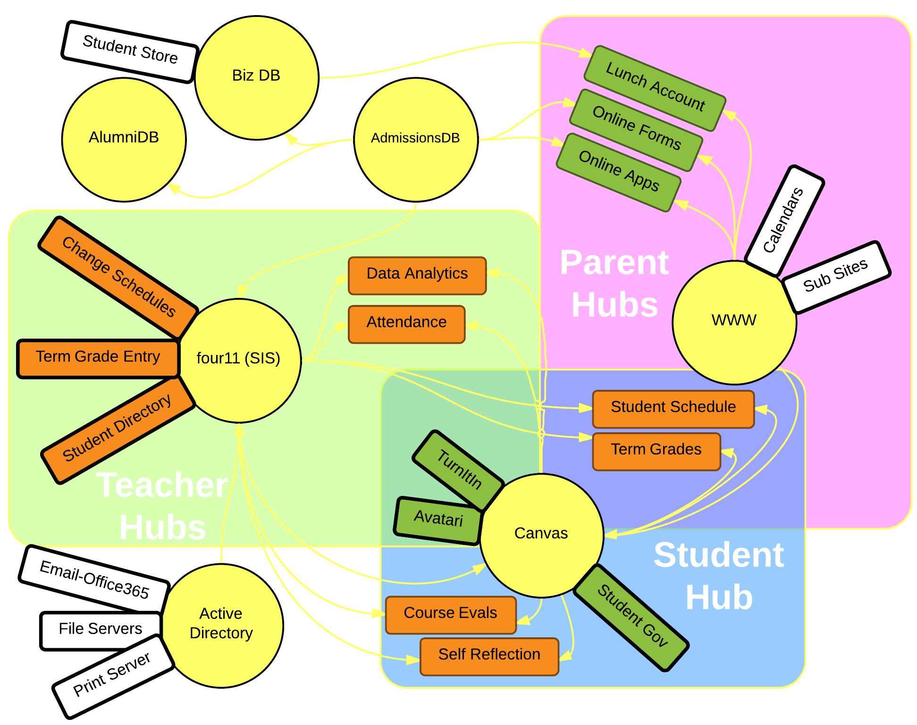
Hubs and Spokes @ EPS
Notes:
Goal: You Should Never have to ask
“Where do I Go for…”
Canvas serves three different types of users -> complicated

Slide 17
PLAN:
Put information where we think it ought to be
Have Canvas reflect our philosophy at Eastside Prep

Slide 18
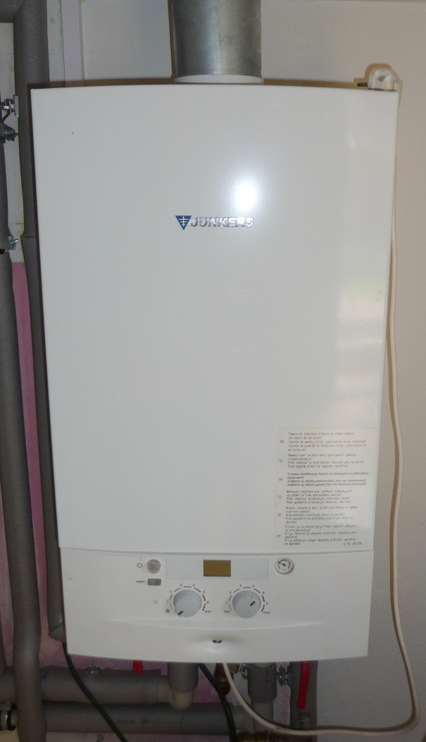
SIS Imports
(as exciting as the water heater)
{"data":
{"supplied_batches":["enrollment"],
"import_type":"instructure_csv"},
"created_at":"2012-09-11T13:18:35-07:00",
"ended_at":null,“
updated_at":"2012-09-11T13:18:35-07:00",
"progress":87,
"id":4892701,
"workflow_state":"importing“
}
Notes:
But they are really cool
And we won’t be talking about them

Slide 19
We’ll Begin Our Tour with the Grades Page

Slide 20
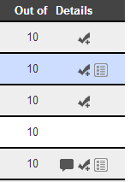
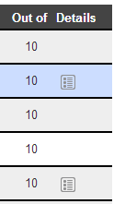
Manage the Viewable Data Points
Student View Parent View
*Note About Security
Notes:
Took Some things out

Slide 21
Clarify Symbols for Students and Parents
Notes:
Clarify for parents

Slide 22
Now We are Moving to the Course Page

Slide 23
Access the SIS from the LMS
Notes:
LTI app example
- handles cross site login
- makes it feel like one hub

Slide 24
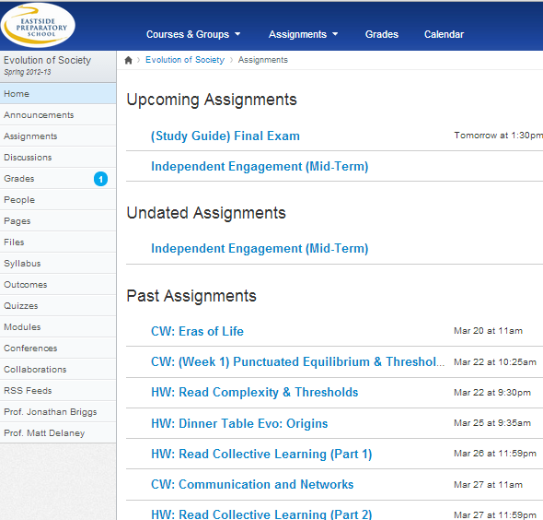
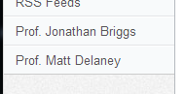
Add Internal Links
Notes:
Nice example of integrating two tools
The javascript for those interested:
if (jQuery("body").attr("class").match(/\bcontext-course_(.[0-9]*)/)) { var courseID = jQuery("body") .attr("class") .match(/\bcontext-course_(.[0-9]*)/)[1]; $.getJSON("/api/v1/courses/"+courseID+"/users", "enrollment_role=TeacherEnrollment", function (data) { $.each(data, function (index, teacher) { $(" div#left-side nav ul#section-tabs") .append("<li class='section added'><a href=/courses/" + courseID + "/users/"+teacher["id"] + ">Prof. "+ teacher["name"] + "</a></li>"); } ); } ); }

Slide 25
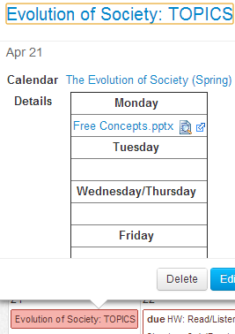
Novel Custom Links
Weekly Agendas
Notes:
Alt + tab to browser and demonstrate
*Pass parameters in URL to preset form fields

Slide 26
Now Let’s Look at Additions and the Exterior
Notes:
Our other features rely more on external sites but utilize canvas capabilities

Slide 27
An SIS Dashboard for Students and Parents
Notes:
Problem: Students and Parents Should Find Everything on the Canvas Hub
Solution: LTI four11 dashboard STUDENTS AND PARENTS
Download Schedule, Grades
*parents need access for each child
Student Specific
Vote for student government
Fill out Course Evaluations

Slide 28
Observation
As our customization skills improved we moved from solving problems to seeing opportunities

Slide 29
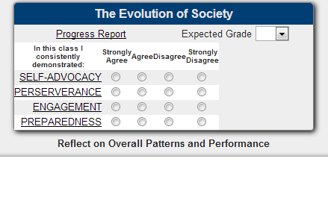
Opportunity: Student Self Assessments
Notes:
With a link built – we can have more interaction from our students.
Student Self Reflections
They happened because it wasn’t a washing machine in a shed

Slide 30
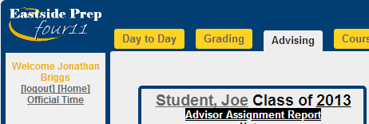
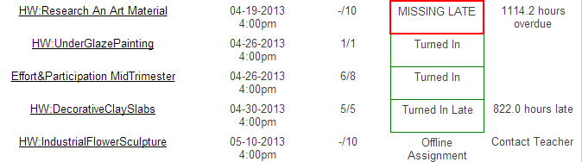
Looking from the Outside In
5,000 API Requests Takes a few minutes
Notes:
Problem: Missing assignment data for advisors - API
Takes forever to figure out if students are missing assignments
Can’t make advisors observers
*slows canvas way down
I’m sure instructure will fix this soon, but why wait?

Slide 31
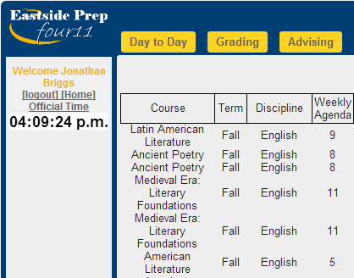

Data Analysis
On Courses
Notes:
API – script a csv export from the SIS and upload through the API to canvas
jQuery("td[data-view='count']").each( function(index,node){ var section = jQuery(node).data("section"); jQuery.getJSON("/canvas_data/section_prenotes/"+section, function(data){ jQuery(node).html(data["count"]); var target = jQuery(node).next() target.html('') jQuery.each(data["prenotes"], function (index, item) { target.append("<span class='toolanchor'>" + index + ",<span class='tooltip'><div>" + item["title"] + "</div></span></span>"); }); } ) } )

Slide 32
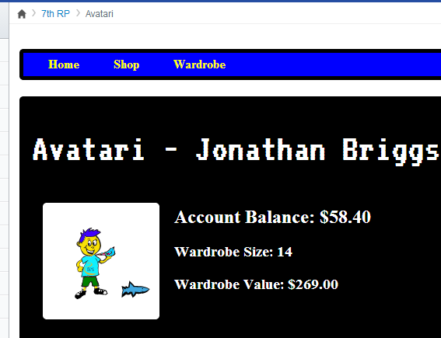




Opportunity: Faculty Want to Gamify a Project Avatari - LTI
https://github.com/JonBriggs/avatari - preAlpha
Notes:
Future is looking bright – moving away from MC tests

Slide 33
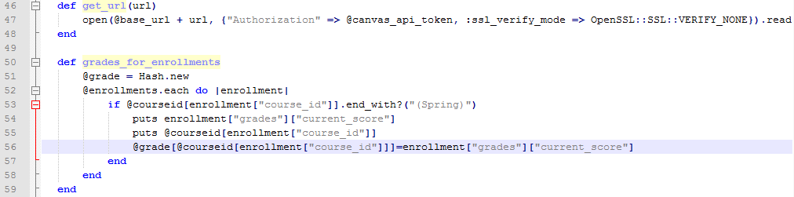
Getting Students in On the Fun
Opportunity: Going Meta in Programming Class
Live Demo
Notes:
End of the intro to programming course – students made API-keys and built desktop apps to access canvas info

Slide 34

Aside: What you never see!
It never works right the first time
These customizations can break stuff - TEST
  Use <yourschool>.beta.instructure.com <yourschool>.test.instructure.com
  Double check the gradebook when doing javascript customizations
  Beware of Caching
It takes twice as long as you account for… even if you account for this rule

Slide 35

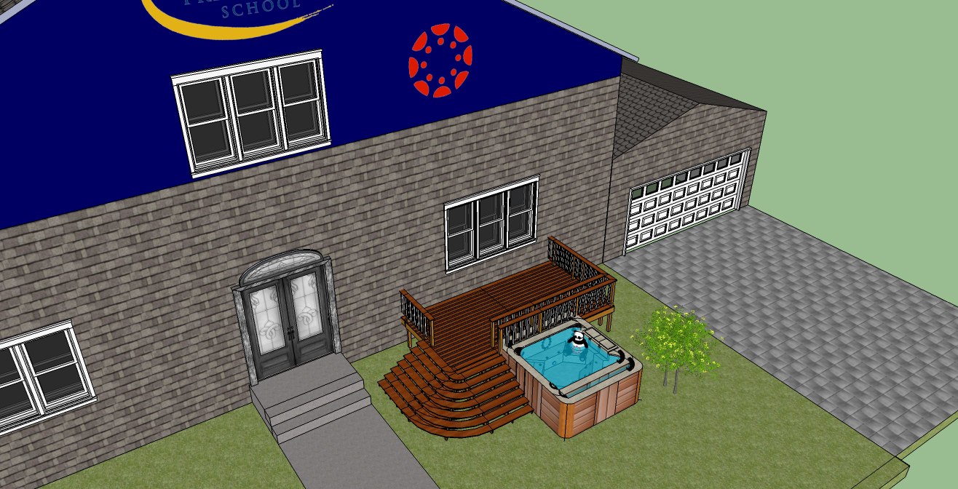
It’s your Canvas
…and you can drive it like a rental
Play with the LTI Apps at
  https://lti-examples.heroku.com/index.html
Check out bit.ly/CustomizingCanvas and learn a tool
Contact us at Eastside Prep
  canvas@eastsideprep.org (or jbriggs@eastsideprep.org )

Slide 36
Contents
Examples – problems fixed
  SIS import scripts (API)
  Remove the graphs (css + javascript)
  Prenotes(javascript + rails knowledge)
  Four11 attendance (lti plus external app)
  EPS Grading Notes (javascript)
  Distribute grades online (lti)
  Missing Assignment Report (api)
Opportunities
  Professor link on home page(javascript + api)
  Distribute schedules, voting, course evals(lti)
  Student Self Assessments(lti)
  Avatari (brand new lti)
  Data mining (api)
  Going Meta programming assignment(api)

Slide 37
Solution: In the javascript bring the links back for students and teachers
https://four11.eastsideprep.org/eps_canvas.js - For full code
Find out if we are on a class page by scanning the body’s class attribute for context-course_12345, save 12345 as the course code.
Look in the menu area under course 12345 for “enrolled as:” to find the role of the user.
    If the role is Observer or not found – remove the node that contains the graphs from the DOM
    If the role is Teacher or Student – Show the div that was hidden by the CSS
*This is a UI solution, easily worked
around by a clever user

Slide 38
Preset Form in URL (Rails Trick)
<li class=%27section%27><a href='https://eastsideprep.instructure.com/courses/" + courseID + "/calendar_events/new?title=" + shortName + ":+TOPICS&start_at=" + preNoteDay.toDateString().split(" ").join("+") + "&end_at=" + preNoteDay.toDateString().split(" ").join("+") + "&description=%3ctable+border=%271%27%3e%3ctr%3e%3cth%3e%3cstrong%3eMonday%3c/strong%3e%3c/th%3e%3c/tr%3e%3ctr%3e%3ctd%3eGuiding+questions,+background+info,+pre-thinking+prompts,+and%2For+context+as+preparation+for+the+next+day%27s+class+(rather+than+solely+assignment+directions).%3c/td%3e%3c/tr%3e%3ctr%3e%3cth%3e%3cstrong%3eTuesday%3c/strong%3e%3c/th%3e%3c/tr%3e%3ctr%3e%3ctd%3e%3c/td%3e%3c/tr%3e%3ctr%3e%3cth%3e%3cstrong%3eWednesday%2FThursday%3c/strong%3e%3c/th%3e%3c/tr%3e%3ctr%3e%3ctd%3e%3c/td%3e%3c/tr%3e%3ctr%3e%3cth%3e%3cstrong%3eFriday%3c/strong%3e%3c/th%3e%3c/tr%3e%3ctr%3e%3ctd%3e%3c/td%3e%3ctr%3e%3c/table%3e'>New Prenote</a></li>
TEST! Different browsers have different max URLs Lengths

Slide 39
Opportunity: Analytics on Canvas Data
Use the API to ask questions about your school?
  Number of assignments per student per day?
  Names of all modules being taught?
  Logins per day per student
  Nearly anything you can think of can be scraped
  Number of prenote entries per teacher per course

Slide 40



Environment @
5th – 12th 1:1 Tablet PC Program
Migrated from a roll-your-own LMS
Agile, dedicated faculty
Notes:
Printer sales openers
- who cares? I don’t – how much is the printer contract?
But I’m going to do it anyway but specific to this talk
EPS

Slide 41

Problem: Canvas Can’t
Accommodate All Needs
Solution: Find or build a spoke to…
Channel data from another hub Add functionality to Canvas
Tweak the design for your users Have fun and try new things
Bonus: Canvas Spokes can be Scoped!

Slide 42
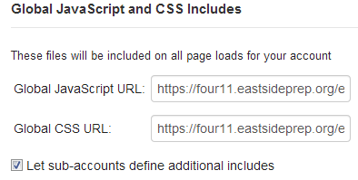

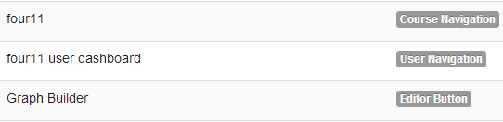
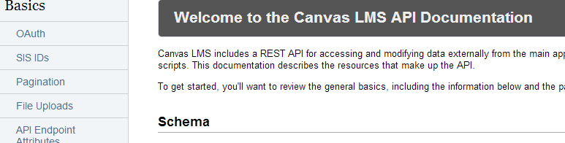
Background: Ways to Customize Canvas
javascript – interact with page content
CSS – Design adjustments (branding)
LTI Tools - Add features to canvas
  Add links to navigation, rich text editor features
  Add External Tools to Modules
  Add facebook style apps
API – talk to canvas behind the scenes

Slide 43
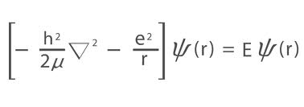
Problem: Math and Science Teachers want better equations - Javascript
Solution: Add in the MathJax library
var mj = document.createElement('script');
mj.type = 'text/javascript';
mj.async = true;
mj.src = 'https://d3eoax9i5htok0.cloudfront.net/mathjax/latest/MathJax.js?config=TeX-MML-AM_HTMLorMML';
document.getElementsByTagName('body')[0].appendChild(mj);

