Slide 1
Customizations:
Where the LMS stops and your school begins

Slide 2
What makes a school great?
Culture!
Make Your LMS Support YOUR Culture

Slide 3
Customize to support the culture
Eastside Prep & Canvas Customizations
Branding
Open Courses
SIS Integration
Faculty – Student Communication
MathJAX
Google Analytics
Grading Notes
Class Agendas
Attendance
Strengths
Schedules
Grade Reports
Student Self Reflections
Course Evaluations
Split Calendars
Assignment Machine

Slide 4
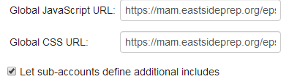


tools
Static Demos live demos questions
Tools
CSS (styling)
JavaScript (programmatic control)
LTI Apps (integrated external web software)
API (direct programmatic access to canvas data)

Slide 5
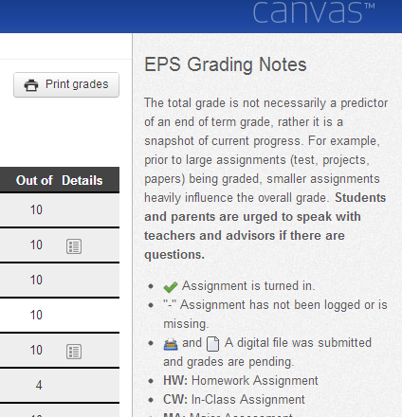
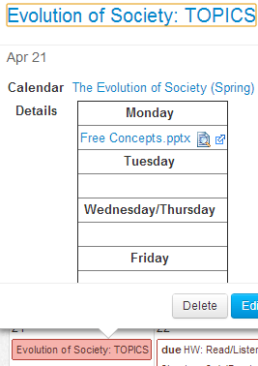
Grading Notes Class Agendas

Slide 6
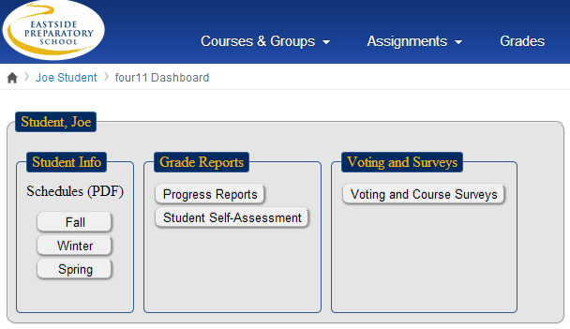
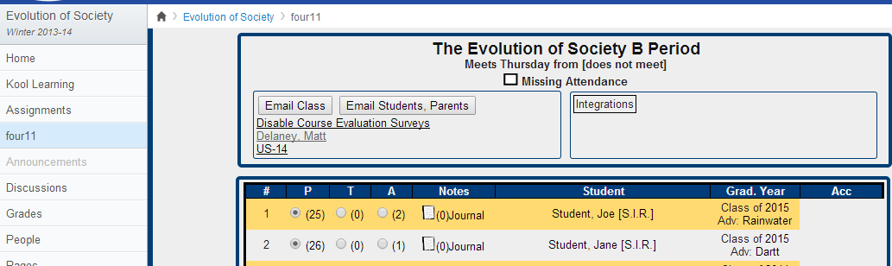
Four11 (SIS) integration

Slide 7
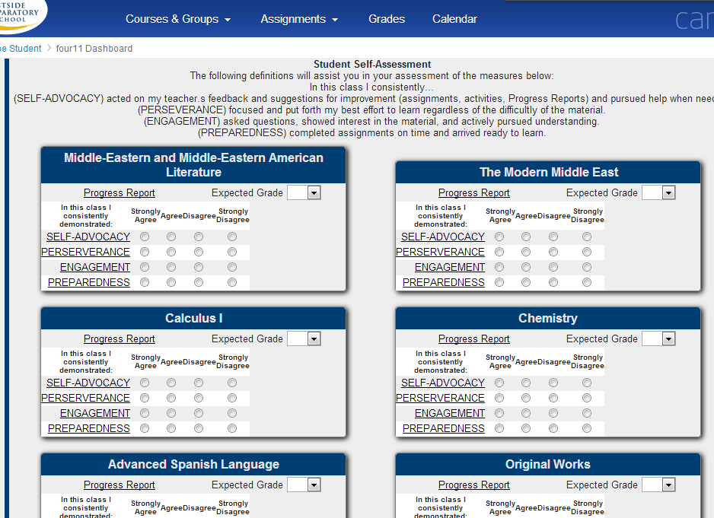
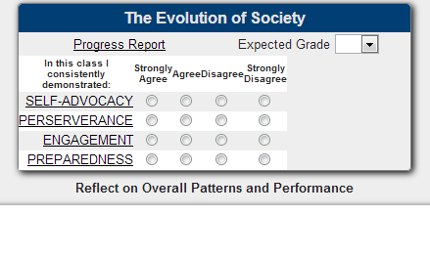
Student self assessments

Slide 8
Live demos
Demos
Google Analytics
Assignment Machine App
  Split Calendars

Slide 9
demand a humble, Trusting lms
One that plays well with others
One that trusts its customers
One that listens to its customers
One that knows the innovations in education are going to come from many sources
One that understands that their decisions affect millions of students

Slide 10
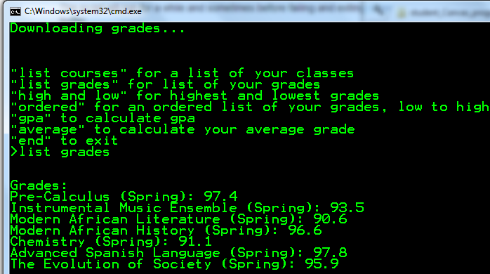
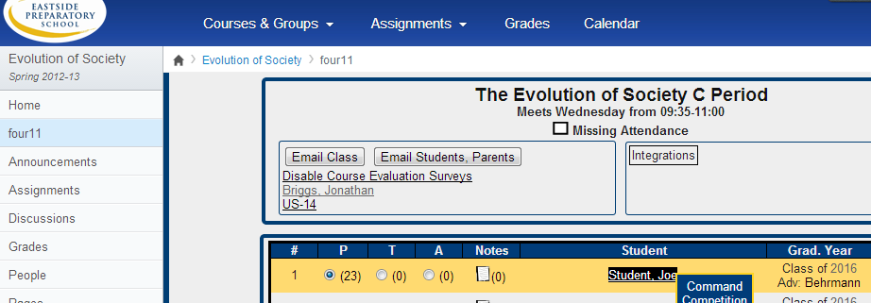
Questions?
Culture!
Make Your LMS Support YOUR School!
Make Your LMS Support YOUR Course!
RESOURCES
Bit.ly/CustomizingCanvas
Help.instructure.com
jbriggs@eastsideprep.org

