Slide 1
Math+Code+Design
Using OpenSCAD to Demystify 3D Modeling

Slide 2
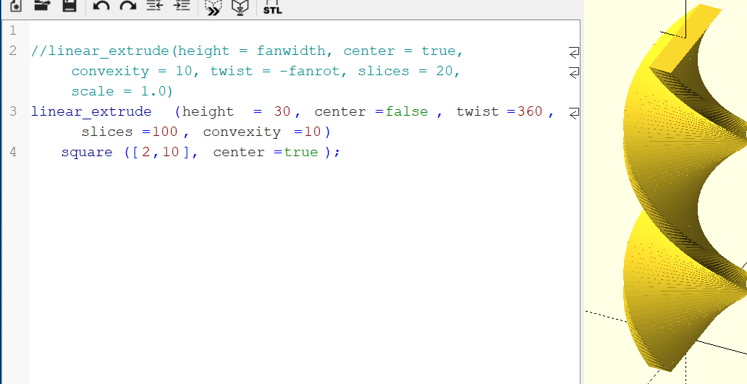
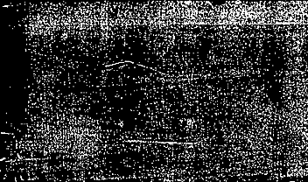
OpenSCAD: a 3D programing Environment
Apparently pronounced open-Scad, though we prefer open-S-CAD
You write code, you get shapes.

Slide 3
Today
10:30 – 10:45: Brief Tour of OpenSCAD
10:45 – 11:05: In pairs, run through the OpenSCAD guide
11:05 – 11:15: Live demo: Building a pencil
11:15 – 11:40: Build a pencil (or object of your choosing) in pairs
11:40 – 12:10: Thinking like a programmer – refactoring the pencil
12:10 – 12:20: How to get your object printed

Slide 4
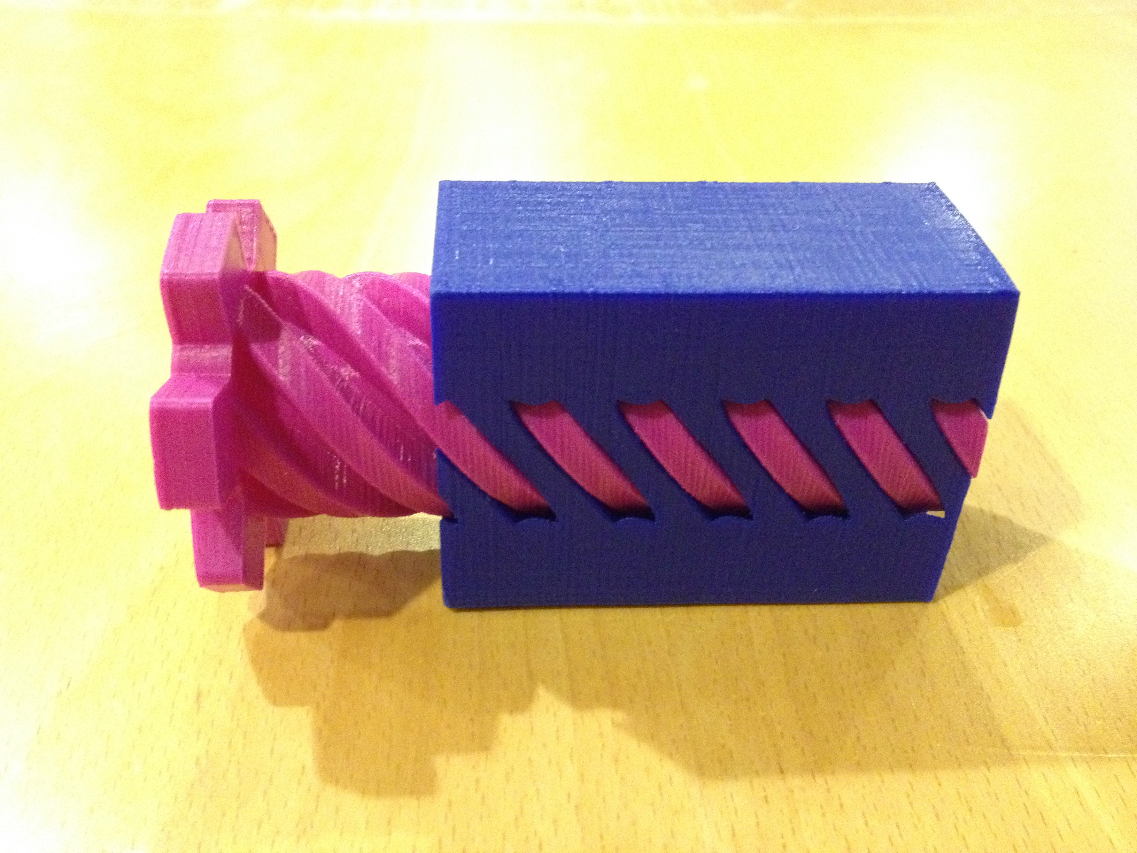
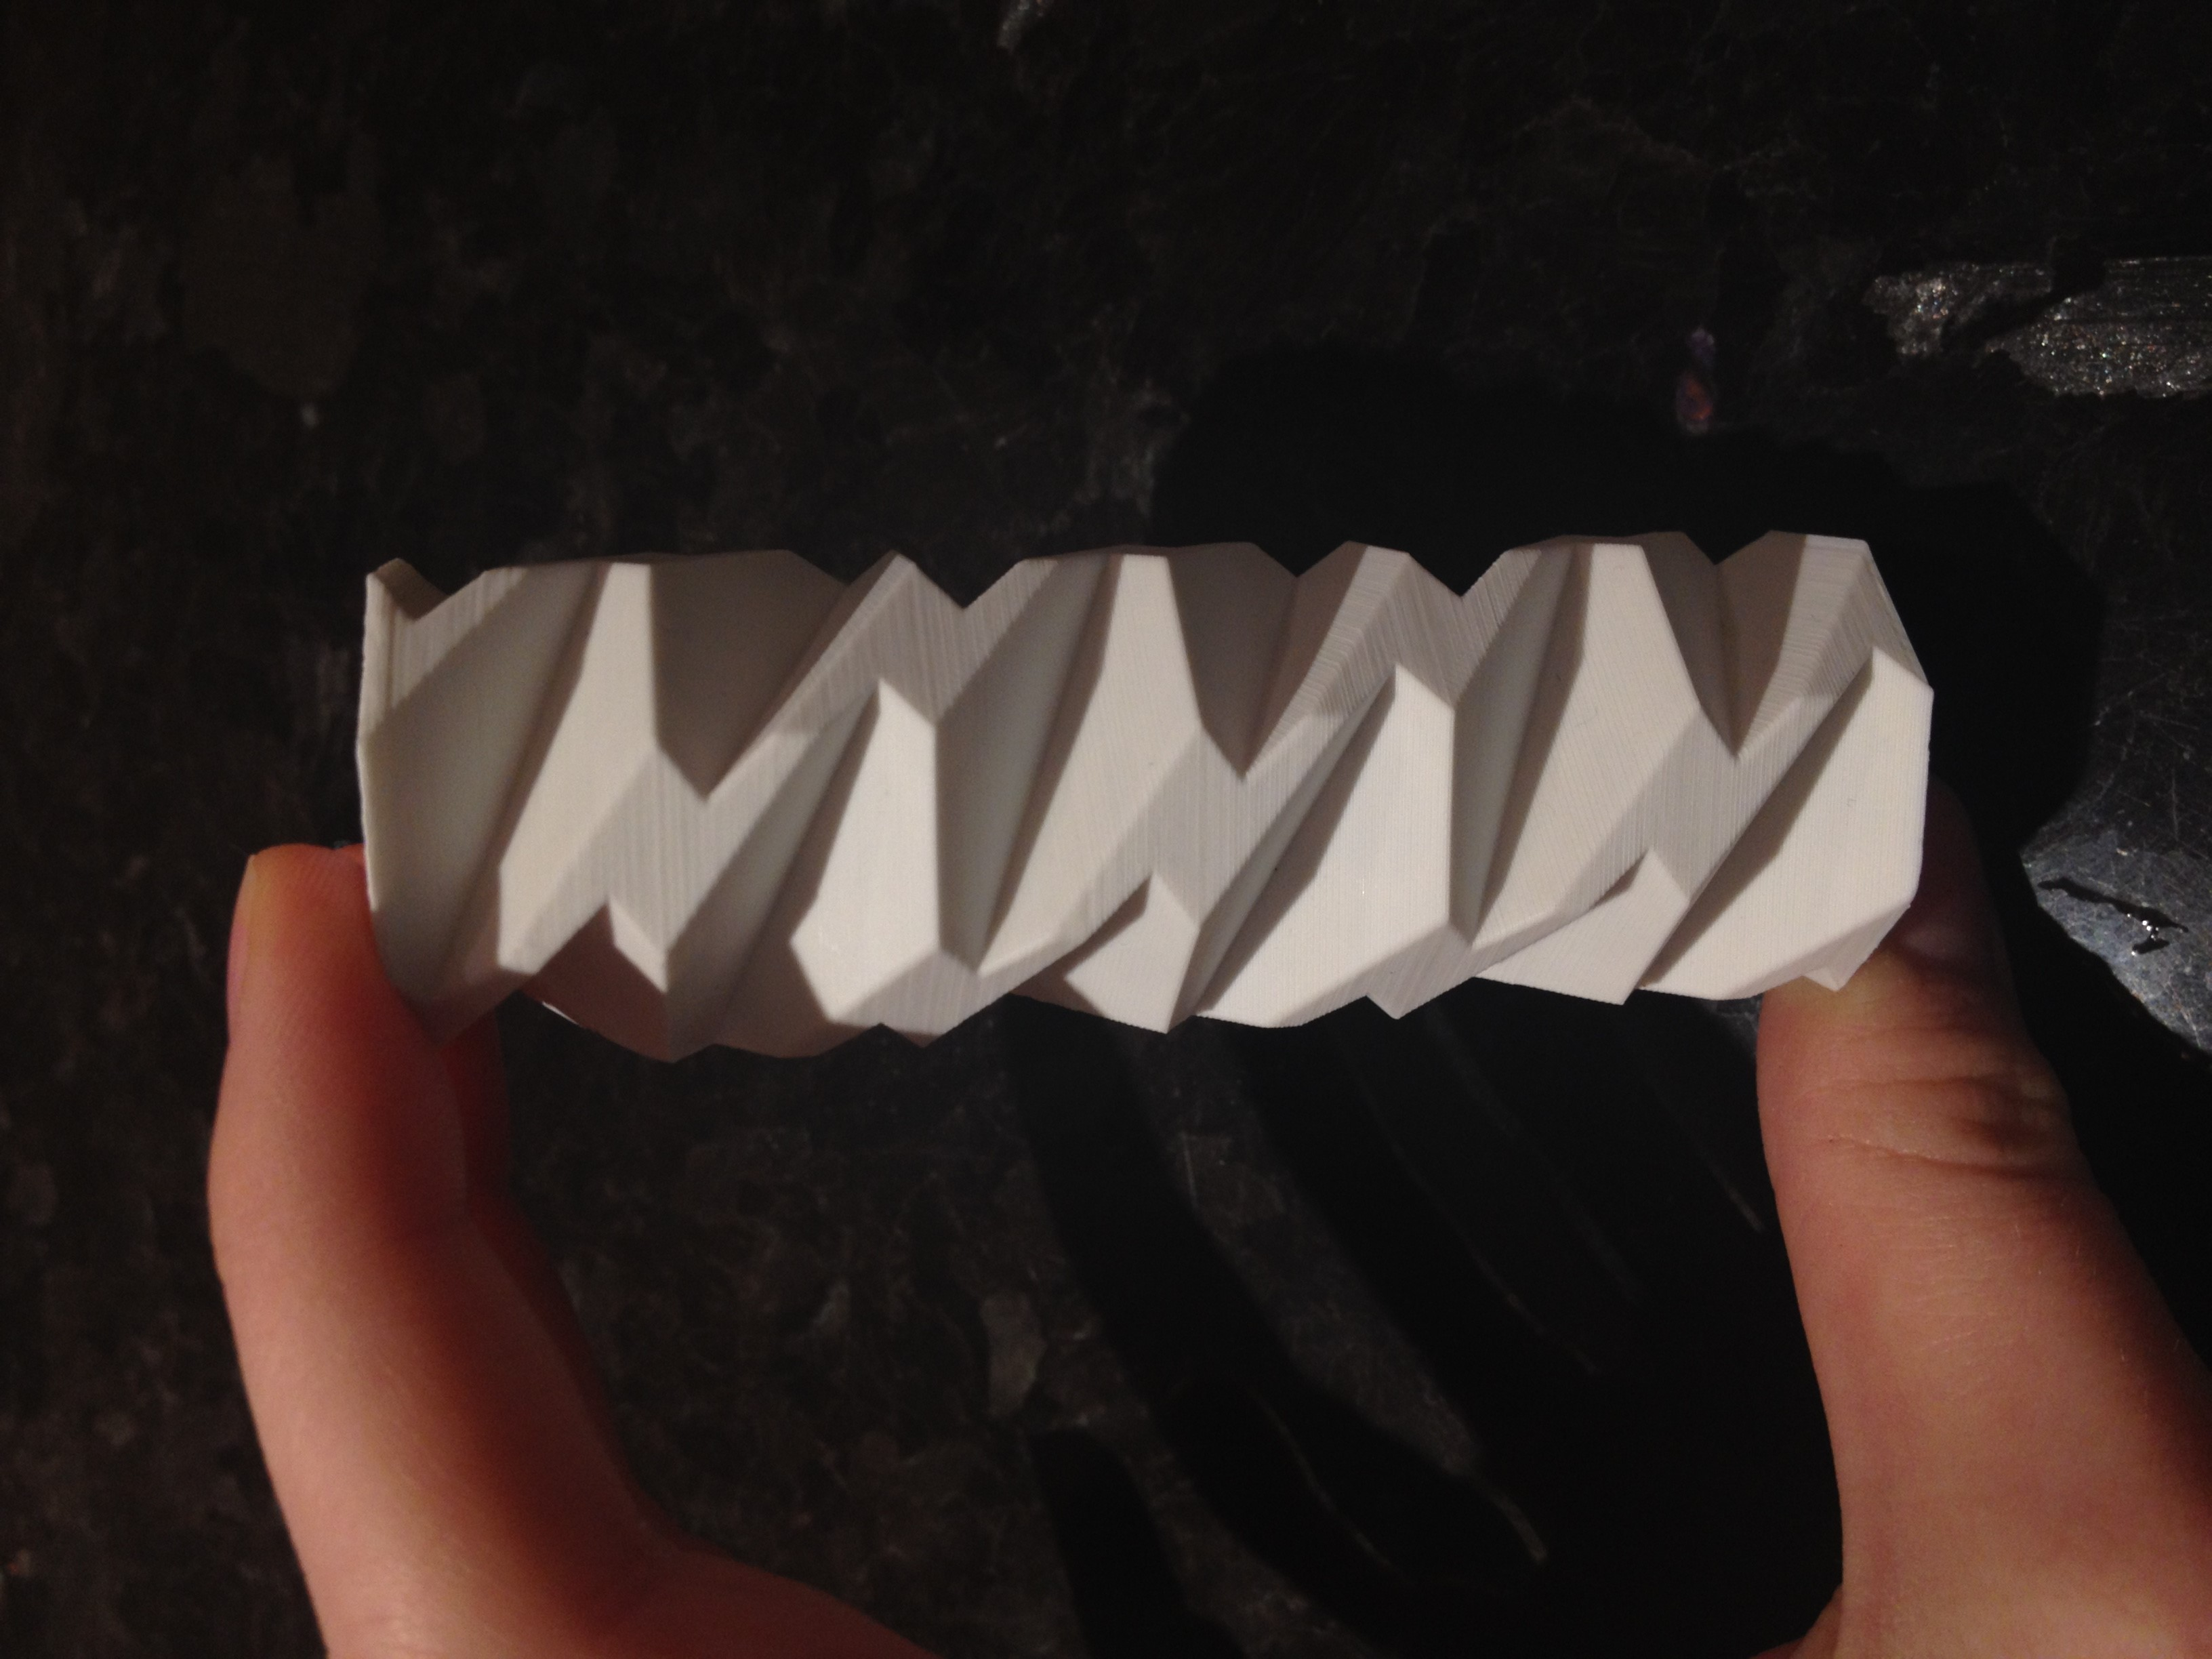
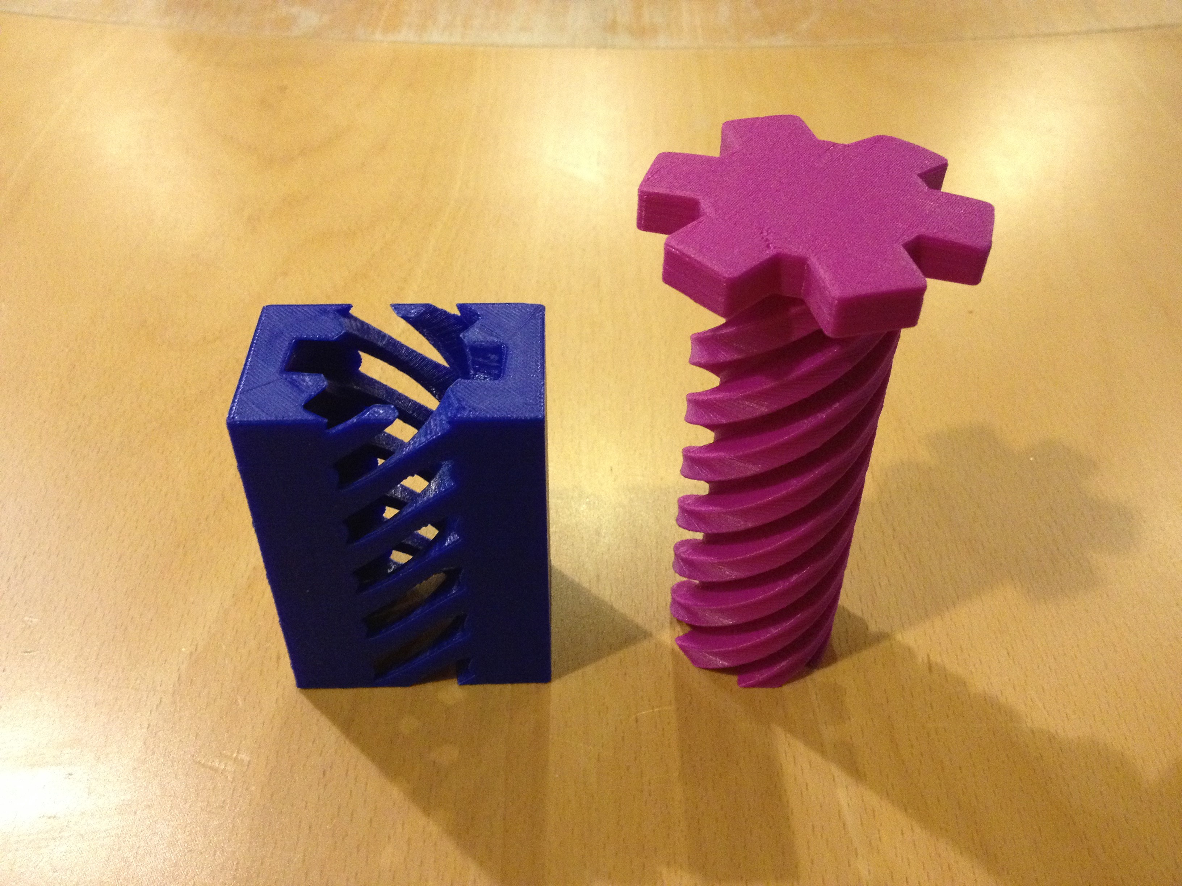
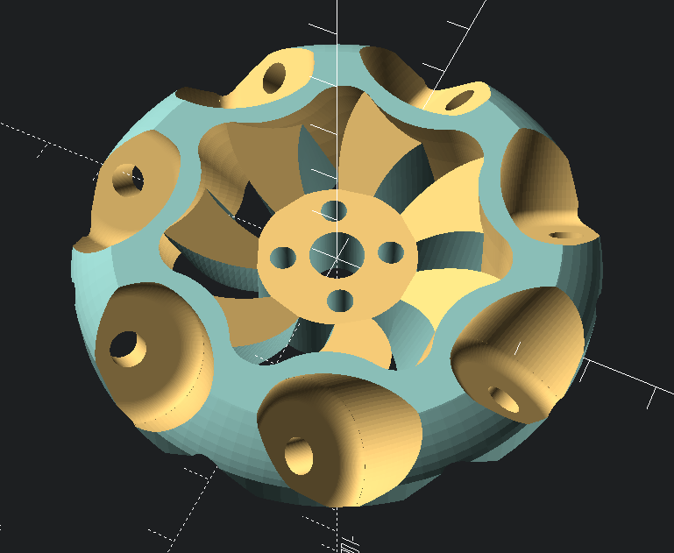
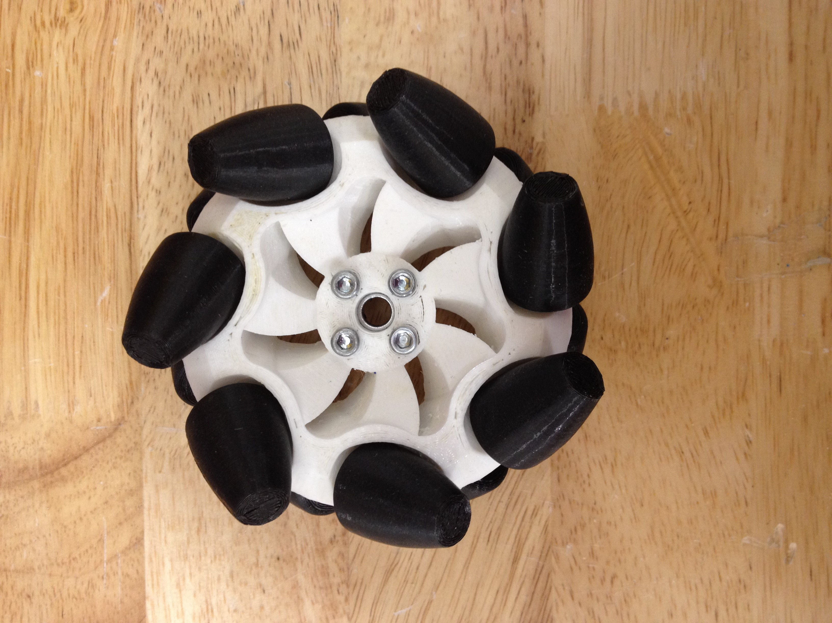
Some Examples

Slide 5
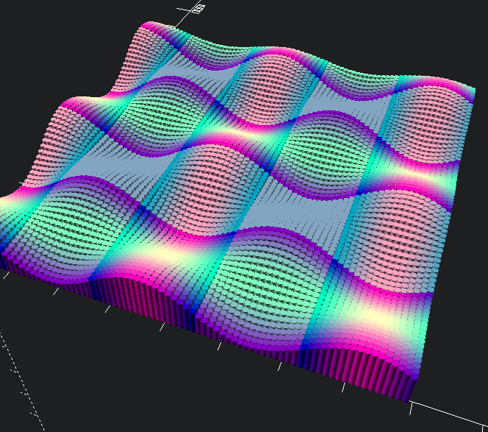
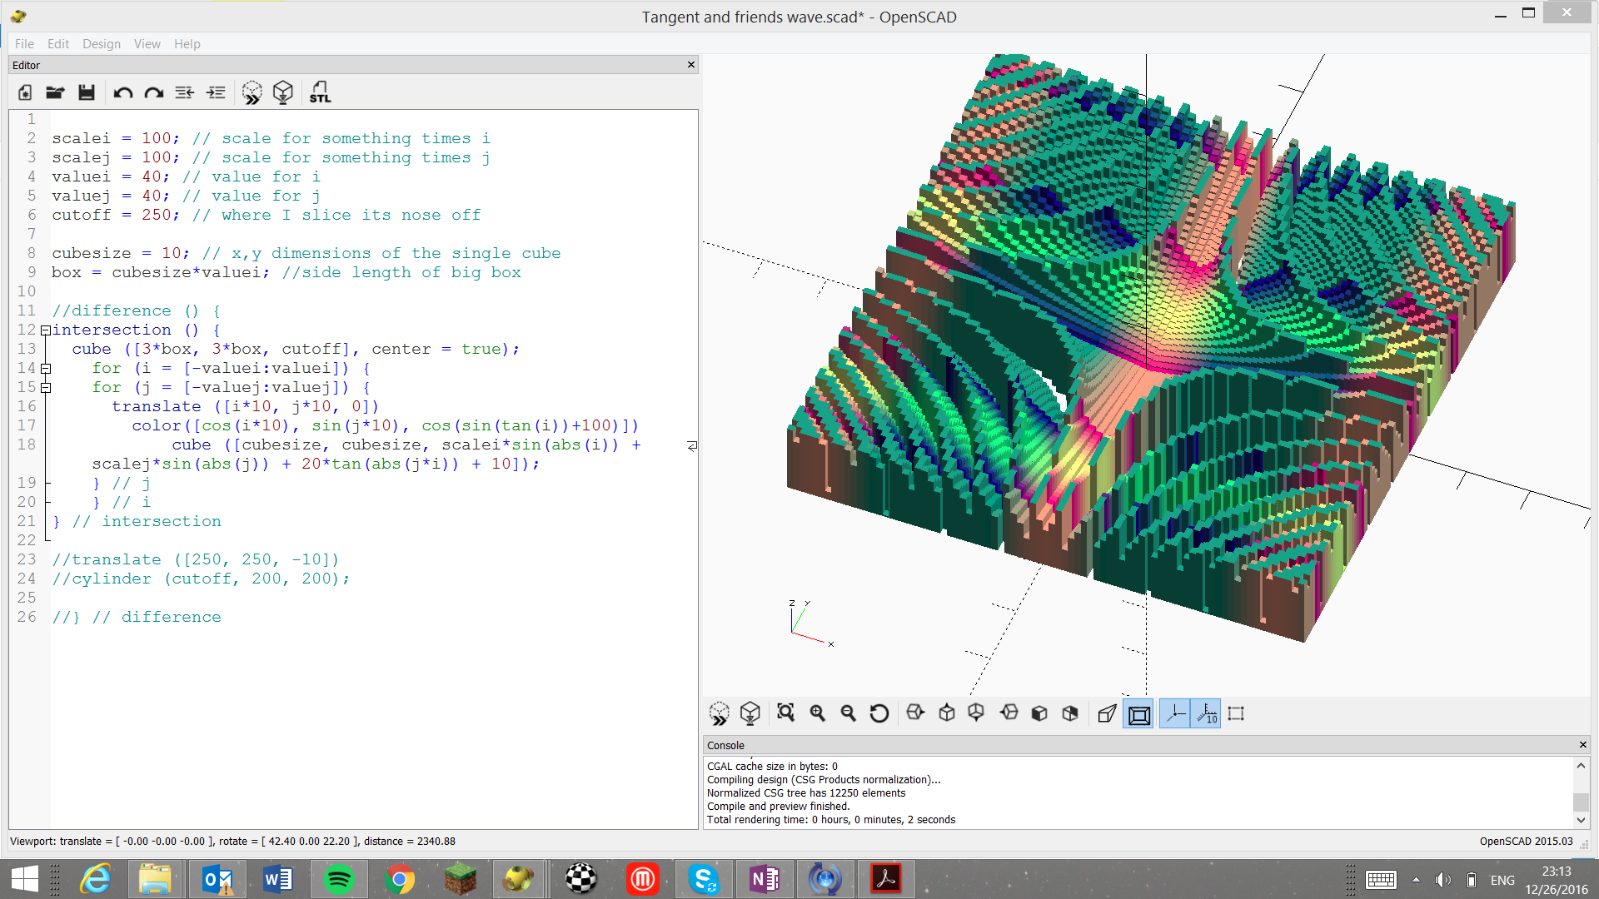
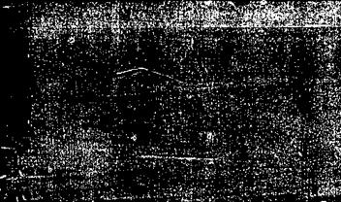
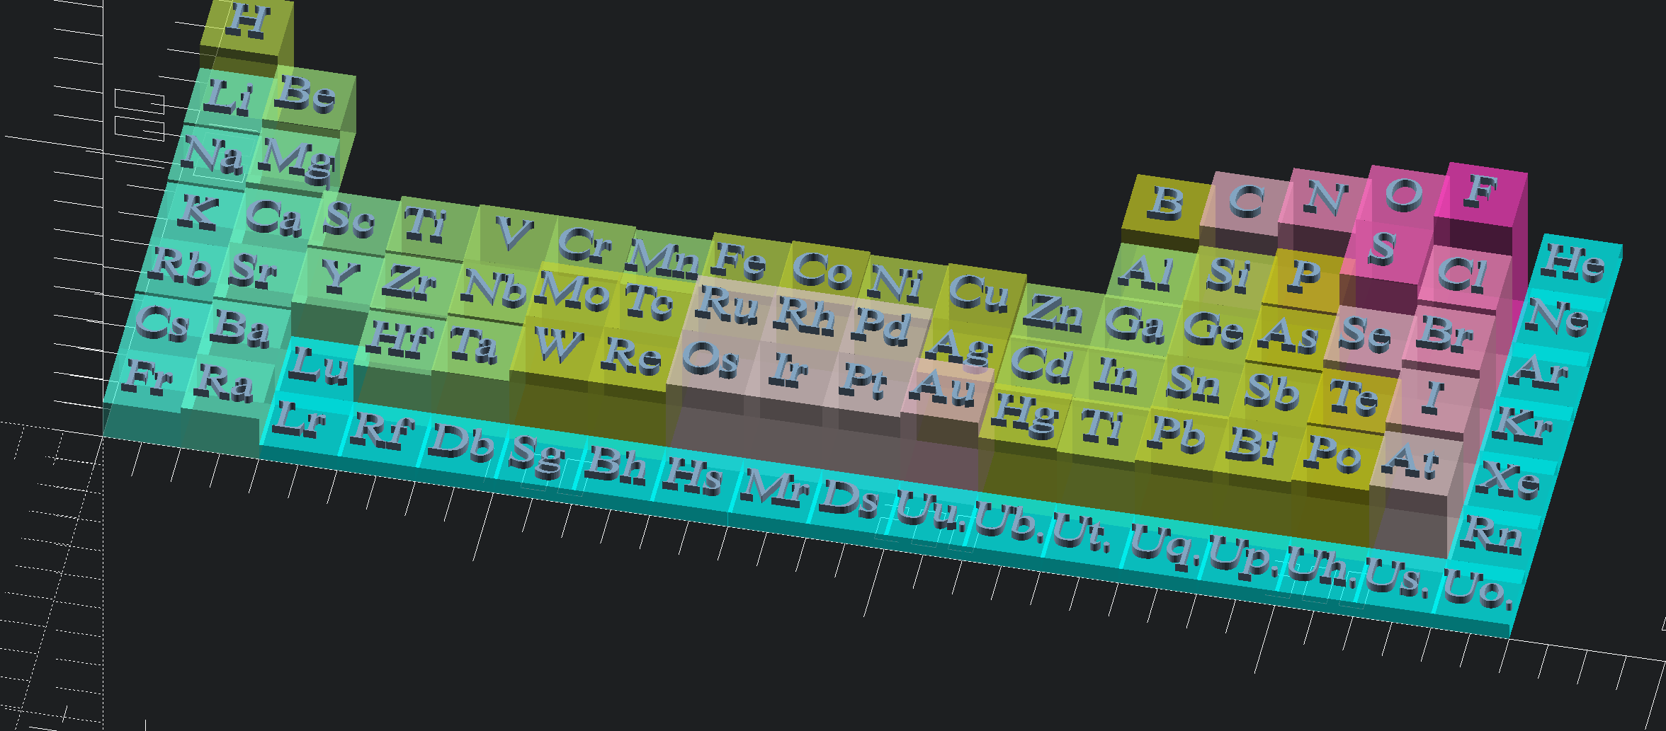
Math/Science Integrated

Slide 6
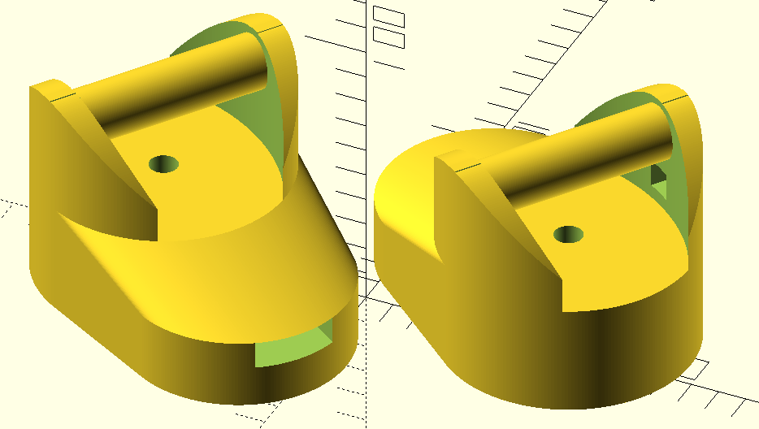
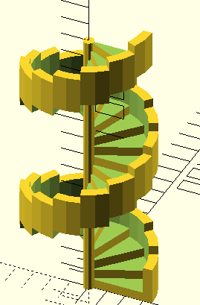
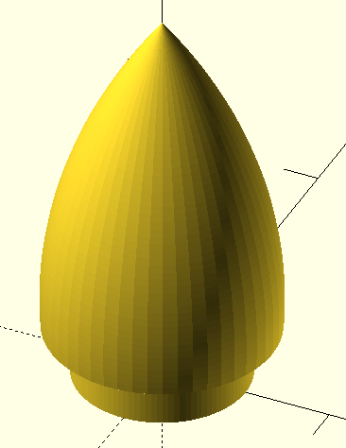
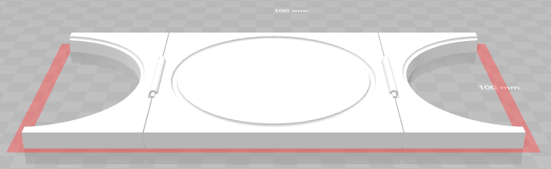
Student Projects

Slide 7
Let’s Begin
10:30 – 10:45: Brief Tour of OpenSCAD
10:45 – 11:05: In pairs, run through the OpenSCAD guide
11:05 – 11:15: Live demo: Building a pencil
11:15 – 11:40: Build a pencil (or object of your choosing) in pairs
11:40 – 12:10: Thinking like a programmer – refactoring the pencil
12:10 – 12:20: How to get your object printed

Slide 8
Jonathan Briggs
http://bit.ly/BriggsNCCE18
jbriggs@eastsideprep.org

