Slide 1

Financial Industry
AI Bias in Loan Approbal Models Data

Slide 2
Introduction
Objectives
Agenda
Analysis
Conclusions
Recomendations

Slide 3

Introduction
The integration of AI to streamline loan approval decisions is undeniably here to stay.
Addressing associated challenges has become a top priority for organizations.
the real hurdle lies in the historically biased data fed into machine learning algorithms for predictions.
Identify factors during the data management phase contribute to these undesirable outcomes.
Back to Agenda Page

Slide 4
Goals / Objectives
Back to Agenda Page
•To offer actionable recommendations for banks to proactively address bias in AI systems within the competitive financial market.
• To uncover and illustrate instances of bias within the data used to develop AI-driven loan eligibility criteria.
• To investigate how AI algorithm biases impact businesses and their customers.

Slide 5
Data Analysis
Back to Agenda Page

Slide 6
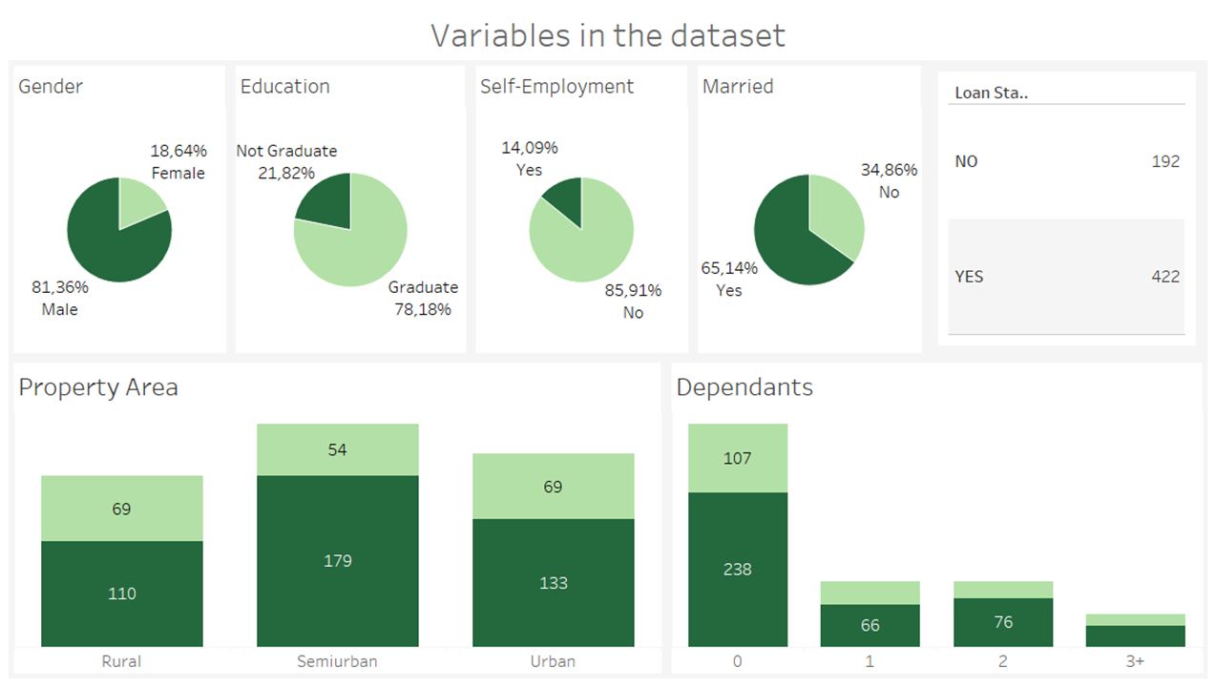

Slide 7
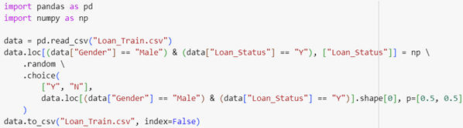
Back to Agenda Page
Modifying approval status

Slide 8
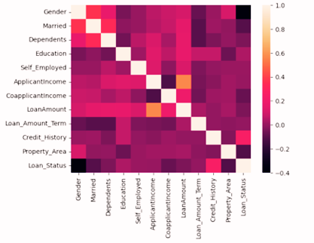
Correlation Matrix
Back to Agenda Page

Slide 9
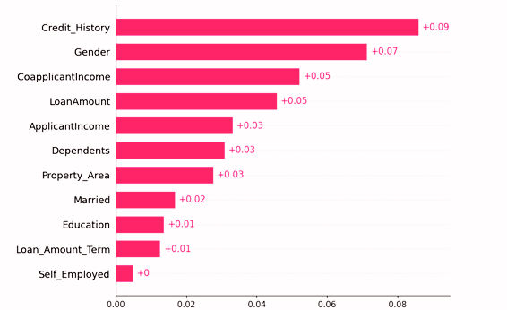
SHAP Plot
Back to Agenda Page

Slide 10
Culmination
Conclusion
Recomendation
HeatMap analysis reviews negative correlation for males post-alteration, indicating gender bias.
SHAP tool reveals unequal influence of gender on loan approval decisions.
Biased data leads to unfair AI-Driven decisions
Further investigation into AI Bias in Loan Approval is encouraged.
Use of Empirical analysis could offer strong foundation for financial institutions to refine their AI Systems.
Unbiased data source
Back to Agenda Page

Slide 11
Implications of the research
Back to Agenda Page
Increased responsibility
Major focus in data management
Exploration of alternatives to traditional lending criteria

Slide 12
Thank You!

