Slide 1


Data Scientist Project
Jon de Ellacuria
May 2023

Slide 2


@TheBridge_Tech twitter analysis
Case Study
The_Bridge account tweets and mentions
From 2023-02-13 to 2023-05-22
SQL Tables
tweets
users
Pretrained Model
Sentiment Analysis
API Deployment

Slide 3
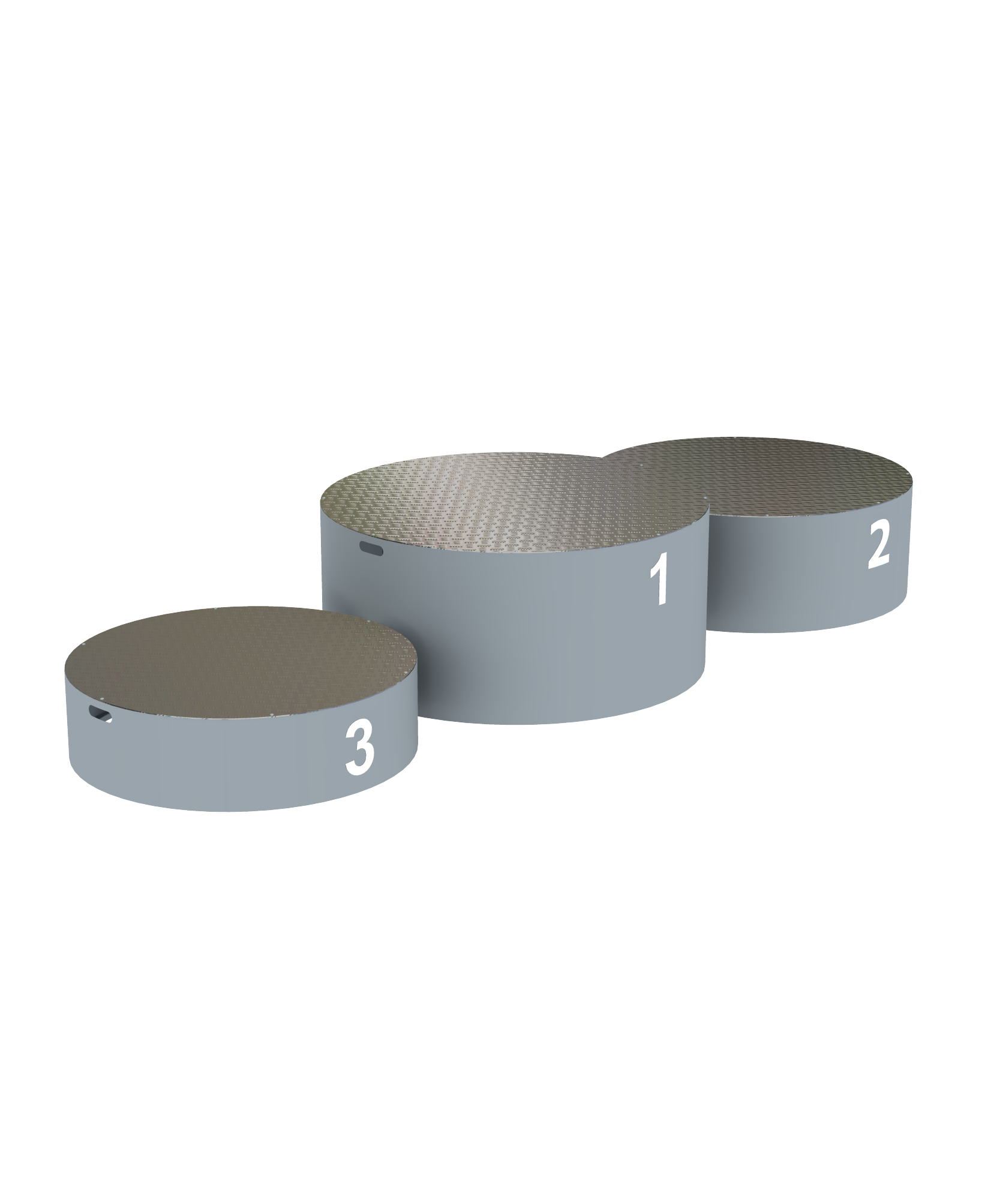

Tweets Analysis
143 tweets ------> 114 spanish
Top 3

Slide 4
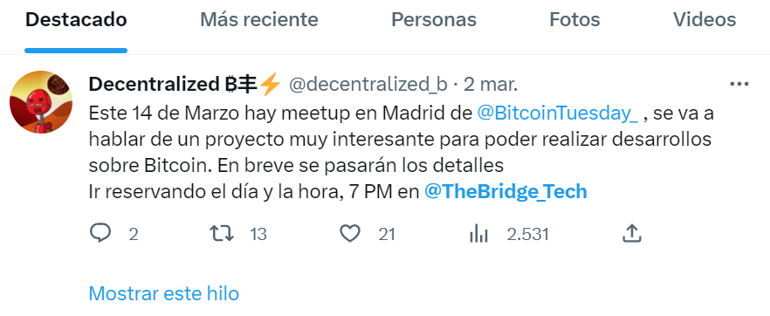
Metrics

Slide 5
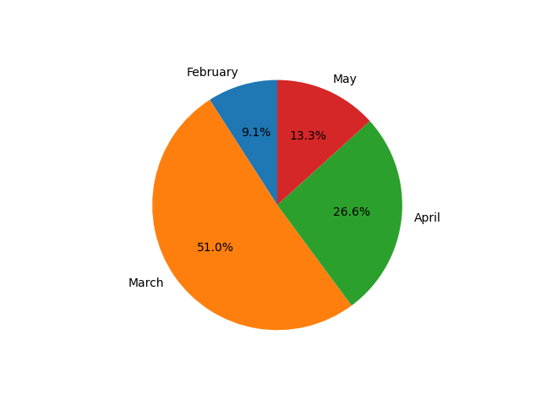
KeyWords
#bootcamp -----------> 14
Entradas ---------------> 14
“No te lo pierdas”---> 12

Slide 6
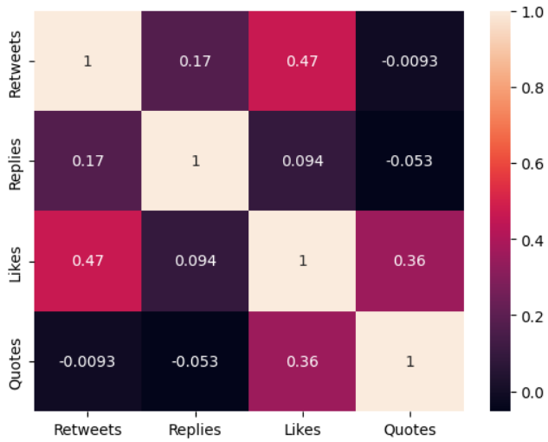
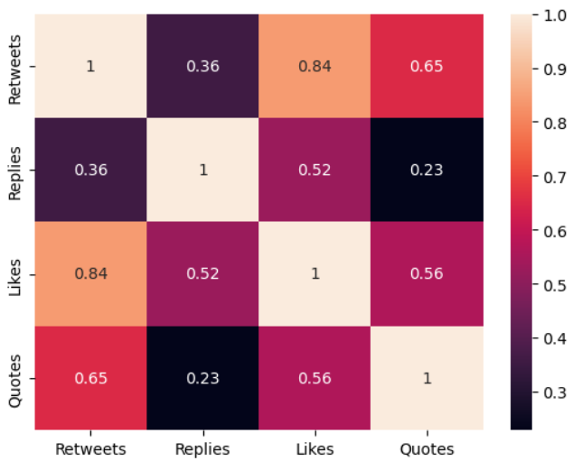
Tweets by The_Bridge
Tweets by others

Slide 7
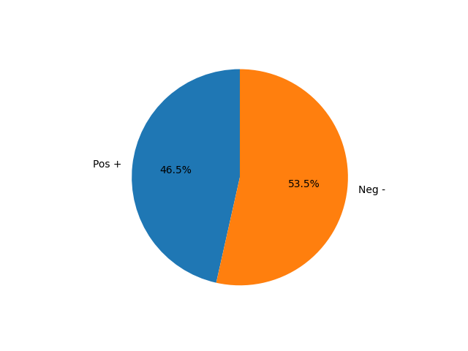
Sentiment Model
114 tweets
Clearest neg
Clearest pos

Slide 8
Metrics & “positivity” rel
Improvements
Twitter trained Model
Built by similar companies
Metrics based Model (Y)
Let´s test
Welcome
Tweets and Users Tables
Model test on ddbb
Try something different

Slide 9
Thanks for watching!

