Slide 1
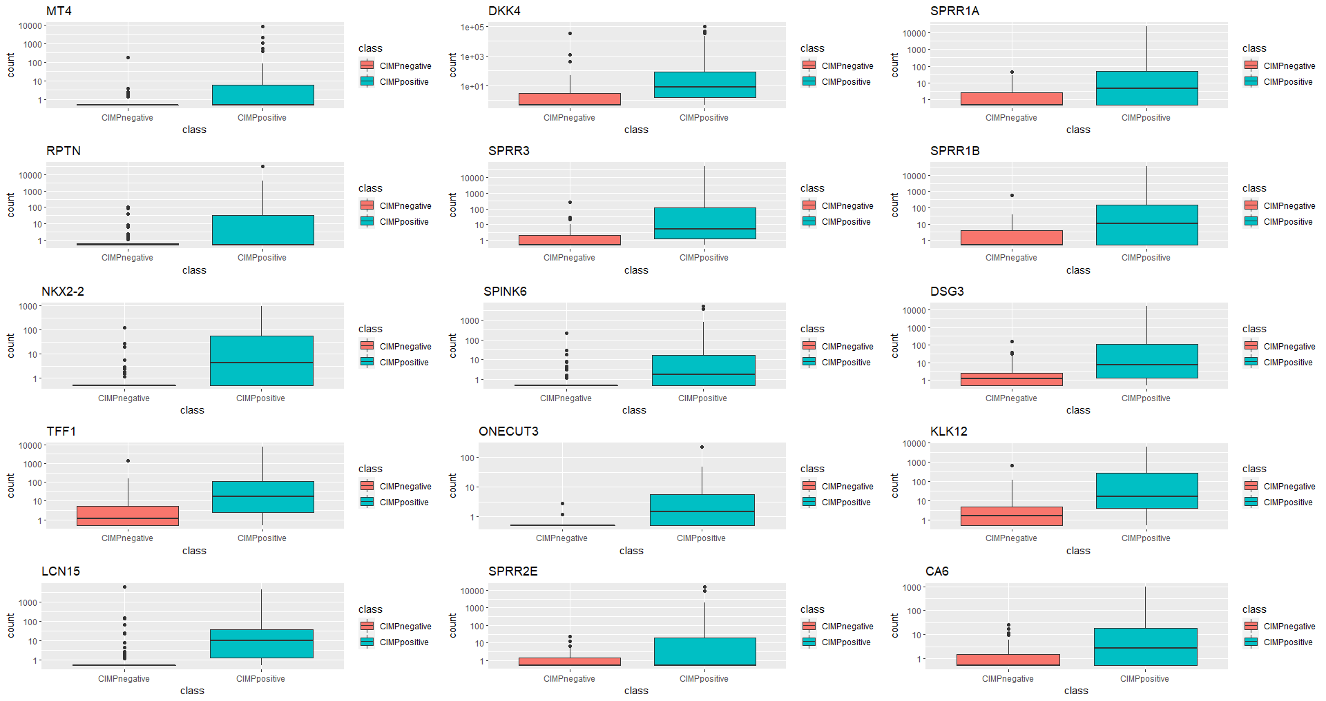
posnegdesc

Slide 2
row | baseMean | log2FoldChange | lfcSE | stat | pvalue | padj
FABP4|2167 | 944.756 | 5.542981 | 0.539936 | 10.266 | 1.00E-24 | 9.13E-22
AMBP|259 | 942.5268 | 5.400826 | 0.561385 | 9.620546 | 6.55E-22 | 3.20E-19
SPRR3|6707 | 111.5915 | 7.147568 | 0.747192 | 9.56591 | 1.11E-21 | 5.30E-19
S100A3|6274 | 358.1412 | 3.757419 | 0.395822 | 9.492702 | 2.25E-21 | 9.42E-19
SPRR1B|6699 | 146.3681 | 7.098812 | 0.763527 | 9.297391 | 1.44E-20 | 5.54E-18
DSG3|1830 | 81.28641 | 6.005842 | 0.662257 | 9.068746 | 1.20E-19 | 3.94E-17
KLK12|43849 | 133.2078 | 5.83079 | 0.642994 | 9.068189 | 1.21E-19 | 3.94E-17
SPRR1A|6698 | 184.626 | 7.452443 | 0.830005 | 8.978788 | 2.74E-19 | 8.06E-17
GPX2|2877 | 1134.138 | 5.011415 | 0.569296 | 8.802827 | 1.33E-18 | 3.56E-16
C6orf15|29113 | 162.7238 | 4.876315 | 0.558562 | 8.730117 | 2.54E-18 | 6.21E-16
NKX2-2|4821 | 40.1384 | 6.977507 | 0.810023 | 8.613962 | 7.06E-18 | 1.68E-15
KRT16|3868 | 1432.421 | 4.14255 | 0.487314 | 8.500784 | 1.88E-17 | 4.29E-15
DBH|1621 | 62.0222 | 4.165862 | 0.498381 | 8.358789 | 6.34E-17 | 1.32E-14
SCGB2A2|4250 | 125.4253 | 4.591862 | 0.554212 | 8.285387 | 1.18E-16 | 2.31E-14
GRIN1|2902 | 55.13945 | 3.2552 | 0.398867 | 8.161108 | 3.32E-16 | 6.10E-14
DKK4|27121 | 2665.961 | 7.82755 | 0.966581 | 8.098185 | 5.58E-16 | 9.80E-14
TFF1|7031 | 196.9972 | 5.888788 | 0.740016 | 7.957647 | 1.75E-15 | 2.83E-13
CDKN1A|1026 | 5910.132 | 1.969407 | 0.249042 | 7.907943 | 2.62E-15 | 4.03E-13
HAS3|3038 | 631.1887 | 2.793416 | 0.354897 | 7.871057 | 3.52E-15 | 5.34E-13
MUC6|4588 | 1056.934 | 4.32324 | 0.551527 | 7.838674 | 4.55E-15 | 6.76E-13

Slide 3
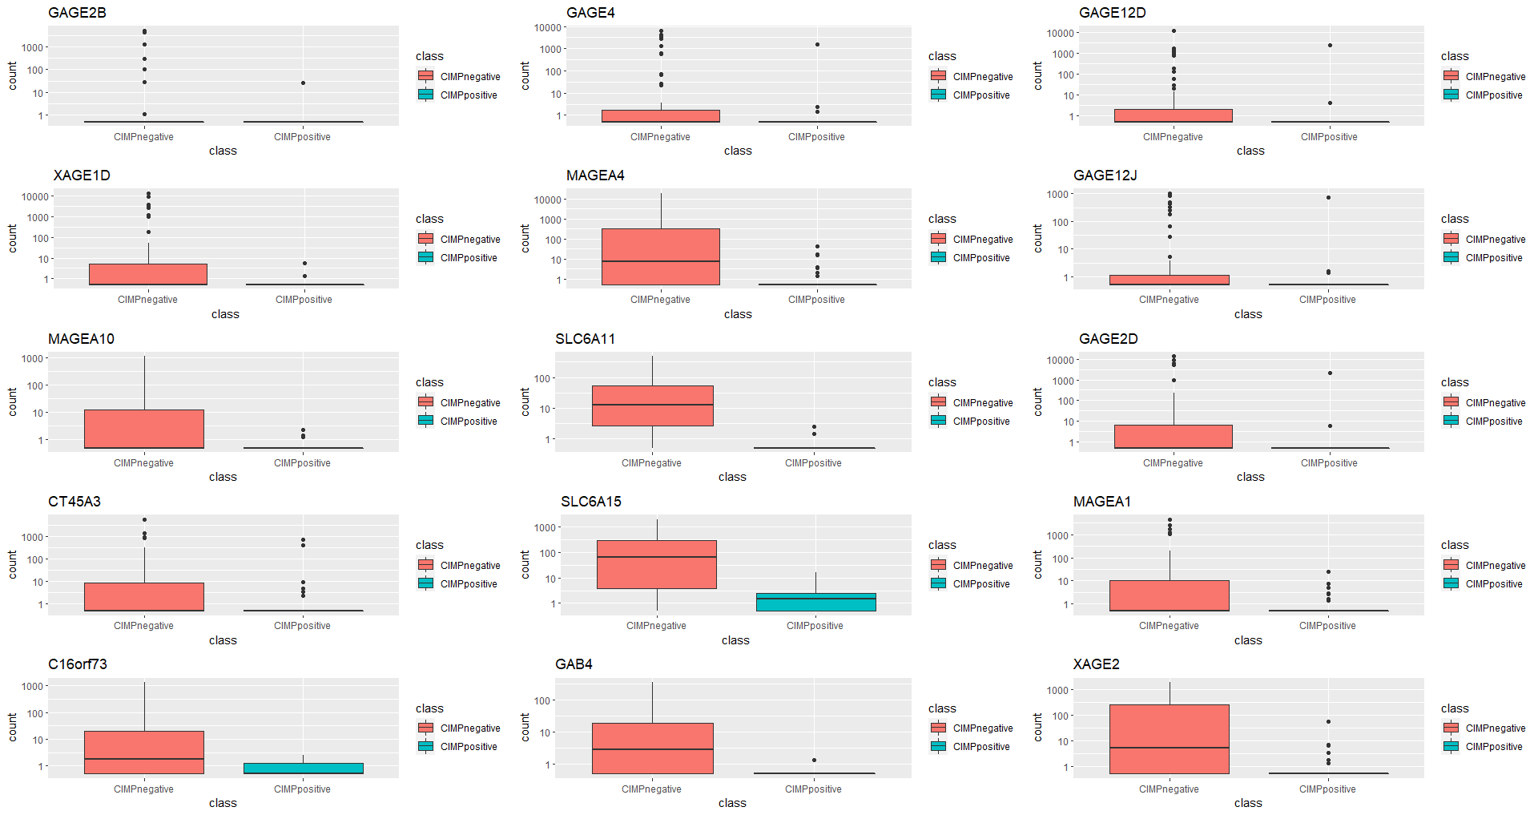
Posnegasc

Slide 4
row | baseMean | log2FoldChange | lfcSE | stat | pvalue | padj
ZNF334|55713 | 182.7714 | -5.02343 | 0.369841 | -13.5827 | 5.07E-42 | 1.02E-37
MX2|4600 | 1609.159 | -2.86067 | 0.220183 | -12.9922 | 1.35E-38 | 1.36E-34
ZNF229|7772 | 153.597 | -5.16255 | 0.409574 | -12.6047 | 1.99E-36 | 1.33E-32
CELF4|56853 | 93.3136 | -3.43146 | 0.277769 | -12.3537 | 4.65E-35 | 2.33E-31
ANO5|203859 | 89.46321 | -3.28409 | 0.268796 | -12.2178 | 2.50E-34 | 1.00E-30
SLC6A15|55117 | 170.9968 | -7.05866 | 0.585914 | -12.0473 | 2.01E-33 | 6.69E-30
SLC6A11|6538 | 30.19355 | -7.76733 | 0.64552 | -12.0327 | 2.39E-33 | 6.85E-30
TSPYL5|85453 | 823.2596 | -3.96001 | 0.346227 | -11.4376 | 2.71E-30 | 6.79E-27
C1orf114|57821 | 83.38628 | -4.33895 | 0.383473 | -11.3149 | 1.11E-29 | 2.46E-26
IQCA1|79781 | 360.5623 | -4.30526 | 0.381568 | -11.2831 | 1.59E-29 | 3.19E-26
GSPT2|23708 | 268.1105 | -3.37675 | 0.300852 | -11.224 | 3.11E-29 | 5.66E-26
DCAF12L1|139170 | 186.9695 | -5.03335 | 0.457899 | -10.9923 | 4.16E-28 | 6.95E-25
C18orf18|147525 | 54.65626 | -2.78022 | 0.253806 | -10.9541 | 6.35E-28 | 9.78E-25
TRO|7216 | 1113.552 | -3.38703 | 0.309801 | -10.9329 | 8.02E-28 | 1.15E-24
CDKN2A|1029 | 3222.229 | -2.88434 | 0.264824 | -10.8916 | 1.26E-27 | 1.69E-24
SLC6A10P|386757 | 310.9802 | -4.60617 | 0.428632 | -10.7462 | 6.17E-27 | 7.73E-24
CTCFL|140690 | 714.2074 | -4.62777 | 0.433706 | -10.6703 | 1.40E-26 | 1.65E-23
FAM24B|196792 | 60.00136 | -3.64004 | 0.345165 | -10.5458 | 5.31E-26 | 5.91E-23
LOC339290|339290 | 477.3648 | -2.51859 | 0.239344 | -10.5229 | 6.78E-26 | 7.14E-23
COL9A1|1297 | 1522.419 | -5.69319 | 0.545629 | -10.4342 | 1.73E-25 | 1.73E-22

Slide 5
Chromatin modifier Genes
row | baseMean | log2FoldChange | lfcSE | stat | pvalue | padj
TP63|8626 | 80.61758 | 1.315378 | 0.386737 | 3.401219 | 0.000671 | 0.004102
PPARG|5468 | 436.4561 | 1.232979 | 0.358761 | 3.436769 | 0.000589 | 0.003682
SATB2|23314 | 275.245 | 1.20488 | 0.355099 | 3.393082 | 0.000691 | 0.004199
HNF1A|6927 | 317.8699 | 1.09888 | 0.351233 | 3.128632 | 0.001756 | 0.008852
PHF7|51533 | 105.0601 | 1.009552 | 0.206023 | 4.900192 | 9.57E-07 | 1.64E-05
MPND|84954 | 1333.108 | 1.004928 | 0.171108 | 5.87305 | 4.28E-09 | 1.49E-07
ESR1|2099 | 8760.428 | 0.985753 | 0.334199 | 2.949601 | 0.003182 | 0.014309
BAHCC1|57597 | 659.7061 | 0.925522 | 0.313998 | 2.94754 | 0.003203 | 0.014372
JHDM1D|80853 | 1458.338 | 0.921843 | 0.191142 | 4.82281 | 1.42E-06 | 2.28E-05
ELP3|55140 | 3712.955 | 0.893795 | 0.207433 | 4.308845 | 1.64E-05 | 0.000186
KDM4B|23030 | 2959.458 | 0.884677 | 0.146473 | 6.039848 | 1.54E-09 | 6.12E-08
IDH1|3417 | 7739.478 | 0.764422 | 0.197338 | 3.873669 | 0.000107 | 0.00091
MBD3|53615 | 5910.863 | 0.747339 | 0.162114 | 4.609952 | 4.03E-06 | 5.59E-05
RBBP7|5931 | 10046.42 | 0.714689 | 0.166505 | 4.292301 | 1.77E-05 | 0.000198
CENPM|79019 | 1022.282 | 0.691093 | 0.204033 | 3.387161 | 0.000706 | 0.004266
SIRT6|51548 | 1200.14 | 0.652366 | 0.14711 | 4.434553 | 9.23E-06 | 0.000115
IDH2|3418 | 9161.751 | 0.652014 | 0.178024 | 3.662504 | 0.00025 | 0.001828
TET2|54790 | 960.7582 | 0.636854 | 0.141479 | 4.5014 | 6.75E-06 | 8.75E-05
UHRF1|29128 | 923.5898 | 0.631361 | 0.186095 | 3.392677 | 0.000692 | 0.004203
DOT1L|84444 | 1633.057 | 0.616071 | 0.115369 | 5.340008 | 9.29E-08 | 2.19E-06

Slide 6
DDR Genes
row | baseMean | log2FoldChange | lfcSE | stat | pvalue | padj
MPG|4350 | 2716.261 | 0.885302 | 0.154255 | 5.739211 | 9.51E-09 | 3.00E-07
DDB2|1643 | 836.3458 | 0.859814 | 0.179436 | 4.791759 | 1.65E-06 | 2.60E-05
NEIL2|252969 | 1056.457 | 0.737265 | 0.151689 | 4.860382 | 1.17E-06 | 1.94E-05
EME2|197342 | 29.69077 | 0.69381 | 0.239888 | 2.892221 | 0.003825 | 0.016577
CHAF1A|10036 | 1501.664 | 0.471728 | 0.150659 | 3.131096 | 0.001742 | 0.008804
XPA|7507 | 432.5832 | 0.410344 | 0.114123 | 3.595633 | 0.000324 | 0.002266
H2AFX|3014 | 5137.117 | 0.409897 | 0.166439 | 2.462744 | 0.013788 | 0.045906
POLG|5428 | 1904.529 | 0.409317 | 0.088243 | 4.638526 | 3.51E-06 | 4.97E-05
XRCC6|2547 | 16486.4 | 0.359763 | 0.10953 | 3.284615 | 0.001021 | 0.005729
CCNH|902 | 998.6264 | 0.3551 | 0.104421 | 3.400646 | 0.000672 | 0.004109
DUT|1854 | 2422.854 | 0.34314 | 0.135355 | 2.535114 | 0.011241 | 0.038941
GTF2H5|404672 | 1866.352 | 0.334866 | 0.127726 | 2.621757 | 0.008748 | 0.03184
TDG|6996 | 1181.825 | 0.333633 | 0.116863 | 2.85491 | 0.004305 | 0.01823
CDK7|1022 | 1235.447 | 0.327647 | 0.111013 | 2.951419 | 0.003163 | 0.014239
RAD23B|5887 | 6962.949 | 0.321183 | 0.110181 | 2.915052 | 0.003556 | 0.015661
XPC|7508 | 1875.151 | 0.242007 | 0.093199 | 2.59666 | 0.009414 | 0.033718
ERCC3|2071 | 2390.216 | -0.24418 | 0.070815 | -3.44813 | 0.000564 | 0.003563
CLK2|1196 | 2467.481 | -0.31058 | 0.110597 | -2.80825 | 0.004981 | 0.020421
ATR|545 | 1278.285 | -0.31959 | 0.12421 | -2.57301 | 0.010082 | 0.035678
MDC1|9656 | 1941.45 | -0.33971 | 0.110326 | -3.07911 | 0.002076 | 0.010126

Slide 7
WNT Genes
row | baseMean | log2FoldChange | lfcSE | stat | pvalue | padj
DKK4|27121 | 2665.961 | 7.82755 | 0.966581 | 8.098185 | 5.58E-16 | 9.80E-14
DKK1|22943 | 880.4829 | 3.028718 | 0.644521 | 4.699174 | 2.61E-06 | 3.87E-05
WIF1|11197 | 341.5405 | 1.834918 | 0.650532 | 2.820644 | 0.004793 | 0.019802
FZD10|11211 | 1373.044 | 1.754145 | 0.396368 | 4.425551 | 9.62E-06 | 0.000118
BAMBI|25805 | 2025.871 | 1.670394 | 0.395351 | 4.225087 | 2.39E-05 | 0.000256
APC2|10297 | 20.84981 | 1.321455 | 0.343977 | 3.841696 | 0.000122 | 0.00101
NKD1|85407 | 622.4273 | 1.152863 | 0.459846 | 2.507061 | 0.012174 | 0.041576
LEF1|51176 | 1869.599 | 1.05518 | 0.354128 | 2.979657 | 0.002886 | 0.013218
AXIN2|8313 | 1587.043 | 1.053401 | 0.344151 | 3.060866 | 0.002207 | 0.010626
GPC4|2239 | 3138.147 | 0.895783 | 0.314289 | 2.850193 | 0.004369 | 0.018432
PORCN|64840 | 1438.088 | 0.844409 | 0.245092 | 3.445272 | 0.00057 | 0.003596
CCND1|595 | 7824.267 | 0.841722 | 0.243462 | 3.457307 | 0.000546 | 0.003462
CAMK2D|817 | 1123.724 | 0.748121 | 0.199391 | 3.752021 | 0.000175 | 0.001366
TCF7|6932 | 1311.242 | 0.657782 | 0.255741 | 2.57206 | 0.01011 | 0.035751
CTNNBIP1|56998 | 2778.264 | 0.628826 | 0.155848 | 4.034864 | 5.46E-05 | 0.00052
CACYBP|27101 | 5330.39 | 0.593716 | 0.125691 | 4.723604 | 2.32E-06 | 3.49E-05
RHOA|387 | 19503.07 | 0.305626 | 0.089696 | 3.407356 | 0.000656 | 0.004021
NFATC3|4775 | 997.6115 | 0.300104 | 0.096945 | 3.09562 | 0.001964 | 0.009692
CSNK1A1|1452 | 9440.52 | 0.26673 | 0.09588 | 2.781925 | 0.005404 | 0.021778
AXIN1|8312 | 2534.04 | 0.250502 | 0.100564 | 2.490983 | 0.012739 | 0.043053

