Slide 1
It is possible to correctly classify unknown CIMP samples with just mutations?
Mutation Selection
for classification benefits
RF, MLP, KNN, SVM Results
For using mutations to classify CIMP
90% accuracy in classification
Strongest Mutations For classification
Via Venn Diagram of strongest mutations from classification
149 Most prevalent mutations in EC
Using Uterine Carcinoma Mutations to Classify Other Cancer Types
2 Uterine Sets (Validation)
2 Non-Uterine Sets (Pan-Cancer)
80% accuracy in validation
Notes:
Using a set of 739 mutations, we can classify Endometrial Carcinoma CIMP samples with 90% accuracy.
Does the model overfit the data?
No, from cross validation
Validation datasets

Slide 2
Mutation Selection
Mutational Separator | Number of mutations
Fishers Exact P value > 0.05 | 845
Fishers Exact P value > 0.01 | 326
Fishers Exact P value > 0.005 | 174
Chi Squared > 3.84 | 739
Chi Squared > 7.68 | 383
Chi Squared > 15.36 | 196
FP = 0, TP > 2 | 556
FP = 0, TP > 3 | 159
FP = 0, TP > 4 | 57
TP – 2 * FP > 2 | 609
TP – 2 * FP > 3 | 214
TP – 2 * FP > 4 | 80
All mutations | 8085
Used in for the benefit of classification accuracy

Slide 3
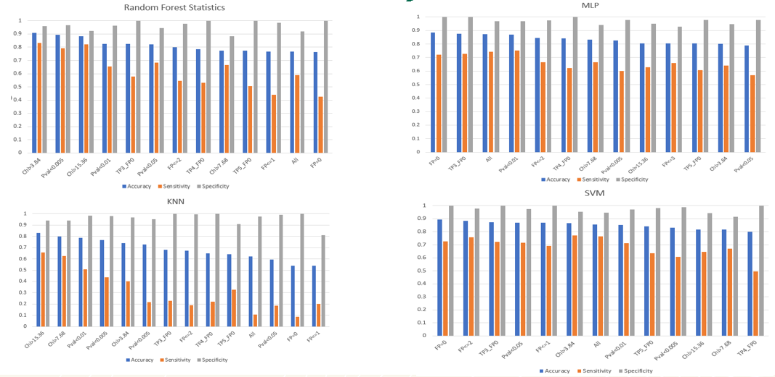
RF, MLP, KNN, SVM Results
Up to 90% accuracies found in classification of CIMP tumors using only mutational data.

Slide 4
How to select mutational selectors
The mutational selectors chosen for the following slides were selected based on the criteria of accuracy and number of mutations.
They are also of unique statistical relevance for each mutational selector.
CHI > 15.36 has 196 mutations and preforms at 88% in RF
P Value > 0.005 has 174 mutations and preformed 89% in RF
TP > 3, FP = 0 has 159 mutations and preformed 88% in SVM

Slide 5
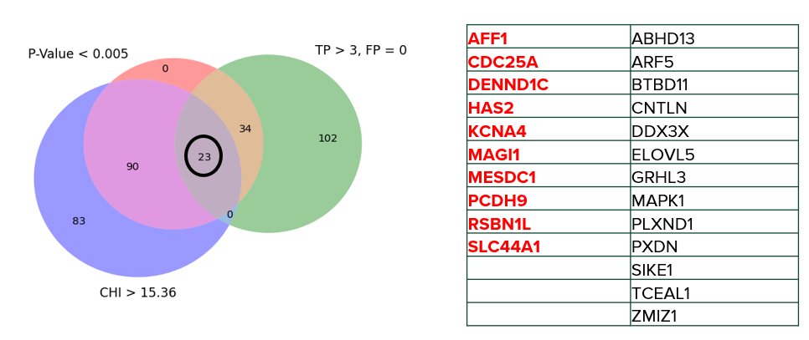
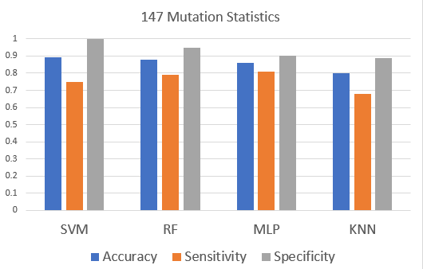
Strongest Mutations For classification
149 most prevalent mutations selected from classification
Notes:
Add bar graph

Slide 6
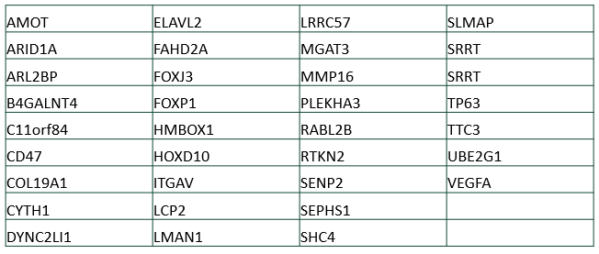
Mutations 34

Slide 7
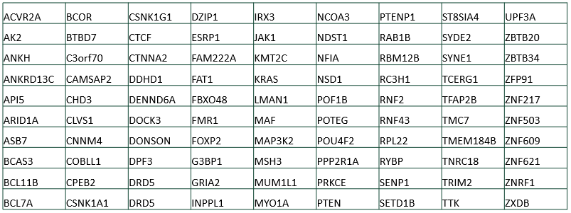
Mutations 90

Slide 8
Using Uterine Carcinoma Mutations to Classify Other Cancer Types
2 Uterine Sets (Validation (Uterine / Ovarian))
2 Non-Uterine Sets (Gastrointestinal)
80% accuracy in validation (+/- 1%)

Slide 9
Validation Mutation Count
Mutational Selectors | ColRec | Gastric | ICGC | Elnitski Cell line
Fishers Exact P value > 0.05 | 210 | 66 | 5 | 121
Fishers Exact P value > 0.01 | 85 | 38 | 3 | 63
Fishers Exact P value > 0.005 | 45 | 22 | 3 | 36
Chi Squared > 3.84 | 153 | 33 | 10 | 52
Chi Squared > 7.68 | 75 | 20 | 4 | 26
Chi Squared > 15.36 | 30 | 11 | 3 | 16
FP = 0, TP > 2 | 131 | 22 | 3 | 79
FP = 0, TP > 3 | 42 | 10 | 1 | 36
FP = 0, TP > 4 | 19 | 3 | 1 | 15
TP – 2 * FP > 2 | 151 | 39 | 1 | 23
TP – 2 * FP > 3 | 55 | 20 | 1 | 9
TP – 2 * FP > 4 | 26 | 10 | 3 | 59
All mutations | 1460 | 215 | 28 | 345

Slide 10
Can we use mutations in order to uncover new discoveries about the CIMP (Genotype and Phenotype)?
Association Rule mining
CIMP is not contributed to one mutation
Gene relationships to cancer
Relationship between CIMP, mutations, and various cancers
Pathway analysis
Relationship between CIMP, mutations, and pathway analysis

Slide 11
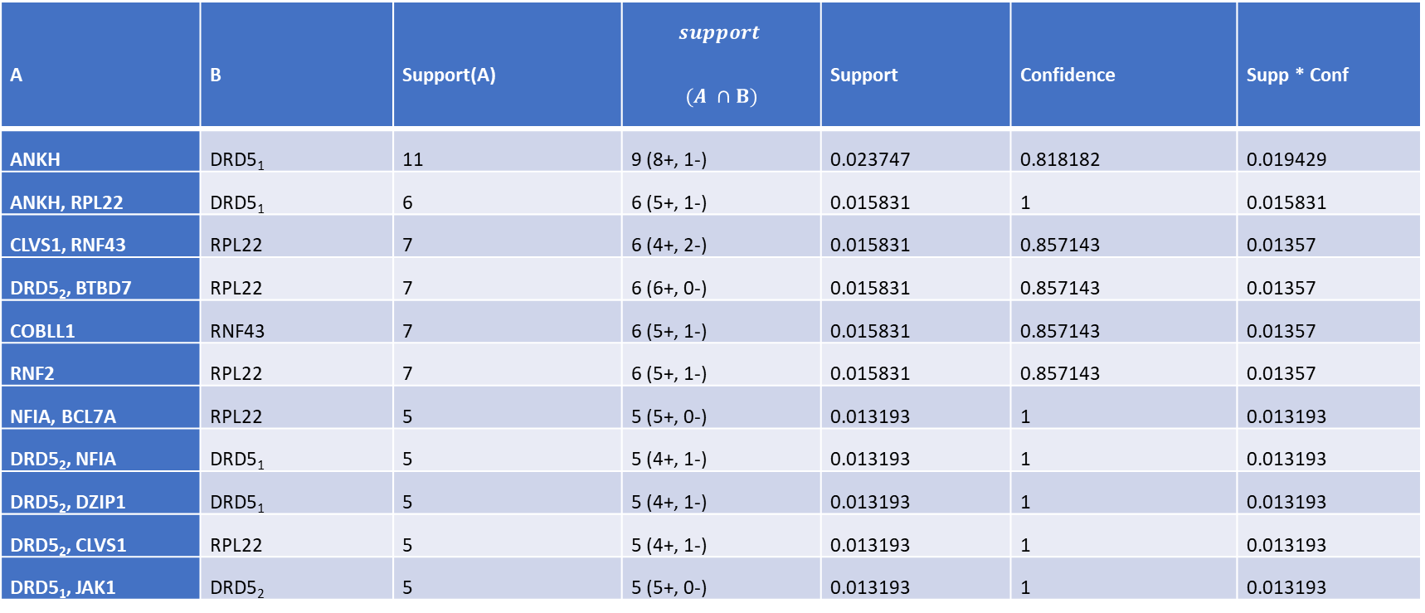
Association Rule mining
A | B | Support(A) | $$support$$ $$(A ∩B)$$ | Support | Confidence | Supp * Conf
ANKH | DRD5₁ | 11 | 9 (8+, 1-) | 0.023747 | 0.818182 | 0.019429
ANKH, RPL22 | DRD5₁ | 6 | 6 (5+, 1-) | 0.015831 | 1 | 0.015831
CLVS1, RNF43 | RPL22 | 7 | 6 (4+, 2-) | 0.015831 | 0.857143 | 0.01357
DRD5₂, BTBD7 | RPL22 | 7 | 6 (6+, 0-) | 0.015831 | 0.857143 | 0.01357
COBLL1 | RNF43 | 7 | 6 (5+, 1-) | 0.015831 | 0.857143 | 0.01357
RNF2 | RPL22 | 7 | 6 (5+, 1-) | 0.015831 | 0.857143 | 0.01357
NFIA, BCL7A | RPL22 | 5 | 5 (5+, 0-) | 0.013193 | 1 | 0.013193
DRD5₂, NFIA | DRD5₁ | 5 | 5 (4+, 1-) | 0.013193 | 1 | 0.013193
DRD5₂, DZIP1 | DRD5₁ | 5 | 5 (4+, 1-) | 0.013193 | 1 | 0.013193
DRD5₂, CLVS1 | RPL22 | 5 | 5 (4+, 1-) | 0.013193 | 1 | 0.013193
DRD5₁, JAK1 | DRD5₂ | 5 | 5 (5+, 0-) | 0.013193 | 1 | 0.013193

Slide 12
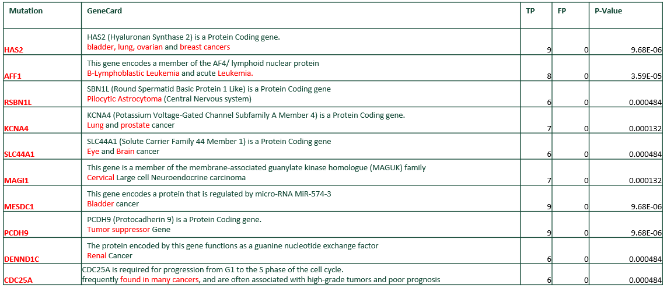
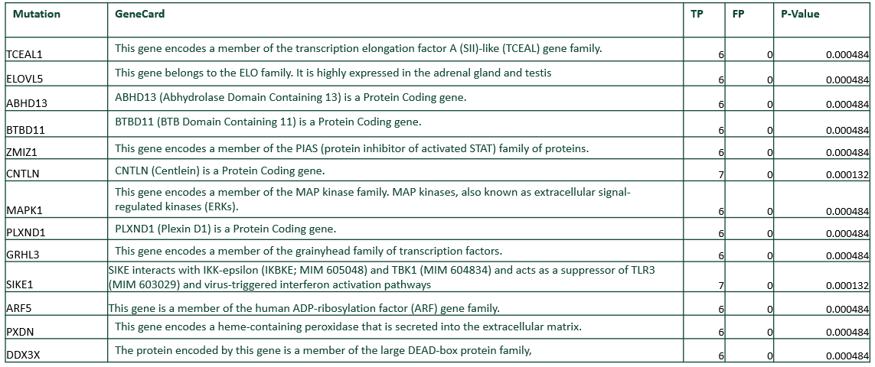
Gene relationships to cancer

Slide 13
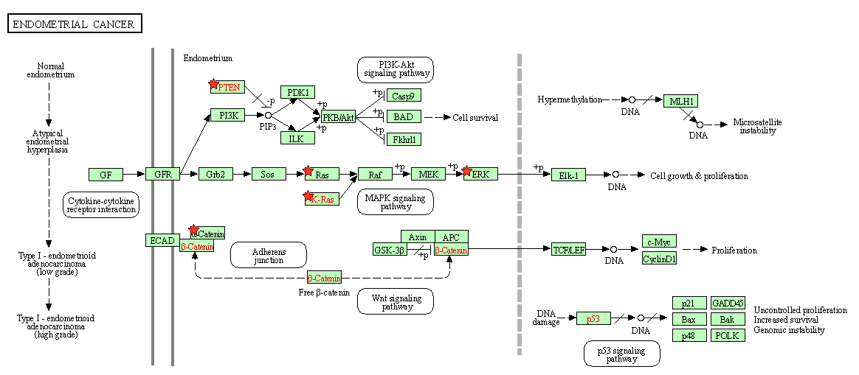
Pathway analysis

