Slide 1
Association Rule Mining
In data science, association rules are used to find correlations and co-occurrences between data sets (Mutations). They are ideally used to explain patterns in data from seemingly independent information. Most can be shown in the statement “if A then B”.
First step is Frequent Itemset Generation
find all itemset whose support is greater than or equal to the threshold
Seconded step is Rule generation:
generate strong association rules from the frequent itemset whose confidence greater than or equal to threshold.

Slide 2
Results
There are 97 association rules all with 100% confidence and contain 7 mutations.
The 7 mutations in each association rule are various combinations of the same 7 mutations.
The 7 mutations are:
PTENP1_GRCh37_9:33674810-33674810_RNA_SNP_A-A-G
PRRG1_GRCh37_X:37312611-37312611_Frame-Shift-Del_DEL_C-C--
RPL22_GRCh37_1:6257785-6257785_Frame-Shift-Del_DEL_T-T--
DDHD1_GRCh37_14:53513450-53513480_3UTR_DEL_AATCAGTTTTAGGCCATTCATGTCCTTCAAG-AATCAGTTTTAGGCCATTCATGTCCTTCAAG-TCAGTTTTAGGCCATTCATGTCCTTCA
TNFSF11_GRCh37_13:43181715-43181715_3UTR_DEL_A-A--
DRD5_GRCh37_4:9785421-9785421_3UTR_SNP_G-G-T
NSD1_GRCh37_5:176722543-176722543_3UTR_DEL_A-A—

Slide 3
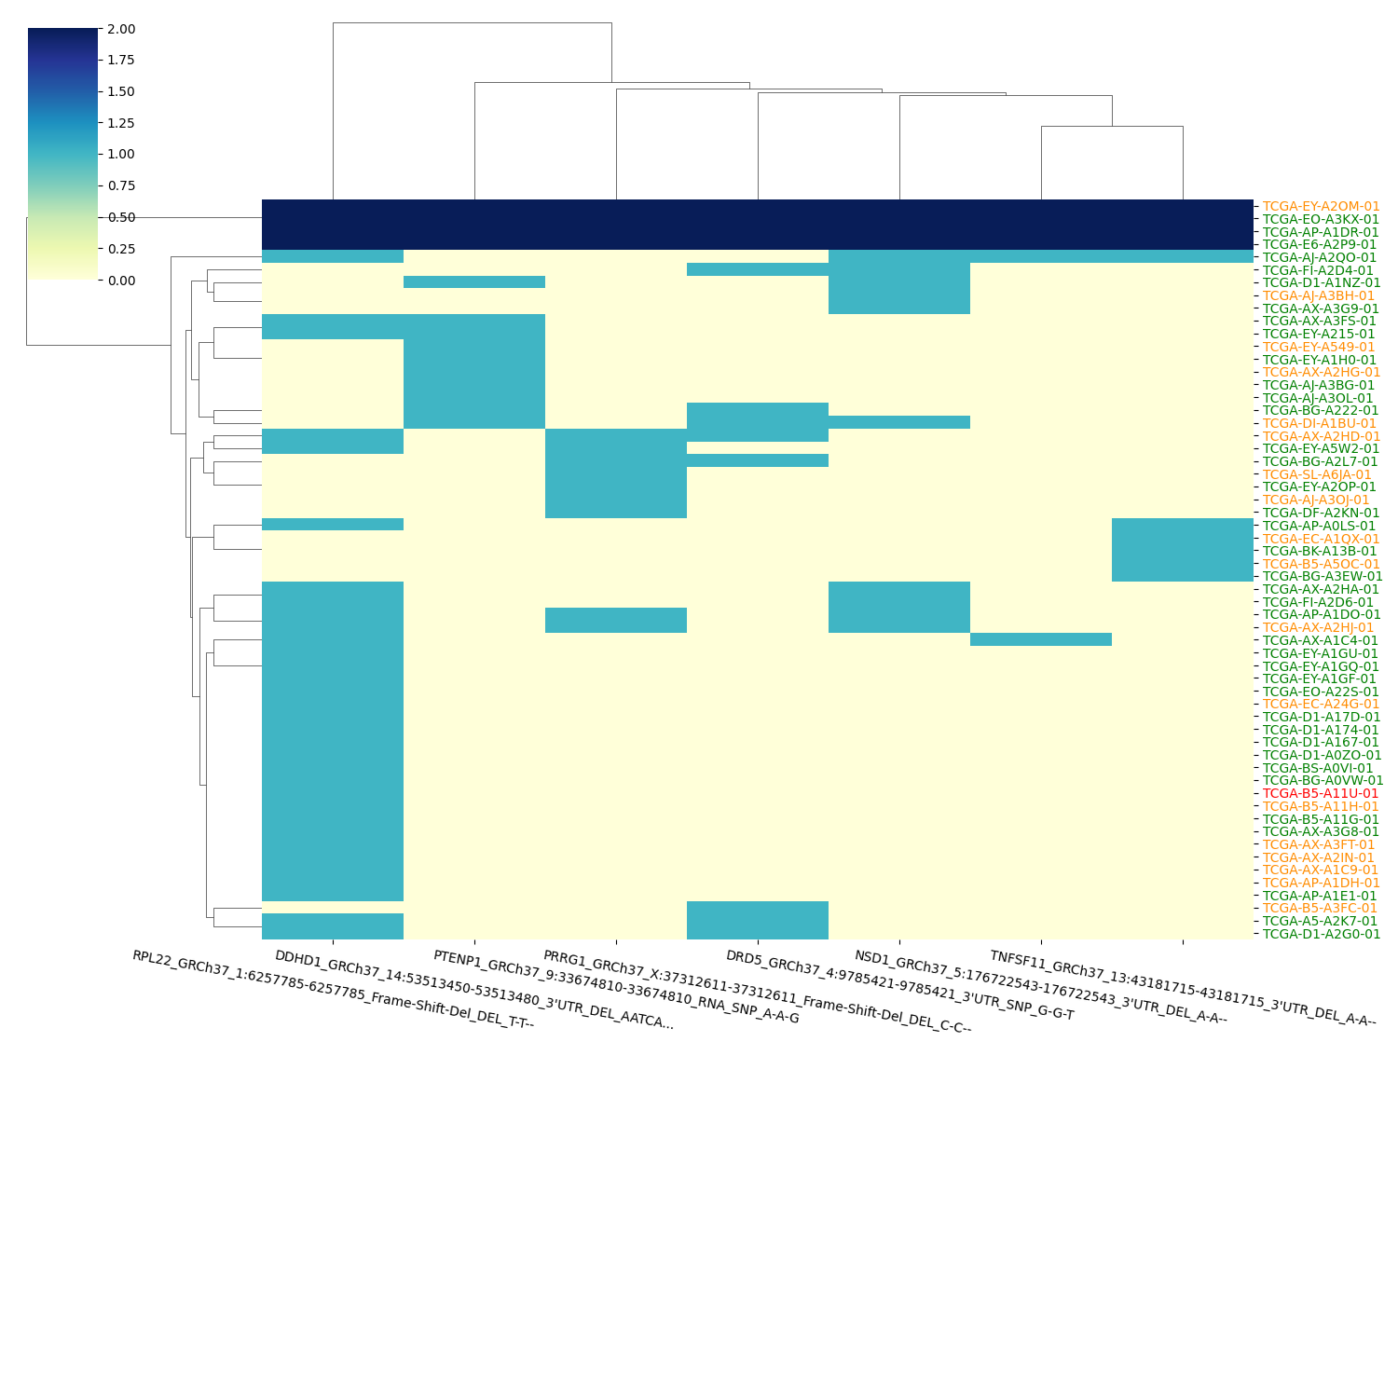
CIMP Heatmap

Slide 4
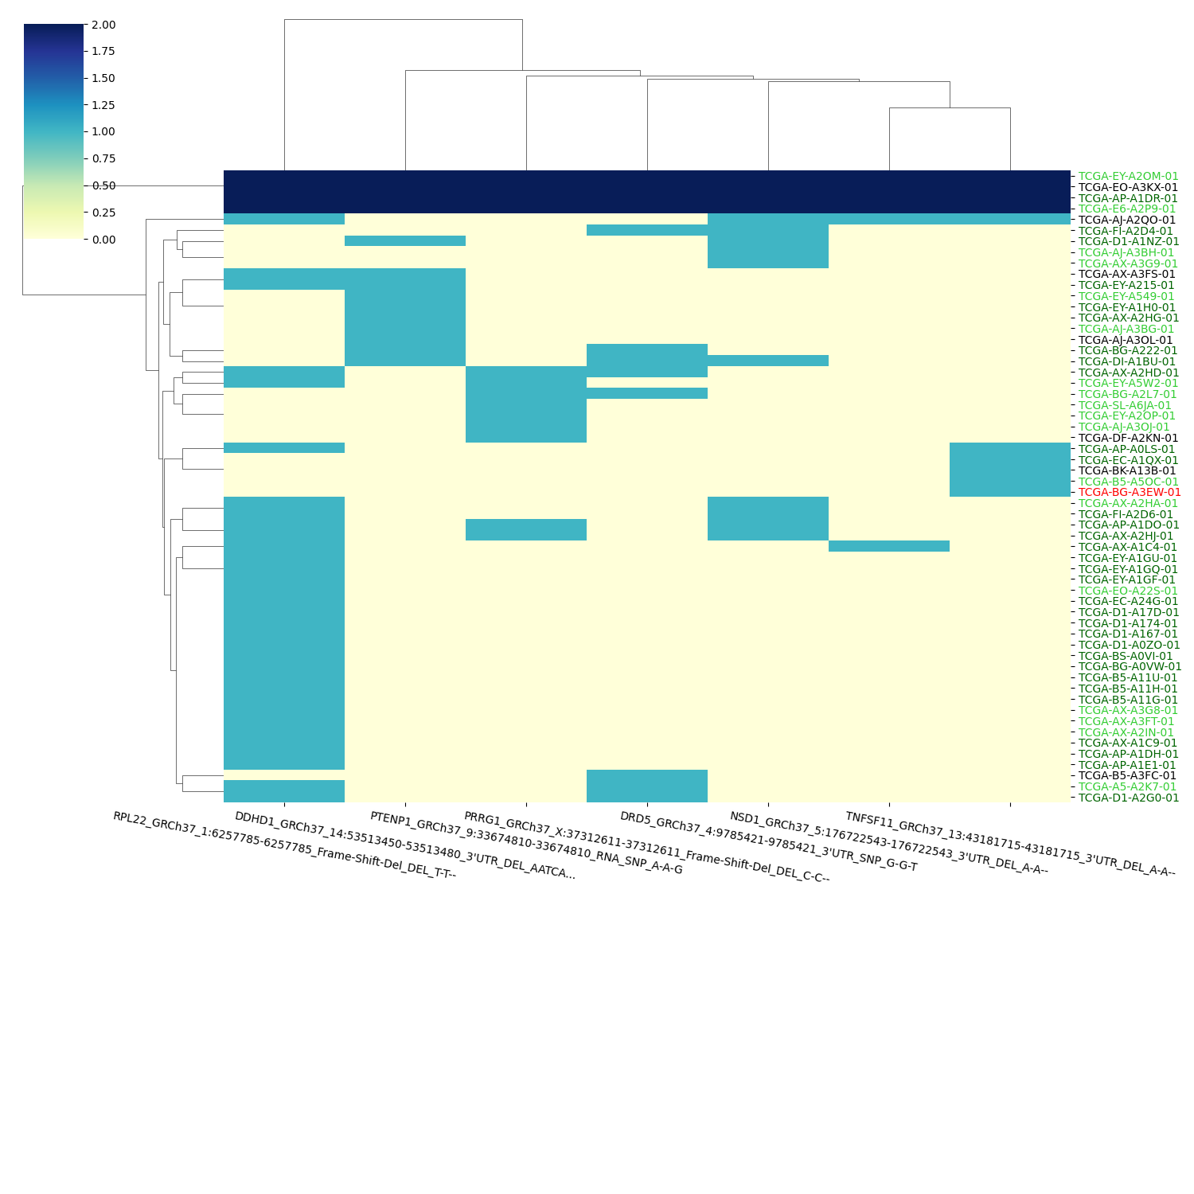
MSI Heatmap

Slide 5
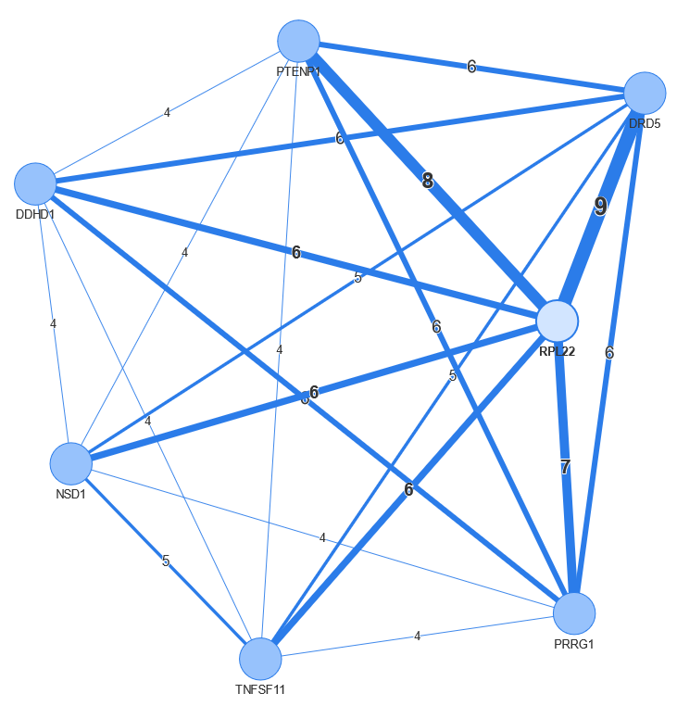
Network Diagram

Slide 6
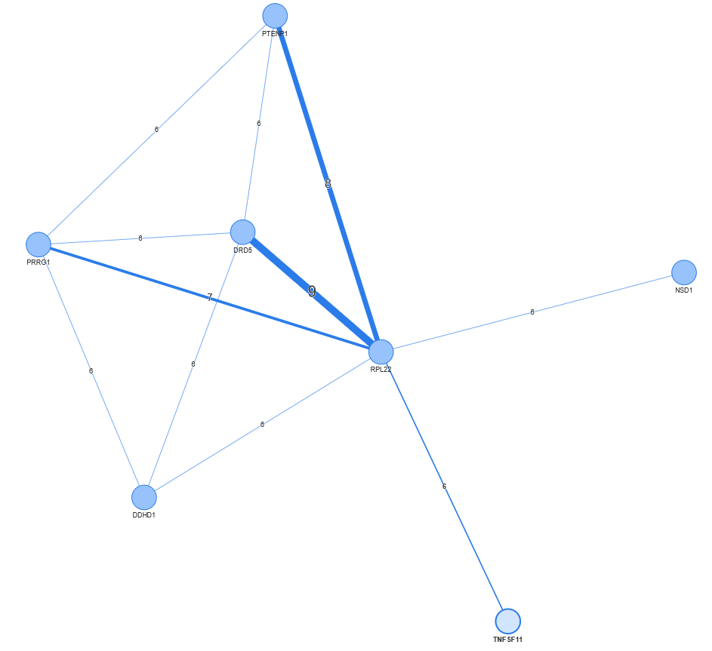
Network Graphic > 5

Slide 7
Samples used in the network (CIMP Status)
TCGA-A5-A2K7-01 | TCGA-AX-A1C4-01 | TCGA-B5-A11G-01 | TCGA-D1-A0ZO-01 | TCGA-EO-A22S-01 | TCGA-FI-A2D4-01
TCGA-AJ-A2QO-01 | TCGA-AX-A1C9-01 | TCGA-B5-A11H-01 | TCGA-D1-A167-01 | TCGA-EO-A3KX-01 | TCGA-FI-A2D6-01
TCGA-AJ-A3BG-01 | TCGA-AX-A2HA-01 | TCGA-B5-A11U-01 | TCGA-D1-A174-01 | TCGA-EY-A1GF-01 | TCGA-SL-A6JA-01
TCGA-AJ-A3BH-01 | TCGA-AX-A2HD-01 | TCGA-B5-A3FC-01 | TCGA-D1-A17D-01 | TCGA-EY-A1GQ-01
TCGA-AJ-A3OJ-01 | TCGA-AX-A2HG-01 | TCGA-B5-A5OC-01 | TCGA-D1-A1NZ-01 | TCGA-EY-A1GU-01
TCGA-AJ-A3OL-01 | TCGA-AX-A2HJ-01 | TCGA-BG-A0VW-01 | TCGA-D1-A2G0-01 | TCGA-EY-A1H0-01
TCGA-AP-A0LS-01 | TCGA-AX-A2IN-01 | TCGA-BG-A222-01 | TCGA-DF-A2KN-01 | TCGA-EY-A215-01
TCGA-AP-A1DH-01 | TCGA-AX-A3FS-01 | TCGA-BG-A2L7-01 | TCGA-DI-A1BU-01 | TCGA-EY-A2OM-01
TCGA-AP-A1DO-01 | TCGA-AX-A3FT-01 | TCGA-BG-A3EW-01 | TCGA-E6-A2P9-01 | TCGA-EY-A2OP-01
TCGA-AP-A1DR-01 | TCGA-AX-A3G8-01 | TCGA-BK-A13B-01 | TCGA-EC-A1QX-01 | TCGA-EY-A549-01
TCGA-AP-A1E1-01 | TCGA-AX-A3G9-01 | TCGA-BS-A0VI-01 | TCGA-EC-A24G-01 | TCGA-EY-A5W2-01

