Slide 1
Random Forest with CIMP data

Slide 2
Overview
Claim: Using a random forest, we can produce lists of mutations that provide 80%+ accuracy in classifying CIMP related data.
Null Hypothesis: The random forest cannot classify CIMP+ to the passing accuracy threshold
Alternative Hypothesis: The random forest can classify CIMP+ to the passing accuracy threshold
Ground: The statistical methods selected have been used in the past to provide meaningful data that was also strongly related to CIMP+. The mutations used in the random forest are selected from the various methods.
Warrant: Each method helps remove mutations that may be poor or not have a strong CIMP relationship
Background: The methods used range from 23 – 5700 mutations, at least removing 2400 of the approximately 8100 poor mutations.

Slide 3
Key Results
The top combination was FP <= 0, 5000 trees, with accuracy of 89.21%
62 of the 144 tests passed the 80% accuracy threshold
27 of the 144 tests passed the 85% accuracy threshold
The number of trees had little effect on the accuracy
On average the combinations with smaller mutation counts (~500) had higher accuracies
The most common high accuracy combinations were:
FP <= 0
FP = 0 TP = 2, 4, 6
Forests Gini importance > 0.01
TP – 2FP > 2, 3

Slide 4
Approach
8 different classifiers of mutations each with 3 different value parameters:
Actual / Expected 5, 7.5, and 10. 5 was out starting ratio then we moved to 10. 7.5 is the middle of the two.
FP <= 0, 1, and 2. These count from zero.
P value < 0.05, 0.01, and 0.005, these have all been threshold we have looked at in the past.
Chi squared > 3.84, 7.68, 15.36, This is doubled each time from 3.84 which is the minimum requirement.
TP-2*FP > 2, 3, and 4. Starting from our beginning threshold 2 and incrementing by 1.
TP>X and FP = 0 where X is 2, 4 or 6. Our best preforming forest from before was TP>4 and FP=0 so I used two below and above to test performance.
Random forests Gini importance > 0.01, 0.001, and 0. These mutations come from the three top preforming forests from the previous forest’s generations.
The union of the other 7 sets. The first union is of all the strictest thresholds, the second is the middle thresholds and the last is the loosest thresholds for all three.
As an example, the strictest union is FP <= 0, P value < 0.005, Chi squared > 15.36, TP-2*FP > 4, TP > 6 FP = 0, and Gini importance > 0.01
The number of trees in a forest can be 50, 100, 500, 1000, 5000, or 10000
This gives a total combination amount of 144 parameter groups (8 * 3 * 6)
Each forest uses 10-fold cross validation
Each forest uses Entropy to split nodes

Slide 5
Data
Initial test is on TCGA Uterine Carcinoma data.
This data is samples / mutations and a column for cimp classification.
This dataset was used for initial testing.

Slide 6
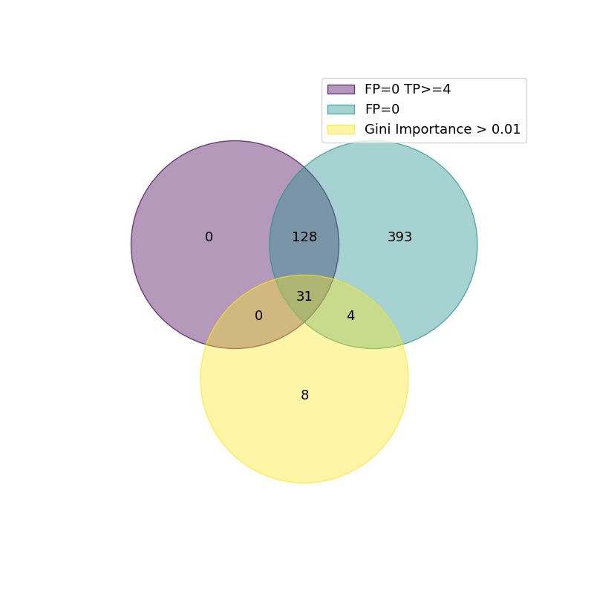
Venn of top three categories

Slide 7
Separator Type | Value | Tree Amount | Three-Fold Run | TP | FP | FN | TN | Accuracy | Sensitivity | Specificity | Precision | Miss Rate | False discovery rate | False omission rate | Included Muts
FP= | 0 | 5000 | 0 | 6.3 | 4.1 | 0 | 27.6 | 0.892105 | 1 | 0.870389 | 0.581503 | 0 | 0.418497 | 0 | 556
FP= | 0 | 1000 | 0 | 6.7 | 4.5 | 0 | 26.8 | 0.881579 | 1 | 0.855994 | 0.603032 | 0 | 0.396968 | 0 | 556
FP0TP>= | 4 | 100 | 4 | 5.8 | 4.5 | 0 | 27.7 | 0.881579 | 1 | 0.859847 | 0.574486 | 0 | 0.425514 | 0 | 159
FP0TP>= | 2 | 50 | 2 | 5.3 | 4.5 | 0 | 28.2 | 0.881579 | 1 | 0.863038 | 0.556709 | 0 | 0.443291 | 0 | 556
FP= | 0 | 10000 | 0 | 6.4 | 4.6 | 0 | 27 | 0.878947 | 1 | 0.85294 | 0.581658 | 0 | 0.418342 | 0 | 556
FP= | 0 | 100 | 0 | 5.9 | 4.7 | 0 | 27.4 | 0.876316 | 1 | 0.854171 | 0.559137 | 0 | 0.440863 | 0 | 556
FP0TP>= | 4 | 50 | 4 | 6.7 | 4.7 | 0 | 26.6 | 0.876316 | 1 | 0.850266 | 0.581566 | 0 | 0.418434 | 0 | 159
FP= | 0 | 50 | 0 | 5.1 | 4.8 | 0 | 28.1 | 0.873684 | 1 | 0.853964 | 0.524276 | 0 | 0.475724 | 0 | 556
Forest> | 0.01 | 10000 | 0.01 | 5.4 | 3.3 | 1.6 | 27.7 | 0.871053 | 0.806706 | 0.895464 | 0.633825 | 0.193294 | 0.366175 | 0.053269 | 43

Slide 8
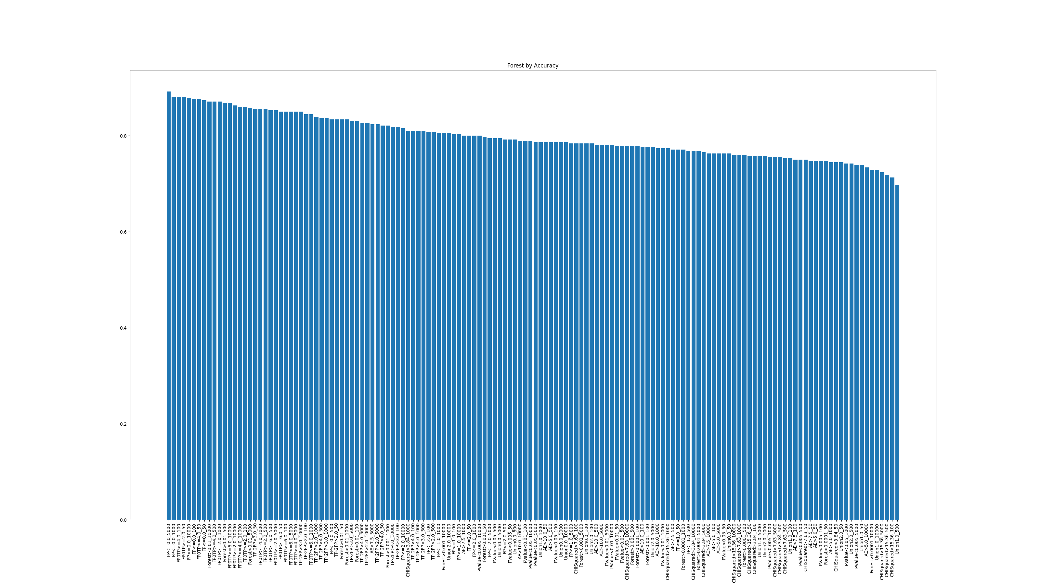
Accuracy ((TP + TN) / (TP + FP + TN + FN))

Slide 9
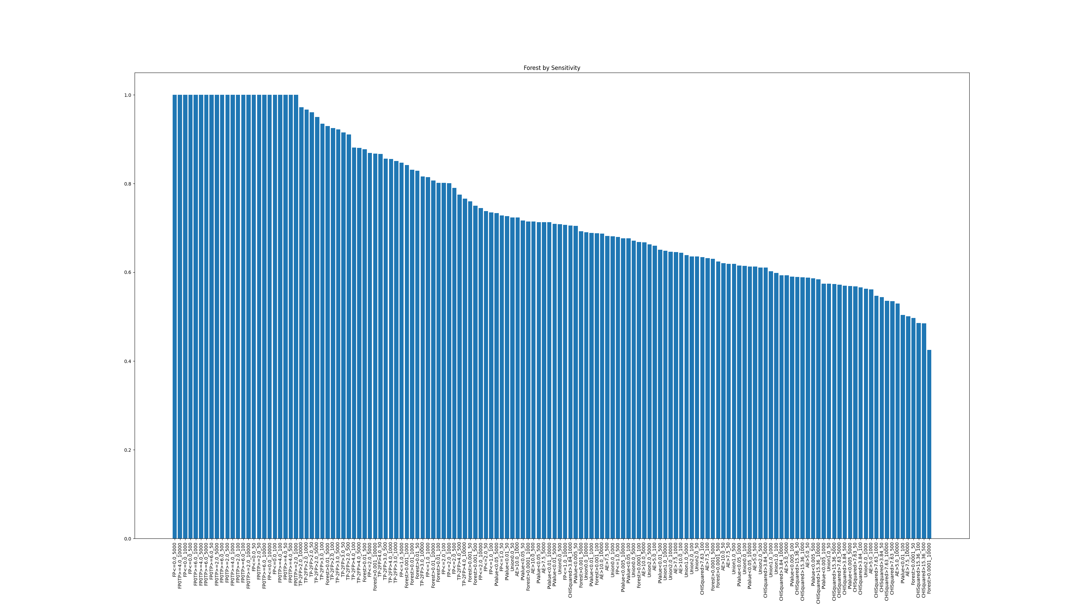
Sensitivity (TP / (TP + FN))

Slide 10
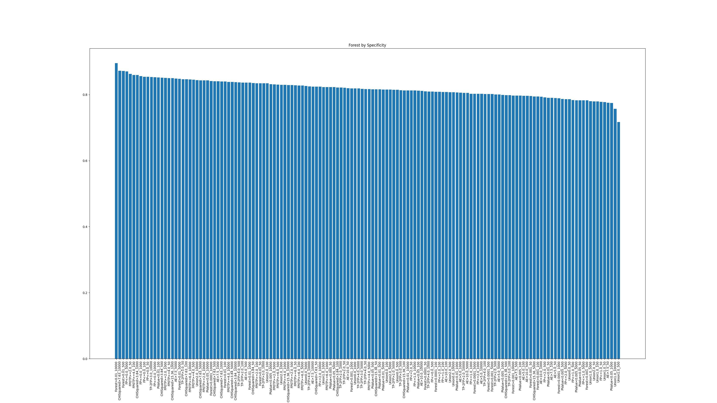
Specificity (TN / (TN + FP))

Slide 11
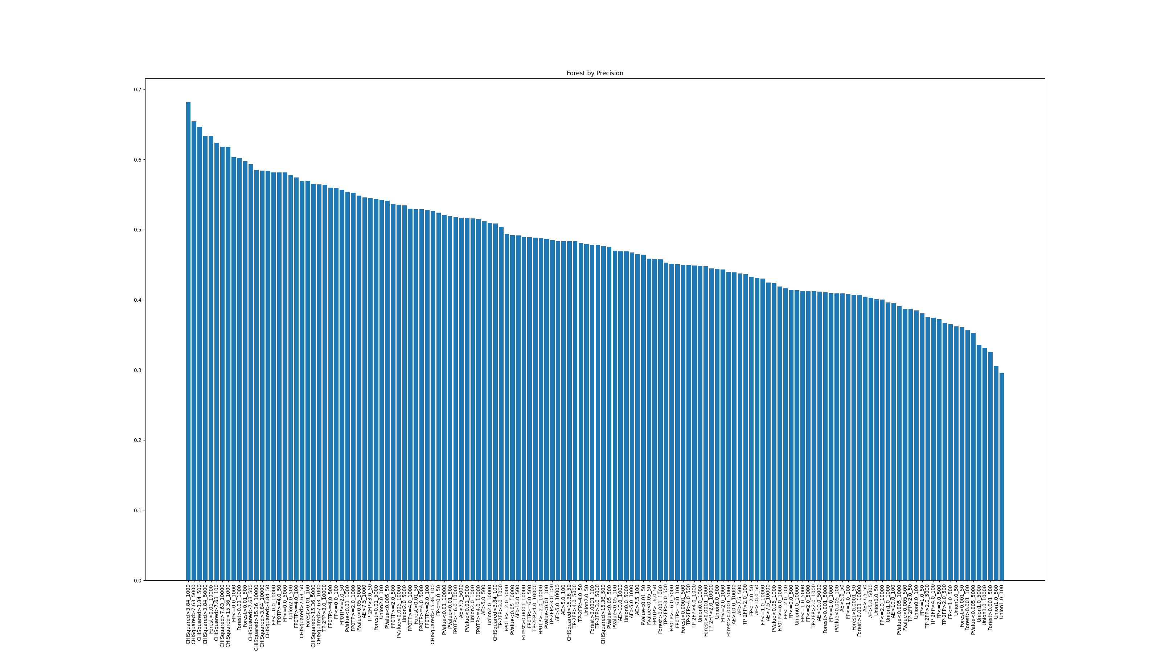
Precision (TP / (TP + FP))

Slide 12
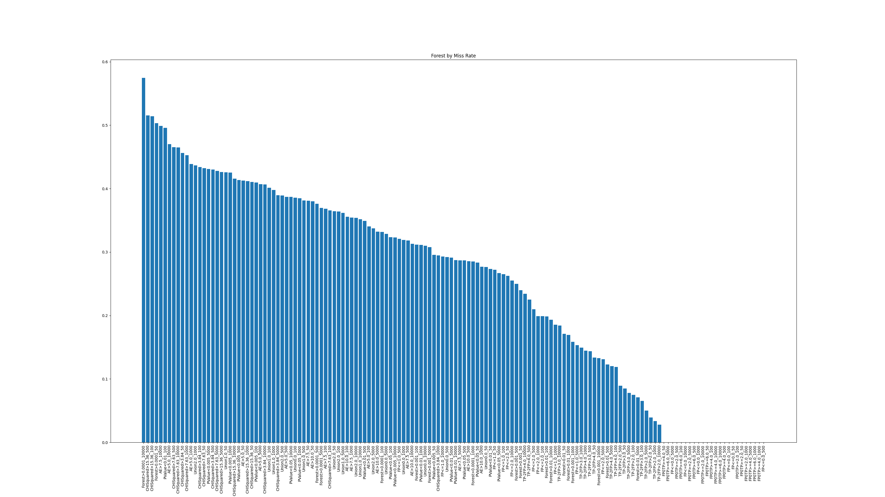
Miss Rate (FN / (FN + TP))

Slide 13
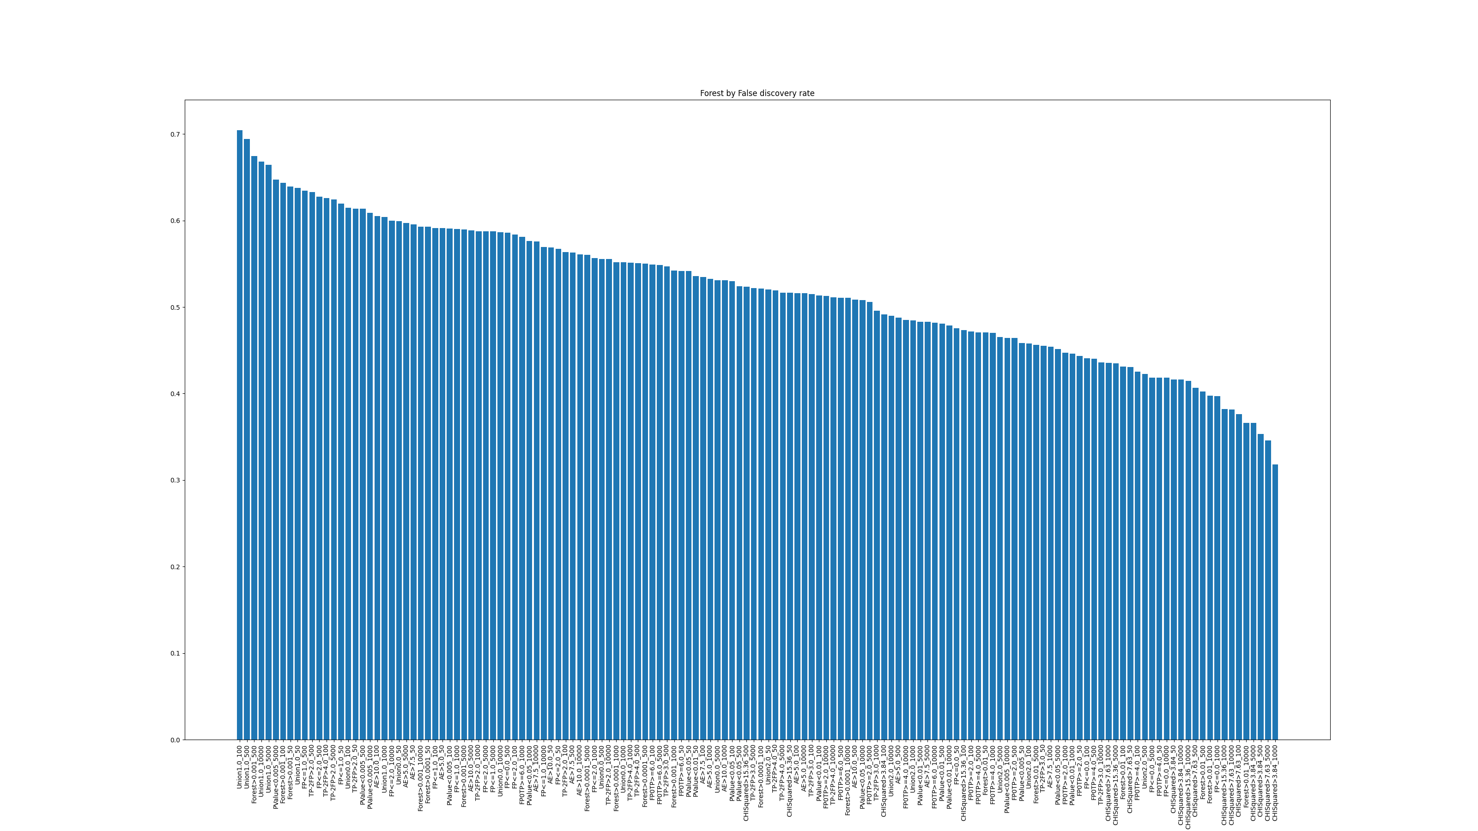
False Discovery Rate (FP / (FP + TP))

Slide 14
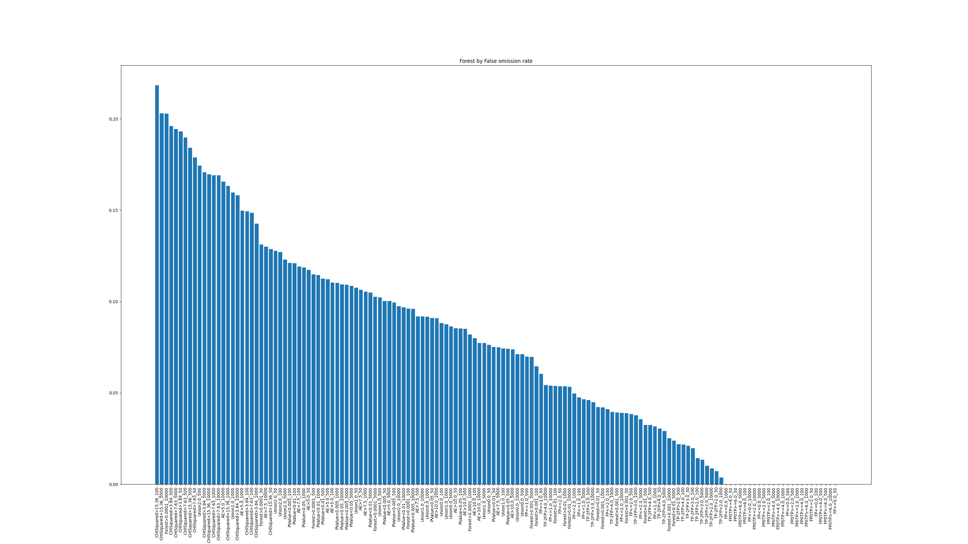
False Omission Rate (FN / (FN + TN))

Slide 15
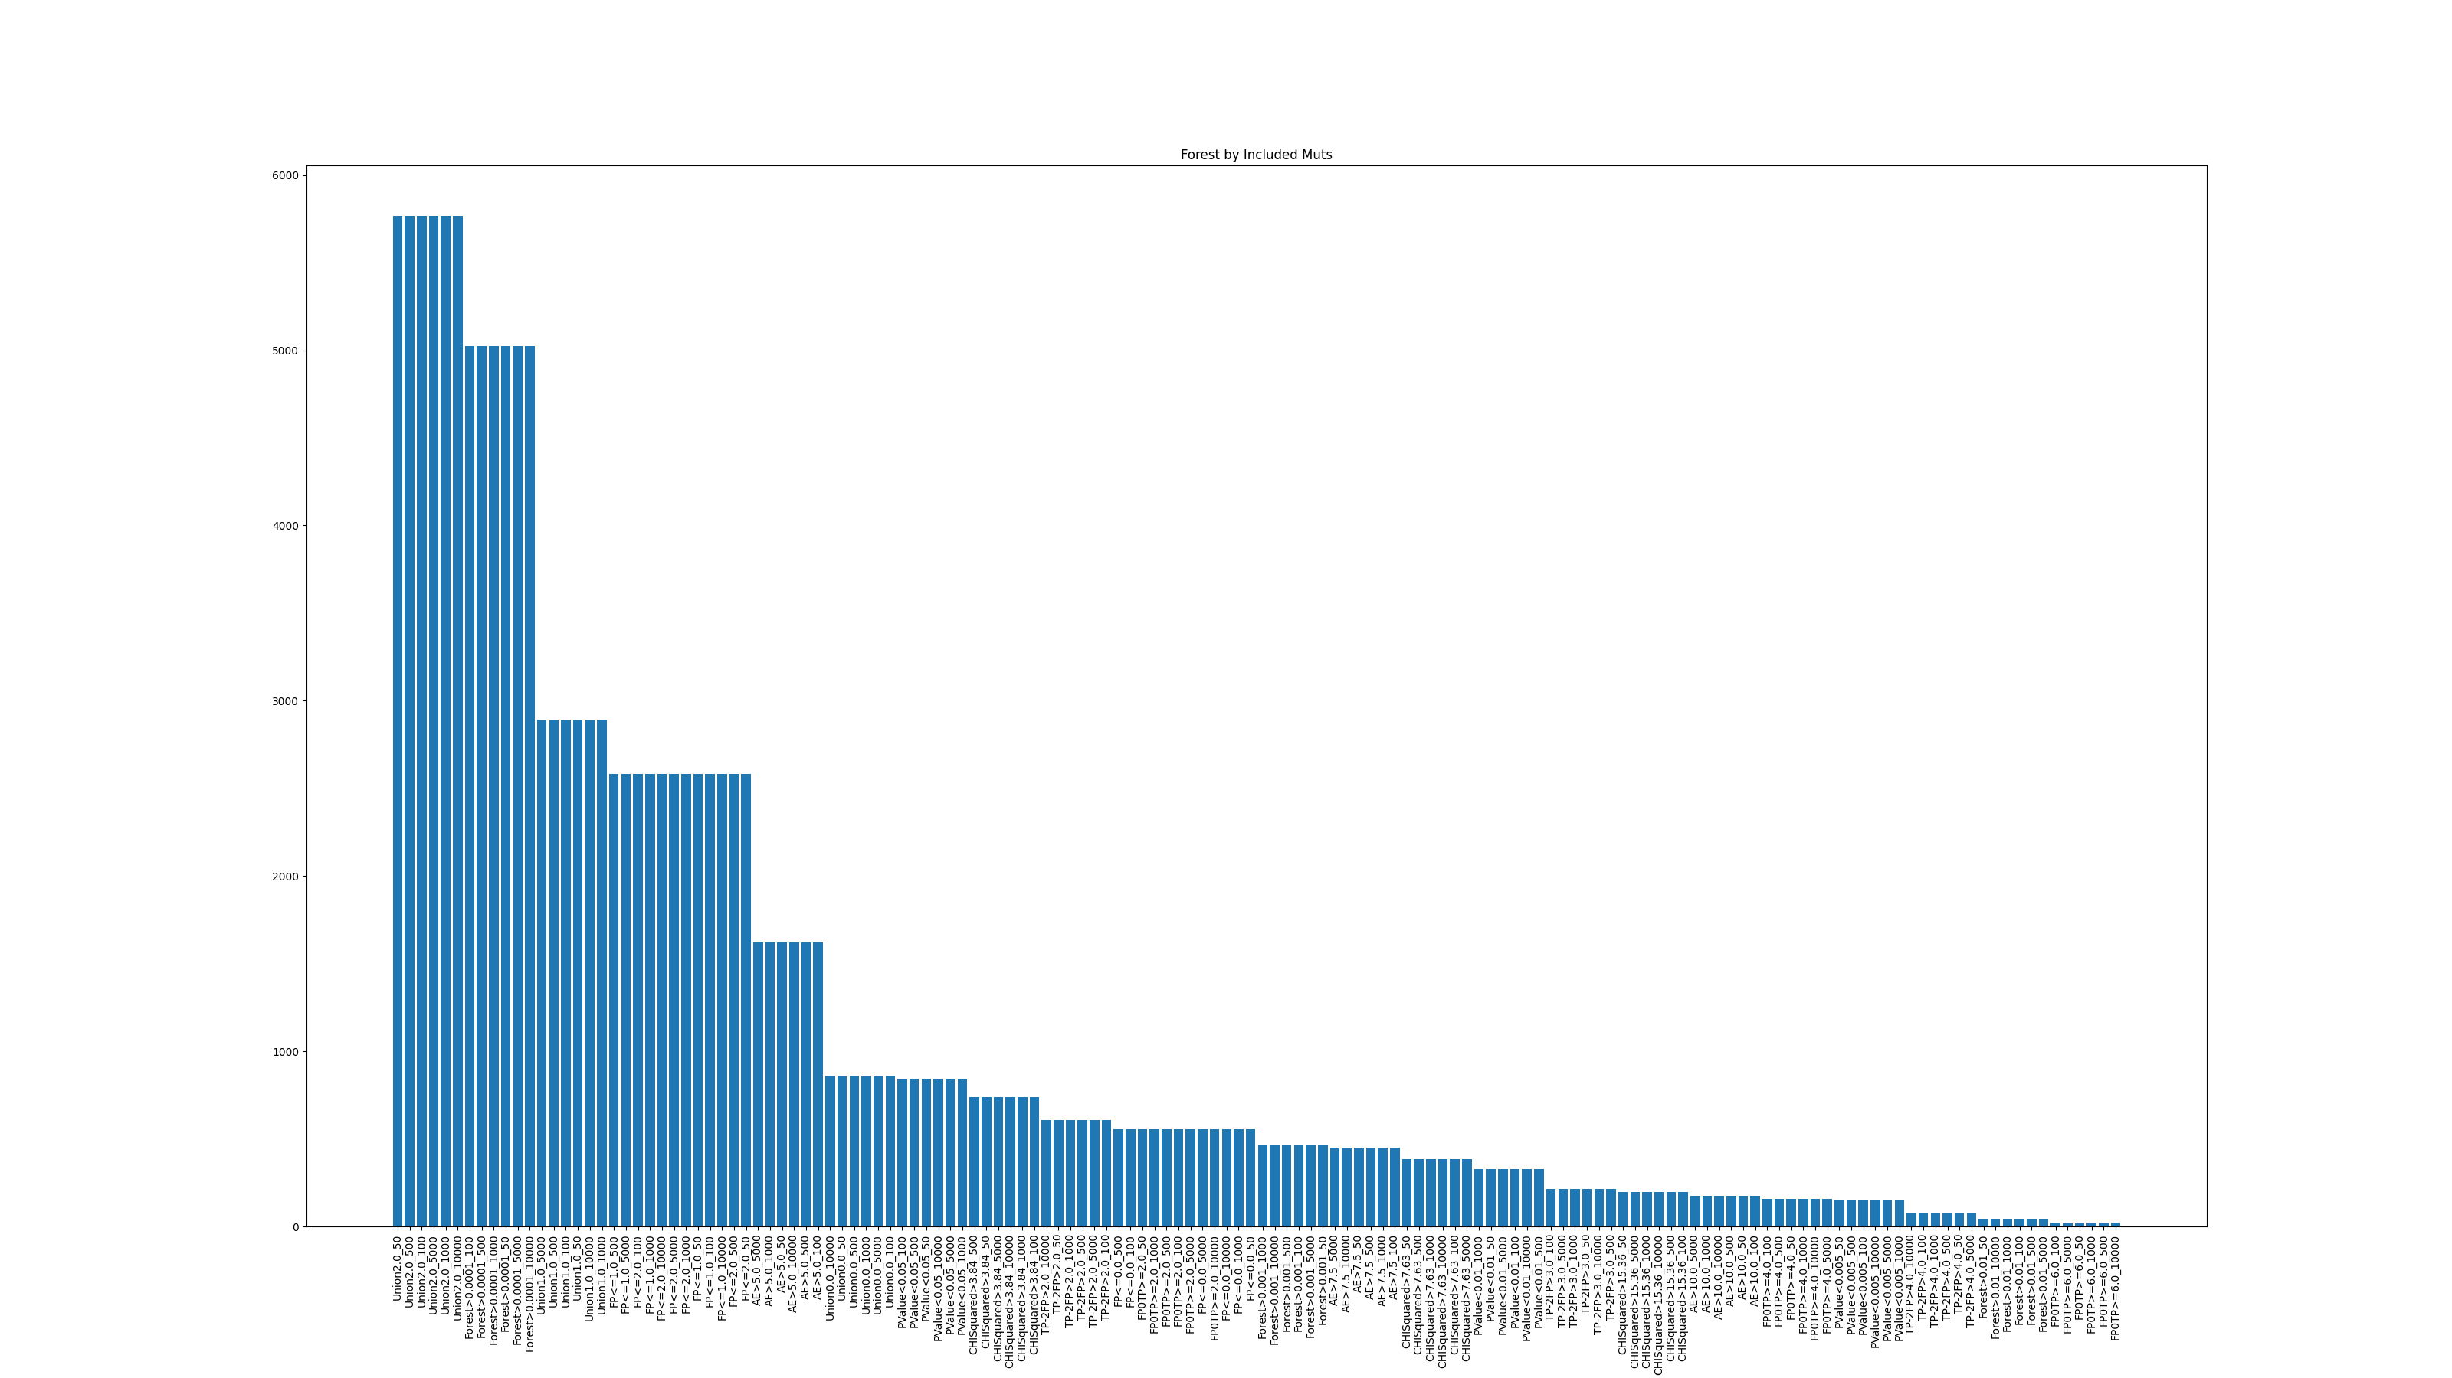
Mutational Count
(How many mutations are included when classifying the forest)

Slide 16
Accuracy – Sorted by Accuracy

Slide 17
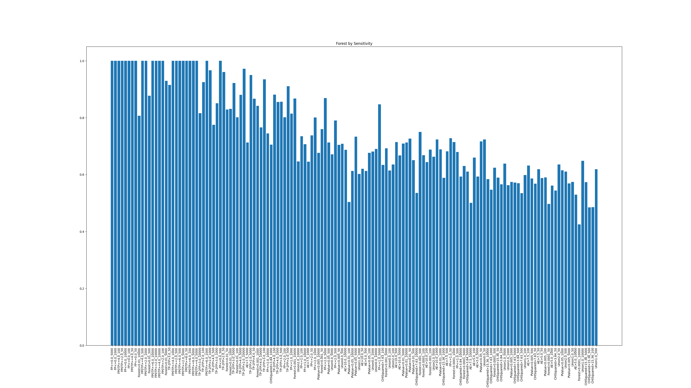


Sensitivity – Sorted by Accuracy

Slide 18
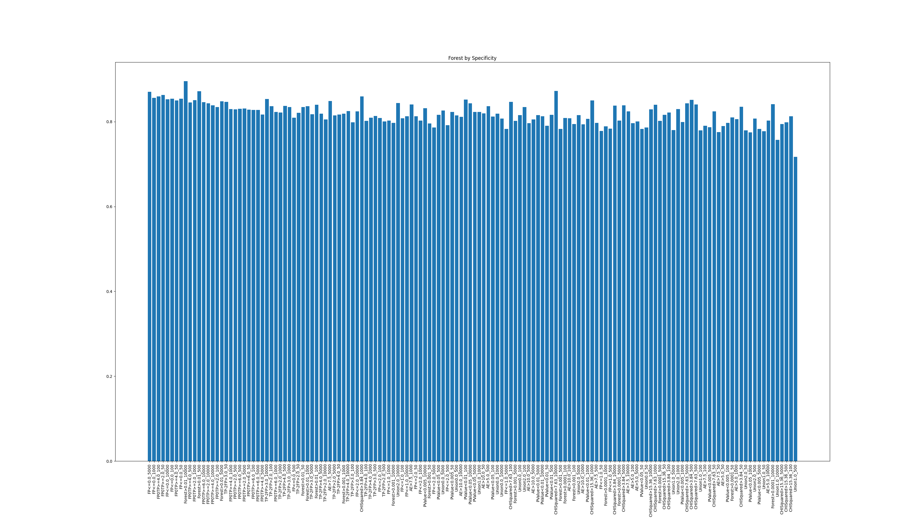
Specificity – Sorted by Accuracy

Slide 19
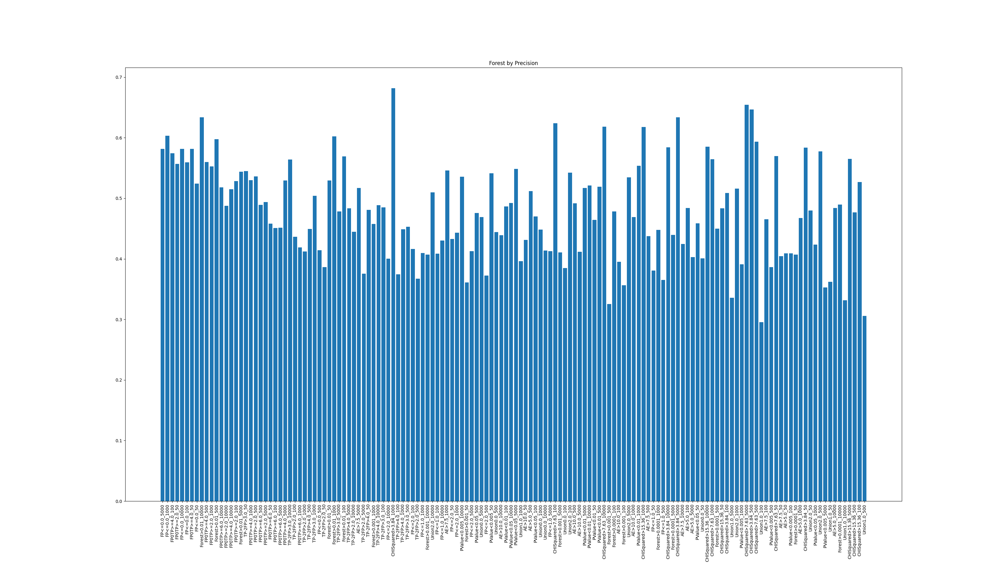
Precision – Sorted by Accuracy

Slide 20
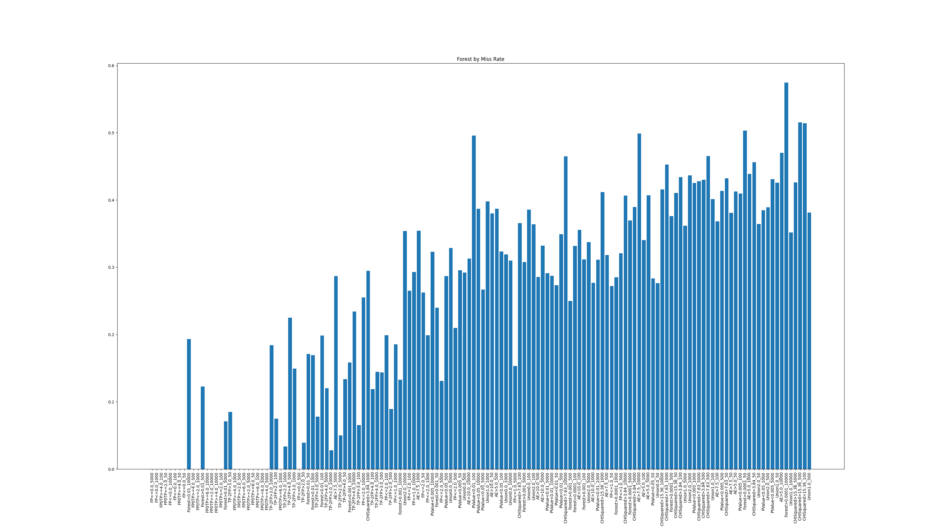
Miss Rate – Sorted by Accuracy

Slide 21
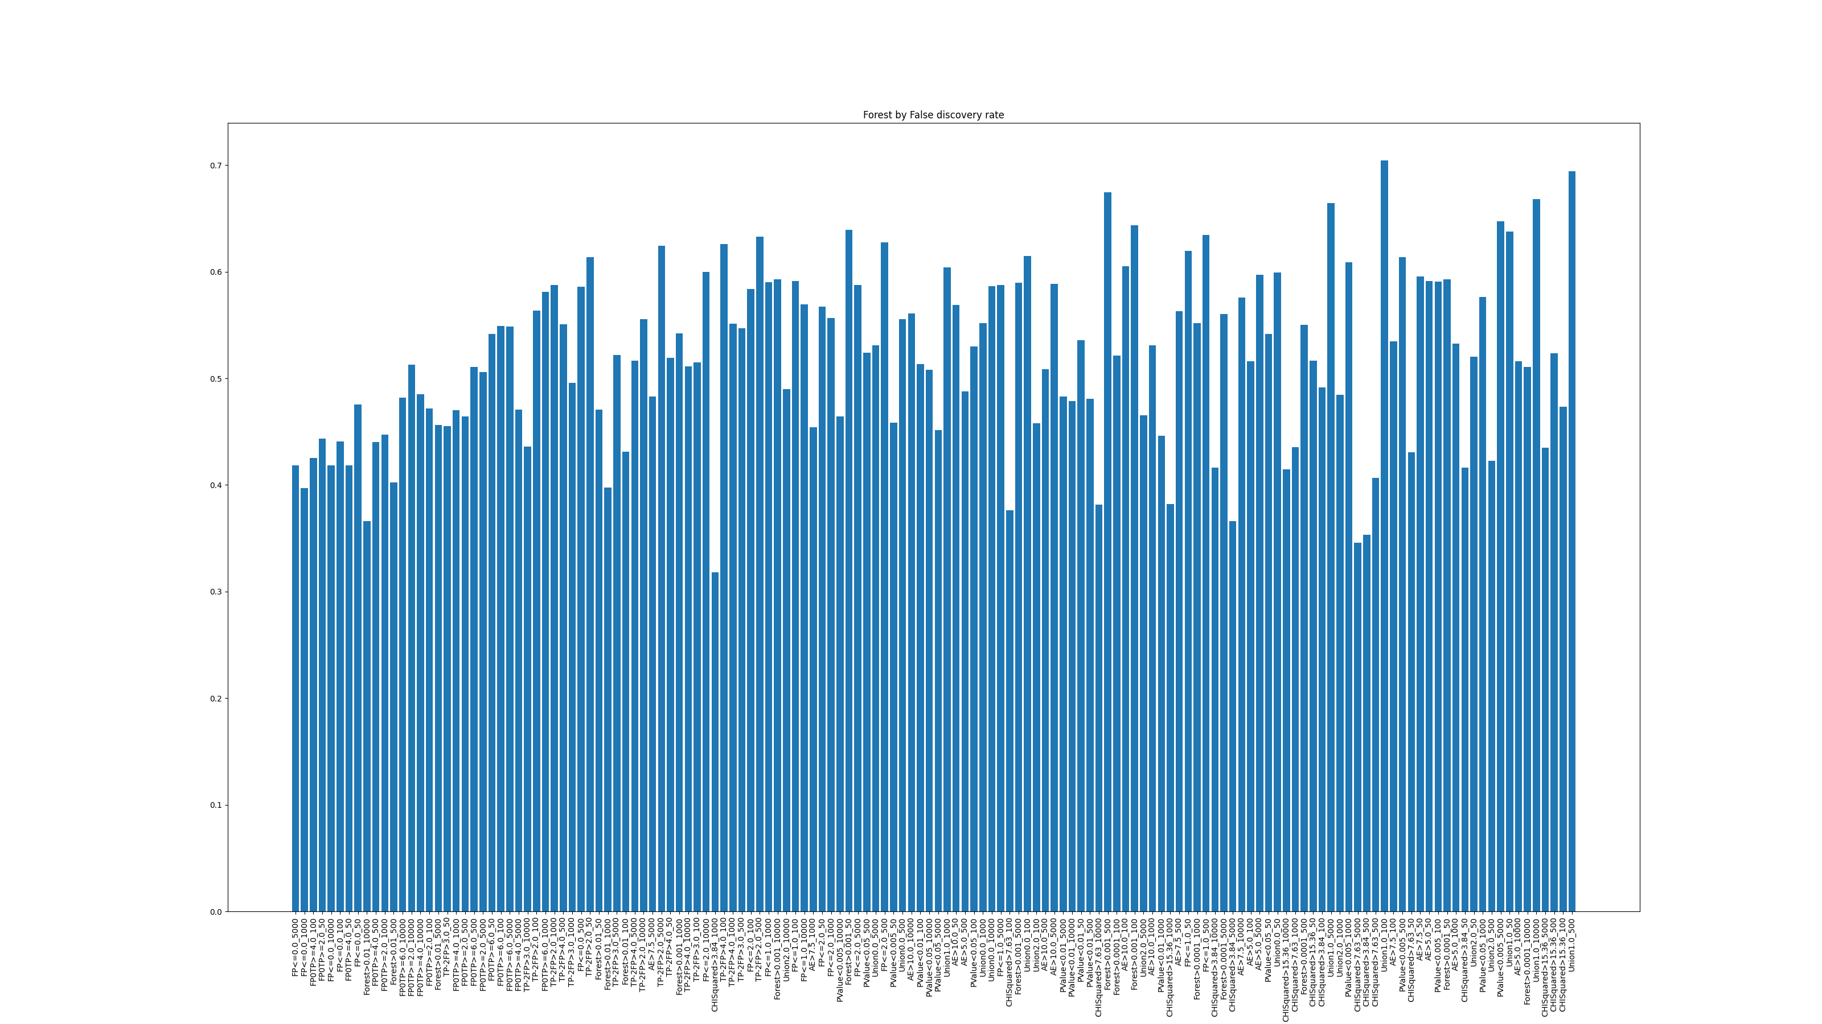
False Discovery Rate – Sorted by Accuracy

Slide 22
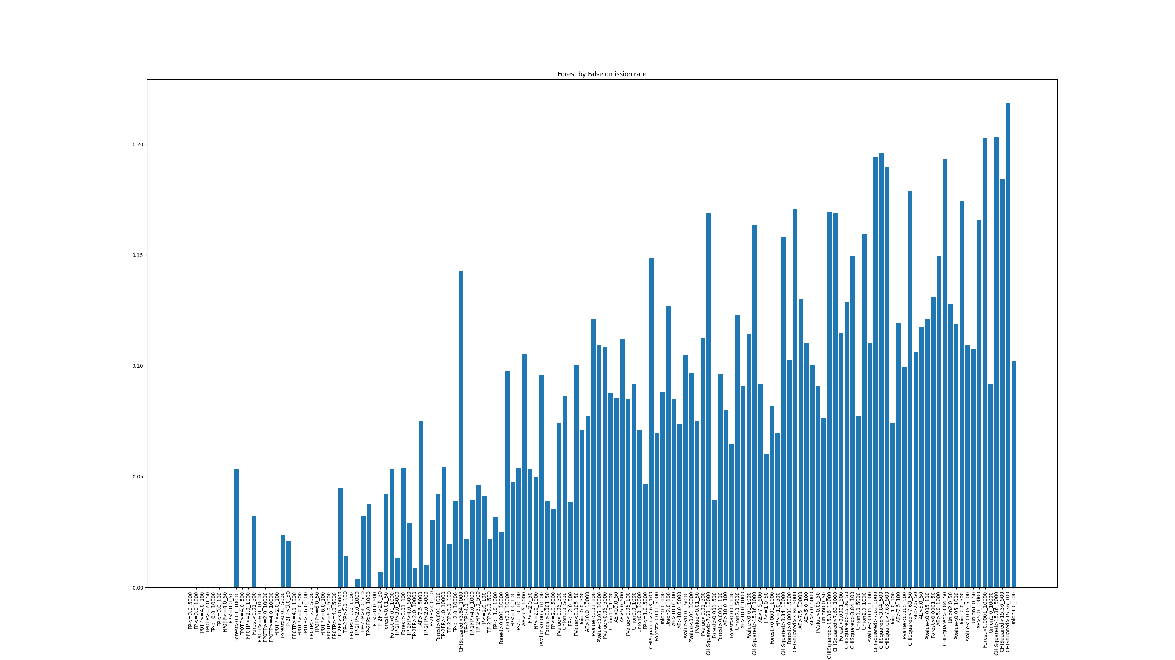
False Omission Rate – Sorted by Accuracy

Slide 23
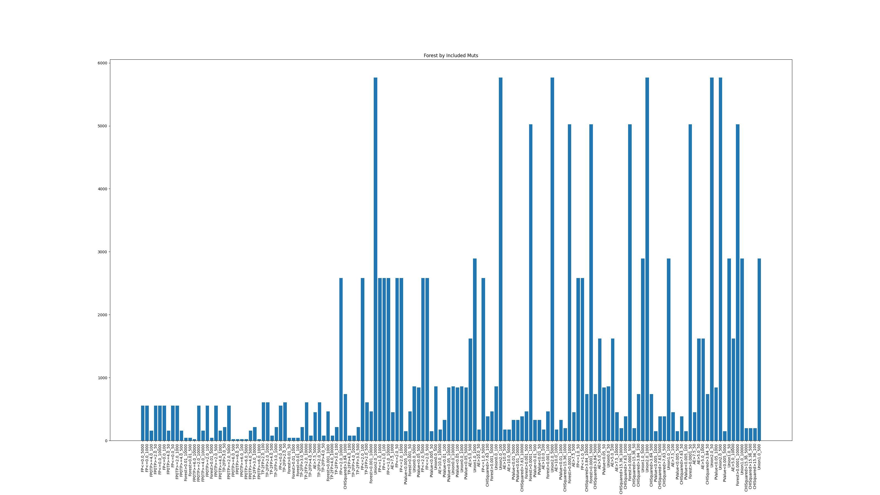
Mutational Counts– Sorted by Accuracy

