Slide 1
Results
These are the mutations that strongly correlate to the CIMP+ phenotype in uterine cancer
Fishers exact value test is the correct tool for finding p-value
Same as TCGA calculation
Chi-squared test is another tool that does well in finding significant data.
With low expected values this is much more likely to catch missing mutations
Actual / Expected rate is a good tool to catch al cases of High CIMP+ and Low Non-CIMP+
While most of these mutations would be caught in the previous two steps this is to ensure that all strongly CIMP+ to Non-CIMP+ mutations are collected
Benjamini-Hochberg’s Step-Up Procedure is the most liberal multiple test correction, but the only one that produces useable data.
The other multiple test corrections only give two to four passable mutations. This is due to the fact that only 10% of the mutations pass 0.05 p value threshold, this puts all mutations at a large disadvantage to most multiple test corrections.
Using a variety of statistical analysis tools, we con confidently show significant mutations in the data.
Using a combination of the above four tools, it should be possible to collect all important CIMP+ mutations while leaving out a large amount of noise from the Non-CIMP+
Using a variety of statistical analysis tools, we con confidently show significant genes in the data.
The same principles can be applied to the gene level data.
With the statistically significant mutations / genes we can move to biological implications of the mutations / genes
Once the first step in the pipeline is complete, we can move to further stages.

Slide 2
TCGA Toulmin analysis
Claim: Using standardized sequence-based inputs along with multiple types of clinical data to establish correlations among mutation sites, affected genes and pathways, and to ultimately separate the commonly abundant passenger mutations from the truly significant events.
Null Hypothesis: The are no mutations that are truly significant from the commonly abundant passenger mutations.
Ground 1: The concept of “significantly mutated genes” (SMG) to describe genes that show a significantly higher mutation rate than the background mutation rate (BMR) when multiple mutational mechanisms are considered.
Ground 2: The mutation relation test (MRT) attempts to reveal correlations and mutual-exclusion relationships among significantly and highly mutated genes in a pairwise fashion.
Ground 3: The data is separated into K subgroups using K – means clustering, where each clinical features is examined with a Fisher's exact test (and optionally, a χ² test) is used to calculate P-values for categorical clinical data.
Warrant 1: Fisher's combined P-value test combines all P-values for a particular gene into a statistic, χ_{c}, according to Fisher's method
Warrant 2: Likelihood ratio test constructs a likelihood ratio-based statistic (χ_{l}) for a gene
Warrant 3: Convolution test calculates a summarized log statistic of joint binomial point probability
Backing for Warrant 1,2,3: We assessed multiple methods of calculating summarized P-values, including a convolution test, a Fisher's combined P-value test, and the likelihood ratio test, using a partially simulated data set (this data set and the associated test simulations are described in the Supplemental Material). By this approach, we determined that the P-value distribution obtained using the CT method most closely resembled the uniform distribution expected under the null (in this case, the null is such that no gene is truly significantly mutated), while the FCPT and LRT methods produced slightly inflated or deflated P-values, respectively.
Rebuttal:
Qualifier:

Slide 3
Aim 1 – Finding important CIMP Mutations
Research Questions:
What is the set of all mutations that are prevalent in CIMP+?
What is the set of all mutations that are prevalent in CIMP-?
What is the set of all mutations that are prevalent in CIMPi?
Claim: There are mutations that strongly correlate to the CIMP+ phenotype in uterine cancer.
Null Hypothesis: The mutation RPL22 at position 6257785 with frame shift deletion of T is not relevant to CIMP
Alternative Hypothesis: The mutation RPL22 at position 6257785 with frame shift deletion of T is relevant to CIMP
Ground 1: P-value, corrected for false discovery rate (FDR)
Ground 2: Covers enough samples in foreground (either in CIMP+ or in CIMP-, depending on which one you are trying to characterize with features)
Ground 3: Is useful for classification (use info gain to build RFs, select important features from RF based on Gini importance, classifier has strong performance as measured by accuracy, sensitivity, and specificity (and possibly other measures), perform k-fold cross-validation, explore RFs over the space of meaningful parameters)
Warrant 1: Using p value, we can find that RPL22 has a p value of 3 * 10^-9 this is less than a p value 0.05. We also find that if using Bonferroni Correction p value (0.05 / 8085) ~ 6 * 10 ^ -6, RPL22 also has a p value smaller than this proving that RPL22 is statistically significant.
Warrant 2: The mutation RPL22 covers 27 samples of CIMP+ more than every other mutation in the data
Warrant 3: RPL22 scores highly in all previously motioned aspects.
Backing for Warrant 1: There are 845 (~10%) mutations that have a p value <= 0.05. While 2 (0.025%) mutations have < 6 * 10 ^ -6 and fit the adjusted p value
Backing for Warrant 2: The foreground there are 108 CIMP+ mutations. The background has 142 CIMP-, and 129 CIMPi samples (271 total). This makes any 1 CIMP+ sample almost twice as important as 1 Non-CIMP+ sample
Backing for Warrant 3: Mutations used in a random forests have shows forest accuracy of up to 90%. This shows a strong ability to differentiate and classify CIMP+ from CIMP-
Rebuttal: Of the ~8000 mutations only ~800 are considered statistically significant. Along side of this the strongest mutation that contains CIMP+ only covers ~25% of the data. This means any given mutation is only able to cover a small potion of the data. While the highest accuracy forest was 90% most forest only has an accuracy between 50 and 70%. Other metrics have a similar outlier as well.
Qualifier: In the data there are mutations that do not relate to CIMP+, this can become problematic when separating the two groupings causing CIMP+ and Non-CIMP+ mixing. If all separation is correct, then the data will correlate to CIMP+

Slide 4
Aim 1 – Finding important CIMP Mutations
Use bioinformatic methods in order to find relevant mutations in CIMP+ and CIMP-
Random Forest
Greedy Selection
CIMP+ Value
CIMP- Value
Create a master list of all relevant mutations in order to properly express all the CIMP samples.
Top 25 mutations from the top 25 forests
Top selected features from X greedy selection methods
Top X CIMP+ occurring features
Top X CIMP- occurring features
Take the union of all lists to form a master list
Repeat the process for CIMP+ subgroups

Slide 5
Aim 2 - Find groups of related mutations
Associations and correlations
Association Rule mining
ClusterGrammer
Cytoscape
Subgroups of samples (share same mutations)
ClusterGrammer
Cytoscape
Clustering (K-means, Hierarchical)

Slide 6
Aim 3 - Find the biological implications associated with:
The relevant mutations.
The related mutations.
The related samples.
The related pathways.

Slide 7
The Toulmin Model of Argument
Claim: There are mutations that strongly correlate to the CIMP+ phenotype in uterine cancer.
Null Hypothesis: EACH mutations that have a p > 0.05 are not relevant
Alternative Hypothesis: EACH mutations that have a p <= 0.05 are relevant
Grounds:
Warrant 1: P-value, corrected for false discovery rate (FDR)
All data with a p value <= 0.05 is typically considered statistically significant. There are mutations with p value <= 0.05.
Warrant 2: Covers enough samples in foreground (either in CIMP+ or in CIMP-, depending on which one you are trying to characterize with features)
There is an almost even split between the foreground CIMP+ and the background CIMP-
Warrant 3: Is useful for classification (use info gain to build RFs, select important features from RF based on Gini importance, classifier has strong performance as measured by accuracy, sensitivity, and specificity (and possibly other measures), perform k-fold cross-validation, explore RFs over the space of meaningful parameters)
The mutations can be used in classification models in order to select important mutations.
Backing for Warrant 1: There are 845 (~10%) mutations that have a p value <= 0.05. These mutations contain at least 3 CIMP+ samples (Up to 27).
Backing for Warrant 2: The foreground there are 108 CIMP+ mutations. The background has 142 CIMP-, and 129 CIMPi samples (271 total)
Backing for Warrant 3: Mutations used in a random forests have shows forest accuracy of up to 90%. This shows a strong ability to differentiate and classify CIMP+ from CIMP-
Rebuttal: Of the ~8000 mutations only ~800 are considered statistically significant. Along side of this the strongest mutation that contains CIMP+ only covers ~25% of the data. This means any given mutation is only able to cover a small potion of the data. While the highest accuracy forest was 90% most forest only has an accuracy between 50 and 70%. Other metrics have a similar outlier as well.
Qualifier: In the data there are mutations that do not relate to CIMP+, this can become problematic when separating the two groupings causing CIMP+ and Non-CIMP+ mixing. If all separation is correct, then the data will correlate to CIMP+

Slide 8
Potential Pipeline
Feature selector
Gini importance > Y
Input Y
Feature data
Important Features
Classifier Y Value X
CIMP+
Accuracy, Sensitivity,
Specificity
Random Forrest generator
Random Forrest evaluator
Y >= X
CIMP- Accuracy, Sensitivity,
Specificity
Parameters input of forests

Slide 9
Feature selector
Parameters input of forests
Input Parameters feature data
If Both TP and FP are max increment p value
If any parameter combination has 10 or more mutations
P value filter
Set FP
Increment FP until Max
Random Forrest generator
Random Forrest evaluator
Set TP
TP += 1
If TP, FP, and P value are max
Increment TP and FP until both Max

Slide 10
n_estimators = 1000
Criterion = entropy
Folds = 5
Test set = 20%
Training set = 80%
Parameter Data
Previous step
RandomForest
Classifier
List of all forest's accuracy
Take top X % of Gini importance features and add to final list
Produce statistics
If accuracy is >= threshold

Slide 11
Input Parameters feature data
Input Parameters
P value filter
Features that meet accuracy thresholds and Gini threshold
Final Feature set
Feature filtering
(remove irrelevant features)
Features that meet the filtering thresholds
Feature selection
(select features based on discriminatory power)
Feature relationship analysis
(identify sets of features that tend to co-occur)
Removed Features
feature relationships
Perform biological analysis and
relax the parameter settings
Removed Features
Removed Features

Slide 12
Filtering based on TP and FP: Selection of features based on coverage of CIMP+ and Non-CIMP+ samples The parameter range is <TP=0,FP=0>.to <TP=MAX-TP,FP=MAX-FP>. Ways of searching space are to increment FP until MAX-FP then Increment TP + 1 until both are MAX Exhaustive Search Begin at <TP=1,FP=0> and combination of <TP=X,FP=Y> with increments of 1 Heuristic Search Begin at <TP=X,FP=A> and end at <TP=Y,FP=B> by increment Z. With X, Y, Z, A, and B, as the input parameters. Other metrics TP – 2FP 2TP – FP CIMP+ - CIMP- CIMP+ - CIMPi – 2CIMP-
Filtering based on p value Selecting features based on the p values The parameter range is 1 to 0, but only p values that are less than 0.05 are considered significant Way of searching space would be to begin at 0 and increment to 0.05 by 0.01 or 0.001 Exhaustive Search Search every possible p value between 0 and 0.05 with increments of 0.001 Do we need to iterate, or can we just look at the most stringent threshold? Heuristic Search Search p values from X to Y in Z increments. With X, Y, and Z as the input parameters.
Filtering based on Info gain Selecting features based on the info gain values The parameter range is 1 to 0. Significance range is variable Ways of searching the space is to begin with 0 and increment by X until reaching 1 Exhaustive Search Search every possible info gain between 0 and 1 with increments of 0.1 Do we need to iterate, or can we just look at the most stringent threshold? Heuristic Search Search info gain from X to Y in Z increments. With X, Y, and Z as the input parameters.
Feature Filtering
Abstract
Filter by p value Select the starting parameters Get features based on the parameter settings Increment parameters then collect features again Continue until the parameter space is complete Remove poor feature sets

Slide 13
Feature Filtering
Abstract
Identify multiple sets of features: Strongest set (minimal set of the features that are most strongly connected with either CIMP+ or CIMP-; this set results from the strictest parameter settings) Strongest set++ Strongest set+++ Strongest set++++ … All relevant features (this set results from the most relaxed parameter settings) REPRESENT THE SETS AS CONCENTRIC CIRCLES; The strongest set is in the center circle; as you move outward, sets get larger; LABEL EACH CIRCLE WITH THE NUMBER OF FEATURES AND THE PARAMETER SETTINGS Repeat previous step for different sets of parameters: P-value TP, FP Info gain Combos of the parameters

Slide 14
Feature filtering
Determine
info gain change metric
If FP = MAX
or
# of Muts
! change
TP + 1
FP = 0
Determine
p value change metric
Filtering based on
Info gain
Filtering based on
TP and FP:
Filtering based on
p value
info gain = New info gain
Start: TP >= X
FP <= Y
Find all mutations That fit
TP and FP
Determine
p value starting metric
p value = New p value
Determine
info gain starting metric
If p value != End
If p value != End
Determine starting
TP and FP
value
Start: p value = X
FP + 1
Find all mutations That fit
< p value
Start: info gain = X
Find all mutations That fit
< p value

Slide 15
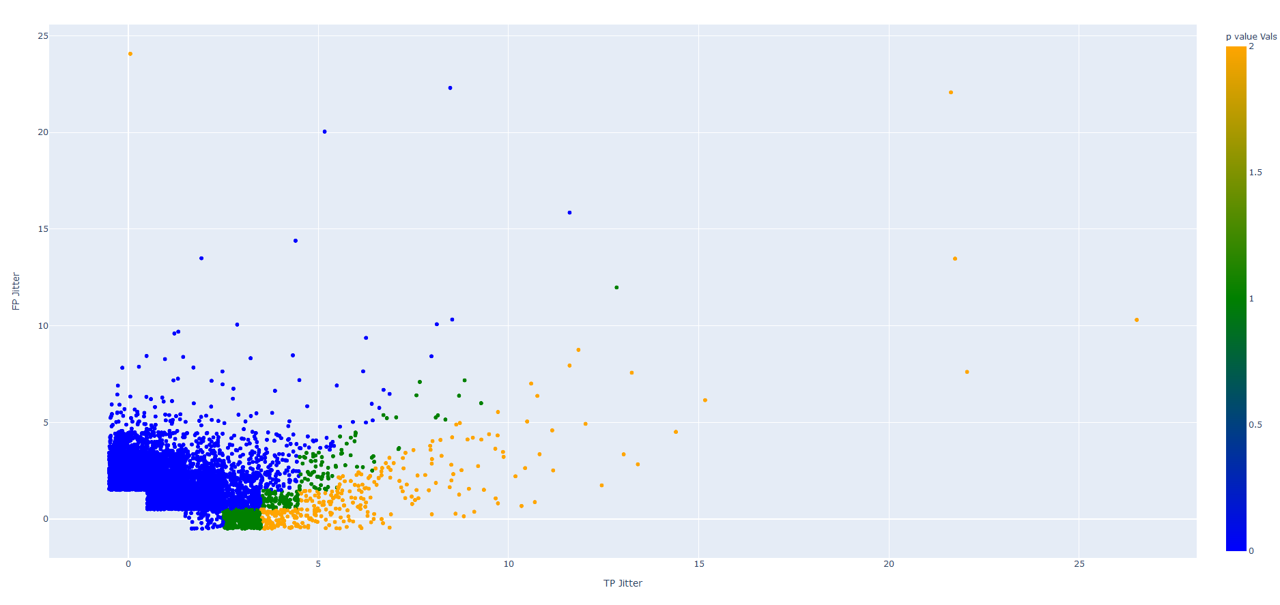
Three level P Value (FP / TP)

Slide 16
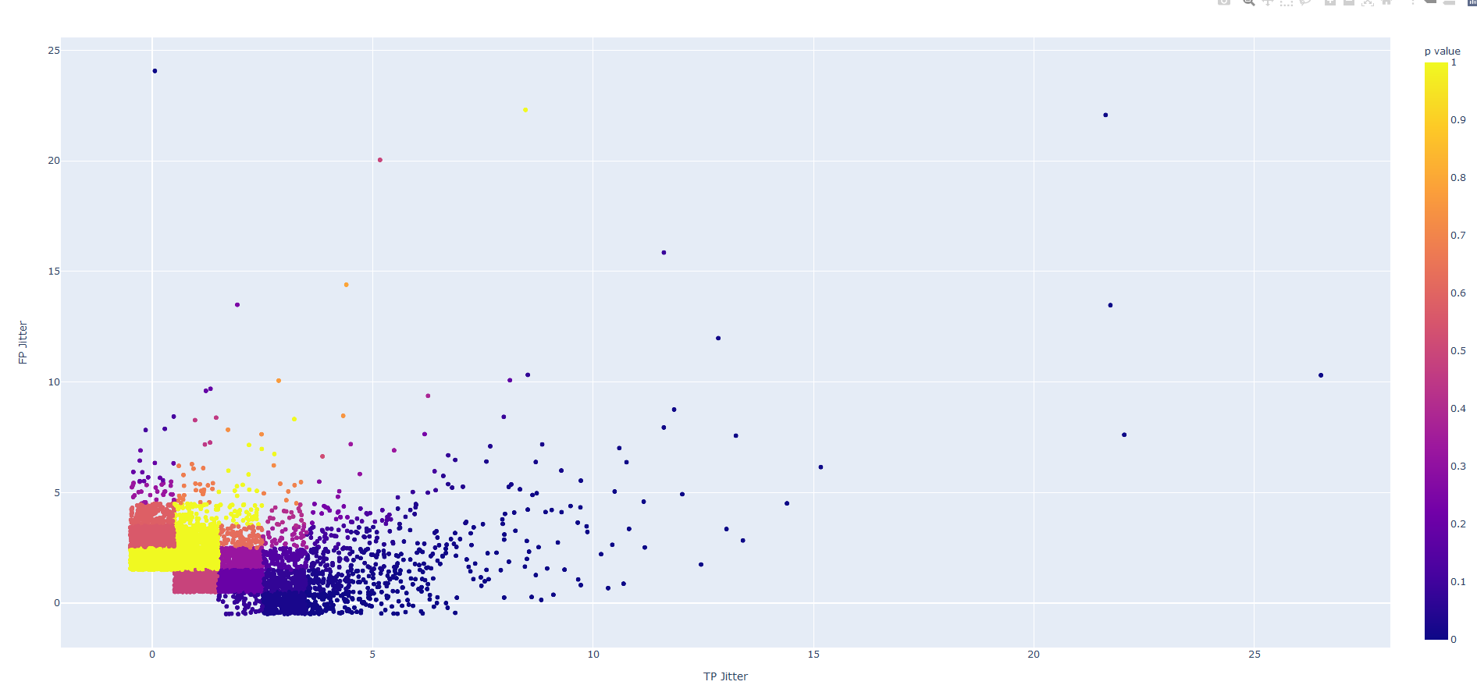
P Value (FP / TP)

Slide 17
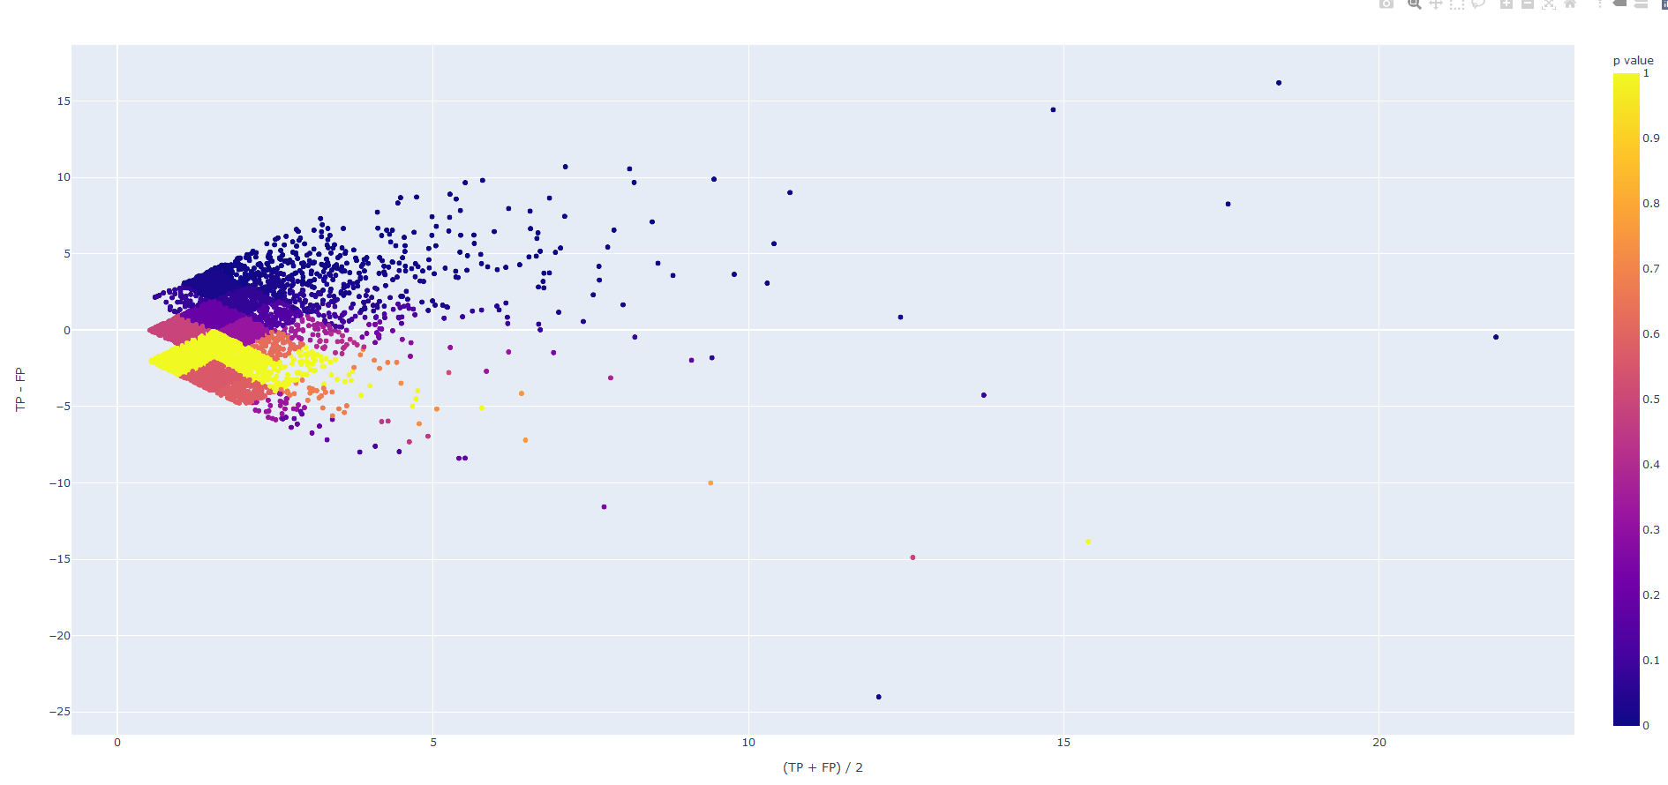
P Value (TP – FP / (TP + FP)/2)

Slide 18
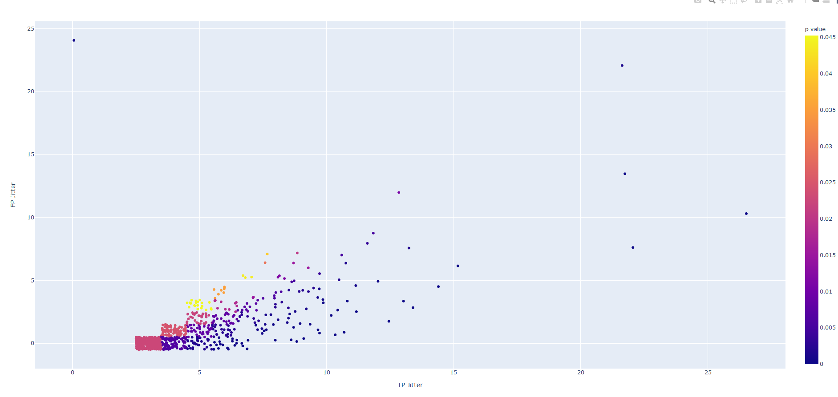
P Value < 0.05 (FP / TP)

Slide 19
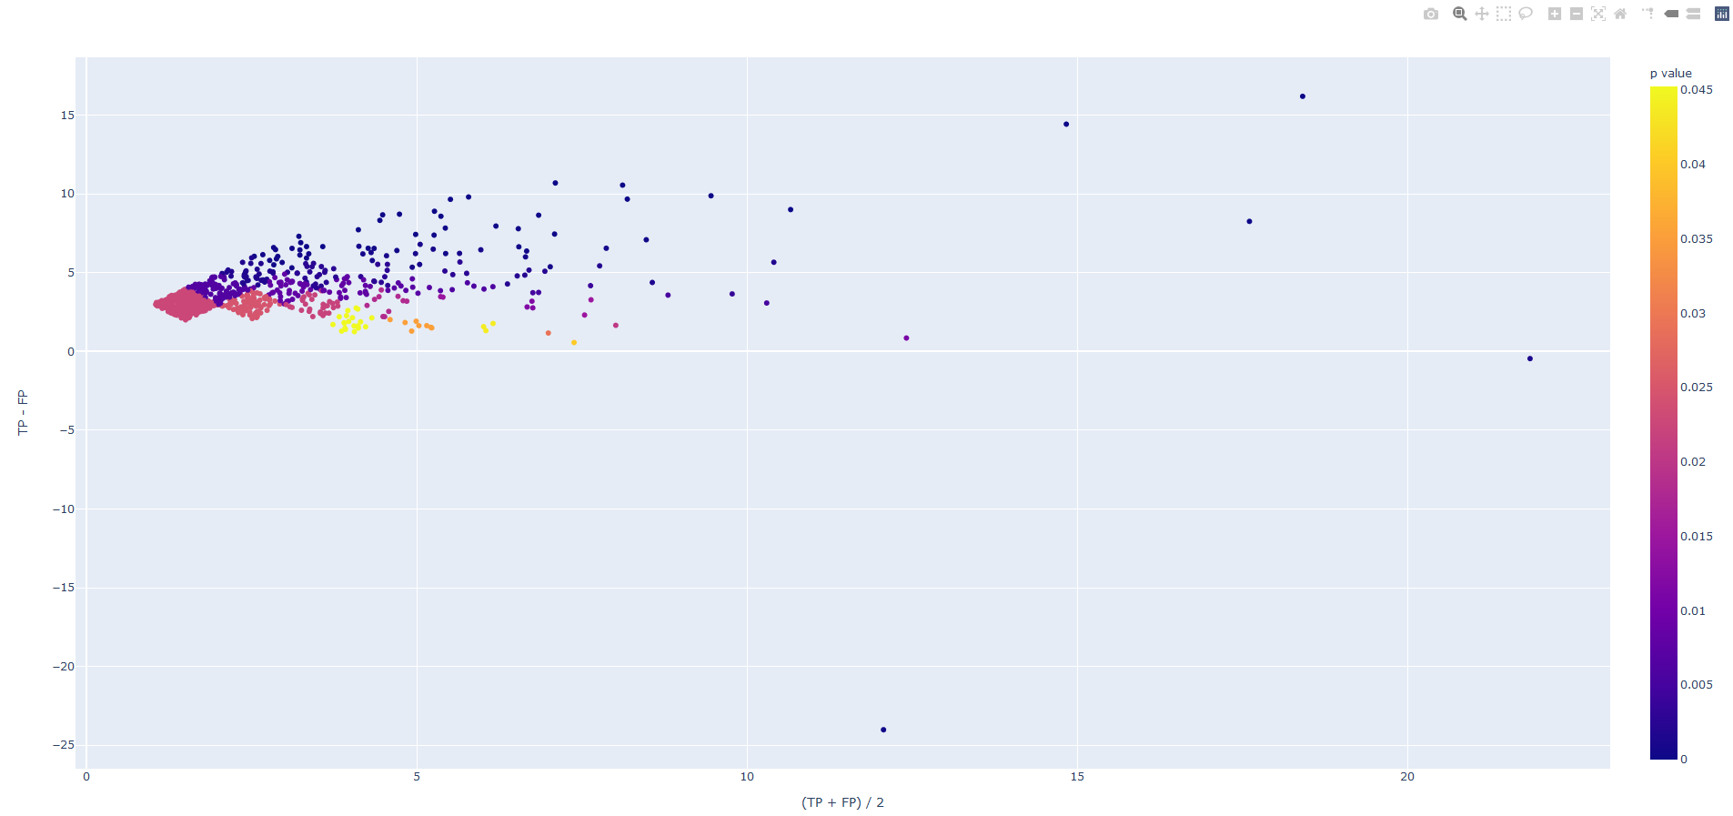
P Value < 0.05 (TP – FP / (TP + FP)/2)

Slide 20
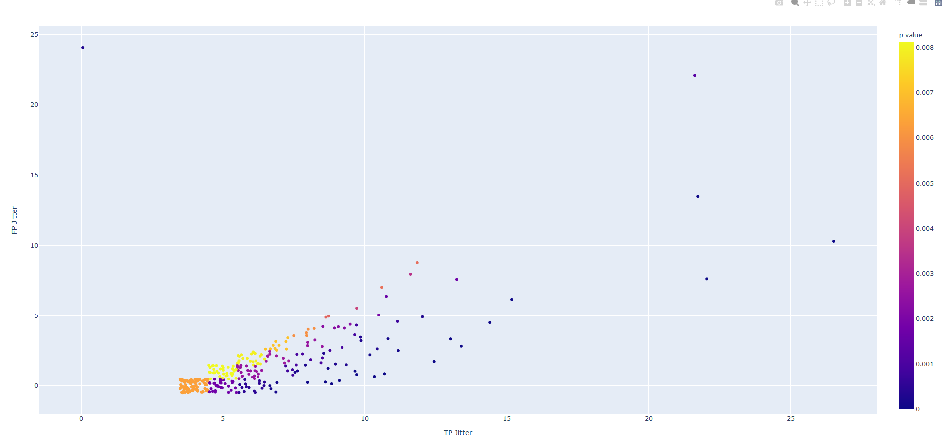
P Value < 0.01 (FP / TP)

Slide 21
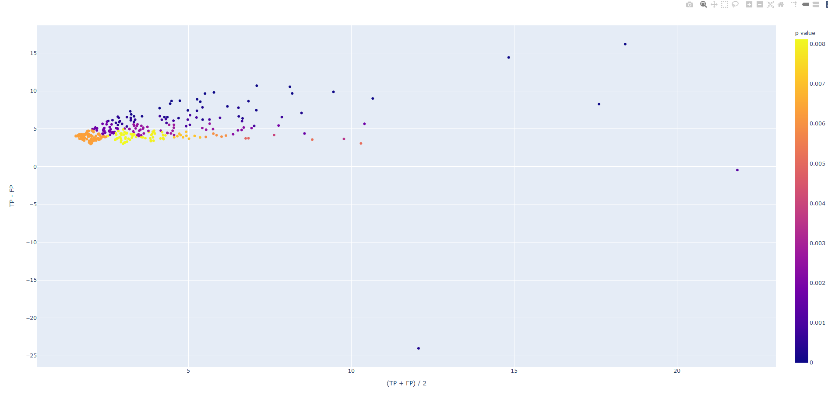
P Value < 0.01 (TP – FP / (TP + FP)/2)

Slide 22
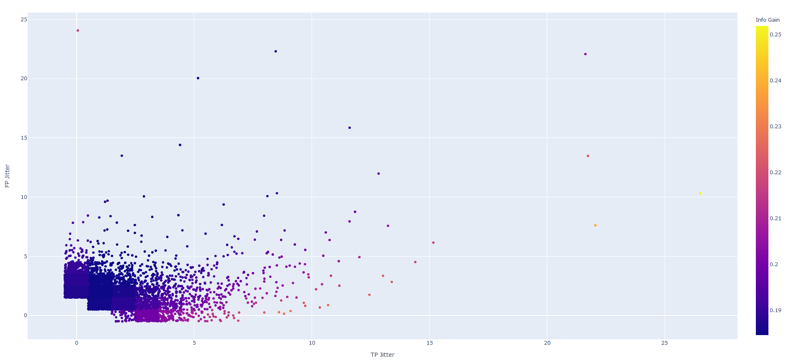
Info Gain (FP / TP)

Slide 23
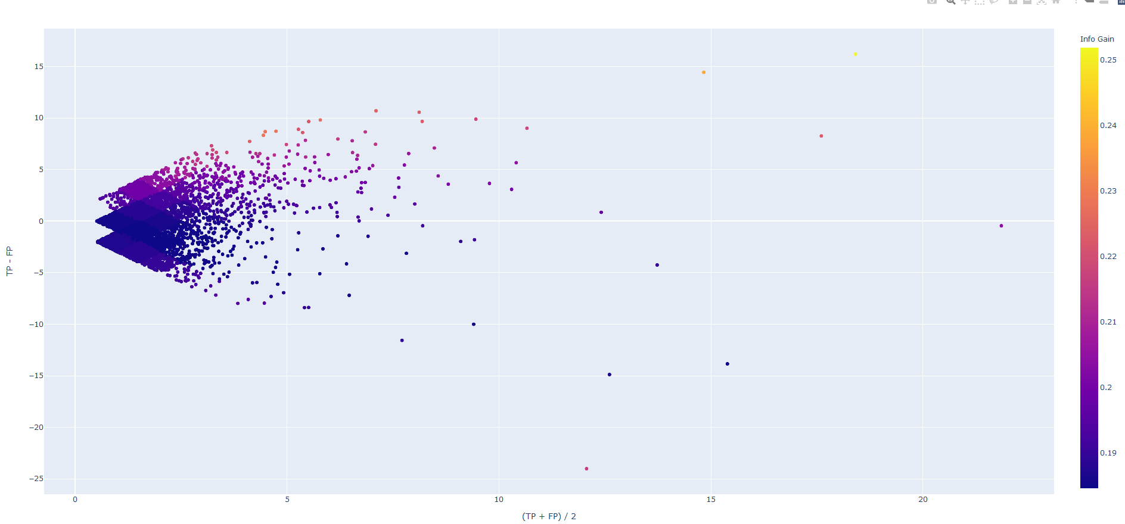
Info Gain (TP – FP / (TP + FP)/2)

Slide 24
How this Relates to Hypothesis and AIMS
The hypothesis is that there are mutations that strongly correlate to the CIMP+ phenotype in uterine cancer.
Slides 8, 9, and 11 aim to find mutations that strongly relate to the CIMP phenotype by producing a list of the most relevant mutations that exist in the data.
Aim 1 is finding important CIMP mutations
Slides 8 and 9 express a way in which we would be able to find all important mutations to CIMP+. The process would give us a concrete list of all important mutational features.
Aim 2 is finding groups of related features
Slide 11 demonstrates possible ways to find relationships between the selected mutations.
Are Aims 1 and 2 fully answered?
Both Aim 1 and 2 can be full answered by the pipeline laid out in the previous slides. When generated, a complete list of important CIMP mutations will be generated, and from this complete list a strong connection can be bult within the important mutations.

Slide 25
Feature selection
The feature list comes from the previous step
Take input for filtering requirements on feature list
Generate forest using the feature list
Filter forests by inputted accuracy constraint
Take relevant mutations from forests that pass the Gini index filtering
Master list is combinations of all relevant forests.

Slide 26
Feature relationship analysis
Feature Data
Feature Data
Feature Data
Association rule mining
Correlation analysis
Clustering
If any features are new add to final set
If any features are new add to final set
If any features are new add to final set
Final Data
Final Data
Final Data

Slide 28
TP + 1
FP = 0
If FP = MAX or # of Muts ! change
Start: TP >= X
FP <= Y
Find all mutations That fit
TP and FP
Filter mutations by p value
Generate forests
Filter forests
by accuracy
If TP and FP = End
FP + 1
End: TP >= Z
FP = MAX
If FP != MAX and # of Muts changed
List all mutations in forests as relevant

Slide 29
p value / 2
If p value != End
Start: p value = X
Find all mutations That fit
< p value
Filter mutations by p value
Generate forests
Filter forests
by accuracy
P value = Y
List all mutations in forests as relevant

Slide 30
info gain / 2
If info gain != End
Start: info gain = X
Find all mutations That fit
> info gain
Filter mutations by info gain
Generate forests
Filter forests
by accuracy
info gain = Y
List all mutations in forests as relevant

Slide 31
Feature selection
Determine
Datasets
Determine the filtering constraint
(Accuracy, Sensitivity, specificity)
Determine filtering requisite for datasets
Filter mutations by p value
Generate
(Forests,
Greedy selection,
Etc...)
Apply filter to generated dataset
List all relevant mutations
List all relevant mutations
Continue with next dataset
If all data sets are not analyzing and the sets still contribute to final list.
Notes:
The feature list comes from the previous step
Take input for filtering requirements on feature list
Generate forest using the feature list
Filter forests by inputted accuracy constraint
Take relevant muttions from forests that past the filtering
Master list is combinations of all relevant forests.

Slide 32
Feature | TP | FP | TN | FN | Info Gain | p value | Accuracy
SMARCAD1_GRCh37_4:95173910-95173910_Frame-Shift-Del_DEL_A-A-- | 2 | 1 | 270 | 106 | 0.188235 | 0.19663 | 0.717678
SMARCA2_GRCh37_9:2104068-2104068_Missense-Mutation_SNP_C-C-T | 0 | 3 | 268 | 108 | 0.188485 | 0.561059 | 0.707124
SMARCA5_GRCh37_4:144445600-144445600_Missense-Mutation_SNP_G-G-A | 0 | 4 | 267 | 108 | 0.189776 | 0.581294 | 0.704485
SMARCA5_GRCh37_4:144445525-144445525_Missense-Mutation_SNP_G-G-A | 1 | 2 | 269 | 107 | 0.184701 | 1 | 0.712401
SMARCA4_GRCh37_19:11121075-11121075_Silent_SNP_C-C-T | 1 | 2 | 269 | 107 | 0.184701 | 1 | 0.712401
SMARCA1_GRCh37_X:128621065-128621065_Missense-Mutation_SNP_C-C-A | 0 | 2 | 269 | 108 | 0.187198 | 1 | 0.709763

Slide 33
row | baseMean | log2FoldChange | lfcSE | stat | pvalue | padj
SMARCC2|6601 | 5849.103 | -0.34808 | 0.115073 | -3.02489 | 0.002487 | 0.01172

Slide 34
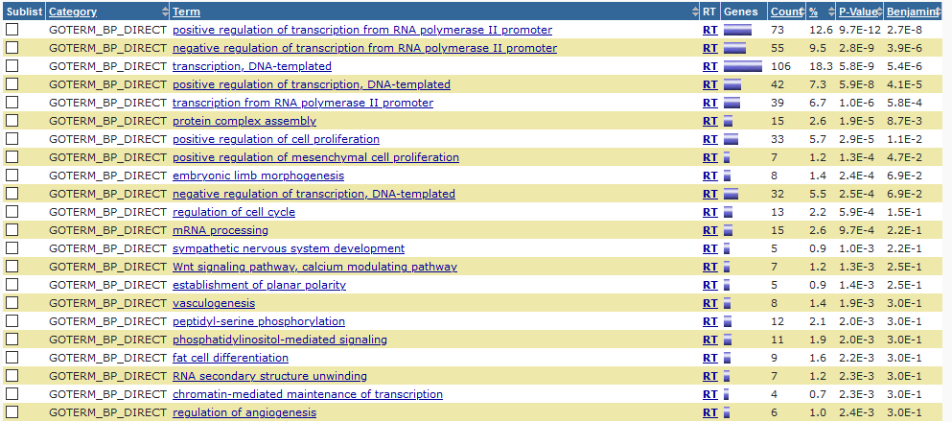
David Analysis

Slide 35
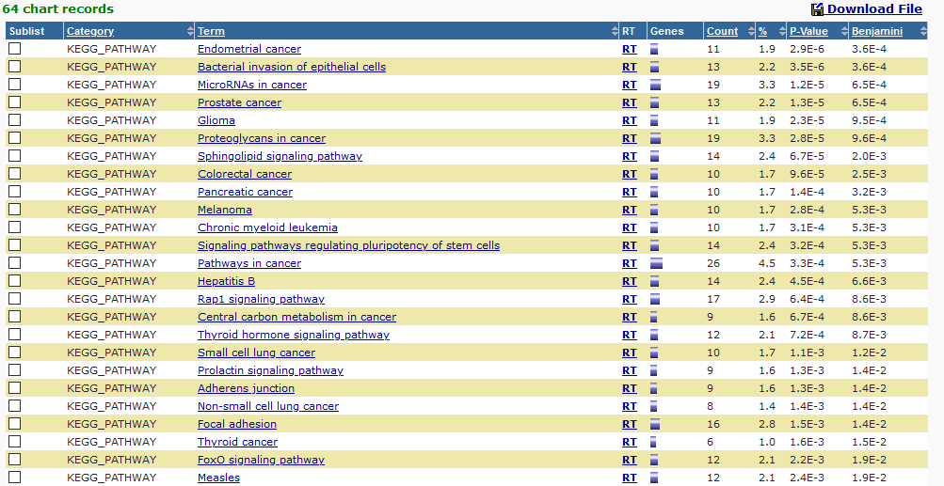
David Analysis

