Slide 1
CIMP Hypothesis
and Aims

Slide 2
Hypothesis
There are mutations that strongly correlate to the CIMP+ phenotype in uterine cancer.
Specific Aims
Aim 1 - Find important Mutations
Aim 2 - Find groups of related mutations
Aim 3 - Interpret findings

Slide 3
Results
There are mutations that strongly correlate to the CIMP+ phenotype in uterine cancer.
845 statistically significant mutations (p value > 0.05, Fishers Exact Value test)
739 statistically significant mutations (Chi squared value > 3.84, Chi Squared test)
609 mutations have a TP – 2FP > 2 (CIMP+ - 2 * Non-CIMP+ > 2)
557 mutations occur exclusively in CIMP+ (CIMP+ >= 2 and Non-CIMP+ = 0)
>=3: 346, >=4: 159, >=5: 57, >=6: 23, =7: 4(KCNA4, SIKE1, CNTLN, MAGI1), =8: 1(AFF1), =9: 3(MESDC1, HAS2, PCDH9)
175 mutations occur 10 to 27.6 time more in CIMP+ than Non-CIMP+
3 mutations were statistically significant after Multiple test correction: RPL22 (Sidak, Bonferroni, Holm’s, Benjamini) DOCK3 (Sidak, Bonferroni, Holm’s, Benjamini), DONSON (Sidak)
3 mutations were found to effect CIMP+: RPL22, DOCK3, KRAS (Cohen’s d > 0.3)
Random Forest found significant mutations:
7476 mutations, TP – 2 FP > 2, # trees 1000, five-fold cross validation, accuracy 79%
8 mutations (Gini importance > 0.01), 165 mutations (Gini importance > 0.001), 4520 mutations (Gini importance > 0)
556 mutations, TP >= 2 , FP = 0, # trees: 1000, five-fold cross validation, Accuracy: 88%
15 mutations (Gini importance > 0.01), 259 mutations (Gini importance > 0.001), 524 mutations (Gini importance > 0)
159 mutations, TP >= 4, FP = 0, # trees 1000, five-fold cross validation, Accuracy 91%
29 mutations (Gini importance > 0.01), 136 mutations (Gini importance > 0.001), 157 mutations (Gini importance > 0)
Power Analysis¹
Assume we want significance < 0.05, effect size > 0.3 and statistical power > 0.8
We require a sample size of at least 175.368 which is smaller than our sample size of 379
Using an adjusted significance level of < 6.184 * 10^-6 (Bonferroni), our new sample size is 643.927
379 is less than 643.927 which means our data is not fit for this p value threshold
All mutations occur in at least 2 samples
Notes:
1. Brownlee, J. (2020, April 23). A gentle introduction to statistical power and power analysis in python. from https://machinelearningmastery.com/statistical-power-and-power-analysis-in-python/

Slide 4
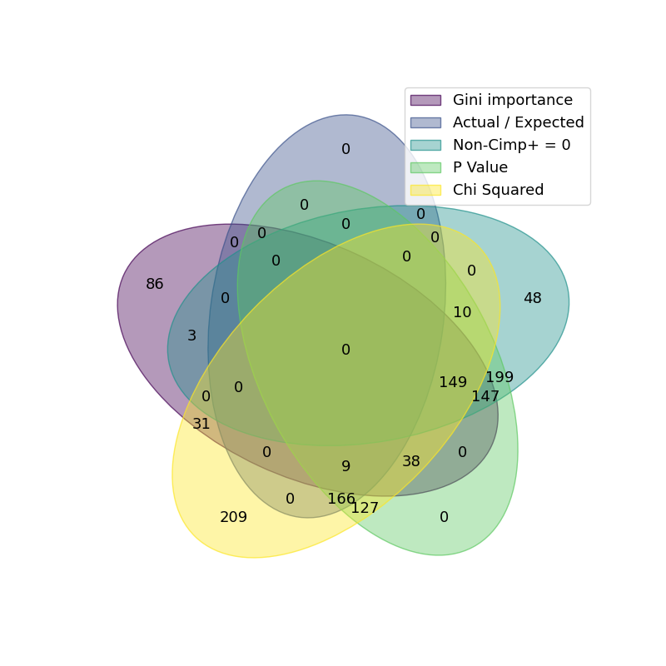
Mutation Overlap: 1,222 Total Mutations

Slide 5

Mutation Overlap: 1,013 Total Mutations
Replaced Chi squared with TP – 2FP > 2

Slide 6
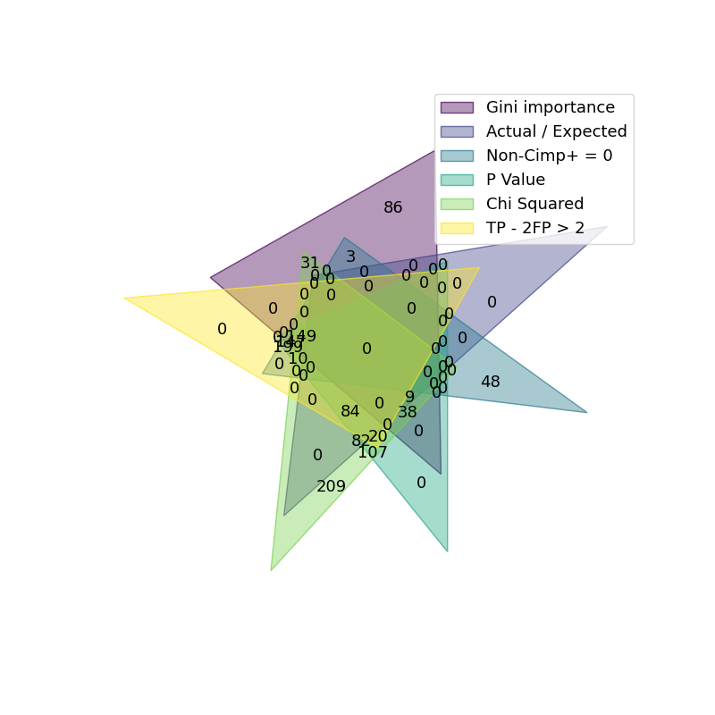
Mutation Overlap: 1,222 Total Mutations

Slide 7
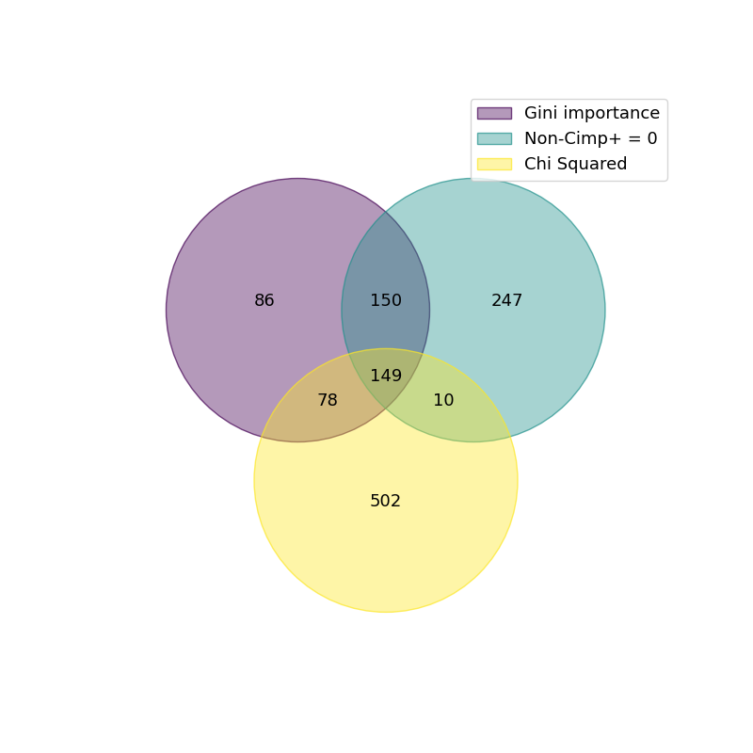
Mutation Overlap: 1,222 Total Mutations
Removed All methods that do not include new mutations

Slide 8
Best Random Forest by accuracy
Random Forest package: from sklearn.ensemble import RandomForestClassifier Select mutation that have TP >= 4 and FP = 0 (Cimp+ >= 4 and Non-CIMP+ = 0) train_test_split( test_size=0.33, train_size = 0.66) RandomForestClassifier(n_estimators = 1000, max_samples = 0.625, oob_score = True, criterion = ”entropy”)
Seperator Type | Seperator Amount | Tree Amount | Criteria | Three-Fold Run | TP | FP | FN | TN | Accuracy | Sensitivity | Specificity | Precision | Miss Rate | False discovery rate | False omission rate
TP_g=X+2 & FP_l=0 | 2 | 1000 | entropy | 0 | 15 | 26 | 0 | 85 | 0.793651 | 1 | 0.765766 | 0.365854 | 0 | 0.634146 | 0
TP_g=X+2 & FP_l=0 | 2 | 1000 | entropy | 1 | 22 | 11 | 0 | 93 | 0.912698 | 1 | 0.894231 | 0.666667 | 0 | 0.333333 | 0
TP_g=X+2 & FP_l=0 | 2 | 1000 | entropy | 2 | 11 | 18 | 0 | 97 | 0.857143 | 1 | 0.843478 | 0.37931 | 0 | 0.62069 | 0
TP_g=X+2 & FP_l=0 | 2 | 1000 | entropy | 3 | 13 | 25 | 0 | 88 | 0.801587 | 1 | 0.778761 | 0.342105 | 0 | 0.657895 | 0
TP_g=X+2 & FP_l=0 | 2 | 1000 | entropy | 4 | 11 | 22 | 0 | 93 | 0.825397 | 1 | 0.808696 | 0.333333 | 0 | 0.666667 | 0

Slide 9
TCGA implementation to statistically significant genes

Slide 10
How TCGA classifies mutational significance
Mutational significance in cancer (MuSiC).
“We assessed multiple methods of calculating summarized P-values, including a convolution test (CT), a Fisher's combined P-value test (FCPT), and the likelihood ratio test (LRT), using a partially simulated data set (this data set and the associated test simulations are described in the Supplemental Material). By this approach, we determined that the P-value distribution obtained using the CT method most closely resembled the uniform distribution expected under the null, while the FCPT and LRT methods produced slightly inflated or deflated P-values, respectively. During the SMG test, a false discovery rate (FDR) also is calculated. We evaluate our SMG test results by establishing a P-value or FDR threshold, and then appropriately filtering the test output.”
Build subgrouping of data.
Using K-means clustering on the data
calculate 7 different variations of p values per grouping (a variation is the calculation excluding a gene ex. P-value without TP53)
Use the (groups * 7) p values in the fishers combined p-value test, likelihood ratio test, and Convolution test.
Mutations are selected on the p value distribution of the three tests with the Convolution test being the largest focus.
Dees, N., Zhang, Q., Kandoth, C., Wendl, M., Schierding, W., Koboldt, D., . . . Ding, L. (2012, August). Music: Identifying mutational significance in cancer genomes. from https://www.ncbi.nlm.nih.gov/pmc/articles/PMC3409272/

Slide 11
How TCGA calculates P-Value
Build subgrouping of data.
Using K-means clustering on the data
calculate 7 different variations of p values and BMR per grouping
AT transitions
AT transversions
CG Transitions
CG transversions
CpG transitions
CpG transversions
Indels
Use the (groups * 7) p values in the fishers combined p-value test, likelihood ratio test, and Convolution test.
Mutations are selected on the p value distribution of the three tests with the Convolution test being the largest focus.

Slide 12
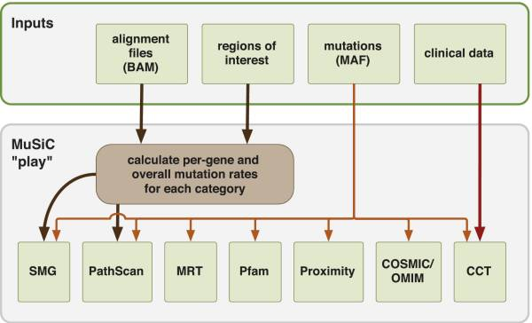
MuSic Play
“MuSiC currently consists of seven analysis modules and an eighth execution module, “MuSiC Play,” which runs each analysis module sequentially. MuSiC Play parses the input and output of each of the individual modules and then produces a composite summary of all executed modules.”

Slide 13
Background
CIMP has be recognized as a hallmark in cancers. CIMP stands for CpG island methylator phenotype, and it has been documented in cancers for various tissue types. The term CIMP has been used to describe DNA methylation at high CIMP genomic regions affecting distinct sets of cancers. These tumors can be classified as CIMP positive and CIMP negative, with a middle CIMP intermediate. These classification can be used to find correlations between cancer samples. “Tumors were found to clustered with respect to methylation of specific genes, suggesting that CIMP could be discerned using appropriate statistical analyses.” The aim is to build a connection between mutations and genes and the CIMP+ phenotype to support the claim of CpG island methylator phenotype in cancers.
Miller, B., Sánchez-Vega, F., & Elnitski, L. (2016). The emergence of pan-cancer cimp and its elusive interpretation. Biomolecules, 6(4), 45. doi:10.3390/biom6040045
Sánchez-Vega, F., Gotea, V., Margolin, G., & Elnitski, L. (2015). Pan-cancer stratification of solid HUMAN Epithelial tumors and cancer cell lines REVEALS commonalities and tissue-specific features of the CPG ISLAND METHYLATOR PHENOTYPE. Epigenetics & Chromatin, 8(1). doi:10.1186/s13072-015-0007-7

Slide 14

Fisher's combined P-value test
“Fisher's combined P-value test combines all P-values for a particular gene into a statistic, χ_{c}, according to Fisher's method.”
“Where p_{i} is the P-value obtained via binomial distribution for the i-th subgroup mutational mechanism type, and k the number of subgroup mutational mechanism categories for a gene. The final P-value for the entire gene is calculated as the probability of observing a value no less than χ_{c}, based on a χ² distribution with 2k degrees of freedom.”
Dees, N., Zhang, Q., Kandoth, C., Wendl, M., Schierding, W., Koboldt, D., . . . Ding, L. (2012, August). Music: Identifying mutational significance in cancer genomes. from https://www.ncbi.nlm.nih.gov/pmc/articles/PMC3409272/

Slide 15

likelihood ratio test
“Likelihood ratio test constructs a likelihood ratio-based statistic (χ_{l}) for a gene.”
“Where M_{i}, C_{i}, R_{i}, and r_{i} are mutation number, coverage, BMR, and maximum likelihood estimate (MLE) of the mutation rate, respectively, for the i-th subgroup mutational mechanism category of a gene, k is the number of mutation types, and L() is the likelihood of observed mutation number for the i-th subgroup mutational mechanism category, defined as the point probability of observing M_{i} mutations given a coverage of C_{i} and a mutation rate of R_{i} or r_{i}. The final P-value for the entire gene is calculated as the probability of observing a value no less than χ_{l}, based on an approximate χ² distribution with k degrees of freedom.”
This requires a p value and maximum likelihood estimate to already be established.
Dees, N., Zhang, Q., Kandoth, C., Wendl, M., Schierding, W., Koboldt, D., . . . Ding, L. (2012, August). Music: Identifying mutational significance in cancer genomes. from https://www.ncbi.nlm.nih.gov/pmc/articles/PMC3409272/

Slide 16

convolution test
“Convolution test calculates a summarized log statistic of joint binomial point probability.”
“where M_{i}, C_{i}, R_{i}, and r_{i} are mutation number, coverage, BMR, and maximum likelihood estimate (MLE). L() is the likelihood of observed mutation number for the i-th subgroup.”
“That the P-value for a gene can be calculated by taking one minus a left-tail probability, i.e., the probability of observing a value less than S_{g}, and the semi exact distribution of S_{g} can be obtained by a binned histogram-based convolution procedure. This procedure is advantageous for the large amounts of data involved in genome-wide investigation of cohort mutations because it provides exact P-values in a minimum amount of computation time.”
Dees, N., Zhang, Q., Kandoth, C., Wendl, M., Schierding, W., Koboldt, D., . . . Ding, L. (2012, August). Music: Identifying mutational significance in cancer genomes. from https://www.ncbi.nlm.nih.gov/pmc/articles/PMC3409272/

Slide 17
Calculation of FDR (TCGA)
During the SMG test, a false discovery rate (FDR) also is calculated. We evaluate our SMG test results by establishing a P-value or FDR threshold (threshold typically 0.2 or less for FDR), and then appropriately filtering the test output.

Slide 18
Aim 1- Finding important CIMP Mutations

Slide 19
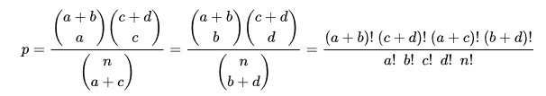
Fishers Exact test
Fisher's exact test is a statistical significance test used in the analysis of contingency tables. Although in practice it is employed when sample sizes are small, it is valid for all sample sizes. It is named after its inventor, Ronald Fisher, and is one of a class of exact tests, so called because the significance of the deviation from a null hypothesis (P-value) can be calculated exactly, rather than relying on an approximation that becomes exact in the limit as the sample size grows to infinity, as with many statistical tests. P = (37! * 342! * 108! * 271!) / (27! * 10! * 261! * 81! * 379!) P = 3.86 x 10^-9
RPL22 |  |  | SUM
 | a | b | a + b
 | c | d | c + d
SUM | a + c | b + d | n
RPL22 |  |  | SUM
 | 27 | 10 | 37
 | 81 | 261 | 342
SUM | 108 | 271 | 379

Slide 20
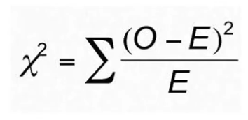
Chi-squared test
chi-squared test, also written as χ² test, is a statistical hypothesis test that is valid to perform when the test statistic is chi-squared distributed under the null hypothesis. Typically used for data sets that are larger than 2 X 2 The expected data is the mean of each classification (ex expected TP is the mean of all mutations TP value) Degree of freedom = (row – 1)(col-1) = (2-1)(2-1) = 1 TP = (27 – 1.42)^2 / 1.42 = 460.80 FP = (10 – 1.98)^2 / 1.98 = 32.49 FN = (81 – 106.57)^2 / 106.57 = 6.14 TN = (261 – 269.01)^2 / 269.01 = 0.24 SUM = 499.67 Refer to power table for significant (Degree of freedom by desired p value) 499.67 > 3.84 RPL22 is deemed statistically significant
RPL22
 | 27 | 10
 | 81 | 261
Expected
 | 1.42 | 1.98
 | 106.57 | 269.01

Slide 21
Actual / Expected rate
Actual / Expected = (TP / TP + FN) / (FP / FP + TN) FP = 0 FP > 0
Feature | TP | FP | TN | FN | Actual / expected
PCDH9 | 9 | 0 | 271 | 99 | 2.26E+14
HAS2 | 9 | 0 | 271 | 99 | 2.26E+14
MESDC1 | 9 | 0 | 271 | 99 | 2.26E+14
AFF1 | 8 | 0 | 271 | 100 | 2.01E+14
MAGI1 | 7 | 0 | 271 | 101 | 1.76E+14
CNTLN | 7 | 0 | 271 | 101 | 1.76E+14
SIKE1 | 7 | 0 | 271 | 101 | 1.76E+14
KCNA4 | 7 | 0 | 271 | 101 | 1.76E+14
BTBD11 | 6 | 0 | 271 | 102 | 1.51E+14
ZMIZ1 | 6 | 0 | 271 | 102 | 1.51E+14
Feature | TP | FP | TN | FN | Actual / expected
DONSON | 11 | 1 | 270 | 97 | 2.76E+01
ZFP91 | 10 | 1 | 270 | 98 | 2.51E+01
MUM1L1 | 10 | 1 | 270 | 98 | 2.51E+01
POTEG | 10 | 1 | 270 | 98 | 2.51E+01
BCAS3 | 9 | 1 | 270 | 99 | 2.26E+01
ANKRD13C | 8 | 1 | 270 | 100 | 2.01E+01
FBXO48 | 8 | 1 | 270 | 100 | 2.01E+01
MAF | 8 | 1 | 270 | 100 | 2.01E+01
TFAP2B | 7 | 1 | 270 | 101 | 1.76E+01
ZBTB34 | 7 | 1 | 270 | 101 | 1.76E+01

Slide 22
Multiple Test Correction and Hypothesis testing
The statistical power of a hypothesis test is the probability of detecting an effect, if there is a true effect present to detect.
p-value (p) is the probability of obtaining a result equal to or more extreme than was observed in the data.
A result of a significance test is claimed to be “statistically significant” if the p-value is less than the significance level. This means that the null hypothesis is rejected.
p <= alpha: reject H0, different distribution.
p > alpha: fail to reject H0, same distribution.
Type I Error. Reject the null hypothesis when there is in fact no significant effect (false positive). The p-value is optimistically small.
Type II Error. Not reject the null hypothesis when there is a significant effect (false negative). The p-value is pessimistically large.
FDR is the false discovery rate an FDR adjusted p-value (or q-value) of 0.05 implies that 5% of significant tests will result in false positives.
Why do we do this?
If all mutations (8085) had a p value of 0.05. 404.25 would be in our false discovery rate and would be inaccurately classified. The goal is to mitigate the false discovery rate while still having a p value that the mutations can still classify into.

Slide 23
Multiple Test Correction
Bonferroni Correction
Sidak Correction
Holm’s Step-Down Procedure
Hochberg’s Step-Up Procedure
a = non-adjusted p value 0.05
a* = adjusted p value
m = The amount of samples
RPL22 p value = 3.86 x 10^-9
Zheng, P. (2018, August 07). An overview of methods to address the multiple comparison problem. From https://towardsdatascience.com/an-overview-of-methods-to-address-the-multiple-comparison-problem-310427b3ba92?gi=553c637ad8c4

Slide 24
Bonferroni Correction
The most conservative of corrections, the Bonferroni correction is also perhaps the most straightforward in its approach. Simply divide α by the number of tests (m).
However, with many tests, α* will become very small. This reduces power, which means that we are very unlikely to make any true discoveries.
In Uterine data:
0.05/8085 = 6.18 x 10^-6
3.86 x 10^-9 < 6.18 x 10^-6
So RPL22 is statistically significant

Slide 25
Sidak Correction
In statistics, the Sidak correction, or Dunn–Sidak correction, is a method used to counteract the problem of multiple comparisons. It is a simple method to control the familywise error rate. When all null hypotheses are true, the method provides familywise error control that is exact for tests that are stochastically independent, is conservative for tests that are positively dependent, and is liberal for tests that are negatively dependent.
α* = 1-(1-α)^(1/m)
1-(1-0.05)^(1/8085) = 6.34 x 10^-6
3.86 x 10^-9 < 6.34 x 10^-6
So RPL22 is statistically significant

Slide 26
Holm’s Step-Down Procedure
An update of the Bonferroni correction, this procedure is more powerful. Rather than controlling the FMER, Holm’s procedure controls for the false discovery rate (FDR) and performed after conducting all hypothesis tests and finding associated p-values at α within a set.
The step-down procedure is best illustrated with an example. Say we have three hypotheses, each with the associated p-value:
RPL22: 3.86 x 10^-9 RPL22 : 3.86 x 10^-9 GFRA2: 0.045 -> DOCK3 : 1.34 x 10^-7 DOCK3: 1.34 x 10^-7 GFRA2 : 0.045
a* = a/(m – rank + 1)
α* = 0.05/(8085–1+1) = 6.18 x 10^-6
Compare the first-ranked p-value with the α*
Because the p-value for RPL22 is less than the calculated α*, we can reject RPL22.
α* = 0.05/(8085–2+1) = 6.18 x 10^-6
1.34 x 10^-7 < 0.025
DOCK3 is rejected
α* = 0.05/(8085–844+1) = 6.90 x 10^-6
0.045 <0.05
GFRA2 is not rejected

Slide 27
Benjamini-Hochberg’s Step-Up Procedure
More powerful than Holm’s step-down procedure, Hochberg’s step-up procedure also seeks to control the FDR and follows a similar process, only p-values are ranked from largest to smallest.
For each ranked p-value, it is compared to the α* calculated for its respective rank (same formula as Holm’s procedure). Testing continues until you reach the first rejected hypothesis. You would then reject all following hypotheses.
RPL22: 3.86 x 10^-9 GFRA2: 0.045 GFRA2: 0.045 -> DOCK3 : 1.34 x 10^-7 DOCK3: 1.34 x 10^-7 RPL22 : 3.86 x 10^-9
a* = a/(n – rank + 1)
α* = 0.05/(8085–7241+1) = 5.91 x 10^ -5
0.045 > 0.0167 – Not rejected
α* = 0.05/(8085–8084+1) = 0.025
1.34 x 10^-7 < 0.025 – rejected
So DOCK3 is significant, and since DOCK3 is significant RPL22 is as well

Slide 28
Cohen's d and Effect Size
Cohen’s d = Mean difference / Standard deviation
If Cohen’s d is bigger than 1, the difference between the two means is larger than one standard deviation, anything larger than 2 means that the difference is larger than two standard deviations.
A d value between 0 to 0.3 is a small effect size, if it is between 0.3 and 0.6 it is a moderate effect size, and an effect size bigger than 0.6 is a large effect size.
RPL22 mean: 0.976
RPL22 STD: 0.297
RPL22 Cohen’s d = 0.328
RPL22 has a moderate effect size

Slide 29
Statistical Power
Statistical power, or the power of a hypothesis test is the probability that the test correctly rejects the null hypothesis. That is, the probability of a true positive result. It is only useful when the null hypothesis is rejected. The higher the statistical power for a given experiment, the lower the probability of making a Type II (false negative) error.
Power = 1 - Type II Error
Low Statistical Power: Large risk of committing Type II errors, e.g., a false negative.
High Statistical Power: Small risk of committing Type II errors.
It is common to design experiments with a statistical power of 80% or better, e.g. 0.80. This means a 20% probability of encountering a Type II area. This different to the 5% likelihood of encountering a Type I error for the standard value for the significance level
For RPL22
Power = 1 – 3.86 * 10 ^ -9
Power = 0.999
0.999 > 0.8
Brownlee, J. (2020, April 23). A gentle introduction to statistical power and power analysis in python. from https://machinelearningmastery.com/statistical-power-and-power-analysis-in-python/

Slide 30
Power Analysis
Statistical power is one piece in a puzzle that has four related parts; they are:
Effect Size. The quantified magnitude of a result present in the population. Effect size is calculated using a specific statistical measure, such as Pearson’s correlation coefficient for the relationship between variables or Cohen’s d for the difference between groups.
Sample Size. The number of observations in the sample.
Significance. The significance level used in the statistical test, e.g. alpha. Often set to 5% or 0.05.
Statistical Power. The probability of accepting the alternative hypothesis if it is true.
All four variables are related. For example, a larger sample size can make an effect easier to detect, and the statistical power can be increased in a test by increasing the significance level.
A power analysis involves estimating one of these four parameters given values for three other parameters. This is a powerful tool in both the design and in the analysis of experiments that we wish to interpret using statistical hypothesis tests.

Slide 31
Aim 1 – Finding important CIMP Mutations RPL22
Research Questions:
What is the set of all mutations that are prevalent in CIMP+?
What is the set of all mutations that are prevalent in CIMP-?
What is the set of all mutations that are prevalent in CIMPi?
Claim: There are mutations that strongly correlate to the CIMP+ phenotype in uterine cancer.
Null Hypothesis: The mutation RPL22 at position 6257785 with frame shift deletion of T is not relevant to CIMP
Alternative Hypothesis: The mutation RPL22 at position 6257785 with frame shift deletion of T is relevant to CIMP
Ground 1: P-value, corrected for false discovery rate (Including, but not limited to Bonferroni Correction, Holm’s Step-Down Procedure, Sidak Correction, and Benjamini-Hochberg’s Step-Up Procedure)
Ground 2: Covers enough samples in foreground (either in CIMP+ or in CIMP-, depending on which one you are trying to characterize with features)
Ground 3: The mutation passes a variety of statistical measures (measures include, but not limited to Actual / Expected rate, Cohen's d and Effect Size, Statistical Power, Power Analysis, Chi-squared test)
Warrant 1: Using p value, we can find that RPL22 has a p value of 3 * 10^-9 this is less than a p value 0.05. We also find that if using Bonferroni Correction p value (0.05 / 8085) ~ 6 * 10 ^ -6, RPL22 also has a p value smaller than this proving that RPL22 is statistically significant.
Warrant 2: The mutation RPL22 covers 27 samples of CIMP+ more than every other mutation in the data, this is larger than 8084 of the other mutations.
Warrant 3: The measures referred to in ground 3 are all reputable statistical measures for finding important data from non-important data. In use we can effectively find all important mutations.
Backing for Warrant 1: There are 845 (~10%) mutations that have a p value <= 0.05. While 2 (0.025%) mutations have < 6 * 10 ^ -6 and fit the adjusted p value
Backing for Warrant 2: The foreground there are 108 CIMP+ mutations. The background has 142 CIMP-, and 129 CIMPi samples (271 total). This makes any 1 CIMP+ sample almost twice as important as 1 Non-CIMP+ sample
Backing for Warrant 3: RPL22 value for:
Actual / Expected rate: 6.775
Cohen's d and Effect Size: 0.593
Statistical Power: 0.999
Chi-squared test: 499.67
Rebuttal: Of the ~8000 mutations only ~800 are considered “statistically significant” (p value < 0.05). Along side of this the strongest mutation that contains CIMP+ only covers ~25% of the data. This means any given mutation is only able to cover a small potion of the data. While the highest accuracy forest was 90% most forest only has an accuracy between 50 and 70%. Other metrics have a similar outlier as well.
Qualifications: In the data there are mutations that do not relate to CIMP+, this can become problematic when separating the two groupings causing CIMP+ and Non-CIMP+ mixing. If all separation is correct, then the data will correlate to CIMP+

Slide 32
Aim 1 – Finding important CIMP Mutations General
Research Questions:
What is the set of all mutations that are prevalent in CIMP+?
What is the set of all mutations that are prevalent in CIMP-?
What is the set of all mutations that are prevalent in CIMPi?
Claim: There are mutations that strongly correlate to the CIMP+ phenotype in uterine cancer.
Null Hypothesis: The mutation X is not relevant to CIMP
Alternative Hypothesis: The mutation X at position Y with frame shift Z is relevant to CIMP
Ground 1: P-value, corrected for false discovery rate (Including, but not limited to Bonferroni Correction, Holm’s Step-Down Procedure, Sidak Correction, and Benjamini-Hochberg’s Step-Up Procedure)
Ground 2: Covers enough samples in foreground (either in CIMP+ or in CIMP-, depending on which one you are trying to characterize with features)
Ground 3: The mutation passes a variety of statistical measures (measures include, but not limited to Actual / Expected rate, Cohen's d and Effect Size, Statistical Power, Power Analysis, Chi-squared test)
Warrant 1: Using p value, we can find that X has a p value of P this is less / greater than a p value 0.05. We also find that if using Bonferroni Correction p value P*, X also has a p value smaller/larger than this proving that X is/isnt statistically significant.
Warrant 2: The mutation X covers TP samples of CIMP+ more than every other mutation in the data, this is larger than M of the other mutations.
Warrant 3: The measures referred to in ground 3 are all reputable statistical measures for finding important data from non-important data. In use we can effectively find all important mutations.
Backing for Warrant 1: There are 845 (~10%) mutations that have a p value <= 0.05. While 2 (0.025%) mutations have < 6 * 10 ^ -6 and fit the adjusted p value
Backing for Warrant 2: The foreground there are 108 CIMP+ mutations. The background has 142 CIMP-, and 129 CIMPi samples (271 total). This makes any 1 CIMP+ sample almost twice as important as 1 Non-CIMP+ sample
Backing for Warrant 3: X value for:
Actual / Expected rate:
Cohen's d and Effect Size:
Statistical Power:
Chi-squared test:
Rebuttal: Of the ~8000 mutations only ~800 are considered “statistically significant” (p value < 0.05). Along side of this the strongest mutation that contains CIMP+ only covers ~25% of the data. This means any given mutation is only able to cover a small potion of the data. While the highest accuracy forest was 90% most forest only has an accuracy between 50 and 70%. Other metrics have a similar outlier as well.
Qualifier: In the data there are mutations that do not relate to CIMP+, this can become problematic when separating the two groupings causing CIMP+ and Non-CIMP+ mixing. If all separation is correct, then the data will correlate to CIMP+

Slide 33
Discussion
How does this relate to the biological question?
Finding reasons on why a mutation is significant helps the claim that CIMP is a significant occurrence in cancer.
If a list of mutations are found to be significant in cancer and significant in CIMP+ then a claim can be made that shows CIMP+ is significant in cancer.
Drawbacks to this method.
This measures only look at the statistically significant of any one mutation. This would not include biological implications or gene level statistics (Though these can be implemented in a similar manor to the mutations)
These measure are unique to each other therefore hold no strong overall significants

