Slide 1
Research questions
What are the interesting mutations? (Greedy)
What are the clusters that exist among the mutations? (ClusterGrammer)
What are the clusters that exist among the samples? (ClusterGrammer)
What is the biological significance of the data? (ClusterGrammer)

Slide 2
If the cost value is 0
Data
Calculate values based on the cost function.
(TP, TP-FP, ext…)
Find the mutation with the cost greatest value
Remove the mutation and the samples the mutation covers
Build graphics
If the cost value is not 0

Slide 3
Summary of Results
Most selection criteria is effective at separating cimp+ from non-cimp+
The most effective was looking at highest Cimp+. This covered 106/108 samples.
The problem is that it also covers 98/271 Non-cimp+
The most effective without Non-Cimp+ was Cimp+ - 2Non-Cimp+
This had 84 Cimp+ and 0 Non-Cimp+

Slide 4
Mutation Level Graphs
Example:
GOT1_GRCh37_10:101163586-101163586_Missense-Mutation_SNP_C-C-T
RPL22_GRCh37_1:6257785-6257785_Frame-Shift-Del_DEL_T-T—
RPL22_GRCh37_1:6246852-6246852_Frame-Shift-Del_DEL_T-T—
KRAS_GRCh37_12:25398281-25398281_Missense-Mutation_SNP_C-C-T_C-C-

Slide 5
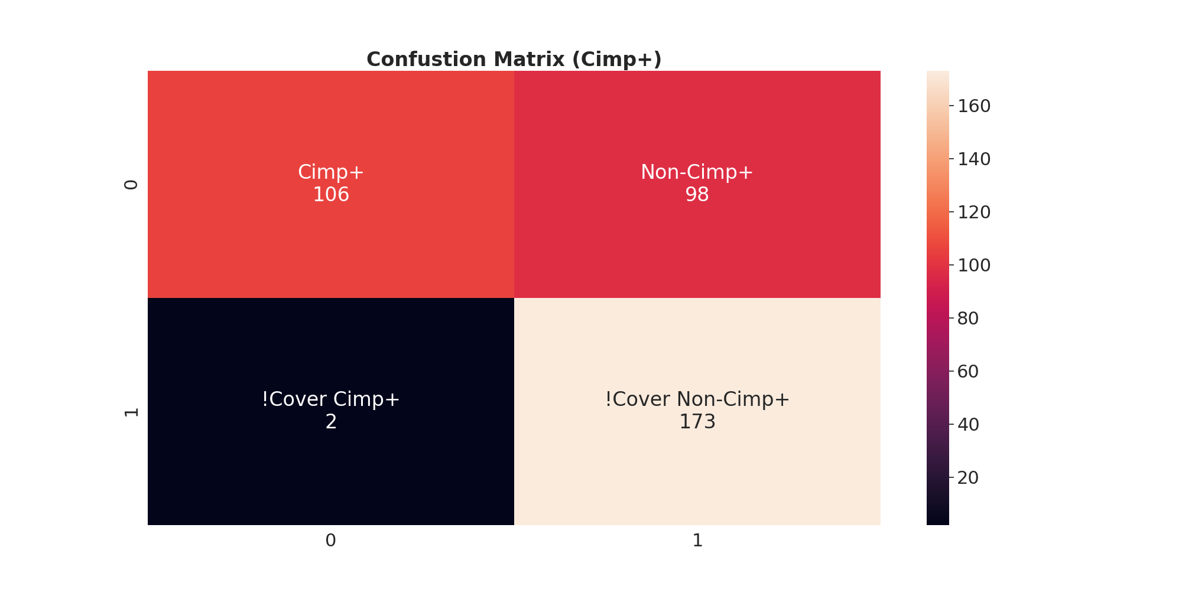
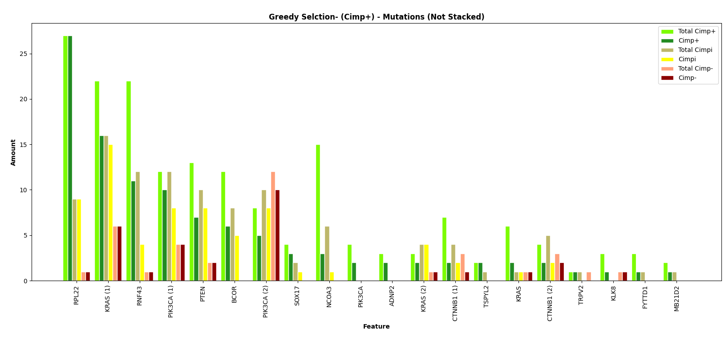
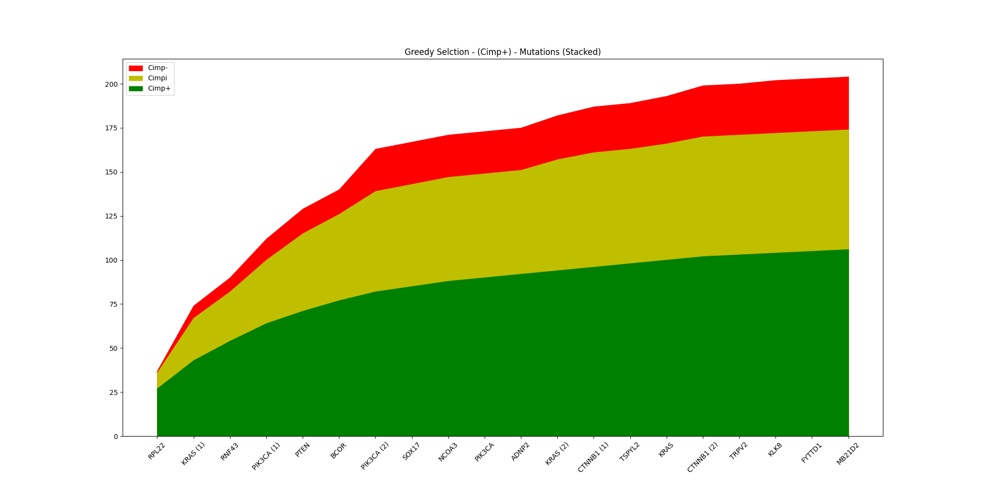
Select by Cimp+

Slide 6
Name | Cimp+ | Non-Cimp+
RPL22 | 27 | 10
KRAS | 16 | 21
RNF43 | 11 | 5
PIK3CA | 10 | 12
PTEN | 7 | 10
BCOR | 6 | 5
PIK3CA | 5 | 18
SOX17 | 3 | 1
NCOA3 | 3 | 1
PIK3CA | 2 | 0
ADNP2 | 2 | 0
KRAS | 2 | 5
CTNNB1 | 2 | 3
TSPYL2 | 2 | 0
Name | Cimp+ | Non-Cimp+
KRAS | 2 | 2
CTNNB1 | 2 | 4
TRPV2 | 1 | 0
KLK8 | 1 | 1
FYTTD1 | 1 | 0
MB21D2 | 1 | 0
Metric | Value
TP | 106
FP | 98
FN | 2
TN | 173
Accuracy | 0.736
Sensitivity | 0.981
Specificity | 0.638
Precision | 0.52
Miss Rate | 0.019
False Discovery Rate | 0.48
False Omission Rate | 0.011

Slide 7
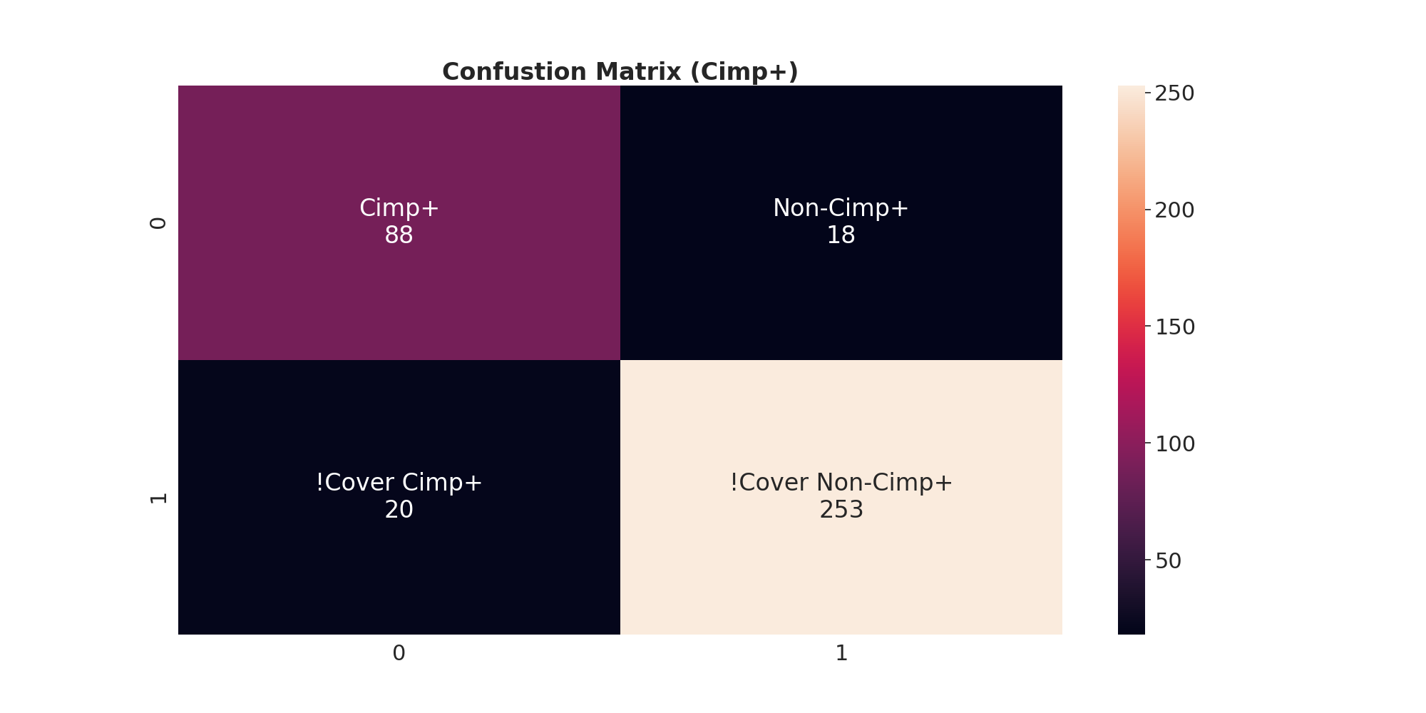
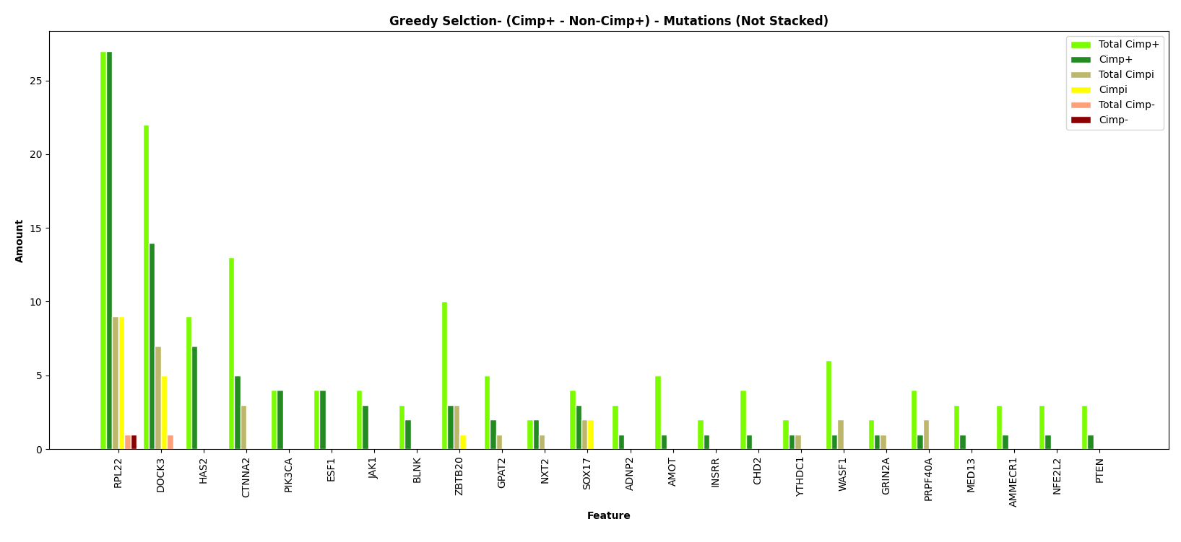
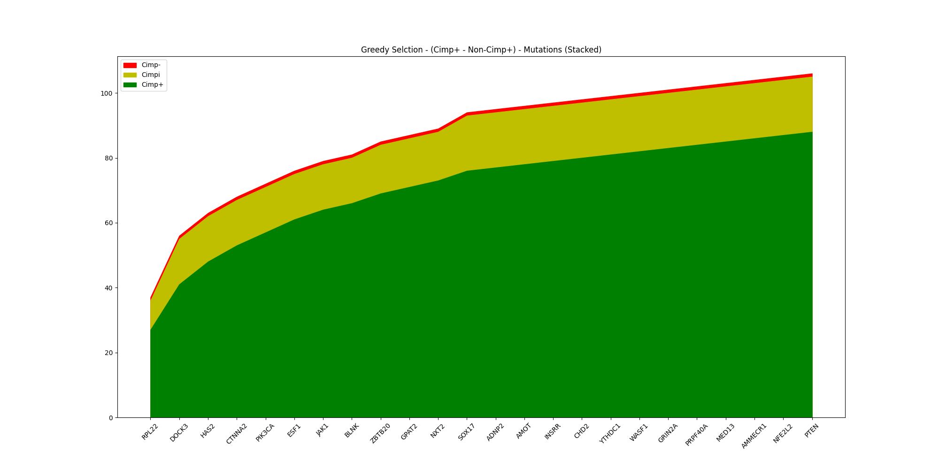
Select by Cimp+ - Non-Cimp+

Slide 8
Name | Cimp+ | Non-Cimp+
RPL22 | 27 | 10
DOCK3 | 14 | 5
HAS2 | 7 | 0
CTNNA2 | 5 | 0
PIK3CA | 4 | 0
ESF1 | 4 | 0
JAK1 | 3 | 0
BLNK | 2 | 0
ZBTB20 | 3 | 1
GPAT2 | 2 | 0
NXT2 | 2 | 0
SOX17 | 3 | 2
ADNP2 | 1 | 0
AMOT | 1 | 0
Name | Cimp+ | Non-Cimp+
INSRR | 1 | 0
CHD2 | 1 | 0
YTHDC1 | 1 | 0
WASF1 | 1 | 0
GRIN2A | 1 | 0
PRPF40A | 1 | 0
MED13 | 1 | 0
AMMECR1 | 1 | 0
NFE2L2 | 1 | 0
PTEN | 1 | 0
Metric | Value
TP | 88
FP | 18
FN | 20
TN | 253
Accuracy | 0.9
Sensitivity | 0.815
Specificity | 0.934
Precision | 0.83
Miss Rate | 0.185
False Discovery Rate | 0.17
False Omission Rate | 0.073

Slide 9

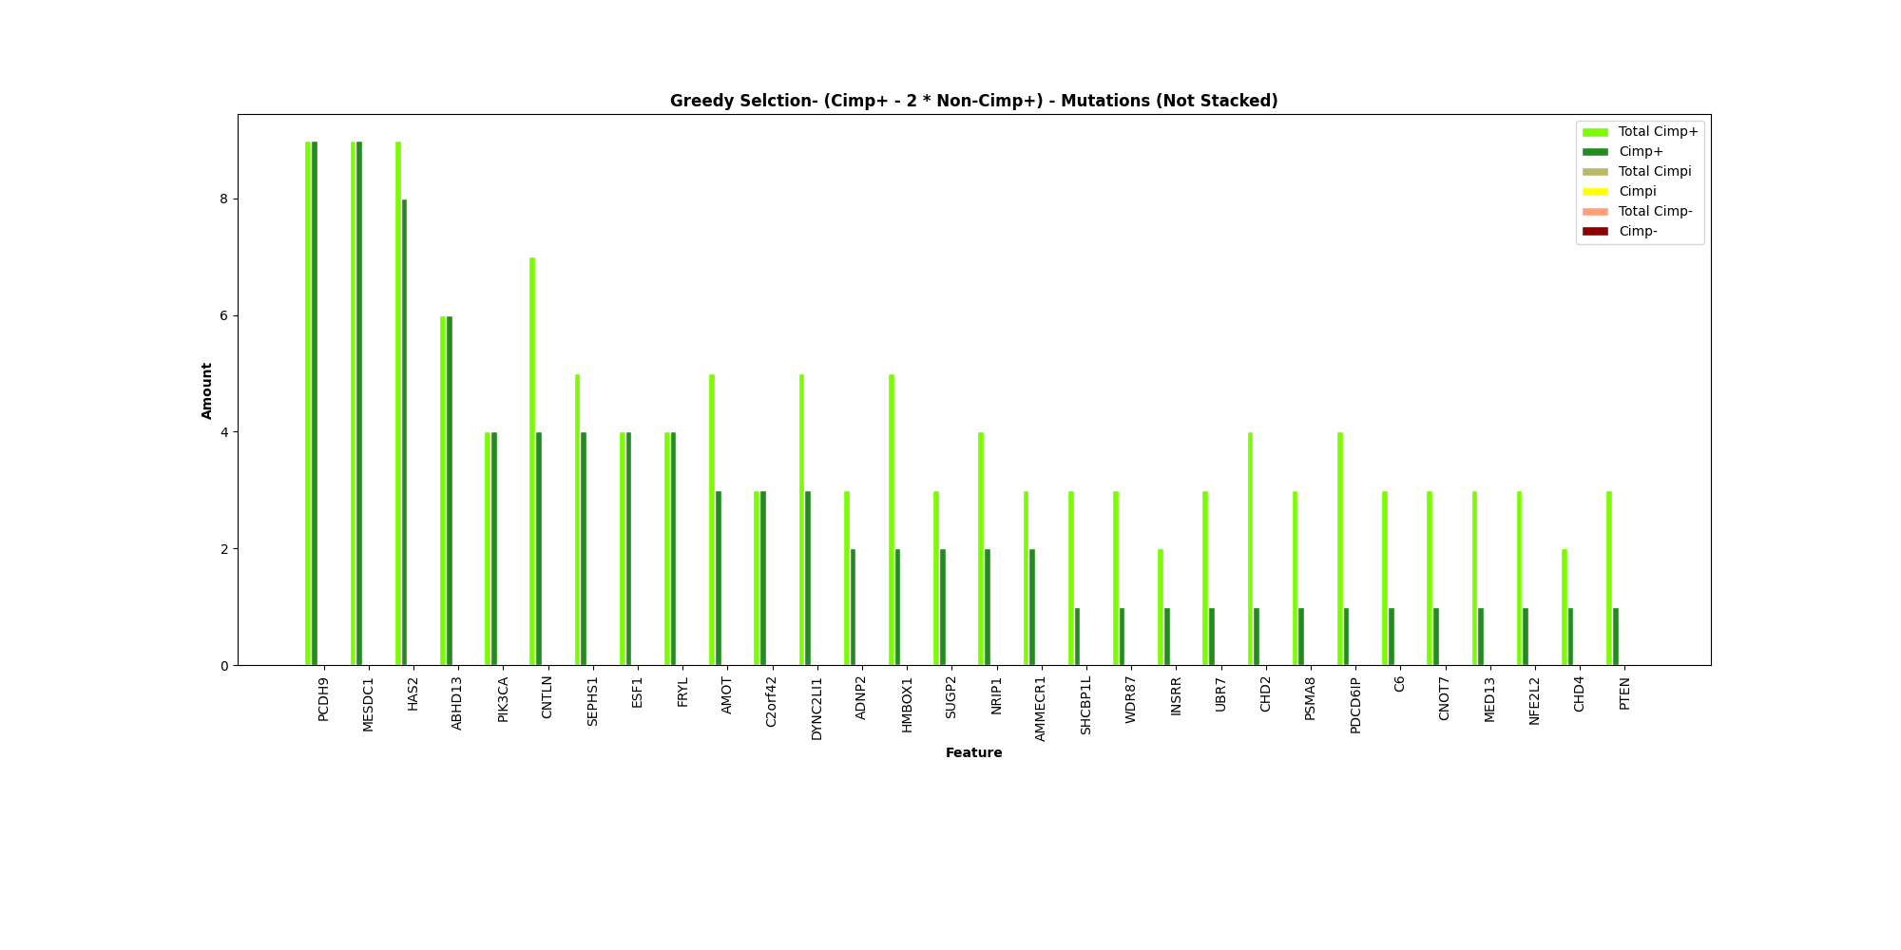
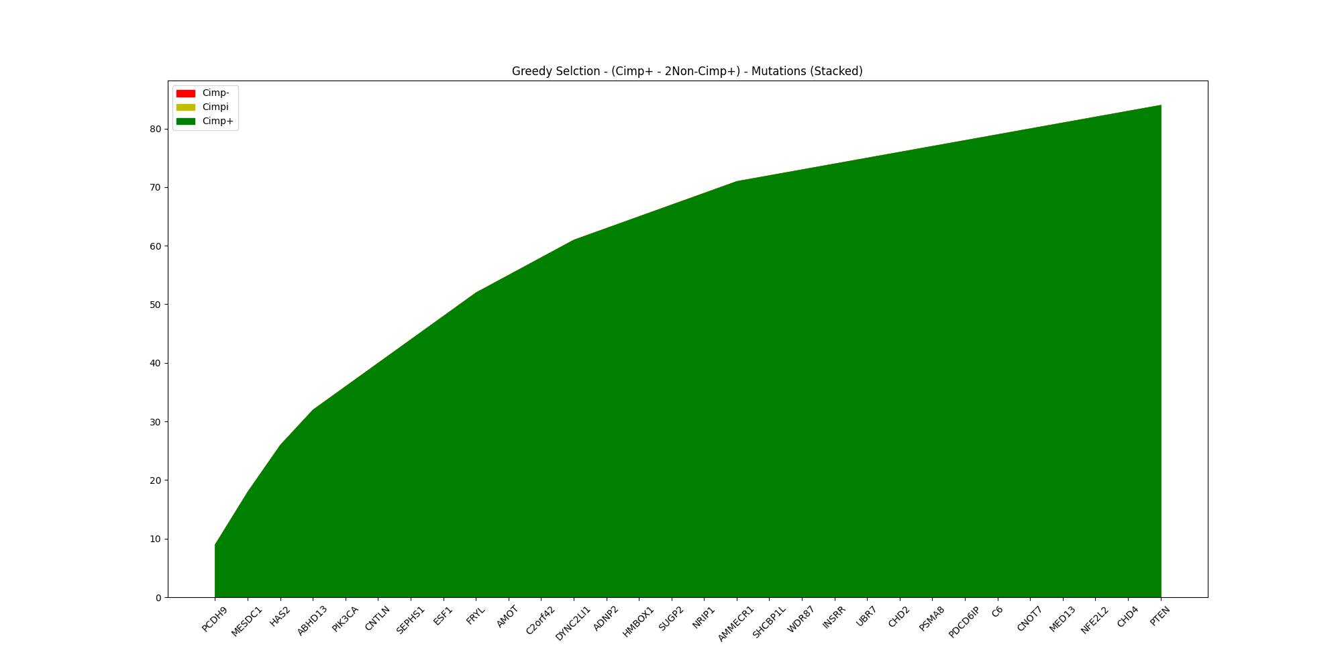
Select by Cimp+ - 2Non-Cimp+

Slide 10
Name | Cimp+ | Non-Cimp+
PCDH9 | 9 | 0
MESDC1 | 9 | 0
HAS2 | 8 | 0
ABHD13 | 6 | 0
PIK3CA | 4 | 0
CNTLN | 4 | 0
SEPHS1 | 4 | 0
ESF1 | 4 | 0
FRYL | 4 | 0
AMOT | 3 | 0
C2orf42 | 3 | 0
DYNC2LI1 | 3 | 0
ADNP2 | 2 | 0
HMBOX1 | 2 | 0
Name | Cimp+ | Non-Cimp+
SUGP2 | 2 | 0
NRIP1 | 2 | 0
AMMECR1 | 2 | 0
SHCBP1L | 1 | 0
WDR87 | 1 | 0
INSRR | 1 | 0
UBR7 | 1 | 0
CHD2 | 1 | 0
PSMA8 | 1 | 0
PDCD6IP | 1 | 0
C6 | 1 | 0
CNOT7 | 1 | 0
MED13 | 1 | 0
(3) | 1 | 0
Metric | Value
TP | 84
FP | 0
FN | 24
TN | 271
Accuracy | 0.937
Sensitivity | 0.778
Specificity | 1
Precision | 1
Miss Rate | 0.222
False Discovery Rate | 0
False Omission Rate | 0.081

Slide 11


Select by Cimp+ - 2Cimp- - Cimpi

Slide 12
Name | Cimp+ | Non-Cimp+
RPL22 | 27 | 10
DOCK3 | 14 | 5
HAS2 | 7 | 0
CTNNA2 | 5 | 0
PIK3CA | 4 | 0
ESF1 | 4 | 0
JAK1 | 3 | 0
BLNK | 2 | 0
ZBTB20 | 3 | 1
GPAT2 | 2 | 0
NXT2 | 2 | 0
SOX17 | 3 | 2
ADNP2 | 1 | 0
AMOT | 1 | 0
Name | Cimp+ | Non-Cimp+
INSRR | 1 | 0
CHD2 | 1 | 0
YTHDC1 | 1 | 0
WASF1 | 1 | 0
GRIN2A | 1 | 0
PRPF40A | 1 | 0
MED13 | 1 | 0
AMMECR1 | 1 | 0
NFE2L2 | 1 | 0
PTEN | 1 | 0
Metric | Value
TP | 88
FP | 18
FN | 20
TN | 253
Accuracy | 0.942
Sensitivity | 0.815
Specificity | 0.996
Precision | 0.989
Miss Rate | 0.185
False Discovery Rate | 0.011
False Omission Rate | 0.073

Slide 13
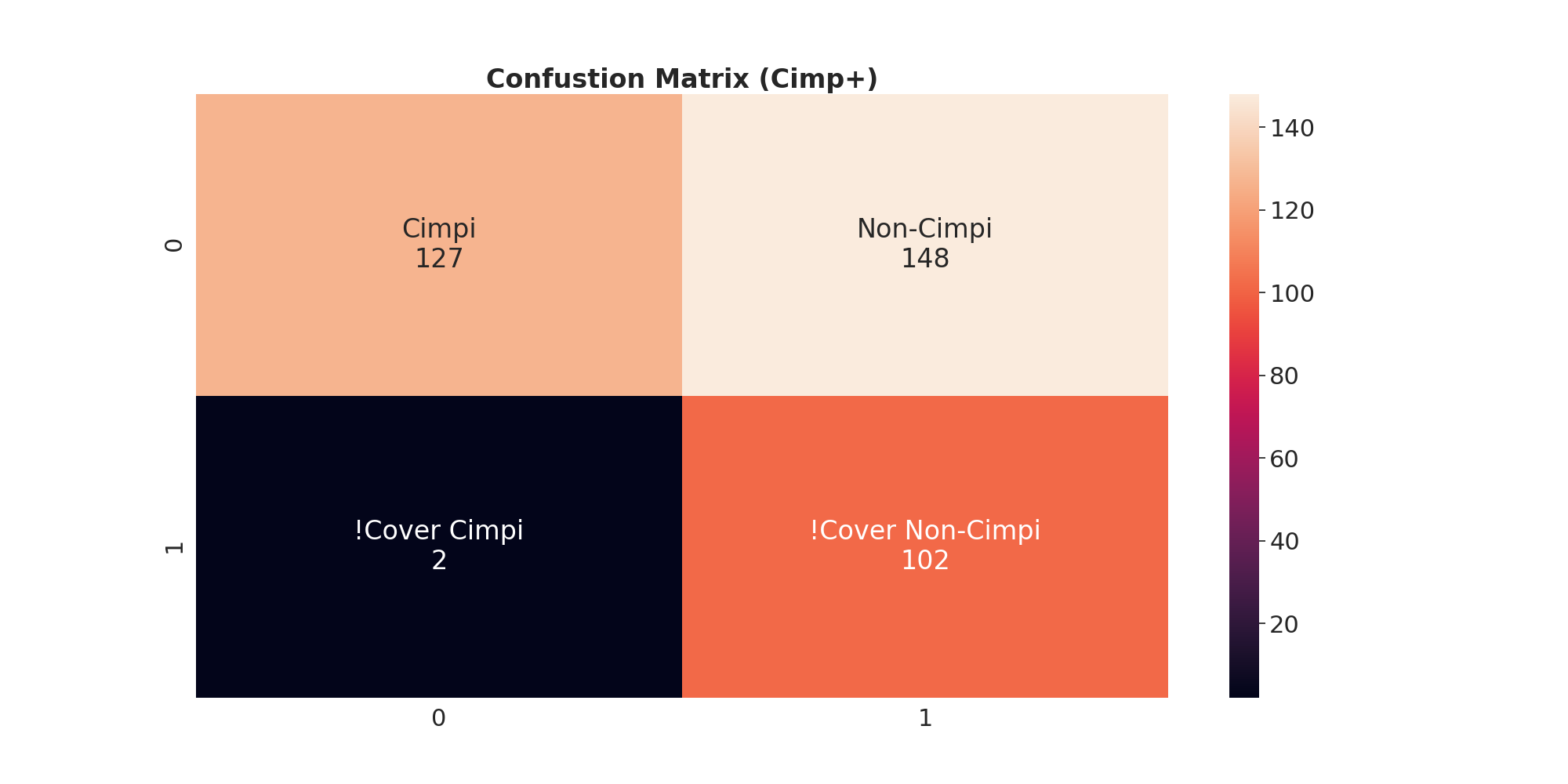
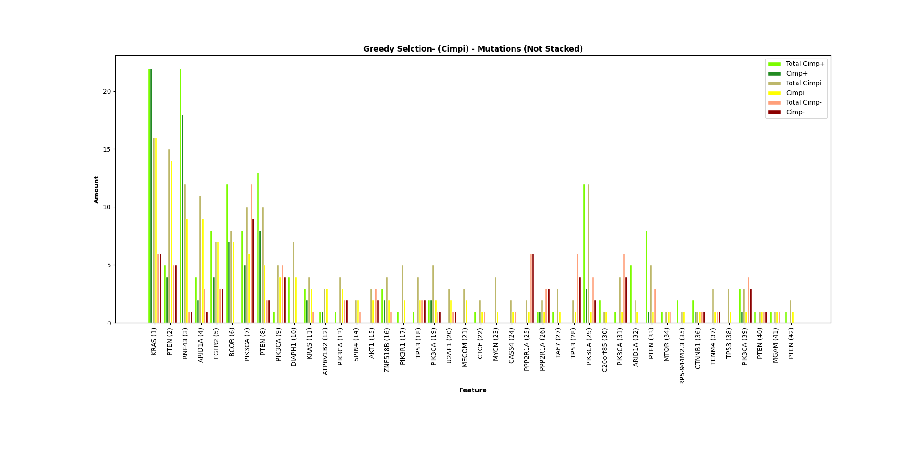
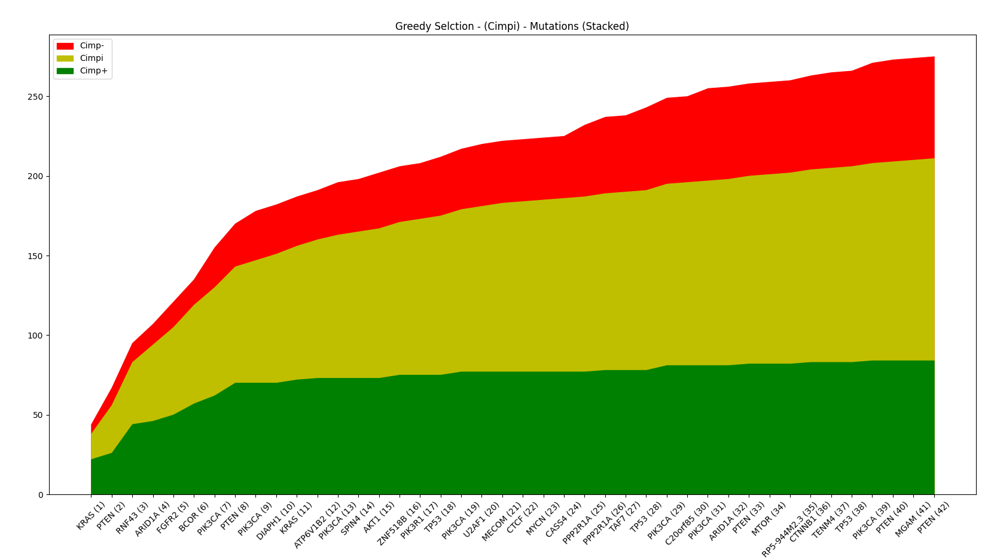
Select by Cimpi

Slide 14
Name | Cimpi | Non-Cimpi
KRAS | 16 | 28
PTEN | 14 | 9
RNF43 | 9 | 19
ARID1A | 9 | 3
FGFR2 | 7 | 7
BCOR | 7 | 7
PIK3CA | 6 | 14
PTEN | 5 | 10
PIK3CA | 4 | 4
DIAPH1 | 4 | 0
KRAS | 3 | 2
ATP6V1B2 | 3 | 1
PIK3CA | 3 | 2
SPIN4 | 2 | 0
Name | Cimpi | Non-Cimpi
AKT1 | 2 | 2
ZNF518B | 2 | 2
PIK3R1 | 2 | 0
TP53 | 2 | 2
PIK3CA | 2 | 3
U2AF1 | 2 | 1
MECOM | 2 | 0
CTCF | 1 | 0
MYCN | 1 | 0
CASS4 | 1 | 0
PPP2R1A | 1 | 6
PPP2R1A | 1 | 4
TAF7 | 1 | 0
(15) | 15 | 22
Metric | Value
TP | 127
FP | 148
FN | 2
TN | 102
Accuracy | 0.604
Sensitivity | 0.984
Specificity | 0.408
Precision | 0.462
Miss Rate | 0.016
False Discovery Rate | 0.538
False Omission Rate | 0.019

Slide 15
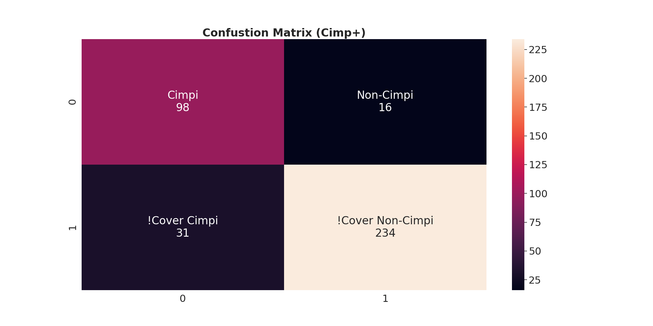
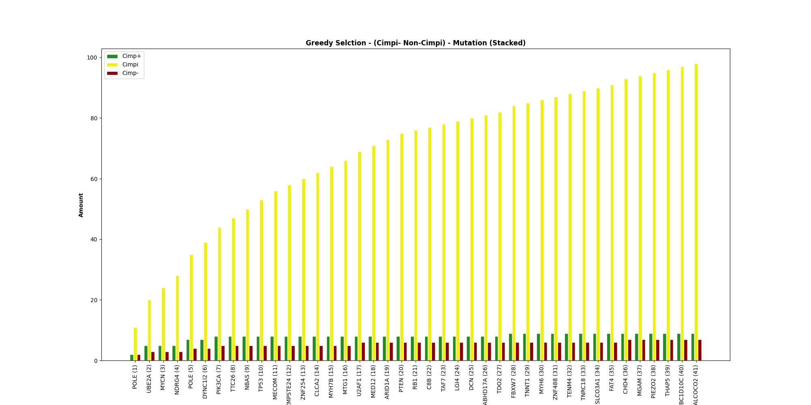
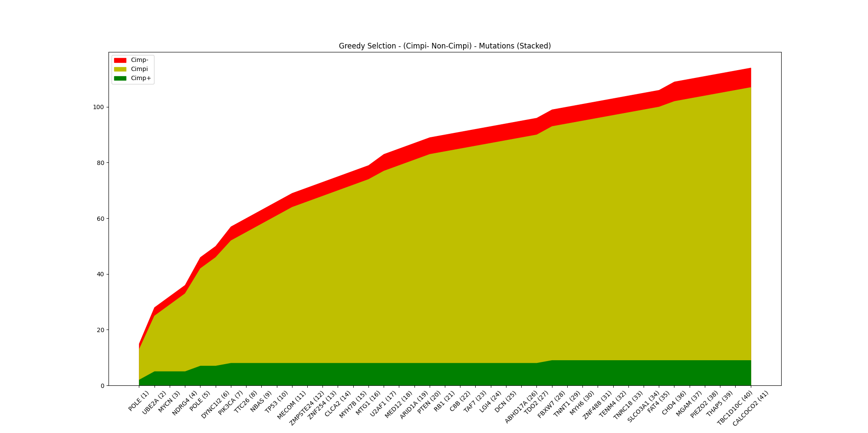
Select by Cimpi – Non-Cimpi

Slide 16
Name | Cimpi | Non-Cimpi
POLE | 11 | 4
UBE2A | 9 | 4
MYCN | 4 | 0
NDRG4 | 4 | 0
POLE | 7 | 3
DYNC1I2 | 4 | 0
PIK3CA | 5 | 2
TTC26 | 3 | 0
NBAS | 3 | 0
TP53 | 3 | 0
MECOM | 3 | 0
ZMPSTE24 | 2 | 0
ZNF254 | 2 | 0
CLCA2 | 2 | 0
Name | Cimpi | Non-Cimpi
MYH7B | 2 | 0
MTG1 | 2 | 0
U2AF1 | 3 | 1
MED12 | 2 | 0
ARID1A | 2 | 0
PTEN | 2 | 0
RB1 | 1 | 0
C8B | 1 | 0
TAF7 | 1 | 0
LG14 | 1 | 0
DCN | 1 | 0
ABHD17A | 1 | 0
TDO2 | 1 | 0
(14) | 16 | 2
Metric | Value
TP | 98
FP | 16
FN | 31
TN | 234
Accuracy | 0.876
Sensitivity | 0.76
Specificity | 0.936
Precision | 0.86
Miss Rate | 0.24
False Discovery Rate | 0.14
False Omission Rate | 0.117

Slide 17

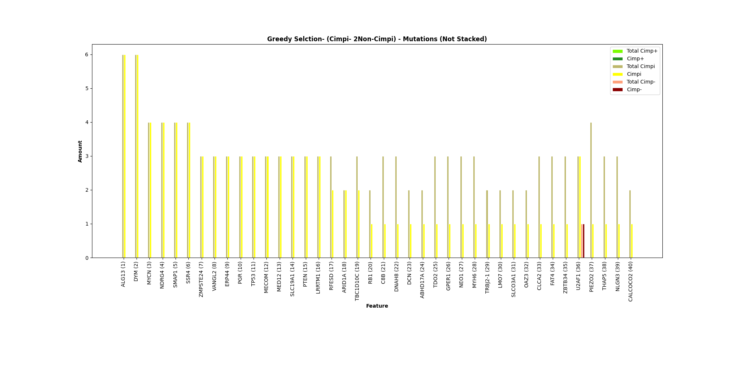
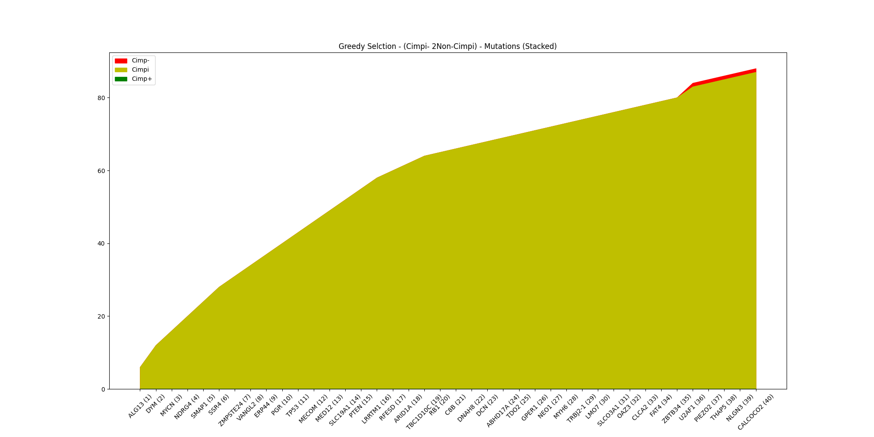
Select by Cimpi – 2Non-Cimpi

Slide 18
Name | Cimpi | Non-Cimpi
ALG13 | 6 | 0
DYM | 6 | 0
MYCN | 4 | 0
NDRG4 | 4 | 0
SMAP1 | 4 | 0
SSR4 | 4 | 0
ZMPSTE24 | 3 | 0
VANGL2 | 3 | 0
ERP44 | 3 | 0
PGR | 3 | 0
TP53 | 3 | 0
MECOM | 3 | 0
MED12 | 3 | 0
SLC19A1 | 3 | 0
Name | Cimpi | Non-Cimpi
PTEN | 3 | 0
LRRTM1 | 3 | 0
RFESD | 2 | 0
ARID1A | 2 | 0
TBC1D10C | 2 | 0
RB1 | 1 | 0
C8B | 1 | 0
DNAH8 | 1 | 0
DCN | 1 | 0
ABHD17A | 1 | 0
TDO2 | 1 | 0
GPER1 | 1 | 0
U2AF1 | 3 | 1
(13) | 13 | 0
Metric | Value
TP | 87
FP | 1
FN | 42
TN | 249
Accuracy | 0.887
Sensitivity | 0.674
Specificity | 0.996
Precision | 0.989
Miss Rate | 0.326
False Discovery Rate | 0.011
False Omission Rate | 0.144

Slide 19
Gene Level Graphs
Examples:
GOT1
RPL22
KRAS

Slide 20
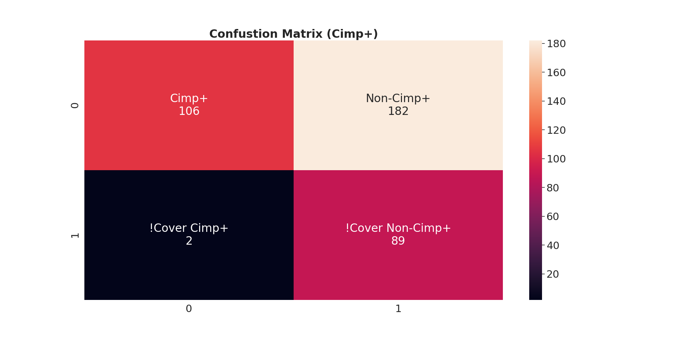
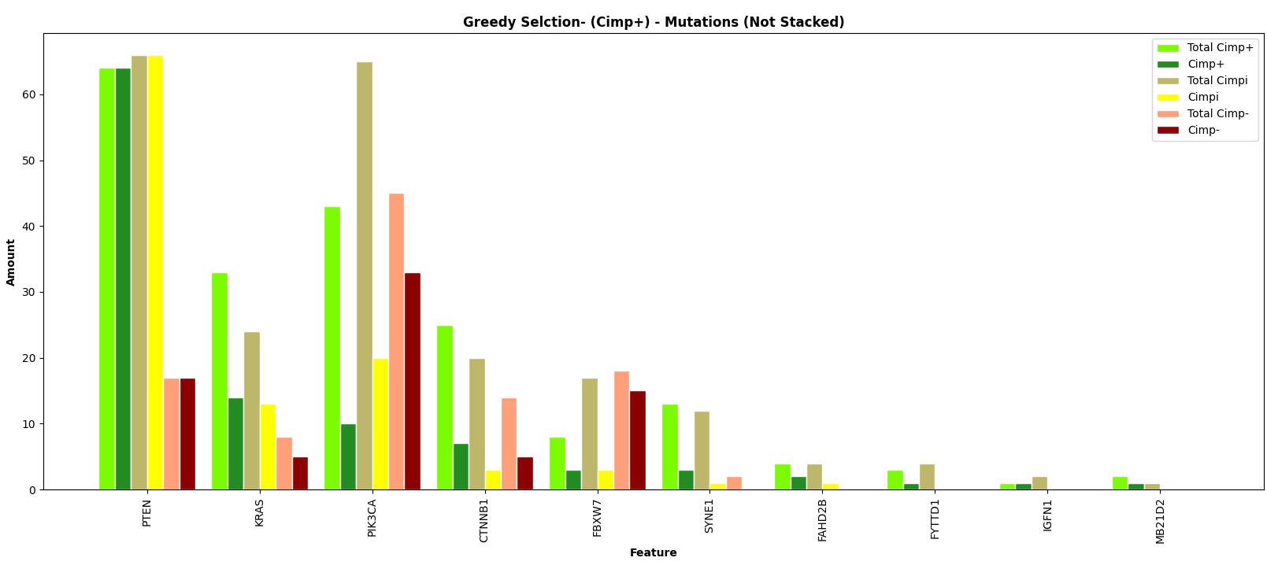
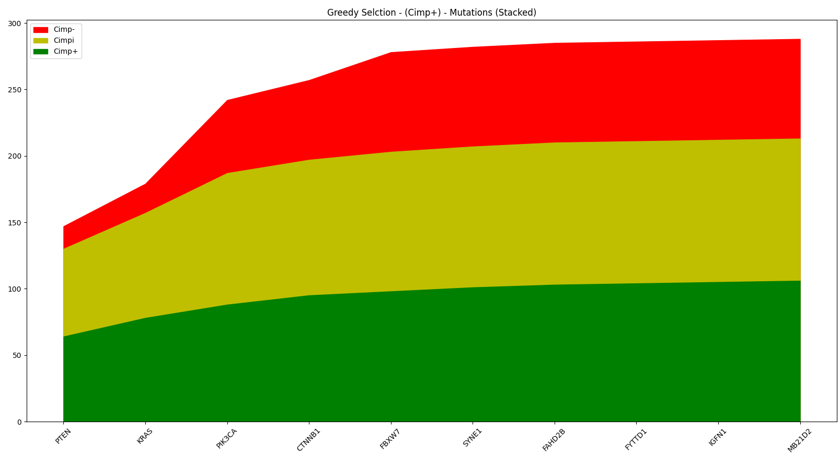
Select by Cimp+

Slide 21
Name | Cimp+ | Non-Cimp+
PTEN | 64 | 83
KRAS | 14 | 18
PIK3CA | 10 | 53
CTNNB1 | 7 | 8
FNXW7 | 3 | 18
SYNE1 | 3 | 1
FAHD2B | 2 | 1
FYTTDI | 1 | 0
IGFN1 | 1 | 0
MB21D2 | 1 | 0
Name | Cimp+ | Non-Cimp+
Metric | Value
TP | 106
FP | 182
FN | 2
TN | 89
Accuracy | 0.515
Sensitivity | 0.981
Specificity | 0.328
Precision | 0.368
Miss Rate | 0.019
False Discovery Rate | 0.632
False Omission Rate | 0.022

Slide 22

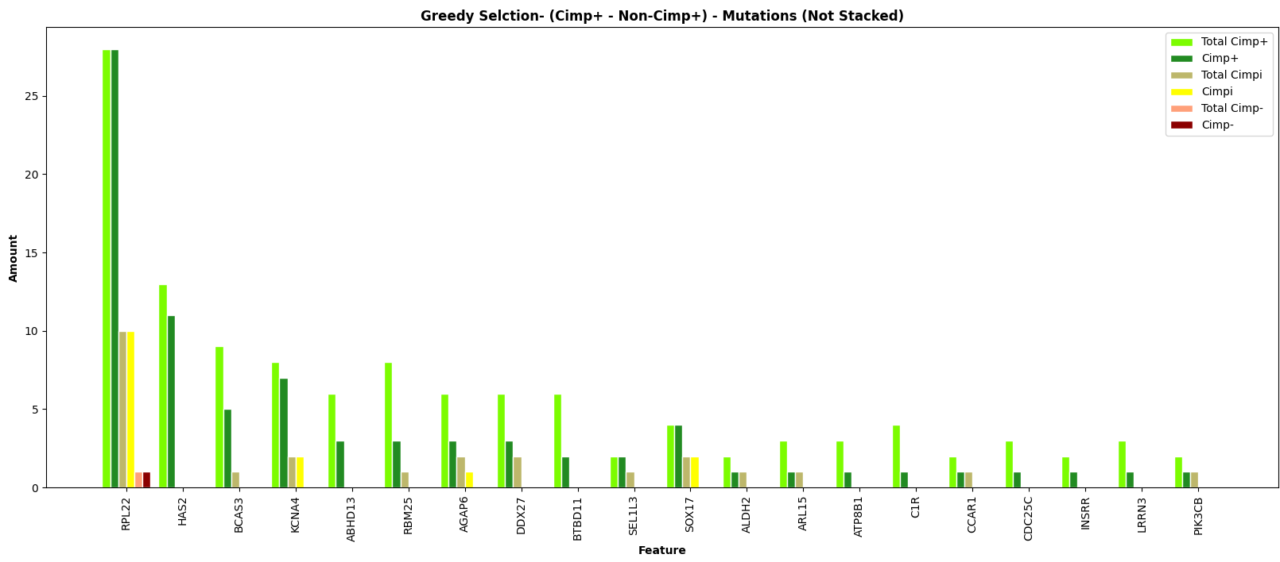
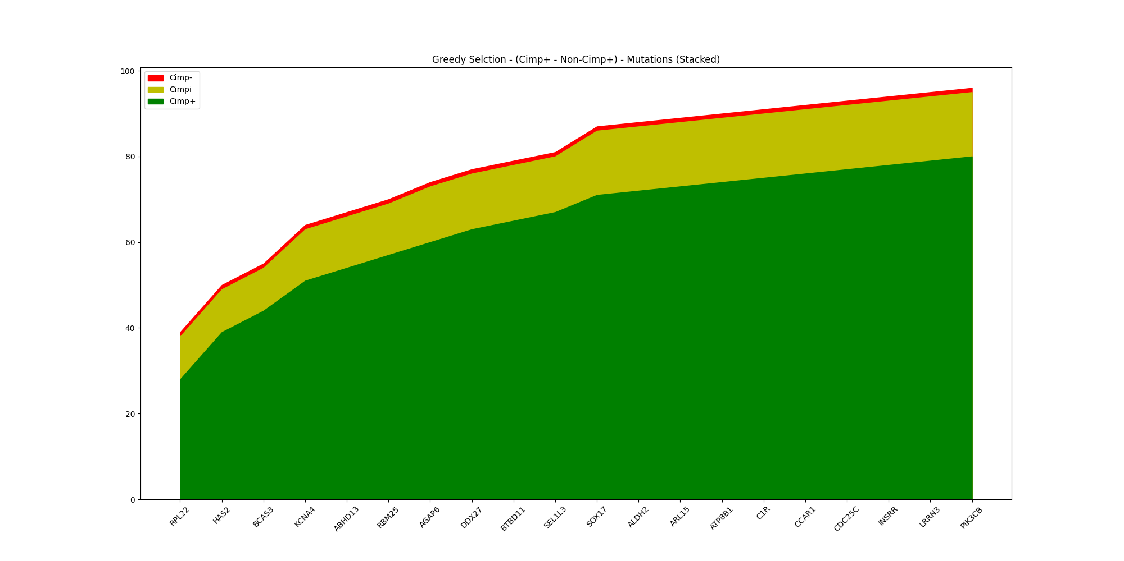
Select by Cimp+ - Non-Cimp+

Slide 23
Name | Cimp+ | Non-Cimp+
RPL22 | 28 | 11
HAS2 | 11 | 0
BCAS3 | 5 | 0
KCNA4 | 7 | 2
ABHD13 | 3 | 0
RBM25 | 3 | 0
AGAP6 | 3 | 1
DDX27 | 3 | 0
BTBD11 | 2 | 0
SEL1L3 | 2 | 0
SOX17 | 4 | 2
ALDH2 | 1 | 0
ARL15 | 1 | 0
C1R | 1 | 0
Name | Cimp+ | Non-Cimp+
CCAR1 | 1 | 0
CDC25C | 1 | 0
INSRR | 1 | 0
LRRN3 | 1 | 0
PIK3CB | 1 | 0
Metric | Value
TP | 80
FP | 16
FN | 28
TN | 255
Accuracy | 0.884
Sensitivity | 0.741
Specificity | 0.941
Precision | 0.833
Miss Rate | 0.259
False Discovery Rate | 0.167
False Omission Rate | 0.099

Slide 24

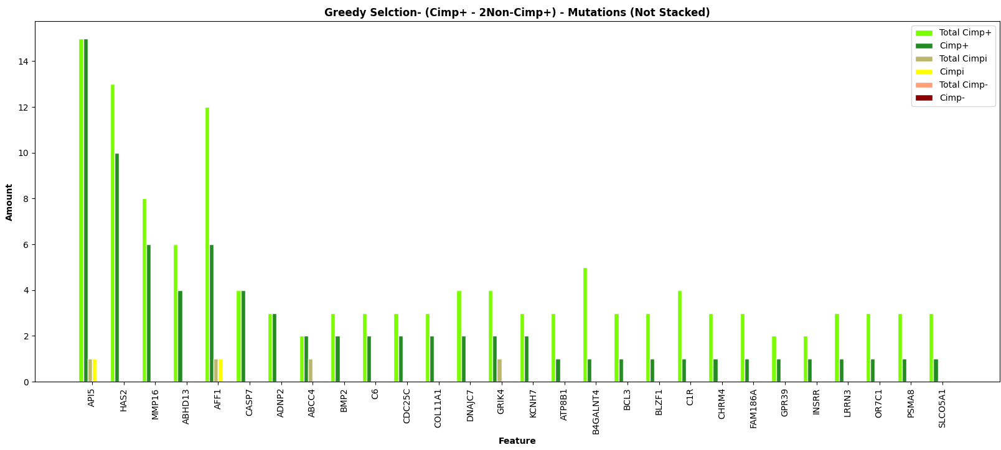
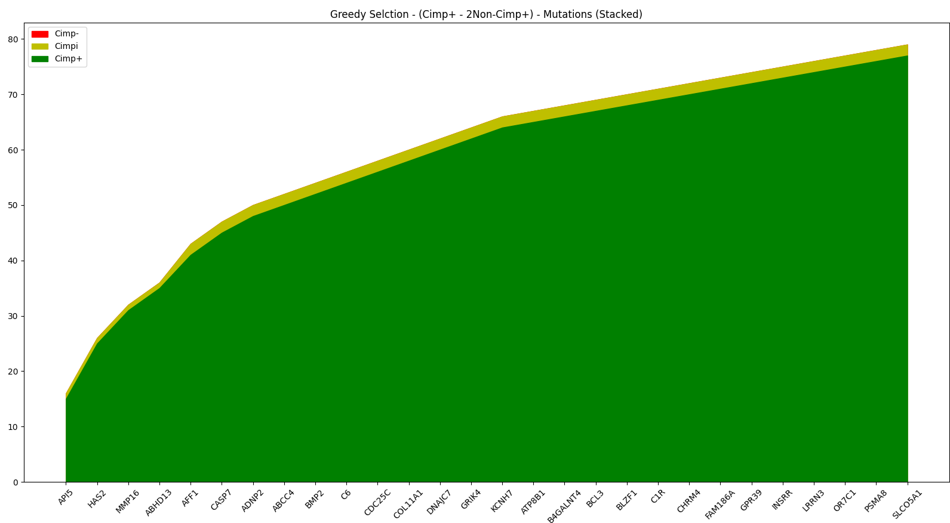
Select by Cimp+ - 2Non-Cimp+

Slide 25
Name | Cimp+ | Non-Cimp+
API5 | 15 | 1
HAS2 | 10 | 0
MMP16 | 6 | 0
ABHD13 | 4 | 0
AFF1 | 6 | 1
CASP7 | 4 | 0
ADNP2 | 3 | 0
ABCC4 | 2 | 0
BMP2 | 2 | 0
C6 | 2 | 0
CDC25C | 2 | 0
COL11A1 | 2 | 0
DNAJC7 | 2 | 0
GRIK4 | 2 | 0
Name | Cimp+ | Non-Cimp+
KCNH7 | 2 | 0
ATP8B1 | 1 | 0
B4GALNT4 | 1 | 0
BCL3 | 1 | 0
BLZF1 | 1 | 0
C1R | 1 | 0
CHRM4 | 1 | 0
FAM186A | 1 | 0
GPR39 | 1 | 0
INSRR | 1 | 0
LRRN3 | 1 | 0
OR7C1 | 1 | 0
PSMA8 | 1 | 0
SLCO5A1 | 1 | 0
Metric | Value
TP | 77
FP | 2
FN | 31
TN | 269
Accuracy | 0.927
Sensitivity | 0.706
Specificity | 0.992
Precision | 0.963
Miss Rate | 0.294
False Discovery Rate | 0.037
False Omission Rate | 0.08

Slide 26
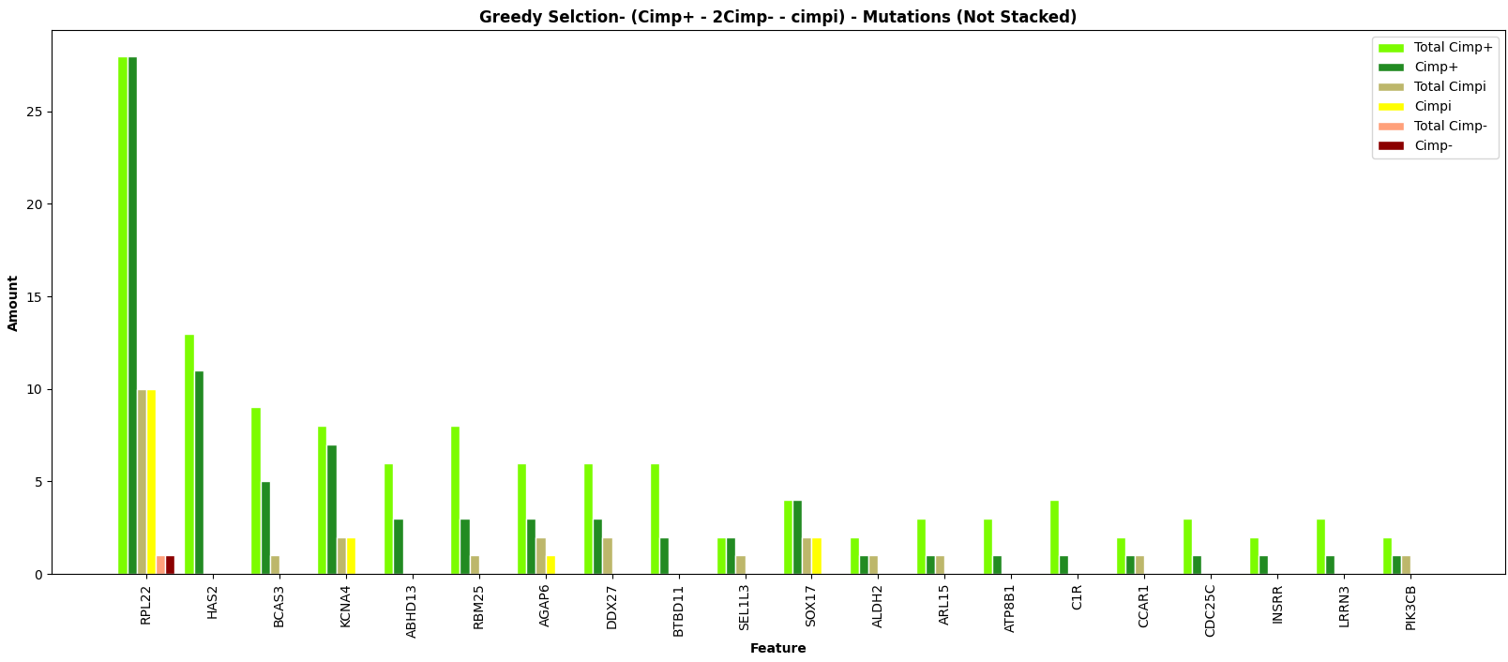

Select by Cimp+ - 2Cimp- - Cimpi

Slide 27
Name | Cimp+ | Non-Cimp+
RPL22 | 28 | 11
HAS2 | 11 | 0
BCAS3 | 5 | 0
KCNA4 | 7 | 2
ABHD13 | 3 | 0
RBM25 | 3 | 0
AGAP6 | 3 | 1
DDX27 | 3 | 0
BTBD11 | 2 | 0
SEL1L3 | 2 | 0
SOX17 | 4 | 2
ALDH2 | 1 | 0
ARL15 | 1 | 0
ATP8B1 | 1 | 0
Name | Cimp+ | Non-Cimp+
C1R | 1 | 0
CCAR1 | 1 | 0
CDC25C | 1 | 0
INSRR | 1 | 0
LRRN3 | 1 | 0
PIC3CB | 1 | 0
Metric | Value
TP | 80
FP | 16
FN | 28
TN | 255
Accuracy | 0.857
Sensitivity | 0.222
Specificity | 0.941
Precision | 0.333
Miss Rate | 0.778
False Discovery Rate | 0.667
False Omission Rate | 0.099

Slide 28
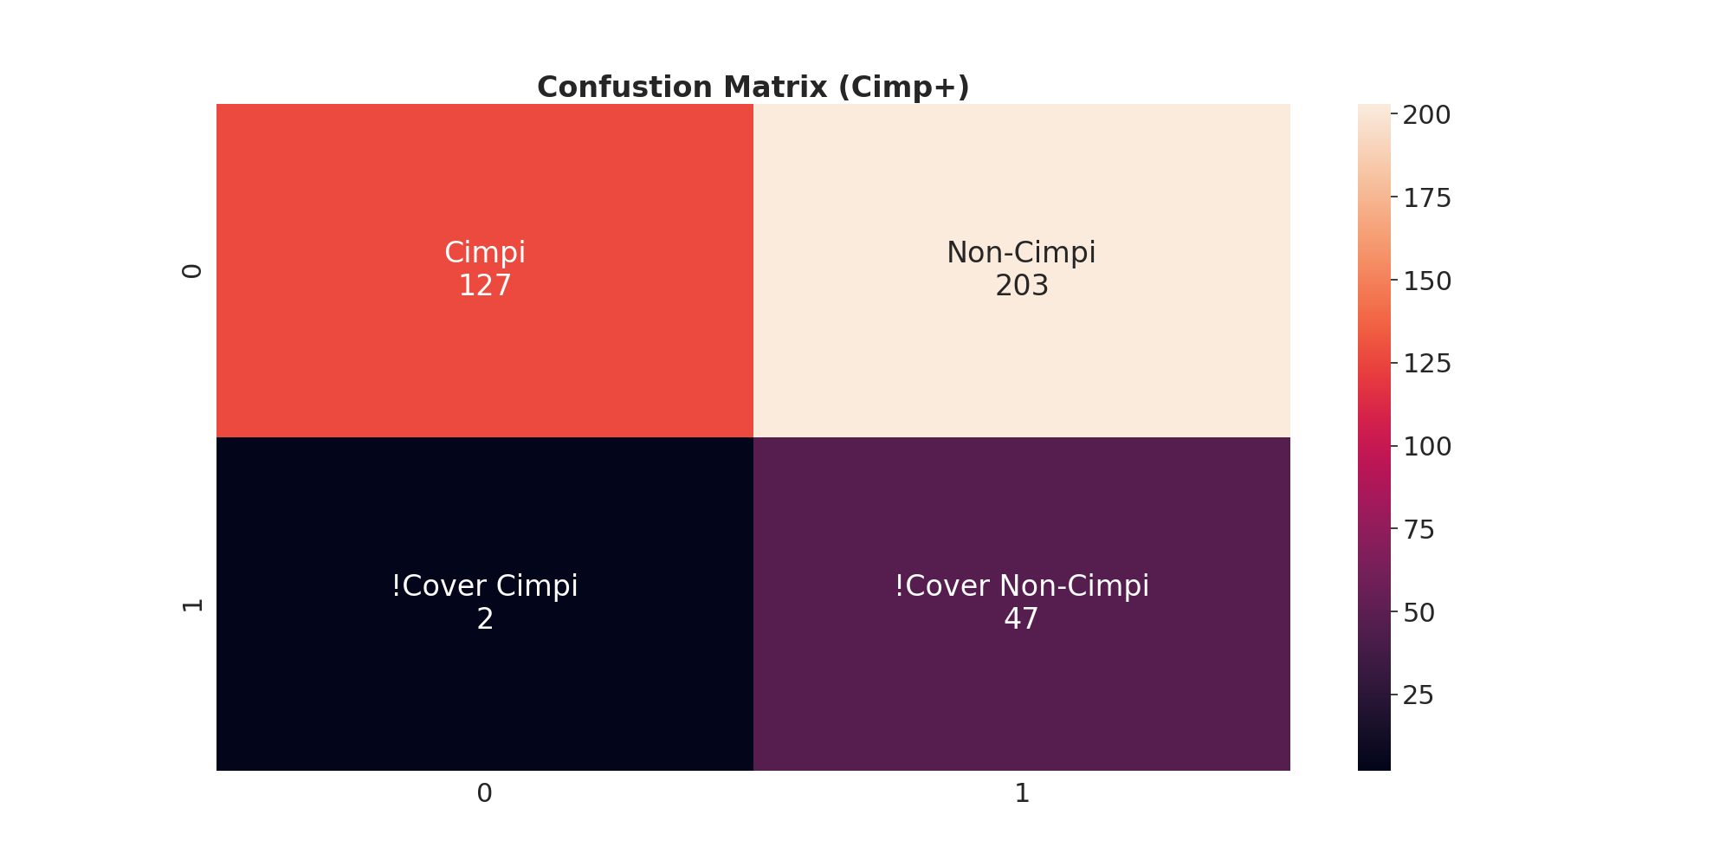
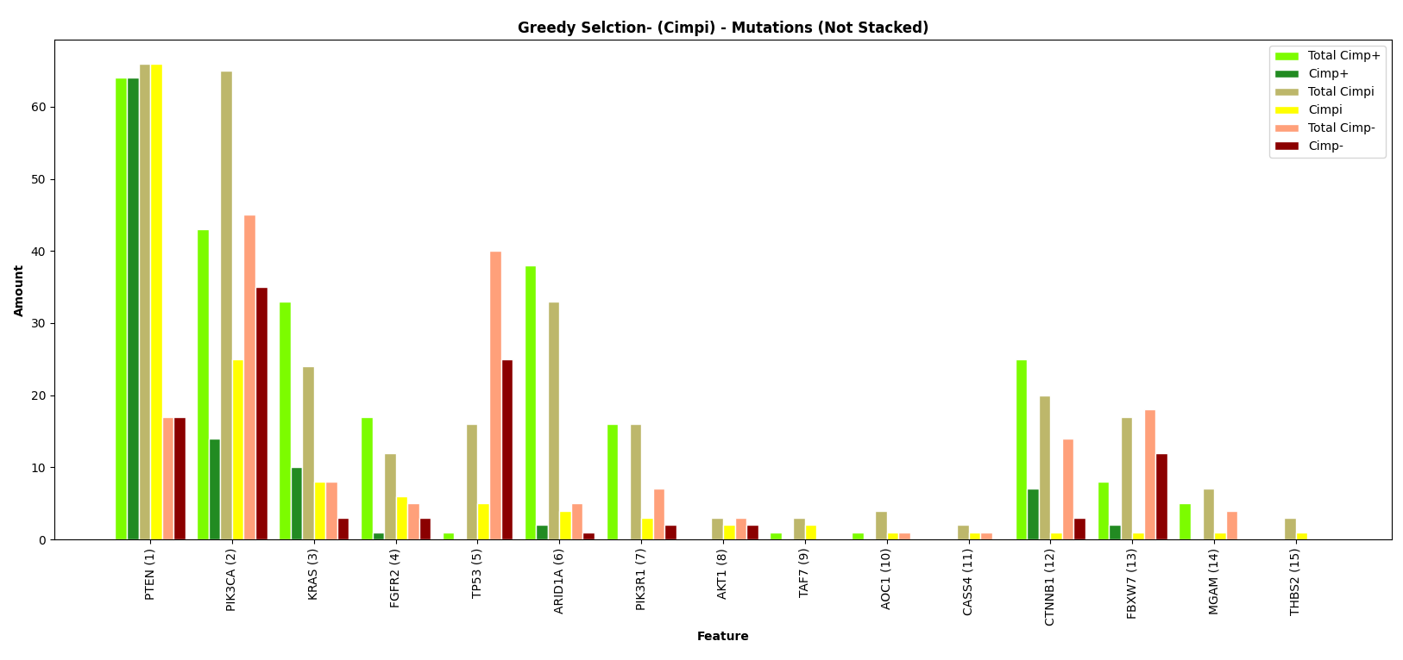
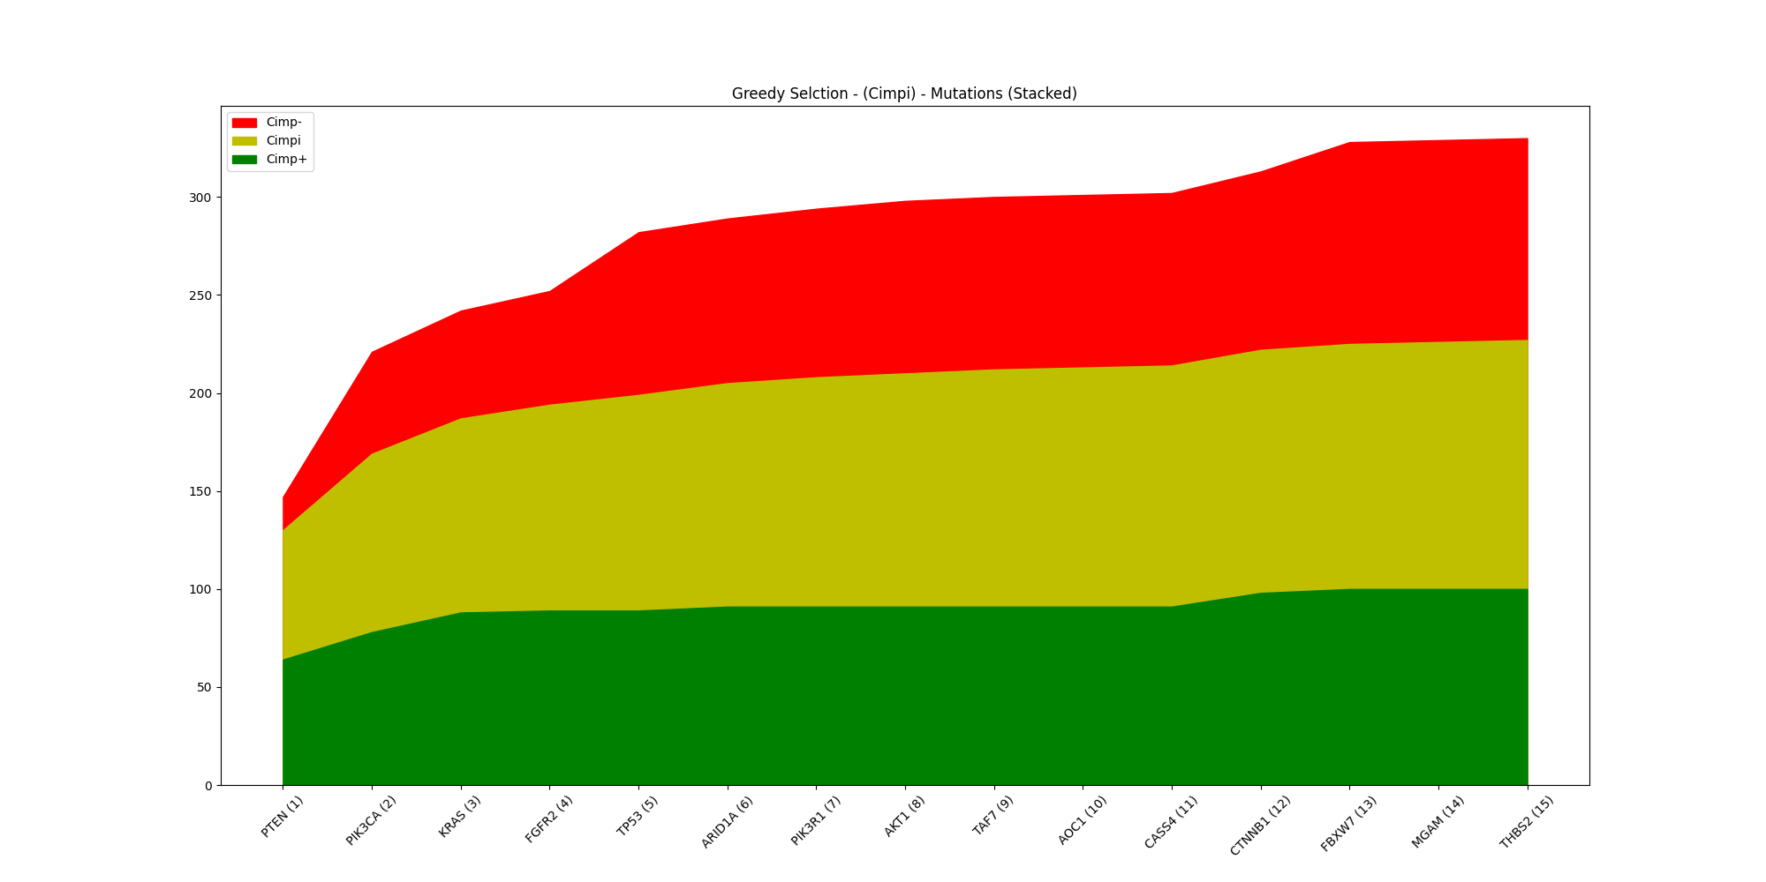
Select by Cimpi

Slide 29
Name | Cimpi | Non-Cimpi
PTEN | 66 | 81
PIK3CA | 25 | 49
KRAS | 8 | 13
FRGFR2 | 6 | 4
TP53 | 5 | 25
ARID1A | 4 | 3
PIK3R1 | 3 | 2
AKT1 | 2 | 2
TAF7 | 2 | 0
AOC1 | 1 | 0
CASS4 | 1 | 0
CTNNB1 | 1 | 10
FBXW7 | 1 | 14
MGAM | 1 | 0
Name | Cimpi | Non-Cimpi
THBS2 | 1 | 0
Metric | Value
TP | 127
FP | 203
FN | 2
TN | 47
Accuracy | 0.459
Sensitivity | 0.984
Specificity | 0.188
Precision | 0.385
Miss Rate | 0.016
False Discovery Rate | 0.615
False Omission Rate | 0.041

Slide 30

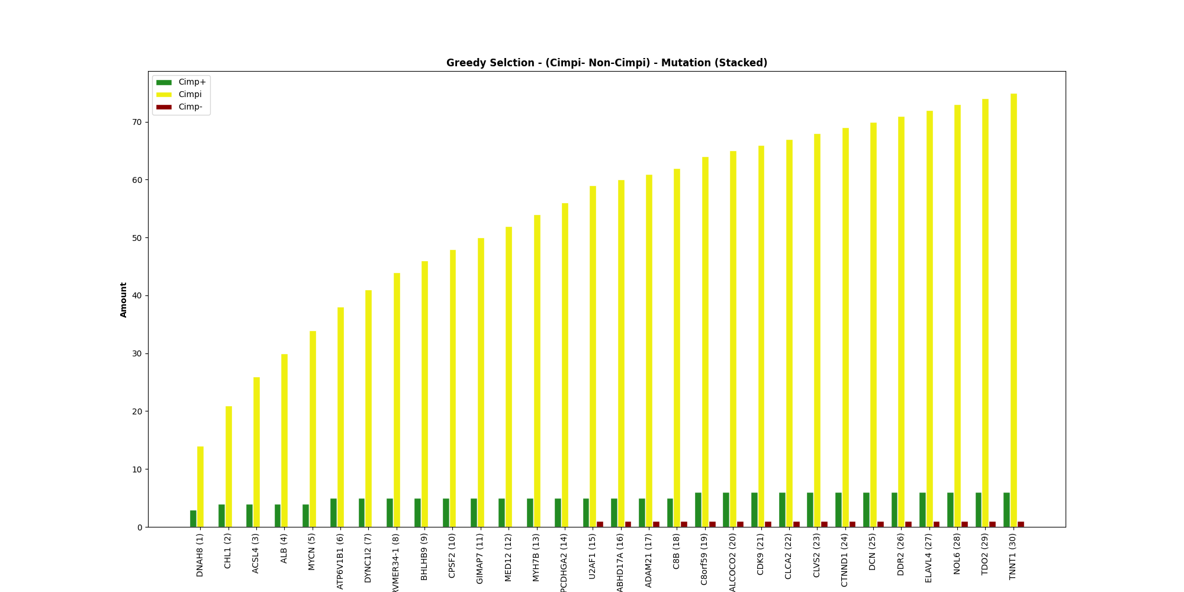
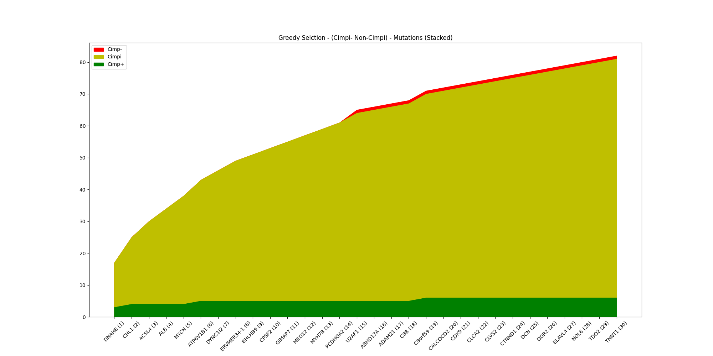
Select by Cimpi – Non-Cimpi

Slide 31
Name | Cimpi | Non-Cimpi
DNAH8 | 14 | 3
CHL1 | 7 | 1
ACSL4 | 5 | 0
ALB | 4 | 0
MYCN | 4 | 0
ATP6V1B1 | 4 | 1
DYNC1I2 | 3 | 0
ERVMER34 | 3 | 0
BHLHB9 | 2 | 0
CPSF2 | 2 | 0
GIMAP7 | 2 | 0
MED12 | 2 | 0
MYH7B | 2 | 0
PCDHGA2 | 2 | 0
Name | Cimpi | Non-Cimpi
U2AF1 | 3 | 1
ABHD17A | 1 | 0
ADAM21 | 1 | 0
C8B | 1 | 0
C8orf59 | 2 | 1
CALCOCO2 | 1 | 0
CDK9 | 1 | 0
CLCA2 | 1 | 0
CLVS2 | 1 | 0
CTNND1 | 1 | 0
DCN | 1 | 0
DDR2 | 1 | 0
ELAVL4 | 1 | 0
(3) | 3 | 0
Metric | Value
TP | 75
FP | 7
FN | 54
TN | 243
Accuracy | 0.839
Sensitivity | 0.581
Specificity | 0.972
Precision | 0.915
Miss Rate | 0.419
False Discovery Rate | 0.085
False Omission Rate | 0.182

Slide 32
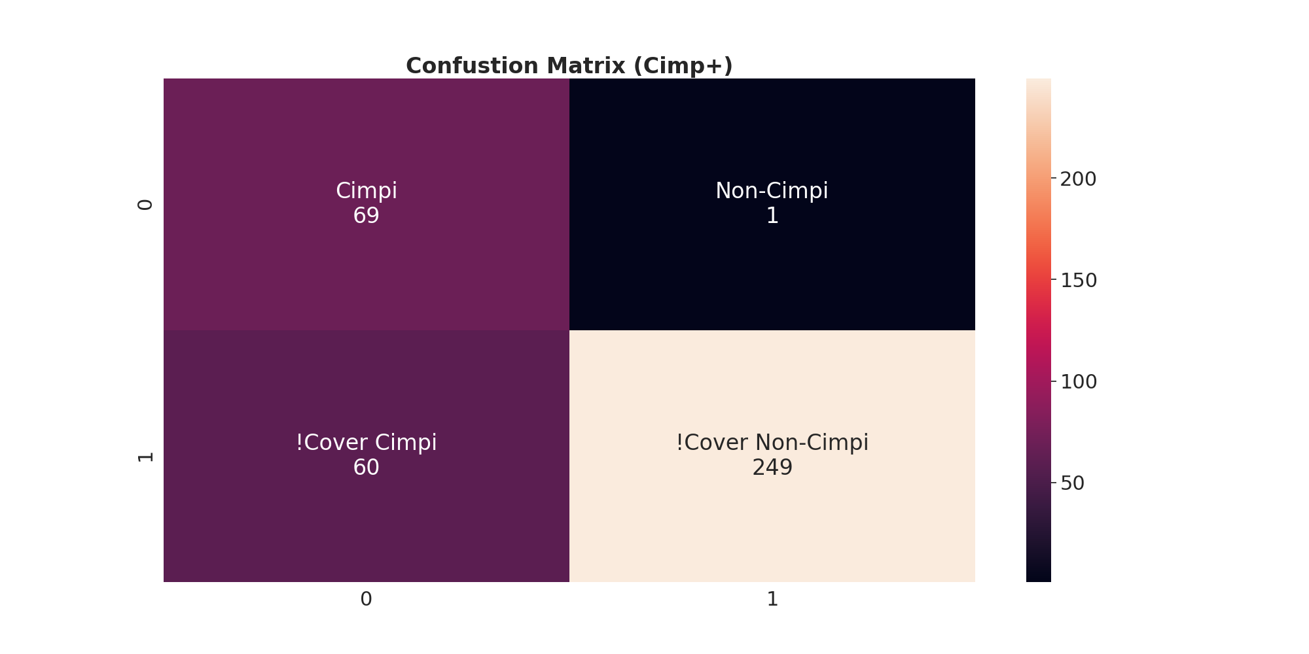
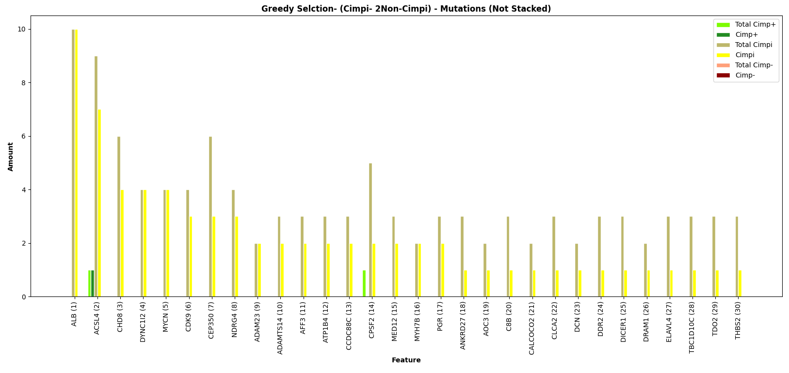
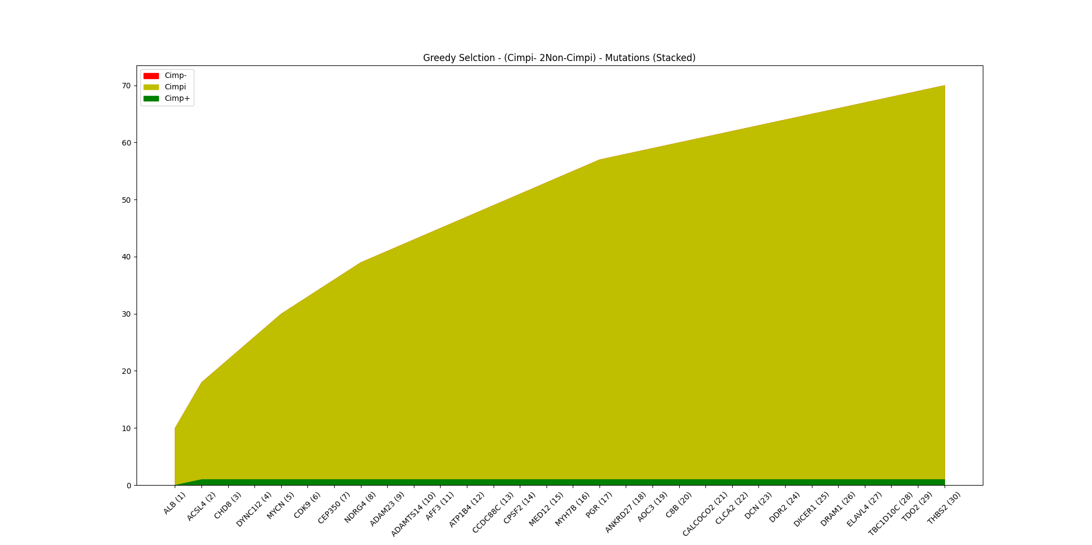
Select by Cimpi – 2Non-Cimpi

Slide 33
Name | Cimpi | Non-Cimpi
ALB | 10 | 0
ACSL4 | 7 | 1
CHD8 | 4 | 0
DYNC1I2 | 4 | 0
MYCN | 4 | 0
CDK9 | 3 | 0
CEP350 | 3 | 0
NDRG4 | 3 | 0
ADAM23 | 2 | 0
ADAMTS14 | 2 | 0
AFF3 | 2 | 0
ATP1B4 | 2 | 0
CCDC88C | 2 | 0
CPSF2 | 2 | 0
Name | Cimpi | Non-Cimpi
MED12 | 2 | 0
MYH7B | 2 | 0
PGR | 2 | 0
ANKRD27 | 1 | 0
AOC3 | 1 | 0
C8B | 1 | 0
CALCOCO2 | 1 | 0
CLCA2 | 1 | 0
DCN | 1 | 0
DDR2 | 1 | 0
DDR2 | 1 | 0
DICER1 | 1 | 0
DRAM1 | 1 | 0
(4) | 4 | 0
Metric | Value
TP | 69
FP | 1
FN | 60
TN | 249
Accuracy | 0.839
Sensitivity | 0.535
Specificity | 0.996
Precision | 0.986
Miss Rate | 0.465
False Discovery Rate | 0.014
False Omission Rate | 0.194

Slide 34
ClusterGrammer with MSI
75 Cimp+
https://maayanlab.cloud/clustergrammer/viz_sim_mats/5f6a216f51ad21000f2ef54c/75_cimppos.txt
75 Non-Cimp+
https://maayanlab.cloud/clustergrammer/viz_sim_mats/5f6a219951ad21000f2ef553/75_noncimp.txt
300 Cimp+
https://maayanlab.cloud/clustergrammer/viz_sim_mats/5f6a21c851ad21000f2ef55a/300_cimppos.txt

Slide 35
ClusterGrammer Results
Set of 75 mutations cimp+:
https://maayanlab.cloud/clustergrammer/viz_sim_mats/5f5be30251ad21000f37b477/75_cimppos.txt
The 300 mutations cimp+:
https://maayanlab.cloud/clustergrammer/viz_sim_mats/5f5bfd0651ad21000f37b50f/300_cimppos.txt
The small set of mutations selected by your greedy algorithm:
https://maayanlab.cloud/clustergrammer/viz_sim_mats/5f5c0ddb51ad21000f37b553/25_TP_FP.txt
Relevant mutations for non-cimp+ (FP > 8):
https://maayanlab.cloud/clustergrammer/viz_sim_mats/5f5bfd4151ad21000f37b516/top_noncimp_9_or_more.txt
on-cimp+ and the 75 most relevant mutations for cimp+:
https://maayanlab.cloud/clustergrammer/viz_sim_mats/5f5bfd6651ad21000f37b51d/75_noncimp.txt

