Slide 1
Research questions
What are the interesting mutations?
What is the clusters that exist among the mutations?
What is the clusters that exist among the samples?
What is the biological significant of the data?

Slide 2
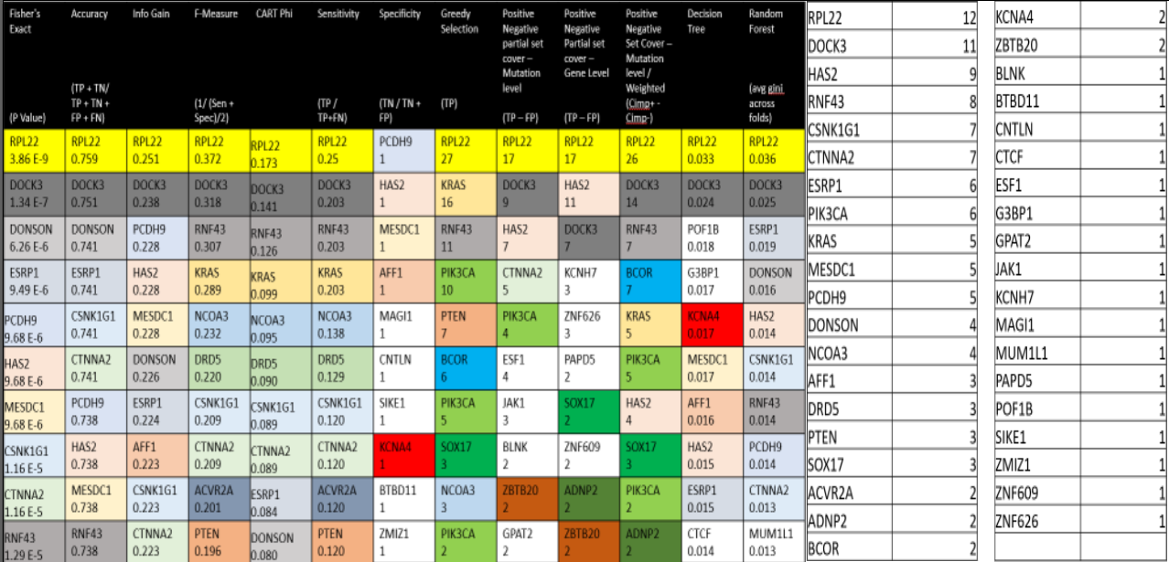
What are the interesting mutations?
Table of top 10 mutations per category
Occurrence of mutations in table

Slide 3
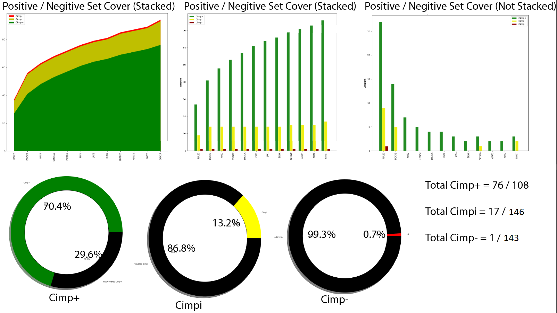
What are the interesting mutations?

Slide 4
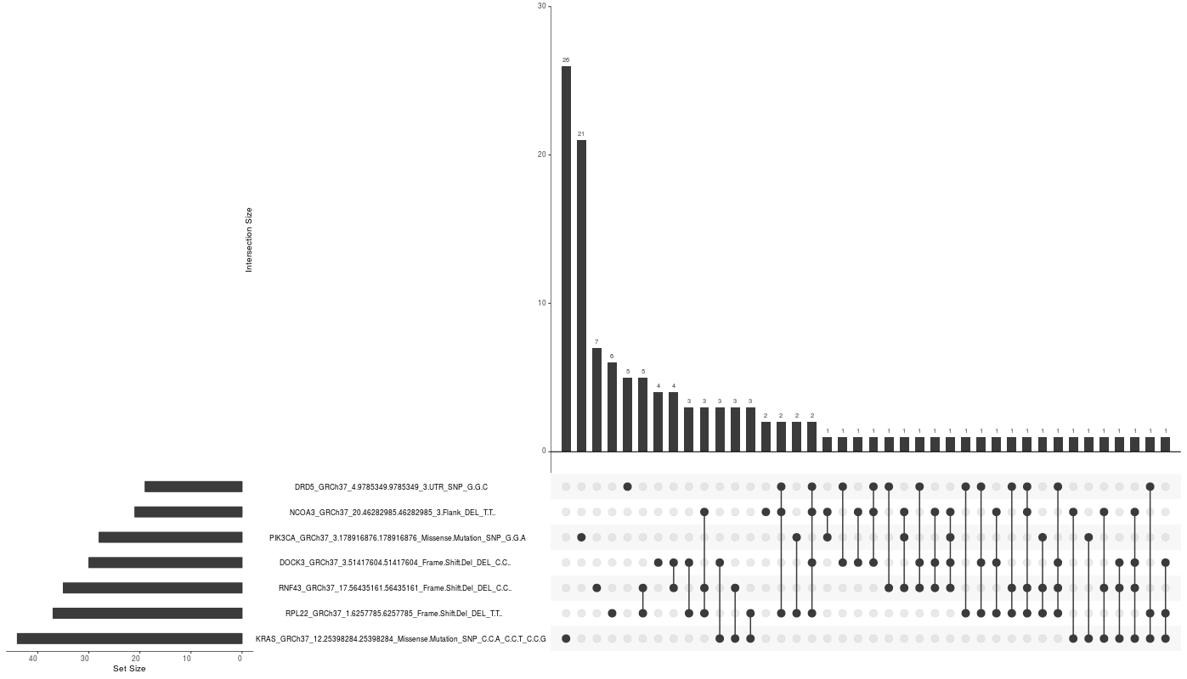
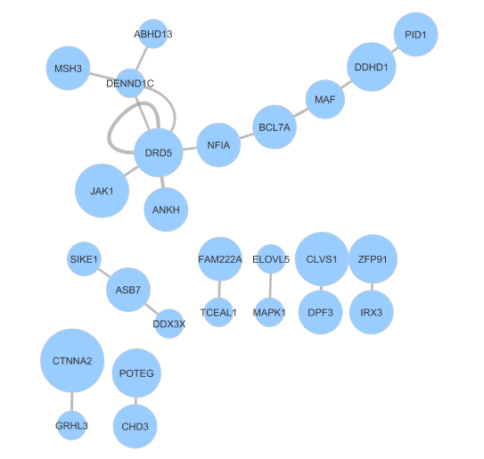
What is the clusters that exist among the mutations?
Network Diagram for top 20 Cimp+
Upset diagram

Slide 5
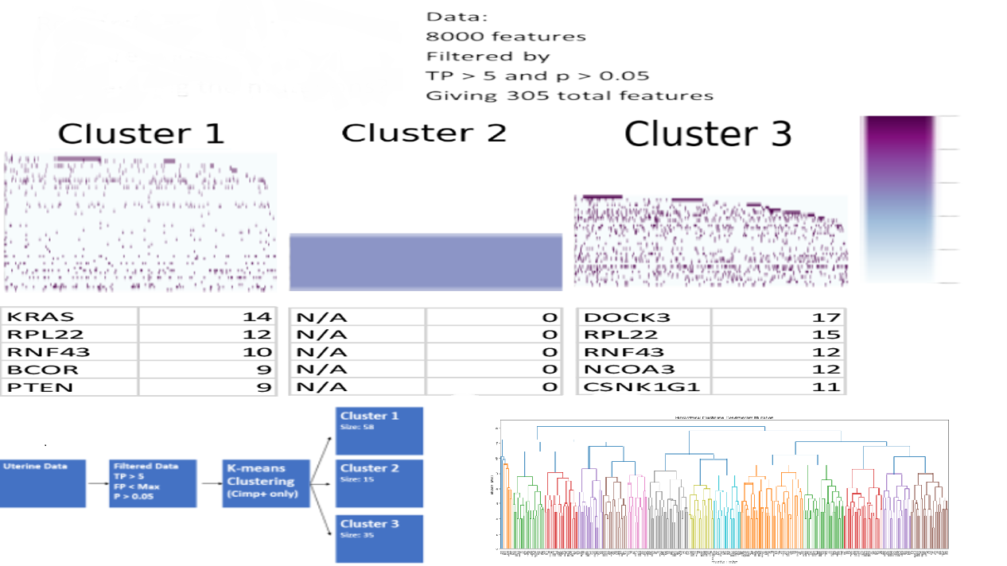
What is the clusters that exist among the mutations?

Slide 6
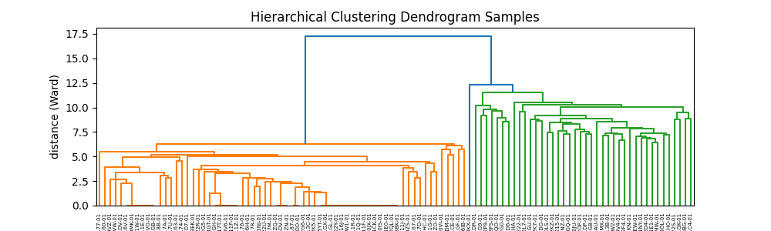
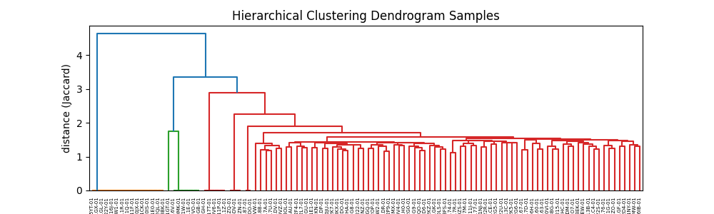
What is the clusters that exist among the samples?

Slide 7
What is the biological significant of the data?
Analysis of the data to find the MSI significance of the mutations and samples.

