Slide 1
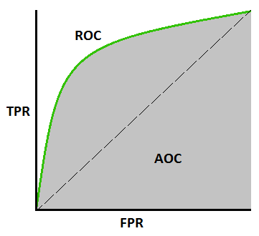
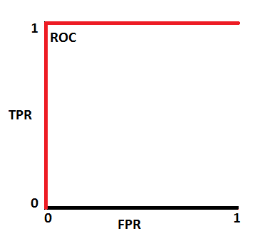
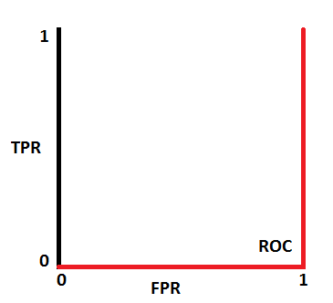
ROC-AUC Curve
An ROC-AUC curve is a performance measurement for classification problems.
ROC is the Receiver Operating Characteristics
AUC is the Area Under the Curve
A ROC-AUC curve uses:
True positive rate / Sensitivity ( TP / TP + FN)
False positive rate / 1 – Specificity ( FP / FP + TN)
If an AUC value is:
1: The Curve has good separability, It always is correct (1 = 1, 0 = 0)
0.5: The model has no separability (1 = 1 , 1 = 0, 0 = 1, 0 = 0)
0: This is a poor model that is always incorrect ( 1 = 0 , 0 = 1)
The goal is to combine multiple aspects of a classification model into a single characteristic.
In the past we looked at exclusively accuracy.
This me tic takes into account Sensitivity, Specificity, and Accuracy

Slide 2
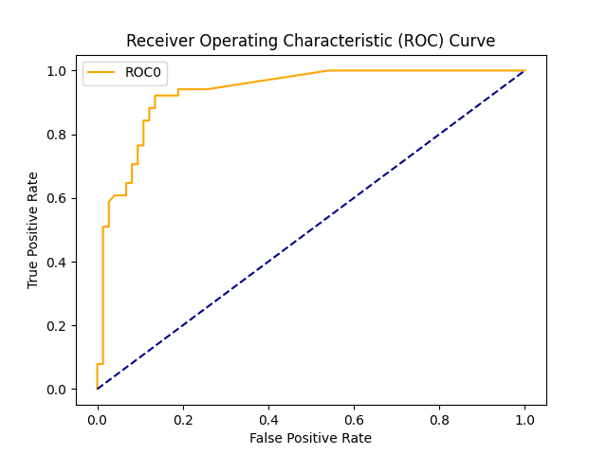
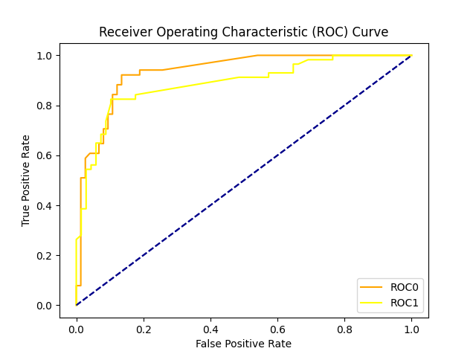
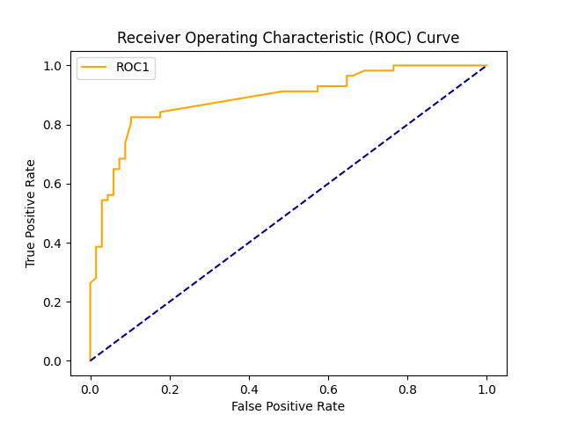
AUC = 93.3
AUC = 88.8
Separator | CHI > 3.84
Max_Features | Log2
Max_samples | 0.75
N_estimator | 50
Accuracy | 84%
Sensitivity | 78%
Specificity | 89%
ROC_AUC | 93%
This graphic shows the curve on the right (ROC0) and the curve on the left (ROC1) in a single graphic.
ROC0 is above ROC1 at most points and covers a larger area.
This shows that the Classification model that build ROC0 is stronger than ROC1’s model
Separator | CHI > 3.84
Max_Features | Auto
Max_samples | 0.75
N_estimator | 50
Accuracy | 75%
Sensitivity | 49%
Specificity | 87%
ROC_AUC | 88%

