Slide 1
What is a phylogenetic network and how do you interpret it.
The classical mathematical model to represent evolution is the phylogenetic tree. However, trees are unable to represent horizontal gene transfer, recombination or hybridization events: in those cases, some branches of the tree combine into a reticulation node, and the tree becomes a network.
In a network there is a central node, and connections from that central node. Networks build out from this central node. The distance from one node to another represents the differences.

Slide 2
Algorithms for phylogenetic networks
Reduce median
Very slow runtime (20+ hours for the 1000 samples)
Potentially more accurate networking.
Median Joining
Very fast runtime (~20 minutes for the 1000 samples)
Potentially less accurate networking.

Slide 3
Tool, packages, and librarys
Format converter from .fasta to .nex:
https://www.hiv.lanl.gov/content/sequence/FORMAT_CONVERSION/form.html
Networking tool:
https://www.fluxus-engineering.com/
Guide to make network:
https://nikosandreakis.blogspot.com/2013/05/how-to-create-nexus-input-files-for.html

Slide 4
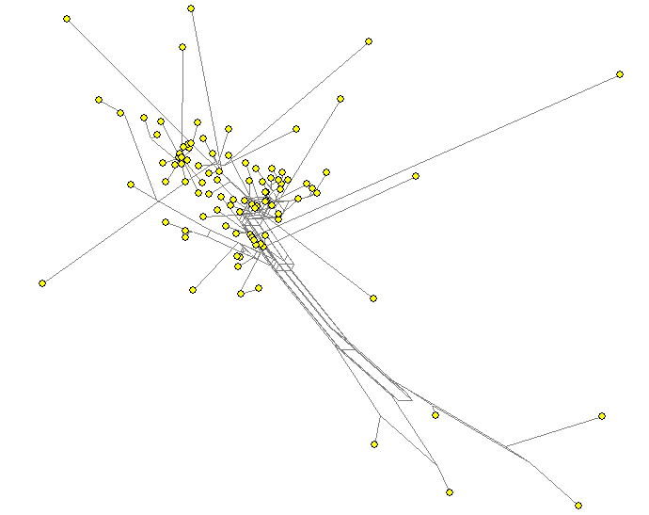
Network 100 Reduced Median

Slide 5
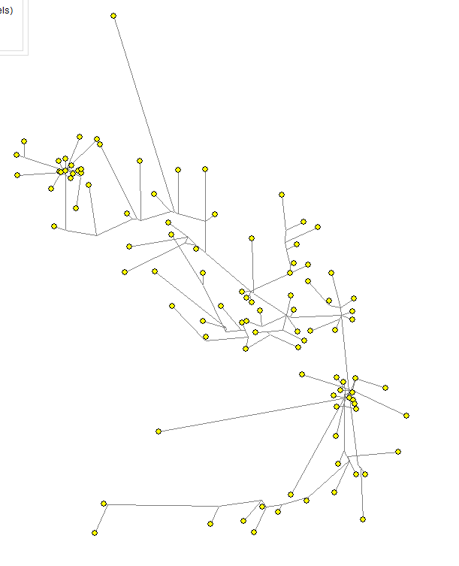
Network 100 Median Joining

Slide 6
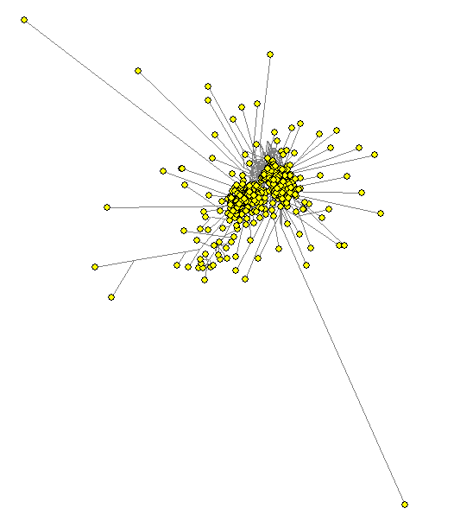
Network 1000 Reduced Median

Slide 7
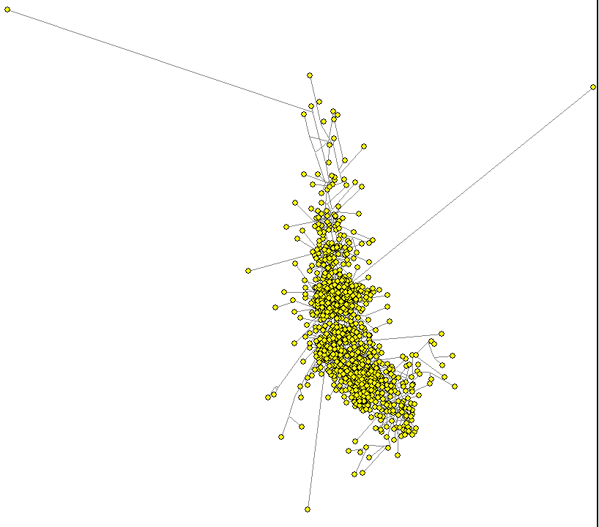
Network 1000 Median Joining

