Slide 1
What is a phylogenetic network and how do you interpret it.
The classical mathematical model to represent evolution is the phylogenetic tree. However, trees are unable to represent horizontal gene transfer, recombination or hybridization events: in those cases, some branches of the tree combine into a reticulation node, and the tree becomes a network.
In a network there is a central node, and connections from that central node. Networks build out from this central node. The distance from one node to another represents the differences.

Slide 2
Algorithms for phylogenetic networks
Reduce median
Very slow runtime (20+ hours for the 1000 samples)
Potentially more accurate networking.
Median Joining
Very fast runtime (~20 minutes for the 1000 samples)
Potentially less accurate networking.

Slide 3
Tool, packages, and libraries
Format converter from .fasta to .nex:
https://www.hiv.lanl.gov/content/sequence/FORMAT_CONVERSION/form.html
Networking tool:
https://www.fluxus-engineering.com/
Guide to make network:
https://nikosandreakis.blogspot.com/2013/05/how-to-create-nexus-input-files-for.html

Slide 4
Production on Network diagrams
Convert .fasta to .nex format By tool: https://www.hiv.lanl.gov/content/sequence/FORMAT_CONVERSION/form.html
Begin with: Aligned .fasta File
Open Network.exe Select calculate network > Network Calculations > Median Joining
File> open Select .nex Once loaded select Calculate network
Network is drawn and can be exported as an .fdi file
File > Open Open the .out file
When network calculation is finished. Open Draw network Produced .out file

Slide 5
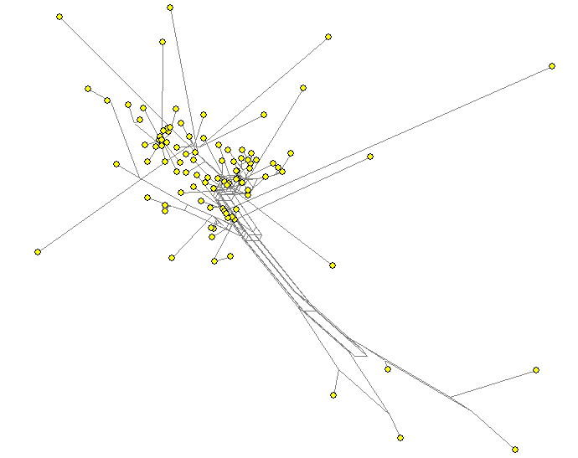
Network 100 Reduced Median

Slide 6
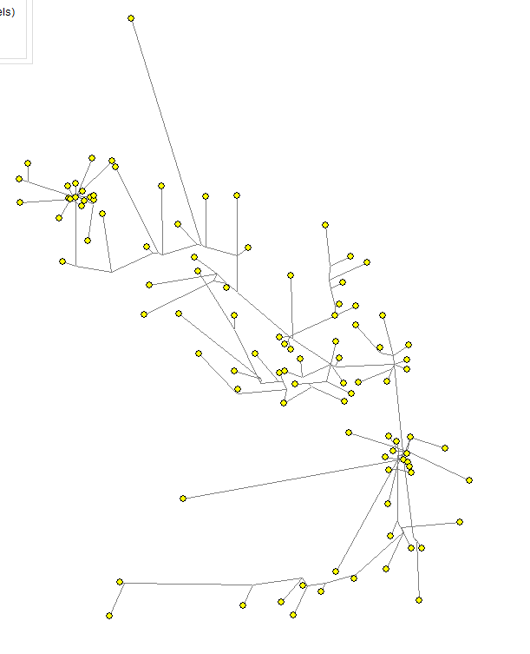
Network 100 Median Joining

Slide 7
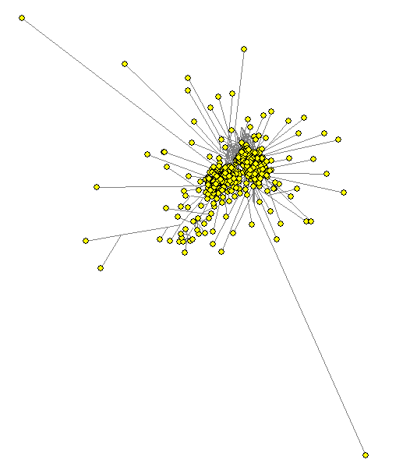
Network 1000 Reduced Median

Slide 8
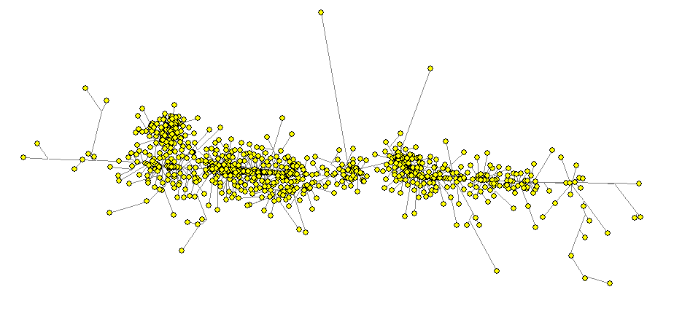
Network 1000 Median Joining

Slide 9
Connections per sample (Median joining 100)
Sample | Total Connections | Connections to node | Connections from node
EPI_ISL_435002 | 10 | 7 | 3
EPI_ISL_468572 | 10 | 6 | 4
EPI_ISL_508800 | 8 | 5 | 3
EPI_ISL_513875 | 7 | 3 | 4
EPI_ISL_511824 | 7 | 2 | 5
EPI_ISL_494739 | 7 | 3 | 4
Reference Sequences | 6 | 5 | 1
EPI_ISL_483233 | 6 | 6 | 0
EPI_ISL_434189 | 6 | 4 | 2
EPI_ISL_491019 | 6 | 4 | 2
EPI_ISL_527628 | 6 | 4 | 2
EPI_ISL_524852 | 6 | 5 | 1
EPI_ISL_509718 | 6 | 4 | 2
EPI_ISL_535698 | 6 | 3 | 3
EPI_ISL_507969 | 6 | 2 | 4
EPI_ISL_495803 | 6 | 1 | 5
EPI_ISL_427622 | 6 | 0 | 6
EPI_ISL_416660 | 6 | 2 | 4
EPI_ISL_530214 | 5 | 4 | 1

Slide 10
Connections per sample (Median joining 1000)
Sample | Total Connections | Connections to node | Connections from node
EPI_ISL_427432 | 23 | 11 | 12
EPI_ISL_421579 | 21 | 6 | 15
EPI_ISL_527671 | 15 | 6 | 9
EPI_ISL_434879 | 13 | 11 | 2
EPI_ISL_496323 | 13 | 8 | 5
EPI_ISL_524416 | 12 | 8 | 4
EPI_ISL_449946 | 12 | 5 | 7
EPI_ISL_435568 | 12 | 5 | 7
EPI_ISL_497199 | 11 | 3 | 8
EPI_ISL_449824 | 11 | 7 | 4
EPI_ISL_498698 | 11 | 6 | 5
EPI_ISL_485942 | 10 | 5 | 5
EPI_ISL_437370 | 10 | 3 | 7
EPI_ISL_485381 | 10 | 4 | 6
EPI_ISL_498740 | 10 | 6 | 4
EPI_ISL_428334 | 10 | 6 | 4
EPI_ISL_507916 | 9 | 9 | 0
EPI_ISL_507709 | 9 | 5 | 4
EPI_ISL_426310 | 9 | 5 | 4
EPI_ISL_417145 | 9 | 5 | 4
Reference Sequences | 8 | 5 | 3

Slide 11
Next steps
Fix fasta to nex converter script
Error where the nex file char length is not properly interpreted.
Become more familiar with the Network X python package
Build the full phylogenetic network

