Slide 1
Goal
What are the mutational patters that occur across various metrics (Month, Week, Location)?
Find and remove poor data (N > 150 and A + T + G + C < 29750)

Slide 2
Method
Count the A, G, C, T, N, -
Filter by N > 150 and A + C + G + T =< 29750
99,639 given samples, 46897 filtered out
leaving 52,742 samples
An additional 1664 samples were removed due to a lack of proper date. (Lacking Month, day, or year)

Slide 3
Examples (Diff = Sample val– Reference val)
Sequence ID | A | T | C | G | N
Reference | 8921 | 9593 | 5492 | 5863 | 0
EPI_ISL_417100 | 8916 | 9593 | 5489 | 5862 | 0
Adjusted | -5 | 0 | -3 | -1 | 0
EPI_ISL_417101 | 8914 | 9591 | 5489 | 5862 | 0
Adjusted | -7 | -2 | -3 | -1 | 0

Slide 4
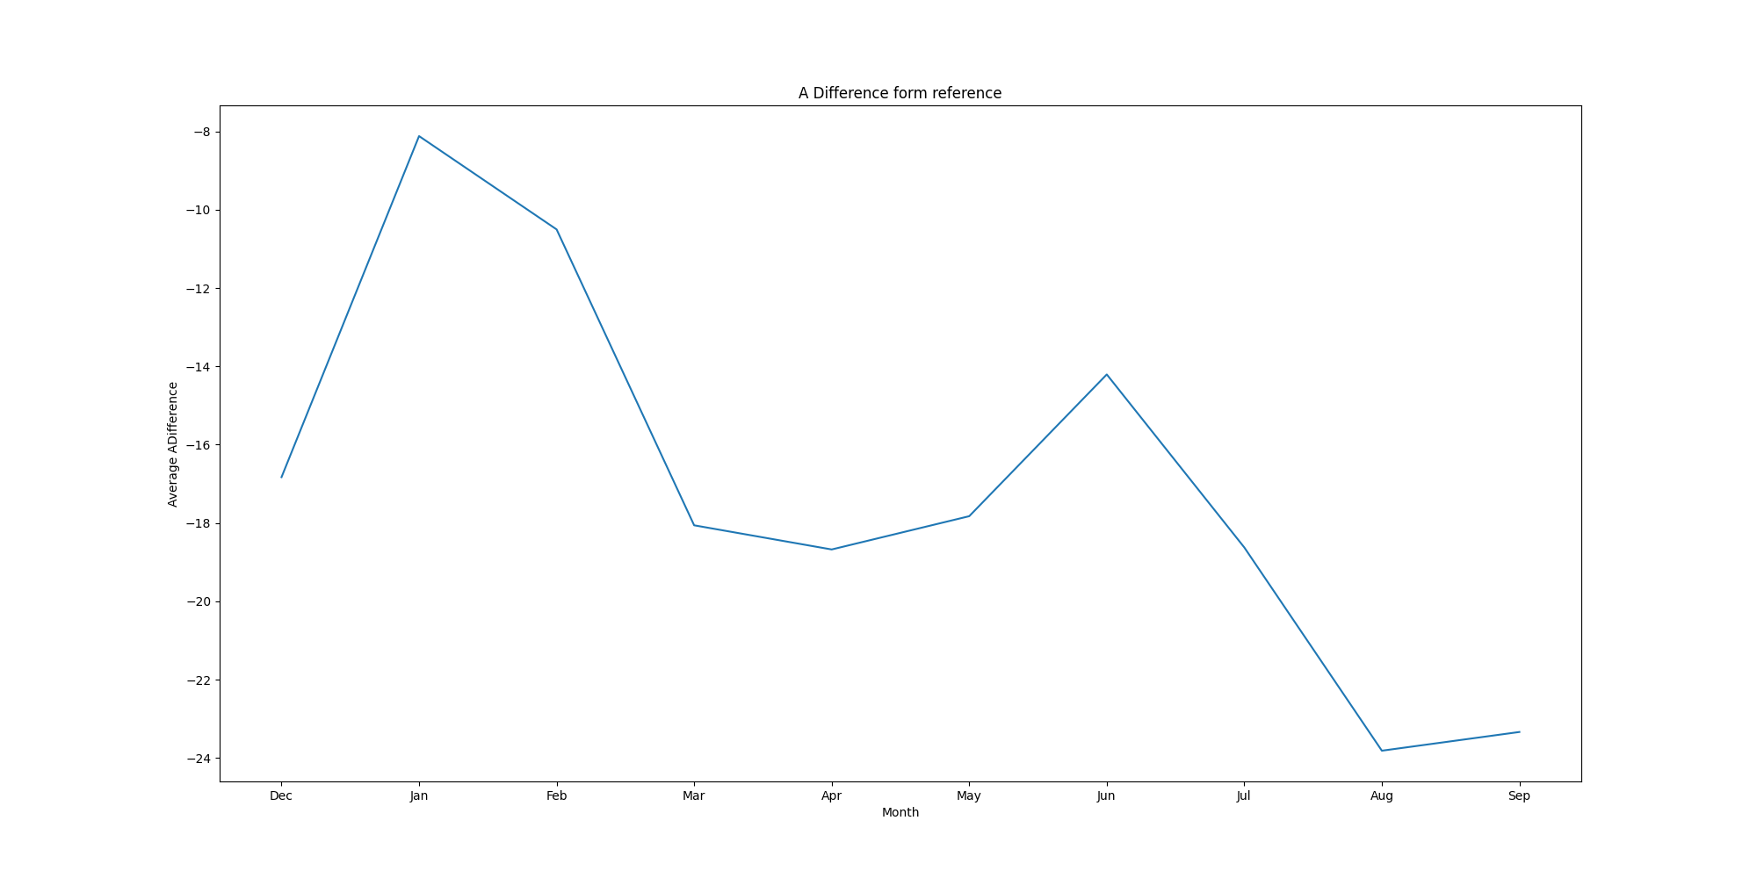
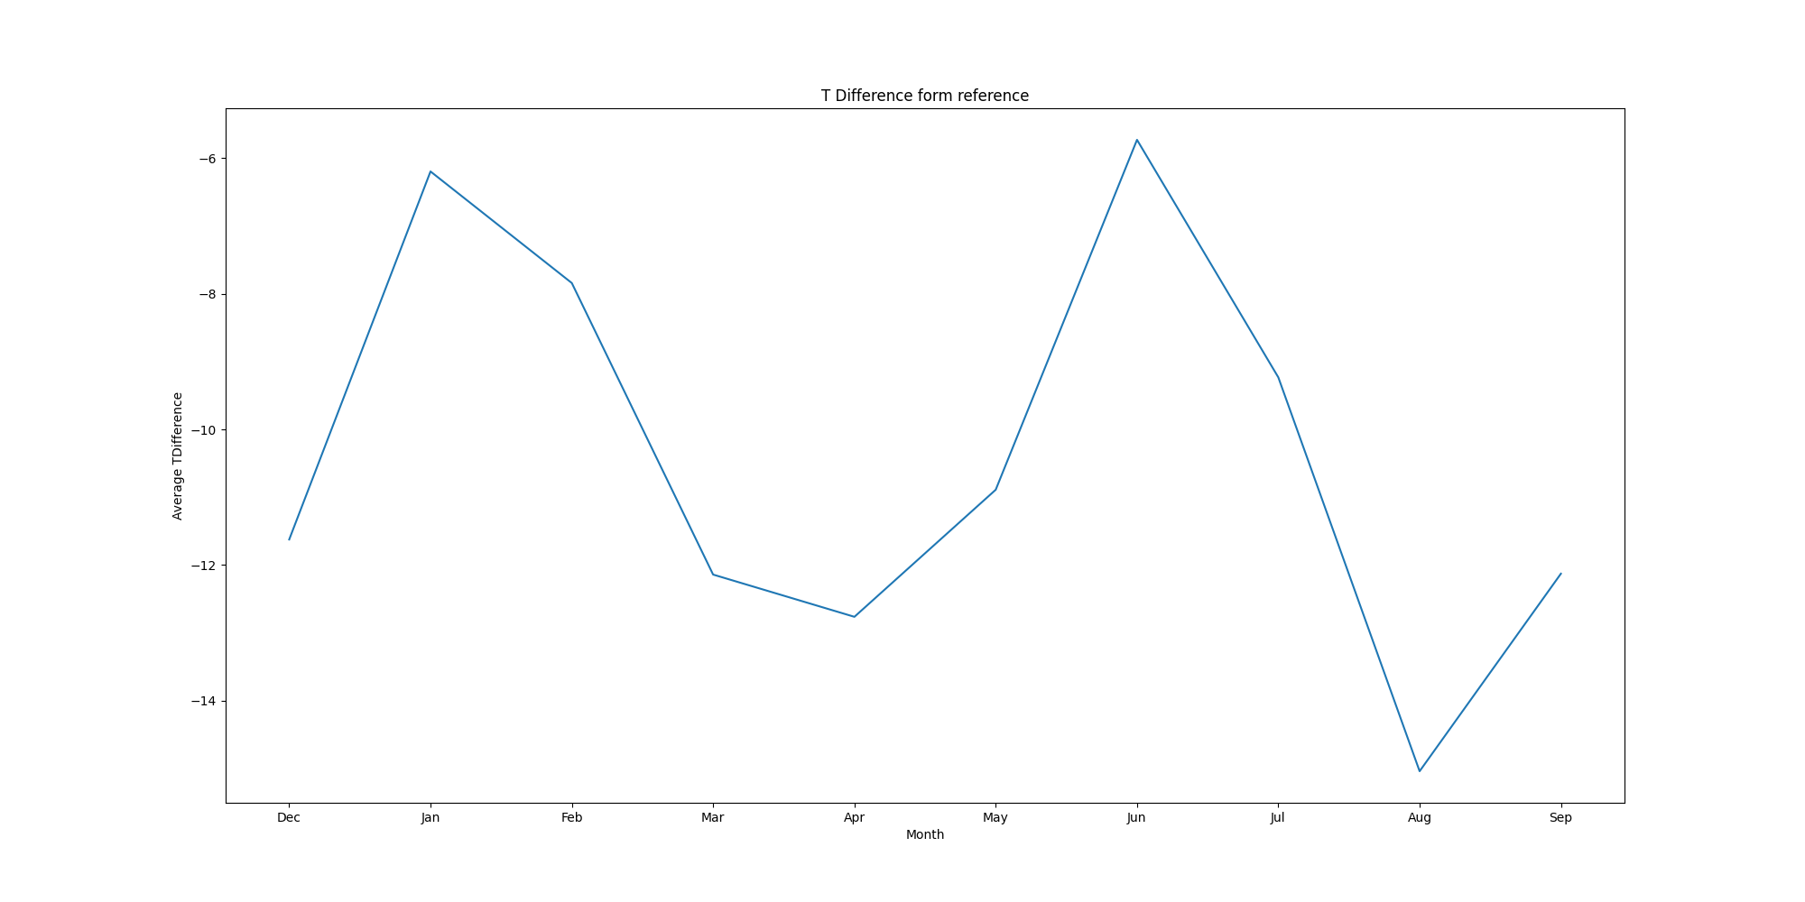
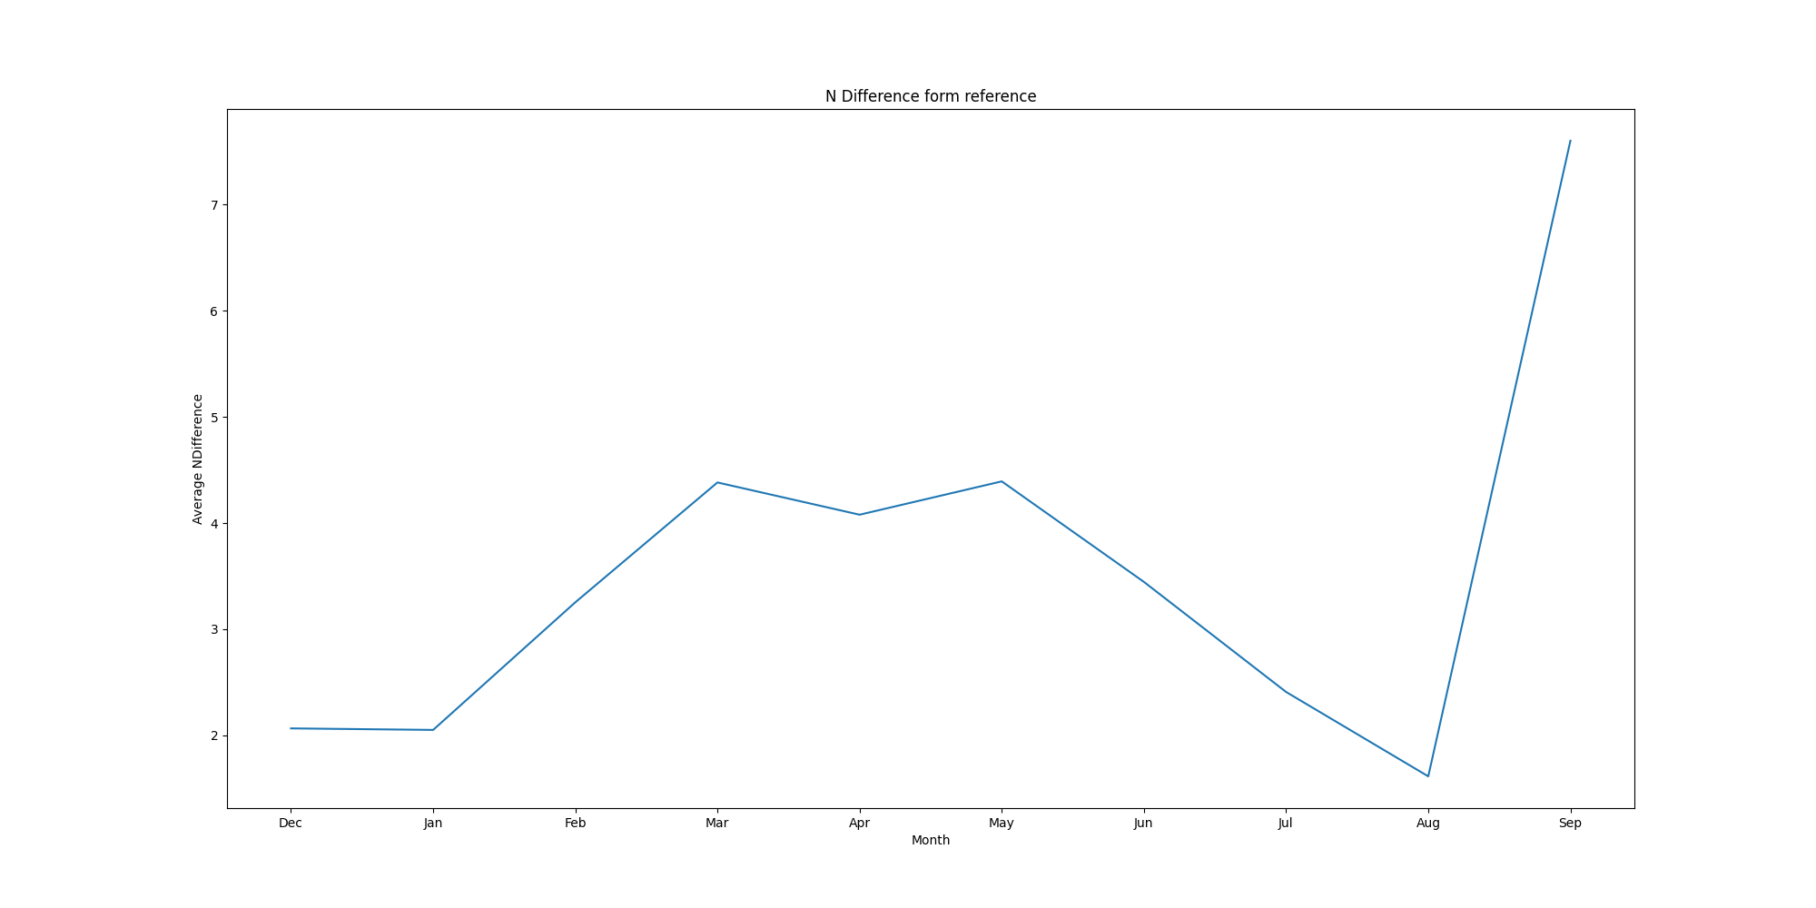
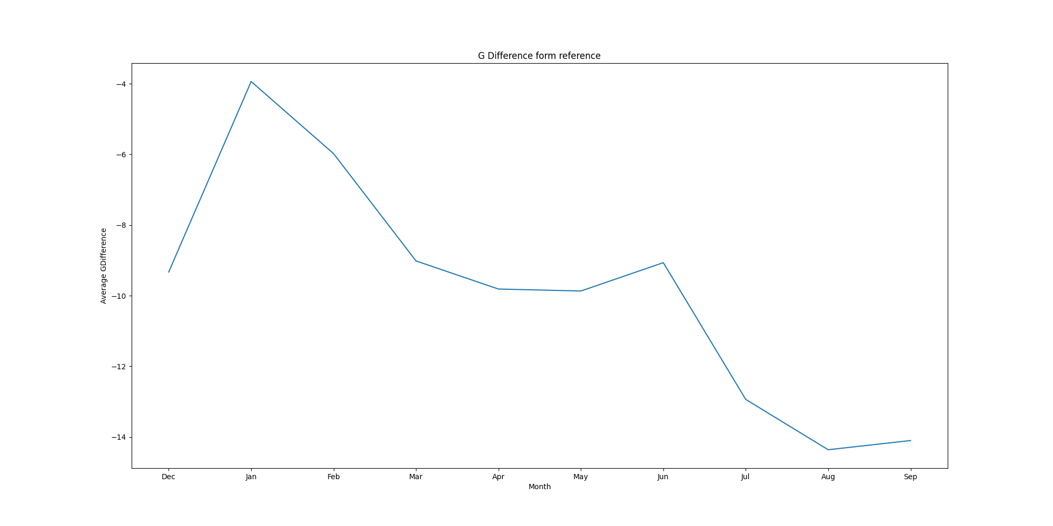
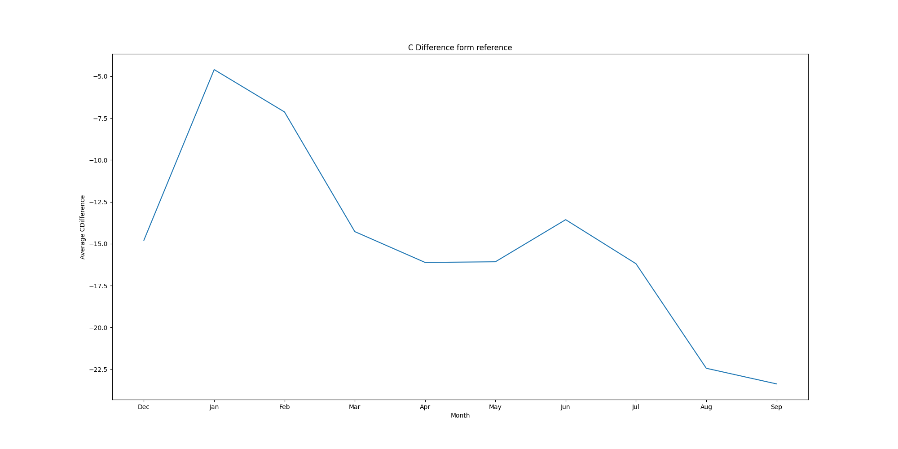
Month Graphs
A | T | N
G | C

Slide 5
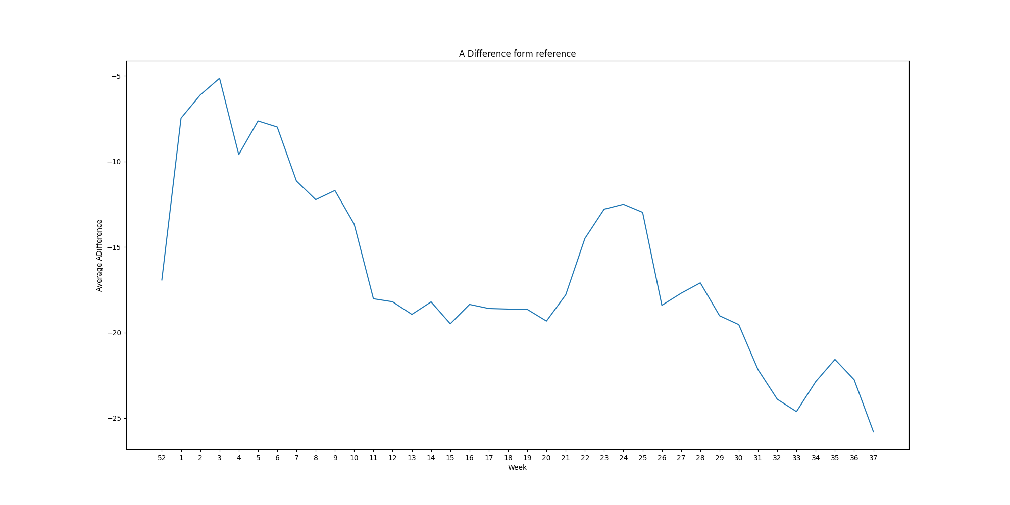
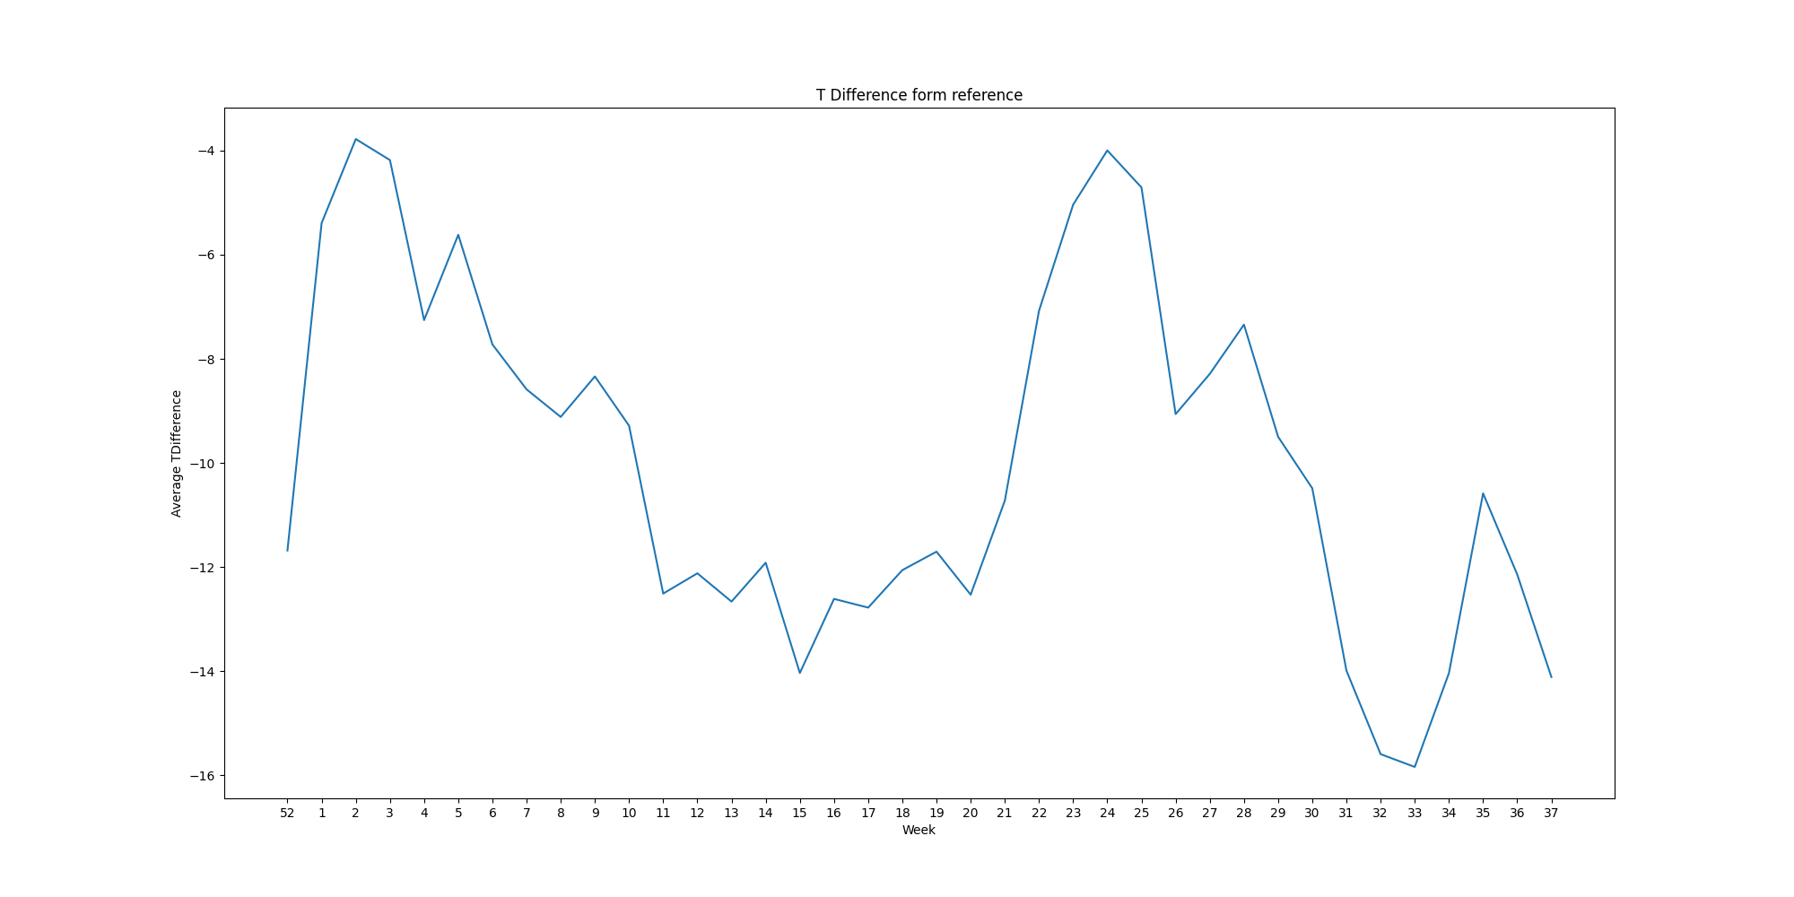
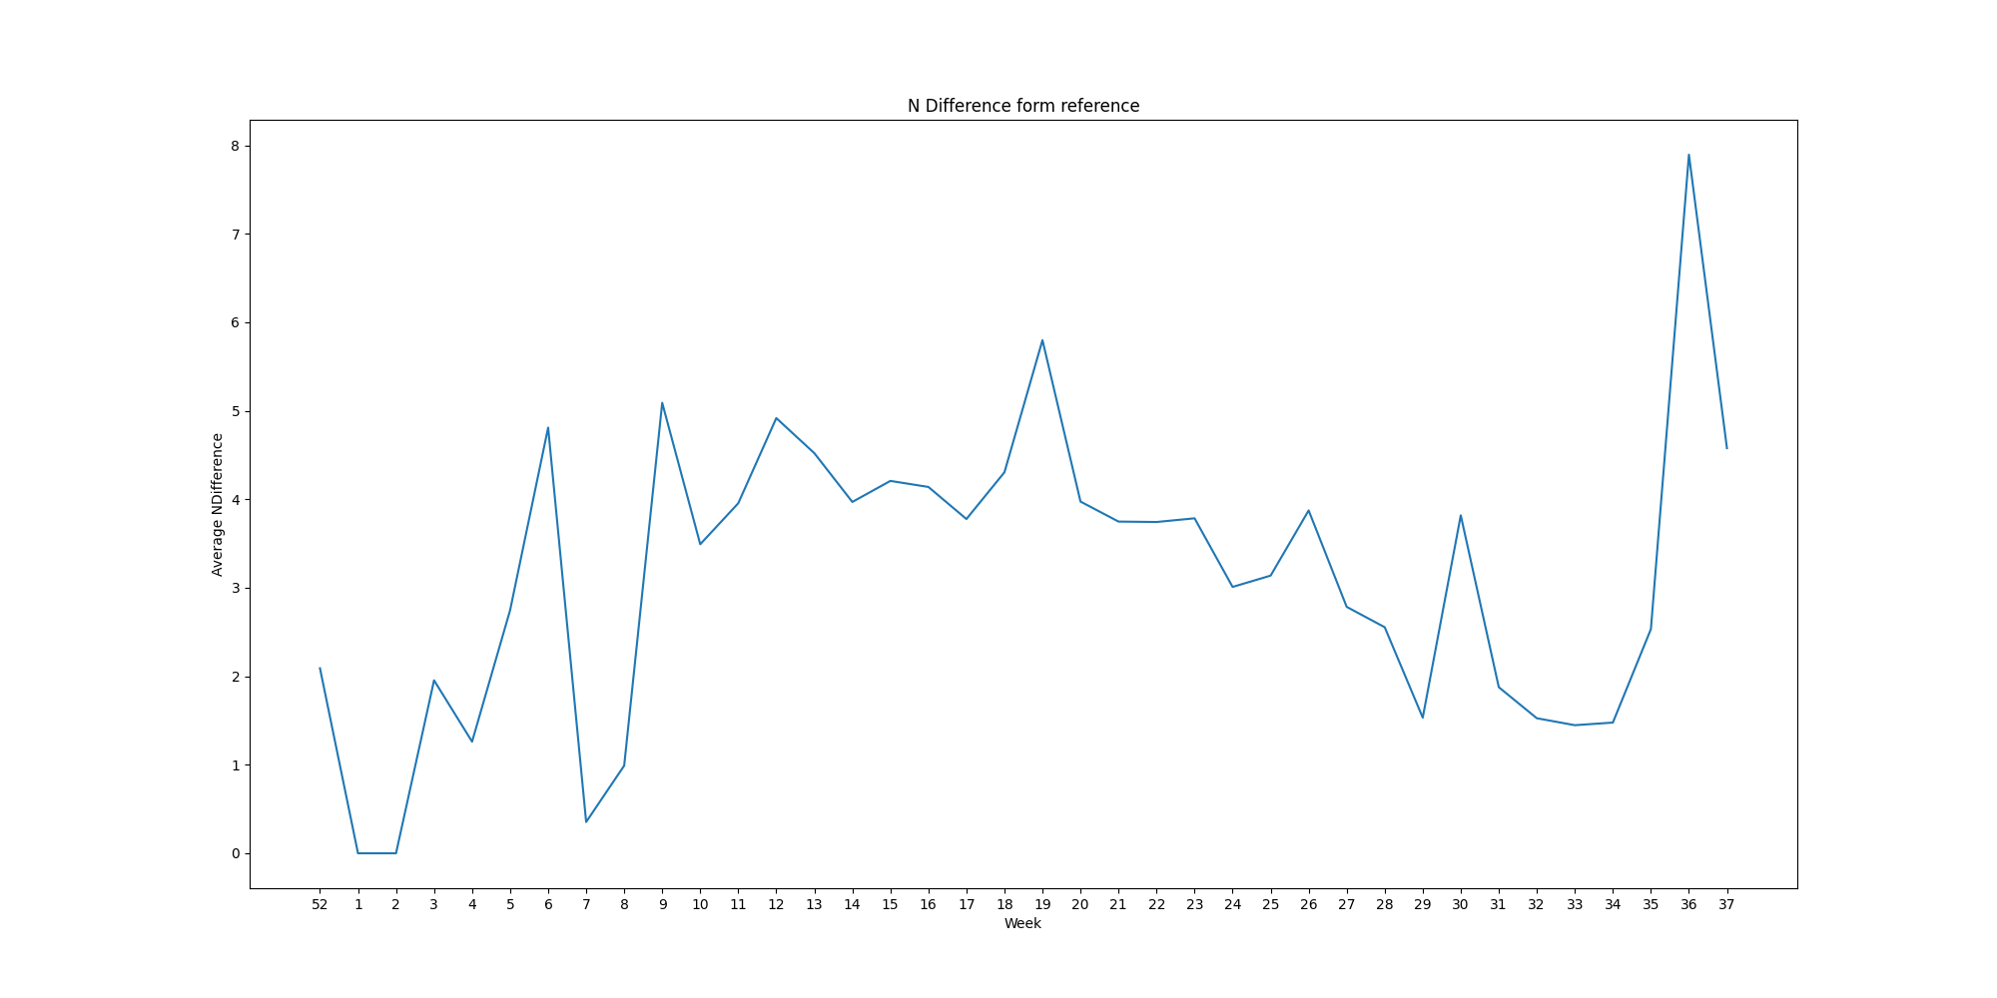
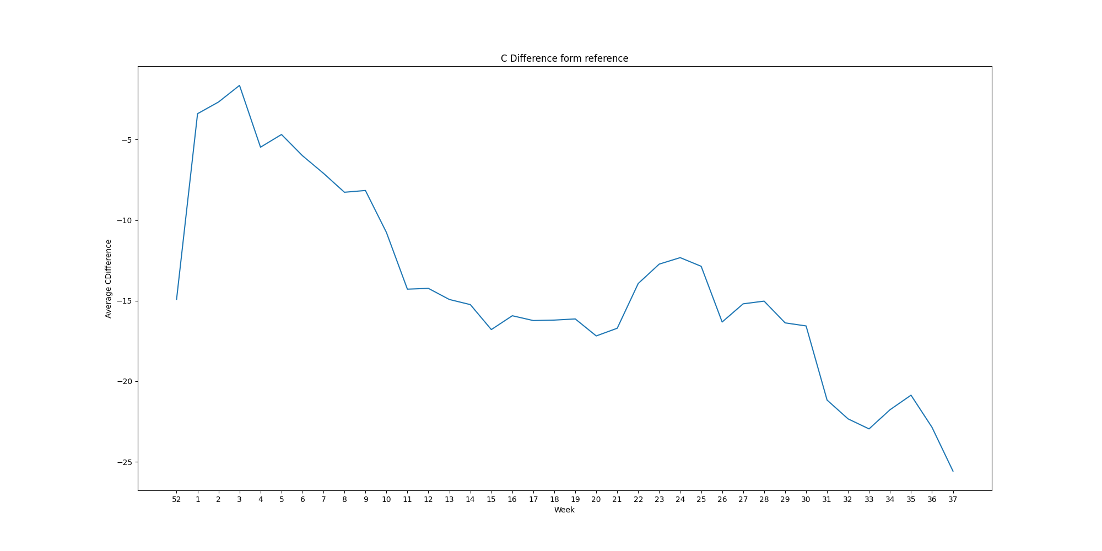
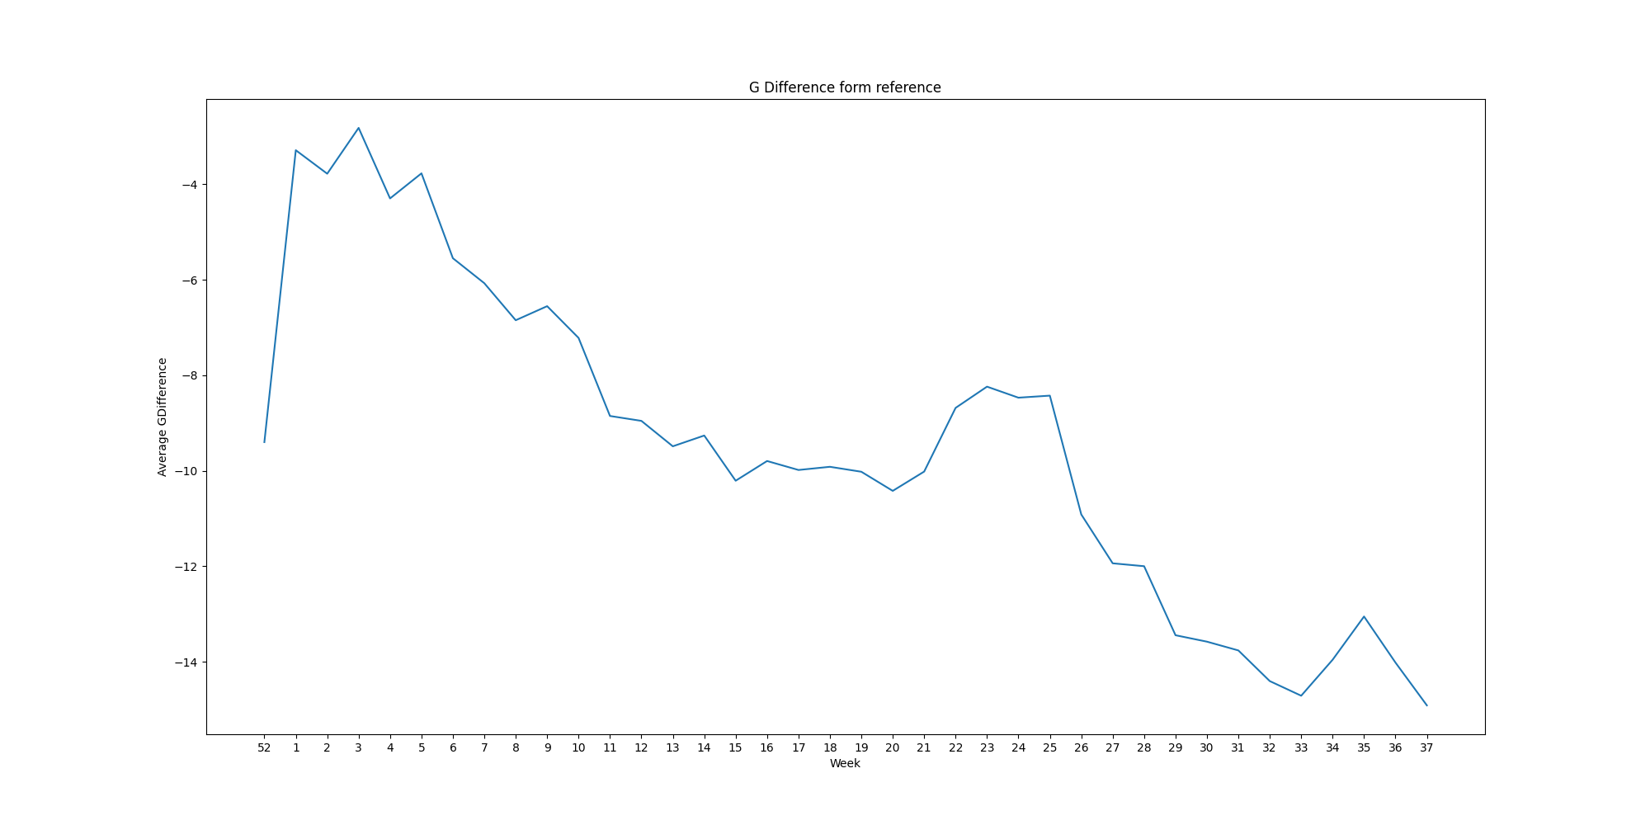
Week Graphs
A | T | N
G | C

Slide 6
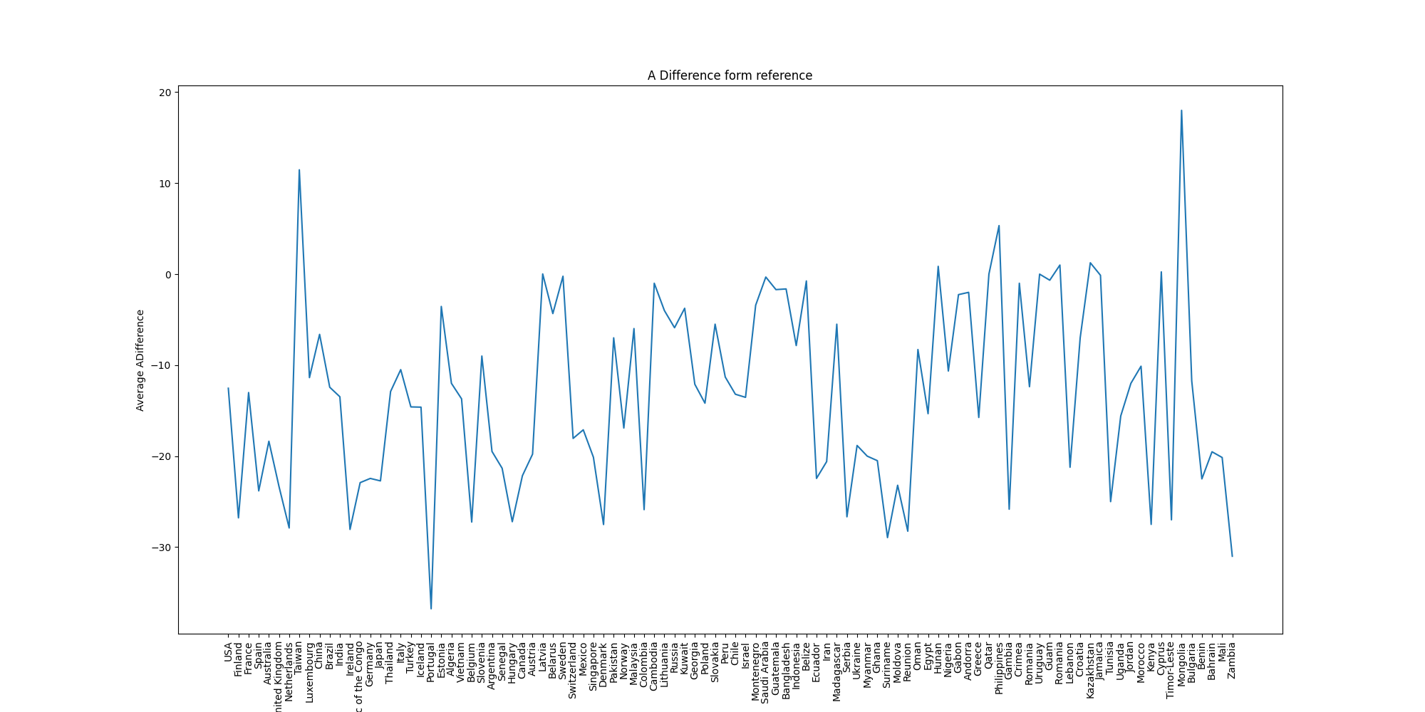
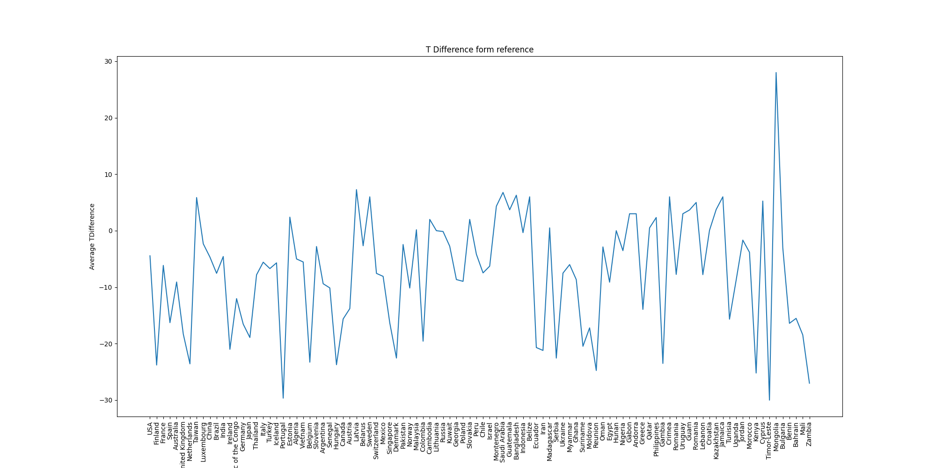
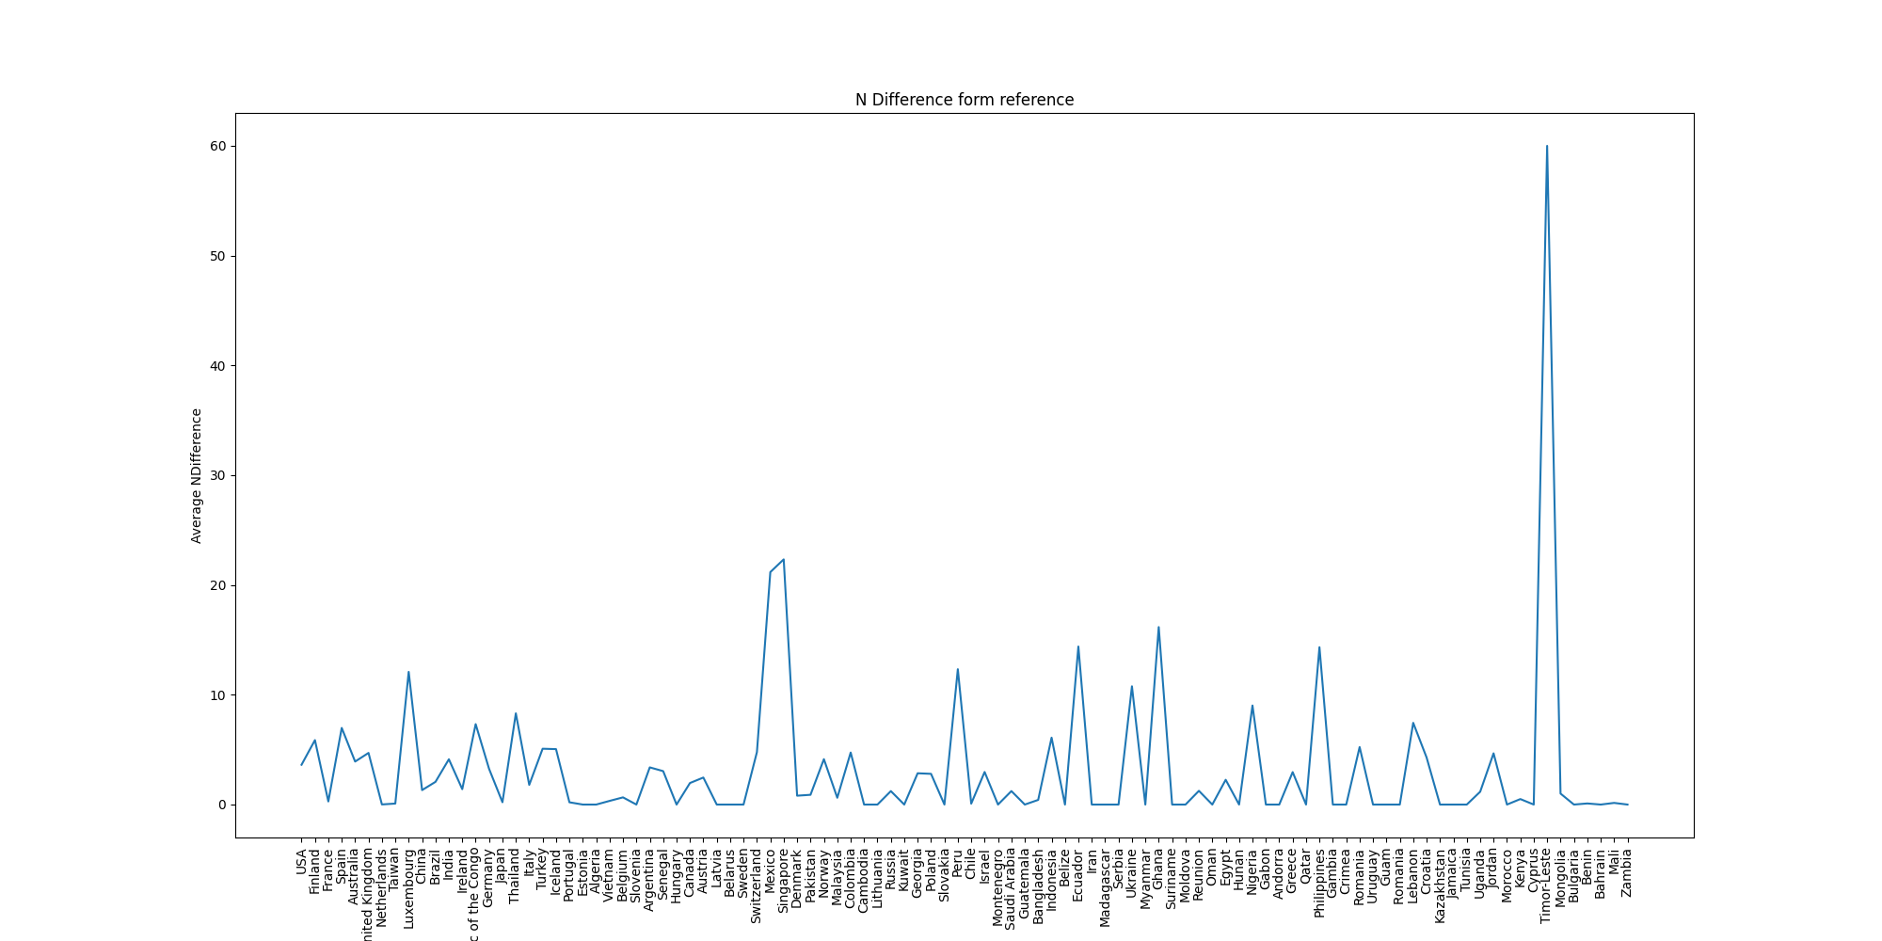
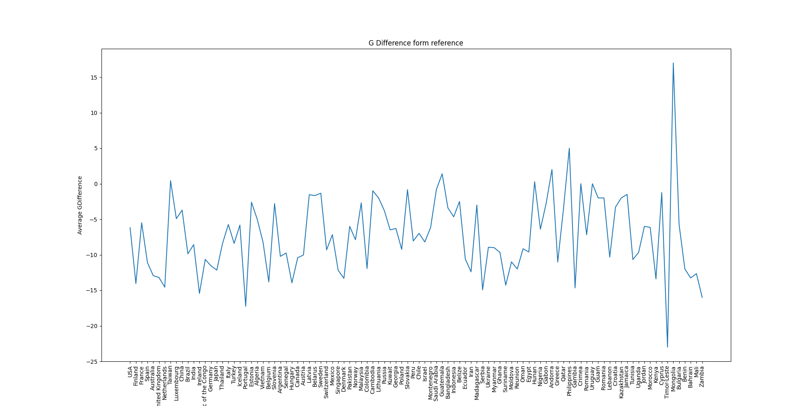
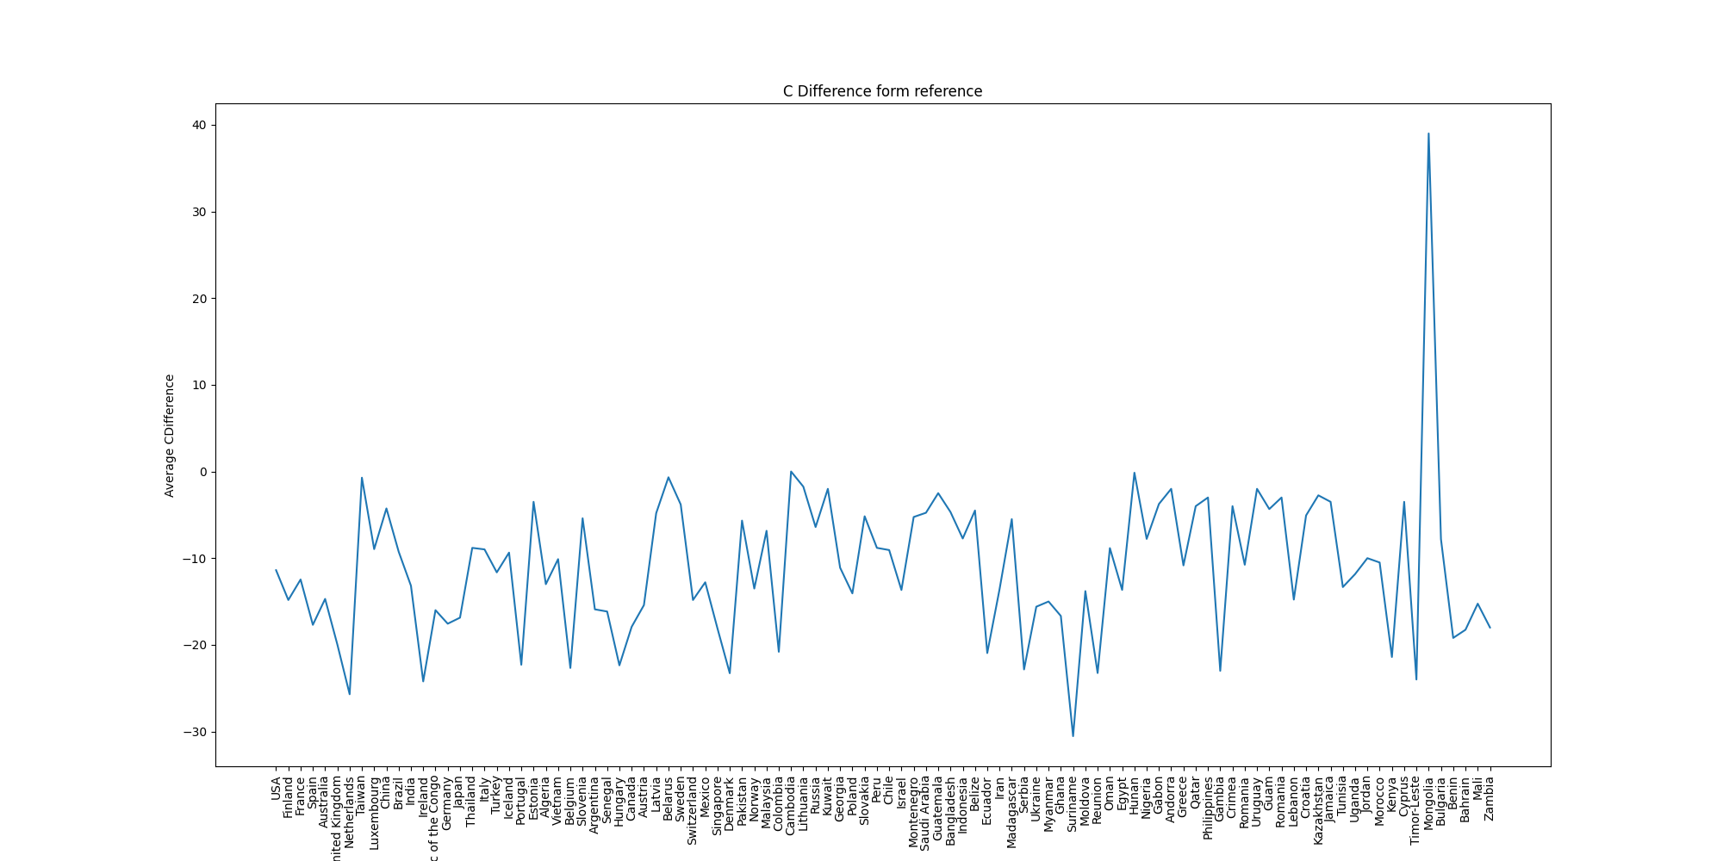
Location Graphs
A | T | N
G | C

Slide 7
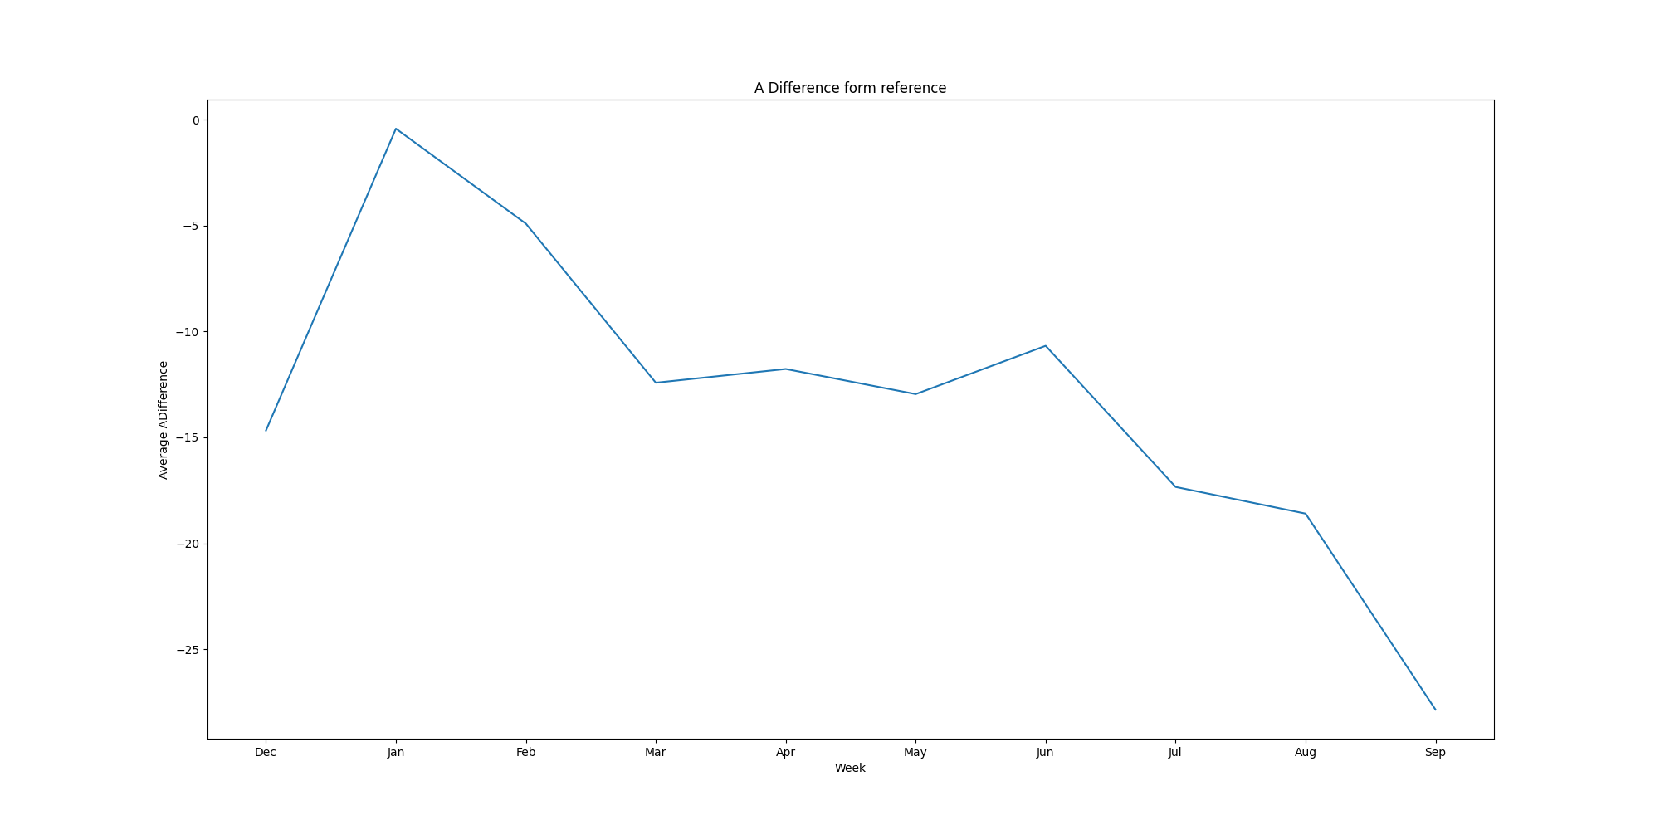
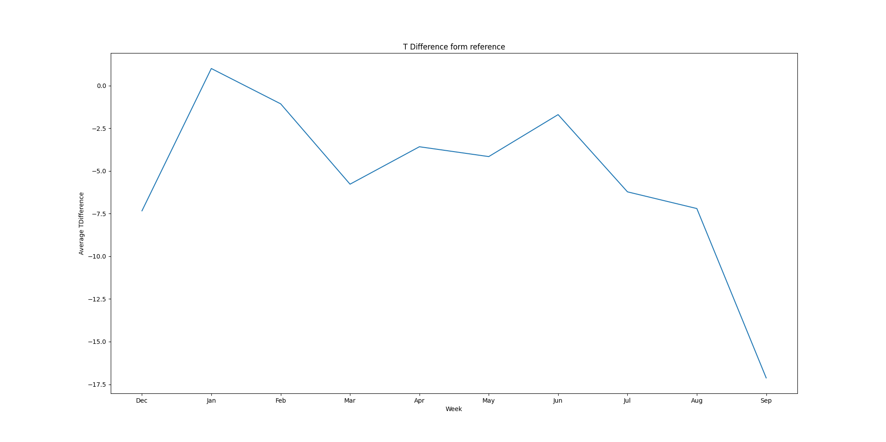
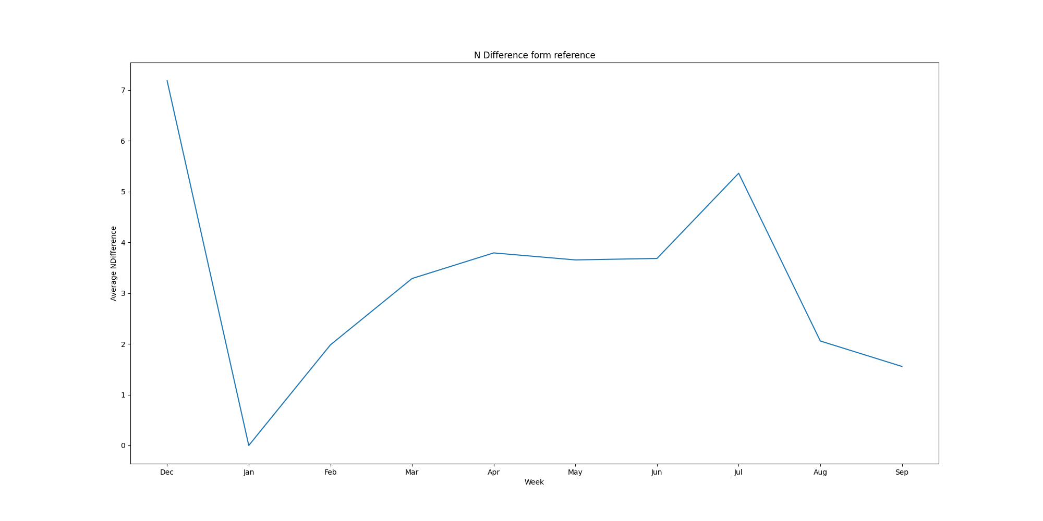
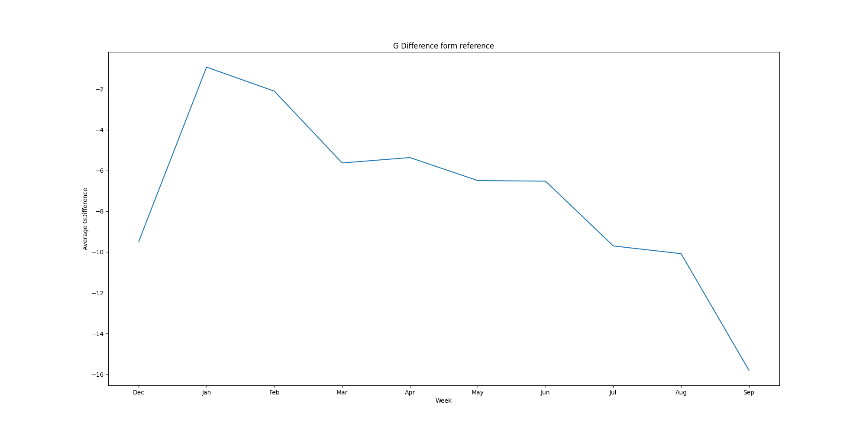
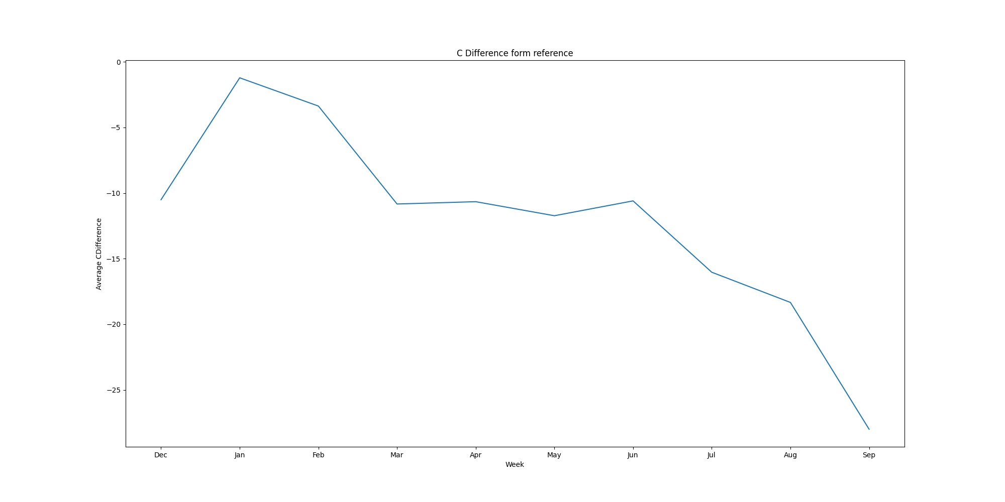
USA Months Graphs
A | T | N
G | C

Slide 8
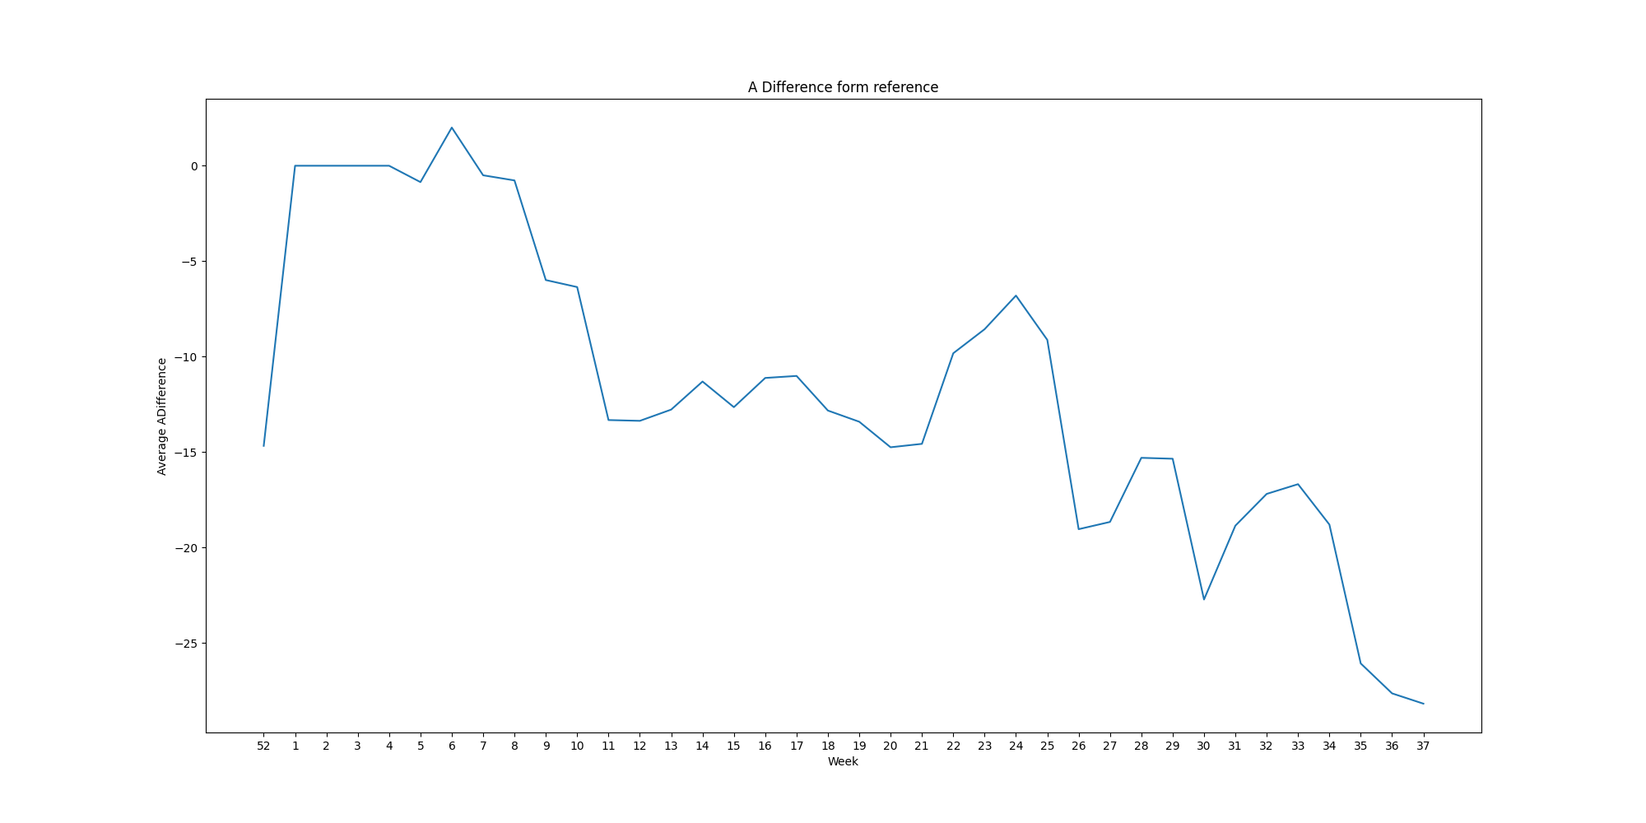
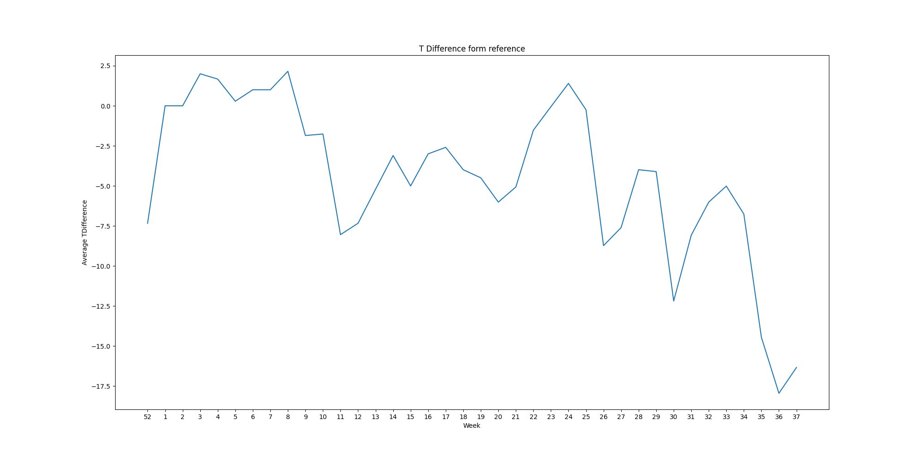
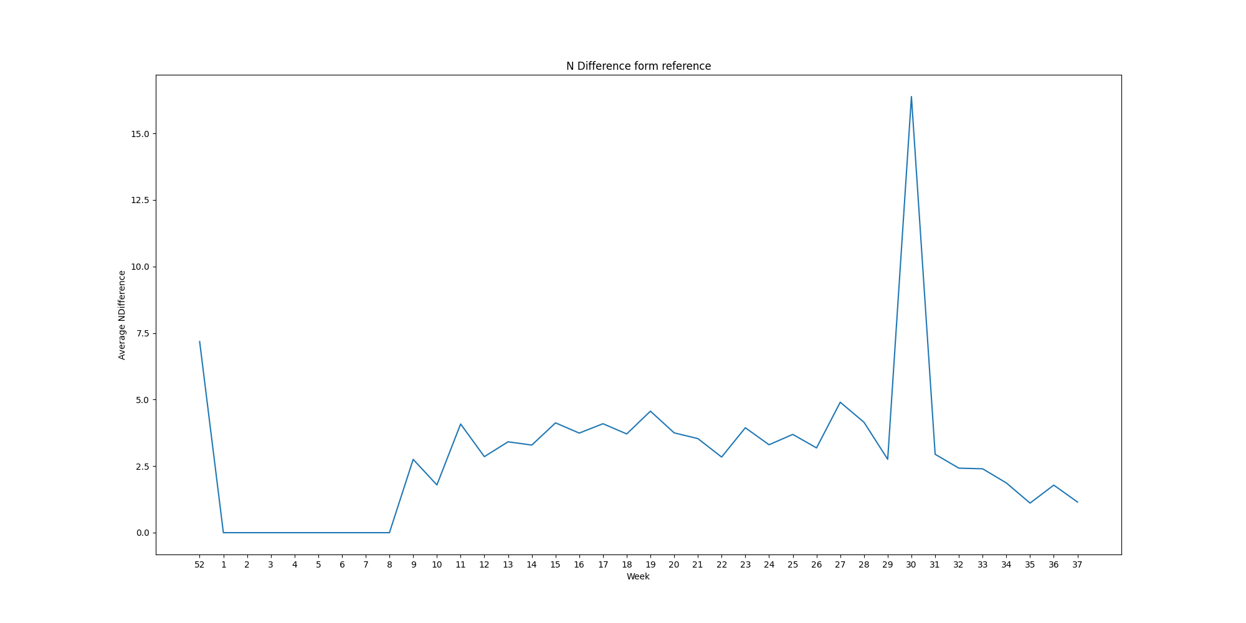
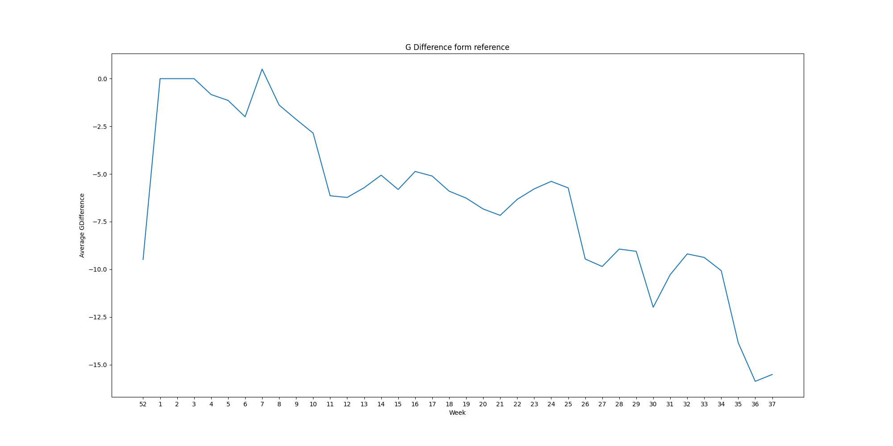
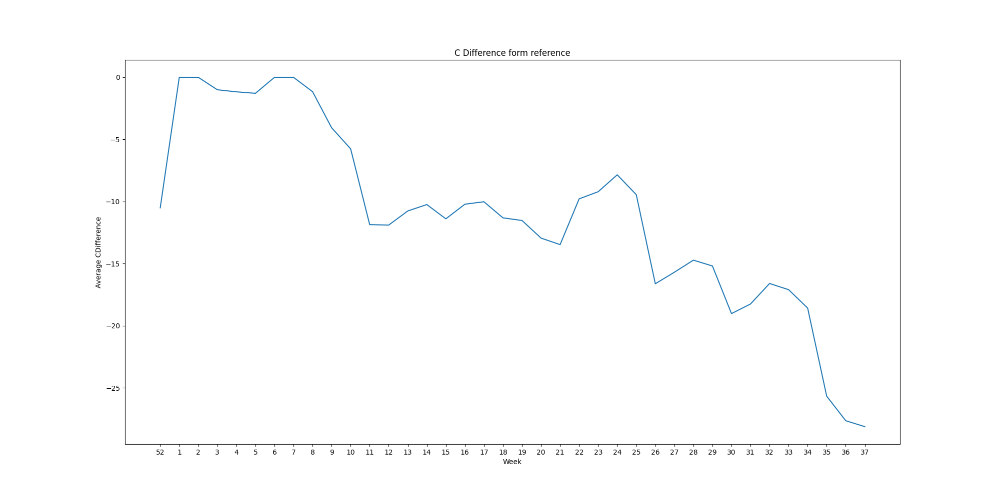
USA Weeks Graphs
A | T | N
G | C

