Slide 1
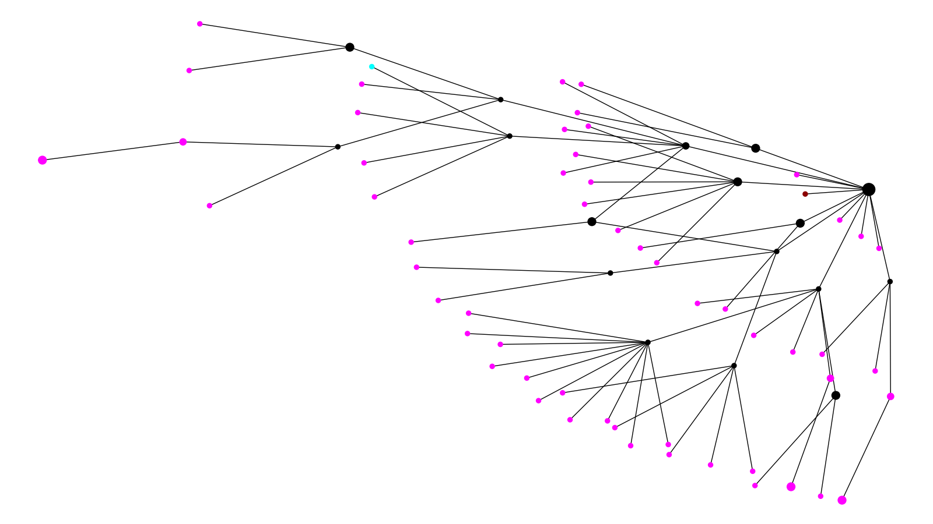
Date Cluster 1
October / November 2020 December 2020 January / February 2021

Slide 2
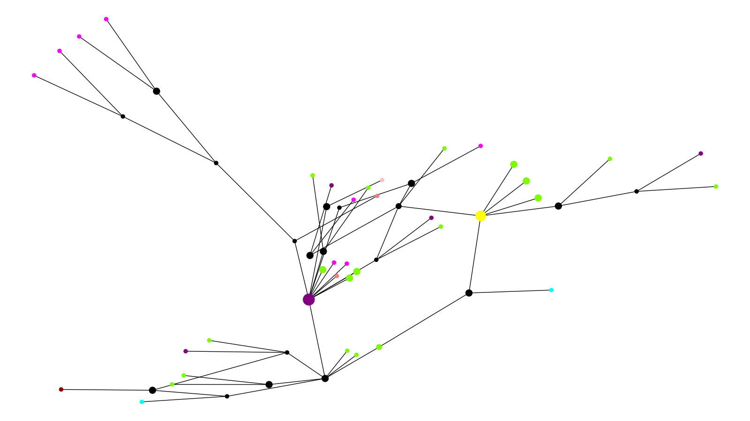
Date Cluster 2
February / March 2020 April 2020 May / June 2020 July 2020 October / November 2020 December 2020 Reference

Slide 3
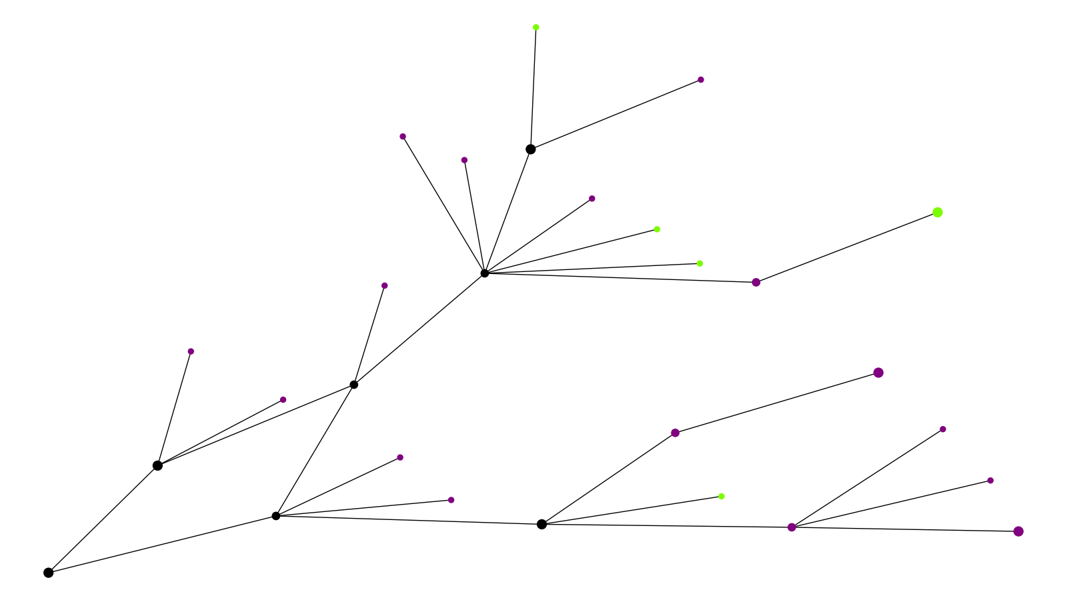
Date Cluster 3
February / March 2020 April 2020

Slide 4
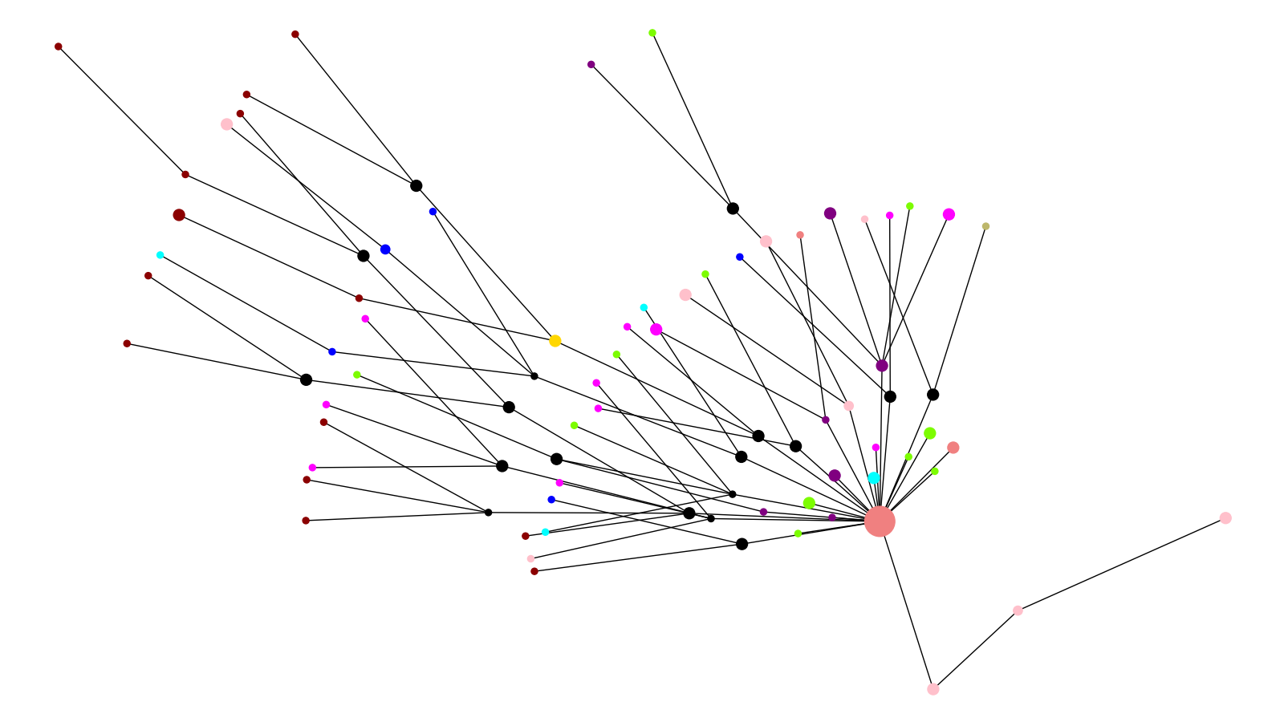
Date Cluster 4
February / March 2020 April 2020 May / June 2020 July 2020 August / September 2020 October / November 2020 December 2020 January / February 2021 UK Reference Brazil Reference

Slide 5
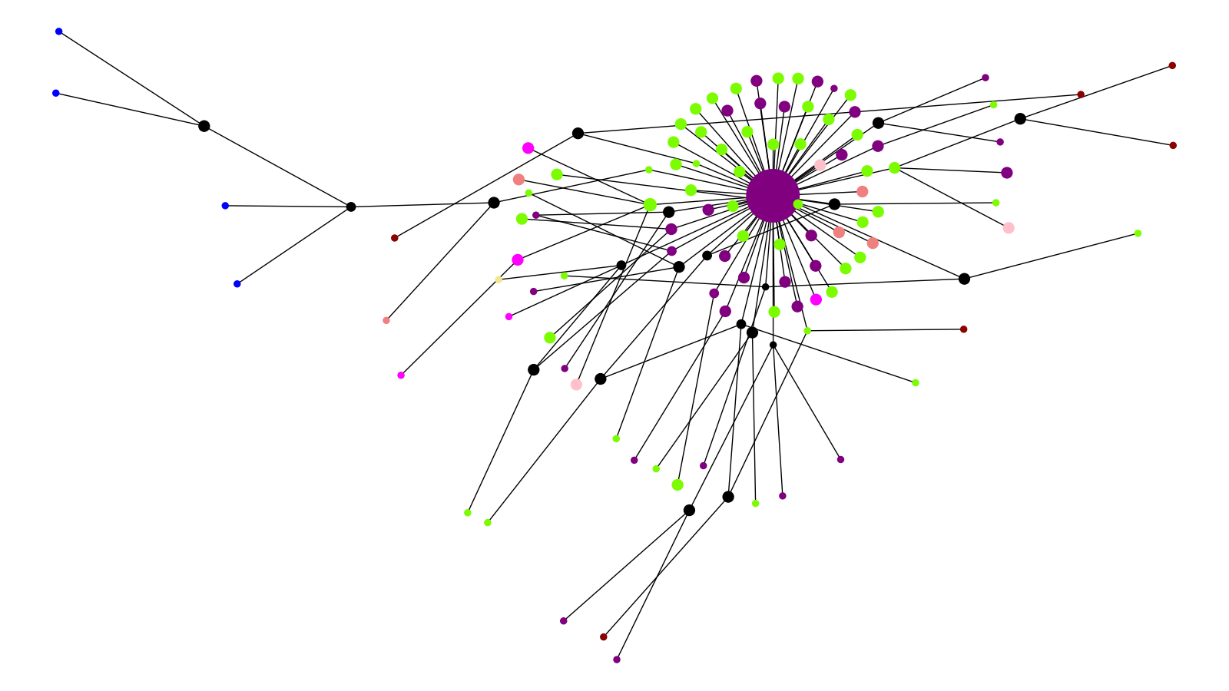
Date Cluster 5
February / March 2020 April 2020 May / June 2020 July 2020 August / September 2020 December 2020 South Africa Ref

Slide 6
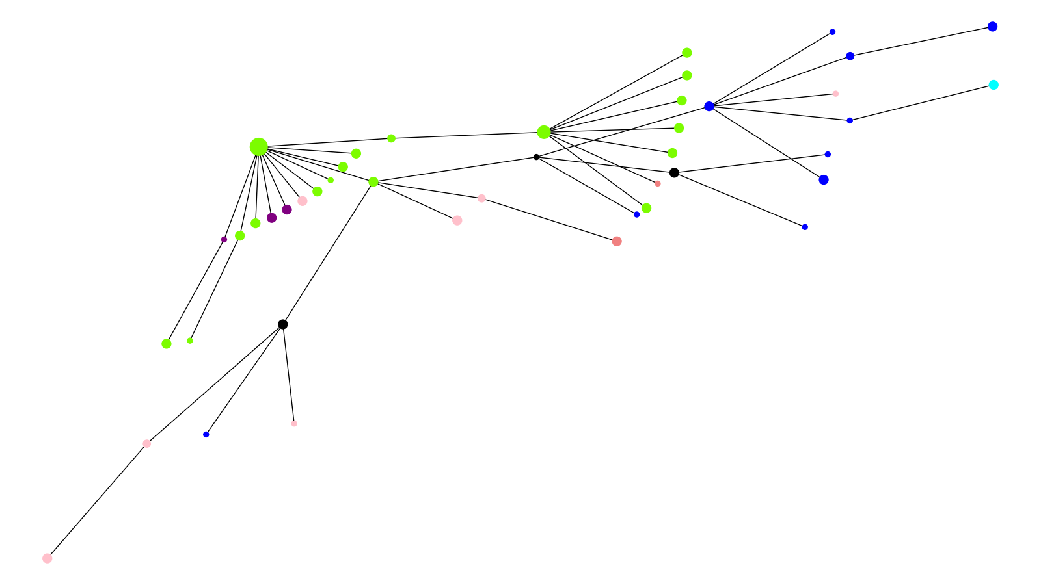
Date Cluster 6
February / March 2020 April 2020 May / June 2020 July 2020 August / September 2020 October / November 2020

Slide 7
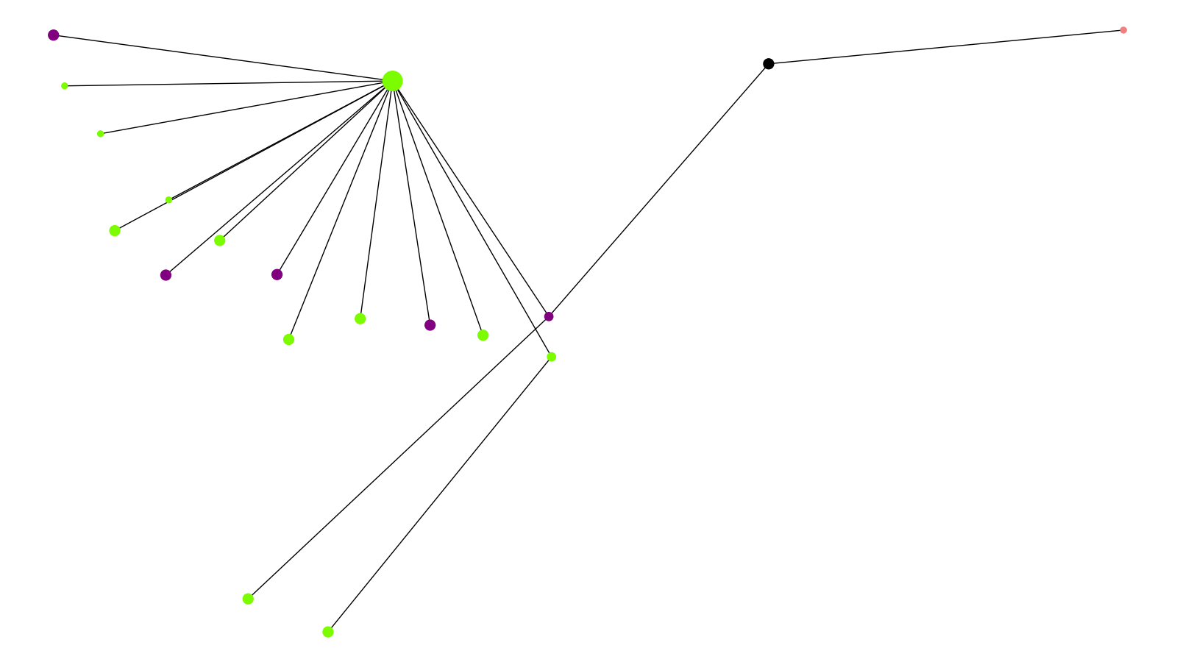
Date Cluster 7
February / March 2020 April 2020

Slide 8
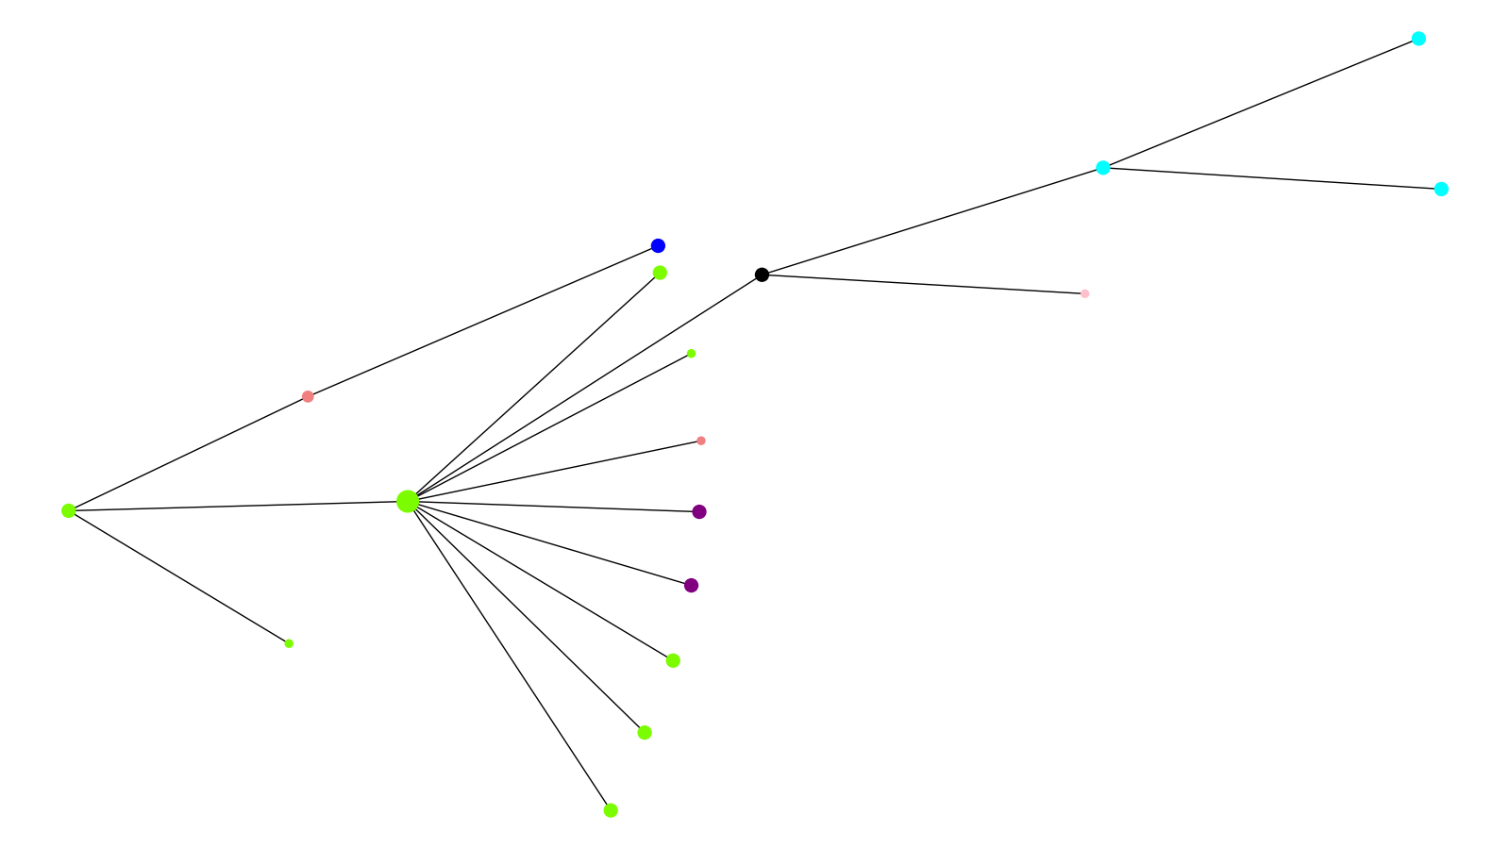
Date Cluster 8
February / March 2020 April 2020 May / June 2020 August / September 2020 October / November 2020

Slide 9
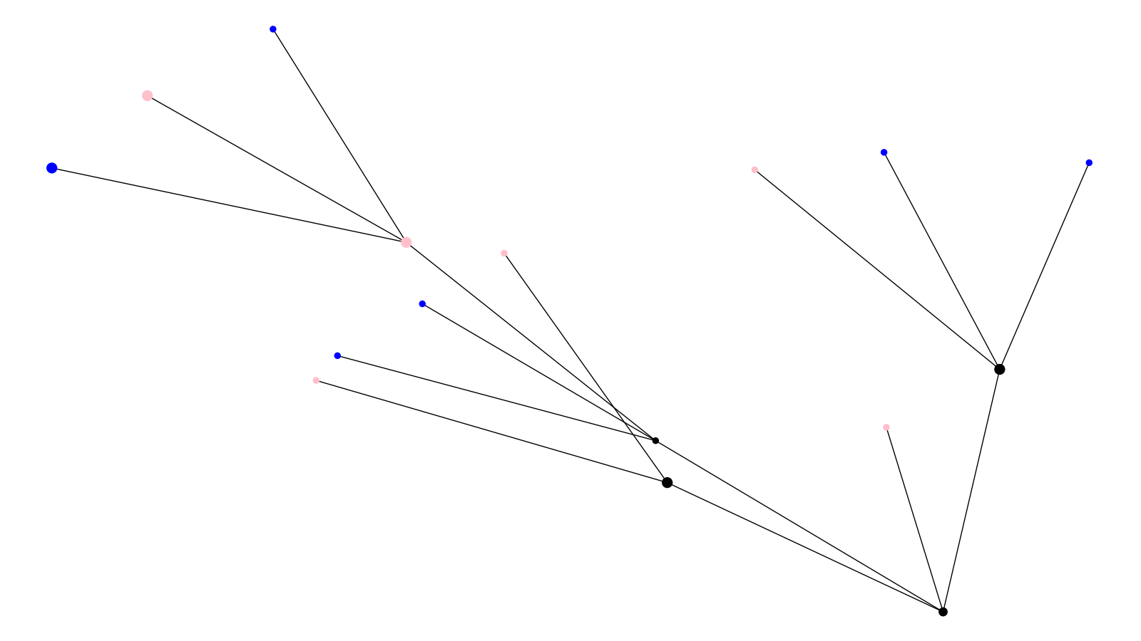
Date Cluster 9
July 2020 August / September 2020

Slide 10
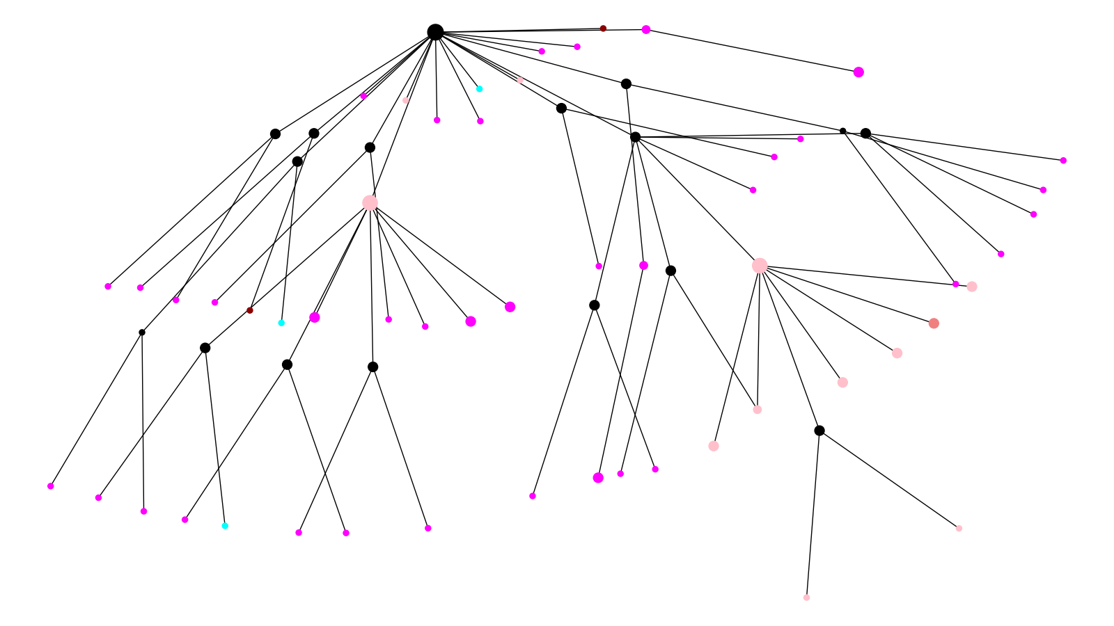
Date Cluster 10
May / June 2020 July 2020 October / November 2020 December 2020

Slide 11
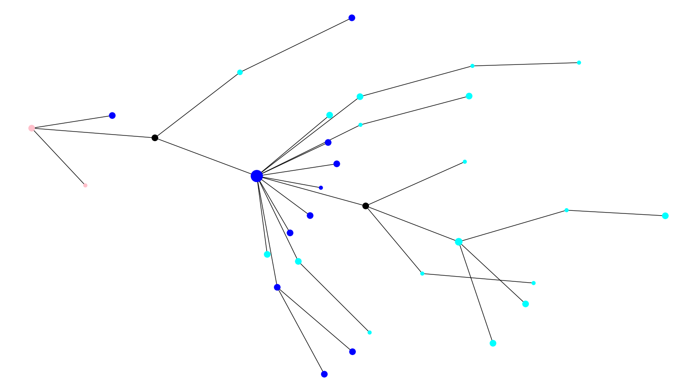
Date Cluster 11
July 2020 August / September 2020 October / November 2020

Slide 12
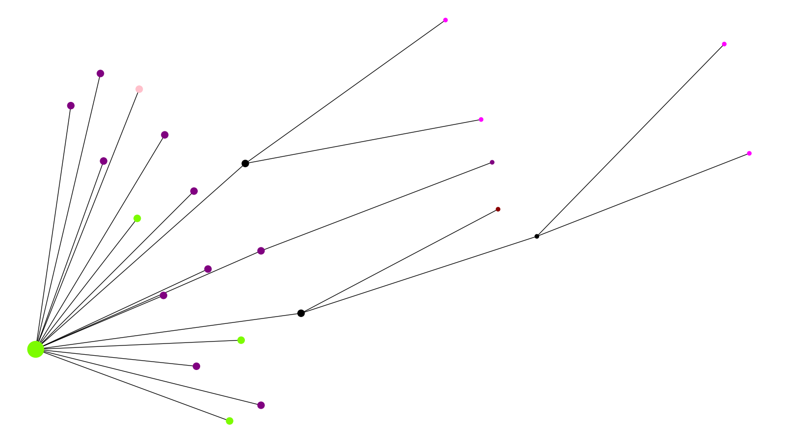
Date Cluster 12
February / March 2020 April 2020 July 2020 December 2020 January / February 2021

Slide 13
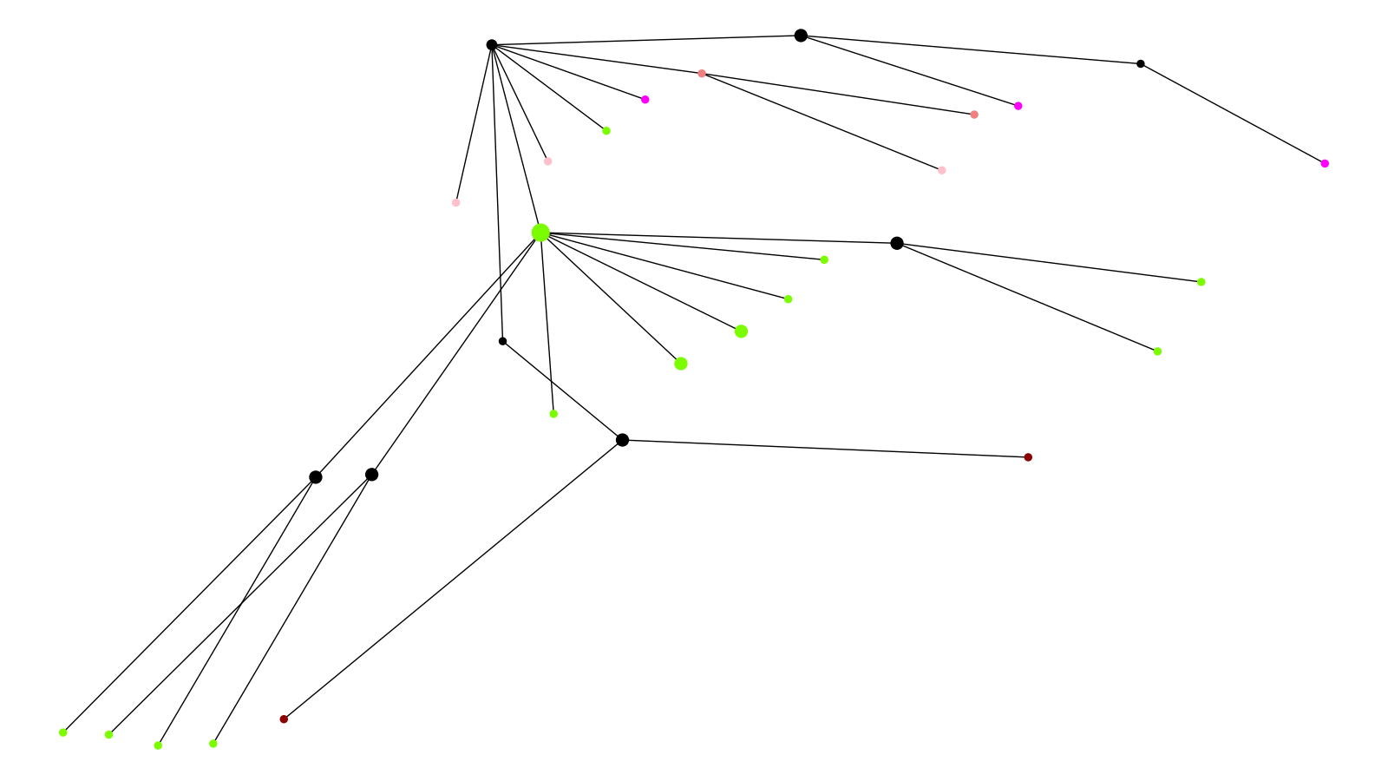
Date Cluster 13
April 2020 May / June 2020 July 2020 January / February 2021

Slide 14
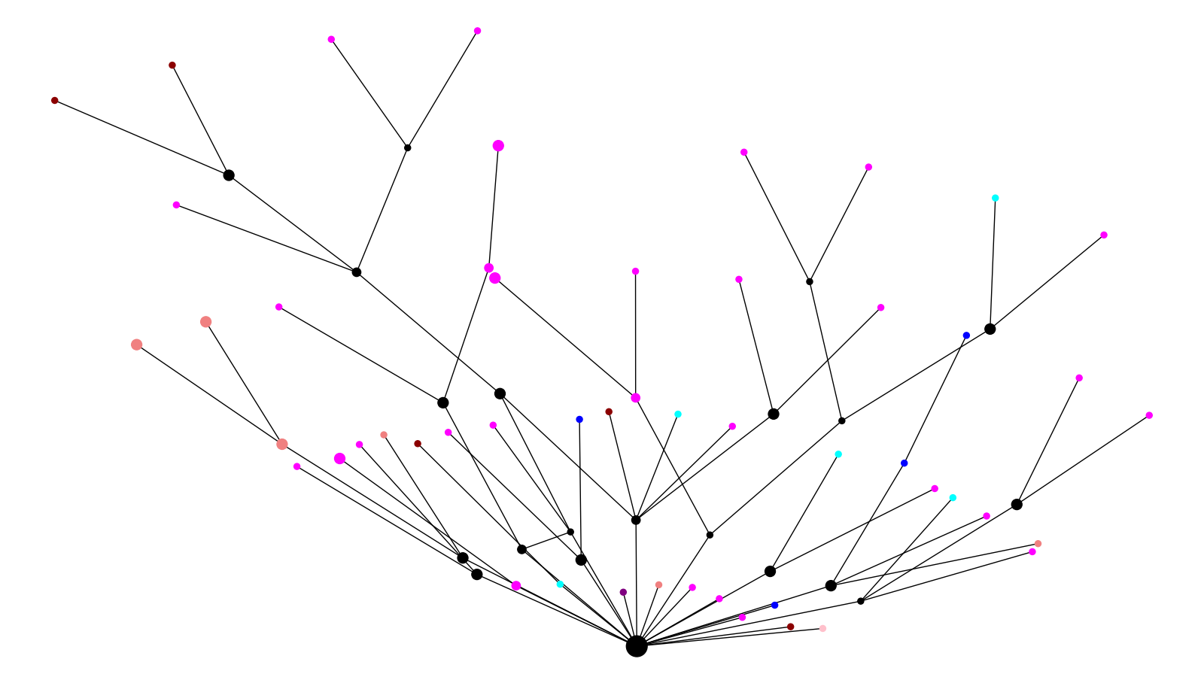
Date Cluster 14
May / June 2020 July 2020 August / September 2020 October / November 2020 December 2020 January / February 2021

Slide 15
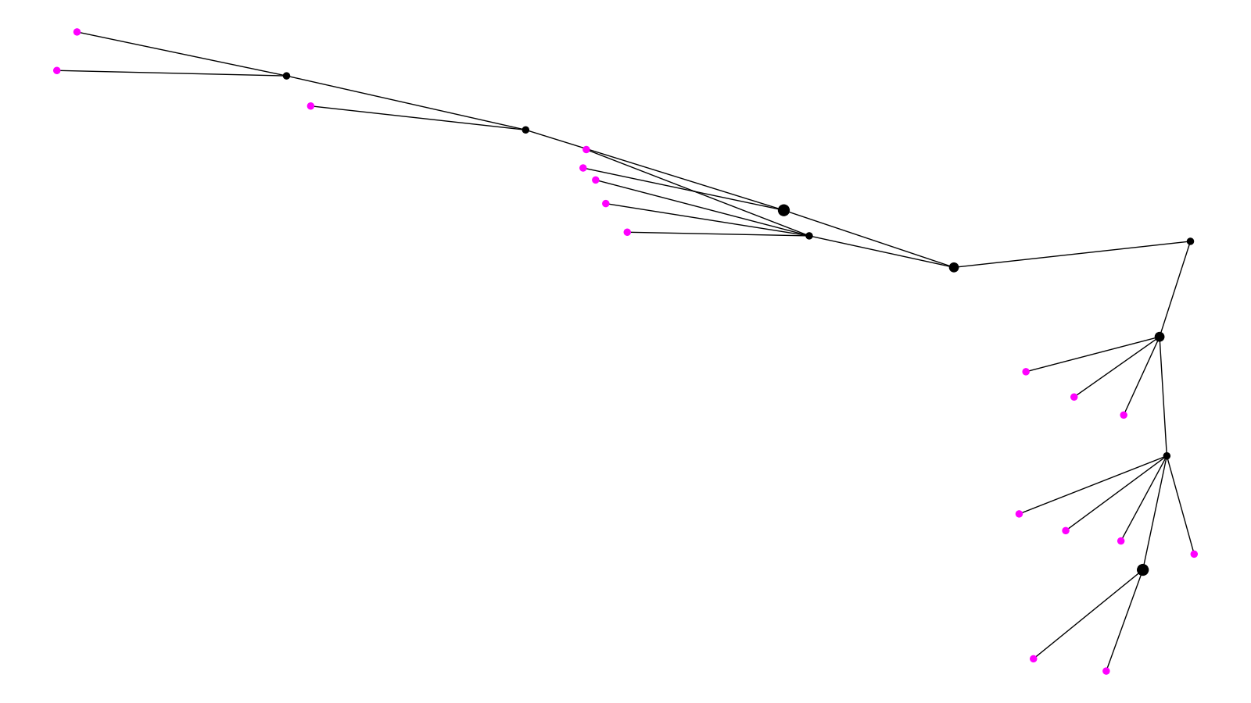
Date Cluster 15
December 2020

