Slide 1
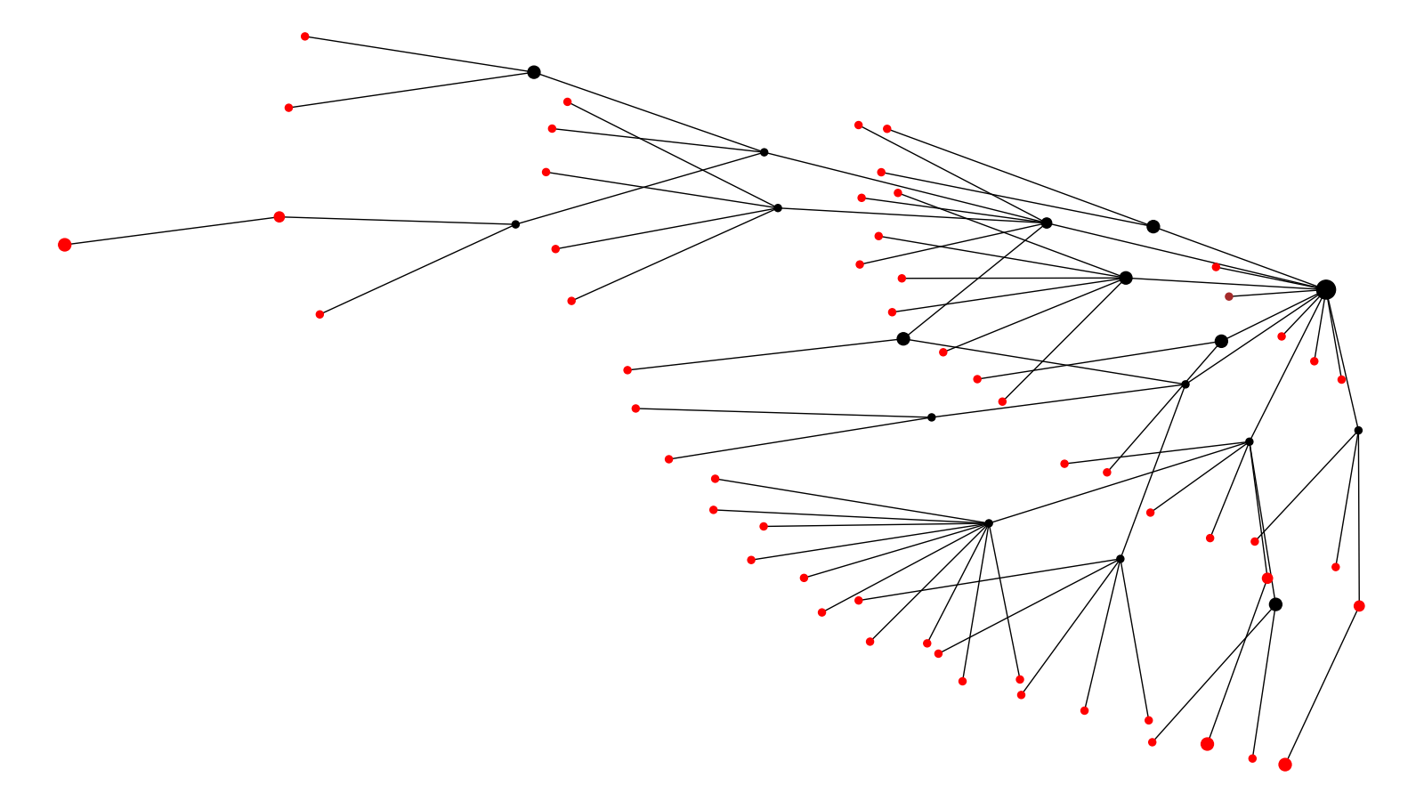
Location Cluster 1
California Texas

Slide 2
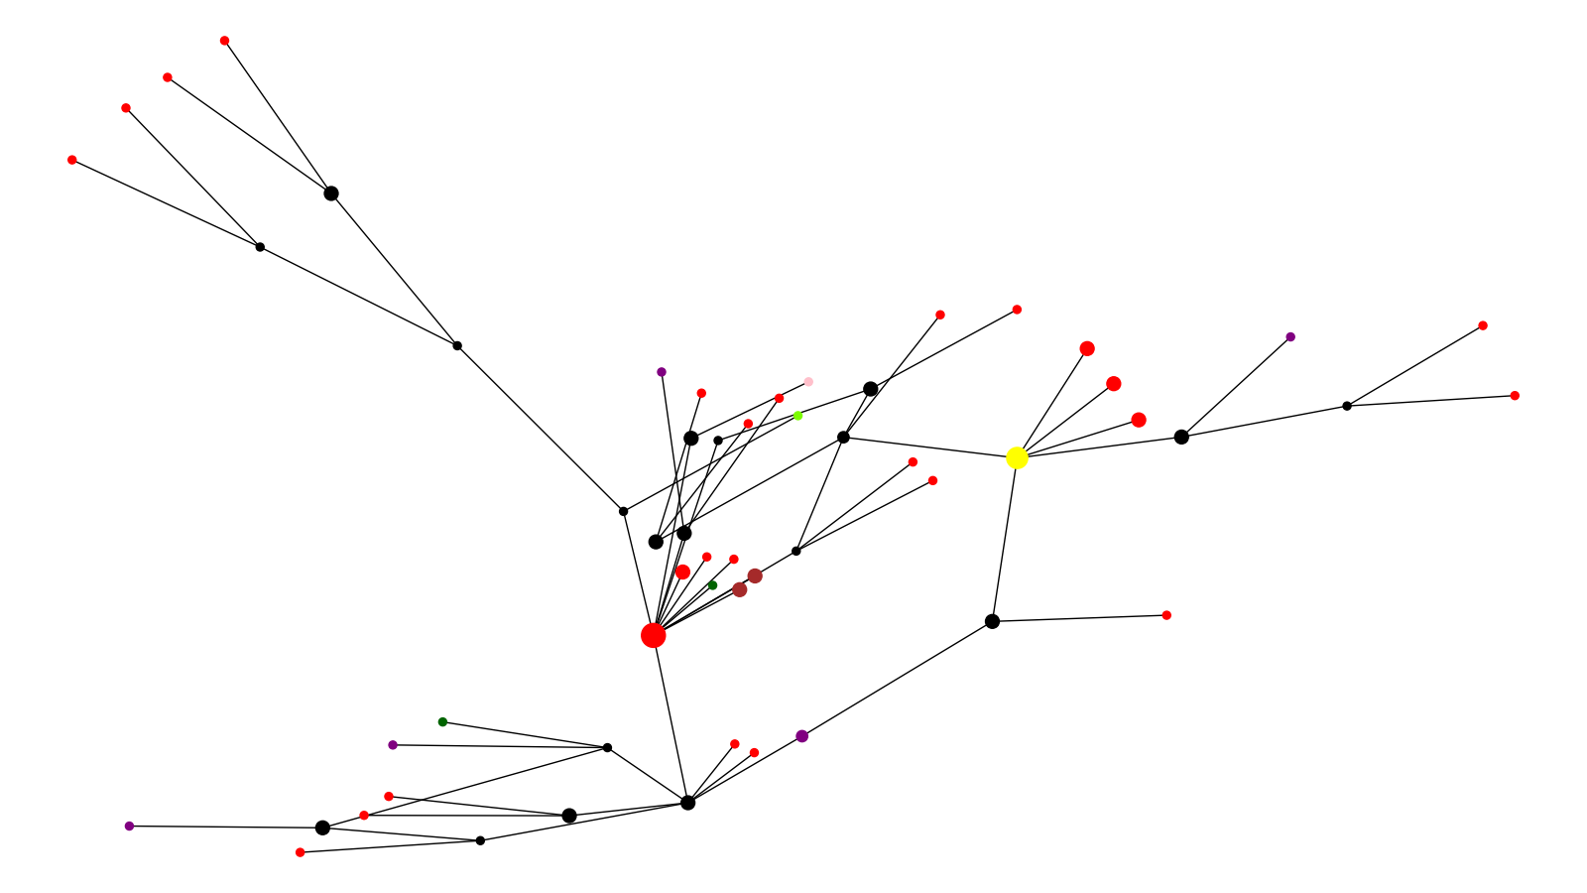
Location Cluster 2
California Montana New York Puerto Rico Texas Reference

Slide 3
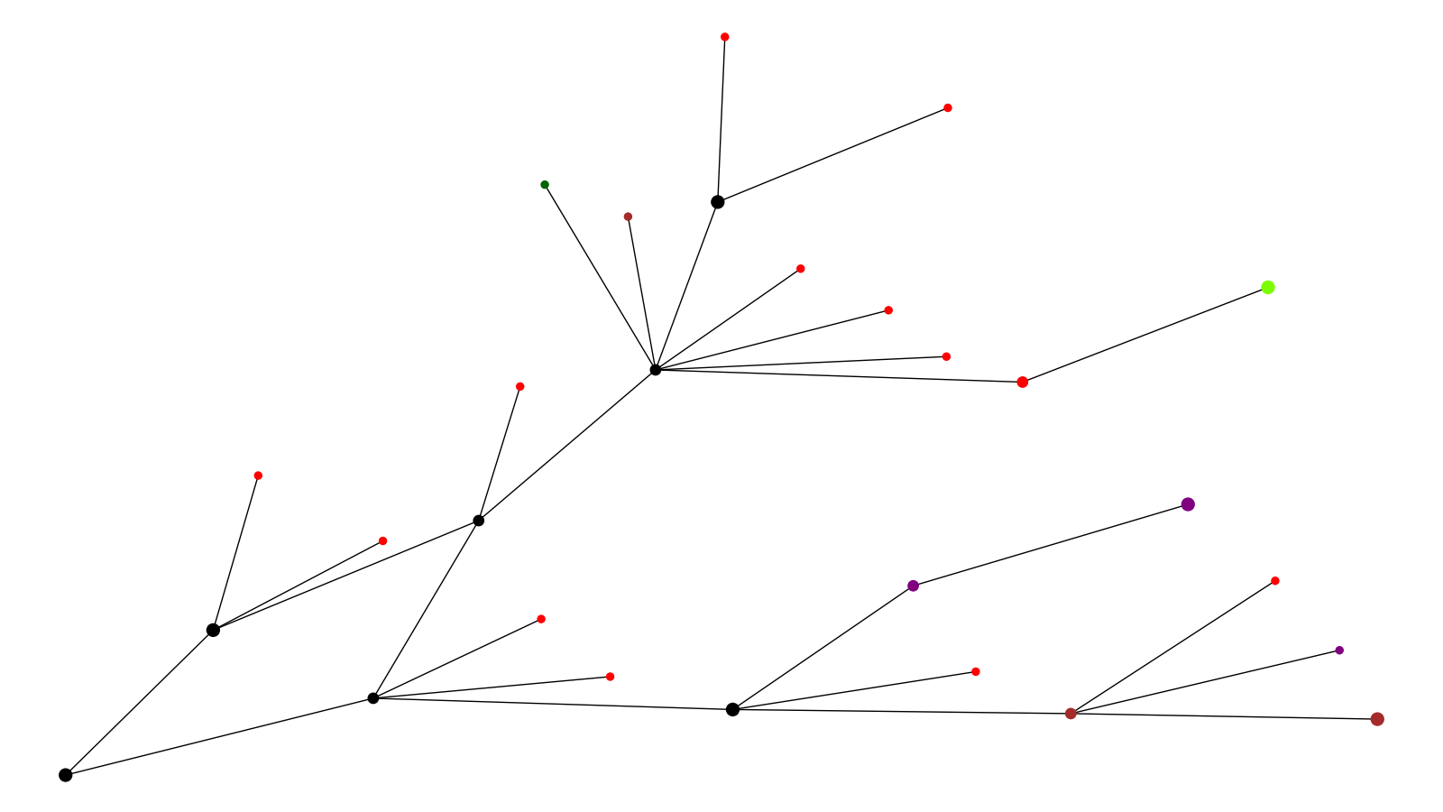
Location Cluster 3
California Montana New York Texas Other

Slide 4
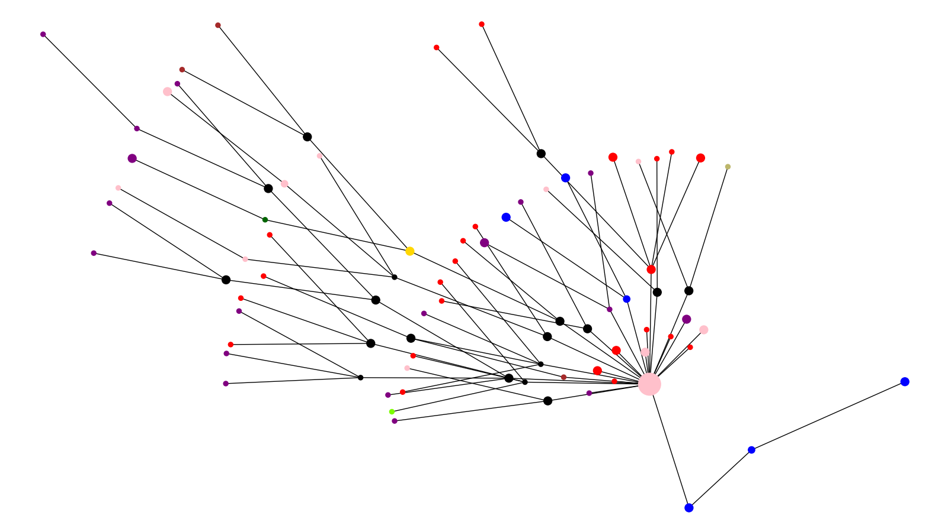
Location Cluster 4
California Montana New York Puerto Rico South Carolina Texas UK Reference Brazil Reference

Slide 5
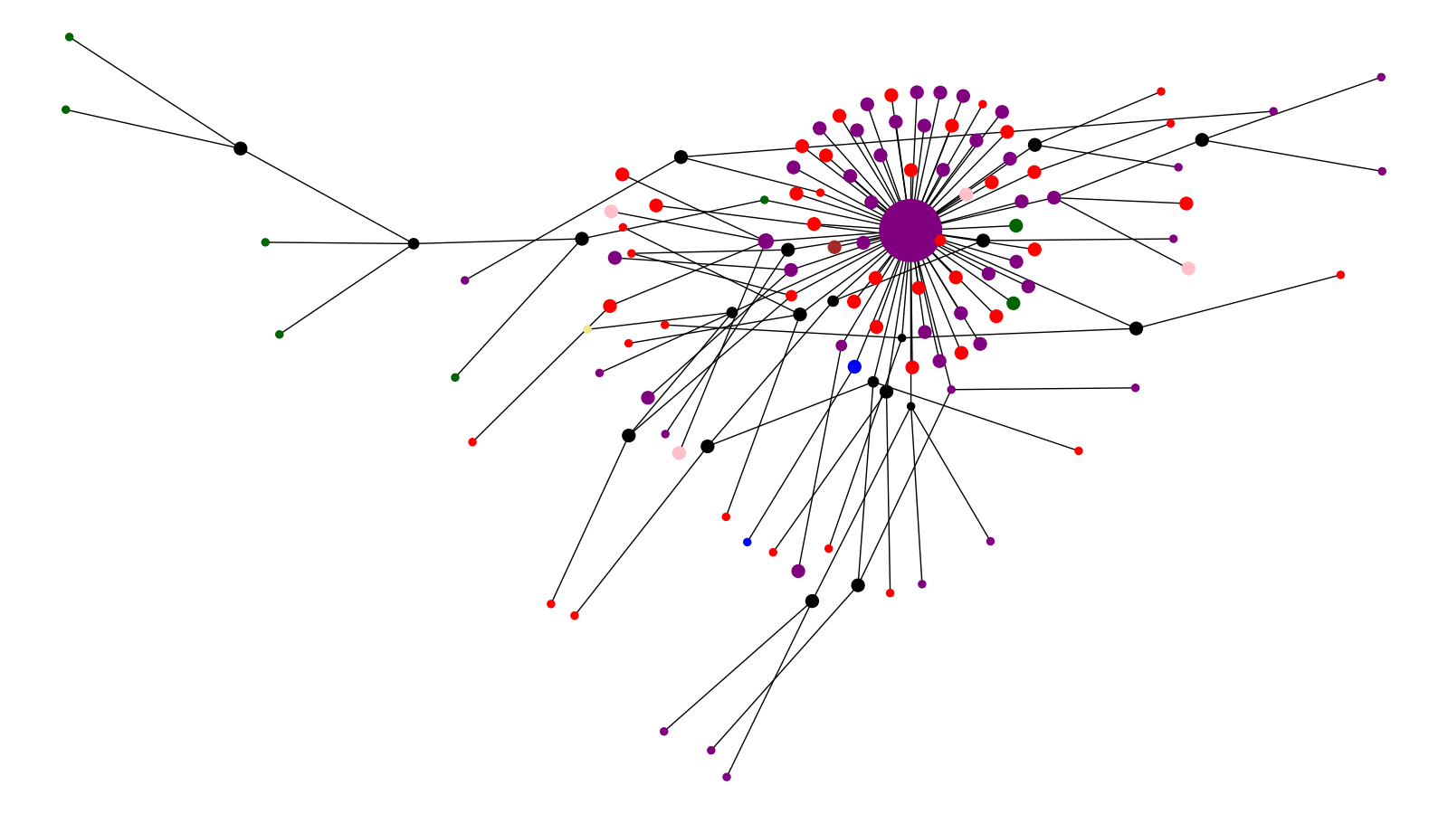
Location Cluster 5
California New York Puerto Rico South Carolina Other South Africa Ref

Slide 6
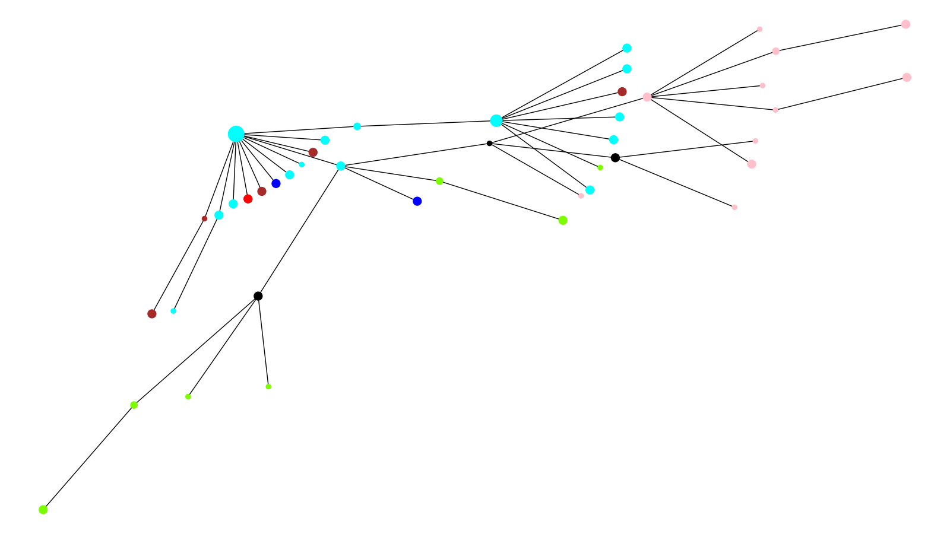
Location Cluster 6
California Montana Puerto Rico South Carolina Louisiana Texas

Slide 7
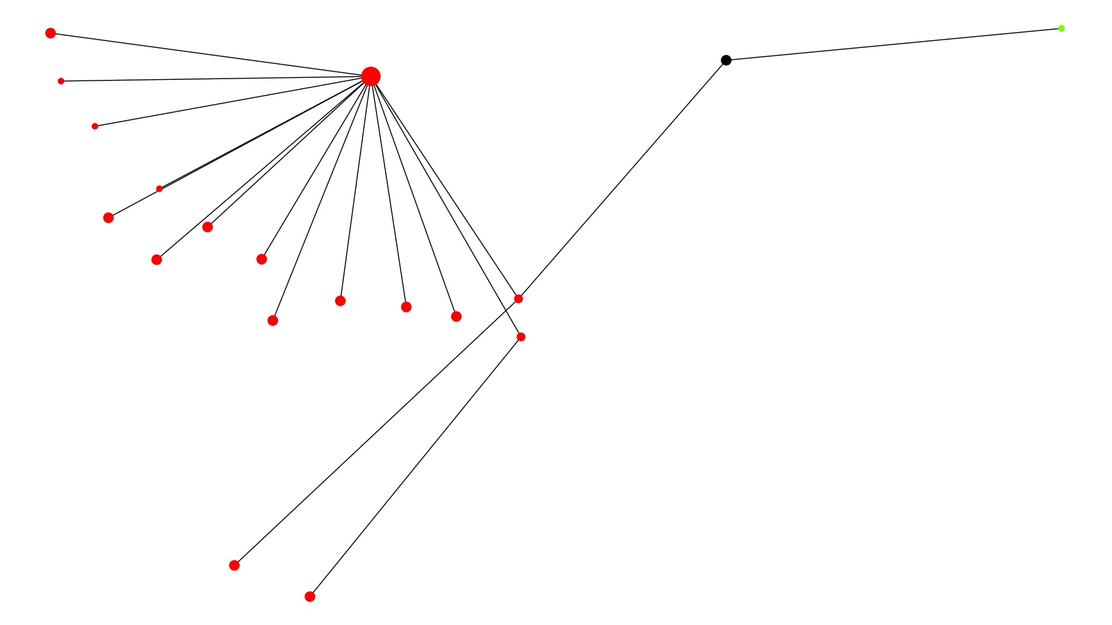
Location Cluster 7
California Montana

Slide 8
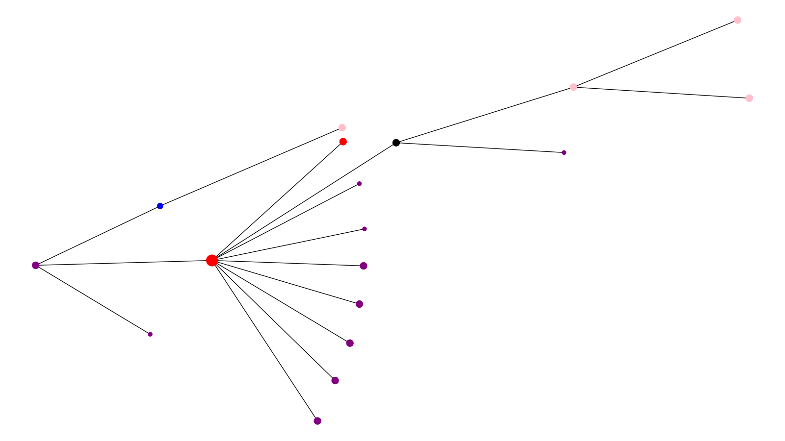
Location Cluster 8
California New York Puerto Rico South Carolina

Slide 9
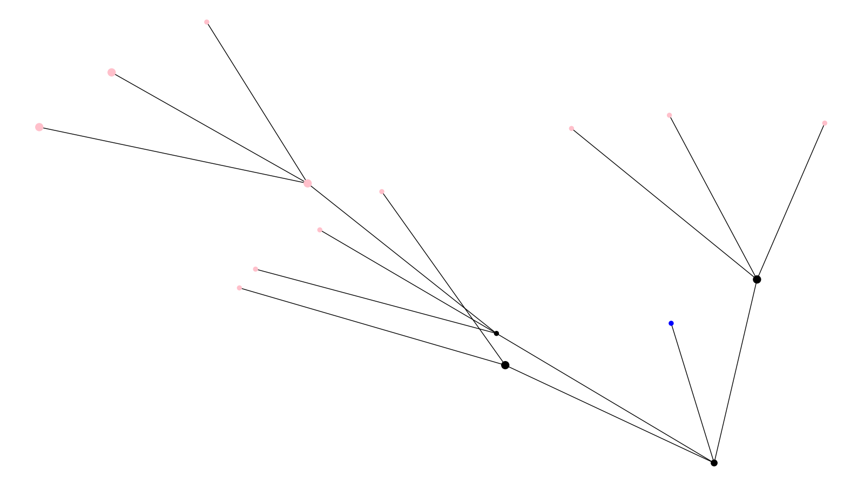
Location Cluster 9
Puerto Rico South Carolina

Slide 10
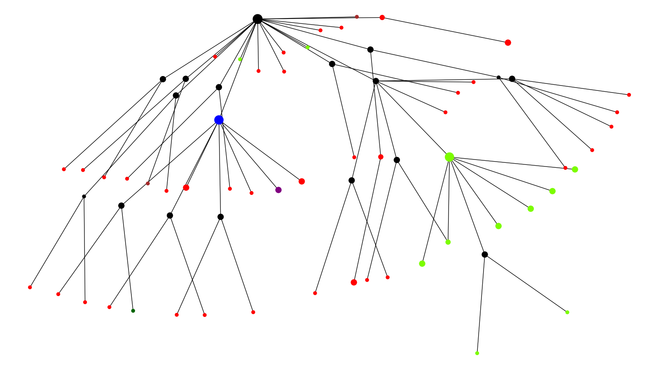
Location Cluster 10
California Montana New York South Carolina Texas

Slide 11
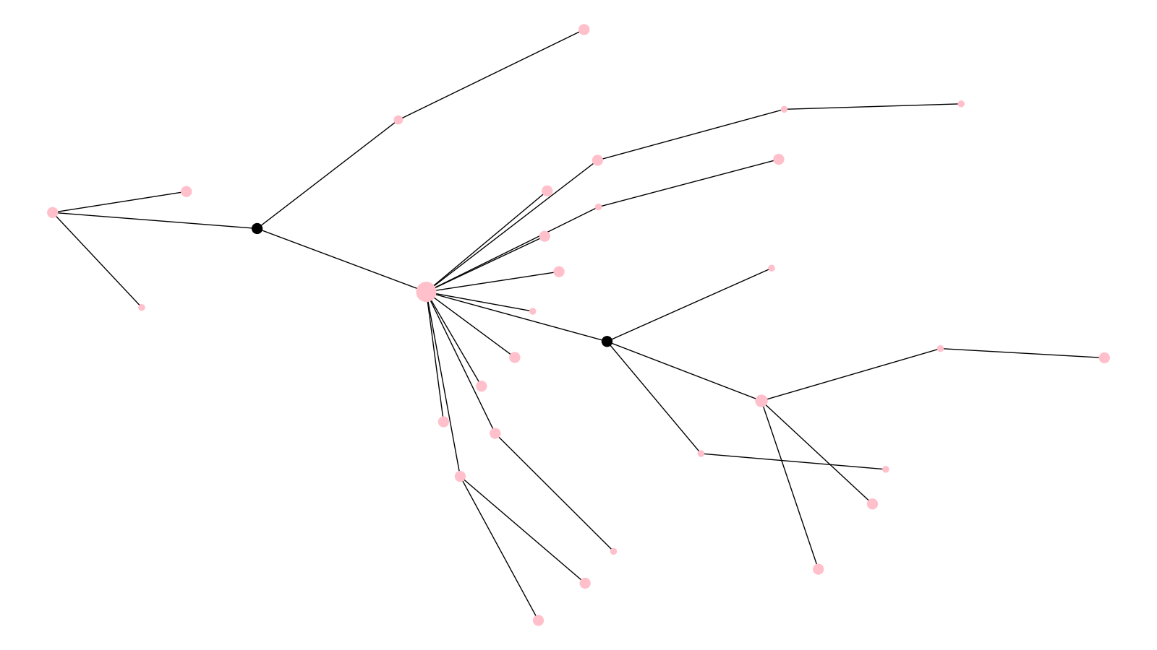
Location Cluster 11
Puerto Rico

Slide 12
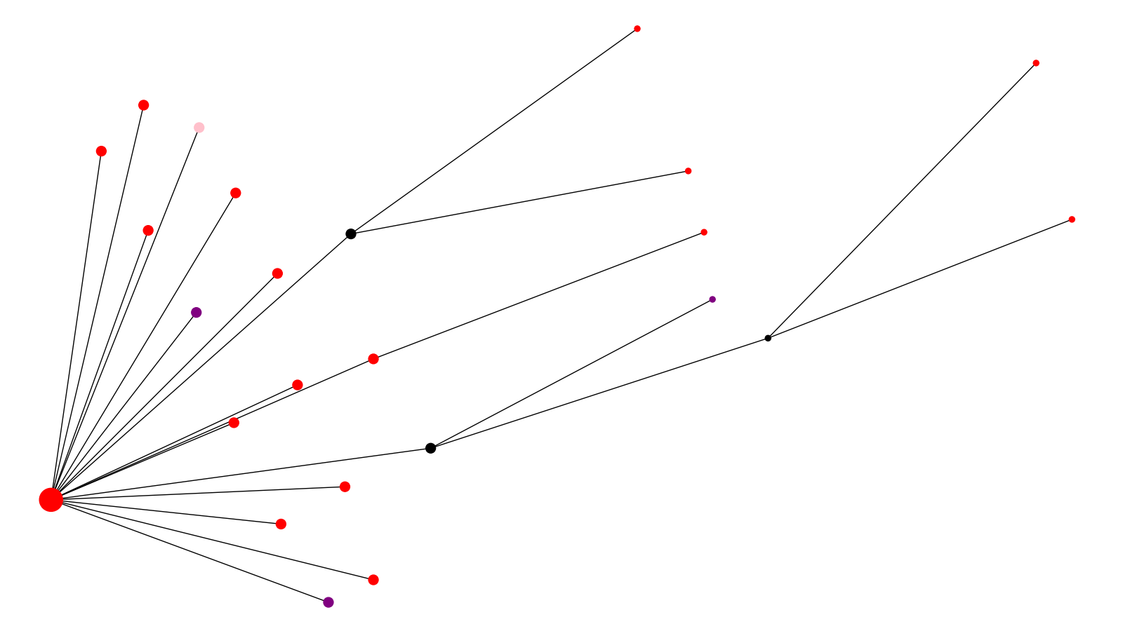
Location Cluster 12
California New York Puerto Rico

Slide 13
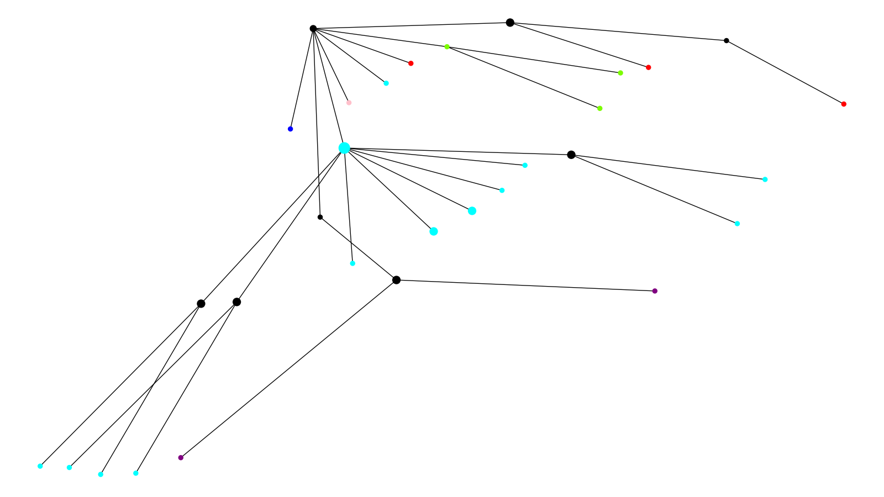
Location Cluster 13
California Montana Puerto Rico South Carolina Louisiana

Slide 14
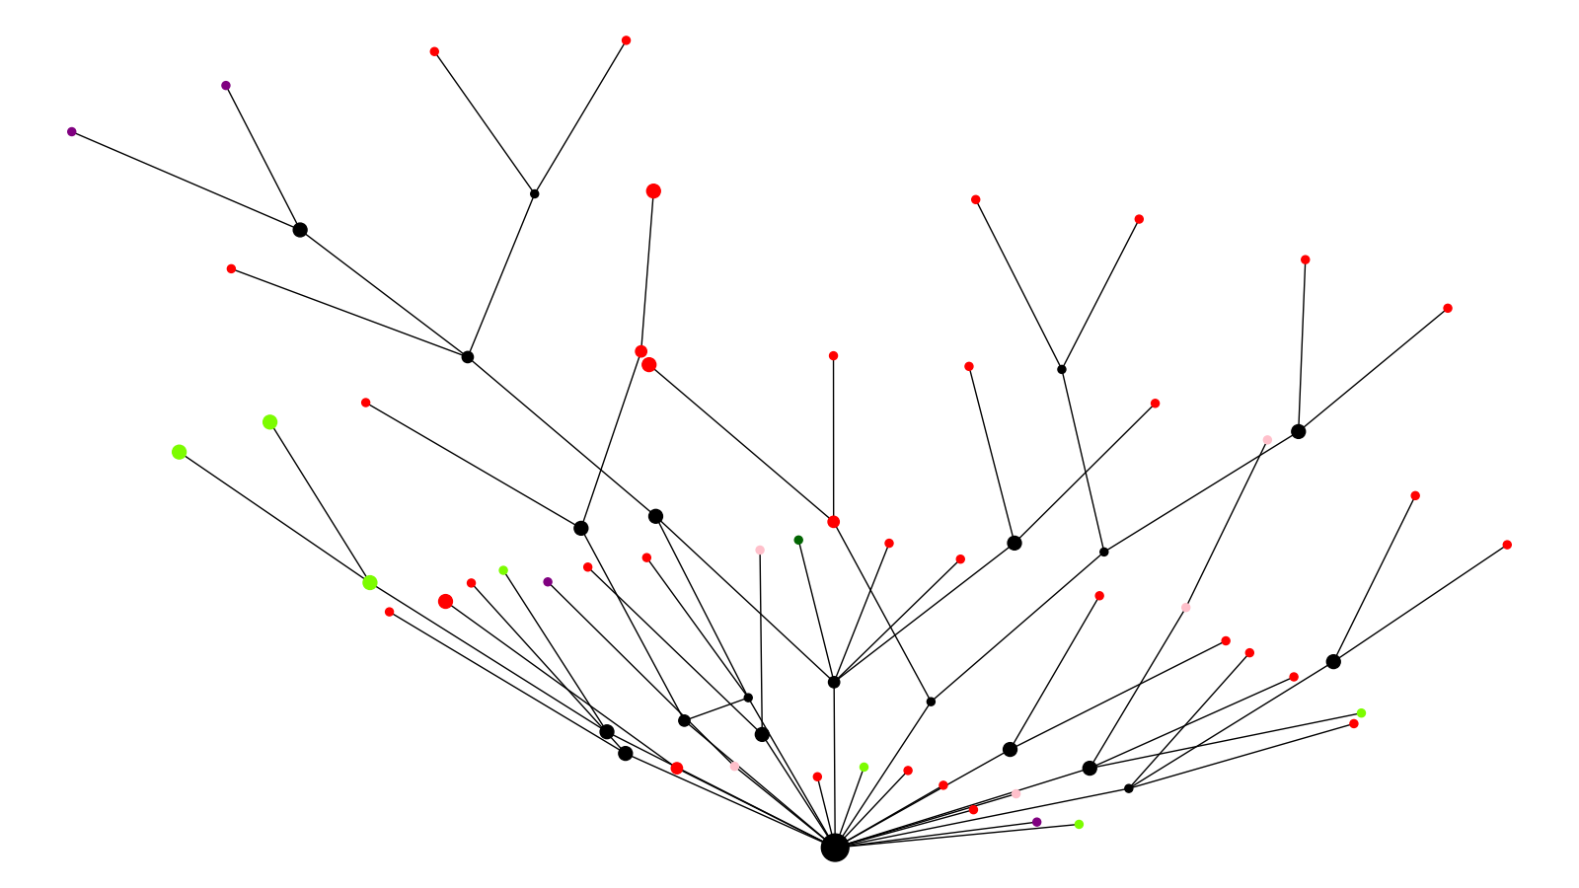
Location Cluster 14
California Montana New York Puerto Rico Other

Slide 15
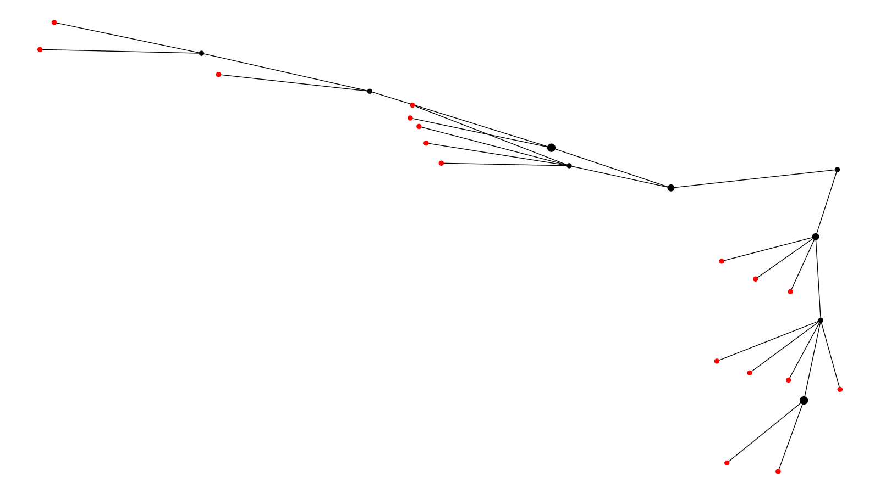
Location Cluster 15
California

