Slide 1
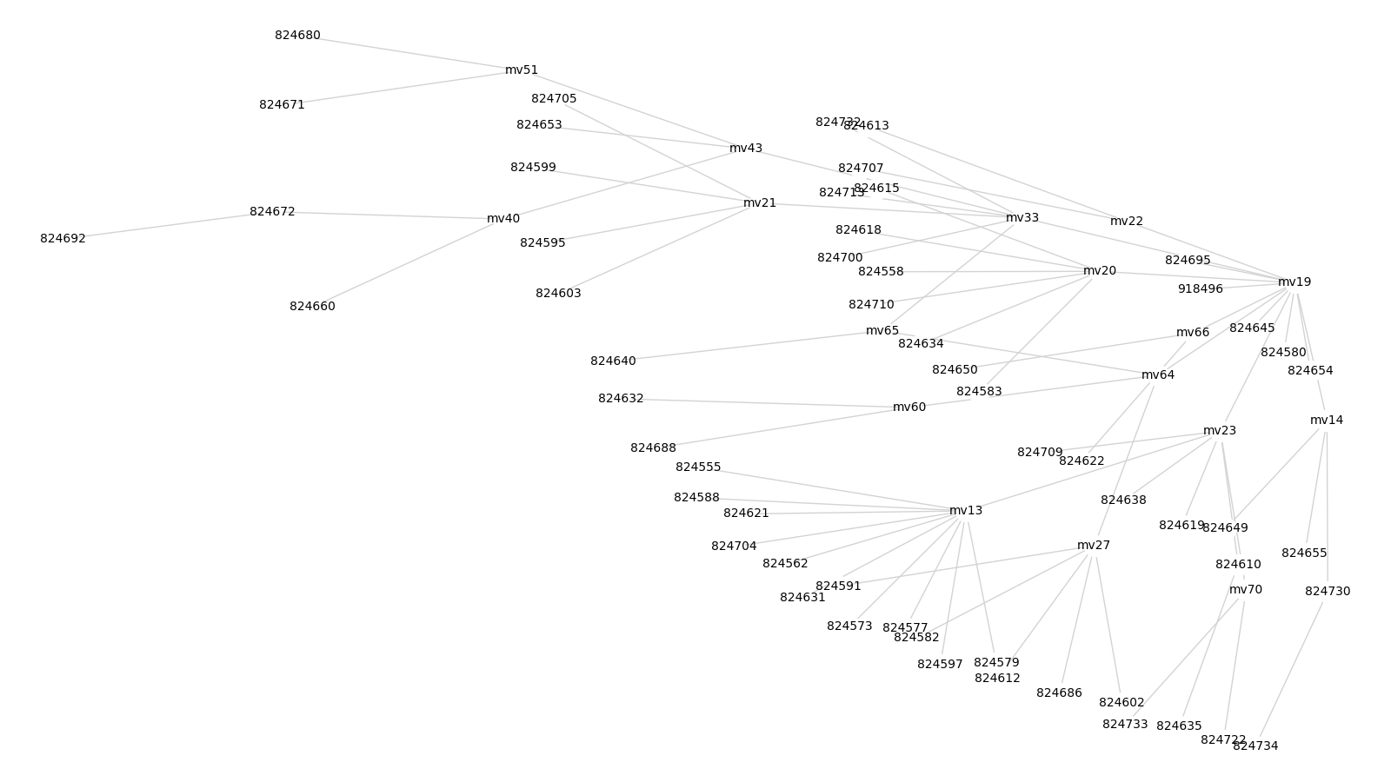
Accession ID Cluster 1

Slide 2
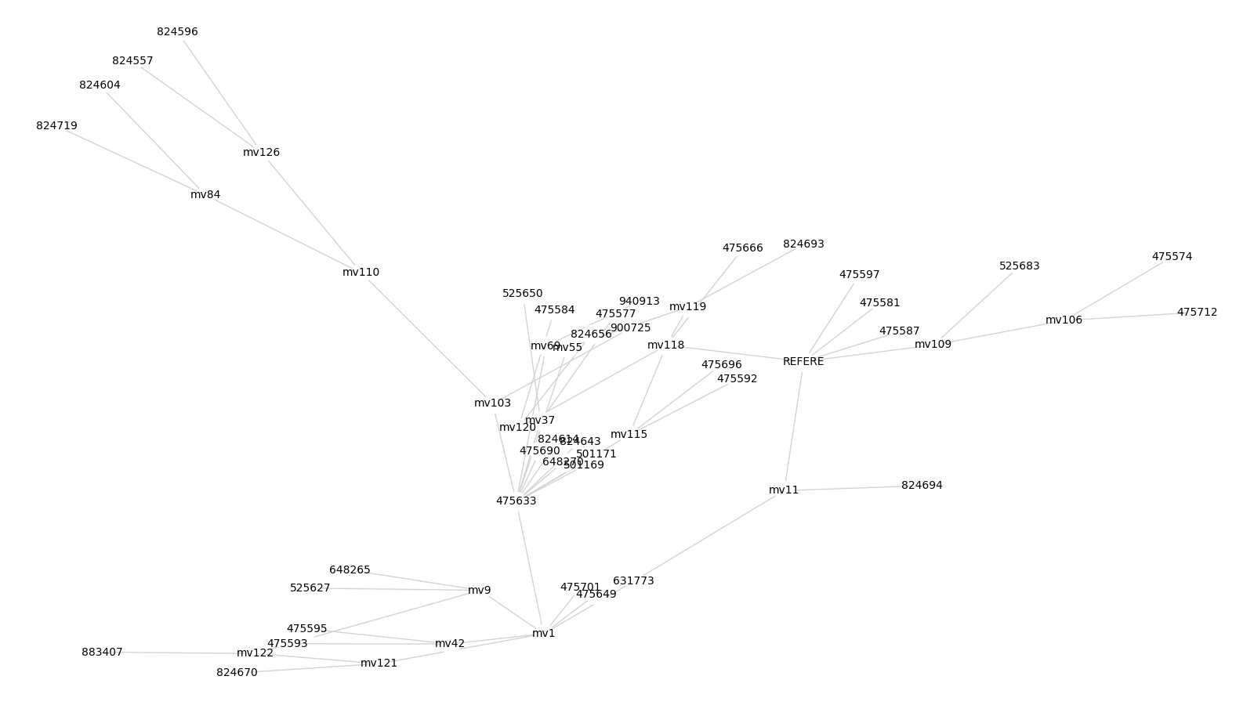
Accession ID Cluster 2

Slide 3
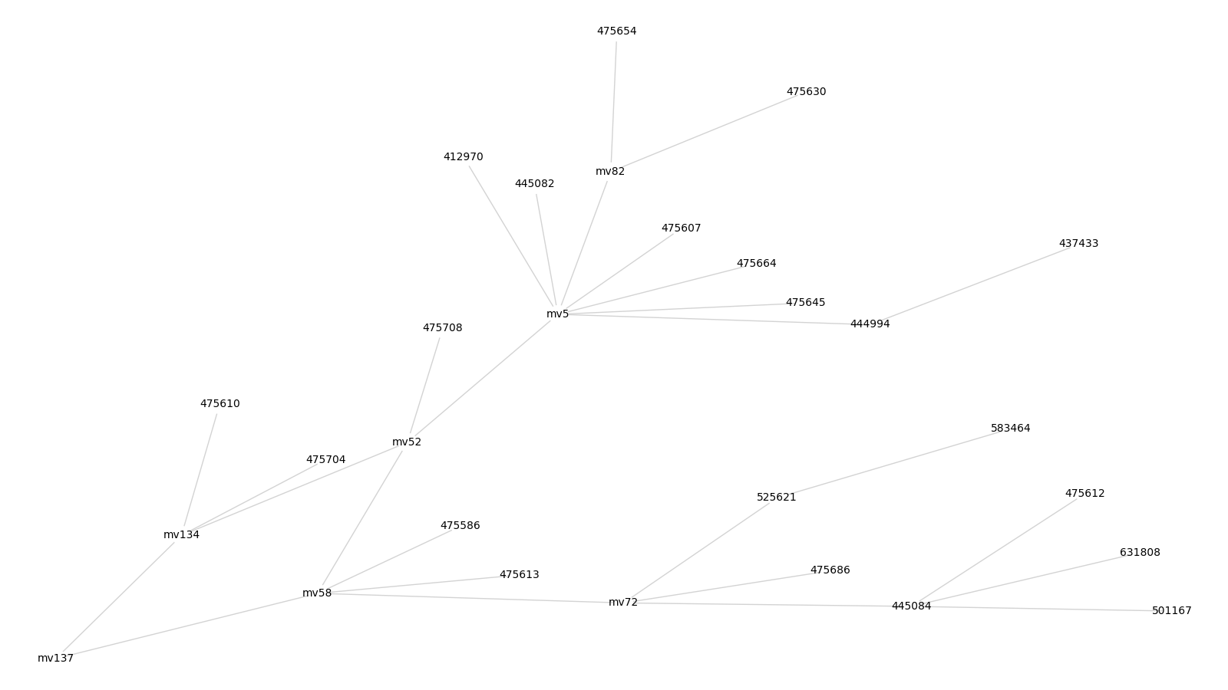
Accession ID Cluster 3

Slide 4
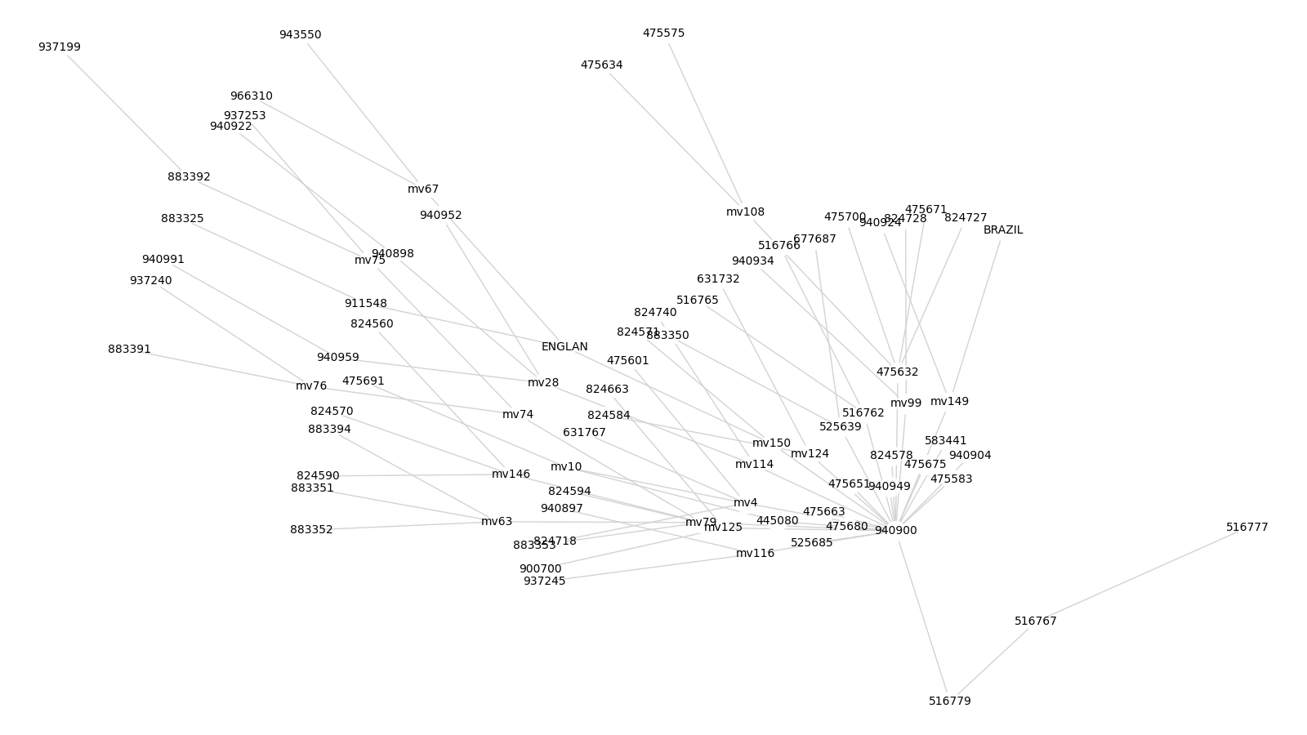
Accession ID Cluster 4

Slide 5
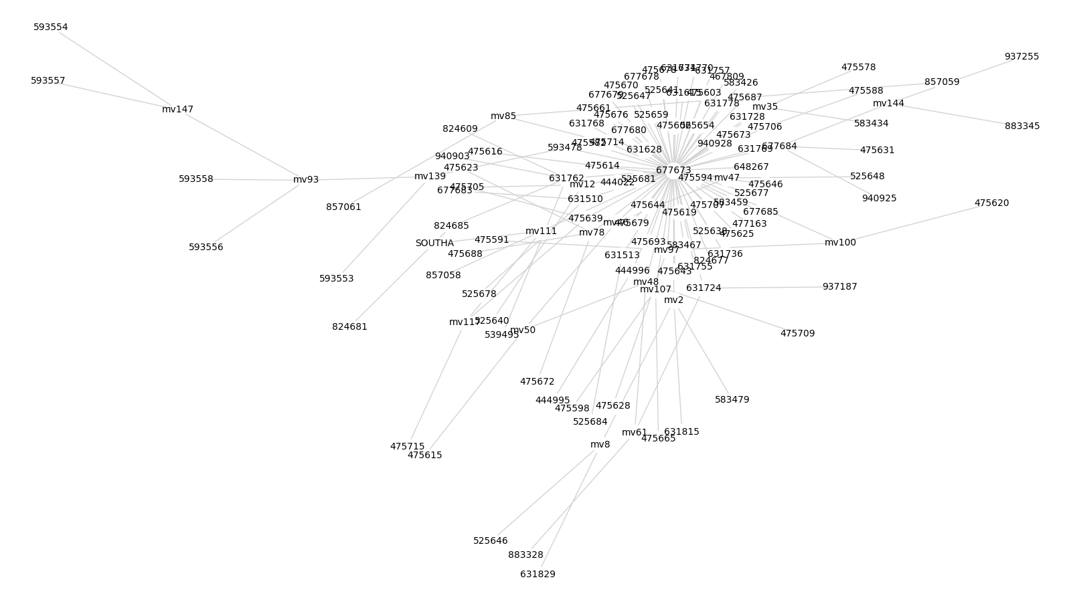
Accession ID Cluster 5

Slide 6
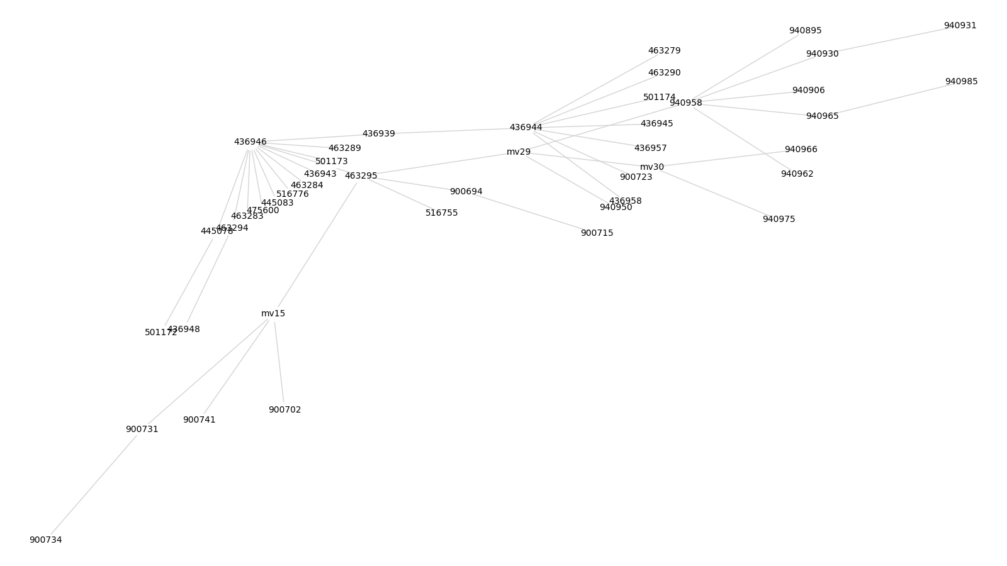
Accession ID Cluster 6

Slide 7
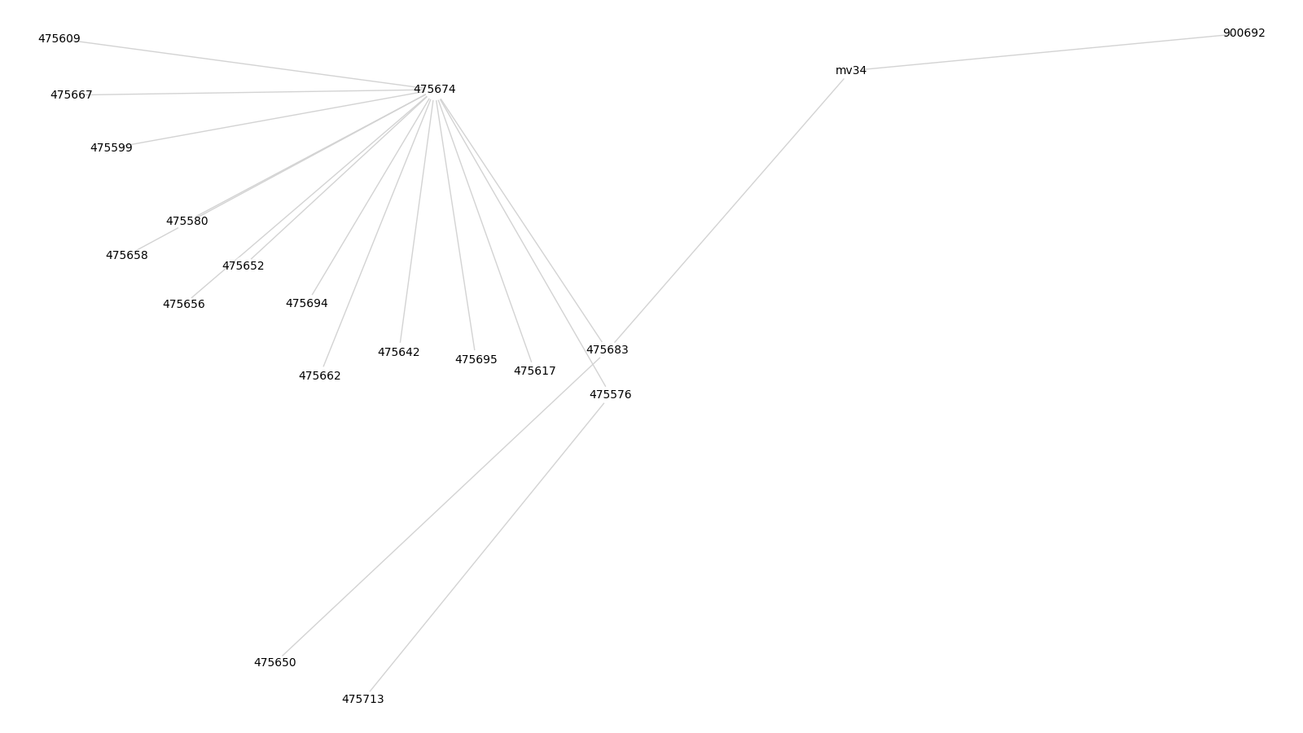
Accession ID Cluster 7

Slide 8
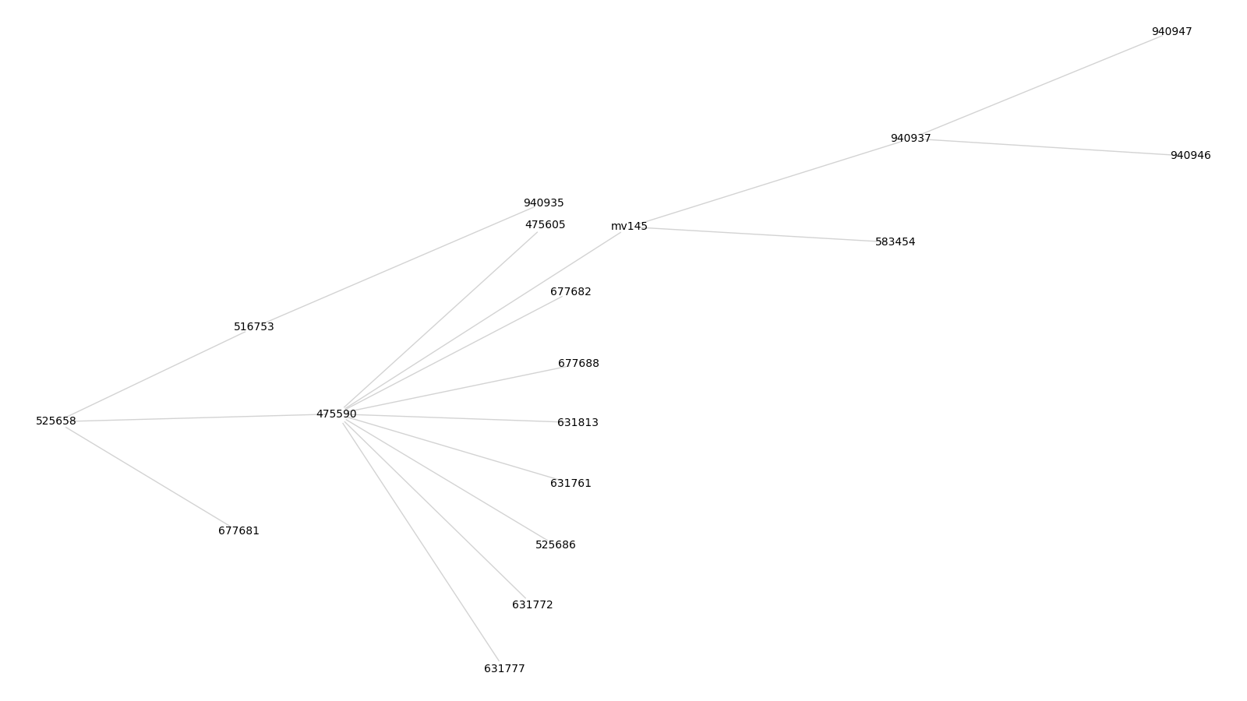
Accession ID Cluster 8

Slide 9
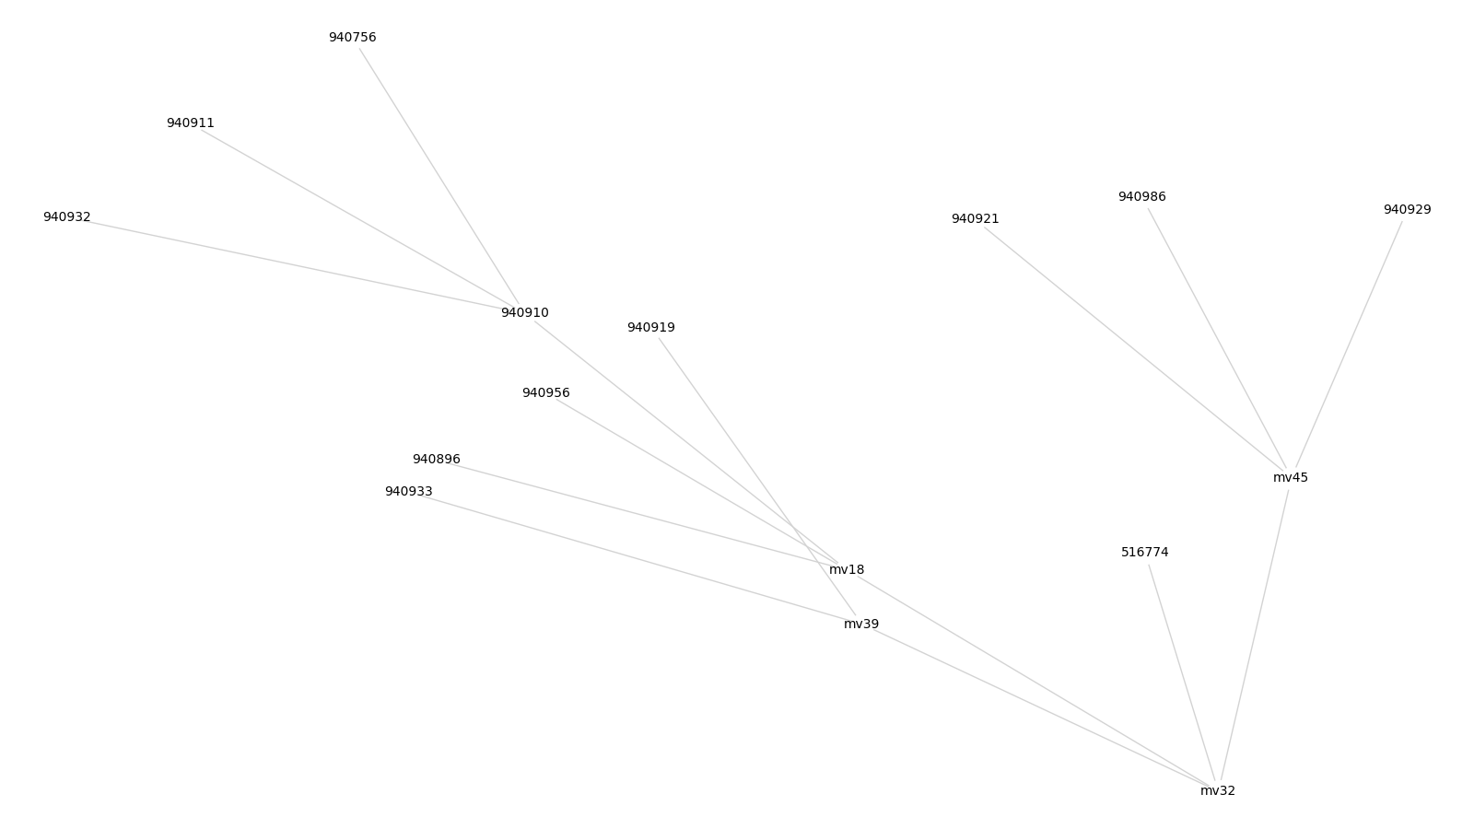
Accession ID Cluster 9

Slide 10
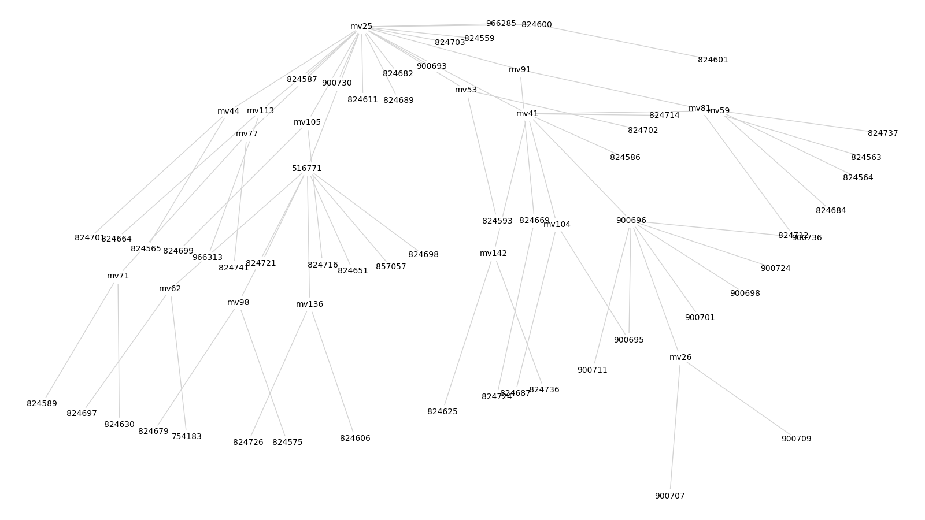
Accession ID Cluster 10

Slide 11
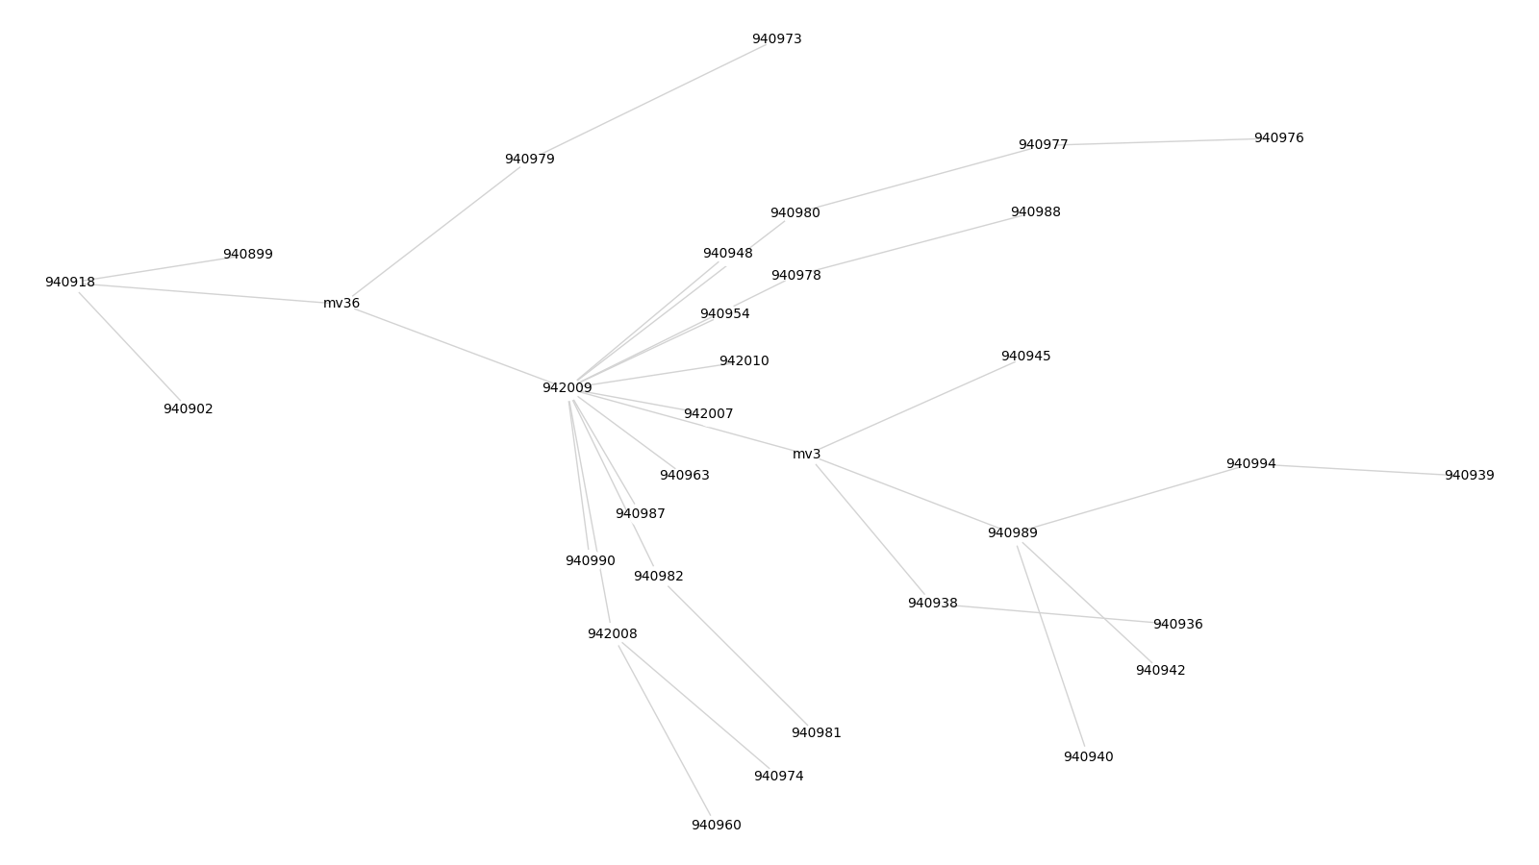
Accession ID Cluster 11

Slide 12
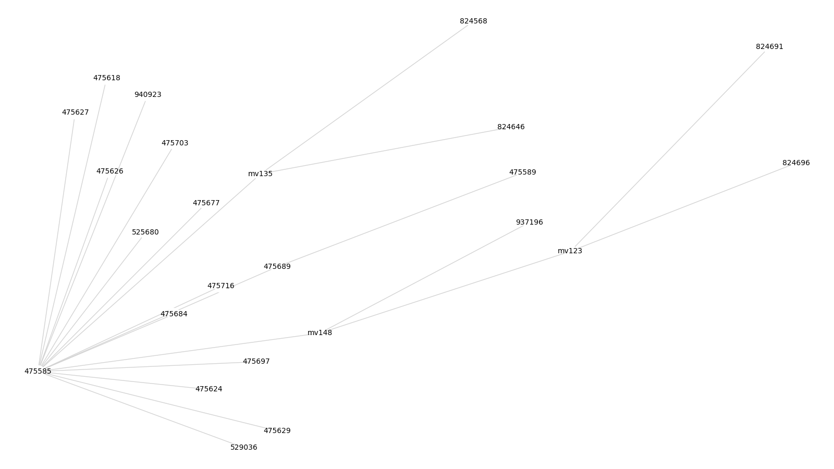
Accession ID Cluster 12

Slide 13
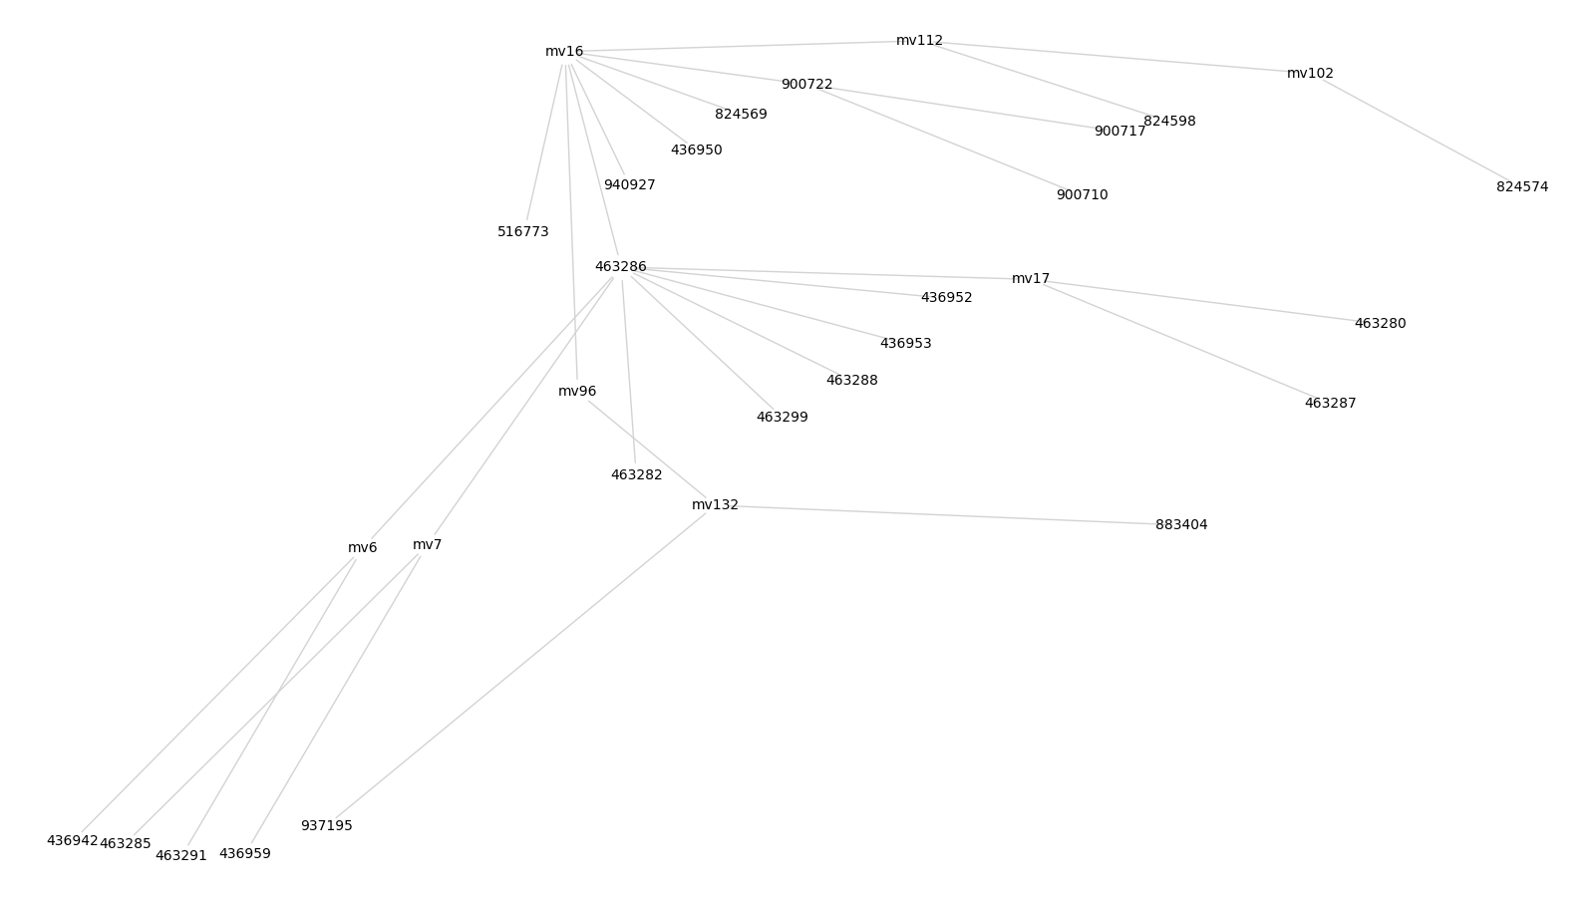
Accession ID Cluster 13

Slide 14
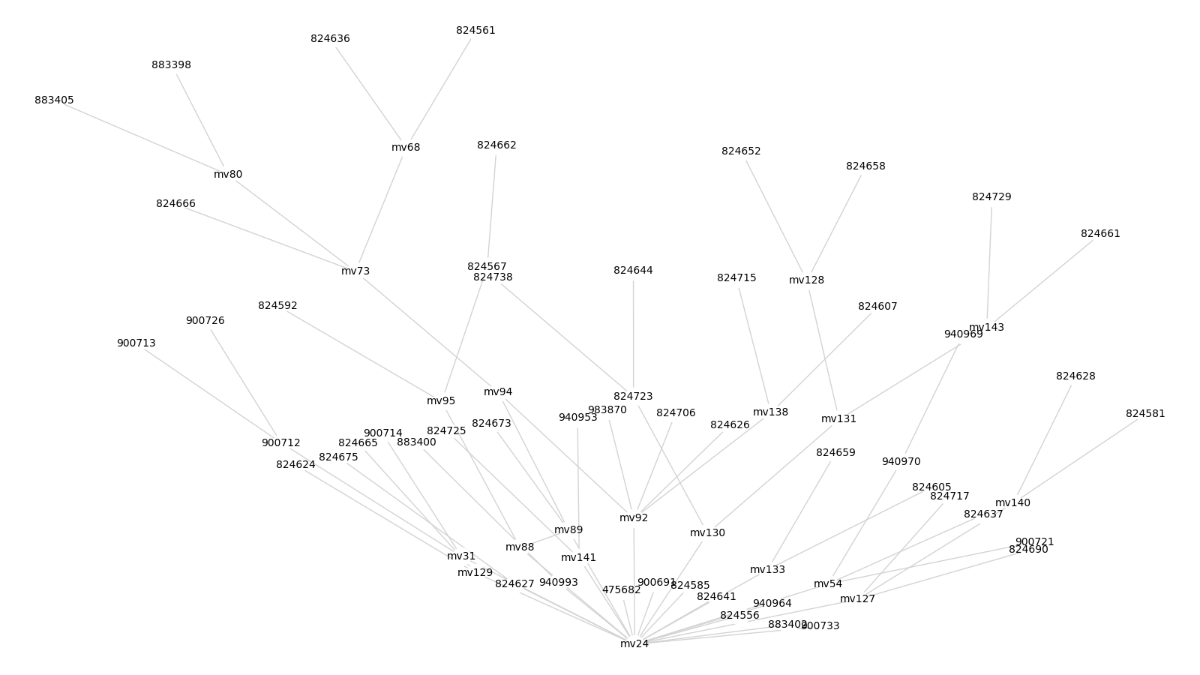
Accession ID Cluster 14

Slide 15
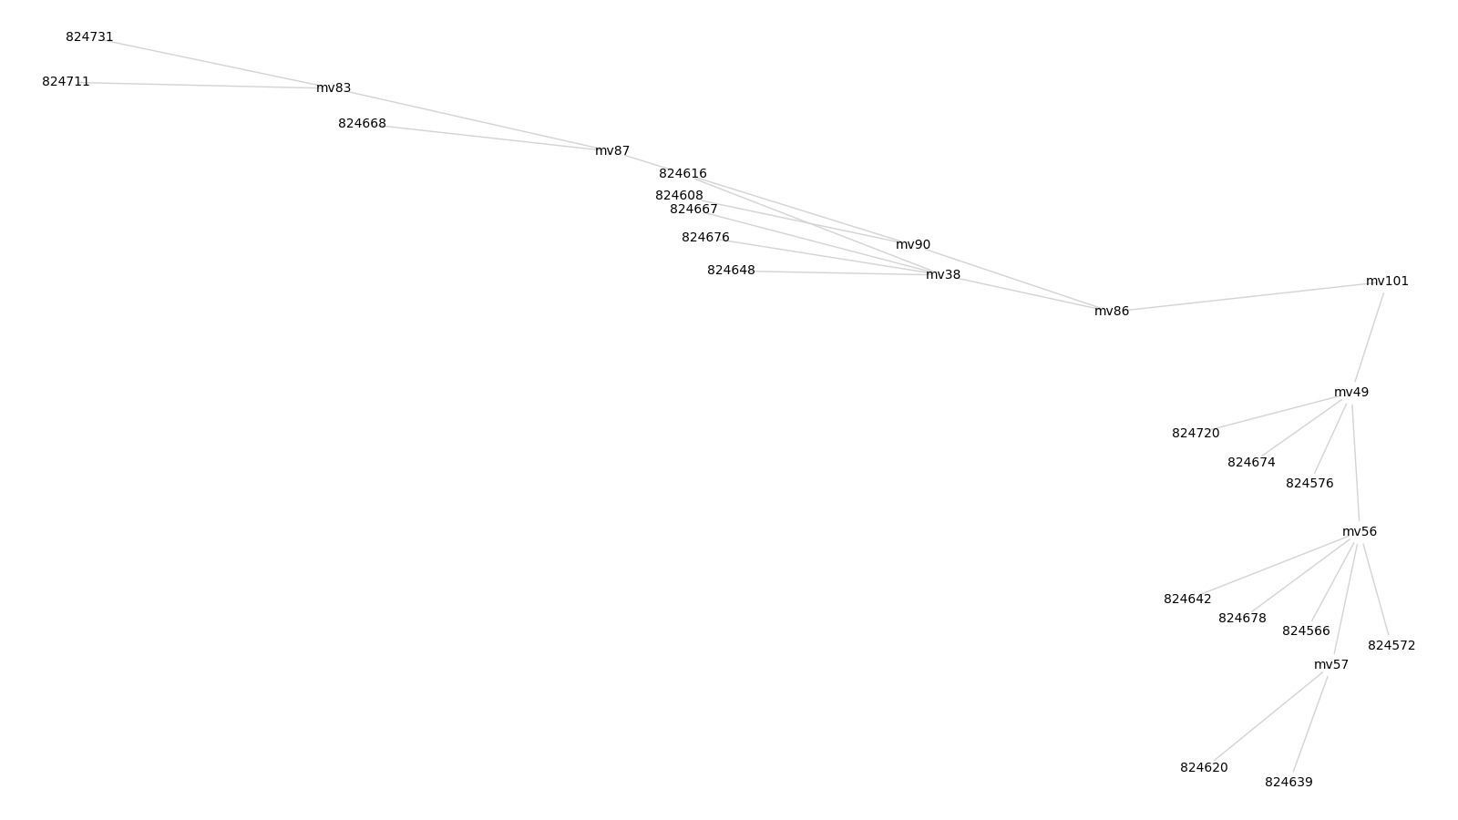
Accession ID Cluster 15

