Slide 1
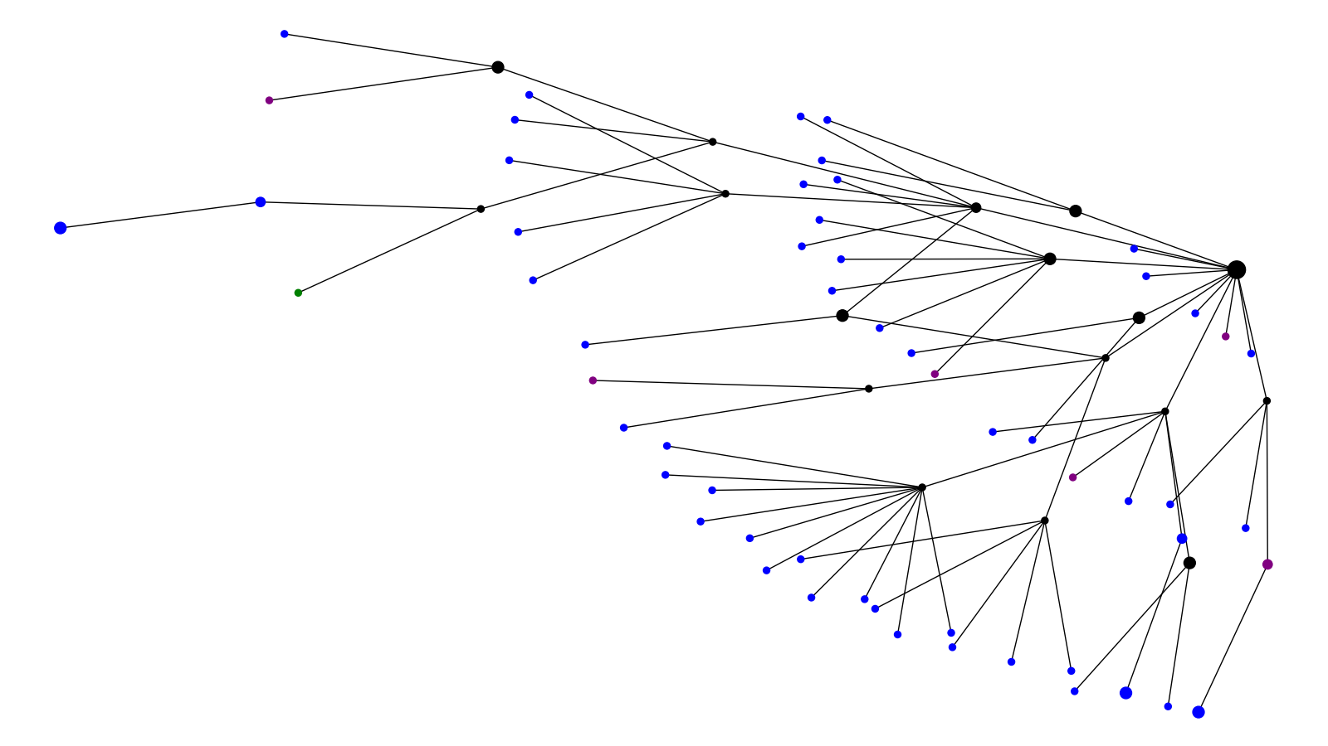
Outcome Cluster 1
Alive Deceased Unknown

Slide 2
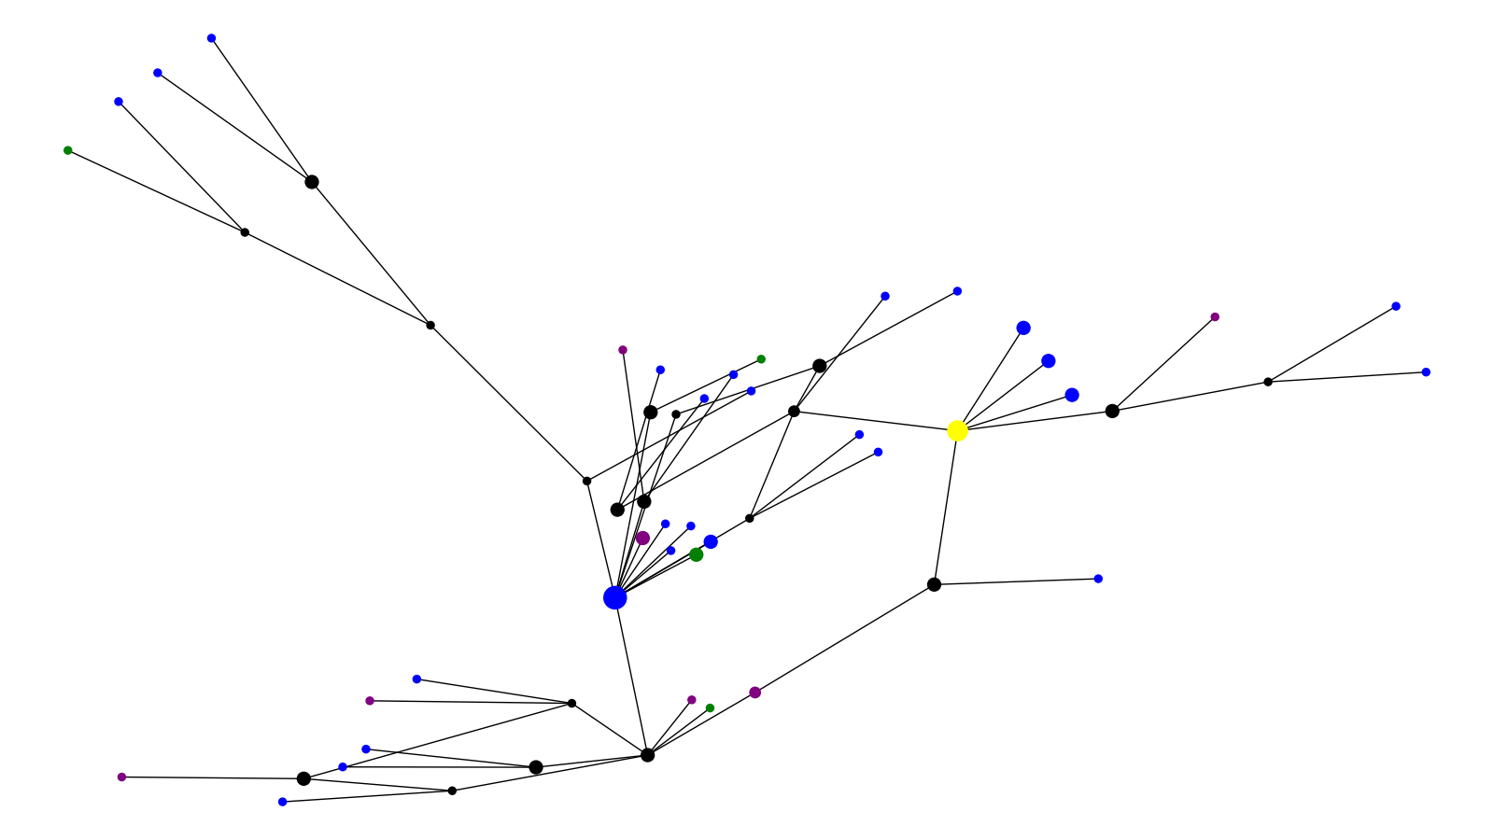
Outcome Cluster 2
Alive Deceased Unknown Reference

Slide 3
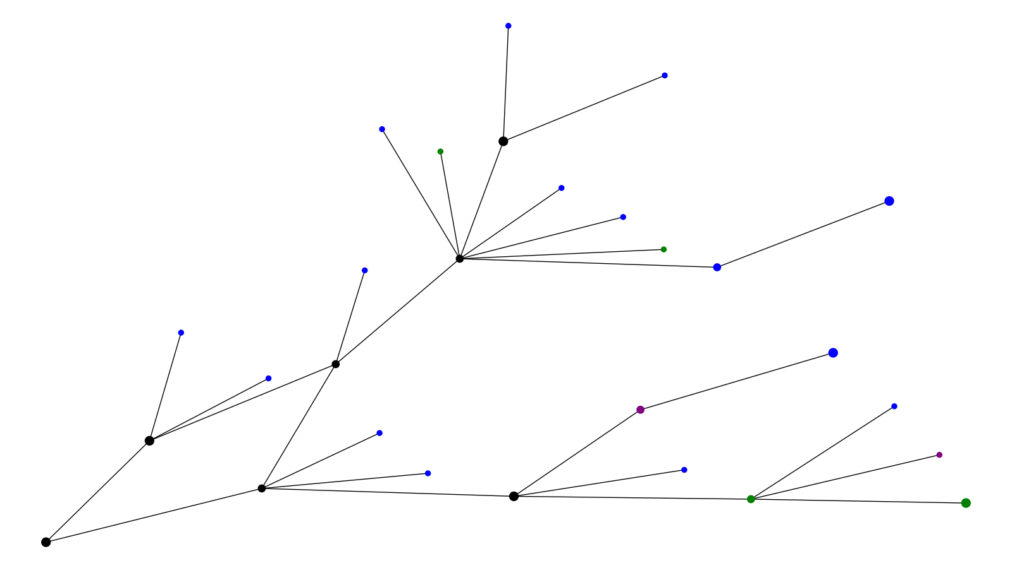
Outcome Cluster 3
Alive Deceased Unknown

Slide 4
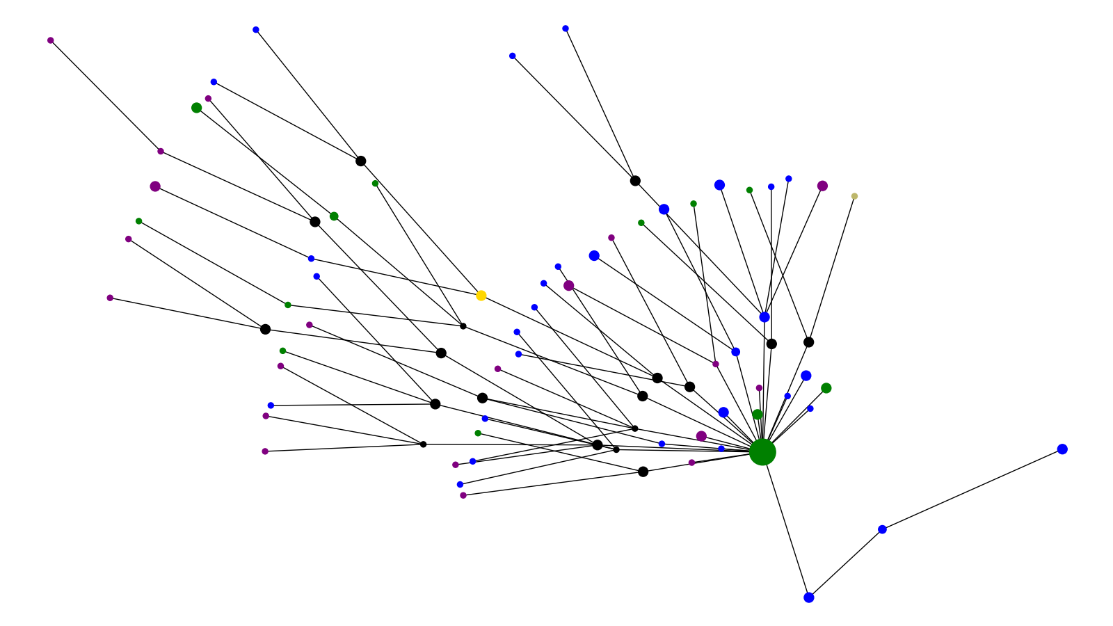
Outcome Cluster 4
Alive Deceased Unknown UK Reference Brazil Reference

Slide 5
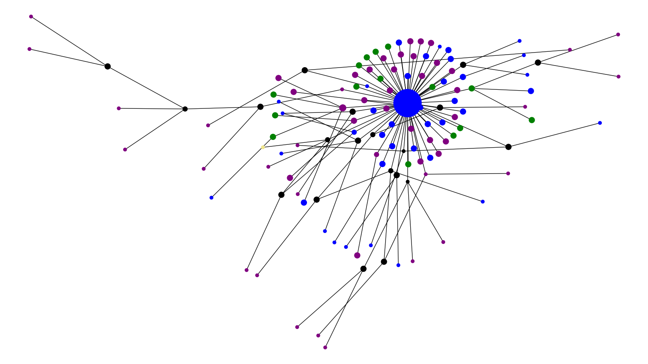
Outcome Cluster 5
Alive Deceased Unknown South Africa Ref

Slide 6
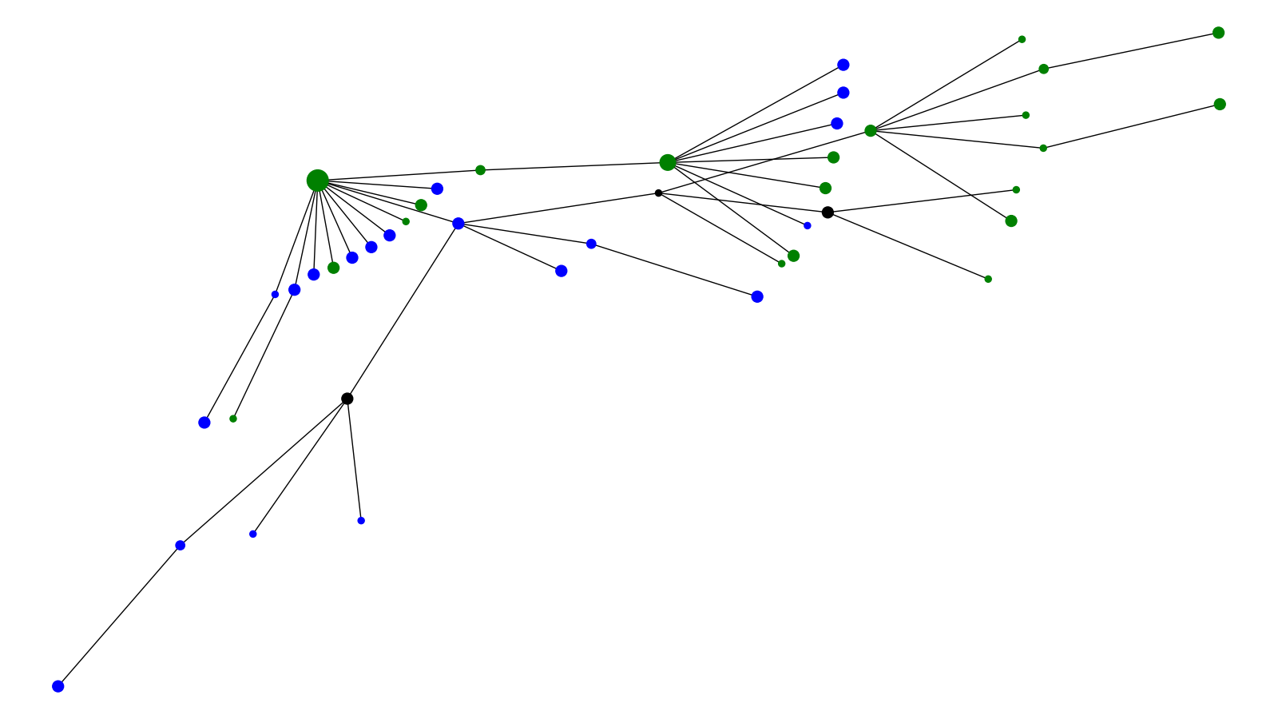
Outcome Cluster 6
Alive Unknown

Slide 7
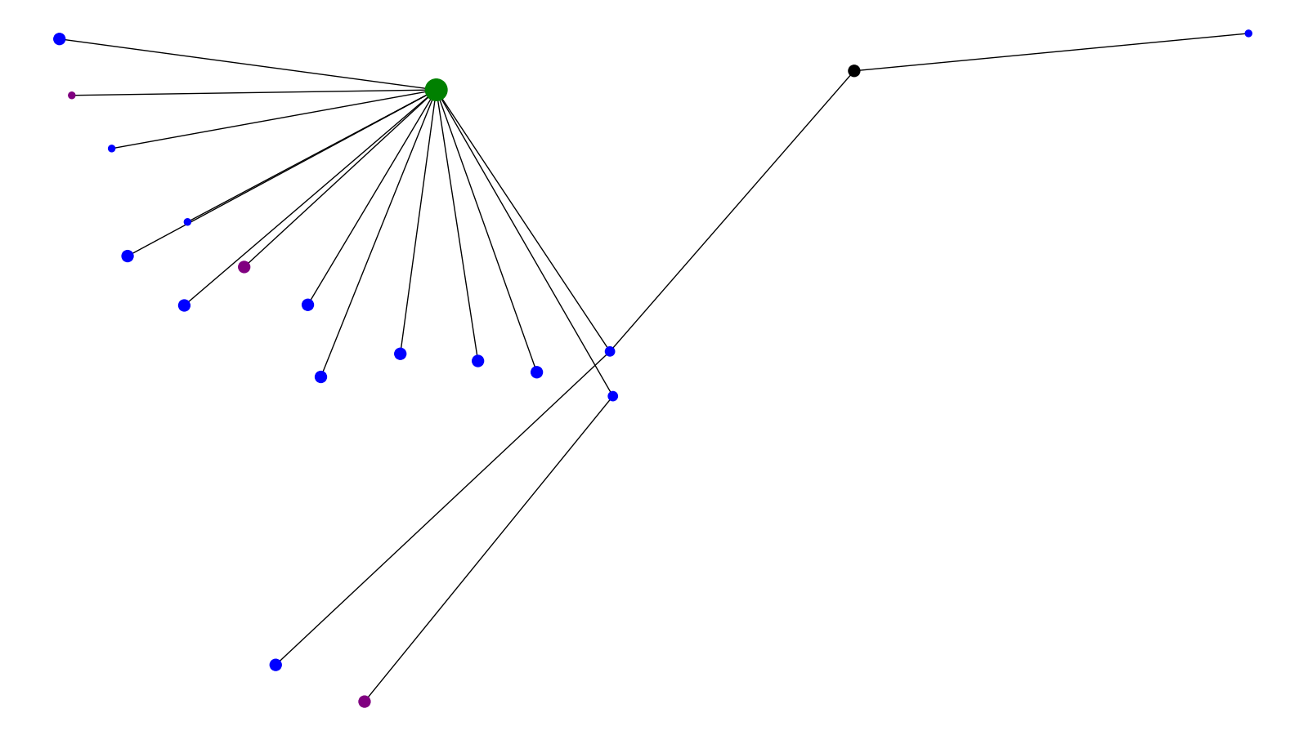
Outcome Cluster 7
Alive Deceased Unknown

Slide 8
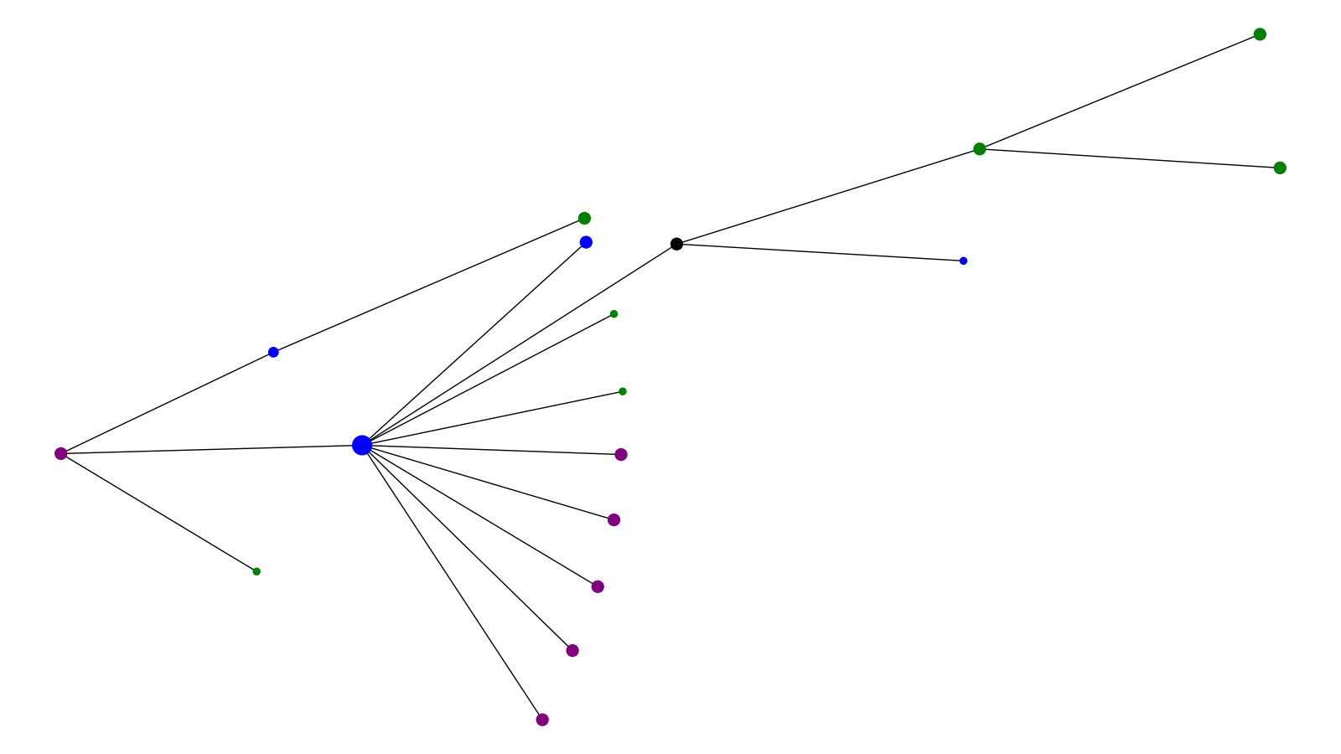
Outcome Cluster 8
Alive Deceased Unknown

Slide 9
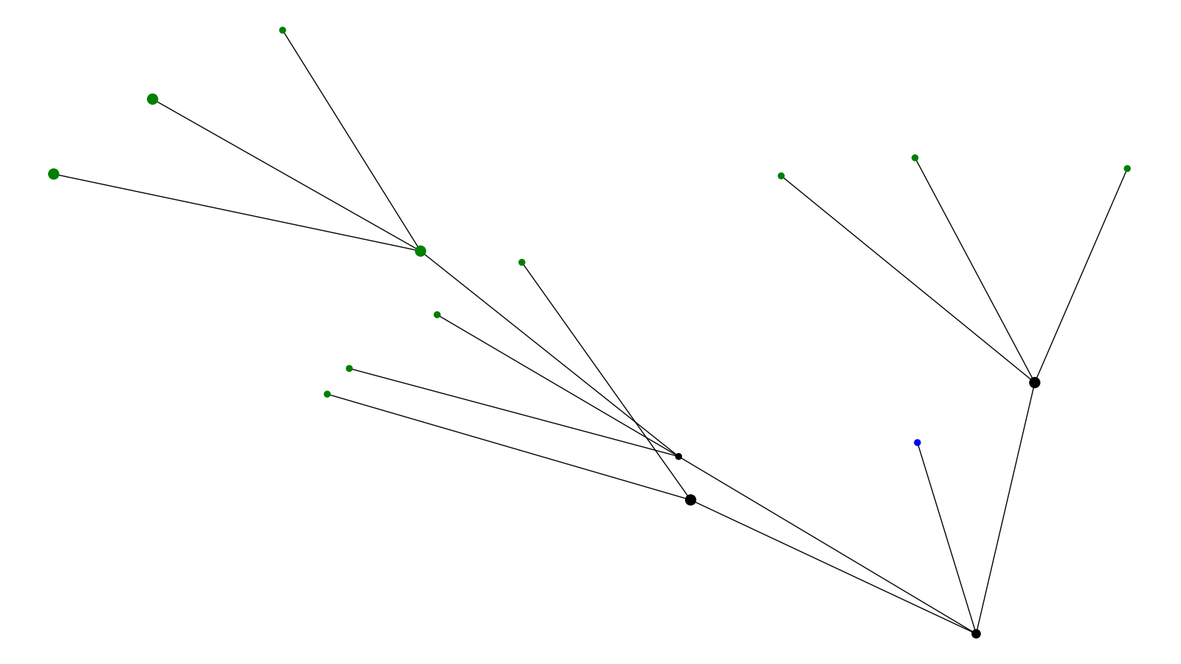
Outcome Cluster 9
Alive Unknown

Slide 10
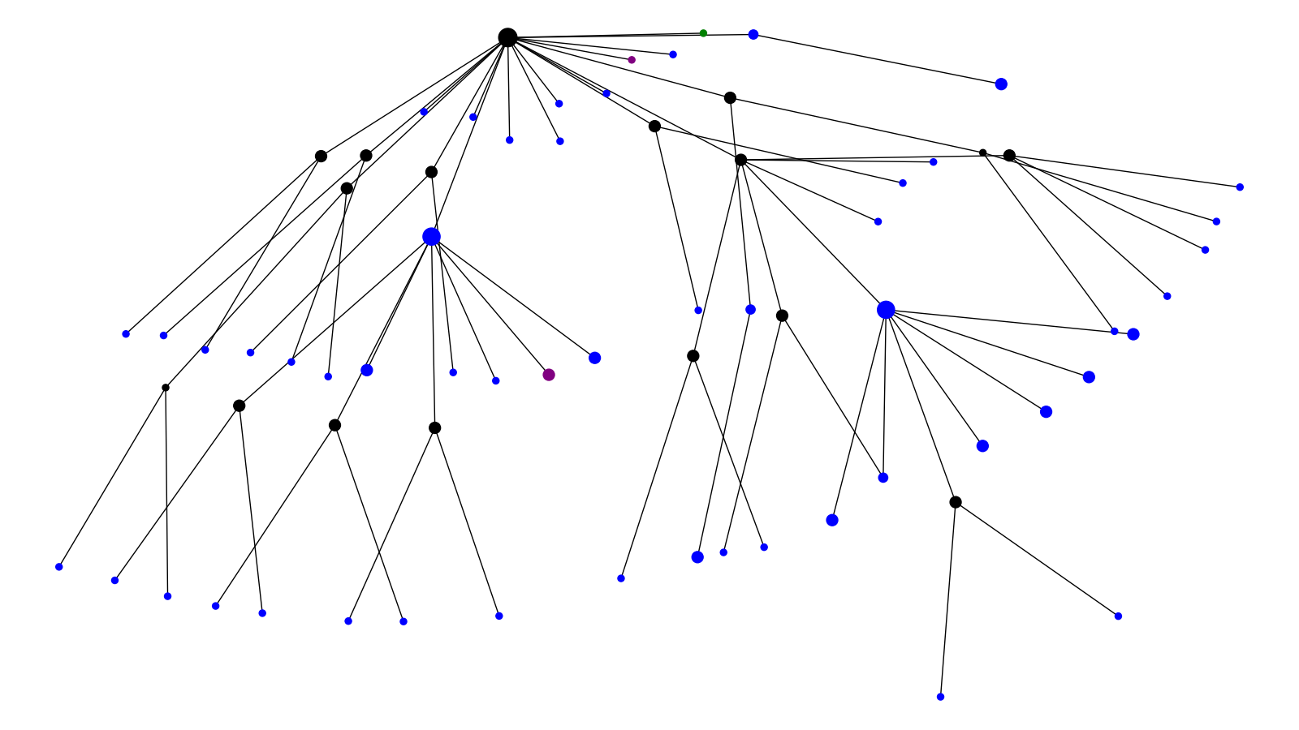
Outcome Cluster 10
Alive Deceased Unknown

Slide 11
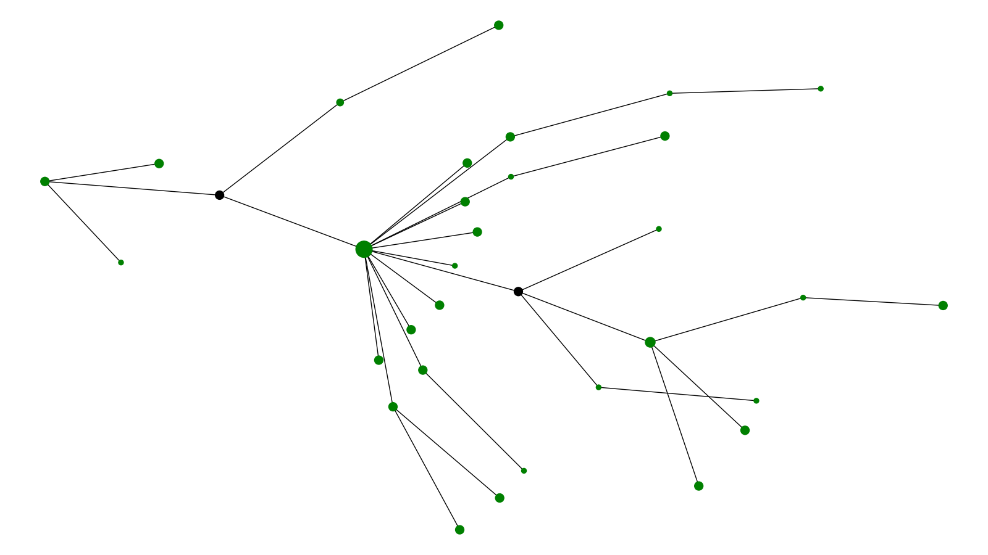
Outcome Cluster 11
Unknown

Slide 12
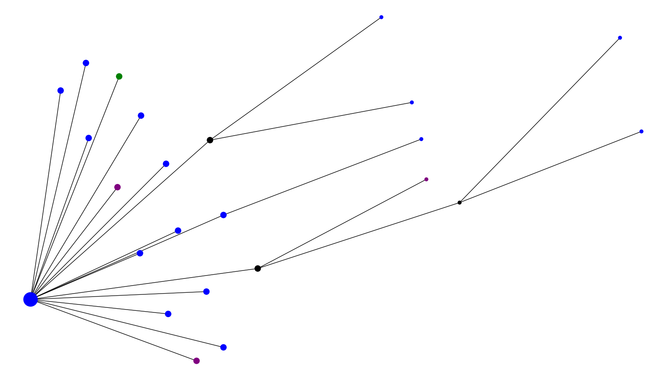
Outcome Cluster 12
Alive Deceased Unknown

Slide 13
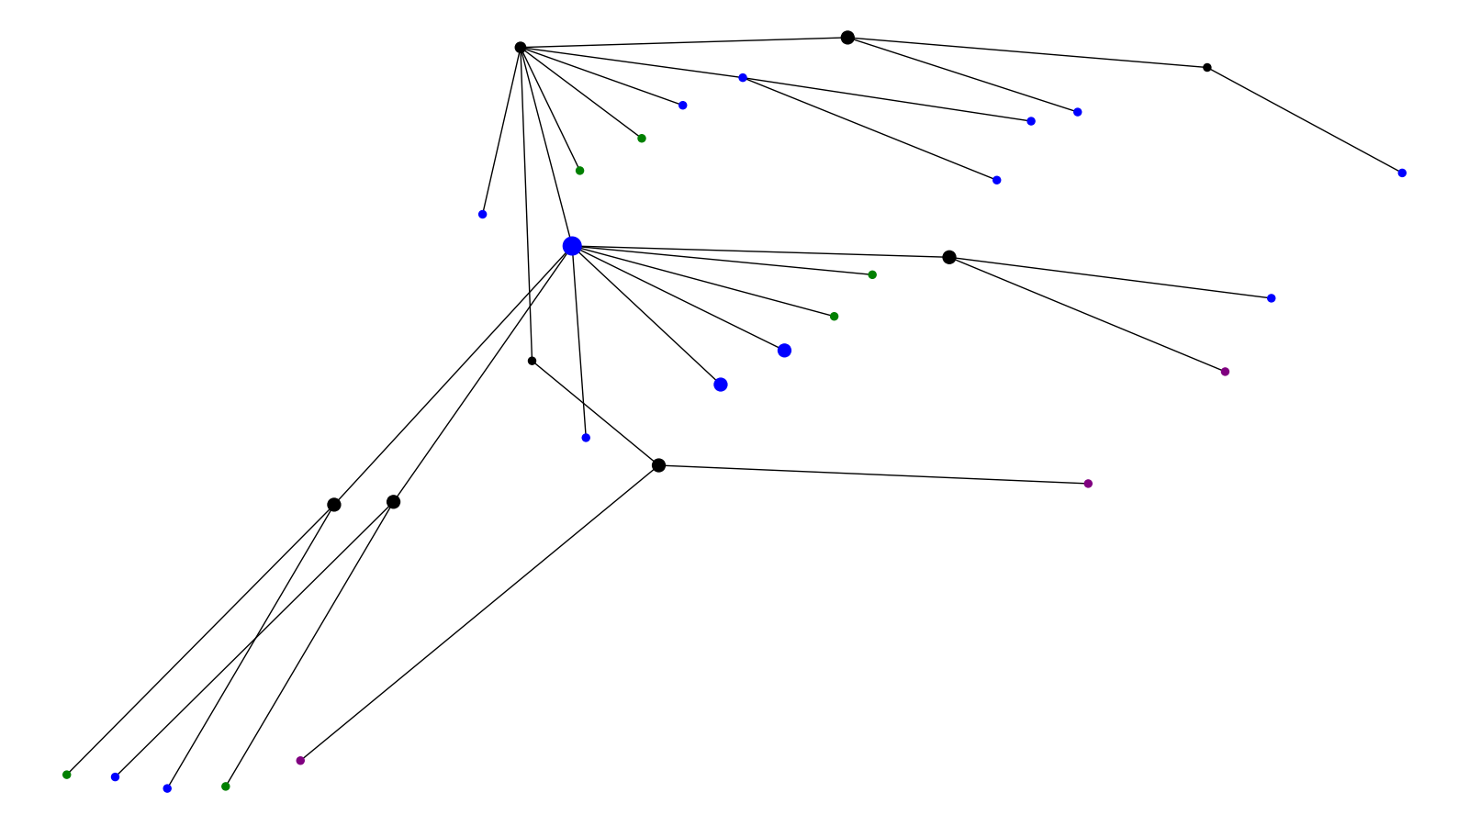
Outcome Cluster 13
Alive Deceased Unknown

Slide 14
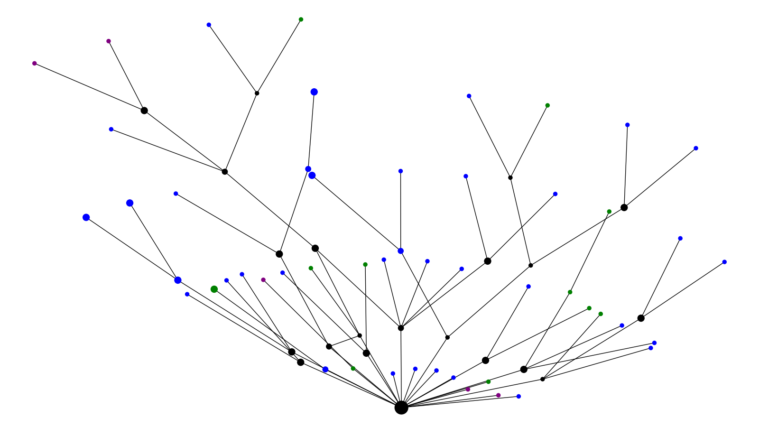
Outcome Cluster 14
Alive Deceased Unknown

Slide 15
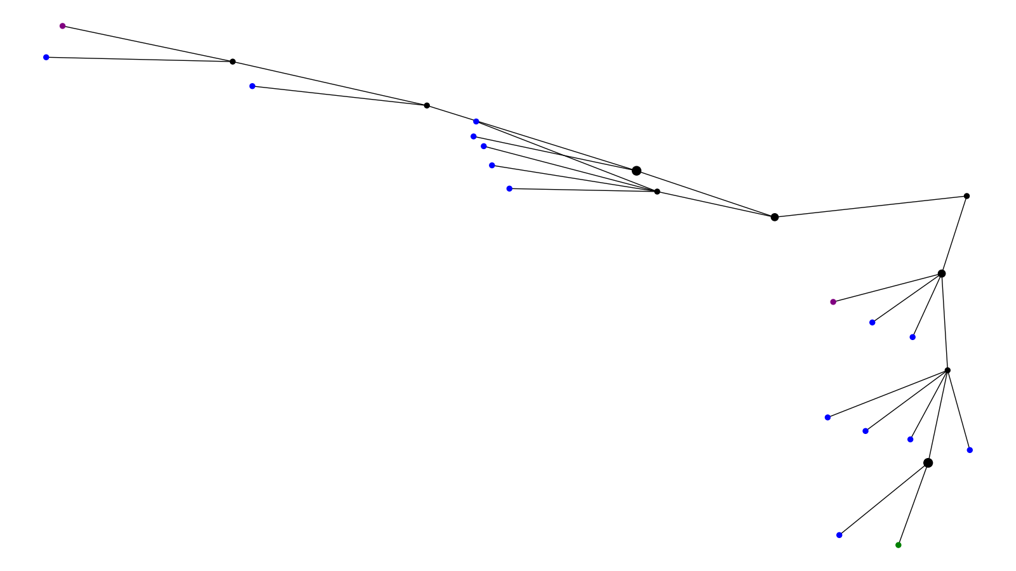
Outcome Cluster 15
Alive Deceased Unknown

