Slide 1
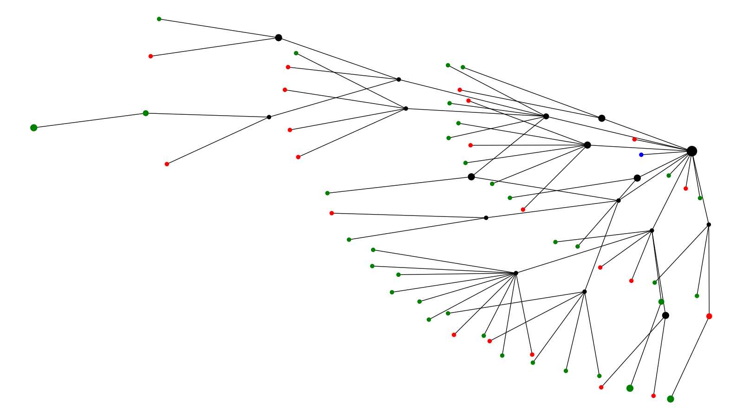
Symptom Cluster 1
Symptomatic Asymptomatic Unknown

Slide 2
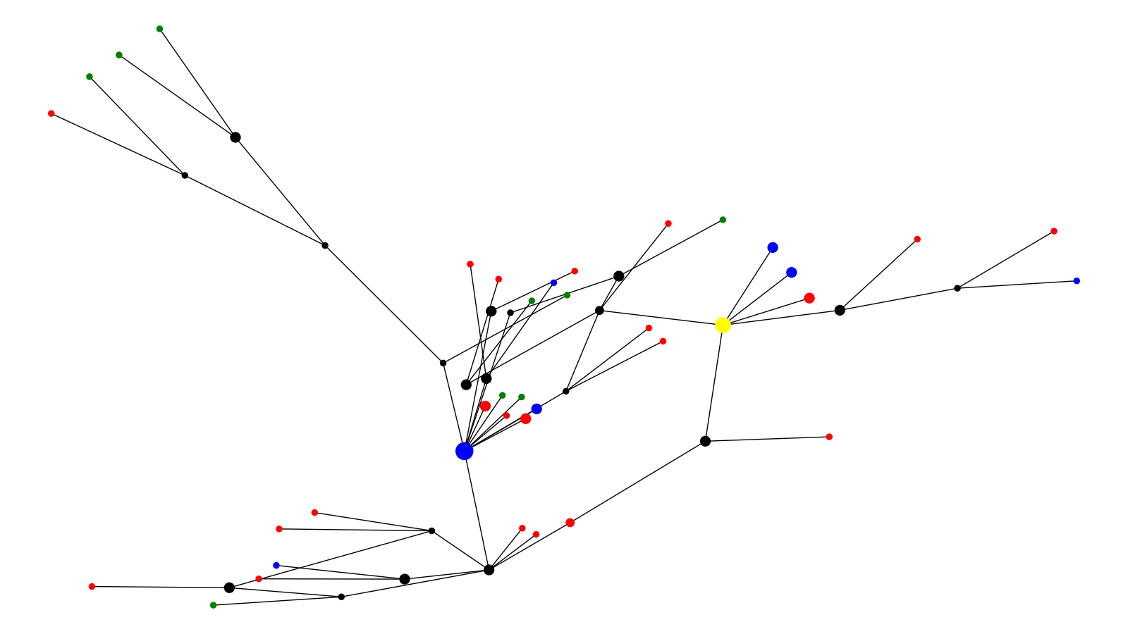
Symptom Cluster 2
Symptomatic Asymptomatic Unknown Reference

Slide 3
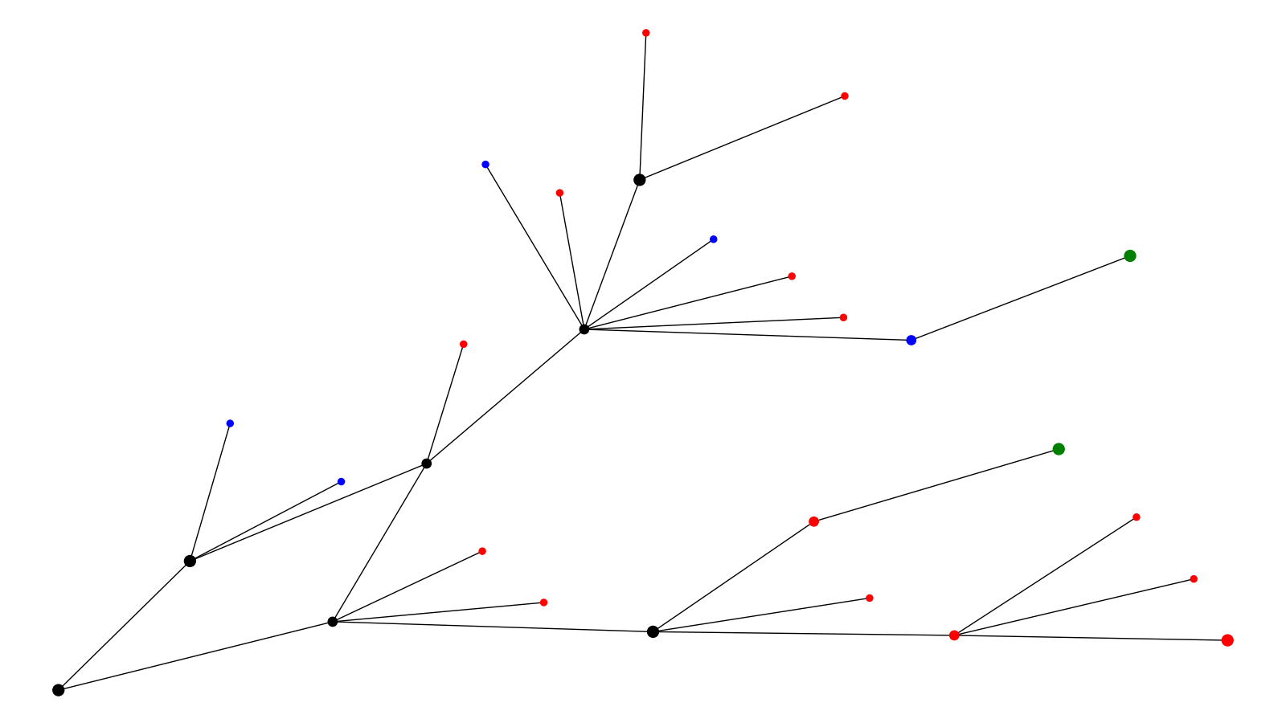
Symptom Cluster 3
Symptomatic Asymptomatic Unknown

Slide 4
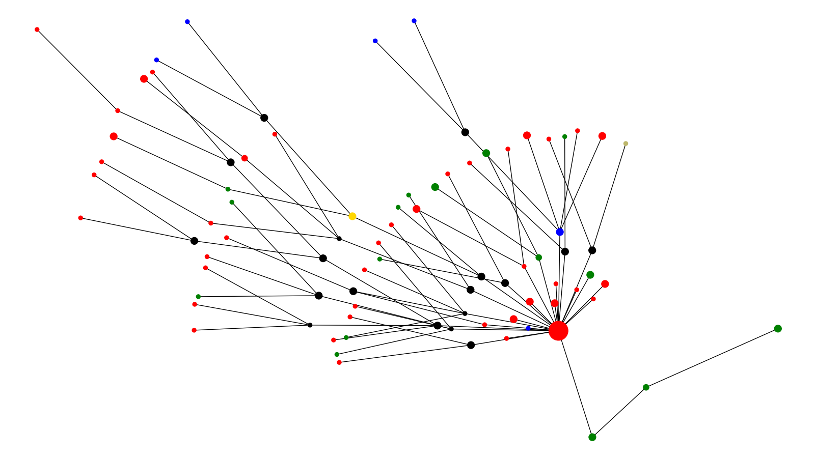
Symptom Cluster 4
Symptomatic Asymptomatic Unknown UK Reference Brazil Reference

Slide 5
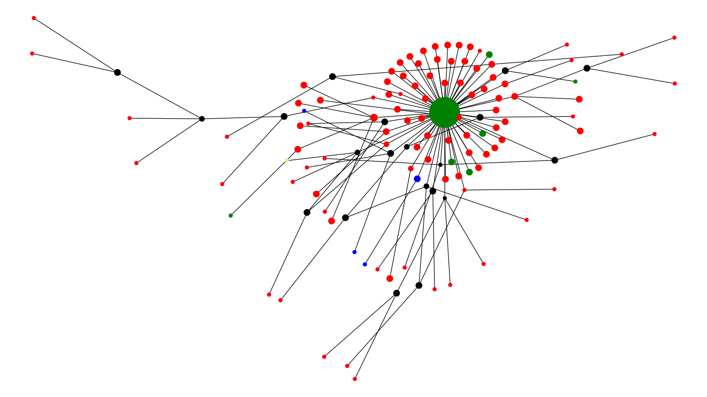
Symptom Cluster 5
Symptomatic Asymptomatic Unknown South Africa Ref

Slide 6
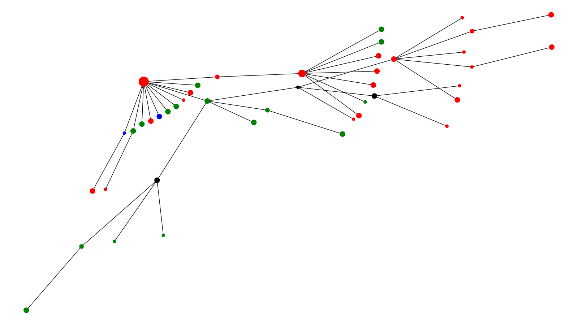
Symptom Cluster 6
Symptomatic Asymptomatic Unknown

Slide 7
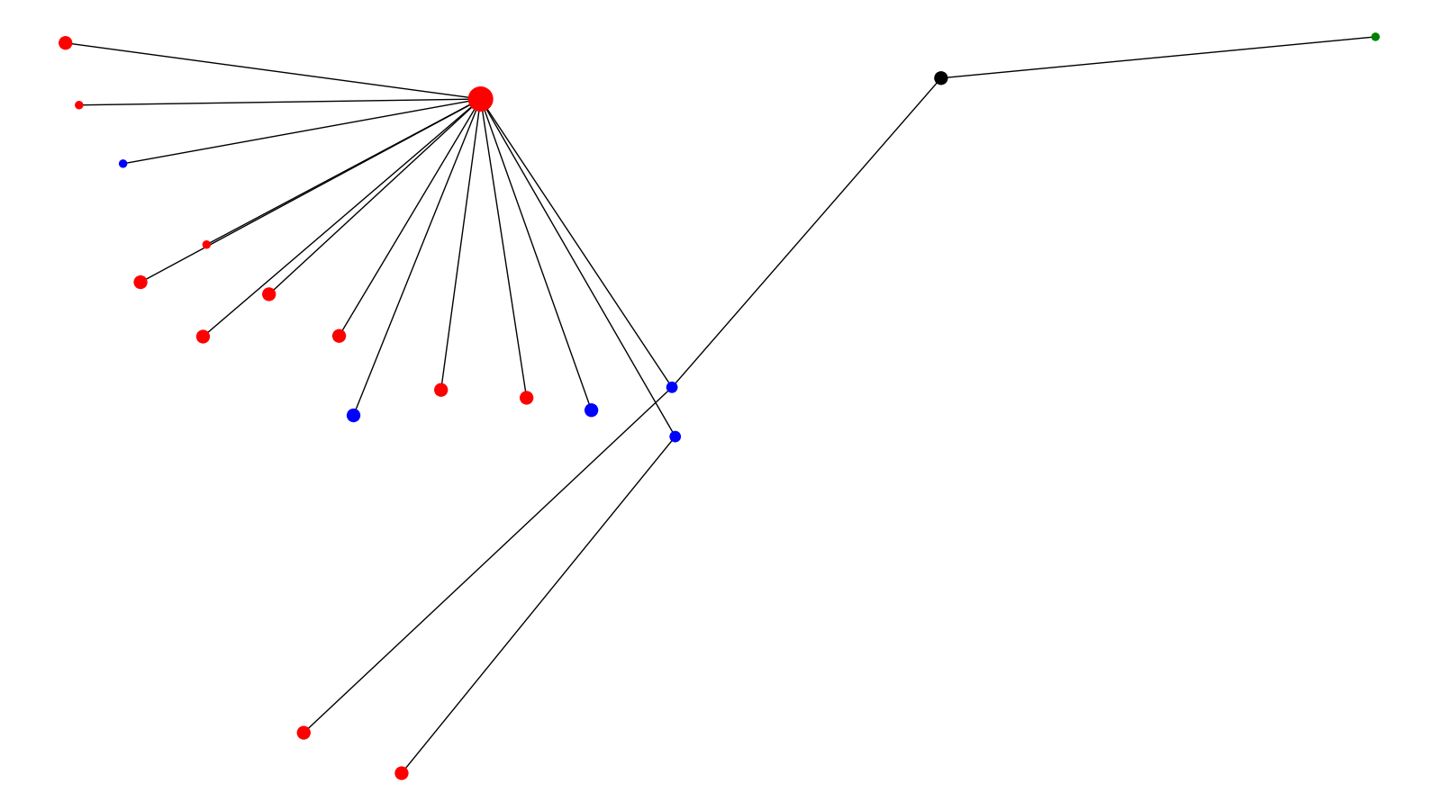
Symptom Cluster 7
Symptomatic Asymptomatic

Slide 8
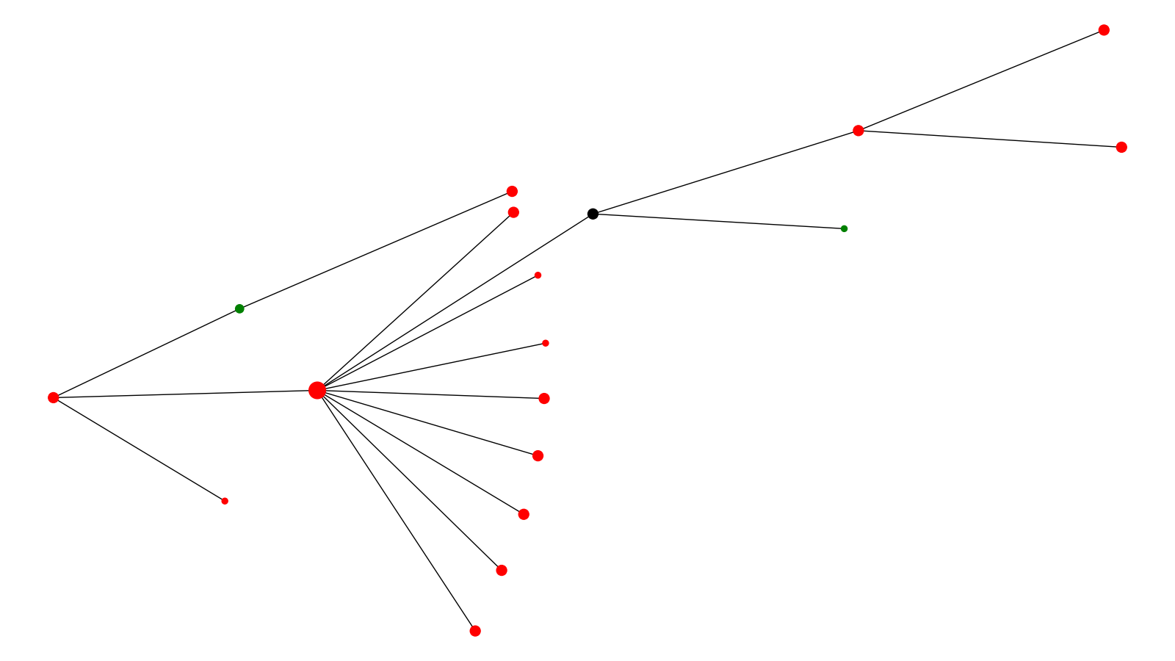
Symptom Cluster 8
Symptomatic Unknown

Slide 9
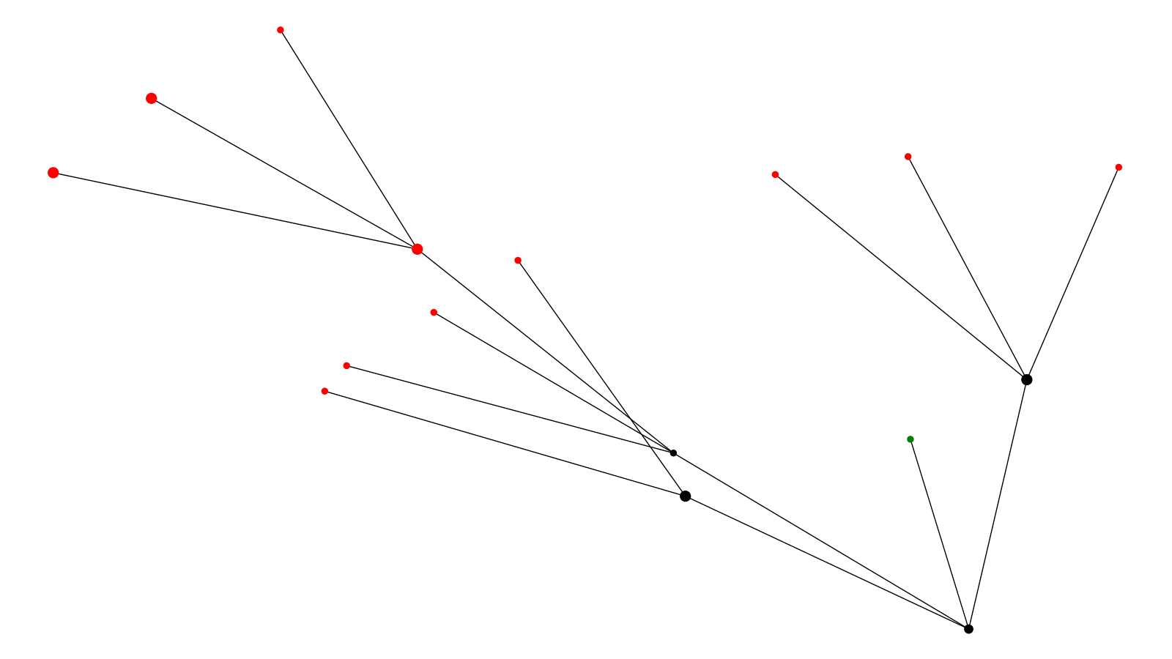
Symptom Cluster 9
Symptomatic Unknown

Slide 10
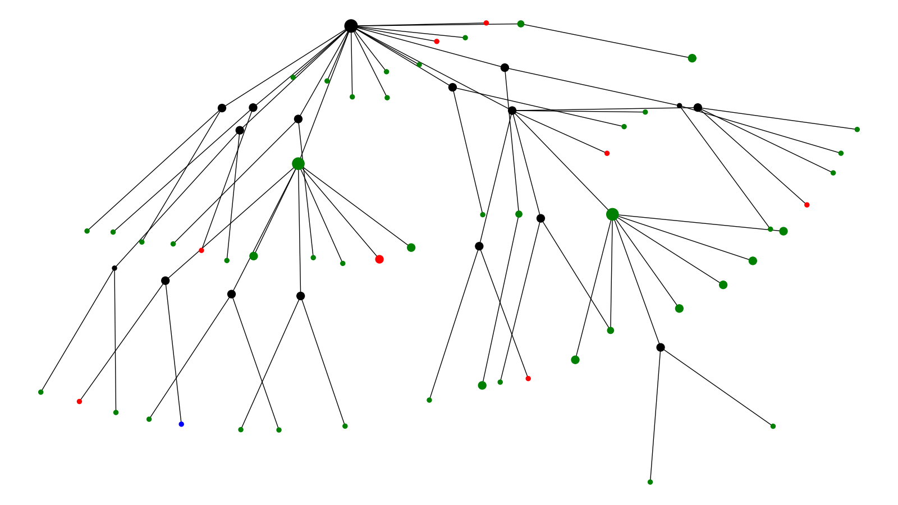
Symptom Cluster 10
Symptomatic Asymptomatic Unknown

Slide 11
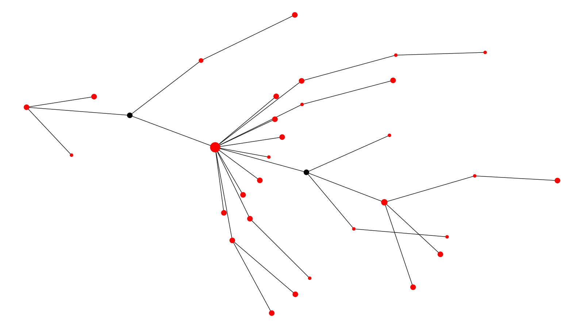
Symptom Cluster 11
Symptomatic

Slide 12
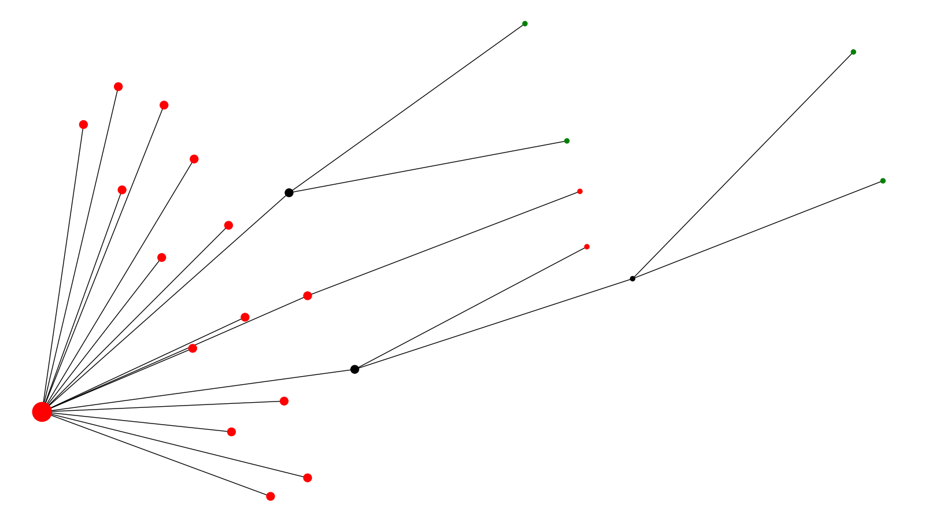
Symptom Cluster 12
Symptomatic Unknown

Slide 13
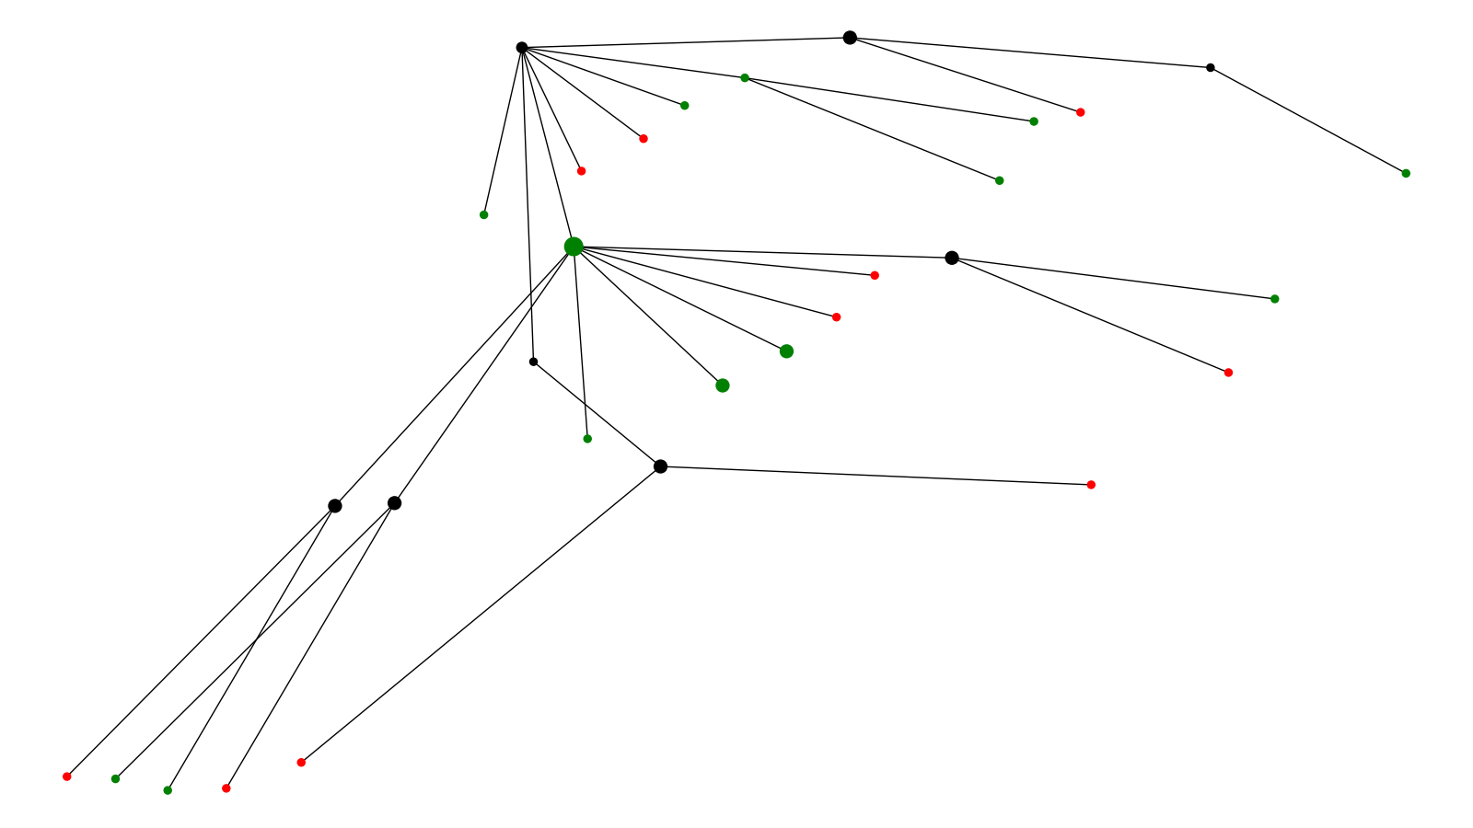
Symptom Cluster 13
Symptomatic Unknown

Slide 14
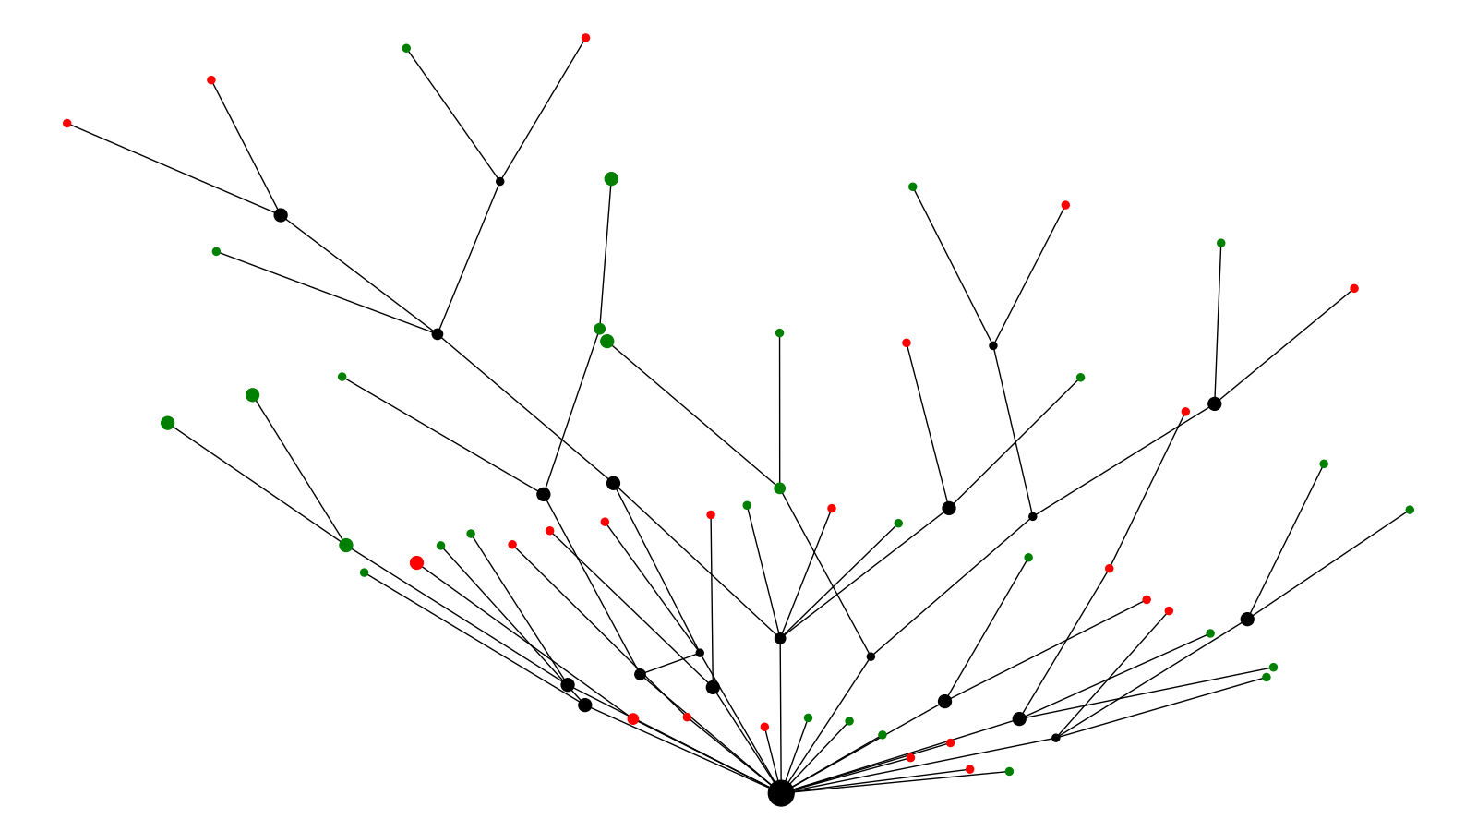
Symptom Cluster 14
Symptomatic Unknown

Slide 15
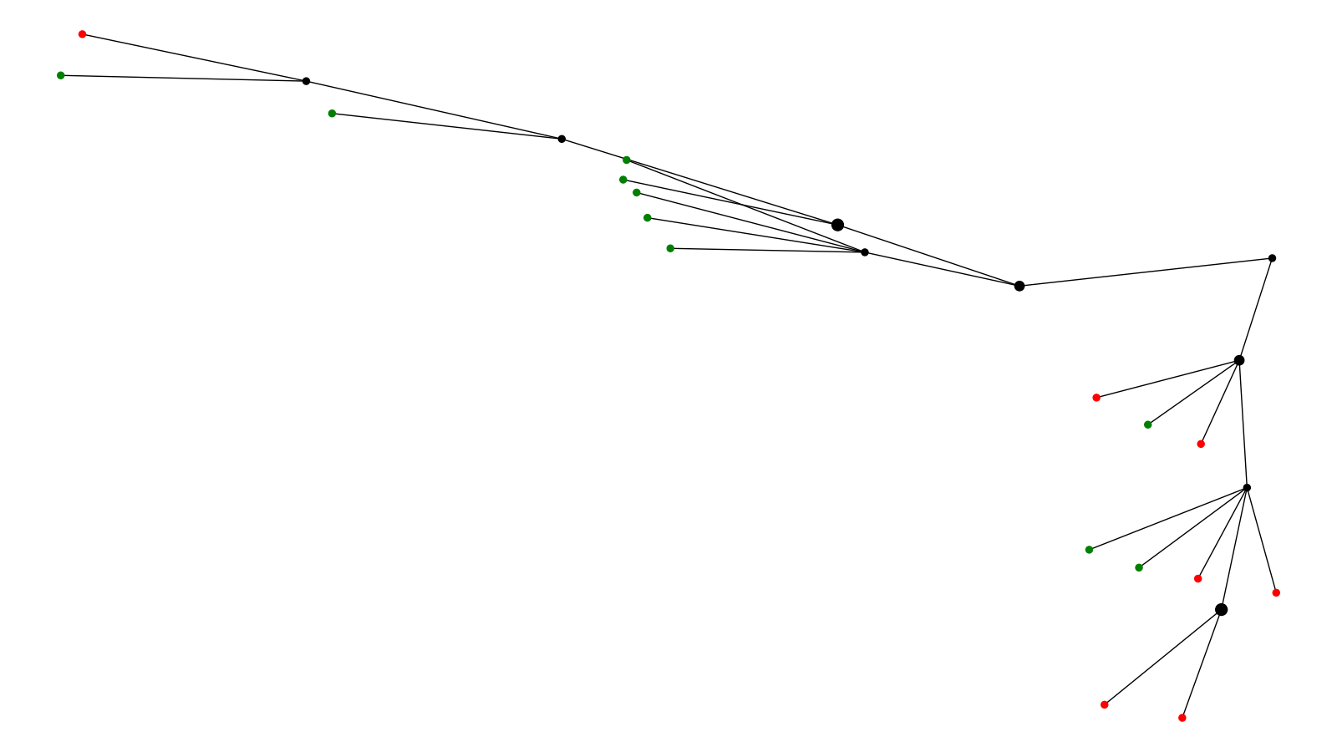
Symptom Cluster 15
Symptomatic Unknown

