Slide 1
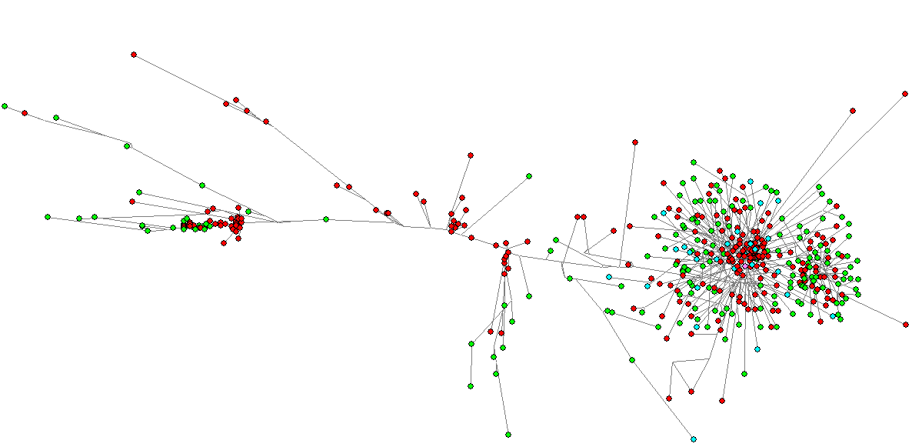
Symptoms
Symptomatic Asymptomatic Unknown Reference

Slide 2
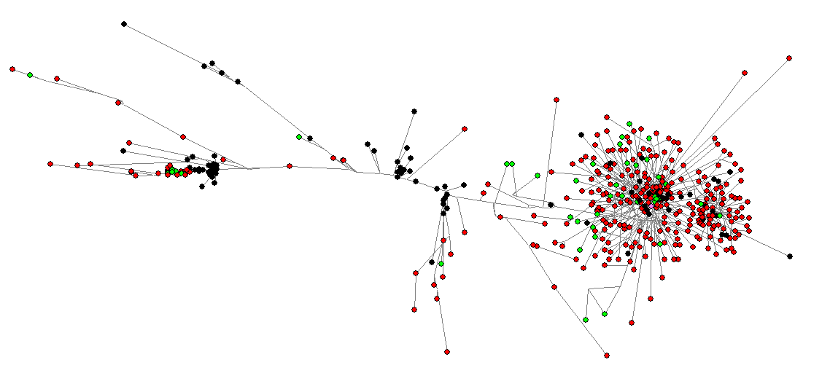
Outcomes
Alive Deceased Unknown Reference

Slide 3
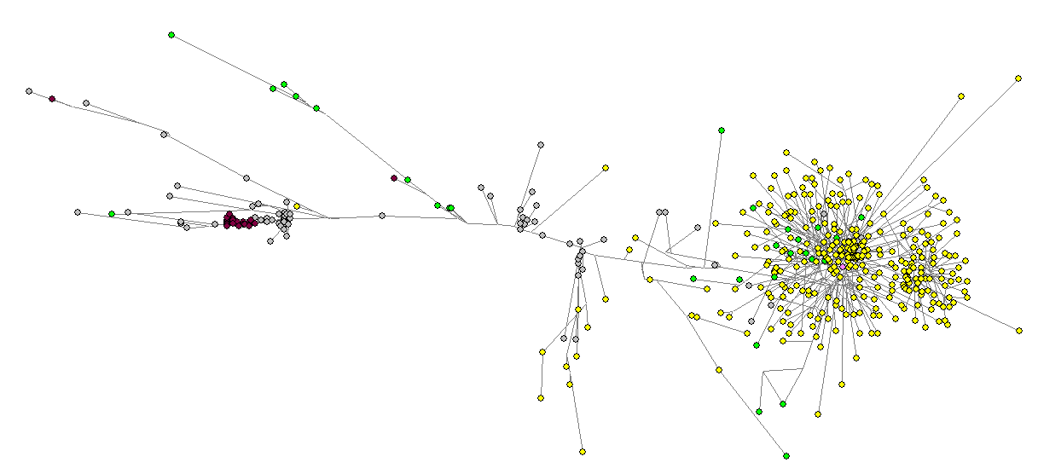
Top 3 states
California New York Louisiana Other Reference

Slide 4
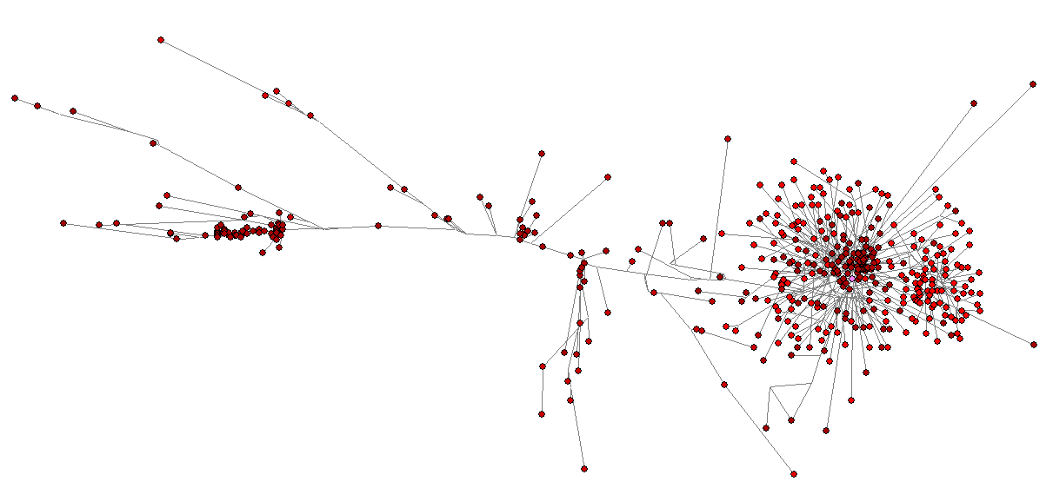
Time
March December Reference

Slide 5
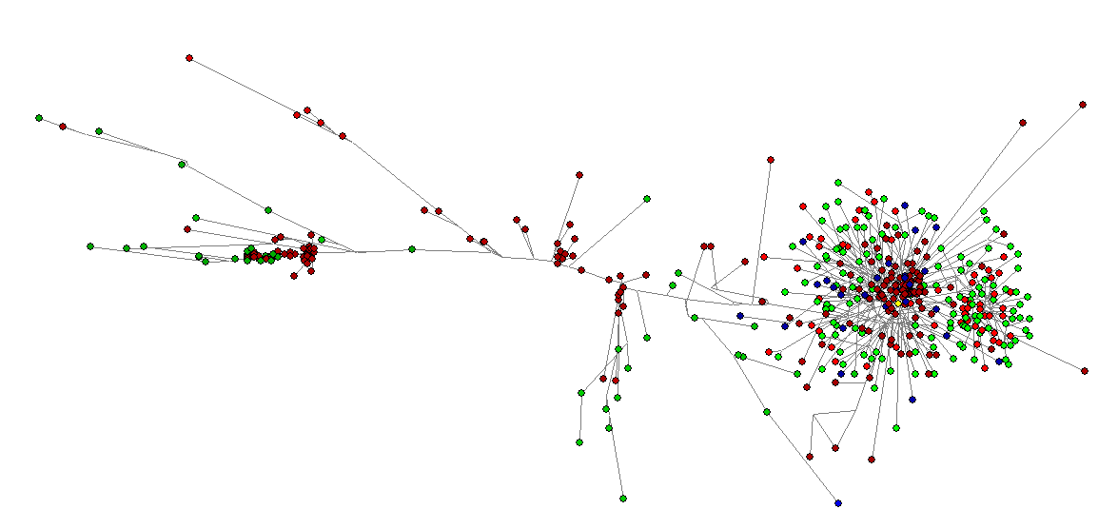
Time and Symptom status
Darker Time Lighter Symptomatic Asymptomatic Unknown Reference

