Slide 1
Capstone: First and Last-Touch Attribution
Learn SQL from Scratch
Jonathan Garcia
July 25, 2018

Slide 2
Table of Contents
Get familiar with CoolTShirts
What is the user journey?
Optimize the campaign budget

Slide 3
1. Get Familiar With CoolTShirts

Slide 4
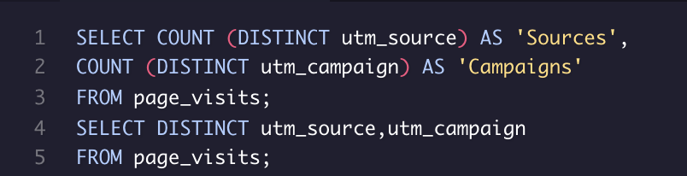
1.1 How many campaigns and sources does CoolTShirts use and how are they related?
CoolTShirts uses 8 different campaigns distributed towards 6 traffic sources.
utm_campaign - Identifies the specific ad or email blast (e.g. retargetting-ad or weekly-newsletter)
utm_source - Identifies which touchpoint sent the traffic (e.g. google, email, or facebook)
Sources | Campaigns
6 | 8
utm_source | utm_campaign
nytimes | getting-to-know-cool-tshirts
email | weekly-newsletter
buzzfeed | ten-crazy-cool-tshirts-facts
email | retargetting-campaign
facebook | retargetting-ad
medium | interview-with-cool-tshirts-founder
google | paid-search
google | cool-tshirts-search

Slide 5

1.2 What pages are on their website?
There are 4 different pages within the CoolTShirts webpage.
landing page
shopping cart
checkout
purchase
page_name
1 - landing_page
2 - shopping_cart
3 - checkout
4 - purchase

Slide 6
2. What is the User Journey?

Slide 7
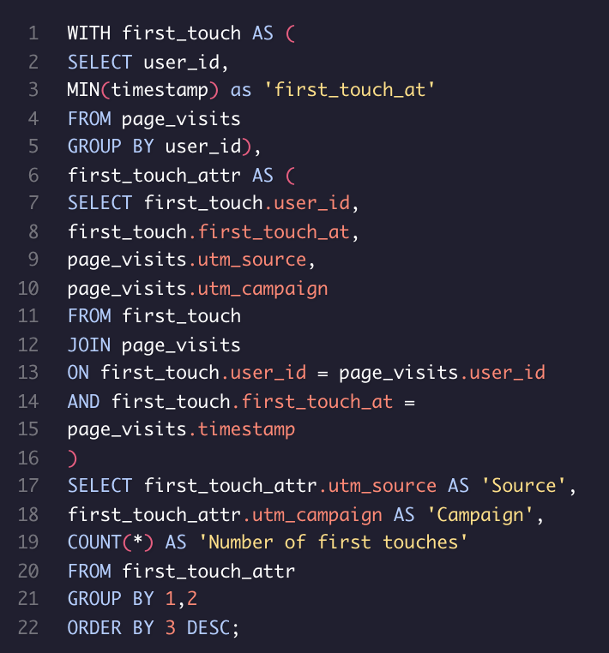
2.1 How many first touches is each campaign responsible for?
The table shows the number of first touches for all campaigns with first touch. Campaigns not present in this table were not included because they do not have a first touch.
Source | Campaign | Number of first touches
medium | interview-with-cool-tshirts-founder | 622
nytimes | getting-to-know-cool-tshirts | 612
buzzfeed | ten-crazy-cool-tshirts-facts | 576
google | cool-tshirts-search | 169

Slide 8
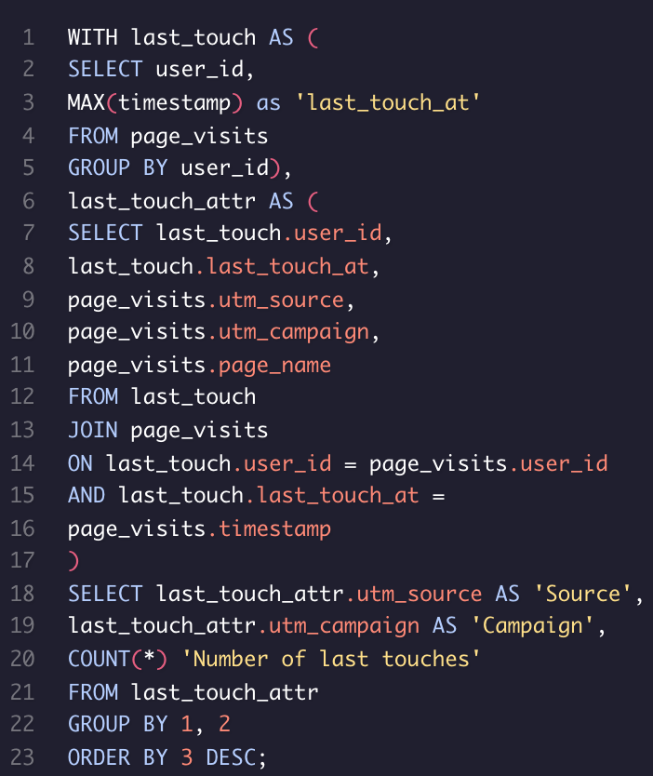
2.2 How many last touches is each campaign responsible for?
Last touches reveal what led a user to return to a website to complete a purchase if they did not make a purchase during the first visit.
Source | Campaign | Number of last touches
email | Weekly-newsletter | 447
facebook | Retargetting-ad | 443
email | Retargetting-campaign | 245
nytimes | Getting-to-know-cool-tshirts | 232
buzzfeed | Ten-crazy-cool-tshirt-facts | 190
medium | Interview with cool tshirts founder | 184
google | Paid-search | 178
google | Cool tshirts search | 60

Slide 9
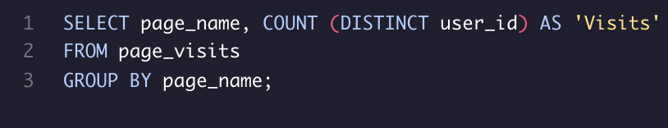
2.3 How many visitors make a purchase?
361 distinct users made a purchase in CoolTShirts according to the results shown in the table.
page_name | Visits
1 – landing_page | 1979
2 – shopping_cart | 1881
3 - checkout | 1431
4 - purchase | 361

Slide 10
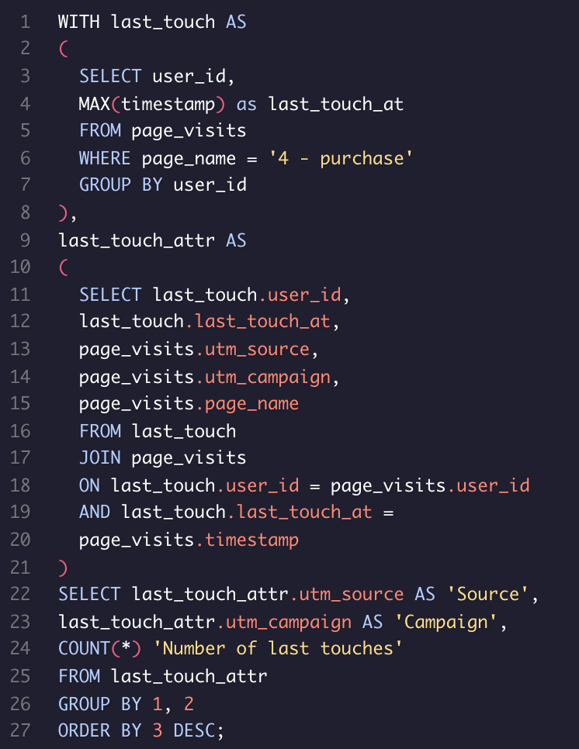
2.4 How many last touches on the purchase page is each campaign responsible for?
By adding a new condition to the query stated in 2.2 we can limit the last touches results to only those ones in the purchases page.
Source | Campaign | Number of last touches
email | weekly-newsletter | 115
facebook | retargetting-ad | 113
email | retargetting-campaign | 54
google | paid-search | 52
buzzfeed | ten-crazy-cool-tshirts-facts | 9
nytimes | getting-to-know-cool-tshirts | 9
medium | interview-with-cool-tshirts-founder | 7
google | cool-tshirts-search | 2

Slide 11
2.5 What is the typical user journey?
The data shows the website needs to improve or simplify the purchase page so the visitor will feel confident enough to make a purchase decision.
Look for nice t-shirts in the landing and search pages
Add those interesting ones to the user’s cart
Review the cosen products and do the checkout
Introduce payment data and carry out the purchase action
Page_name | Visits
1 – Landing_page | 1979
2 – shopping_cart | 1881
3 - checkout | 1431
4 - purchase | 361

Slide 12
3.Optimize the campaign budget

Slide 13
3.1 CoolTShirts can re-invest in 5 campaigns.
Which should they pick and why?
In order to answer this question let’s consider the ratio between the number of last touches at the purchase page and the number of last touches at any page. By following the data stated in questions 2.2 and 2.4 we can calculate this ratio as shown in the table on the right. Indeed the 4 bottom campaigns have the lowest ratios far away from their upper sisters. Since the question asks for 5 campaigns we could also include the retargetting-campaign to complete the group. Now that we have identified the campaigns that achieve less purchases, we will take a look in the next slide to the first touches table (described in question 2.1).
Campaign | Ratio
Weekly-newsletter | 0.257
Retargetting-ad | 0.255
Retargetting-campaign | 0.220
Paid-search | 0.292
Ten-crazy-cool-tshirts-facts | 0.047
Getting-to-know-cool-tshirts | 0.038
Interview-with-cool-tshirts-founder | 0.038
Cool-tshirts-search | 0.033

Slide 14
CoolTShirts can re-invest in 5 campaigns.
Which should they pick and why?
It seems that campaigns that achieve a lower purchase ratio are those ones that work better for bringing new users to the CoolTShirts page. The data suggests the company should invest more into the 4 campaigns with highest purchase ratios (or into the flow of the purchase procedure) in order to balance the ‘discovering’ campaigns and the ‘selling’ ones.
Those high-selling campaigns (the ones not included in this table) have no first touches, meaning that the users who bought through them already knew the website. Maybe by improving the number of first touches in these campaigns CoolTShirts would achieve more purchases from users that did not know the website.
Source | Campaign | Number of first touches | Ratio
medium | interview-with-cool-tshirtsfounder | 622 | 0.038
nytimes | getting-to-know-cool-tshirts | 612 | 0.038
buzzfeed | ten-crazy-cool-tshirts-facts | 576 | 0.047
google | cool-tshirts-search | 169 | 0.033

