Slide 1
Heaps
CS 302 – Data Structures
Sections 8.8, 9.1, and 9.2

Slide 2
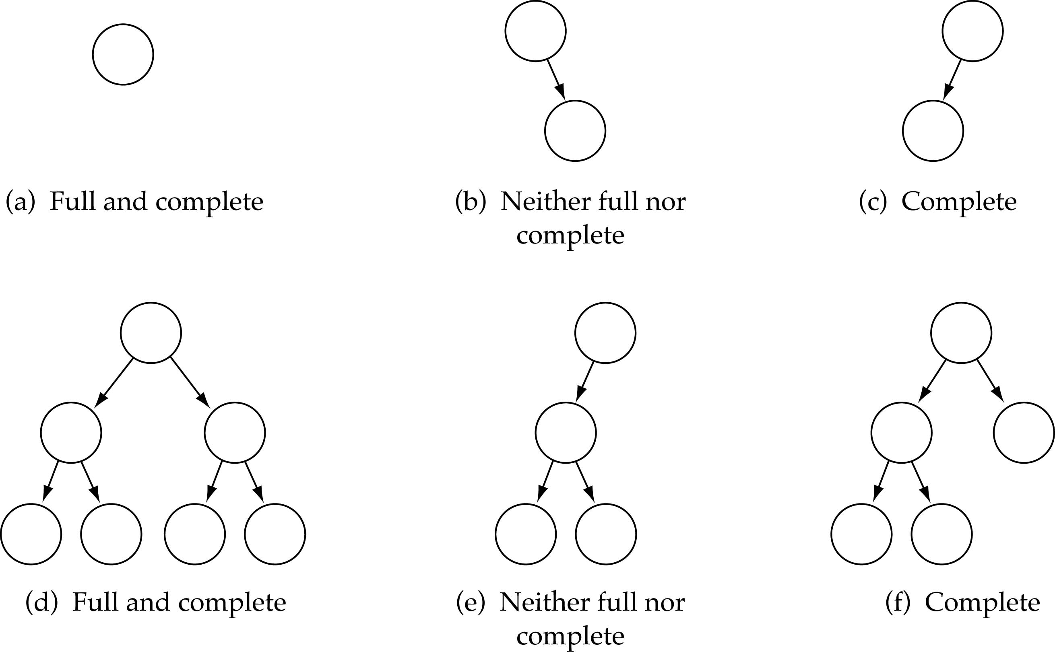
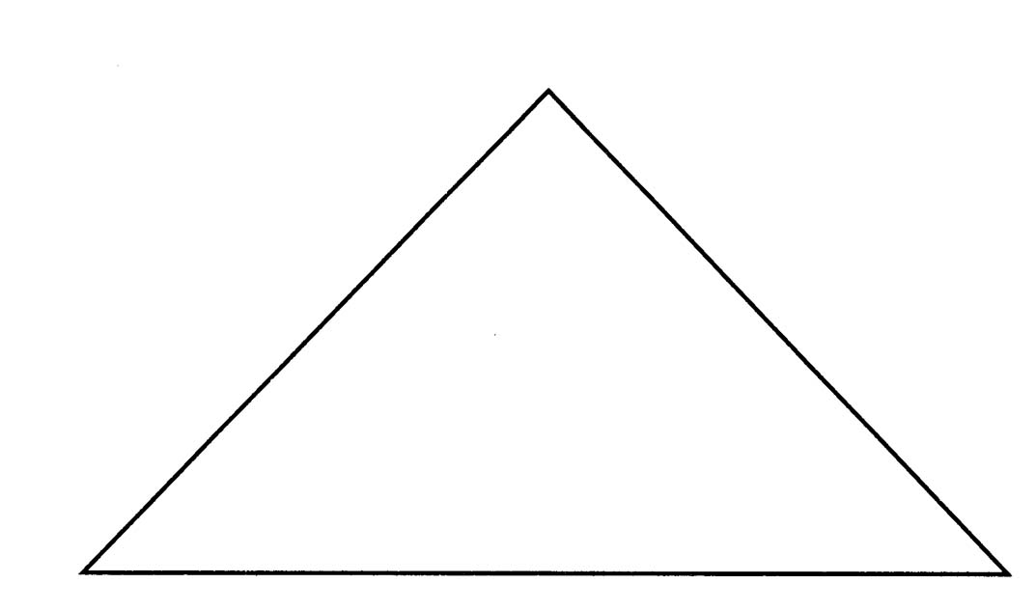
Full Binary Tree
Every non-leaf node has two children
Leaves are on the same level
Full Binary Tree

Slide 3
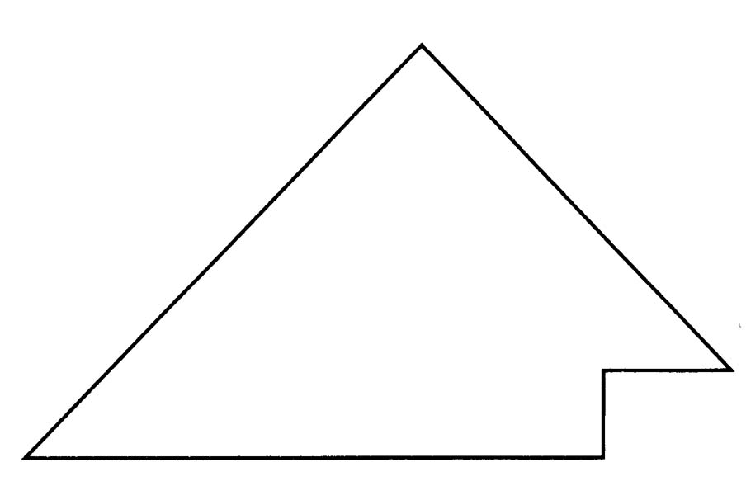
Complete Binary Tree
(1) A binary tree that is either full or full through the next-to-last level
(2) The last level is full from left to right (i.e., leaves are as far to the left as possible)
Complete Binary Tree

Slide 4
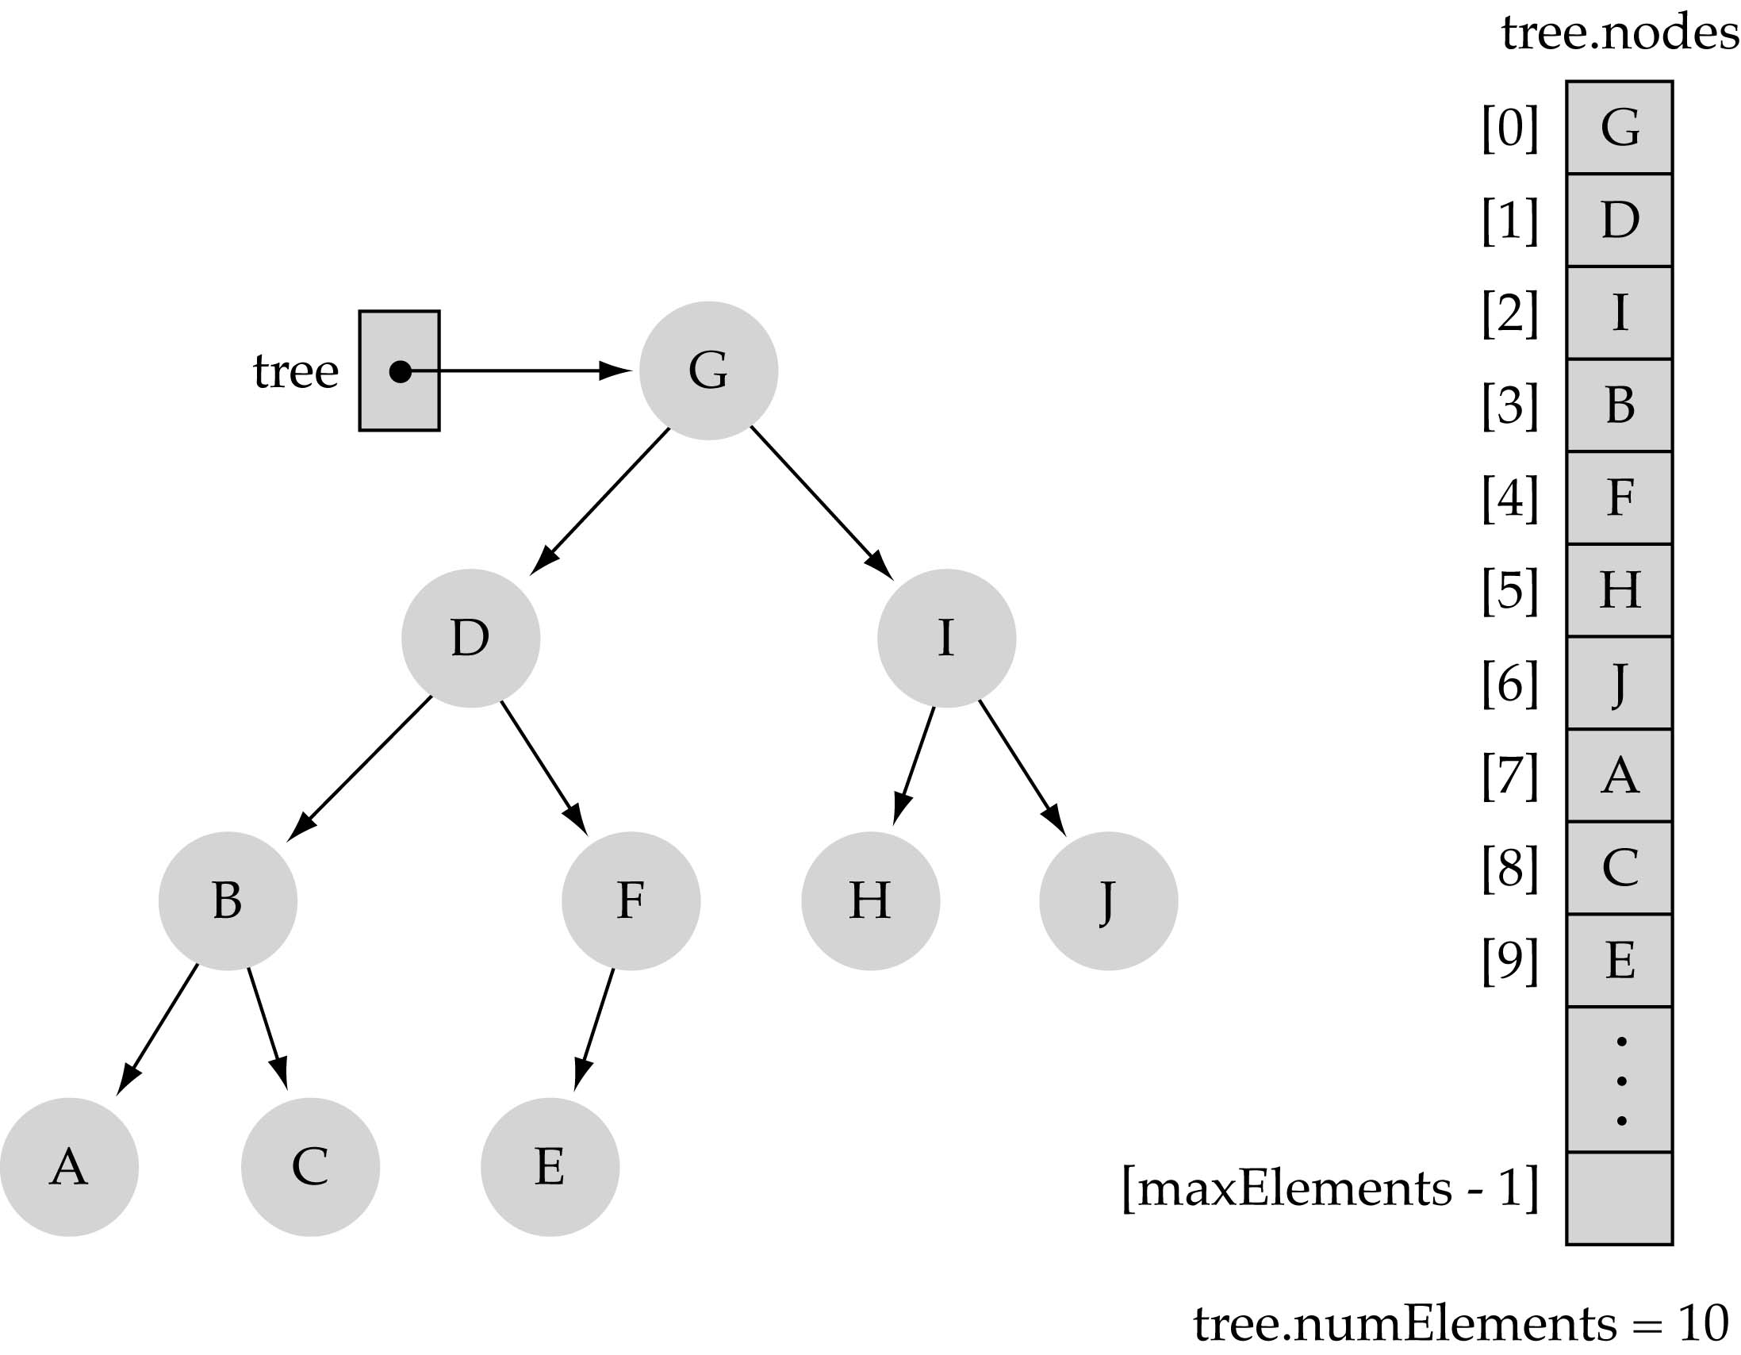
Array-based representation of binary trees
Memory savings (i.e., no pointers)
Preserve parent-child relationships
Store: (i) level by level, and (ii) left to right
0
1
2
4
5
6
3
7
8
9

Slide 5
Array-based representation of binary trees (cont.)
Parent-child relationships:
  left child of tree.nodes[index] = tree.nodes[2*index+1]
  right child of tree.nodes[index] = tree.nodes[2*index+2]
  parent node of tree.nodes[index] = tree.nodes[(index-1)/2]
Leaf nodes:
  tree.nodes[numElements/2] to tree.nodes[numElements - 1]
  (int division)

Slide 6
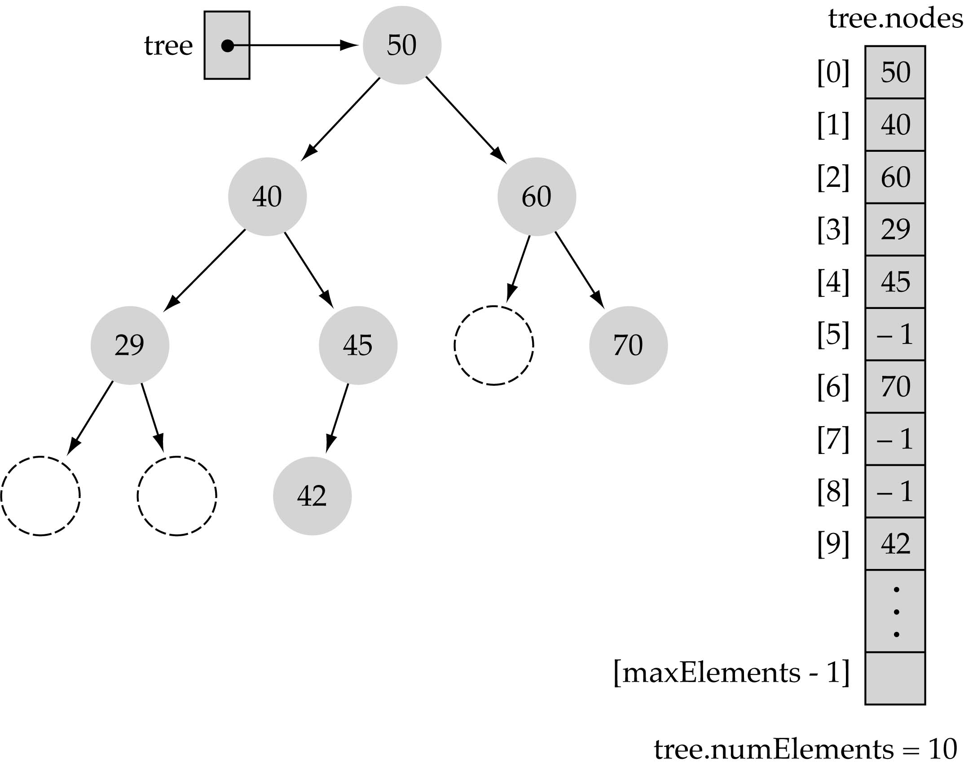
Array-based representation of binary trees (cont.)
Full or complete trees can be implemented efficiently using an array-based representation (i.e., elements occupy contiguous array slots).
“Dummy nodes" are
required for trees which
are not full or complete.

Slide 7
What is a heap?
It is a binary tree with the following properties:
  Property 1: it is a complete binary tree
  Property 2: (heap property): the value stored at a node is greater or equal to the values stored at the children

Slide 8
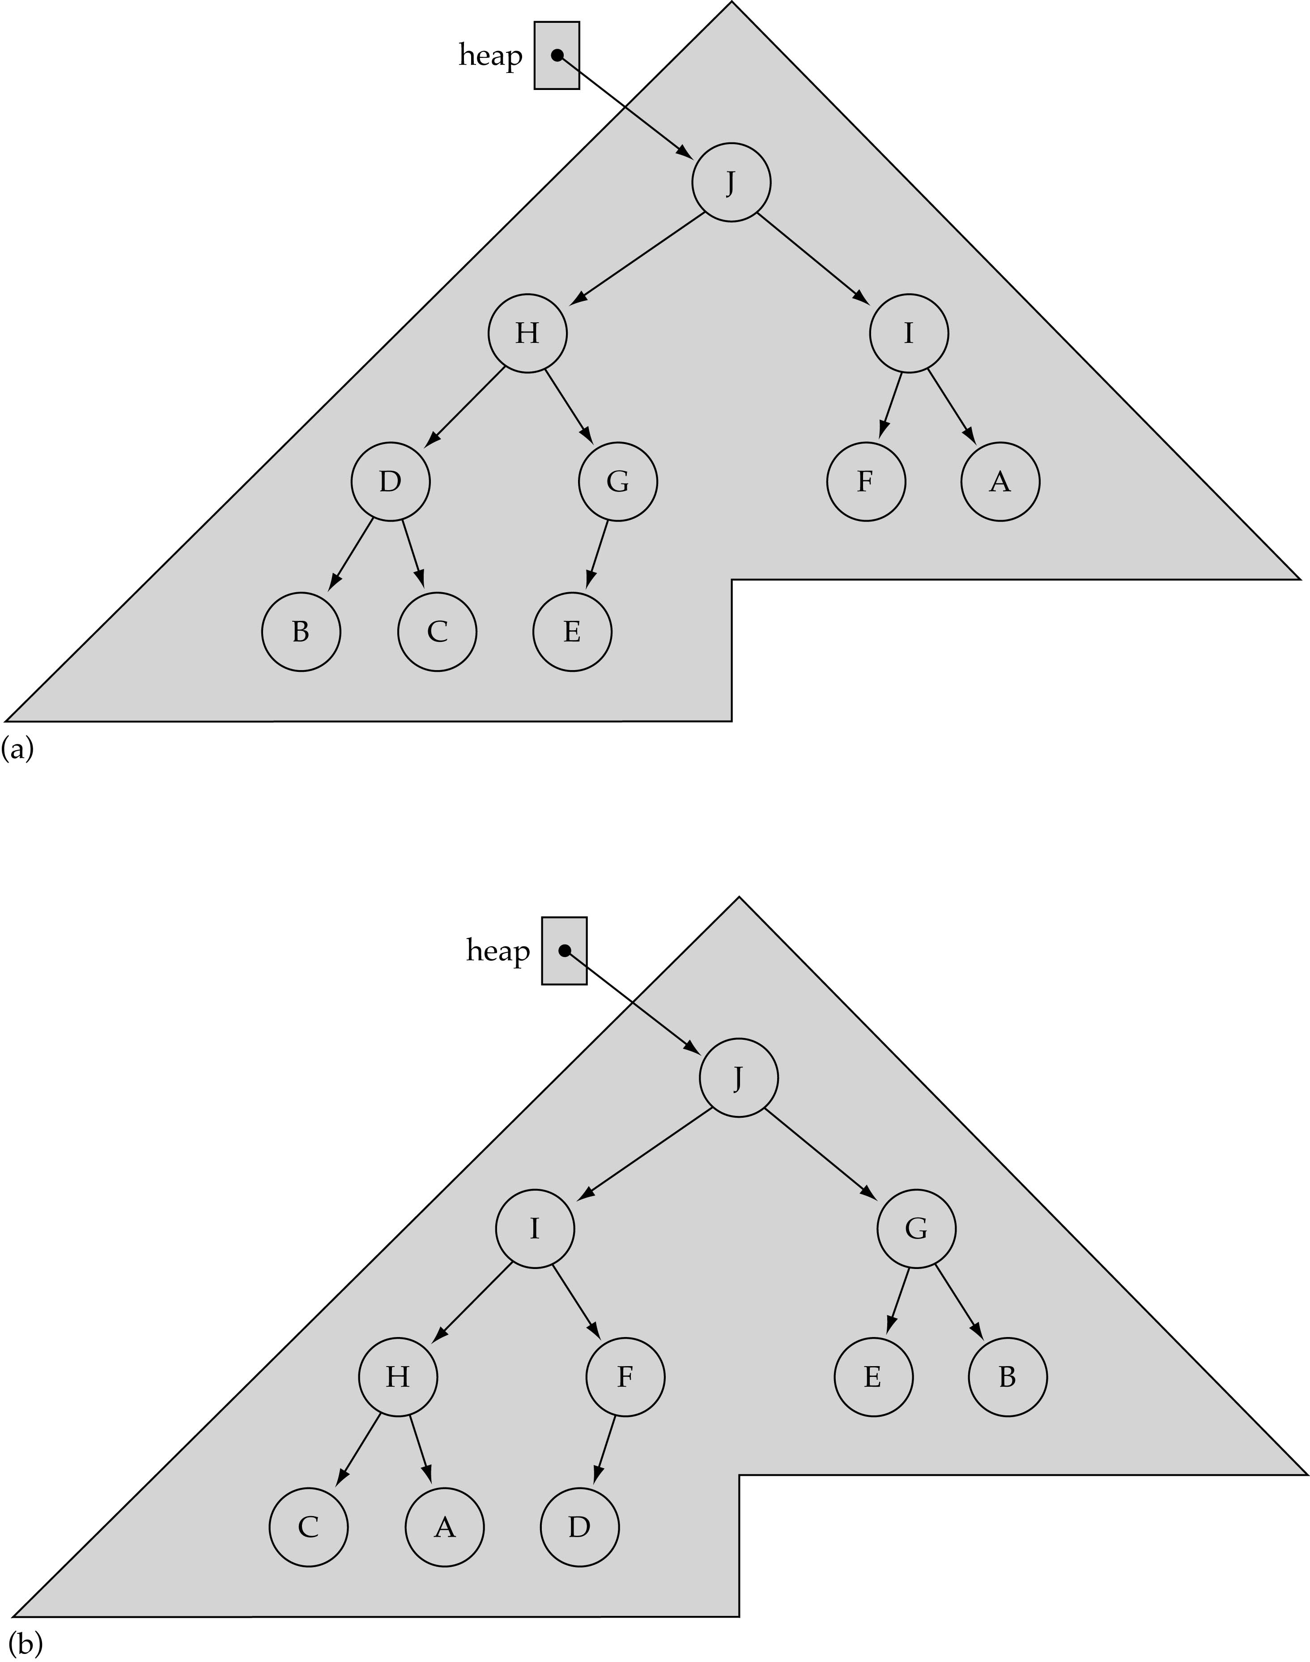
Not unique!

Slide 9
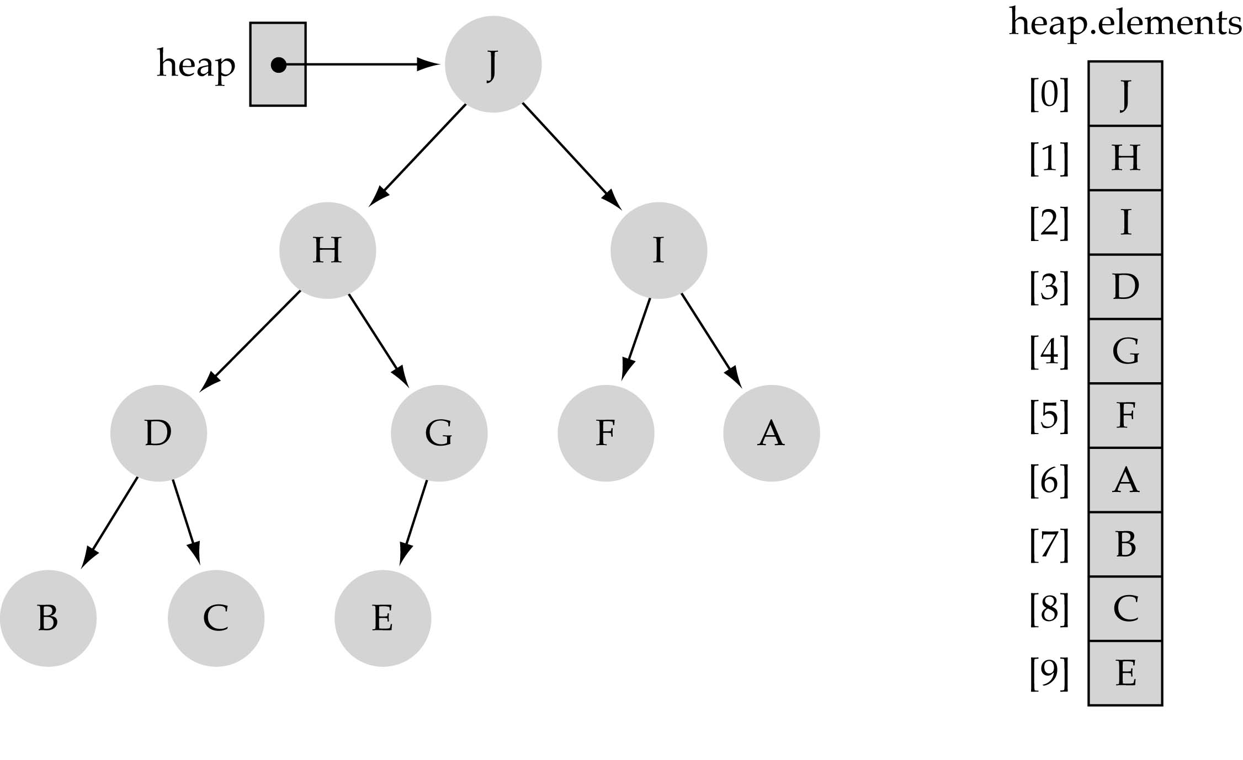
Largest heap element
From Property 2, the largest value of the heap is always stored at the root

Slide 10
Heap implementation
Heaps are always implemented as arrays!

Slide 11
Heap Specification
template<class ItemType>
struct HeapType {
void ReheapDown(int, int);
void ReheapUp(int, int);
ItemType *elements; // dynamic array
int numElements;
};

Slide 12
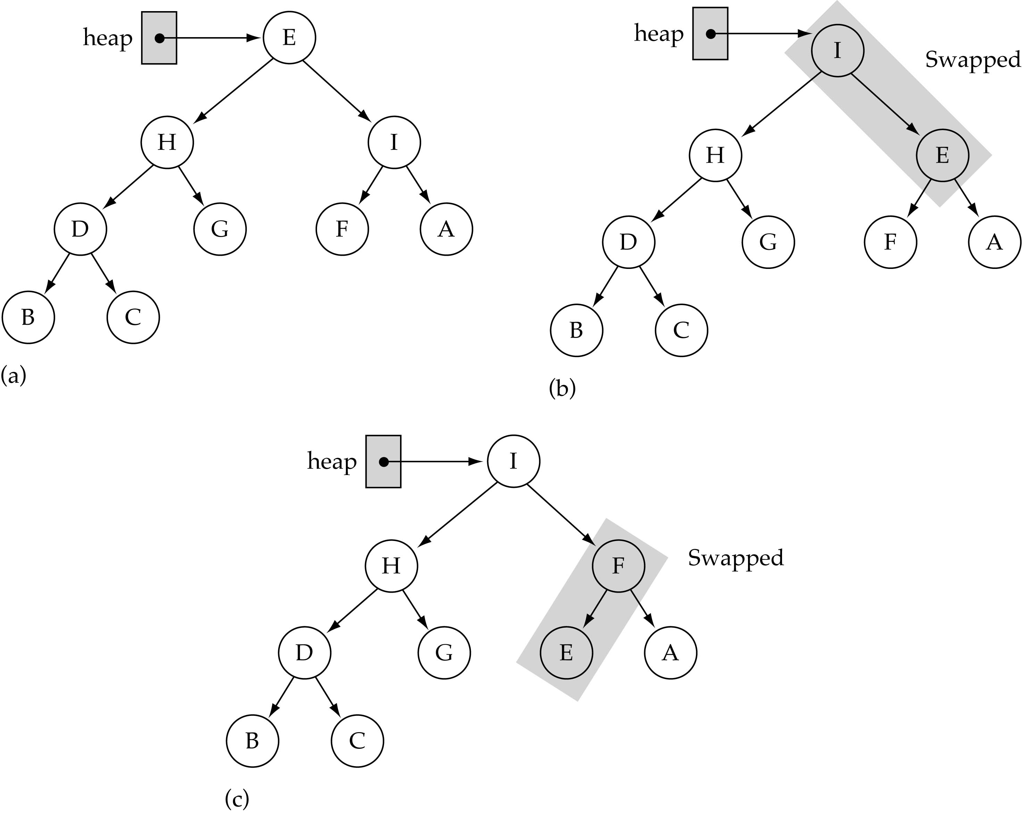
The ReheapDown function
Assumption:
heap property is
violated at the
root of the tree
bottom

Slide 13
ReheapDown function
rightmost node
at the last level
template<class ItemType>
void HeapType<ItemType>::ReheapDown(int root, int bottom)
{
int maxChild, rightChild, leftChild;
leftChild = 2*root+1;
rightChild = 2*root+2;
if(leftChild <= bottom) { // left child is part of the heap
if(leftChild == bottom) // only one child
maxChild = leftChild;
else { // two children
if(elements[leftChild] <= elements[rightChild])
maxChild = rightChild;
else
maxChild = leftChild;
}
if(elements[root] < elements[maxChild]) {// compare max child with parent
Swap(elements, root, maxChild);
ReheapDown(maxChild, bottom);
}
}
}
O(logN)

Slide 14
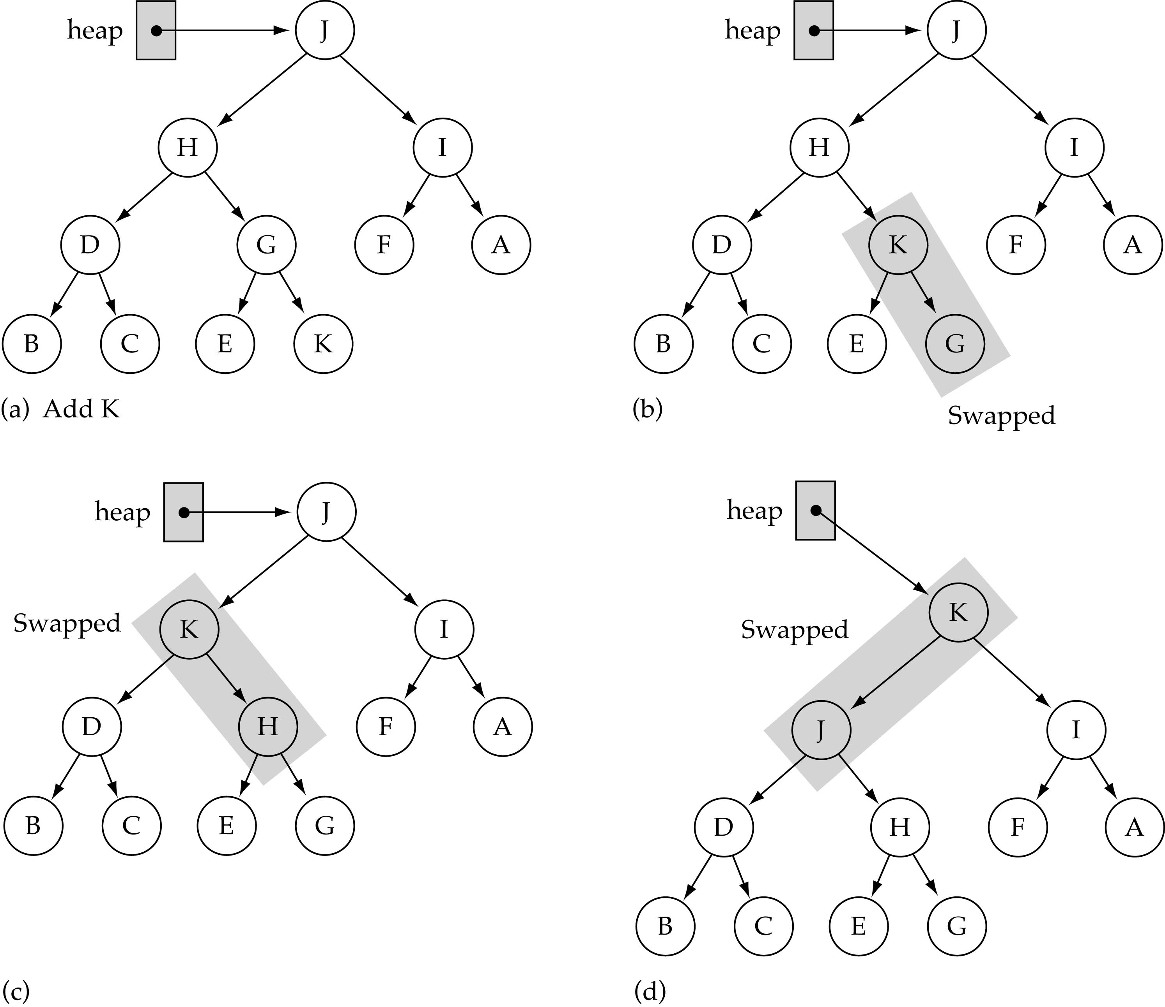
The ReheapUp function
bottom
bottom
Assumption:
heap property is
violated at the
rightmost node
of the last level
of the tree
bottom

Slide 15
ReheapUp function
rightmost node
at the last level
template<class ItemType>
void HeapType<ItemType>::ReheapUp(int root, int bottom)
{
int parent;
if(bottom > root) { // tree is not empty
parent = (bottom-1)/2;
if(elements[parent] < elements[bottom]) {
Swap(elements, parent, bottom);
ReheapUp(root, parent);
}
}
}
O(logN)

Slide 16
Priority Queues
What is a priority queue?
  It is a queue with each element being associated with a "priority"
  From the elements in the queue, the one with the highest priority is dequeued first

Slide 17
Priority queue specification
template<class ItemType>
class PQType {
public:
PQType(int);
~PQType();
void MakeEmpty();
bool IsEmpty() const;
bool IsFull() const;
void Enqueue(ItemType);
void Dequeue(ItemType&);
private:
int numItems; // num of elements in the queue
HeapType<ItemType> heap;
int maxItems; // array size
};

Slide 18
Dequeue: remove the largest element from the heap
(1) Copy the bottom rightmost element to the root
(2) Delete the bottom rightmost node
(3) Fix the heap property by calling ReheapDown

Slide 19
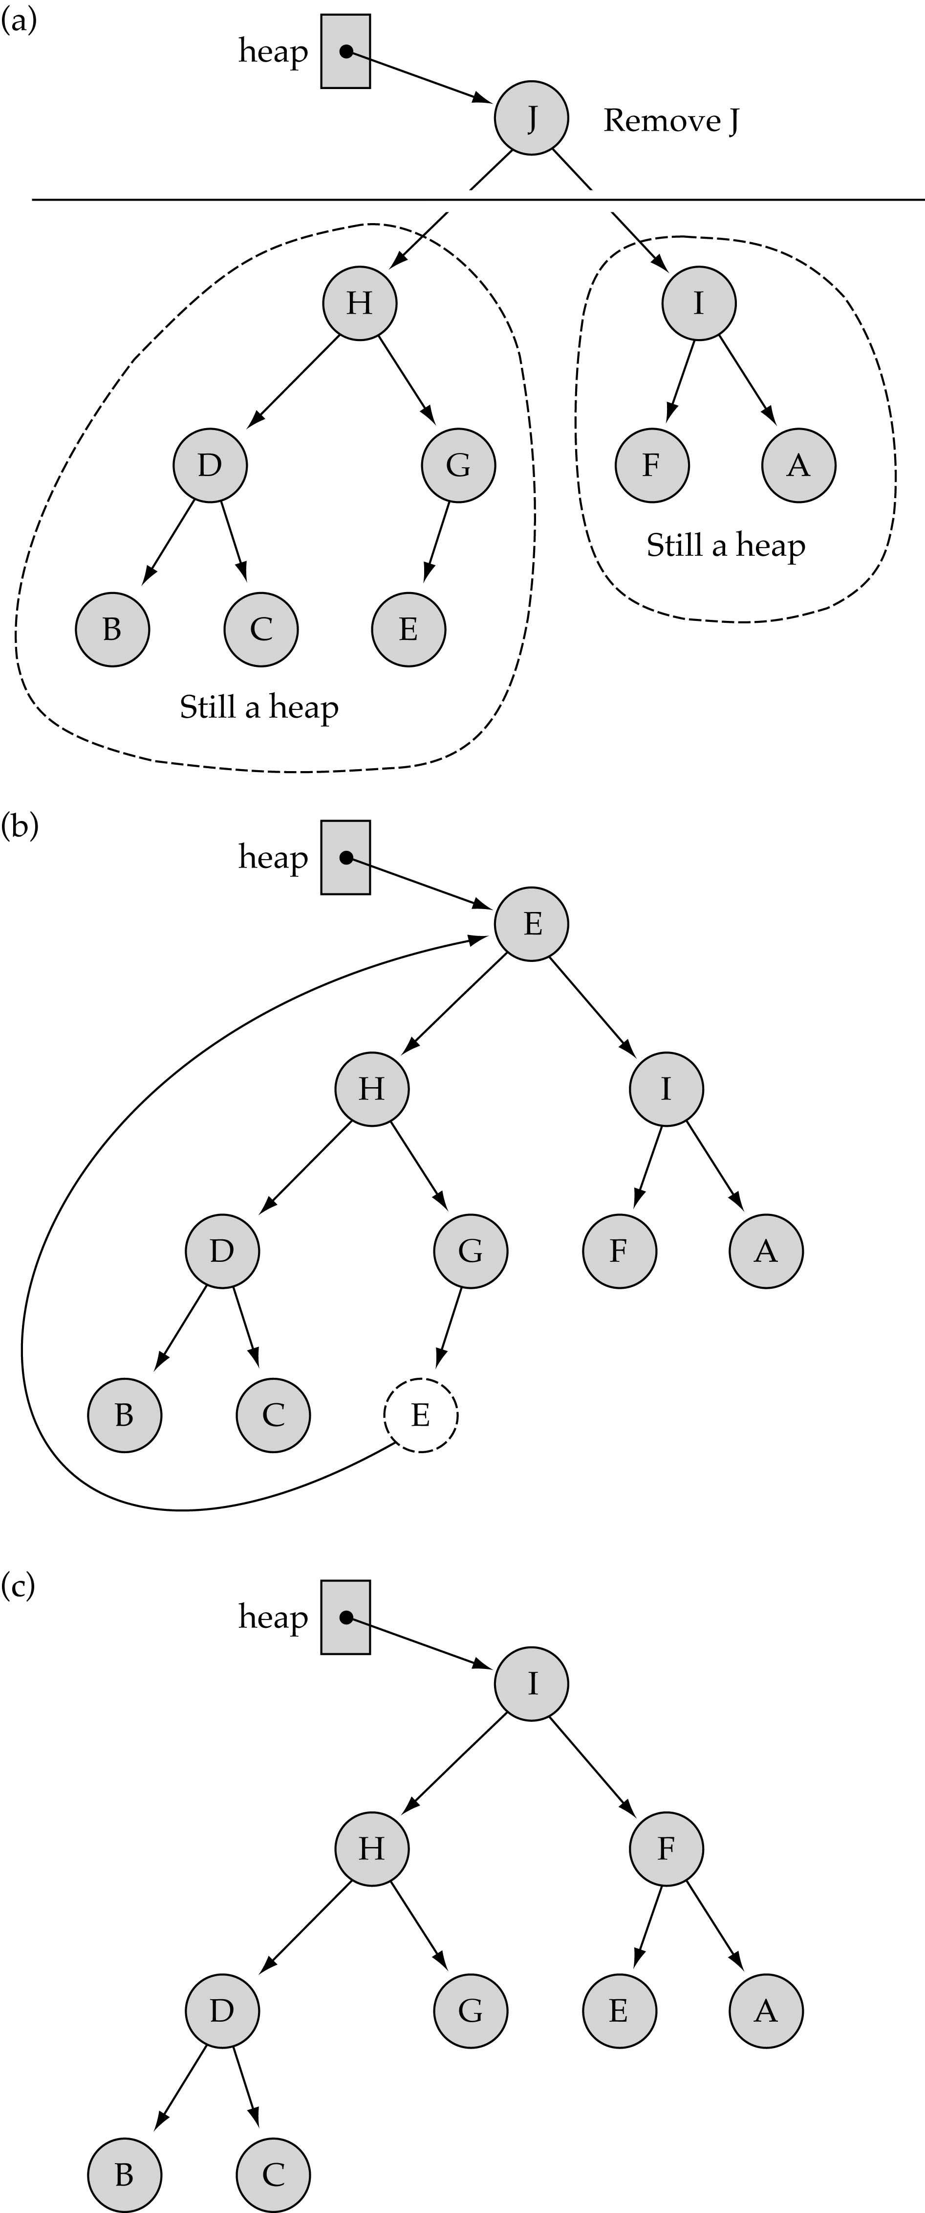
Removing the largest element from the heap (cont.)

Slide 20
Removing the largest element from the heap (cont.)

Slide 21
Dequeue
template<class ItemType>
void PQType<ItemType>::Dequeue(ItemType& item)
{
item = heap.elements[0];
heap.elements[0] = heap.elements[numItems-1];
numItems--;
heap.ReheapDown(0, numItems-1);
}
bottom
O(logN)

Slide 22
Enqueue: insert a new element into the heap
(1) Insert new element in the leftmost place at the bottom level (start new level if last level is full).
(2) Fix the heap property by calling ReheapUp .

Slide 23
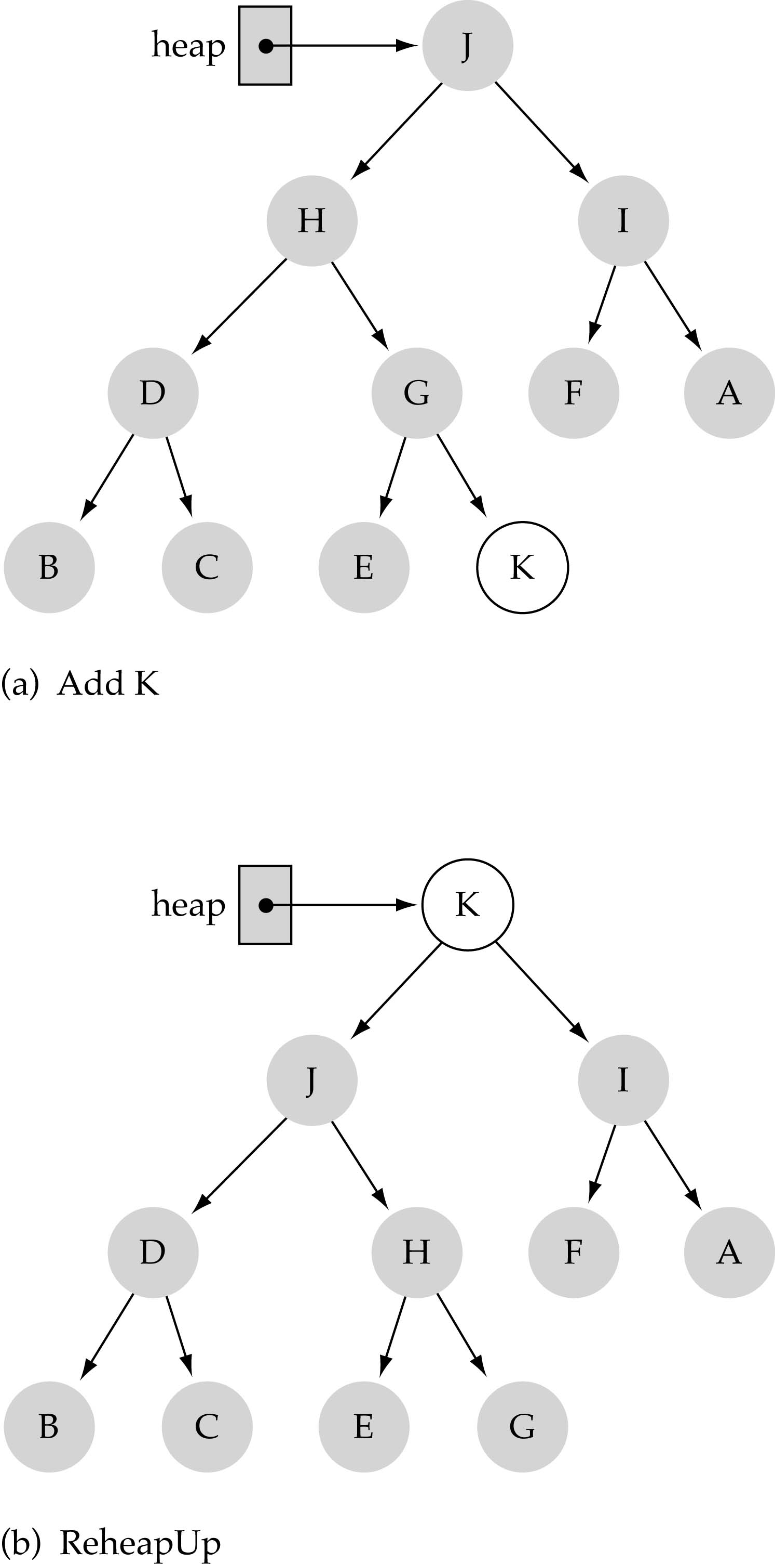
Inserting a new element into the heap (cont.)

Slide 24
Enqueue
template<class ItemType>
void PQType<ItemType>::Enqueue(ItemType newItem)
{
numItems++;
heap.elements[numItems-1] = newItem;
heap.ReheapUp(0, numItems-1]);
}
bottom
O(logN)

Slide 25
Other Functions
template<class ItemType>
PQType<ItemType>::PQType(int max)
{
maxItems = max;
heap.elements = new ItemType[max];
numItems = 0;
}
template<class ItemType>
PQType<ItemType>::MakeEmpty()
{
numItems = 0;
}
template<class ItemType>
PQType<ItemType>::~PQType()
{
delete [ ] heap.elements;
}

Slide 26
Other Functions
(cont.)
template<class ItemType>
bool PQType<ItemType>::IsFull() const
{
return numItems == maxItems;
}
template<class ItemType>
bool PQType<ItemType>::IsEmpty() const
{
return numItems == 0;
}

Slide 27
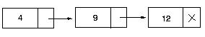
Comparing heaps with other priority queue implementations
Priority queue using a sorted list
12
4
O(N) on the average!
Remove a key in O(1) time
Insert a key in O(N) time
Priority queue using heaps
  - Remove a key in O(logN) time
  - Insert a key in O(logN) time
O(lgN) on the average!

Slide 28
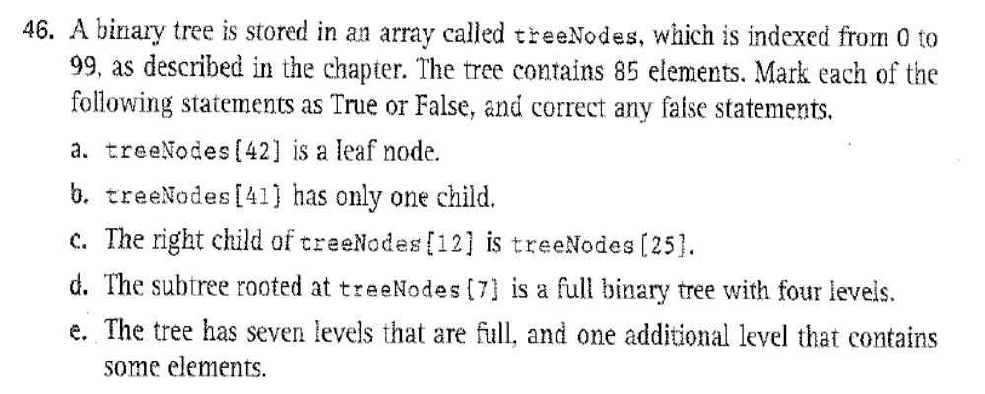
Exercise 46, p. 545

