Slide 1
ASTR 3300 Project
June Ryu

Slide 2
Index
Proposal / Abstract
Definitions
Method
Visualisation
Conclusion / Future steps

Slide 3
Proposal / Abstract
This final project is to comprehend the knowledge of data analysis and machine learning covered in ASTR 3300, Astro-statistics. Main goal for this project is to use machine learning to verify RRL stars from variable stars data. The target dataset is GAIA Data Release 3. From the list a handful of stars will be carefully selected that we are certain of RRL and used to train the module. After such the module will analyze dataset of variable stars to sort out RRL stars. The project could also be modified to verify other binary stars. Target size is approximately 100 random selected stars. I can increase the size once the module is fully complete and functional. There are papers that conducted similar ideas, so I can reference them too.

Slide 4
Definition
What is RR Lyrae?
Group of giant stars of the class called pulsating variables that pulsate with periods of about 0.2-1 day. (…) There are several subclasses designated RRa, RRb, RRc, and RRd.

Slide 5
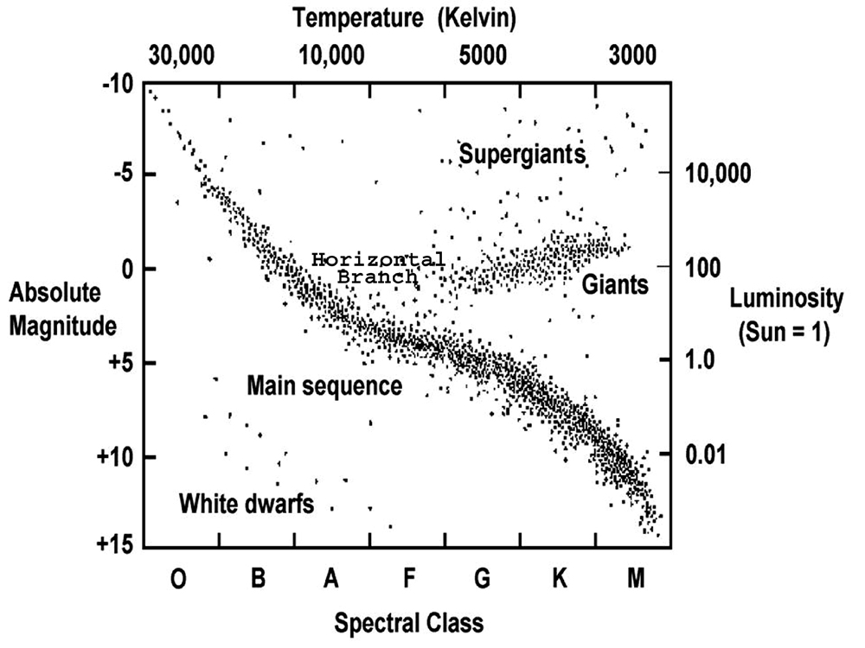
Definition
H-R Diagram

Slide 6
Methods
RandomForestClassifier
Handful of stars – good data (Train data)
Notes:
Why RandomForest? – bc dataset has many columns?

Slide 7
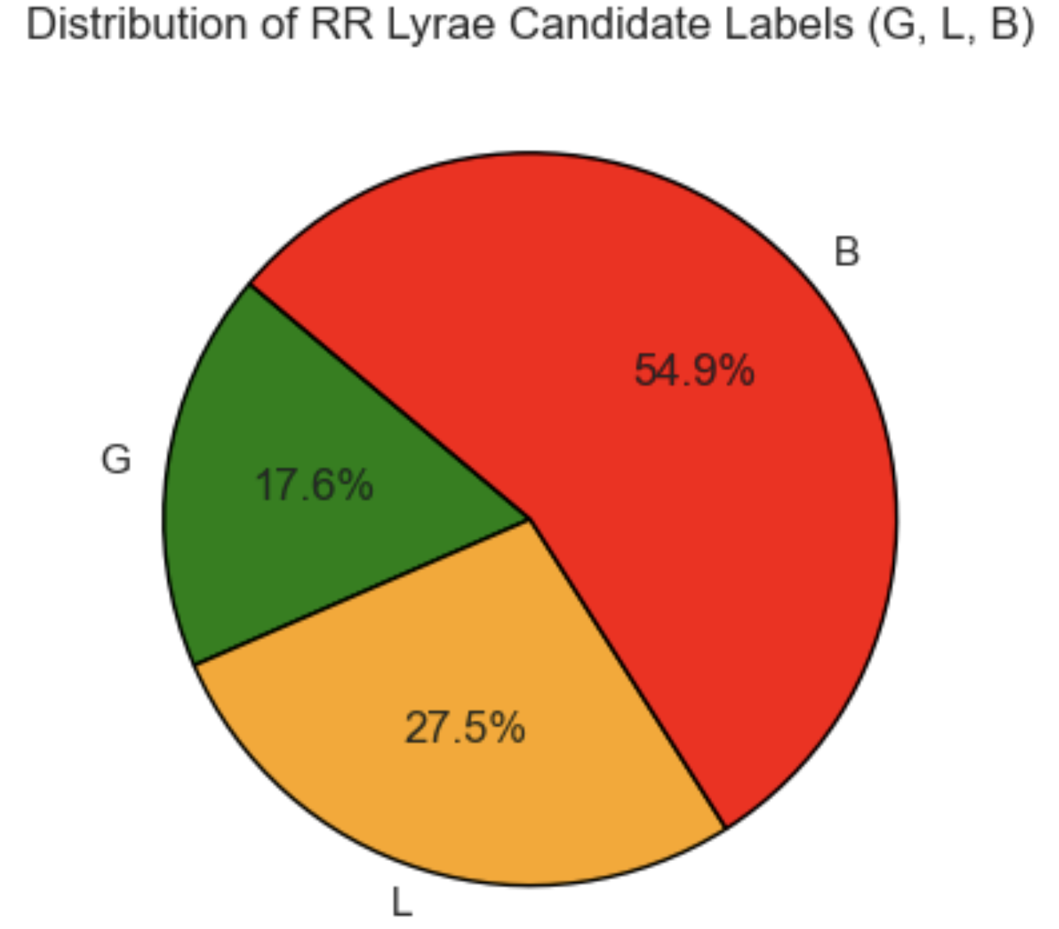
Graph

Slide 8
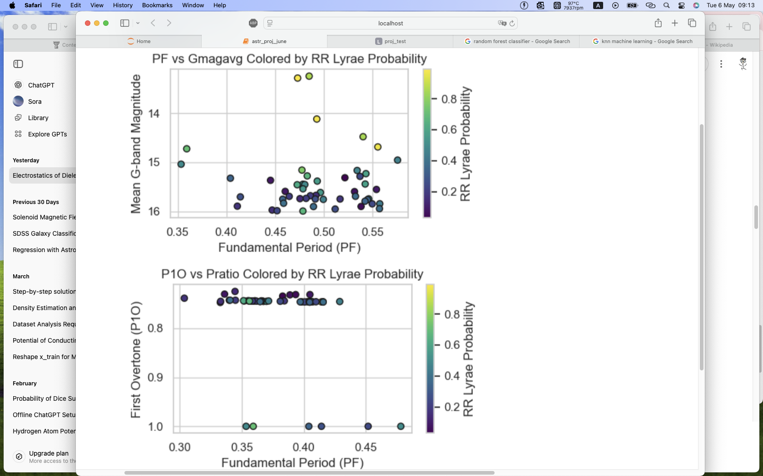
Graph

Slide 9
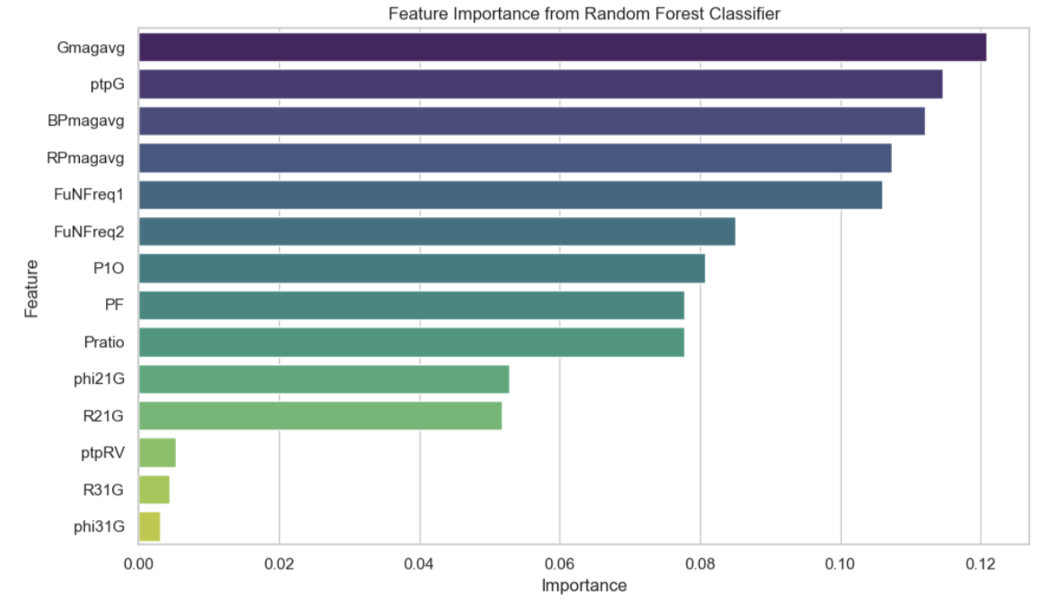
Graph

Slide 10
Conclusion
Works..!
Still need some labour

Slide 11
Future Steps?
Training dataset / Target dataset labeling and size
Applying to whole dataset? (GAIA DR3)
– Columns are different! Needs some organizing / modification
Soley on GAIA DR3
– RRL data used are not actual observation.
– more verification still needed
Notes:
Rather than using just good dataset, also use noise / abnormal data as bad to train?

Slide 12
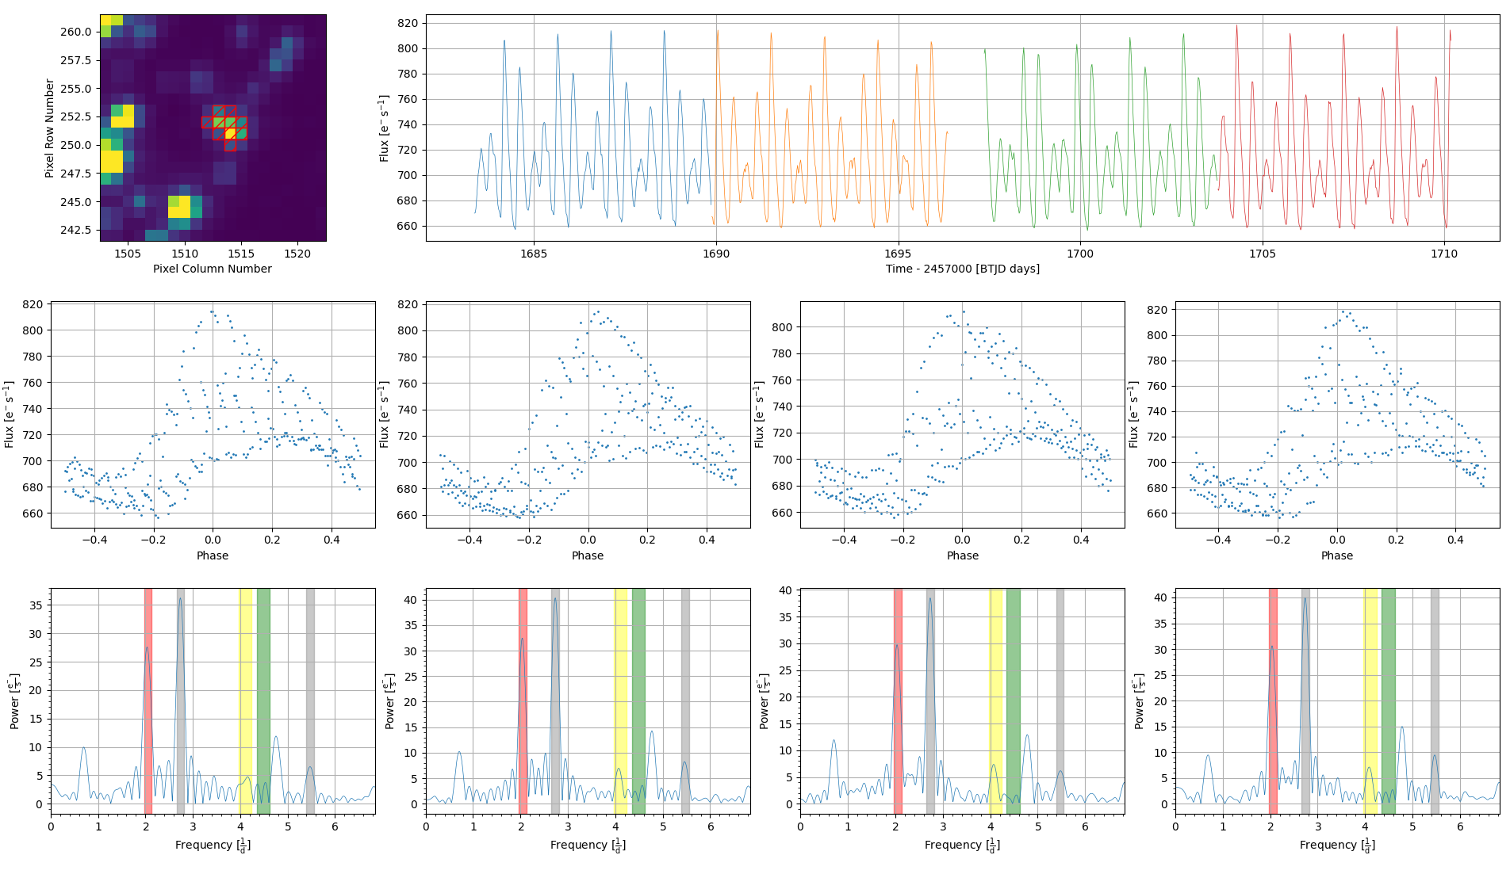
Notes:
An FFI image, raw light curve, folded light curves, and Fourier analyses of TESS data for the RRd star GAIA DR3 1675317762640137728.

Slide 13
Thank you!

Slide 14
Questions..?

